Slide 1
ANNUAL PERFORMANCE PLAN 2018 / 2019
Prepared by:
Pascal Moloi
Chief Executive Officer
Date:
18 April 2018

Slide 2
HDA Act: Section 6
The Purpose of the Act is to provide for the:
Establishment of the Agency which will facilitate the acquisition of land and landed property;
Objects, roles, powers and duties of the agency; and
Fast tracking of land acquisition and housing development services for the purpose of creating sustainable human settlement
Section 6: Land which may be acquired
C
The Agency may, after consultation with the land owner, identify, acquire and hold land:
Registered or vested in the State or any organ of state and which it is prepared to dispose of;
privately owned; or
communal land for residential or community development purposes
E
Subject to section 25 of the Constitution of the Republic of South Africa, 1996, the Minister may expropriate land for the purposes of creating sustainable human settlements
Sections 6 to 23 of the Expropriation Act, 1975 (Act No. 63 of 1975), apply with the changes required by the context to the expropriation of land, and a reference in that Act to –
Minister must be construed as a reference to the Minister responsible for housing; and
section 2 must be construed as a reference to subsection (2).
i
Any consultation between organs of state in terms of this Act must be done in terms of Chapter 3 of the Intergovernmental Relations Framework Act, 2005 (Act No. 13 of 2005).

Slide 3
HDA Act: Functions
Functions of the HDA (S.7)
1. Development Planning
Develop a development plan to be approved by the Minister in consultation with the relevant authorities in the provinces and municipalities;
Develop strategic plans with regard to the identification and acquisition of state, privately and communal owned land which is suitable for residential and community development;
Prepare necessary documentation for consideration and approval by the relevant authorities as may be required in terms of any other applicable law;
Monitor progress of the development of land and landed property acquired for the purposes of creating sustainable human settlements;
Enhance the capacity of organs of state including skills transfer to enable them to meet the demand for housing delivery;
Ensure that there is collaboration and intergovernmental and integrated alignment for housing development services;
Identify, acquire, hold, develop and release state, privately and communal owned land for residential and community development;
Undertake such project management services as may be necessary, including assistance relating to approvals required for housing development;
Contract with any organ of state for the purpose of acquiring available land for residential housing and community development for the creation of sustainable human settlement;
Assist organs of state in dealing with housing developments that have not been completed within the anticipated project period;
Assist organs of state with the upgrading of informal settlements; and
Assist organs of state in respect of emergency housing solutions.
2. Land Acquisition, Holding, Development and Monitoring
3. Capacity Support to Organs of State
4. Collaboration & IGR
5. Project/Programme Management
6. Unblocking
7. Informal Settlement Upgrading Support
8. Emergency Housing Solutions Support

Slide 4
Summary of short to medium term priorities (1/2)
HDA’s Commitment
The Board reaffirms its commitment to give effect to the mandate of the HDA working with the CEO and the entire Executive Management of the HDA.
More focus on programmes and projects on regeneration of Mining Towns.
The need to ensure that that the Policy cohesion amongst the spheres of government.
Strengthen internal capacity of the Agency – HDA Resourcing Framework
The resourcing of the HDA financially is very central to it in order to give effect to its Mandate.
Further engage as part of the Human Settlement’s sector funding framework, the need to ensure that there is direct funding targeted at National Priority Projects
Accelerate land assembly programme and rezoning. An intergovernmental platform for contracting is
required – DHS, DLRD, DPW, Municipalities and Provinces and State owned entities
The HDA to invest in development projects using HDA owned land
Declare the number of catalytic projects and other national priority projects as National Priority Development Areas (NPDA) i.e. Knysna, Duncan Village
Resilient, integrated and sustainable human settlement
Performance-oriented
Teamwork
Excellence
Accountability
Build capable and developmental Agency geared to transform the sector and lead in the development of resilient, integrated and sustainable human settlements.
Integrity

Slide 5
Summary of short to medium term priorities (2/2)
HDA’s Commitment
The Board reaffirms its commitment to give effect to the mandate of the HDA working with the CEO and the entire Executive Management of the HDA.
Implementation of Informal settlements upgrading projects
More efforts to influence IGR planning and contracting (vertical and horizontal alignment
Leveraging on crowding in private sector investment to accelerate delivery.
Strengthen relationships and collaboration with other HS agencies
As part of enhancing governance decision making and cohesion) – the Minister and Board to meet Quarterly and DG and CEO to engage on a regular basis
Resilient, integrated and sustainable human settlement
Performance-oriented
Teamwork
Excellence
Accountability
Build capable and developmental Agency geared to transform the sector and lead in the development of resilient, integrated and sustainable human settlements.
Integrity

Slide 6
Proposed Priorities:
Recommendations
Land
Compensation framework to be finalised at Cabinet level.
Development of IGR Delivery Agreements to deal with land assembly and rezoning (selected properties)
Unlocking:
SOC land – based on selective approach
Target specific portions
Covert what we have
Expropriation with a conscience
Top-slice USDG and HSDG for land
Policy, Regulation and Legislation
HSD Act (that supersede other services Acts)
BNG forms the basis for White Paper
Establishing a HSDB
Cabinet to adopt a process to fast track policy
Key Focus Areas and Activities for 2018 and Beyond…
Governance
Simplify and speed-up decision making
Use communication more effective
Guidance through Inter Governmental Relations
Develop a single planning and performance monitoring platform
Invest in Priority Projects (asset growth)
Programme / Project Investment: E.g. Duncan Village, Knysna
MSP / PHDA / SIPs / 9 Point Plan / Restructuring Zones to guide investment
Investment Framework
Funding and Resourcing (fiscal gap)
Dora
Raising capital (National , Foreign Direct Investment, BRICS)
Crowd-in Pty Investments (DFI Support, DBSA, PIC, GPF)
Minister to approve exemption i.t.o S54 of PFMA to enable agency to source funding, retain surplus and generating revenue

Slide 7
Additional Priority Interventions and Key Projects
Issues as raised by the Minister on the 3rd February 2018.
c
Priority Intervention | Indicator Number
Identification and Declaration of Priority Housing Development Areas (PHDA’s-39) | 2C.3
Project packaging and housing developments: Knysna Fire Rehabilitation Development Southern Cape Development Corridor Imizamo Yethu Duncan Village | 4A.6
Facilitation and completion of the Inter-Ministerial agreement on the release of state land | 4B.5
Establishment of a Project Management Office within the HDA | 1A.2
Targets on transformation and empowerment | 1B.5
c

Slide 8
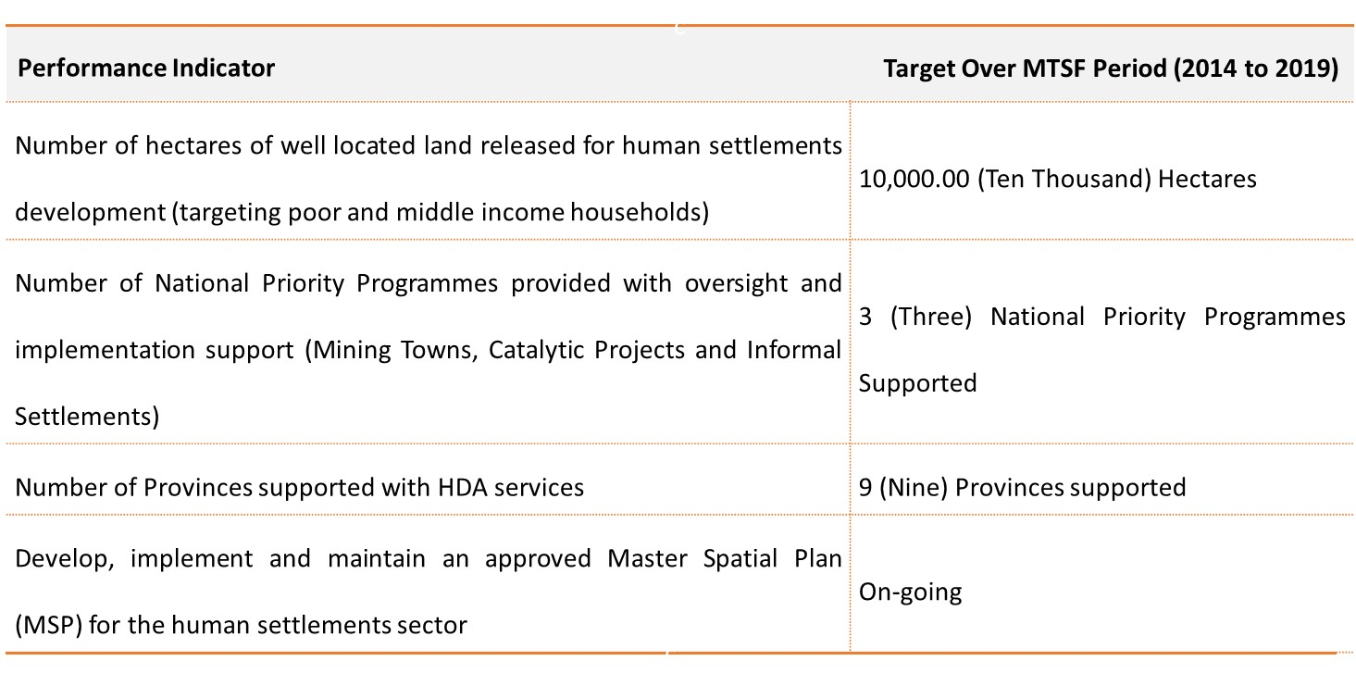
Medium Term Strategic Framework Targets
Management of the N2 Gateway Project in the Western Cape
Management of the Zanemvula Project in the Eastern Cape
build a credible housing database covering both housing and land needs to be established.
restructured to become a fully-fledged developer whose role goes beyond land assembly

Slide 9
National Priority Programmes
MTSF Target: 50 mega projects
MTSF Target: 276 ISU’s
MTSF Target: 22 mining towns

Slide 10
The HDA’s Expanded Developer Role
The Developer role has been carefully framed and scoped to partner with and not crowd out the private sector.
The Developer role, will incorporate some of the human settlements functions currently undertaken by Provinces and Municipalities. Strengthened IGR thus becomes a key enabler.
The developer role will be phased in incrementally, with the short-term focus being on achievable developments / projects with short-to-medium term delivery potential.

Slide 11
MACRO PERFORMANCE INDICATORS
2018 / 2019

Slide 12
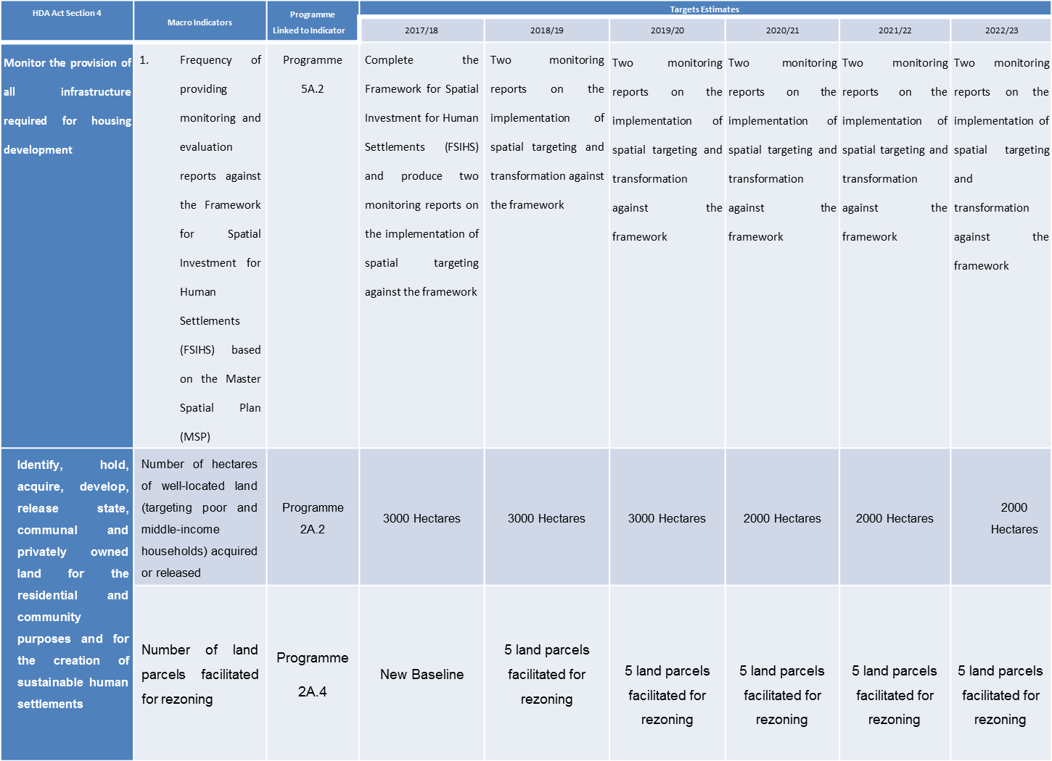
MACRO PERFORMANCE INDICATORS

Slide 13
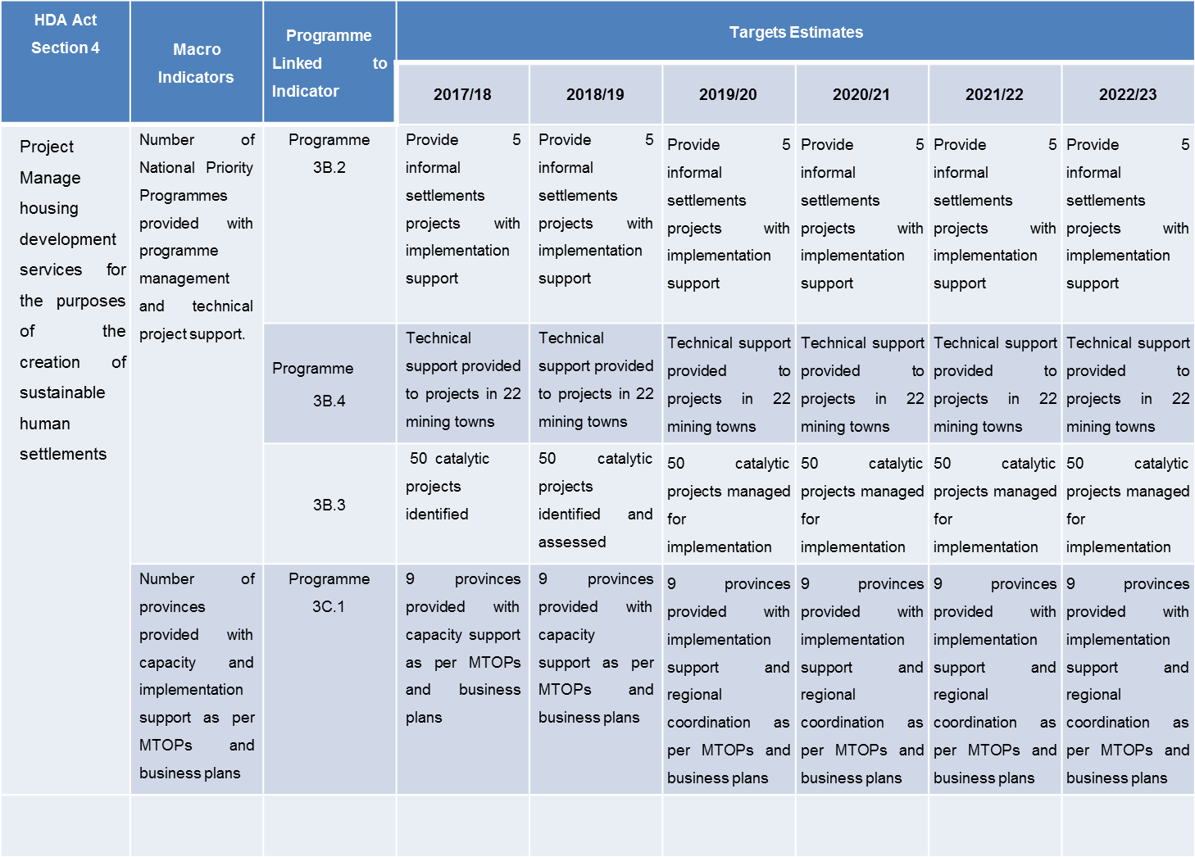
MACRO INDICATORS

Slide 14
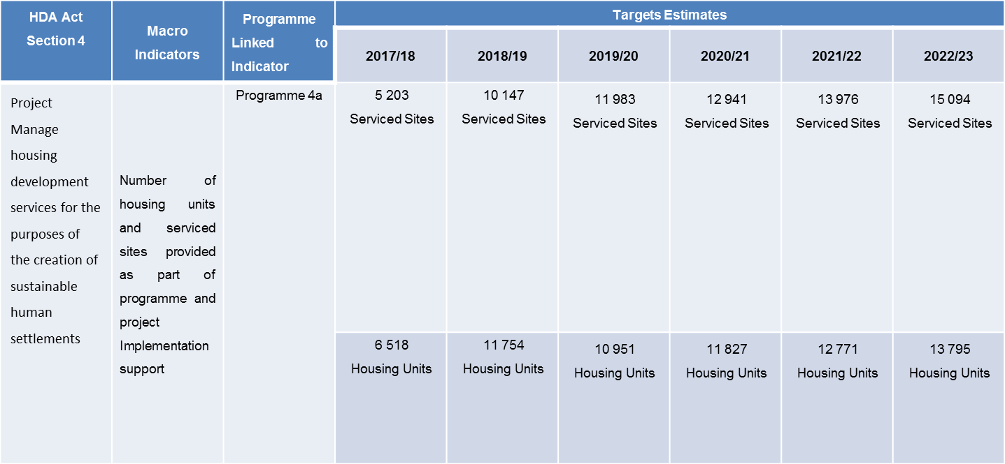
MACRO PERFORMANCE INDICATORS

Slide 15
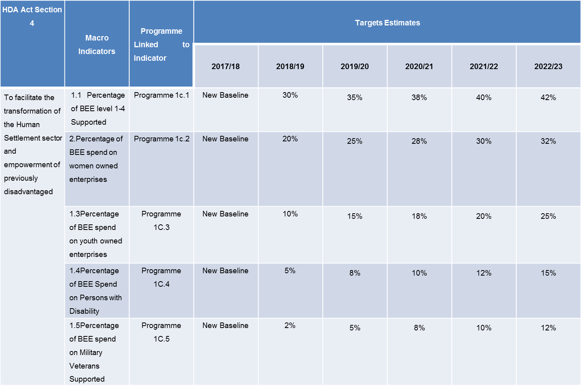
MACRO PERFORMANCE INDICATORS

Slide 16
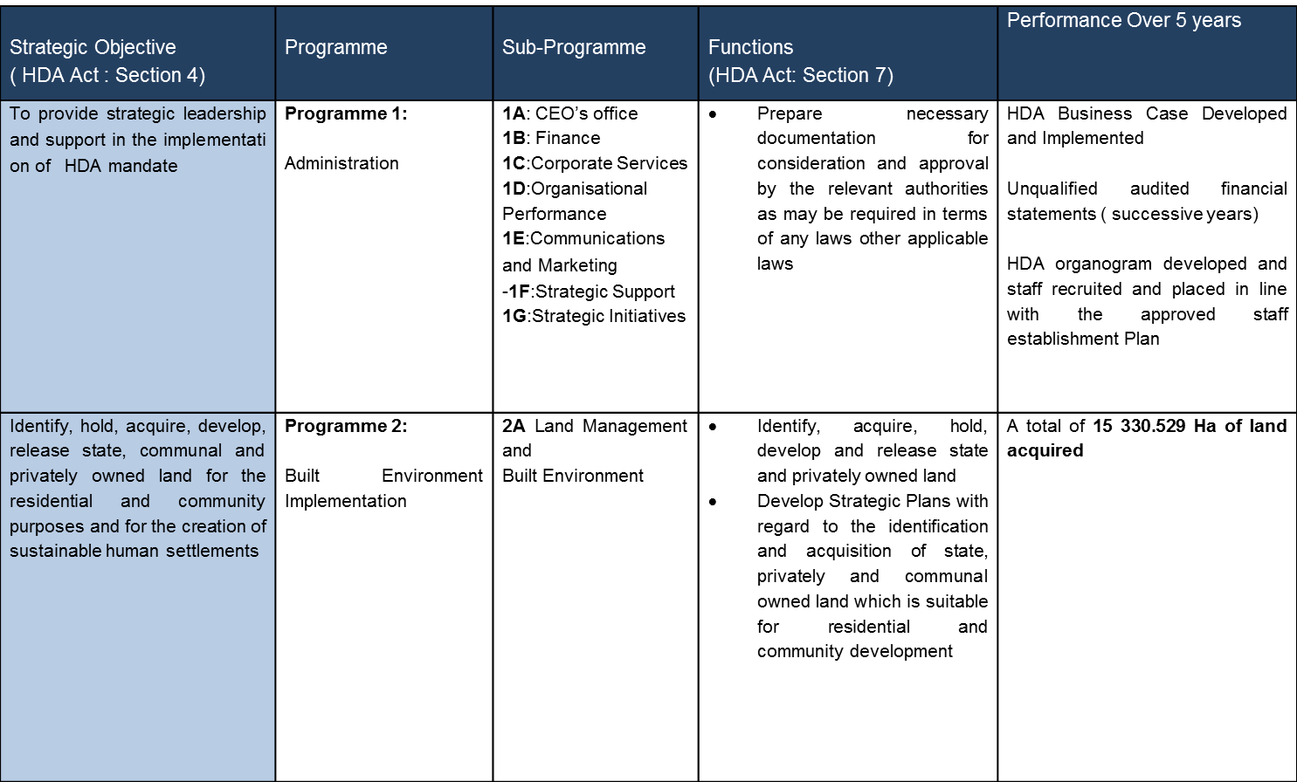
ALIGNMENT OF HDA PROGRAMMES TO HDA ACT

Slide 17
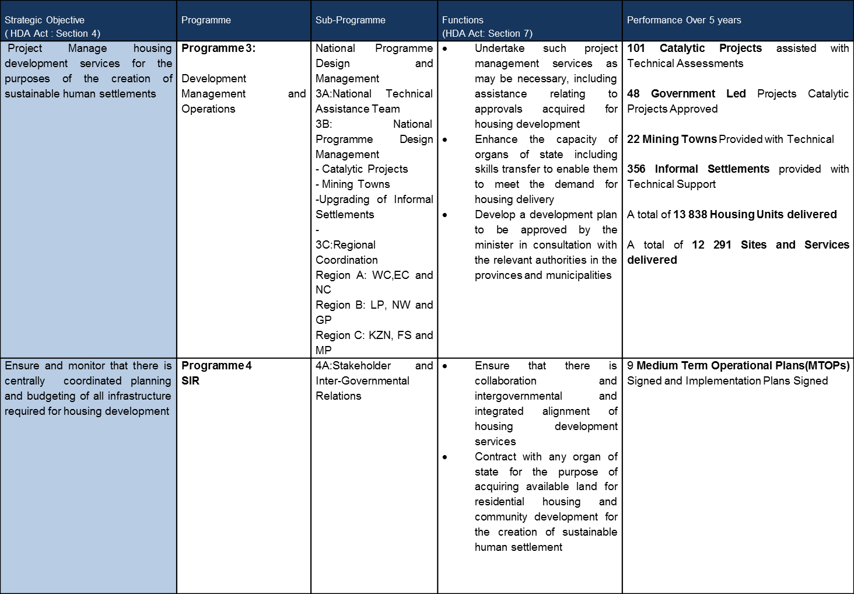

Slide 18
ALIGNMENT OF HDA PROGRAMMES TO HDA ACT

Slide 19
MACRO PERFORMANCE INDICATORS
2018 / 2019

Slide 20
MACRO PERFORMANCE INDICATORS

Slide 21
MACRO INDICATORS

Slide 22
MACRO PERFORMANCE INDICATORS

Slide 23
MACRO PERFORMANCE INDICATORS

Slide 24
PROGRAMME 1: ADMINISTRATION
CEO’S OFFICE, FINANCE, CORPORATE SUPPORT, ORGANISATIONAL PERFRMANCE, COMMUNICATIONS AND MARKETING

Slide 25
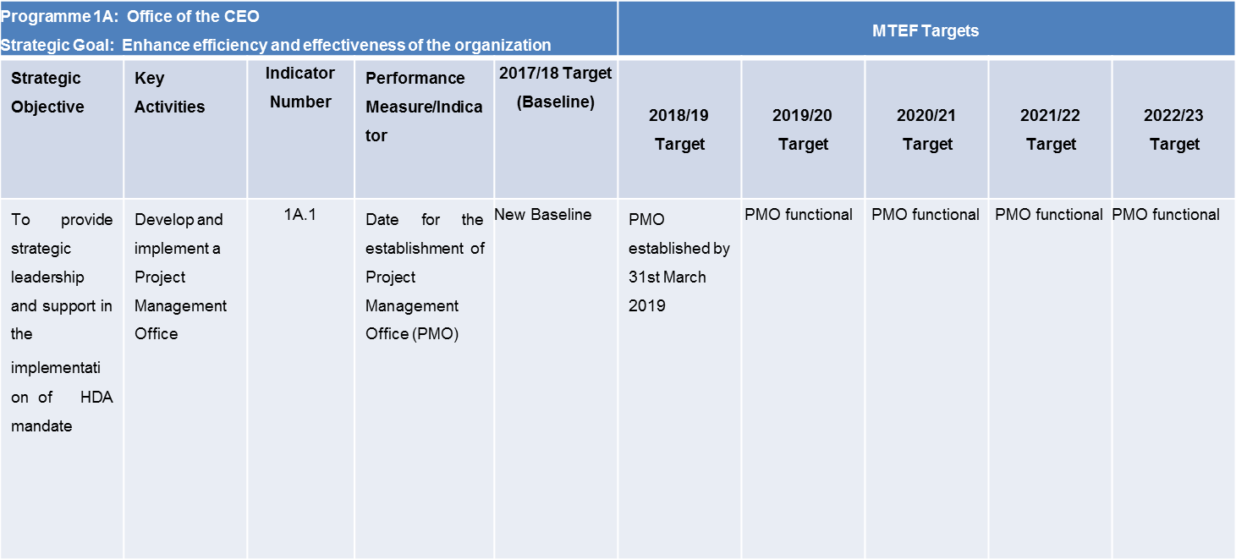
MTEF

Slide 26
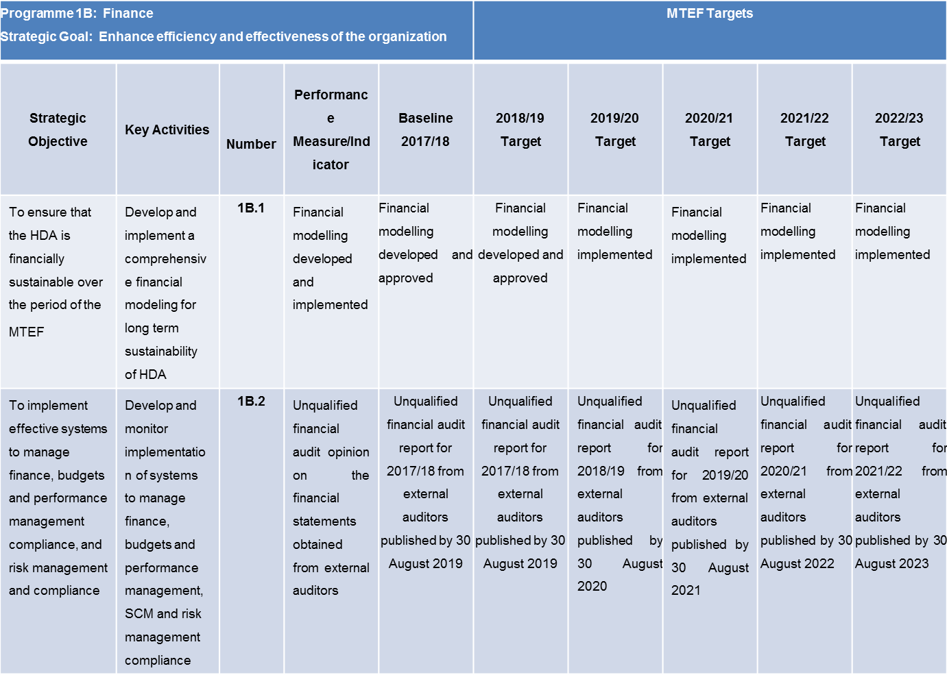
MTEF

Slide 27
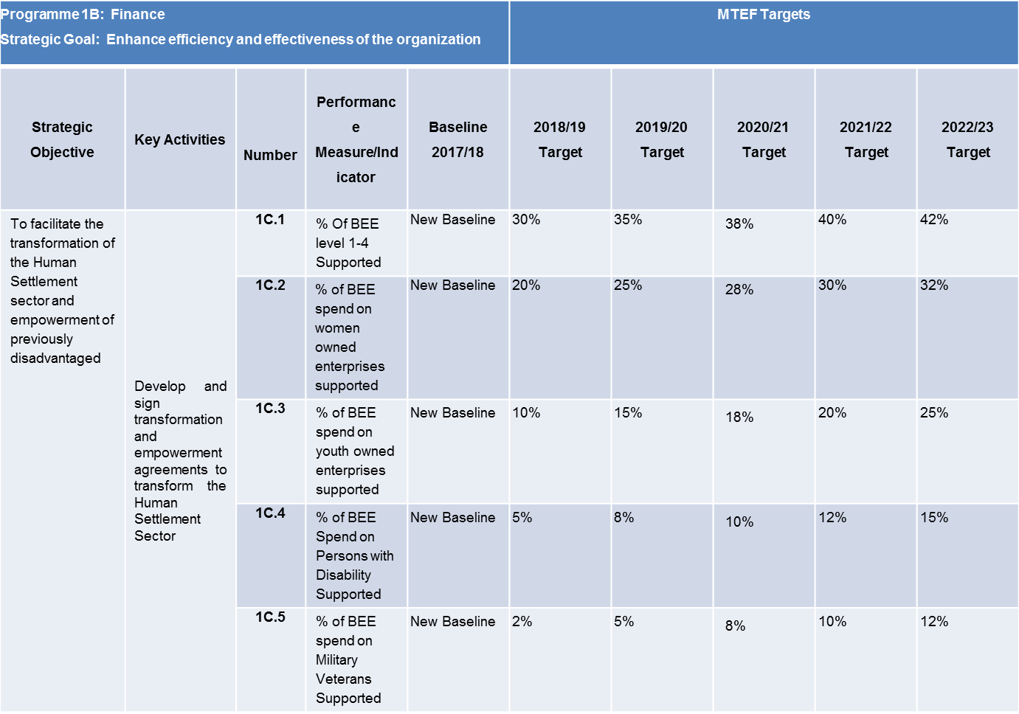
MTEF

Slide 28
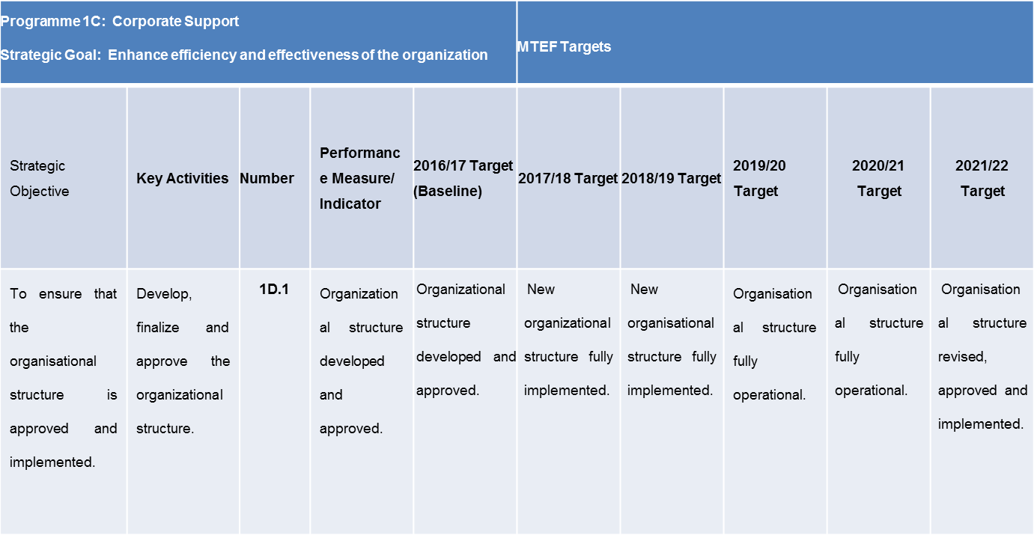
MTEF

Slide 29
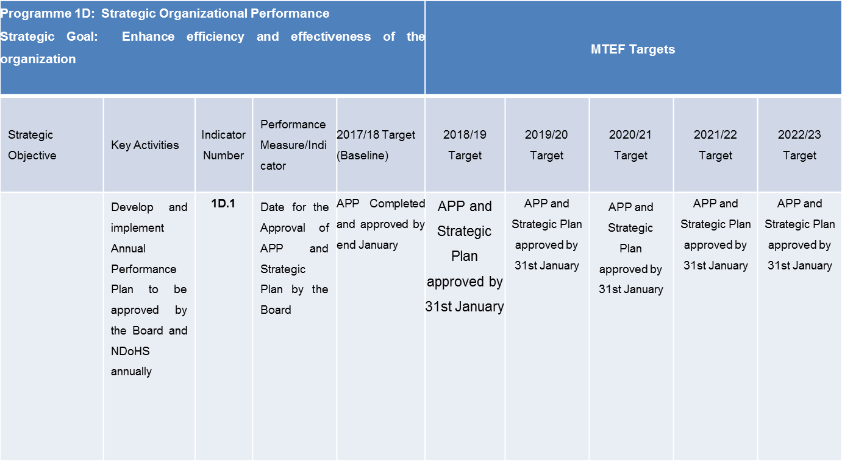
MTEF

Slide 30
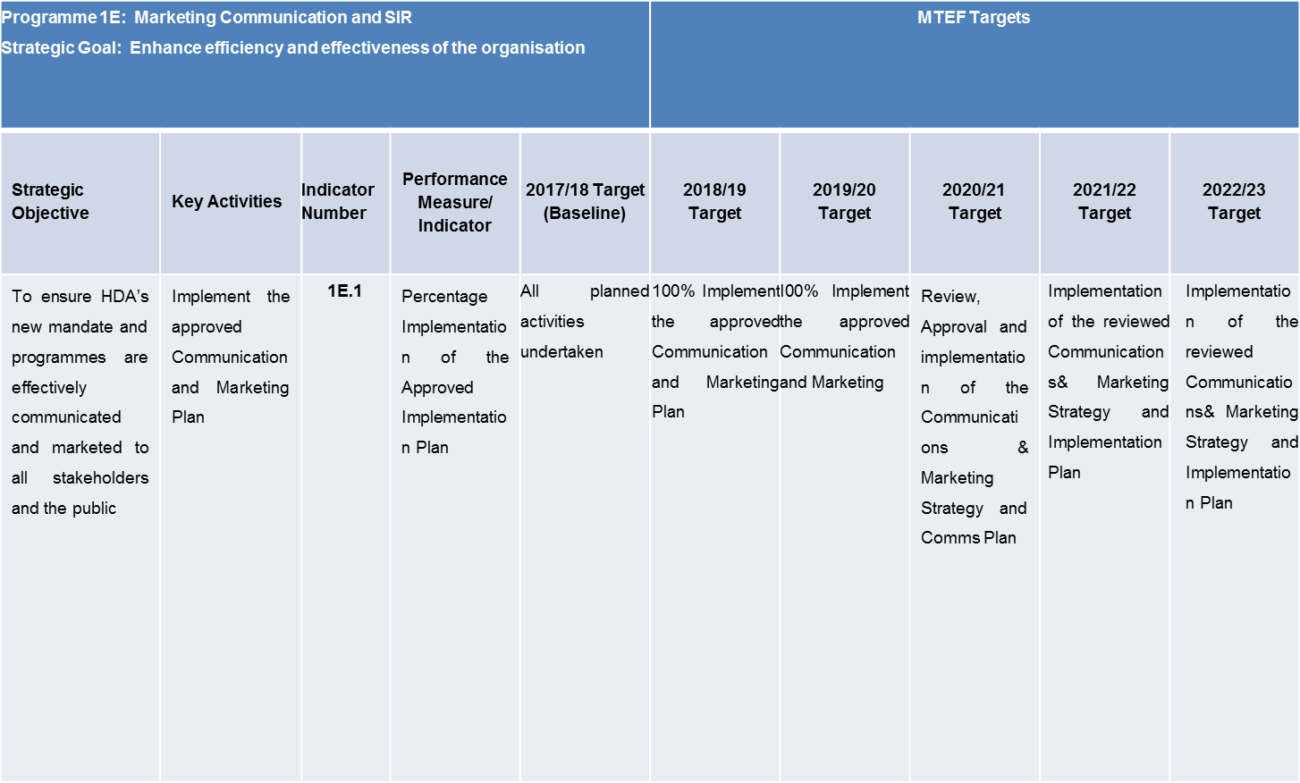
MTEF

Slide 31
LAND MANAGEMENT AND BUILT ENVIRONMENT IMPLEMENTATION

Slide 32
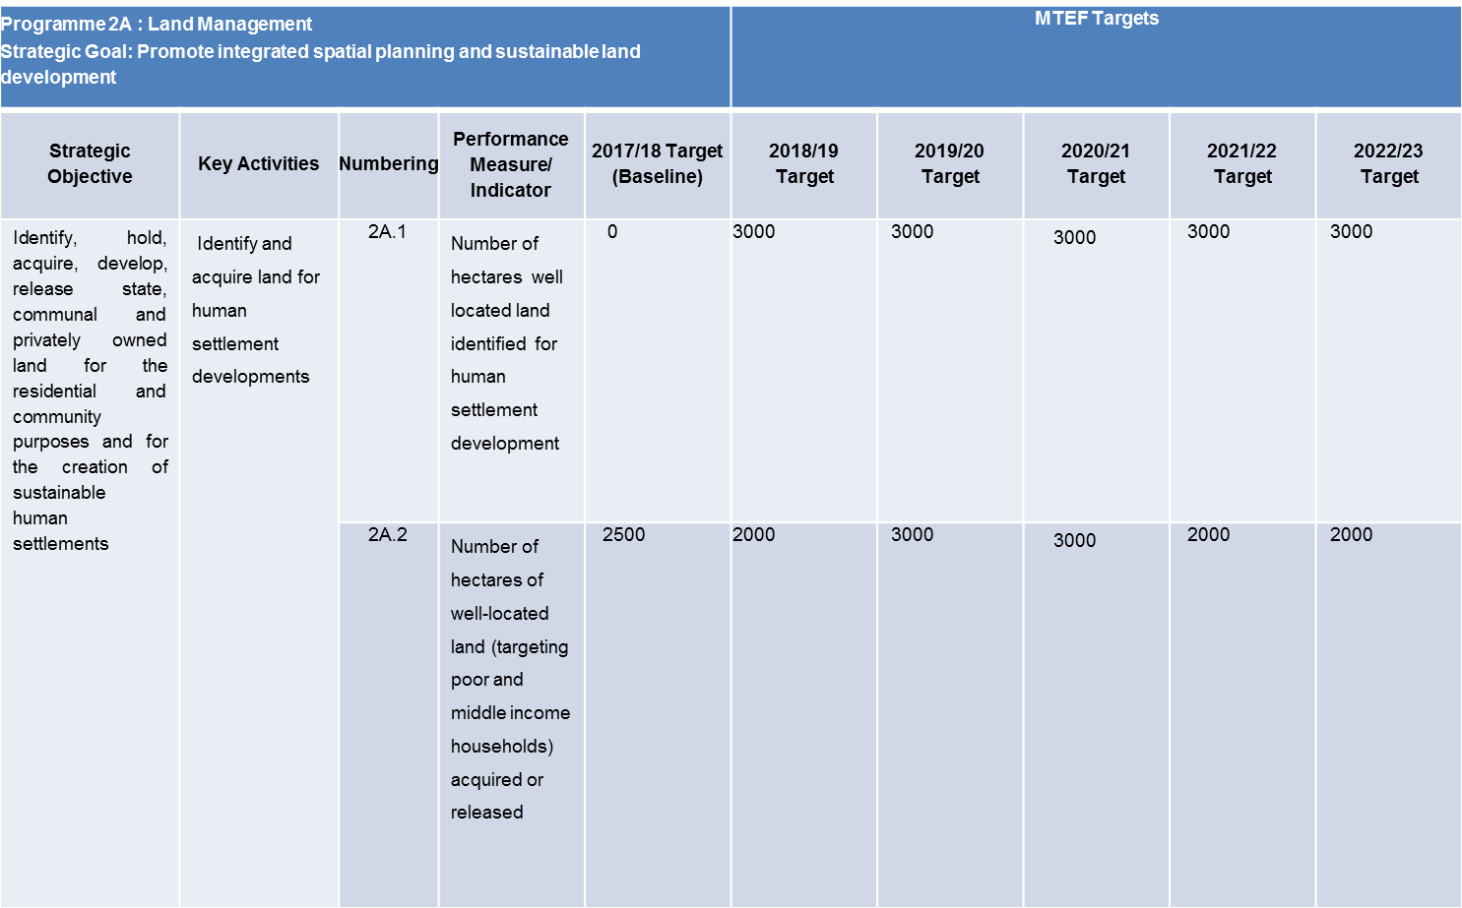
MTEF

Slide 33
MTEF
 | Packaging Identified Projects for development | Programme 2A : Land Management Strategic Goal: Promote integrated spatial planning and sustainable land development |  |  |  |  | MTEF Targets
 |  | Strategic Objective | Key Activities | Numbering | Performance Measure/ Indicator | 2017/18 Target (Baseline) | 2018/19 Target | 2019/20 Target | 2020/21 Target | 2021/22 Target | 2022/23 Target
 |  | 2A.4 |  |  | Number of Parcels of land facilitated for rezoning | New baseline | 5 Parcels facilitated for rezoning | 5 Parcels facilitated for rezoning | 5 Parcels facilitated for rezoning | 5 Parcels facilitated for rezoning | 5 Parcels facilitated for rezoning
 |  | 2A.5 |  |  | Number of projects packaged for development | New Baseline | 5 Projects | 5 Projects | 5 Projects | 5 Projects | 5 Projects
 |  | 2A.6 |  |  | Date of approval of inter-ministerial agreement on release of state land | New Baseline | Approved inter-ministerial agreement on the release of state land by 31st March 2019 | N/a | N/a | N/a | N/a

Slide 34
NATIONAL PROGRAMME DESIGN MANAGEMENT AND REGIONAL COORDINATION AND HUMAN SETTLEMENTS IMPLEMENTATION SUPPORT SERVICES
2018 / 2019

Slide 35
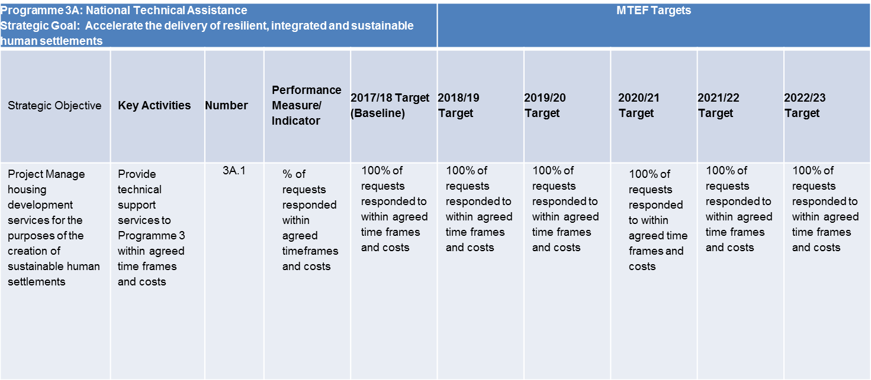
MTEF

Slide 36
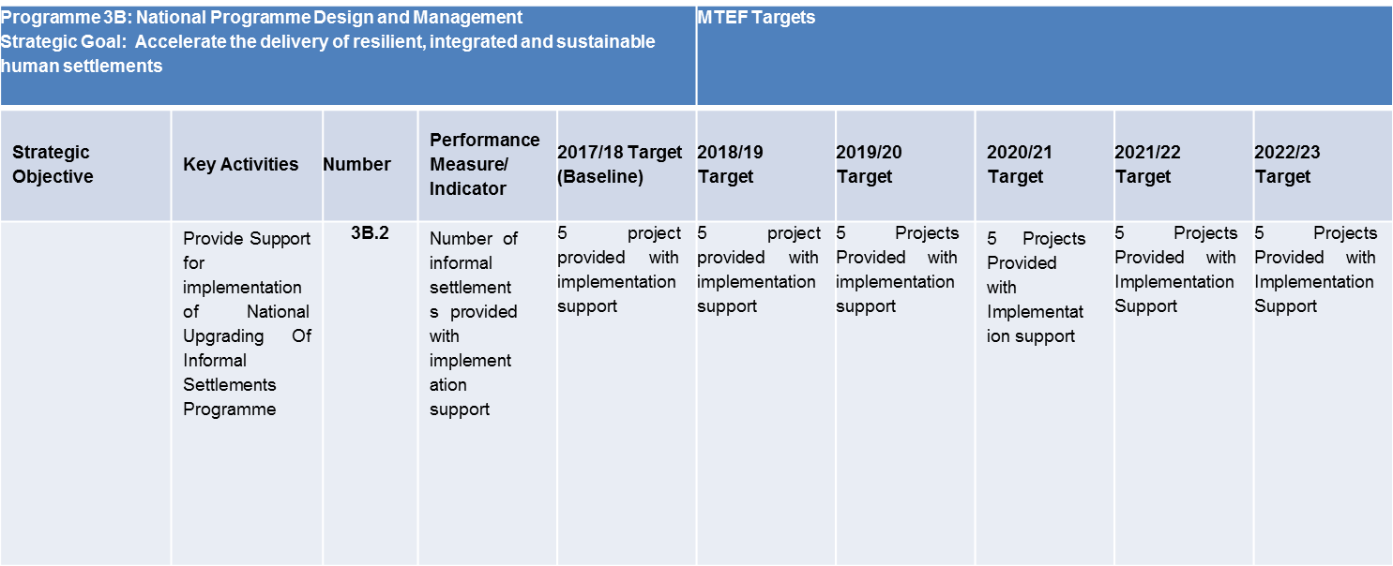
MTEF

Slide 37
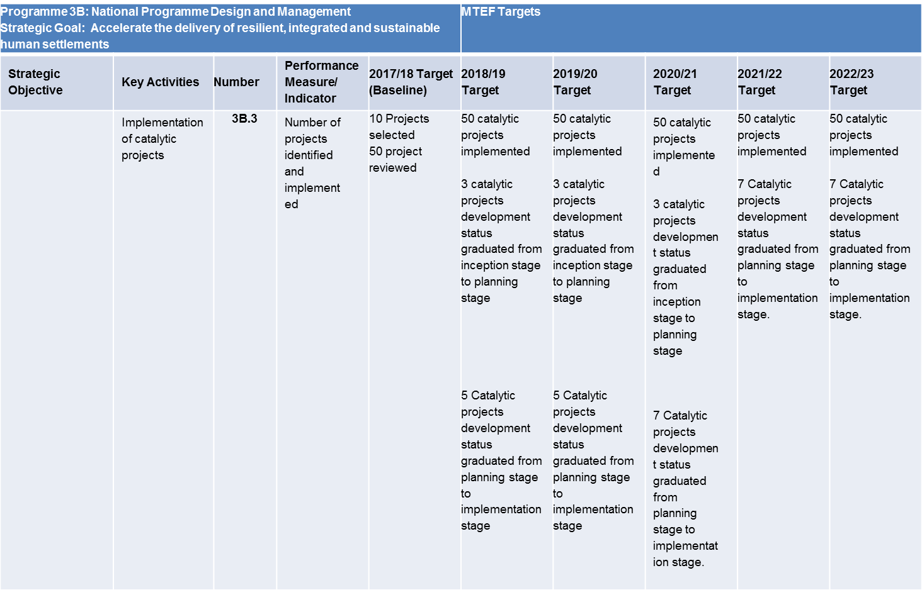
MTEF

Slide 38
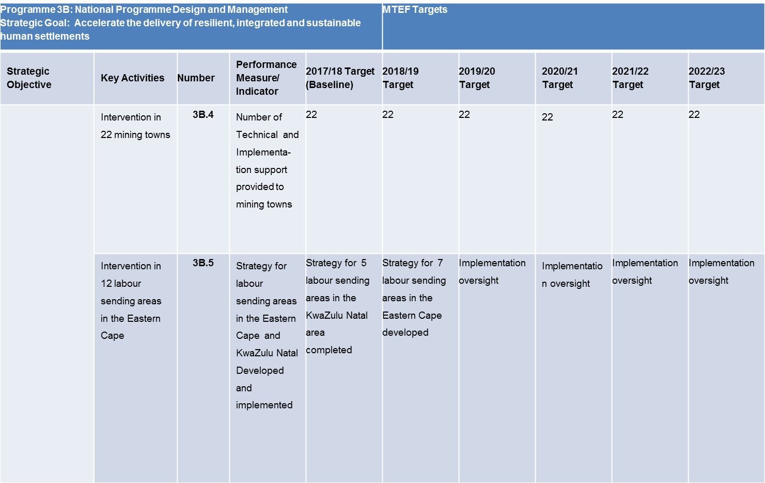
MTEF

Slide 39
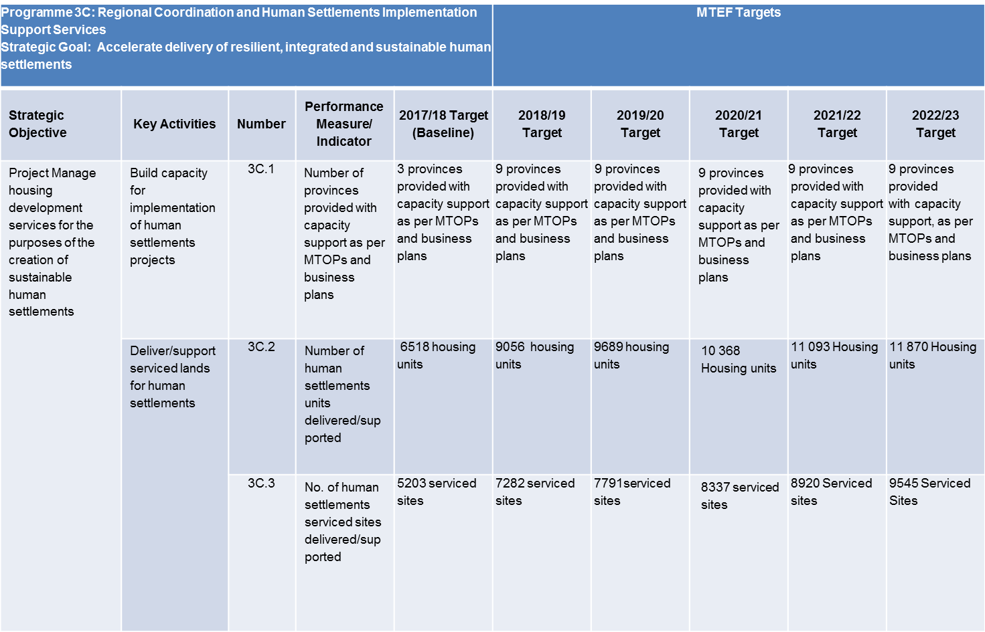
MTEF

Slide 40
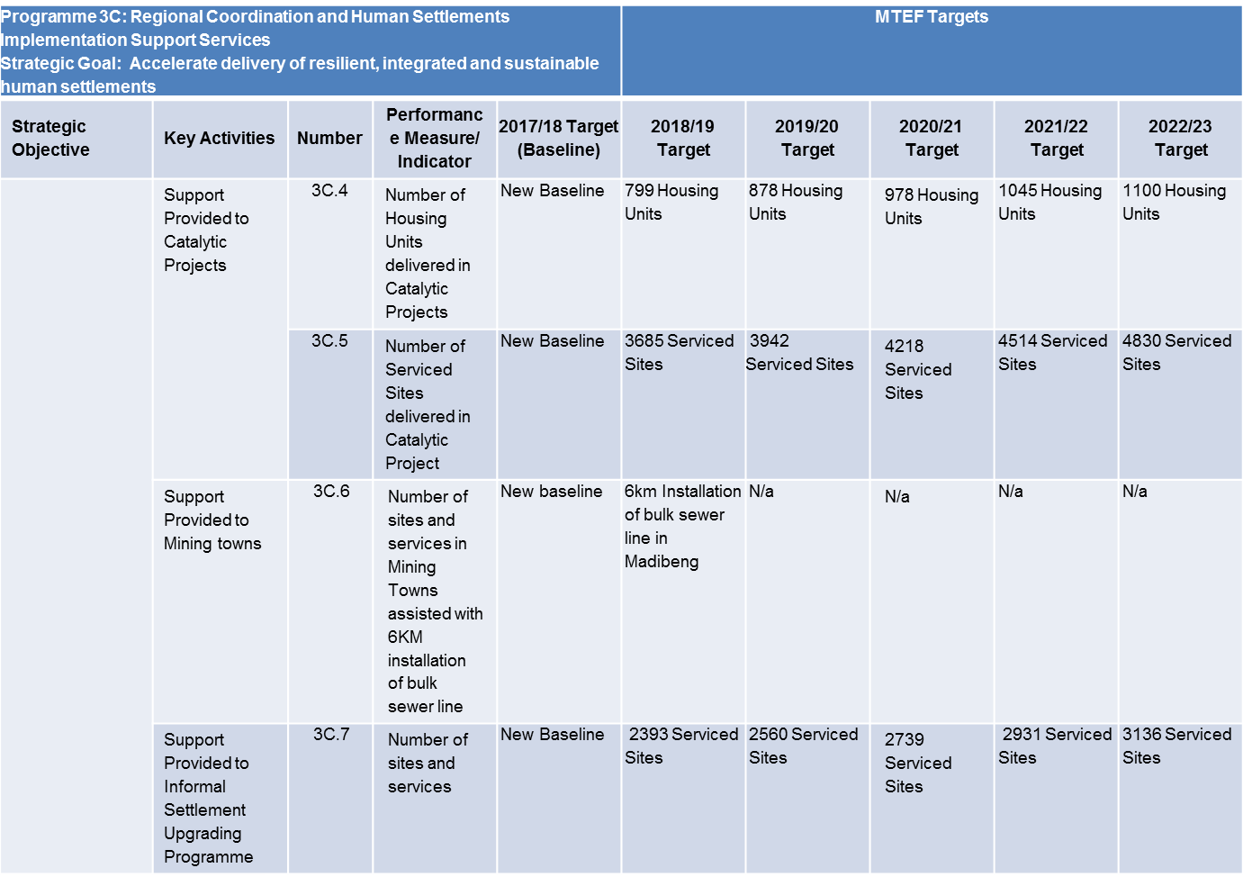
MTEF

Slide 41
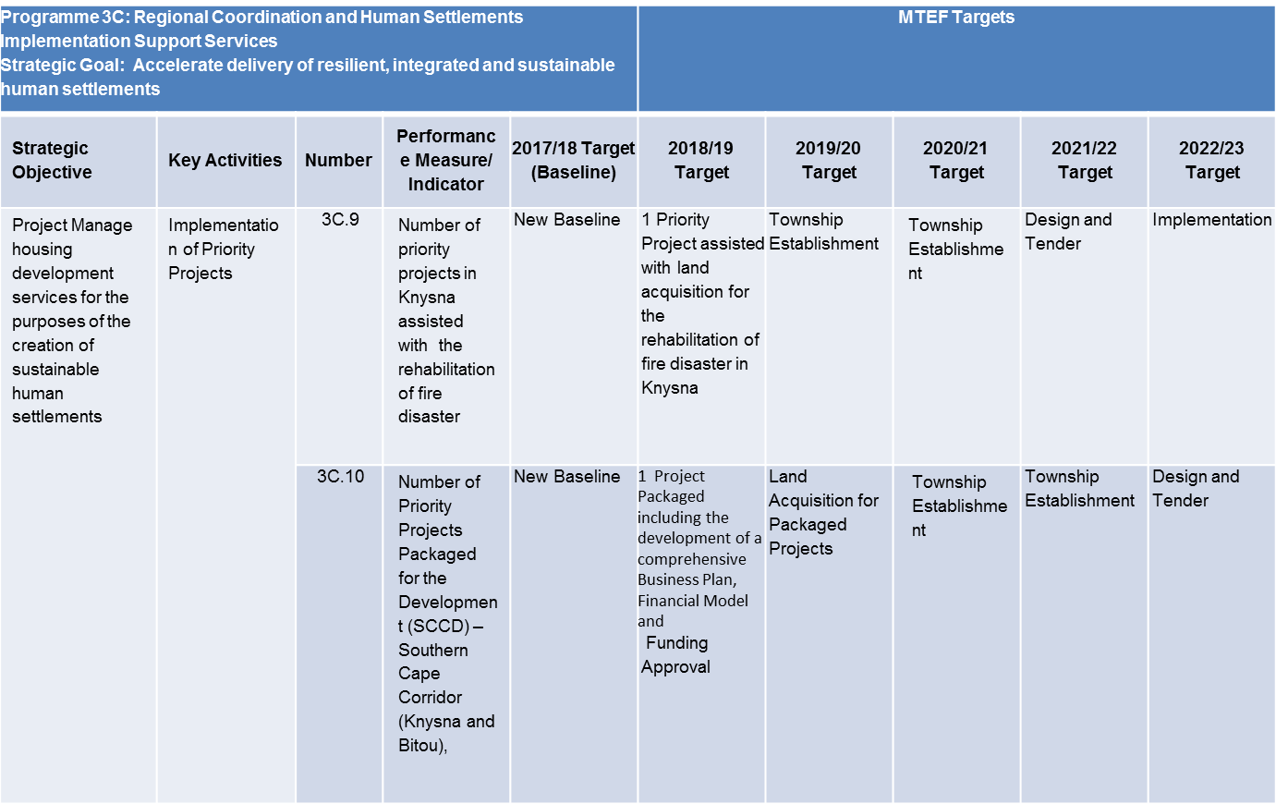
MTEF

Slide 42
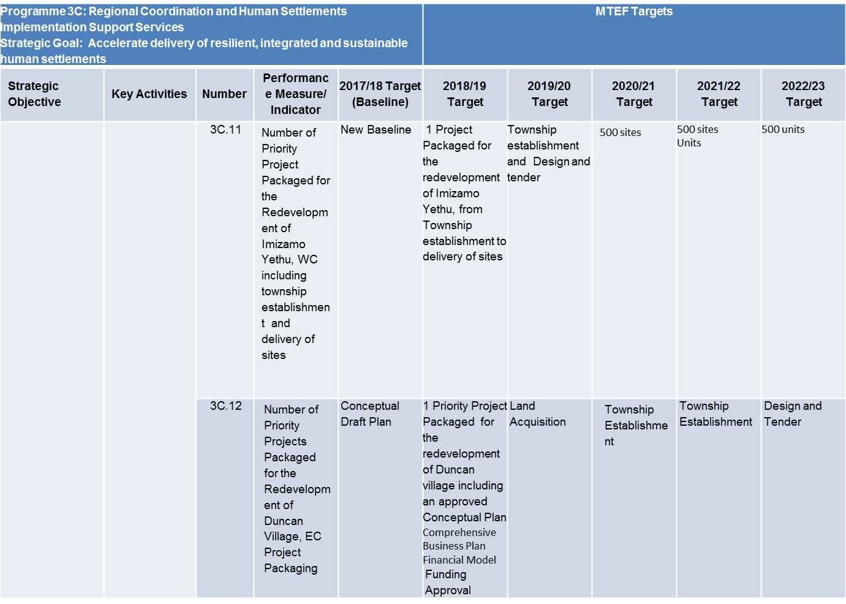
MTEF

Slide 43
STAKEHOLDER AND INTERGOVERNMENTAL RELATIONS

Slide 44
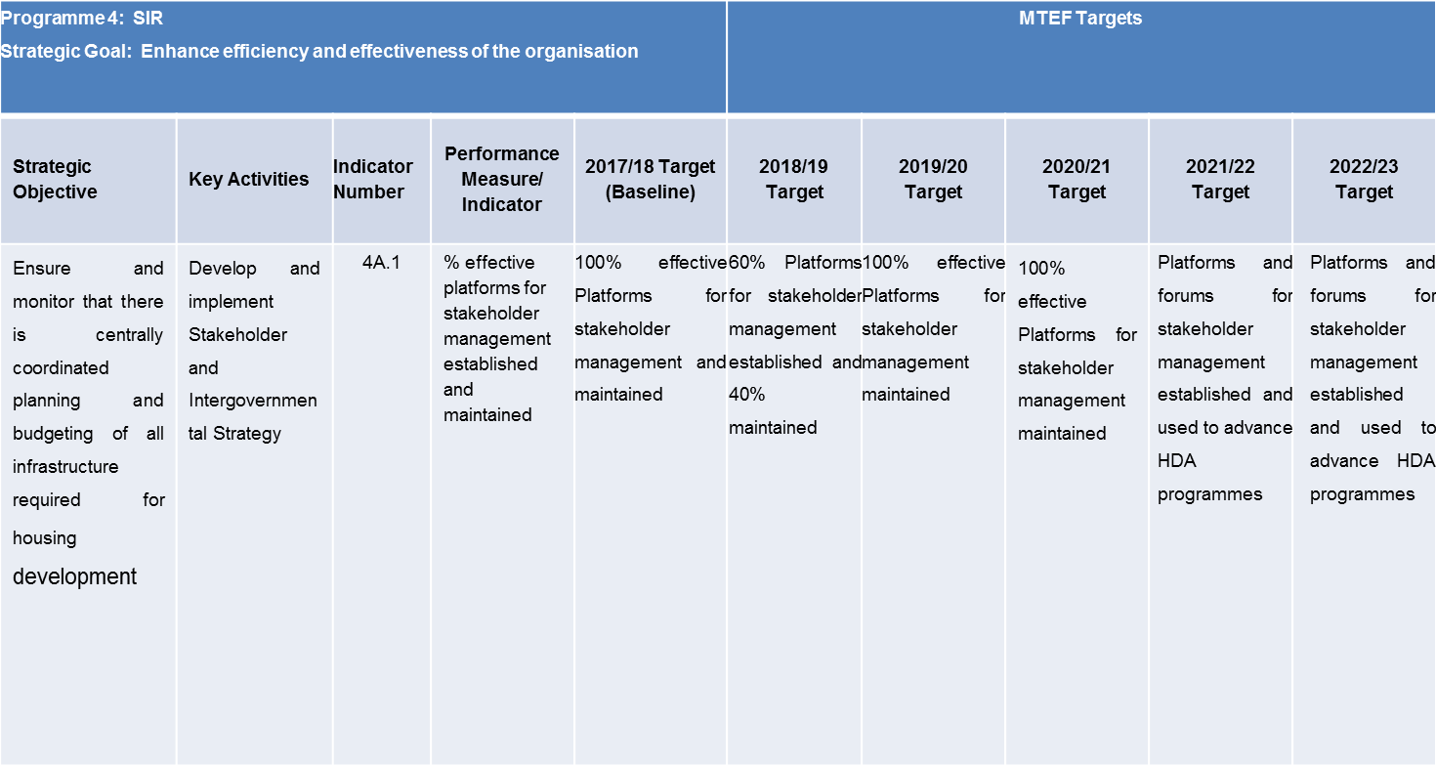
MTEF

Slide 45
SPATIONAL INFORMATION ANALYSIS
2018 / 2019

Slide 46
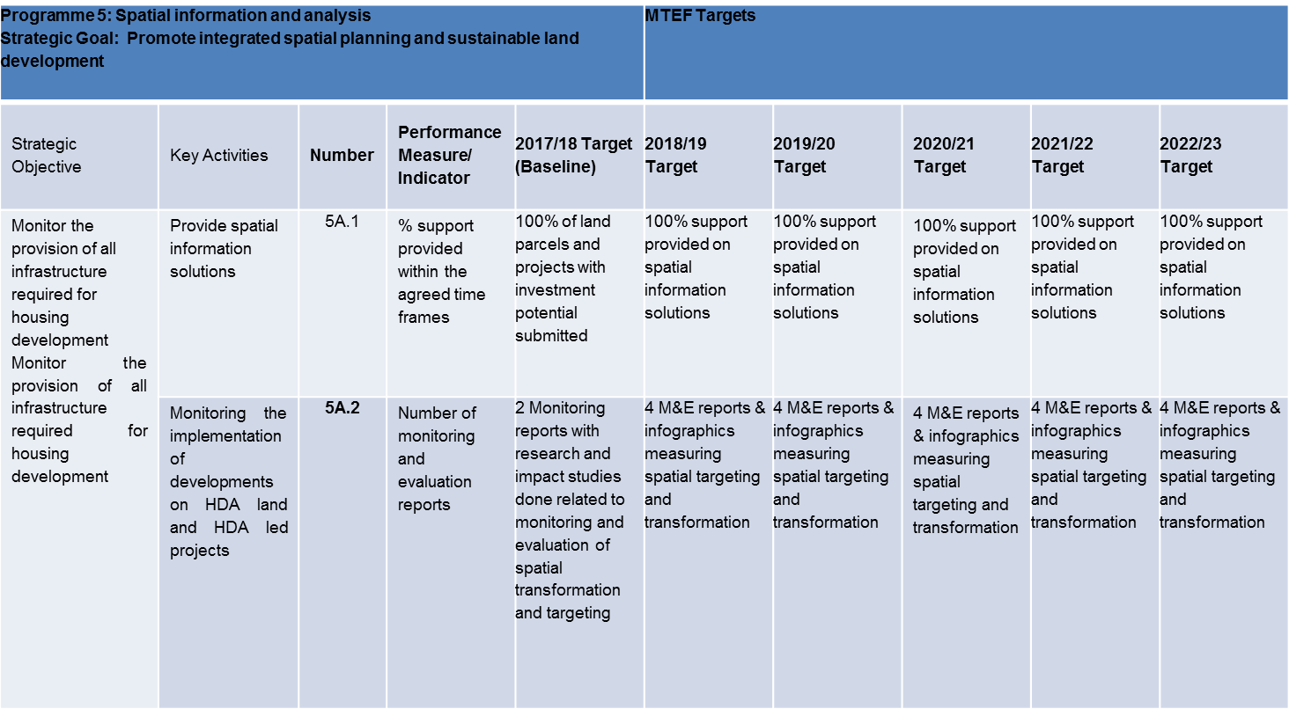
MTEF

Slide 47
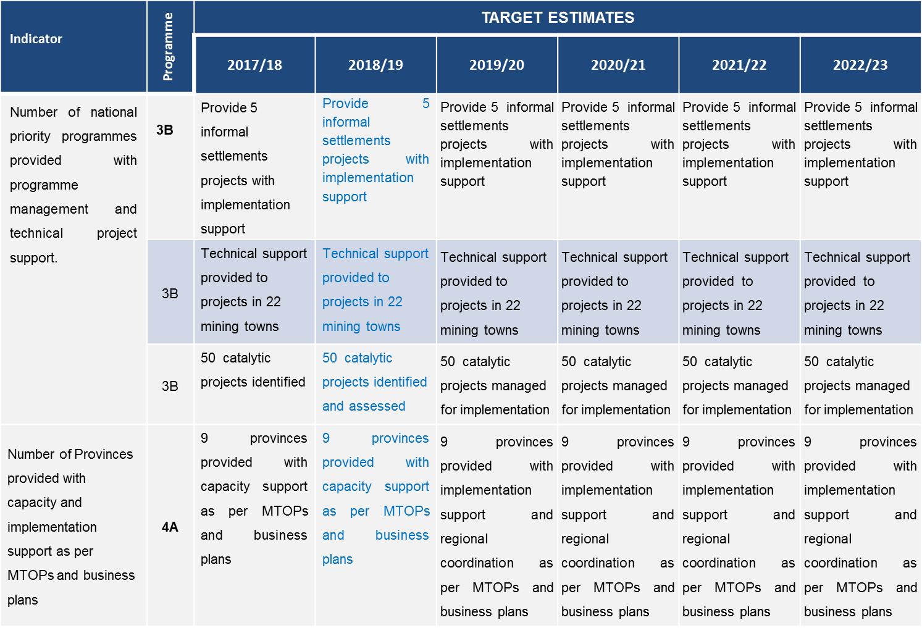
MACRO PERFORMANCE INDICATORS

Slide 48
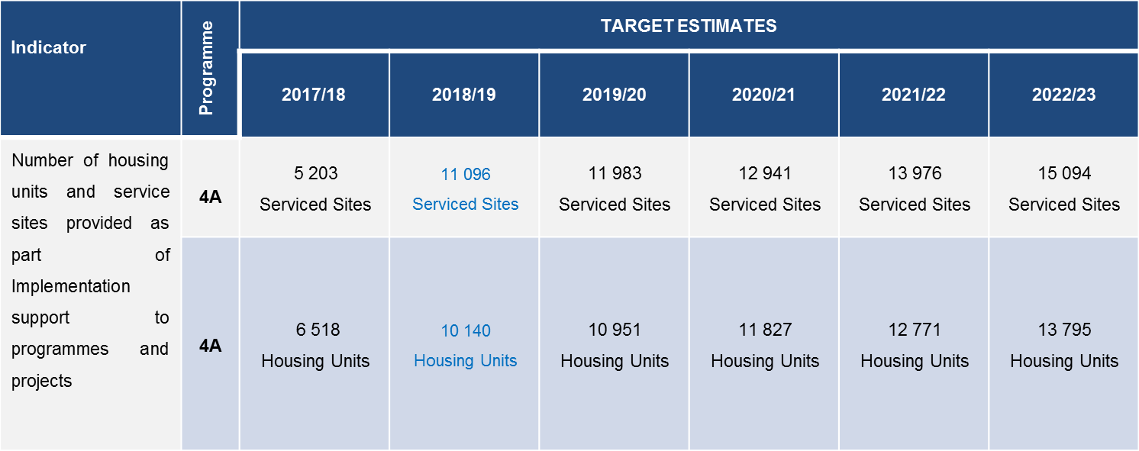
MACRO PERFORMANCE INDICATORS

Slide 49
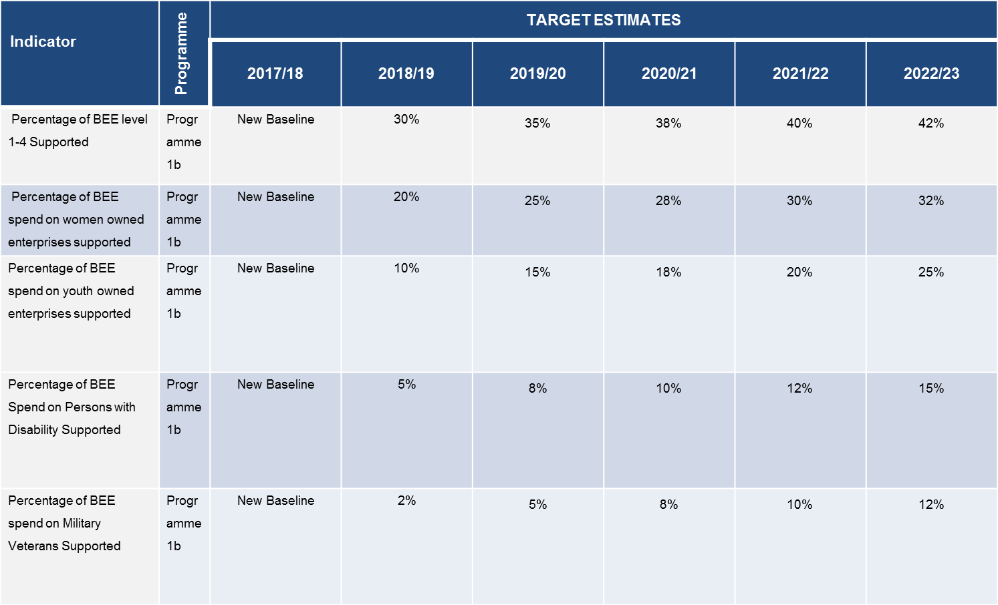
MACRO PERFORMANCE INDICATORS

Slide 50
HDA BUDGET
2018 / 2019

Slide 51
HDA BUDGET
2018 / 2019

Slide 52
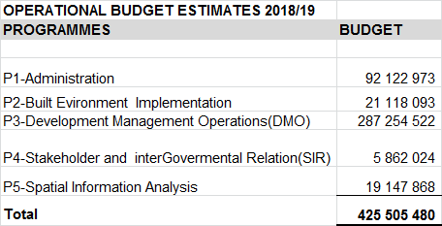
HDA Budget 2018-2019

Slide 53
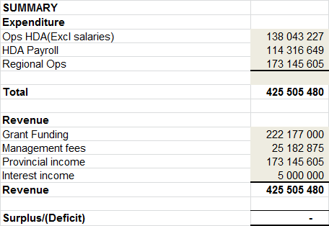
HDA Budget 2018-2019

Slide 54
HDA Budget 2018-2019

Slide 55
HDA Budget 2018-2019 – Provincial Transfers
Provincial Transfers
Limpopo | R240 988 000
Kwa-zulu Natal | R53 218 437
Northern Cape | R114 473 700
Free State | R102 683 278
Northwest | R715 355 759
Gauteng | R858 400 000
Total | R2 085 119 174

Slide 56
2018/2019
PROJECTS-ESTIMATED -2018/19
Province
Limpopo
Project |  |  | Amount invoiced | Amount received
PMU
1st & 2nd Tranches |  |  | 29 988 000,00 | 29 988 000,00
Disaster Housing |  |  | 37 040 000,00 | 37 040 000,00
Rural Housing Programme 5000
- First tranche |  |  | 150 000 000,00 | 150 000 000,00
- Second tranche |  |  | 23 960 000,00 | 23 960 000,00
TOTAL |  |  | 240 988 000,00 | 240 988 000,00
Project |  |  | Amount invoiced | Amount received
Kwa Zulu Natal
Wembezi B Serviced Sites Housing P K18 |  |  | 19 218 437,31 | 19 218 437,31
CATALYTIC PROJECTS
- HSDG Catalytic Projects |  |  | 8 606 845,00 | 8 606 845,03
- HSDG Catalytic Projects |  |  | 8 606 845,00 | 8 606 845,00
- HSDG Catalytic Projects |  |  | 8 181 310,00 | 8 181 310,00
- HSDG Catalytic Projects |  |  | 8 605 000,00 | 8 605 000,00
TOTAL |  |  | 53 218 437,31 | 53 218 437,34

Slide 57
2018/2019
Project |  |  | Amount invoiced | Amount received
Northern Cape
SNAKE PARK - 1660
- First Tranche |  |  | 11 250 000,00 | 11 250 000,00
- Second Tranche |  |  | 7 971 860,00 | 7 971 860,00
- Third Tranche |  |  | 13 526 868,00 | 13 526 868,00
- Fourth Tranche |  |  | 37 246 843,20 | 37 246 843,20
HEUNINGVLEI
- Fifth Tranche |  |  | 1 593 056,00 | 1 593 056,00
- Sixth Tranche |  |  | 7 056 964,31 | 7 056 964,31
GAMAGARA SESHENG
- First Tranche |  |  | 5 072 769,50 | 5 072 769,50
- Second Tranche |  |  | 10 753 851,85 | 10 753 851,85
- Third Tranche |  |  | 15 377 488,00 | 15 377 488,00
LAND
Managent Fee - Gamagara(Khatu) |  |  | 2 720 000,00 | 2 720 000,00
Managent Fee - De Aar - Erf 635 |  |  | 204 000,00 | 204 000,00
Managent Fee - Portion 12 Farm Pensfontein 449 |  |  | 1 700 000,00 | 1 700 000,00
TOTAL |  |  | 114 473 700,86 | 114 473 700,86
Project |  |  | Amount invoiced | Amount received
Free State
Accreditation Support
Catalytic Projects - Baken Park |  |  | 9 500 000,00 | 9 500 000,00
- Sasolburg |  |  | 4 000 000,00 | 4 000 000,00
- Sasolburg |  |  | 10 426 111,79 | 10 426 111,79
-Baken Park |  |  | 15 601 000,00 | 15 601 000,00
- Estoire Properties |  |  | 11 145 416,00 | 11 145 416,00
Tittle deed restoration project |  |  | 52 010 750,00 | 52 010 750,00
TOTAL |  |  | 102 683 277,79 | 102 683 277,79

Slide 58
Project |  |  | Amount invoiced | Amount received
Northwest
Catalytic Projects - Matlosana & Flamwood |  |  | 99 008 000,00 | 99 008 000,00
- Matlosana & Flamwood |  |  | 44 185 327,00 | 44 185 327,00
- Rustenburg Bokamoso |  |  | 184 800 000,00 | 184 800 000,00
- Madibeng Bulk Services |  |  | 26 250 000,00 | 26 250 000,00
- Naledi Stella |  |  | 32 065 110,00 | 32 065 110,00
- Ditsobotla - Colligny |  |  | 69 993 554,40 | 69 993 554,40
- Rustenburg Bokamoso - 2nd Tranche |  |  | 35 503 040,00 | 35 503 040,00
- Marikana Extension 13 |  |  | 223 550 728,00 | 223 550 728,00
TOTAL |  |  | 715 355 759,40 | 715 355 759,40
Gauteng Province
LAND AQUSITION
Acquisition of 2 Properties in JHB |  |  | 15 000 000,00 | -
Transfer of Funding the Acquisition in Daggafontein |  |  | 90 400 000,00 | 90 400 000,00
MEGA PROJECTS |  |  | 6 000 000,00 | 6 000 000,00
Implementation of Catalytic Mega projects |  |  | 550 000 000,00 | 550 000 000,00
CITY OF JOBURG
- Ennerdale Ext 9 Installation of Services |  |  | 40 000 000,00 | 40 000 000,00
MOGALE CITY
- Munsieville South Construction of services |  |  | 48 000 000,00 | 48 000 000,00
CITY OF TSHWANE
- NWHC/MAWIGA Project - Title Deeds registration |  |  | 24 000 000,00 | 24 000 000,00
VARIOUS MUNICIPALITIES
- Hlano Portfolio - Transfer of properties |  |  | 100 000 000,00 | 100 000 000,00
TOTAL |  |  | 873 400 000,00 | 858 400 000,00

