Slide 1


Slide 2






“I alone cannot change the world, but I can cast a stone across the water to create many ripples.” Mother Teresa
CREATING CHANGE THROUGH
Collective leadership
Leadership
Technology
People
Processes
Systems

Slide 3
“We cannot sit through life hoping for change, we must create the change we are hoping for”
Eleesha
Content
Collective Leadership
CREATING CHANGE through
1
Legislative Mandate & Environment
4
Linking policy and statistics
2
Who are we & How we work
5
Legislative Reform
6
Strategic Priorities
3
Planning, Performance, Risks & Financial position

Slide 4

Who are we?
A national government department
Accountable to the Minister in the Presidency: Planning, Monitoring and Evaluation
Mandated to:
collect, produce and disseminate official and other statistics
coordinate producers of statistics
Activities regulated by the Statistics Act (Act 6 of 1999) provides for independence and oversight by a council

Slide 5



Mandate
Fundamental Principles of Official Statistics
(United Nations adopted 10 principles)
Statistics Act (Act 6 of 1999)*
Statistical production
Statistical coordination
African Charter on Statistics
(African Union adopted 6 principles*)
National
*Undergoing review
CREATING CHANGE through
Collective Leadership
Continental
*Still to be ratified by SA
Global
Global

Slide 6
Role players in the Statistical Environment
Government
President
Serving the:
Public
Business
Organs of state
Appoints SG
Removes SG
Minister
Approves Work
Programme on advice
of SG & Council
Manages performance
of the SG
Appoints the Council
Statistics Council
Safeguards official statistics
Advises both Minister
and the SG
Independent of Stats SA
Statistician-General
Execute the Statistics Act
Exercises independence
Defends statistical methods & best practice
Responsible for official and other statistics
Institutes and stops series without interference

Slide 7





The Minister in the Presidency
Collective Leadership
CREATING CHANGE through

Slide 8





Strategic direction (15/16 – 19/20)
CREATING CHANGE through
Collective Leadership
What have we set out to achieve in our strategy?
Informing a nation
Trusted statistics
Partners in statistics
Capable organisation
Statistical leadership
2018/19 Work Programme is the fourth year of implementing the Strategic Plan

Slide 9

Stats SA at a glance
3015
Staff Members
HO: 1875
PO: 1140
568 work programme targets
R2,27 Billion
Annual Budget
More than 260
statistical reports

Slide 10
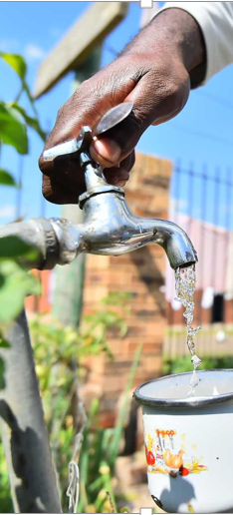
What we do
Measuring Society
Health
Housing
Education
Gender
Deaths
Population
Births
Marriages
Divorces
Census
Labour
Single headed households
Poverty
Youth unemployment
CRIME
Access to Water
Vulnerable groups
Access to Electricity
Causes of death
Access to Transport
Statistical Reports: 45
52
Notes:
The United Nations principles state official statistics are produced:
As public information which is relevant, impartial and accessible.
With professional standards and ethics.
Using accountable and transparent methods and procedures.
Ensuring misuse and erroneous interpretation is prevented.
In a cost-effective manner.
With all individual data as confidential
Within required statistical system legislation.
With coordination nationally among producers.
Using international standards, concepts, classifications, methods.
Where international cooperation is fostered.

Slide 11

Measuring the Economy
What we do
Trade
Manufacturing
Finances
Provincial spending
Forestry
GDP
Services
Employment
Consumer Price Index
Primary Sector
Producer price Index
Prices
Mining
Government
Transport sector
Communication
Wholesale Trade
Buildings
Electricity
Agriculture
Statistical Reports: 224
Notes:
The United Nations principles state official statistics are produced:
As public information which is relevant, impartial and accessible.
With professional standards and ethics.
Using accountable and transparent methods and procedures.
Ensuring misuse and erroneous interpretation is prevented.
In a cost-effective manner.
With all individual data as confidential
Within required statistical system legislation.
With coordination nationally among producers.
Using international standards, concepts, classifications, methods.
Where international cooperation is fostered.

Slide 12

International footprint
Continental
DGs Committee
StatCOM
SHaSA
ASSD
African Peer review Mechanism
Support & sharing:
  Technical
  Strategy
  Governance
2
International
1
UNSC
BRICS
City/Expert Groups
Study tours: in- and outbound
3
Regional: SADC
Statistics Committee
Support & sharing:
  Technical
  Strategy
  Governance

Slide 13
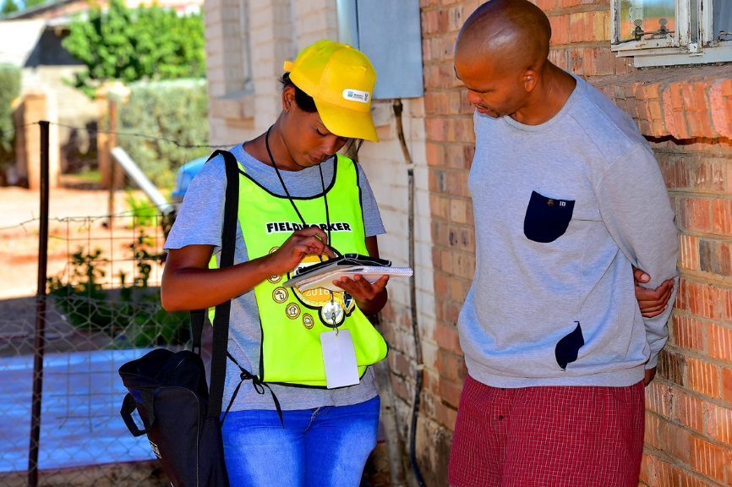
How do we improve our service delivery?

Slide 14
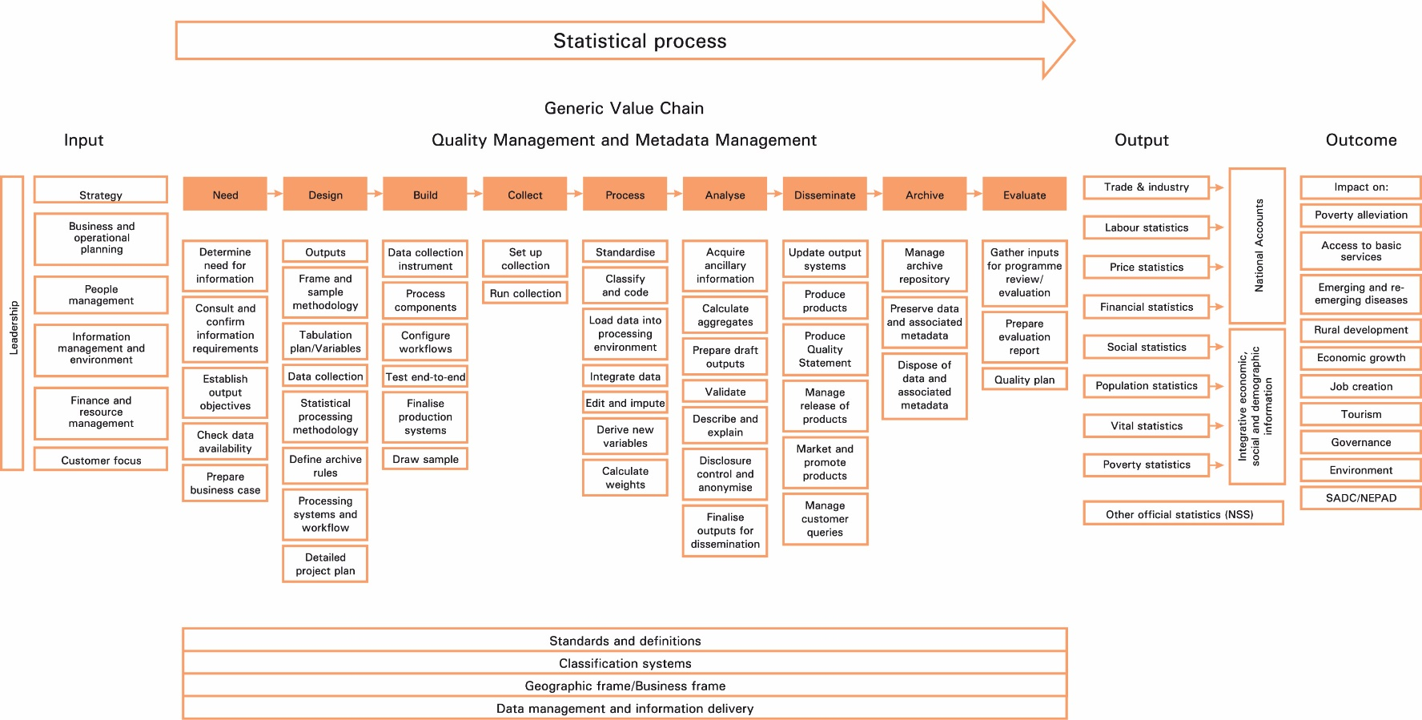

Our statistics value chain
Collective Leadership
CREATING CHANGE through
Modernise and innovate our business processes
(digital transformation)
Upskilling – digital skills

Slide 15
Planning, Performance & Risks
Insert content here in the provided are.
Insert content here in the provided are.

Slide 16


Feedback on tracking tool
LEGISLATIVE REFORM
ABUSE OF SICK LEAVE
Work-in-Progress
Detailed slide to follow
Work-in-Progress
The average days sick leave per employee remains below 12 days per annum
Education programme rolled out on leave and sick leave in 2017
AG AUDIT OUTCOMES
BUDGET REVIEW AND RECOMMENDATIONS REPORT
Clean audit for 2016/17 – no material findings
Audit mitigation plan compiled for 2017/18
Monitored monthly
Committee raised concerns on budget cuts
Increasing use: Approved Integrated Communication and Marketing strategy

Slide 17
Stats SA planning
Strategic review
Mid-term review of performance of the organization (2015/16, 2016/17, 2017/18)
Strategic monitoring & evaluation
F
A
Strategic analysis
Internal/ external situation analysis
Workforce analysis (vacancies)
Financial analysis (budget cuts)
Strategy implementation
Preparing for implementation
(Buy-in, Communication, Roles and responsibilities)
Structure alignment
Alignment of human resources
Roll-out of change
(systems, processes, skills development)
Collective
leadership
responsibility
E
B
Strategy formulation
Reviewed strategic outcomes & objectives
Service delivery model
Reprioritisation (Critical/ Important/Non-critical)
D
C
Strategic planning
Compiled Work programme

Slide 18

Organisational performance
Collective Leadership
CREATING CHANGE through
Audited performance
Audited performance
Estimated performance Q4
2015/16
2016/17
2017/18
40,7%
40,6%
40,9%
82%
87%
85%
1,2%
8,8%
vacancy
98%
1,2%
10,9%
vacancy
97%
1,2%
13,8%
vacancy
101%
Stopped filling vacancies from October 2016
A total of 170 staff left Stats SA

Slide 20
Financial position
Collective Leadership
CREATING CHANGE through
ENE allocation
ENE Cut
% cut in CoE
Vacancy
2017/18
R2 108 billion
R141 million
9%
13,8%
R2 165 billion +
R70 million for CPS
R37 million for census
2018/19
R215 million
13%
R2 294 billion +
R145 million for census
2019/20
R254 million
13%
2020/21
R2 449 billion +
R855 million for census
13%
R269 million

Slide 21




Stats SA @ risk
Collective Leadership
CREATING CHANGE through
1
DEMAND
1
2
BUDGET
Increasing demand for statistical information
National
Continental
Global
Other
Severe budget cuts
Warm bodies not affordable
IES/LCS not fully funded
  Poverty estimates impacted
  CPI basket
4
2
4
SUPPLY
3
3
PEOPLE
Basic statistics at risk – declining quality over time
Discontinued integrative statistical products (value-add) & environmental accounts products
Skills level (capability)
Declining skills base (cannot fill critical vacancies)
104 staff left in 2017/18
Staff over-stretched – may be exposed to errors

Slide 22
Key indicators at risk
Collective Leadership
CREATING CHANGE through
GDP
IES/LCS – Poverty and service delivery indicators
Consequence for
Economic growth
Consequence for
Socio-economic planning &
policy development
Determining the CPI basket
Employment
CPI
Key
Consequence for
Job creation
Consequence for
Inflation targeting and
Monetary policy
Indicators
at risk
POPULATION estimates
Fertility & Mortality
Consequence for
DoRA
Consequence for
Health policy & planning

Slide 23
2018
STATE OF THE NATION
Linking policy and statistics

Slide 24
Policy Agenda
SONA 2018
Mining
Education
Social Grants
Transformation
Infrastructure
Health and NHI
Economic Policy
State/governance
Land and agriculture
National Minimum Wage
Corruption/state capture
Jobs, especially for youth
Social Sector/Civil Society
Fourth industrial revolution
Re-industrialise/ stimulate manufacturing
Small business, co-ops, township enterprises
Thuma Mina

Slide 25
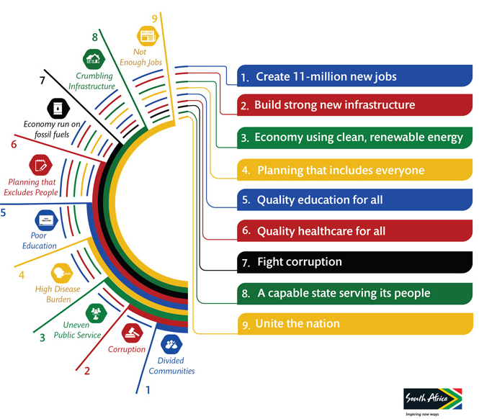
National policy agenda (NDP)

Slide 26

Continental policy agenda

Slide 27

















Global policy agenda: SDGs
*Sustainable Development Goals: Baseline report 2017
SA can report on 68,1% of Social Goals
SA can report on 69% of Economic Goals
SA can report on 29,4% of the Means of Implementation
SA can report on 56,5% of Environmental Goals
SA can report on 73% of the Peace and Security Goal

Slide 28
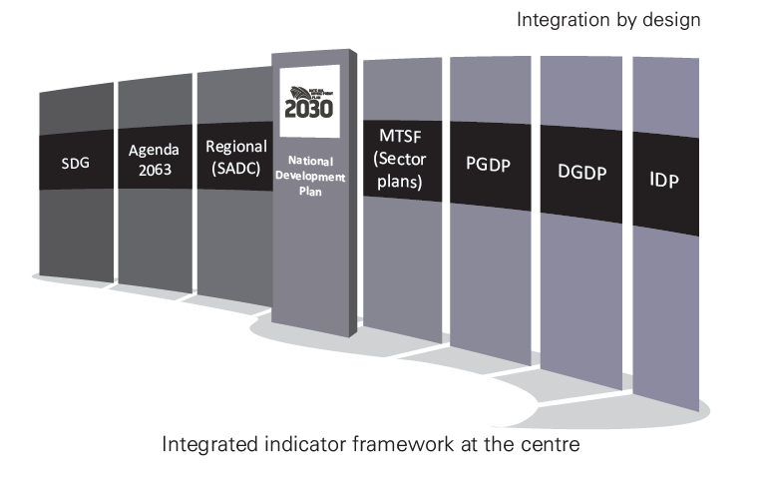
Integrated Indicator framework
Collective Leadership
CREATING CHANGE through
An integrated indicator framework is in development that aligns indicators of the African Agenda 2063 and SDGs to the NDP and seeks to identify data gaps

Slide 29
STATS SA SURVEYS / PRODUCTS
NDP (SONA)
STATISTICAL
THEMES
DEVELOPMENT OUTCOMES

Slide 30
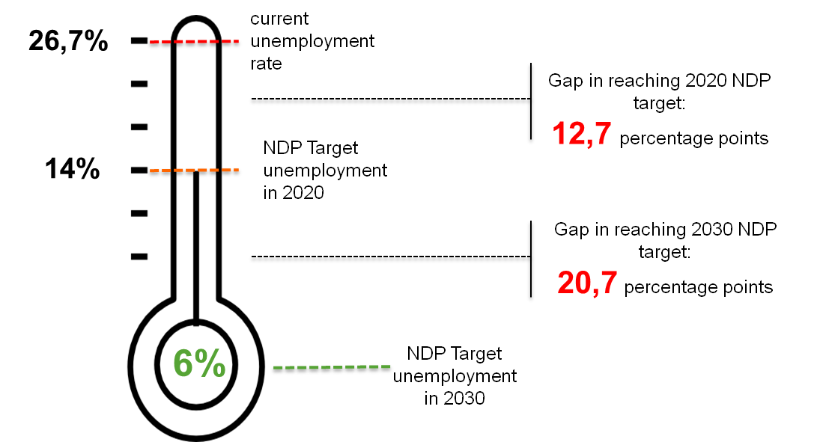
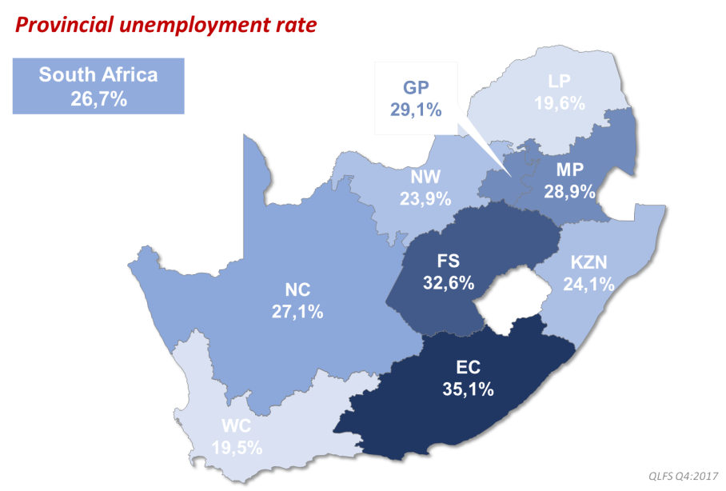
NDP (SONA)
STATISTICAL
THEMES
STATS SA SURVEYS / PRODUCTS
Employment, Jobs Summit, Youth Employment Service
Employment, job creation & decent work
QLFS, QES
DEVELOPMENT OUTCOMES
Decent employment through inclusive economic growth

Slide 31
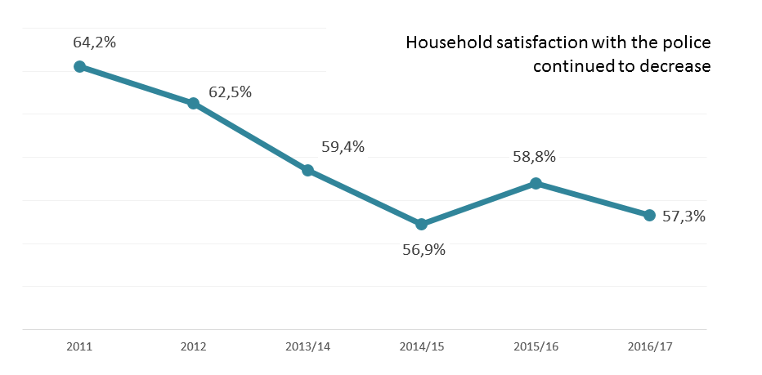
NDP (SONA)
STATISTICAL
THEMES
STATS SA SURVEYS / PRODUCTS
Ethical behaviour and ethical leadership
Governance
VOCS
Victims of Crime Survey, 2016/17
DEVELOPMENT OUTCOMES
An efficient, effective and development-oriented public service

Slide 32
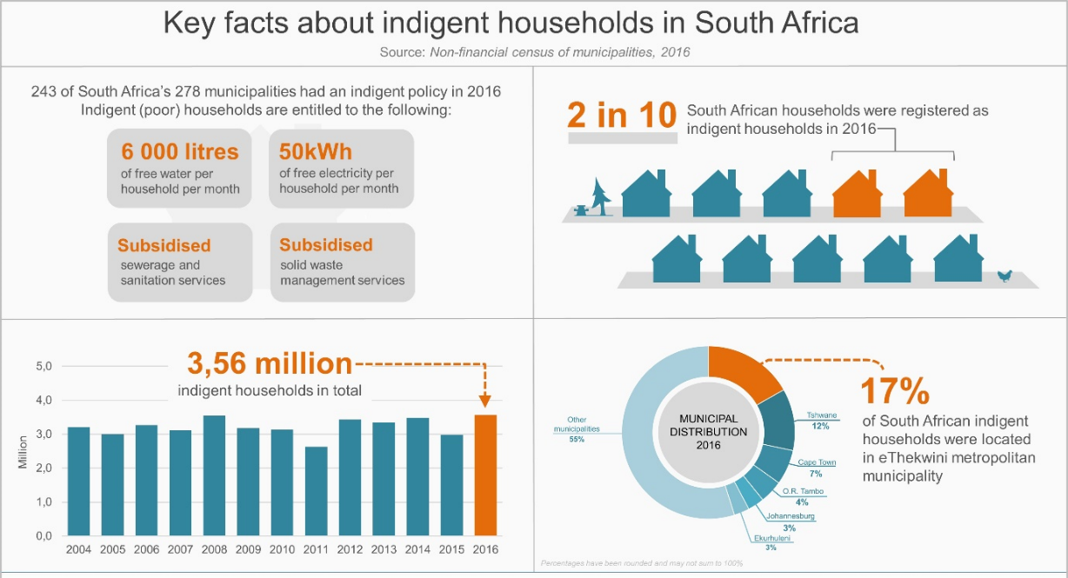
NDP (SONA)
STATISTICAL
THEMES
STATS SA SURVEYS / PRODUCTS
Life circumstances, service delivery & poverty
IES, LCS, GHS
Non-financial census of municipalities
Poverty & inequality
Non-financial census of municipalities 2015
DEVELOPMENT OUTCOMES
A comprehensive, responsive and sustainable social protection system

Slide 33
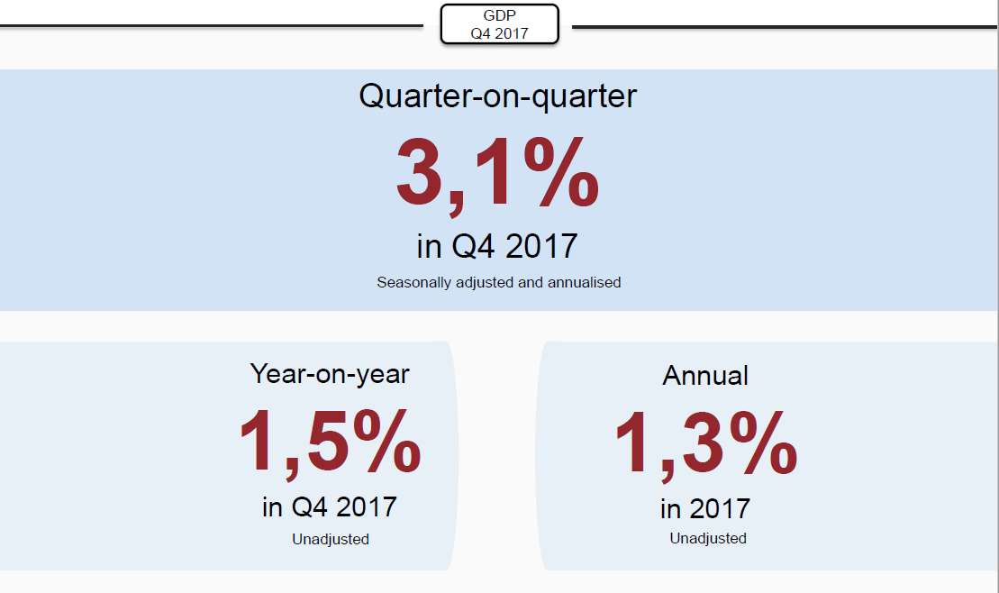
NDP (SONA)
STATISTICAL
THEMES
STATS SA SURVEYS / PRODUCTS
GDP, various other economic releases
Economic growth and investment
Economic dynamics
GDP Q4
2017
DEVELOPMENT OUTCOMES
An efficient, competitive and responsive economic infrastructure network

Slide 34


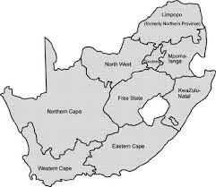

NDP (SONA)
STATISTICAL
THEMES
STATS SA SURVEYS / PRODUCTS
Social Sector Summit
Population dynamics
GHS
WATER
85% (2002) to 89% (2016) access improved water source. Early increases, now stagnated and even decline in some cases
SOLID FUEL COOKING
0,5% (2016) households still use coal for cooking compared to 3% (2002)
ELECTRICITY
77,1% (2002) to 84, 2% (2016), decline from 86% in 2014
BUCKET/NONE
Percentage without toilet facilities, improved from 11,2 % in 2003 to 4,2% in 2016
REFUSE REMOVAL
64,9% (2016) weekly compared to
56,7 (2002)
ACCESS TO IMPROVED SANITATION
The % of households with access to improved sanitation increased from 62,3% in 2002 to 81% in 2016.
GHS 2016
DEVELOPMENT OUTCOMES
Sustainable human settlements and improved quality of household life

Slide 35
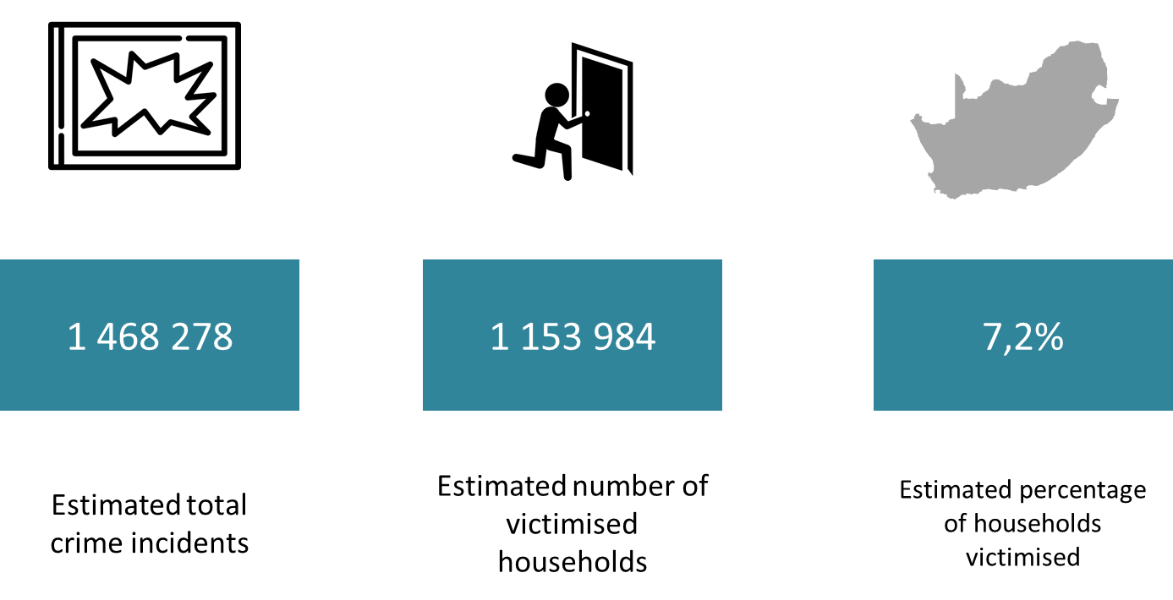
NDP (SONA)
STATISTICAL
THEMES
STATS SA SURVEYS / PRODUCTS
Families can be safe, productive and content
Safety & security
VOCS
General experience of crime
Victims of Crime Survey, 2016/17
DEVELOPMENT OUTCOMES
All people in South Africa are and feel safe

Slide 36
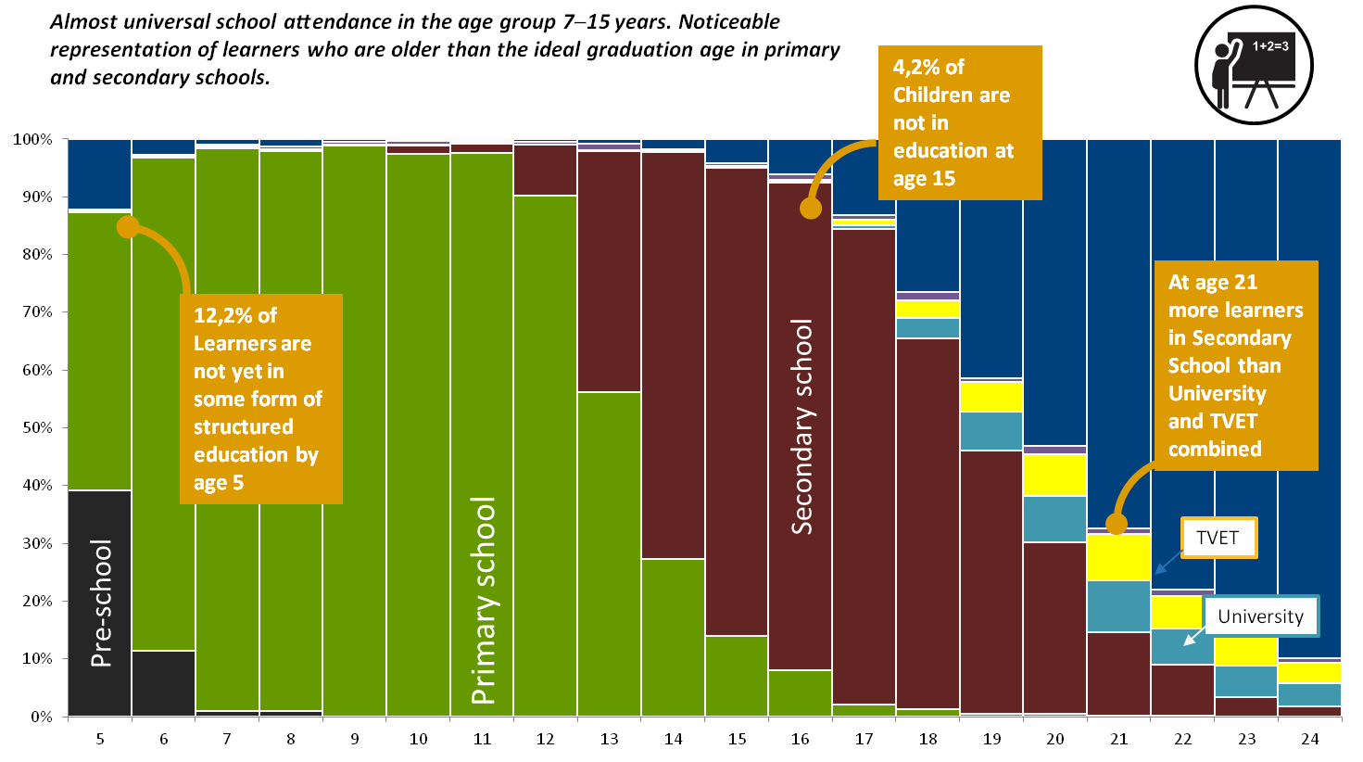
NDP (SONA)
STATISTICAL
THEMES
STATS SA SURVEYS / PRODUCTS
GHS/ Financial statistics of higher education institutions
ECD, Basic and Higher Education
Education
GHS 2016
DEVELOPMENT OUTCOMES
Skilled and capable workforce to support an inclusive growth path

Slide 37
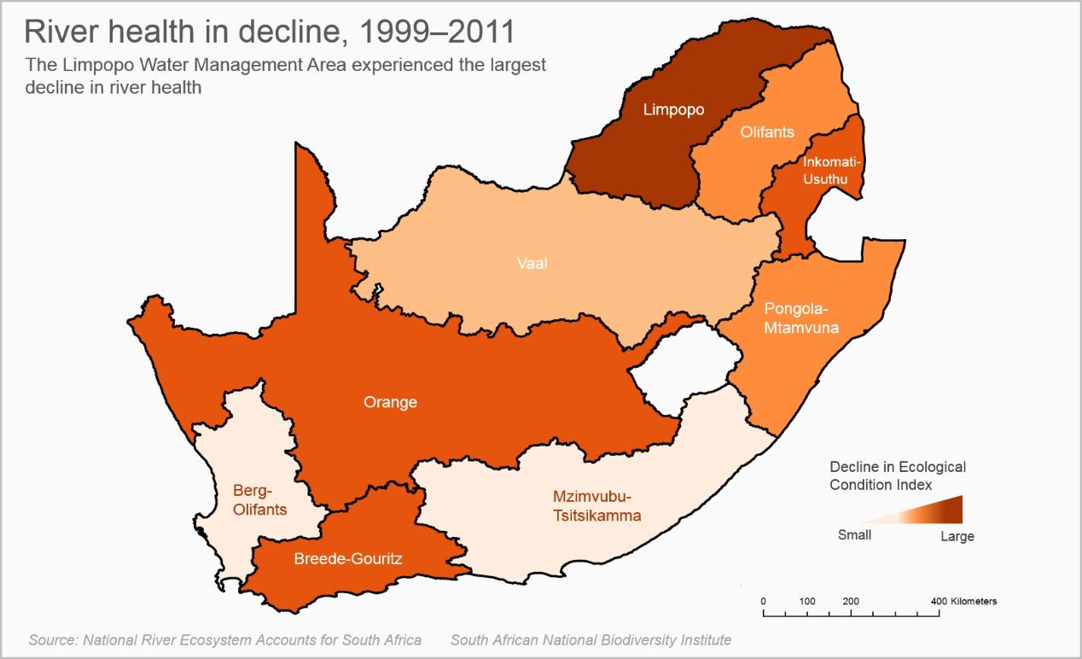
NDP (SONA)
STATISTICAL
THEMES
STATS SA SURVEYS / PRODUCTS
Sustainable resource management
Agriculture Survey
Some of the SEEA releases
Drought
National River Ecosystem Accounts for SA
DEVELOPMENT OUTCOMES
Protect and enhance environmental assets and natural resources

Slide 38
NDP (SONA)
STATISTICAL
THEMES
STATS SA SURVEYS / PRODUCTS
Lifestyle diseases / HIV
Causes of Death
SADHS
Health
Number of deaths in South Africa, 1997−2016
Decline in
deaths continues
DEVELOPMENT OUTCOMES
A long and healthy life for South Africans

Slide 39
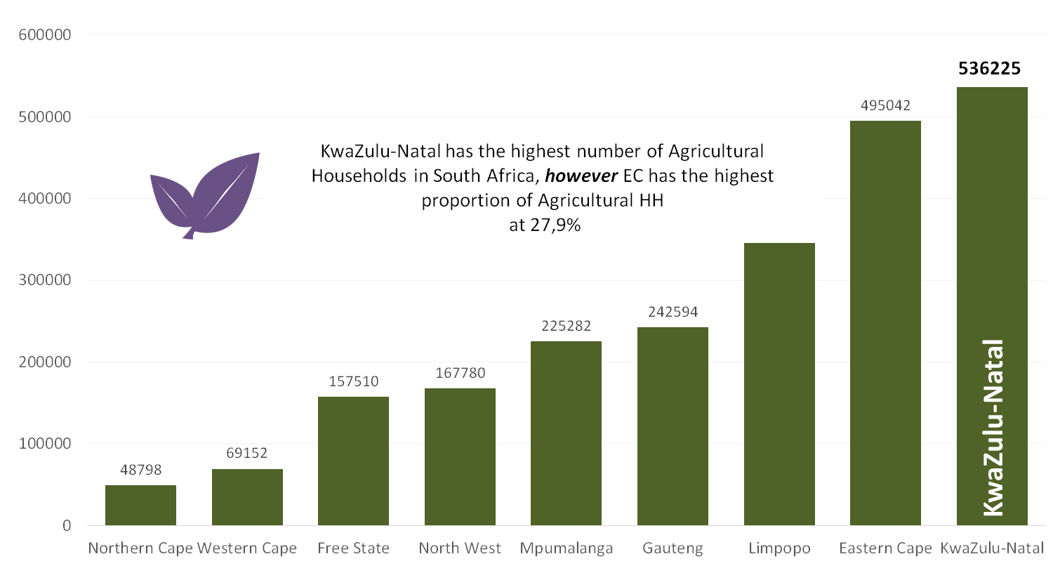
NDP (SONA)
STATISTICAL
THEMES
STATS SA SURVEYS / PRODUCTS
Rural development, food security & land reform
Annual survey of commercial agriculture, CS
Agriculture
Number of Agricultural households by province
CS 2016
DEVELOPMENT OUTCOMES
Vibrant, equitable, sustainable rural communities contributing towards food security for all

Slide 40

Looking Ahead

Slide 41

Increasing use
Collective Leadership
CREATING CHANGE through
Active Citizenry
Public
Media (print and social)
Website
Stats SA:
Policy development & implementation
Statistical products & services offerings:
Website
Print products
Digital products
Social media
Capacity development
User support
Target audience
Linking products and services to the needs
Organs of State
Government institutions
Cabinet
Parliament
Planning, Forecasting & Decision-making
Other organisations
Business
Academia
International agencies

Slide 42
Legislative reform
Collective Leadership
CREATING CHANGE through
2018
2011
Final Consultations with Statistics Council
March - April
2015
Drafting of Policy Document, and
Statistical Regulations
National & Provincial Consultations on
Legislative Reform
2017
2013
2014
2016
2-Study Tours
Consultations
EXCO
Statistics Council
To follow the DPME legislation process April – May
Prepare new Draft Amendment Bill – June to July
Present to the Portfolio Committee - July
Follow “Parliamentary Process” to have Bill enacted - August
2010
Stats SA and Council Symposium on strengthening the Act
Cabinet Decision on consultations on legislative reform using 5 focal areas
2nd Legal Opinion
Draft Amendment Bill
Comparative Schedules on some domestic laws and some international statistics acts
2-Study Tours
New Strategic Direction of Stats SA
1st Legal Opinion

Slide 43
Investment in the future
Collective Leadership
CREATING CHANGE through
Skills in SANSS
Tertiary
Schools
Internship
Inside Stats SA
Statistical leadership
Leadership deployment
Training to lead the Statistics system
Skills deployment
Training for the Statistics system
Talent management
Training for the Statistics Value chain
Skilling for the data and digital revolution
Skills intake
Development, exposure, mentoring
Bursaries
Student support
Partner with IoHL
Maths4stats
Soccer4stats
Teacher focus
Learner focus

Slide 44
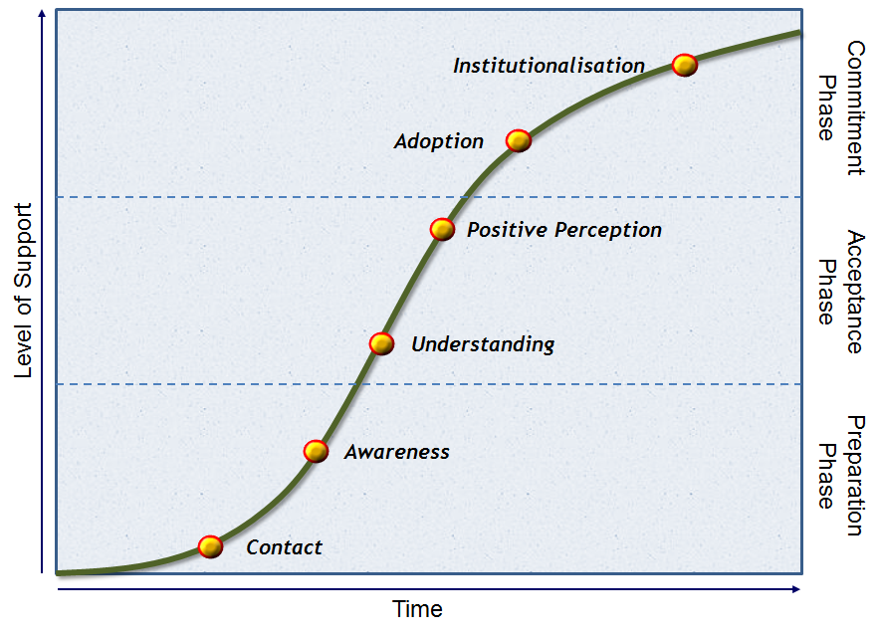

Agenda for Change and Transformation
Collective Leadership
CREATING CHANGE through
Structure
Strategy
Systems
Shared Values
Skills
Style
Staff
We have started the conversation

Slide 45
Strategic priorities 18/19 – 20/21
Collective Leadership
CREATING CHANGE through
1
Finalise legislative reform
2
Maintain the quality of basic statistics
3
Roll-out the Integrated Indicator Framework
4
Integrate, innovate & modernise our business processes
5
Restructure and rationalise (redeployment & reskilling)
6
Coordinate, partnerships & designate statistics as official
7
Census 2021

Slide 46
Thank you

