Slide 1

Rural Housing Loan Fund
Annual Performance Plan 2018/19
Presentation to Parliamentary Portfolio Committee
18 April 2018
Chief Executive Officer: Jabulani Fakazi
Chief Financial Officer: Bruce Gordon

Slide 2
Outline
RHLF mandate
Service delivery model
How we create value for people in our mandate
Policy Context, Market and Regulatory Environments
2018/19 Annual Performance Plan
  Strategic Oriented Outcomes
  Statement of Financial Position
  Statement of Financial Performance
Governance Structure
Concluding remarks

Slide 3
Mandate and Core Business
Households access to housing finance
Facilitate access to incremental housing finance for low income households in rural areas.
Rural areas
Communal land, rural towns and small towns
Monthly Income
Maximum R15 000
Focus on borrowers earning under R3 500

Slide 4
Business model
Intermediaries
Carry credit risk of beneficiaries
Loan requirements
Unsecured, so can never lose homes
Cost of borrowing
National Credit Act allows REPO + 27%
Market to clients
Commercial and Community based organisations
Wholesale Lending
Wholesale funds to retail intermediaries
Must be repaid
People empowered to decide for themselves
Ideally disbursed through building merchants
Must be used for housing as defined in mandate
RHLF discounts to those who charge less (Pricing Policy below)
Each 2% discount to retail clients, RHLF offers 1% to intermediary
Most RHLF retail borrowers pay 15%

Slide 5
Why Wholesale Lending Model not Direct Lending
Cost effective as funds used for development not operations —financially sustainable
Intermediaries bear cost of branch networks
Competition among intermediaries means borrowers shop around for best deal
Crowding-in private sector effort and funding:
  Intermediaries borrow elsewhere once established
  State not competing with private sector
  Fiscus focuses on socio-economic development
At establishment developed incremental housing finance industry – partly achieved
Now transforming industry by bringing in black and women owned lenders & CBOs
Intermediaries carry borrower credit risk, not state

Slide 6
Demographics of developmental clients 2017/8
Name | Location | Black shareholding | Black woman shareholding | RHLF interest
Kabo | Zeerust, NW | 80% | 75% | 20 ords + Prefs
Thusanang Basadi (CBO) | Orange Farm, GP | 100% | 100% | Nil
Home Improvement Finance | Somerset West, WC | 30% | 30% | Nil
Lehae | Maluti-a-Phofung, Free State | 80% | 80% | 20% ords + Prefs
Boikago (CFI/CBO) | Mahikeng, NW | 100% | 52% | Nil
Makoko | Sekhukhune, Limpopo | 100% | Nil | Nil
Shiyendlele (CBO) | Umtshezi, KZN | 100% | 67% | Nil
Igatsha | KwaDukuza, KZN | 100% | 60% | Negotiating 25% ords

Slide 7
Creating value for people in RHLF’s mandate
Mission: To empower people in rural areas to maximise their housing choices and improve their living conditions through access to housing finance

Slide 8
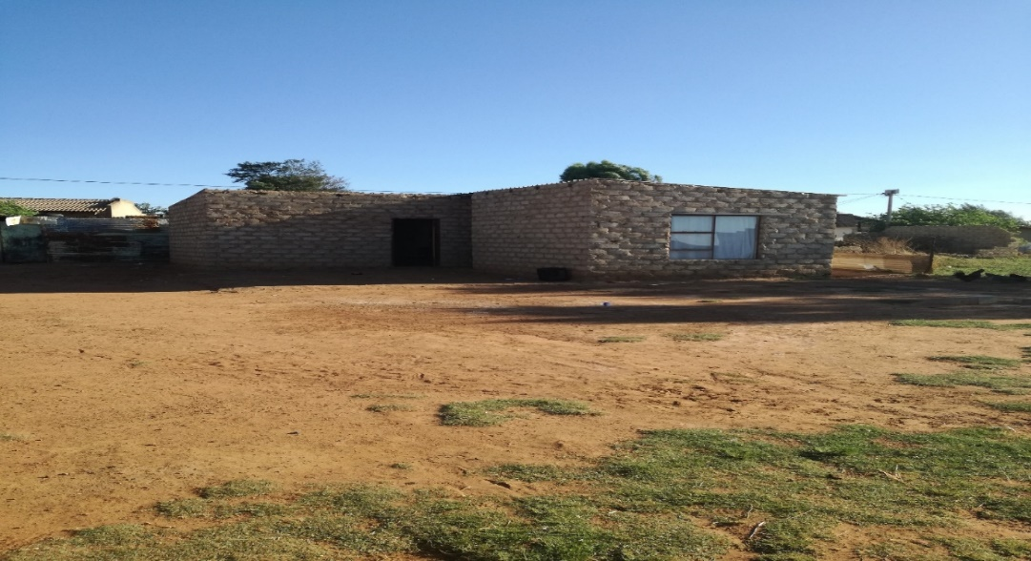
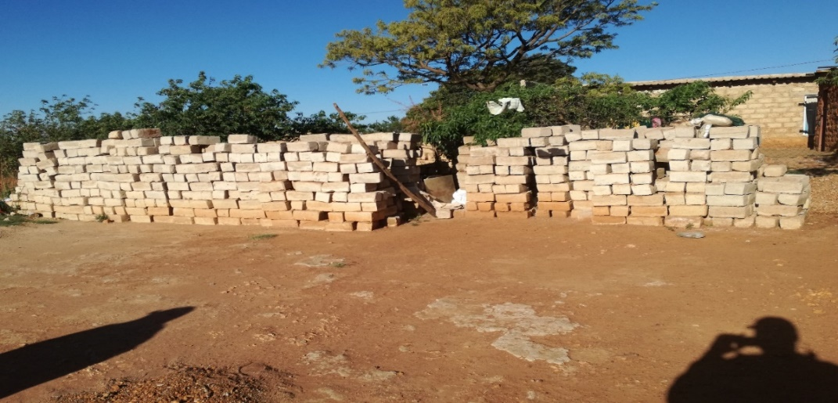
Thembisile Hani LM, Thembalethu (Mpumalanga)
This borrower is 66 years old
First loan R2 000 on 26 August 2014 from Lendcor through BuildIt.
Wants to build a six roomed house but starting with three rooms
Supports four grandchildren
Earns a pension grant of R1 600 per month and assistance from her children who live in Pretoria.
Second loan of R2 500 on the 23 June 2017 to make bricks
She is currently stockpiling the bricks and is happy with the service she received from Lendcor

Slide 9
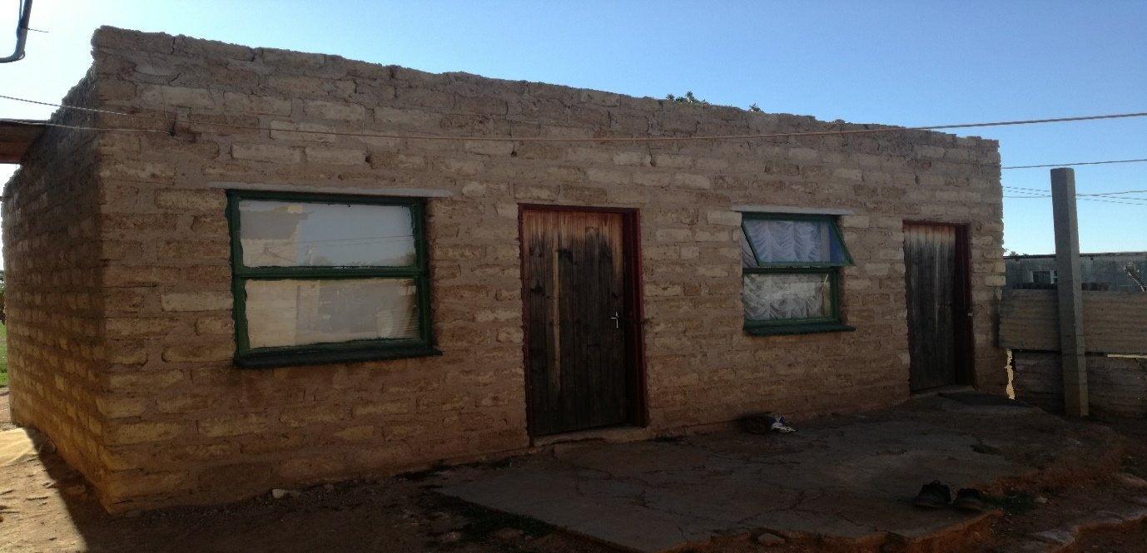
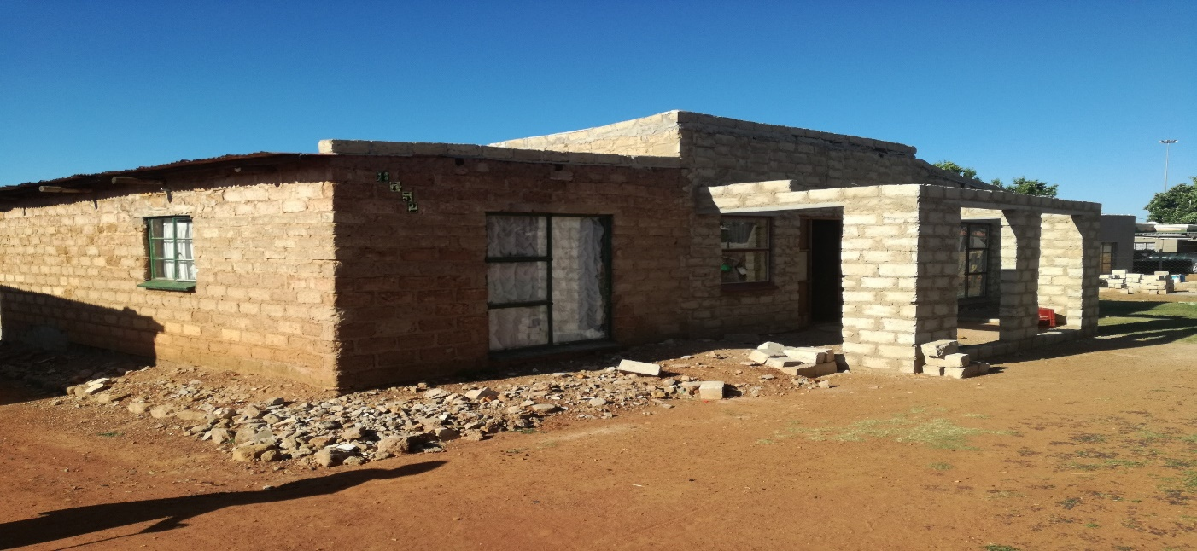
Thembisile Hani LM, KwaMhlanga (Mpumalanga)
69 years old pensioner receiving monthly pension grant of R1 600.
Has access to water from water harvesting,
Access to electricity from Eskom
First of R2 500 on the 11th November 2015 from Lendcor through BuildIt to build outside rooms for two grandchildren.
Added savings to pay for labour
Lives with five grandchildren and says her house is too small
Second loan of R2 500 on the 4th April 2017 to build a veranda in front of the house
Borrower was very happy that Lendcor is assisting pensioners.

Slide 10
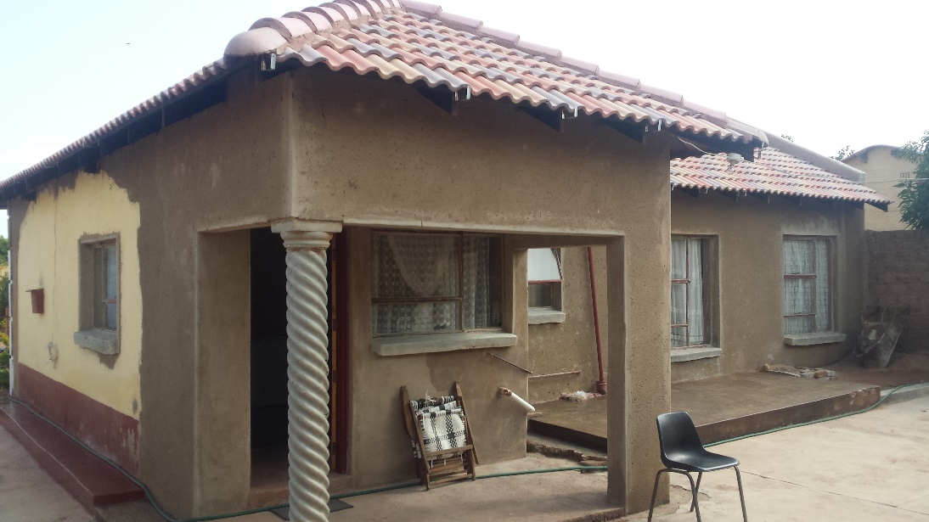
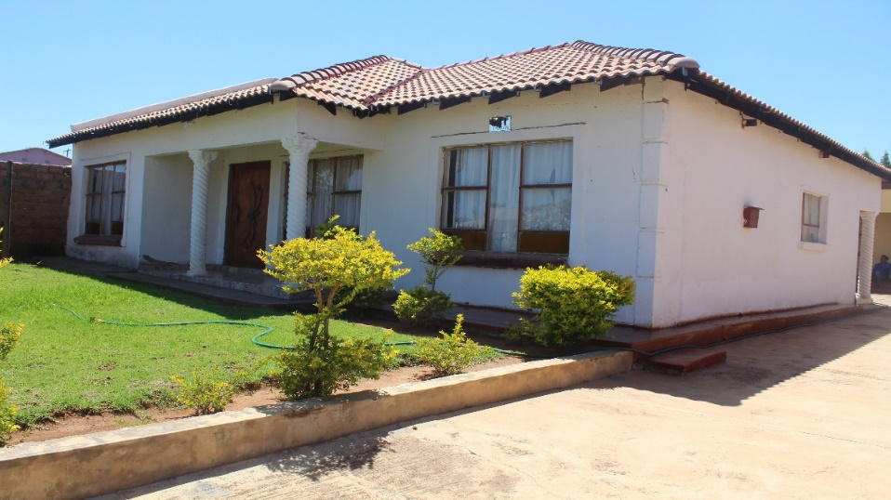
Elias Motsoaledi LM, Groblersdal (Limpopo)
Borrower is a single parent with one child, employed in the private sector
Earns between R9 800 and R15 000 per month.
She took the first loan of R18 633 in May 2014 from Thuthukani to extend the pre-1994 government house for her parents.
She then took the second loan of R32 850 in April 2016 for roofing material to complete the house

Slide 11
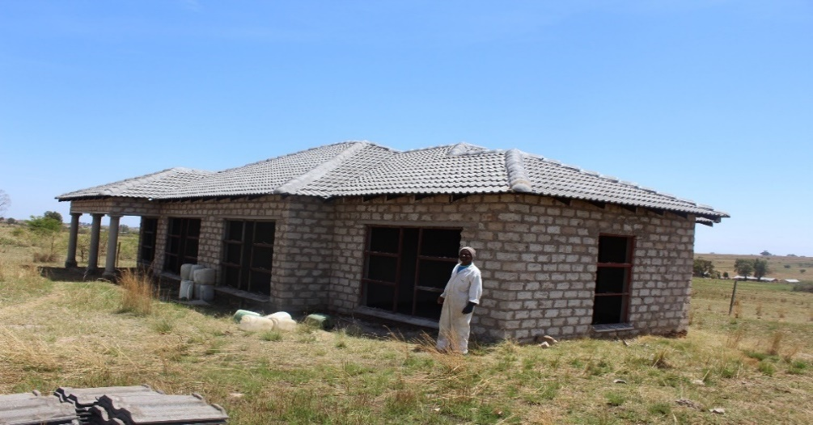
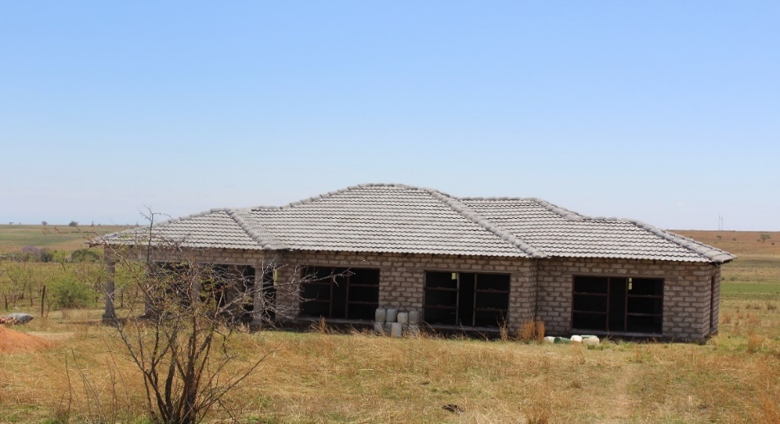
Elias Motsoaledi LM, Grobesdal, Ramogwerane (Limpopo)
54 year old took first loan of R27 850 in May 2014 from Thuthukani to purchase window frames and roofing material for a new house
Savings and the loan not enough to complete the house, so second loan R22 168 on 8 March 2016 to plaster, install flooring and electrify
Lives with his parents while building
Employed in the private sector and earns between R9 800 and R15 000 per month. He stated that he will take another loan to build double garage separately as his future plans.

Slide 12
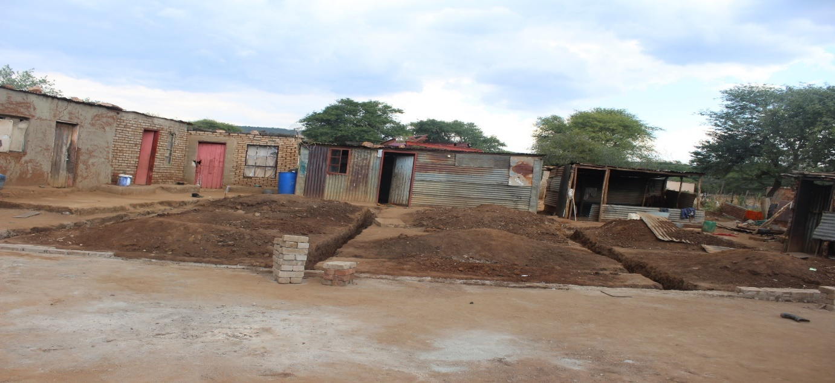
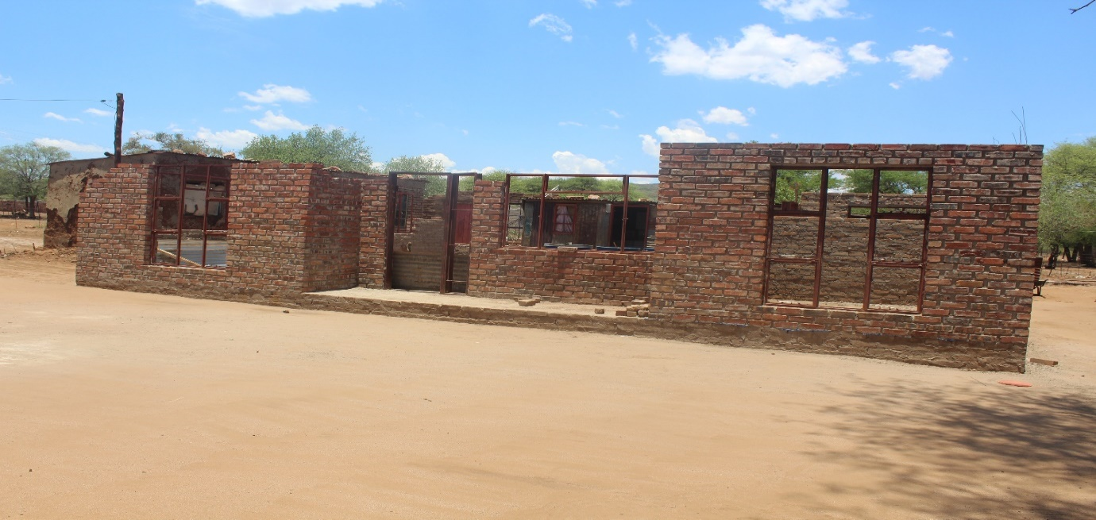
Ramotshere Moiloa LM, Nyetse, Zeerust, North West
Borrower pensioner took her first loan of R2 005 on 18 November 2016 from Kabo Financial Enterprises. She used the loan amount to build the foundation of a 6-roomed house.
The borrower went back to Kabo and took a second loan of R4 160 on 8 May 2017 to build the house.
She stays with 9 members in the household.
Her income is made up of old age and child support grant of R1 600 and R2430 per month, respectively.

Slide 13
POLICY, MARKET & REGULATORY ENVIRONMENTS

Slide 14
Policy Context
Outcome 8: Human Settlements
Adequate housing
Comprehensive Rural Development Programme
Ensuring funding reach priority rural areas
Housing
Informal settlements upgrading
SMME and Co-operatives Development
Finance SMMEs & Coops to on-lend
Inclusive rural economy
Transforming rural human settlements
Support entrepreneurs & job creation
Improved quality of living environments
National Development Plan

Slide 15
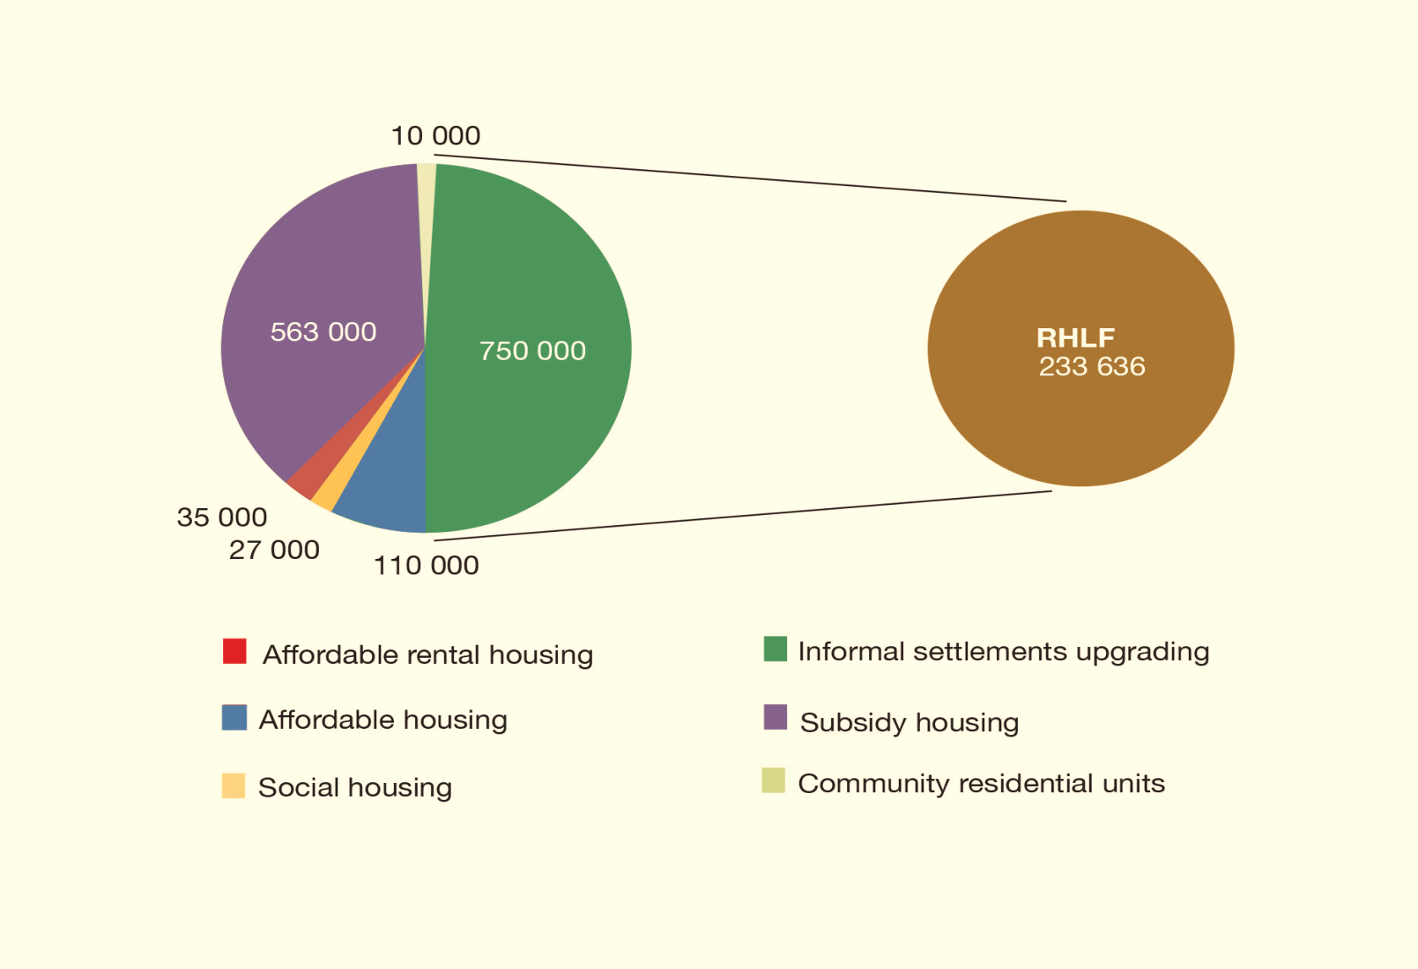
MINISTER’S COMMITMENT AND RHLF CONTRIBUTION
(MTSF Targets)
RHLF MTSF target = 233 636 loans
Performance at end of Q3 2017/18 = 66.4% (155 236)
Consequence of poor market conditions that have prevailed during the current MTSF period

Slide 16
Market and Regulatory Environment
Market conditions
Economic growth
Unemployment
Interest rates
Regulatory Environment
Interest rate caps
Credit Life Insurance fee
Court Judgements, e.g. EAOs
Inflation
Fees (initiation, service)
Levels on indebtedness
Rand exchange rate

Slide 17
Interest rates – legal maximums allowed by National Credit Act
RHLF Loans are usually unsecured
Type of loan | Maximum above REPO | Actual maximum allowed (current RR)
Unsecured housing/developmental credit | 27% | 33,5%
Other unsecured | 21% | 27,5%
When these revised rates were proposed, RHLF made representations to the Department of Trade and Industry that housing loans should be cheaper than other loans

Slide 18
RHLF Pricing Policy
Rate charged to retail borrowers | Rate charged by the Rural Housing Loan Fund
REPO +≥ 25 % | Prime + 4%
REPO + ≥ 23-24.9 % | Prime + 3%
REPO + ≥ 21-22.9 % | Prime + 2%
REPO + ≥ 19-20.9 % | Prime + 1%
REPO + ≥ 17-18.9 % | Prime %
REPO + ≤ 16.9% | Prime – 1.5%
Community based organisations are charged Prime MINUS 2.5%
RHLF prices on development goals, not risk
Repo=6.50%
Prime=10%

Slide 19
Interest rates – Mortgage vs Incremental costs
Aim: to own a R500 000 home
Bond | Loan | 500 000
 | Interest rate | 12,0% | Prime + 2
 | Term | 240 | Months
 | Repayments | 5 505
 | Total | 1 321 303
Income needed at 30% for repayments |  | 18 351 | per month
Incremental | Loan | 50 000
 | Interest rate | 22,0%
 | Term | 24 | Months
 | Repayments | 2 594
 | Total | 62 254
 | Ten loans | 622 538
Income needed at 30% for repayments |  | 8 646
For speed of completion one pays an extra |  | 698 766
And needs double the income

Slide 20
2018/19 Annual Performance Plan:
Strategic Oriented Outcomes
Statement of Comprehensive Income
Statement of Financial Position

Slide 21
Stakeholder and business process perspective

Slide 22
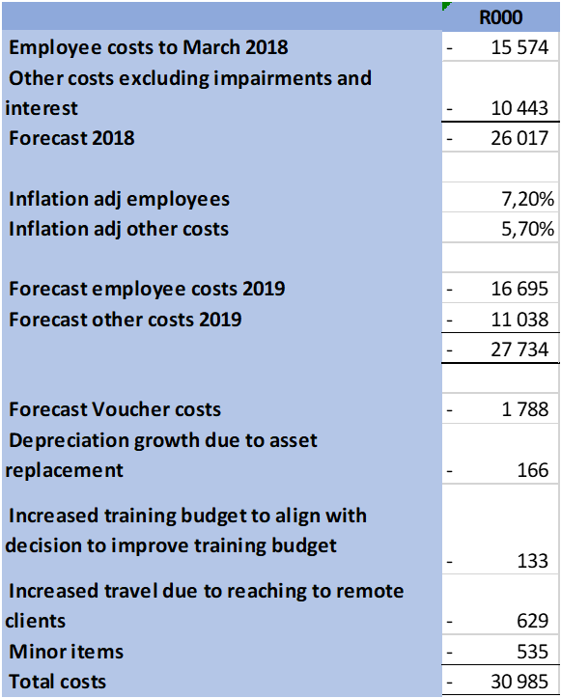
Financial Perspective: Capital Preservation
The 2019 profit is higher despite higher expenses as a result of debtors provisions in income statement reducing by R6 million.

Slide 23
Learning and Growth Perspective
RHLF has a policy of recruiting only interns, where possible. We have a high budget for training to ensure our employees grow.
9 of the 17 current employees joined as interns.

Slide 24
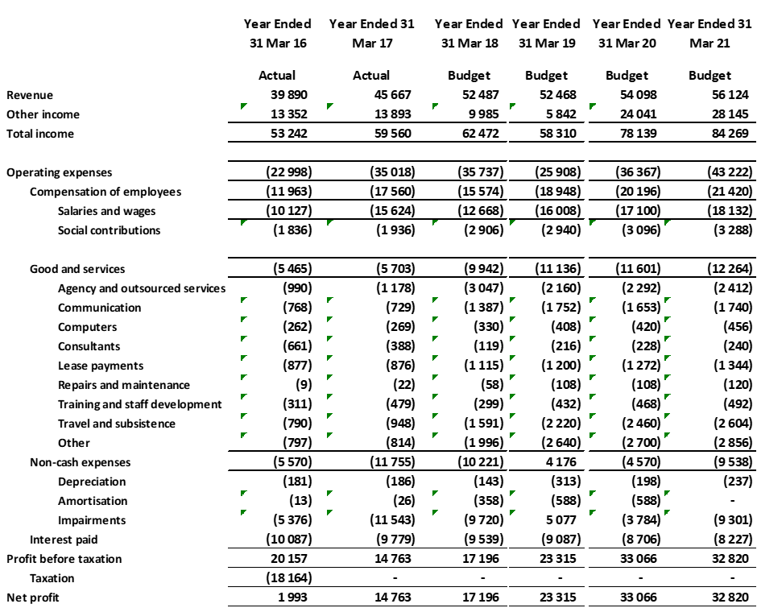
Statement of comprehensive income

Slide 25
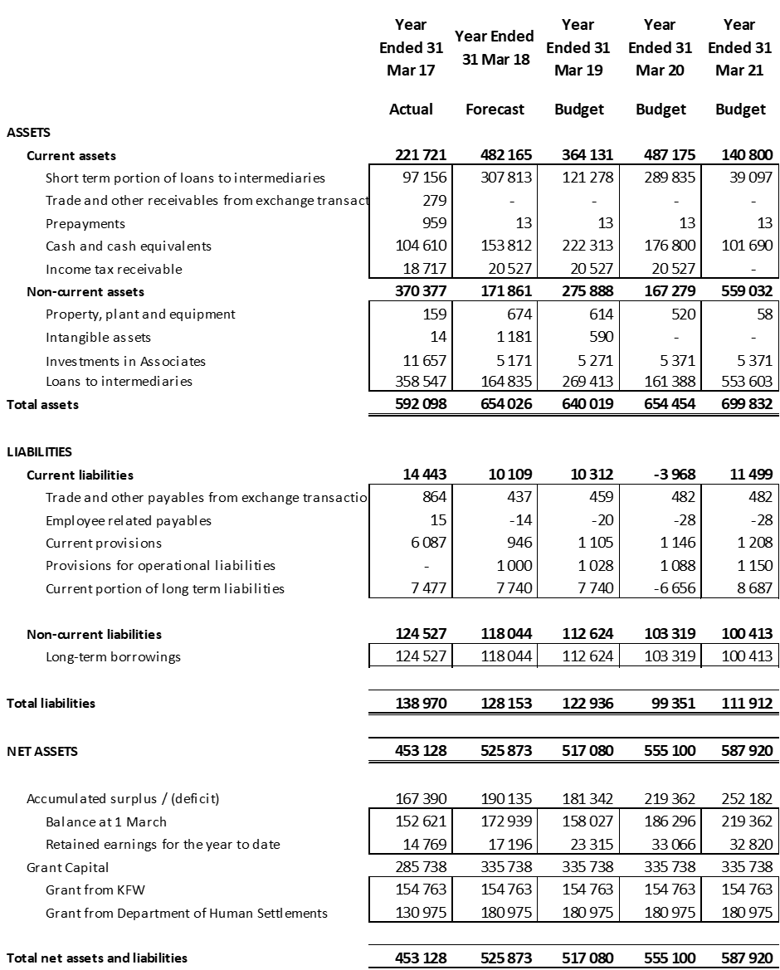
Statement of Financial Position

Slide 26
Governance Structure
&
Concluding remarks

Slide 27
THE RHLF BOARD & committees
MOI provides for 8 Non-executive directors and 1 Executive director
4 Vacancies—not filled since 2014 because of pending DFI consolidation

Slide 28

Concluding remarks
As part of the planned HSDB, great opportunities exist to scale up delivery of incremental housing finance product
Opportunities identified in:
  Scaling up delivery of loans in rural areas and small towns
  Proving non-mortgage loans in upgrading informal settlements
  Extending and improving quality of BNG houses (more than 4.5 million delivered)
  Improving quality of pre-1994 housing stocks
  Enhancing housing secondary market in townships as households trade-up
RHLF business model resonates with active citizenry advocated in the NDP
Providing housing finance credit is a sustainable delivery model as funds are repaid and revolved for further lending

