Slide 1
ANNUAL PERFORMANCE PLAN 2018 / 2019
PORTFOLIO COMMITTEE ON PUBLIC SERVICE AND ADMINSITRATION

Slide 2
Agenda
Situational Analysis
Annual Performance Plan
Annual Budget 2018 / 2019
Questions

Slide 3
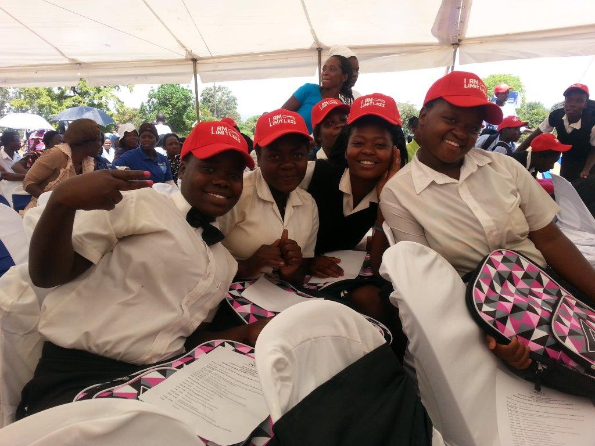
SITUATIONAL ANALYSIS

Slide 4
Situational Analysis
The NYDA Board of Directors has undertaken the process of appointment of the Chief Executive Officer and has appointed the CEO in its committed time of four months.
The Chief Executive will embark on the process of recruiting the vacant positions on the Executive of the Chief Financial Officer and the Executive Director: Operations.
The Agency has continued with fundraising efforts and has recently concluded agreements with the Free State and Limpopo Provincial Governments for the grant programme of R2 million each respectively.
The Agency is currently undertaking consultations with young people on the Integrated Youth Development Strategy. Once completed the IYDS shall provide a blueprint and all encompassing youth development approach. It is proposed that it also places the Agency at the forefront of the Monitoring and Evaluation of youth development in South Africa.

Slide 5
Strategy
Economic Development
Education and skills development
National Youth Service
Universal access to products and services
Mainstreaming through lobby and advocacy
Research and Policy including Integrated Youth Development Strategy

Slide 6
Annual performance plan 2018 / 2019

Slide 7
SOCIO-ECONOMIC EMPOWERMENT FOR YOUNG PEOPLE
Strategic Objective | KPI’s | 2018/19 Annual target | 2019/20 Annual Target | 2020/21 Annual Target
To provide Socio-economic empowerment interventions and support for young people in South Africa (6 KPI’S) | Number of youth owned enterprises supported through Grant programme | 840 | 880 | 920
 | Number of beneficiaries supported with business development support services offered by the NYDA | 18,900 | 18,900 | 20,700
 | Number of jobs created and or sustained through supporting entrepreneurs and enterprises | 3,360 | 3,520 | 3,680
 | Number of jobs facilitated through placements in Job opportunities | 5,250 | 5,500 | 5,750
 | Establishment of the NYDA Youth Fund | Develop and implement Project Plan | Set up the NYDA Youth Fund and consult stakeholders | Implement the NYDA Youth Fund
 | Establishment of the NYDA Skills Fund | Develop and implement Project Plan | Set up the NYDA Skills Fund and consult stakeholders | Implement NYDA Skills Fund

Slide 8
EDUCATION AND SKILLS DEVELOPMENT
Strategic Objective | KPI’s | 2018/19 Annual target | 2019/20 Annual Target | 2020/21 Annual Target
To facilitate and implement skills programmes (1 KPI) | Number of young people trained to enter the job market (Job preparedness and Life Skills Programmes) | 67,725 | 70,950 | 74,175
To facilitate and implement education opportunities in order to improve the quality education attainment for the youth (1 KPI) | Implement the Solomon Mahlangu Scholarship Programme | Continued support and monitoring for 1st,2nd ,3rd and 4th year students | Continued support and monitoring for 2nd ,3rd and 4th year students | Continued support and monitoring for 3rd and 4th year students

Slide 9
UNIVERSAL ACCESS TO YOUNG PEOPLE AND KEY STAKEHOLDERS LOBBIED
Strategic Objective | KPI’s | 2018/19 Annual target | 2019/20 Annual Target | 2020/21 Annual Target
To provide increased universal access to young people (2 KPI’S ) | Number of young people provided with youth development information (Branch CRM, Outreach, Social hits platforms and Call Center) | 1,750,000 | 2,325,000 | 2,400,000
 | Number of service delivery channels operationalised for young people to access NYDA information (increase of the NYDA’s footprint) | 25 | 26 | Close out report
To lobby key stakeholders to support and implement youth development programmes (1 KPI) | Number of public and private key stakeholders lobbied to implement youth development programmes | 18 | 26 | 32

Slide 10
NATIONAL YOUTH SERVICE
Strategic Objective | KPI’s | 2018/19 Annual target | 2019/20 Annual Target | 2020/21 Annual Target
To engage young people in Service activities geared towards fostering patriotism, social cohesion and nation building (5 KPI’S) | Protocols, procedures and coordination tool developed and implemented for national, provincial & local government | Develop and implement protocol, procedure and coordination tool for national, provincial and local government | Develop and implement protocol, procedure and coordination tool for national, provincial and local government | Develop and implement protocol, procedure and coordination tool for national, provincial and local government
 | Facilitate the development of annual plans by government departments for 2019/2020 | Facilitate the development of annual plans by government departments for 2019/2020 | Facilitate the development of annual plans by government departments for 2020/2021 | Facilitate the development of annual plans by government departments for 2021/2022
 | Number of National Youth Service Programme (NYS) projects registered | 60 | 65 | 70
 | Number of young people enrolled and participating in the NYS Category 1 | 5,000 | 10,000 | 15,000
 | Number of young people enrolled and participating NYS Category 2 and 3 Expanded Volunteer Programme (EVP) implemented. | 50,000 | 250,000 | 603,092

Slide 11
RESEARCH AND POLICY
Strategic Objective | KPI | 2018/19 Annual Target | 2019/20 Annual Target | 2020/21 Annual Target
To create and produce information and knowledge for better youth development planning and decision making (3 KPI’s) | Number of Stakeholder Satisfaction Surveys conducted | 4 | 4 | 4
 | Design Corporate Strategy and Planning structure aligned to the Integrated Youth Development Strategy (IYDS) | Presentation and approval of the Corporate Strategy and Planning structure by NYDA | Implement approved Corporate Strategy and Planning aligned to the Integrated Youth Development Strategy | Implement approved Corporate Strategy and Planning aligned to the Integrated Youth Development Strategy
 | Review of M&E Framework and align to the Integrated Youth Development Strategy (IYDS) | Review of M&E Framework and align to the Integrated Youth Development Strategy (IYDS) | Implement M&E Framework aligned to the Integrated Youth Development Strategy | Implement M&E Framework aligned to the Integrated Youth Development Strategy

Slide 12
SUMMARY OF KPI’S SHOWING THE 3 YEAR PROJECTIONS
Strategic Objective | KPI’s | 2018/19 Annual Target | 2019/20 Annual Target | 2020/21 Annual Target
To establish a credible, efficient and effective organisation (3 KPI’s) | Implement the HR Strategy | Develop and implement protocol, procedure and coordination tool for national, provincial and local government | Implement the protocol, procedure and coordination tool for national, provincial and local government | Review the protocol, procedure and coordination tool for national, provincial and local government
 | Implement an integrated Marketing & Communications Strategy | Facilitate the development of annual plans by government departments for 2019/2020 | Facilitate the development of annual plans by government departments for 2020/2021 | Facilitate the development of annual plans by government departments for 2021/2022
 | Payment of legitimate Service Provider invoices within the 30-day period | 60 | 65 | 70

Slide 13
Annual budget 2018 / 2019

Slide 14
Annual Budget 2018 / 2019
Key Programmatic Area | Budget allocation 16 / 17 | % | Budget allocation 17 / 18 | % | Budget allocation 18 / 19 | Medium Term Strategic Framework outcome
Economic Participation | R59 253 300 | 16% | R68 777 015 | 6% | R73 853 745 | Decent employment through inclusive economic growth
Education and skills development | R74 099 686 | 1% | R72 853 169 | -10% | R65 374 415 | Quality basic education & decent employment through inclusive economic growth
National Youth Service | R56 802 100 | 1% | R40 043 329 | 75% | R70 120 850 | Nation building and social cohesion
Universal access to opportunities | R24 611 821 | 39% | R34 140 983 | 60% | R54 604 949 | An efficient, effective and development orientated public service
Research and Policy | R10 173 573 | -4% | R9 726 600 | 7% | R10 411 400 | Decent employment through inclusive economic growth
Administration | R81 283 719 | -2% | R79 852 400 | 3% | R82 294 241 | An efficient, effective and development orientated public service
Employee costs | R145 529 300 | 5% | R152 461 700 | 12% | R170 000 000 | An efficient, effective and development orientated public service
Total | R451 753 500 |  | R457 855 196 |  | R526 000 000

Slide 15
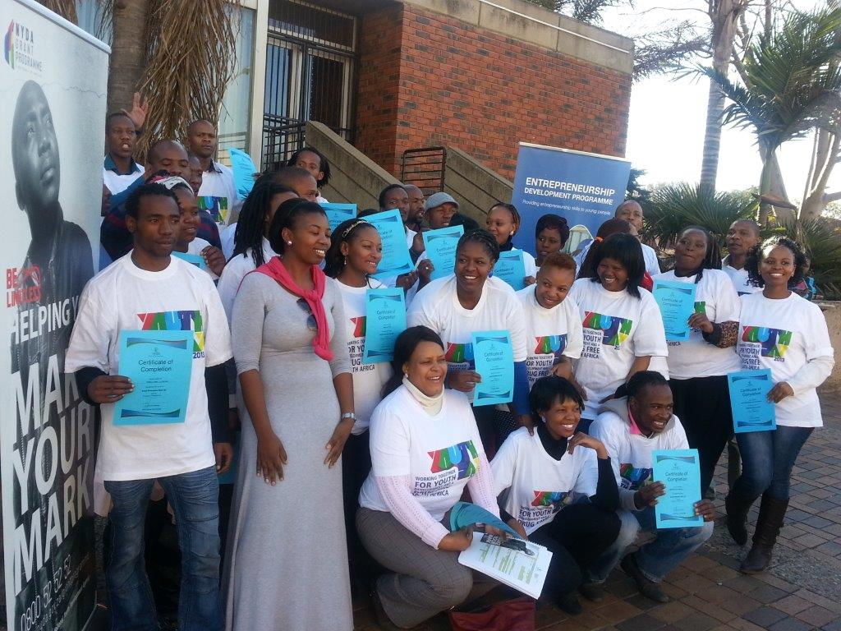
questions

