Slide 1

NATIONAL DEPARTMENT OF HUMAN SETTLEMENTS
ANNUAL PERFORMANCE PLAN
2018/19
16 APRIL 2018

Slide 2
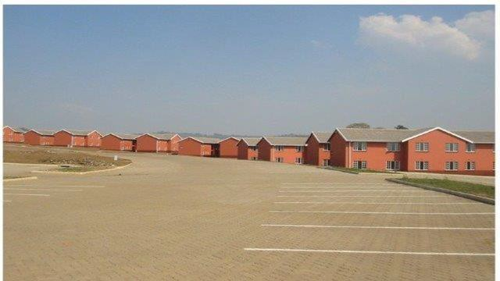

CONTENTS
NHFC Overview
Mandate and Business Model
Overview of APP
Business Performance
NHFC Footprint
Financial Performance
Governance and Risk
Acacia Park, Munsduzi - Pietermaritzburg, KZN

Slide 3
NHFC OVERVIEW
Established: 1996
Type of Organisation: Development Finance Institution (DFI)
Ownership:
Total Assets:
Total liabilities:
Funding Status:
Credit Rating:
Main business:
State Owned Company, 100% SA government R3,4 billion (31 Dec 2017 – group)
R323 million (31 Dec 2017 – group) Self sustaining
Long term A+, short term A1
Broadening and deepening access to affordable housing
finance for the low-to-middle income SA households
Geographic activities: National
Number of Employees: Group 70
Company 53

Slide 4
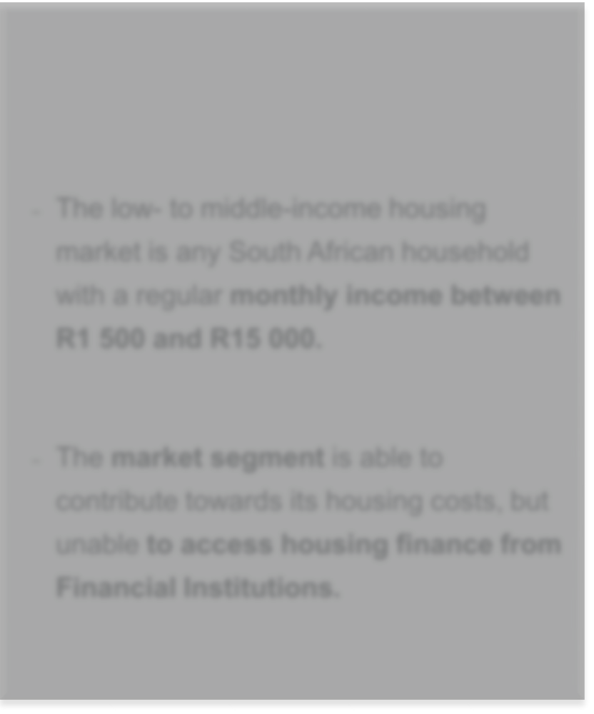



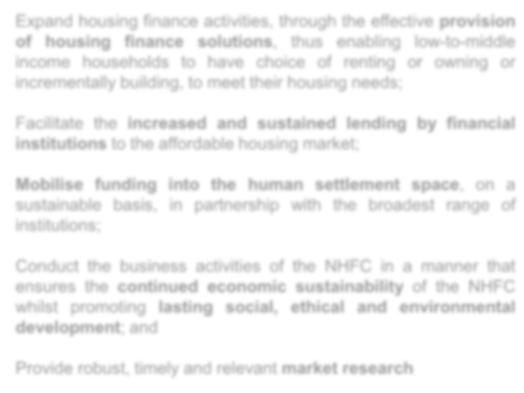
NHFC MANDATE
The National Housing Finance Corporation Soc Ltd (NHFC) is a state owned Development Finance Institution with a principal mandate to broaden and deepen access to affordable housing finance for the low- and middle- income households.
Ta r g e t M a r k e t :
S t r a t e g i c O b j e c t i v e s
Expand housing finance activities, through the effective provision of housing finance solutions, thus enabling low-to-middle income households to have choice of renting or owning or incrementally building, to meet their housing needs;
− The low- to middle-income housing market is any South African household with a regular monthly income between R1 500 and R15 000.
Facilitate the increased and sustained lending by financial institutions to the affordable housing market;
Mobilise funding into the human settlement space, on a sustainable basis, in partnership with the broadest range of institutions;
− The market segment is able to contribute towards its housing costs, but unable to access housing finance from Financial Institutions.
Conduct the business activities of the NHFC in a manner that ensures the continued economic sustainability of the NHFC whilst promoting lasting social, ethical and environmental development; and
Provide robust, timely and relevant market research

Slide 5
VALUES, MISSION, VISION
VALUES
► Ownership
► Passion for purpose
► Teamwork
► Integrity
► Creativity
► Achievement
MISSION
Provide innovative and affordable housing finance solutions to the low- to middle-income market
VISION
To be the leader in the development of the low- to middle-income housing market

Slide 6

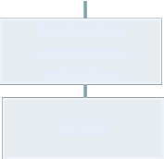
BUSINESS MODEL
DEMAND SIDE
SUPPLY SIDE
Promoting private sector provisions of
end-user finance to the target market
Financing residential developments
 |  | PROJECTS Social
 |  | PROJECTS Integrated
 |  | PROJECTS Multiple projects
Financing rental Stock
 | Wholesale funding to RFIs
 | PROJECTS Private rental
Providing Incremental loans for building
 | Wholesale funding to RFIs
Wholesale funding
to RFIs
Innovative solutions
Facilitating government subsidies
Income-linked
mortgages
Instalment sales
FLISP
eg: Equity & debt investment
eg: Wholesale funding to RFIs

Slide 7
CUMULATIVE DEVELOPMENTAL IMPACT
CUMULATIVE DEVELOPMENT IMPACT
FINANCIAL PERFORMANCE
Cumulative funds disbursed directly by NHFC since 1996
(R million)
Profit before taxation (R Million)
7500
7400
7300
7200
7100
7000
6900
6800
6700
100
Company Group
7 438
83
80
60
51
7 132
Cumulative units/housing opportunities delivered through our funding, interventions and partnerships since 1996
40
20
7
19
6 891
(thousands)
0
2016
520
514
2015
2017
500
-20
480
477
-40
2015
2016
2017
460
447
-60
-56
440
-80
Private-sector funds leveraged through ourfunding, interventions and partnerships since 1996
(R billion)
420
-100
-86
400
2015
2016
2017
20 19 |  |  |  |  |  | 19
18 |  |  |  | 18
17
16 |  | 16
15
14
13
10
 |  | 2015 |  | 2016 |  | 2017

Slide 8
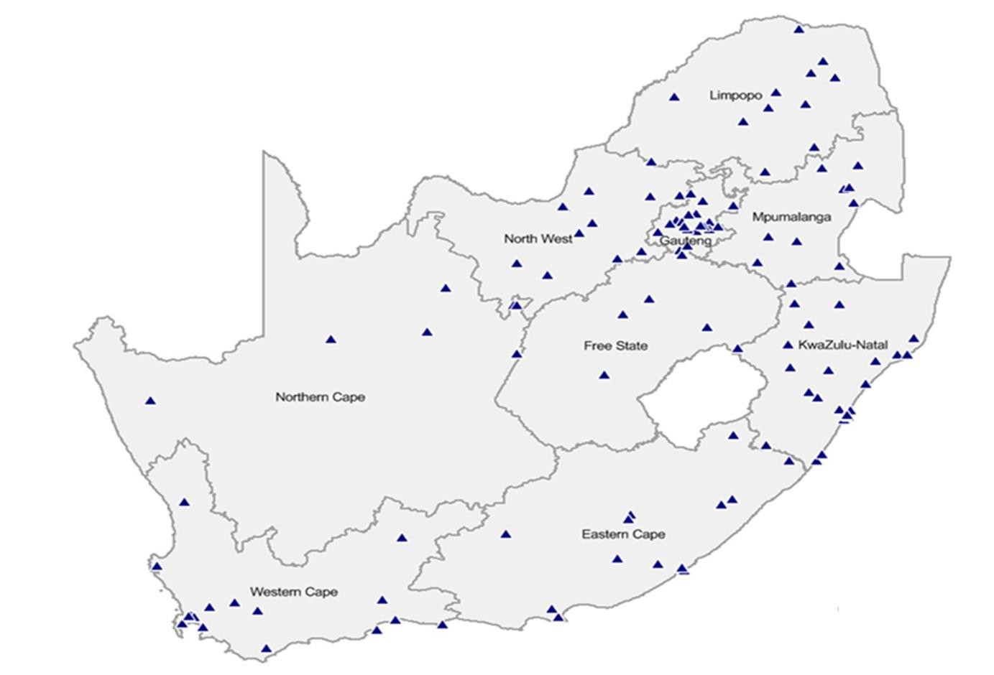
NHFC’S REACH

Slide 9

ANNUAL PERFORMANCE PLAN 2018/19
9
Morgan's Villas ,Mitchells Plain, Cape Town

Slide 10
ALIGNMENT TO GOVERNMENTAL POLICIES AND
PLANS
The Annual Performance Plan (APP) for 2018/19 is aligned to the Medium Term Strategic Framework (MTSF), Outcome 8 and the approved Strategic Plan which covers the period 2014/15 to 2018/19 (5 year cycle).
The NHFC, through its programmes as well as other interventions, such as its equity investments, is supportive of the National Development Plan (NDP) commitment of revising the housing system. Examples of these are:
  Provision of housing finance options (private and social rental, home ownership, instalment
sale agreements, incremental loans);
  Inner-city developments; and
  Leveraging of private sector funding into the affordable market.
10

Slide 11
OPERATING ENVIRONMENT
The Market Context
Current economic and market conditions negatively affects both the NHFC’s beneficiaries and clients. Reducing interest rate environment.
Quality of Pipeline
Recent adjustments in subsidy quantum and capped rentals in Social housing expected to improve viability of social housing projects.
More start-up or emerging clients need to come on board as the seasoned graduate to be funded by Banks. However, these require significant handholding to get off the ground with long turn-around times.
Lack of Bankable Projects
Shareholder Funding Support
Confirmed grant capital over MTEF albeit lower than originally requested.
DFI Consolidation
Work towards imminent DFI Consolidation. Impact on staff. Delivering on core business.
Drivers of financial sustainability
Operational efficiencies continue. Management of level of Non-
Performing Portfolio.
11

Slide 12

K | EY FACTORS IMPACTING APP
DFI Consolidation | APP has been prepared for the NHFC Group and not the consolidated Human Settlements DFI. National Treasury has advised that individual APP’s must be submitted until such a time as a formal consolidation is approved. A second scenario is included for a consolidated APP for the March 2018/19 financial year (including RHLF & NURCHA). Combined APP is a simplistic combination of the three draft APPs without taking into account synergies and opportunities. Funding assumption for both scenarios include only approved capital allocations. Consolidated APP to be presented to governance structures.
Tax Status of NHFC | APP incorporated impact of Taxation Laws Amendment Act No 15 of 2016, published in the Government Gazette on 19 January 2017 under notice 40562 which rendered NHFC exempt from normal tax with effect from 1 April 2016.
CTCHC | Implementation of the wind-down is being delayed due to shareholder engagements and the process to obtain the required PFMA approvals. APP considers wind-down. This treatment will be guided by the progress on the relevant governance and approval processes.
12

Slide 13
NHFC - OVERVIEW OF 5 YEAR TARGETS
 | Approved Strategic Plan MTSF (2014/15 to 2018/19) | MTSF 3rd submission (APP 2018/19)
Funding Assumptions
Shareholder support (R'm) | 530 | 610
Debt funding (R'm) | - | -
Total funding requirements (R'm) | 530 | 610
Funding Impact
Disbursements (R'm) | 2 367 | 2 098
Leveraged funds (R'm)* | 3 096 | 6 788
Total funding impact (R'm) | 5 463 | 8 886
Developmental Impact
Number of housing opportunities created* | 47 897 | 109 570
Number of beneficiaries benefitting | 182 009 | 416 365
Number of jobs facilitated | 28 734 | 44 402
BEE targeted disbursement (R'm) | 474 | 1 110
Notwithstanding challenges in some of the programmes overall funding impact as well as developmental impact has not been compromised. This is mainly due to the leveraged contribution from strategic partners which continue to yield success.
13

Slide 14
PERFORMANCE AGAINST 5 YEAR MTSF
 | MTSF 5 YR Targets 2015 – 2019 | MTSF Budget (2015, 2016, 2017 & 2018) | MTSF Actual (2015, 2016, 2017 & 2018) | % Achieved (2015, 2016, 2017 & 2018) | % Budgeted to have achieved of 5YR Targets 2015 – 2018 | % Actually Achieved of 5YR Targets 2015 – 2018
Approvals R'm | 2 380 | 1 635 | 1 192 | 73% | 69% | 50%
Disbursements R'm | 2 367 | 1 926 | 1 671 | 87% | 81% | 71%
Funds Leveraged R'm | 3 096 | 2 983 | 6 006 | 201% | 96% | 194%
Disbursements: Broader BEE R'm | 474 | 547 | 841 | 154% | 115% | 177%
Housing Opportunities | 47 897 | 43 876 | 102 937 | 235% | 92% | 215%
Housing Opportunities (excl incremental ) | 30 399 | 25 294 | 31 969 | 126% | 83% | 105%
Number of beneficiaries benefiting | 182 009 | 166 730 | 391 159 | 235% | 92% | 215%
Estimated number of jobs facilitated | 28 734 | 24 681 | 36 648 | 148% | 86% | 1128%
BOARD
Approval targets remain under threat - quality and quantity of the deal flow in both private rental and social housing, credit criteria & viability assumptions.
Disbursements – delayed draws by IHS and HIP, committed funds will however be taken up fully within the MTSF enabling achievement of target.
Leveraged programmes continue to yield success.
26

Slide 15
NHFC – CONTRIBUTION TO NDOHS MTSF TARGETS
 | NDOHS MTSF Target | NHFC
 |  | MTSF |  | MTSF 3rd submission
 |  | Strategic Plan |  | APP 2018/19
 |  | Target | % MTSF | Forecast | % MTSF
Social Housing Units | 27 000 | 5 899 | 22% | 7 428 | 28%
Private Rental Housing Units | 25 000 | 15 390 | 62% | 21 271 | 85%
Total Rental |  | 21 289 |  | 28 699
Affordable Housing Units |  | 9 110 |  | 9 903
Incremental Housing Loans |  | 17 498 |  | 70 968
Total Affordable Housing | 110 000 | 26 608 | 24% | 80 871 | 74%
Total |  | 47 897 |  | 109 570
Forecast to meet all targets.
Above budgeted performance mainly as a result of leveraged contribution from a retail intermediary and the
strategic partnerships.
14

Slide 16
KEY PERFORMANCE INDICATORS – PROGRAMME 1
Programme | Expand housing finance activities through effective provision of housing finance opportunities through disbursements
Outcomes | Adequate housing and improved quality of living environments
Performance indicator | Audited / Actual |  |  | Forecast |  | Budget
 | 2014/15 | 2015/16 | 2016/17 | 2017/18 | 2018/19 | 2019/20 | 2020/21
Estimated number of housing opportunities facilitated through disbursements | 4 012 | 1 423 | 2 725 | 2 797 | 2 661 | 2 298 | 1 876
Number of beneficiaries benefitting (factor of 3.8 utilised) | 15 246 | 5 407 | 10 354 | 10 630 | 10 111 | 8 731 | 7 129
Value of funds disbursed( R'm) | 729 | 241 | 306 | 395 | 428 | 346 | 247
Value of approvals (R'm) | 186 | 340 | 302 | 364 | 225 | 247 | 267
Forecast for FY 2017/18 updated considering performance to date and in some instances the impact thereof in the outer years.
The decrease over the MTEF is due to:
limited shareholder funding; and
existing commitments relating to strategic partnership that is forecasted to be completed and not repeated for later periods.
16

Slide 17
PROGRAMME 1 – HOUSING OPPORTUNITIES
Performance indicator | Actual | Actual | Actual | Forecast | Budget
Number of housing opportunities facilitated through disbursements | 2014/15 | 2015/16 | 2016/17 | 2017/18 | 2018/19 | 2019/20 | 2020/21
Number of Social Affordable Housing Units* | 1 195 | 500 | 1 861 | 2 242 | 1 630 | 1 336 | 1 076
Number of Private Rental Housing Units* | 656 | 78 | 738 | 290 | 826 | 720 | 800
Total Rental | 1 851 | 578 | 2 599 | 2 532 | 2 456 | 2 056 | 1 876
Number of Affordable Housing Units** | 2 161 | 845 | 126 | 265 | 205 | 242 | -
Total | 4 012 | 1 423 | 2 725 | 2 797 | 2 661 | 2 298 | 1 876
Number of beneficiaries benefitting (factor of 3.8 utilised) | 15 246 | 5 407 | 10 355 | 10 630 | 10 112 | 8 731 | 7 129
Decrease in 2015/16 driven by a combination of a reduced business pipeline (due to previous funding constraints), the prevailing subdued economic and market context, challenges impacting the social housing space, lack of bankable projects and challenges in meeting of the Conditions Precedent in approved projects.
* Social and Private Rental - estimated number of units arising from disbursements. Social Affordable Housing reduced in outer years in line with shareholder support.
Going into 2017/18 and given low level of disbursements in the Private Rental sector in prior year, there was no significant roll- over hence decrease in 2017/18.
** Affordable Housing – estimated number of mortgage loans originated through Strategic Partnerships, average loan size being R500 000. Instalment Purchase Agreements originated through intermediaries, units from previously funded integrated developments mainly Space, Mettle and CTCHC.
The decrease over the MTSF is due to market conditions impacting integrated developments and intermediaries as well as the projected forecast of key significant existing commitments relating to strategic partnerships which is completed and not repeated at the same scale.
17

Slide 18
PROGRAMME 1 - DISBURSEMENTS
Performance indicator | Actual | Actual | Actual | Forecast | Budget
Value of disbursements | 2014/15 | 2015/16* | 2016/17* | 2017/18 | 2018/19 | 2019/20 | 2020/21
Social Affordable Housing** | 234 | 23 | 197 | 150 | 127 | 90 | 99
Private Rental Housing | 133 | 76 | 44 | 108 | 198 | 135 | 149
Total Rental Housing | 367 | 99 | 240 | 258 | 325 | 225 | 247
Affordable Housing**** | 362 | 142 | 66 | 137 | 102 | 121 | -
Total value of disbursements | 729 | 241 | 306 | 395 | 427 | 346 | 247
* The decrease in 2015/16 and 2016/17 is driven by a combination of a reduced business pipeline (due to previous funding constraints), the prevailing subdued economic and market context which negatively affect both the households and clients of NHFC, challenges impacting the social housing space, lack of bankable projects and challenges in meeting of the Conditions Precedent in approved projects.
** As in prior year, Social Affordable Housing reduced in outer years in line with shareholder support.
*** The decrease over the MTSF is due to market conditions impacting integrated developments and intermediaries as well as the projected forecast of key significant existing commitments relating to strategic partnerships which is forecasted to be completed and not repeated at the same scale. Decrease in 2016/17 as a result of revised projections for HIP to achieve full disbursement later due to delays in finalising funding arrangements; disbursements for IHS drawn firs from foreign currency partner.
18

Slide 19
PROGRAMME 1 - APPROVALS
Performance indicator | Actual | Actual | Actual | Forecast | Budget
Value of approvals* | 2014/15 | 2015/16 | 2016/17 | 2017/18 | 2018/19 | 2019/20 | 2020/21
Social Affordable Housing** | 38 | 142 | 143 | 79 | 90 | 99 | 106
Private Rental Housing*** | 148 | 73 | 159 | 286 | 135 | 149 | 160
Total Rental Housing | 186 | 215 | 302 | 365 | 225 | 247 | 267
Affordable Housing**** | - | 125 | - | - | - | - | -
Total value of approvals | 186 | 340 | 302 | 365 | 225 | 247 | 267
* Facilities approved by the relevant governance structure in line with the delegated authority.
Facilities may be withdrawn and/or not taken by the client.
** Budget for social housing reduced in line shareholder support.
*** No further approvals in line with risk appetite.
19

Slide 20
KEY PERFORMANCE INDICATORS – PROGRAMME 2
Programme | Facilitate the increased and sustained lending by financial institutions
Outcomes | Increased and sustained lending by private sector to human settlement developments
Performance indicator | Actual |  |  | Forecast | Budget
 | 2014/15 | 2015/16 | 2016/17 | 2017/18 | 2018/19 | 2019/20 | 2020/21
Estimated number of housing opportunities facilitated through leveraged funds | 5 100 | 28 963 | 33 428 | 24 489 | 3 973 | 4 373 | 3 679
Number of beneficiaries benefitting (factor of 3.8 utilised) | 19 380 | 110 059 | 127 026 | 93 056 | 15 096 | 16 616 | 13 982
Value of leveraged funds from the Private sector (R'm) | 821 | 1 509 | 1 634 | 2 042 | 782 | 885 | 434
Forecast for FY 2017/18 updated considering performance to date and in some instances the impact thereof in the outer years.
Movement in FY 2017/18 vs 2018/19 housing opportunities: Forecast for FY2018 updated giving effect to actual impact to date for retail intermediary previously in distress.
Movement in FY 2017/18 vs 2018/19 leveraged funds: Forecast for FY2018 updated giving effect to actual impact to date for retail intermediary previously in distress and recognition of OPIC contribution and debt funding on projects delivered and impact.
The decrease over the MTEF is due to existing commitments relating to strategic partnership that is forecasted to be completed and not repeated for later periods.
19

Slide 21
PROGRAMME 2 – HOUSING OPPORTUNITIES
Performance indicator | Actual | Actual | Actual | Forecast | Budget
Number of housing opportunities facilitated through leveraged funds | 2014/15 | 2015/16 | 2016/17 | 2017/18 | 2018/19 | 2019/20 | 2020/21
Number of Private Rental Housing Units* | 4 050 | 3 977 | 4 302 | 3 200 | 3 154 | 3 406 | 3 679
Number of Affordable Housing Units** | 1 050 | 1 763 | 1381 | 1 289 | 819 | 967 | -
Number of Incremental Housing Loans*** | - | 23 223 | 27 745 | 20 000 | - | - | -
Total | 5 100 | 28 963 | 33 428 | 24 489 | 3 973 | 4 373 | 3679
Number of beneficiaries benefitting (factor of 3.8 utilised) | 19 380 | 110 059 | 127 026 | 93 0566 | 15 097 | 16 616 | 13 980
Housing units include completed, transferred or occupied rented units.
* Private Rental - estimated number of units arising from Strategic Partnership with TUHF. Decrease from 2016/17 due to impact of entrance of listed property investments vehicles.
** Affordable Housing
– estimated number of mortgage loans arising through funds leveraged through Strategic
Partnerships such as HIP and IHS, the average loan size being R500 000.
The decrease over the MTSF is due to market conditions impacting integrated developments and intermediaries as well as the projected forecast of key significant existing commitments relating to strategic partnerships which is forecasted to be completed and not repeated at the same scale.
*** Incremental - estimated number of loans arising from funds leveraged by Intermediaries, the average loan size being R15 000. The facility was due to be repaid in 2018/19 hence no impact beyond.
21

Slide 22
PROGRAMME 2 – LEVERAGED FUNDS
Performance indicator | Actual | Actual | Actual | Forecast | Budget
Value of leveraged funds from the Private sector* | 2014/15 | 2015/16 | 2016/17 | 2017/18 | 2018/19 | 2019/20 | 2020/21
 | R'm | R'm | R'm | R'm | R'm | R'm | R'm
Rental Housing | 321 | 367 | 367 | 353 | 372 | 402 | 434
Affordable Housing** | 500 | 684 | 684 | 1 289 | 410 | 483 | -
Incremental Housing*** | - | 458 | 458 | 400 | - | - | -
Value of total funds leveraged | 821 | 1 509 | 1 509 | 2042 | 782 | 885 | 434
* Formula applied based on historical observation: Rental Housing 1:0,3; Affordable Housing 1:4. Integrated developments and Instalments Purchase Agreements: existing commitments and projects funded previously and contribution from strategic partnership with TUHF.
** The decrease over the MTSF is due to market conditions impacting integrated developments and intermediaries as well as the projected forecast of key significant existing commitments relating to strategic partnerships to be completed and not repeated at the same scale.
*** Funds leveraged through existing facility with retail intermediary. Facility is fully repaid in 2017/18 hence no impact in that year.
22

Slide 23
OTHER DEVELOPMENTAL IMPACT
Performance indicator | Actual |  |  | Forecast | Budget
 | 2014/15 | 2015/16 | 2016/17 | 2017/18 | 2018/19 | 2019/20 | 2020/21
Estimated number of jobs facilitated* | 11 887 | 9 157 | 8 802 | 6 802 | 7 753 | 6 975 | 7 583
Value of disbursements targeted towards women, youth & emerging BEE entrepreneurs (R'm)** | 144 | 226 | 217 | 254 | 269 | 291 | 314
The drivers for both indicators are the level of disbursements, and the contribution from the strategic partnership with TUHF.
* Formula applied: for every R1 m spent in a project 11.13 jobs created based on outcome of research by NDOHS.
The decrease 2015/16 and 2017/18 is mainly due to the decrease in disbursements.
** The original APP forecast assumed 20% of funding going to BEE, but per the current position, in terms of the disbursements, 80% of the Private Rental disbursements go to BEE.
23

Slide 24

GROUP SUMMARY STATEMENT OF FINANCIAL
PERFORMANCE
Lending income Interest on investments | Projected growth in disbursements. Decrease in interest rates. Doubtful revenue following the move of key clients into non-performing portfolio. Interplay between interest on investments and lending income (deployment of capital) resulting in reduction in investment income.
Rental Income | Income and expenses previously recognised on a net basis now been brought in on a gross basis; rental income being R20 million and operating expenses R16 million.
Sale of houses / Cost of sales | Decrease in the sale of houses (cost of sales) over the MTEF in line with the strategic decision to exit the business of CTCHC being a developer after completion of the existing projects.
Impairments | Driven by growth in advances portfolio. Credit loss ratio of 3% assumed (18/19). Impairments in 2017/18 below budget
Operational expenses | Overhead structure has improved with the previously concluded re- organisation. Includes opex of rental property (see rental income) also DFI related costs.
Finance cost | Decrease in line with assumption of no additional borrowings.
GROUP
Mar-17 Actual R' 000 | Mar-18 Forecast R' 000 | Mar-19 Budget R' 000
174 770 62 519 3 848 884 34 783 | 159 354 66 704 20 016 858 22 099 | 173 605 42 704 21 157 - 13 965
276 804 (31 814) (58 611) | 269 032 (20 808) (40 328) | 251 431 (13 266) (83 372)
186 379 15 557 (103 933) | 207 896 19 179 (124 946) | 154 793 16 217 (129 442)
98 003 (19 770) 5 180 | 102 129 (17 765) 6 512 | 41 568 (15 462) 7 164
83 413 (37 837) | 90 876 - | 33 269 -
45 576 | 90 876 | 33 269
Lending income Interest on investments Rental Income Dividends received Sale of houses Revenue
Cost of sales
Net Impairments and bad debts
Gross profit
Other operating income Operating expenses Operating profit/ (Loss) Finance costs
Share of profit of associates Profit/ (Loss before tax) Taxation
Surplus after tax
23

Slide 25

GROUP SUMMARY STATEMENT OF FINANCIAL
POSITION
Mar-17 Actual R'000 | Mar-18 Forecast R'000 | Mar-19 Budget R'000
1 818 984 | 2 110 162 | 2 370 667
173 204 | 179 716 | 186 880
122 485 | 96 748 | 97 559
91 124 | 88 802 | 88 802
1 744 | 4 492 | 5 392
2 207 541 | 2 479 920 | 2 749 300
72 844 | 51 224 | 57 993
959 342 | 797 034 | 650 216
43 204 | 55 022 | 16 766
3 282 931 | 3 383 200 | 3 474 276
2 924 690 | 3 057 862 | 3 171 131
39 225 | 41 971 | 44 909
282 543 | 249 648 | 216 379
36 473 | 33 719 | 41 857
3 282 931 | 3 383 200 | 3 474 275
Loan assets Money market investments | Driven by level of disbursements and quality of the book. Interplay between loan assets and money market investments (deployment of capital).
Instalment sale agreements Properties developed for sale | Overall reduction in construction activities of CTCHC. No new investment.
Funds under management | FLISP - Gauteng remains the only province in which NHFC is the implementing agent for the FLISP programme.
Other financial liabilities | In line with repayment schedule, no new borrowings.
Assets
Loans assets Equity Investments
Instalment sale receivables Investment property
Other non current assets
Properties developed for sale Money market investments Othe current assets
Total
Net assets and liabilities
Net assets
Funds under management Other Financial Liabilities Current liabilities
Total
25

Slide 26
KEY PERFORMANCE INDICATORS
 |  |  | Actual Mar-17 | Forecast Mar-18 | Budget Mar-19
 | Profit before tax (R'000) | Company | 50 680 | 83 383 | 20 950
 |  | Group | 83 413 | 90 876 | 33 269
 | Return on equity (%) | Company | 0.3% | 2.8% | 0.7%
 |  | Group | 1.6% | 3.0% | 1.0%
 | Return on assets (%) | Company | 1.6% | 2.6% | 0.6%
 |  | Group | 2.5% | 2.7% | 1.0%
 | Cost to income ratio (%) | Company | 39% | 45% | 54%
 |  | Group | 43% | 50% | 54%
 | Credit Loss Ratio (%) | Company | 4% | 2% | 3%
 | [Incl bad debts] | Group | 3% | 2% | 3%
 | Debt:Equity (%) | Company | 10% | 8% | 7%
 |  | Group | 10% | 8% | 7%
 | Asset growth (loan book) | Company | -2% | 12% | 11%
 |  | Group | 1% | 16% | 12%
 | Collection on performing book | Company | 95% | 95% | 95%
 |  | Group | 95% | 95% | 95%
26

Slide 27
OUTLOOK
Improved economic outlook
  Higher quality and volumes of property deals expected
  Measured impairments & write offs in 2018/19 (like in 2017/18)
Benefits of leveraging larger asset base of consolidated DFI
BOARD
26

Slide 28











CORPORATE GOVERNANCE
Audit Committee
Social & Ethics Committee
Board Credit & Investment Committee
BOARD
Board Development Impact & Strategy Committee
Board Human Resources Ethics & Remuneration Committee
Board Risk
Committee
Executive Committee (EXCO)
26

Slide 29




AND SUPPORTING GOVERNANCE STRUCTURES
RISK UNIVERSE
BOARD OF DIRECTORS
Assurance providers (internal and external auditors)
Board Risk Committee Audit Committee
Enterprise Risk Management
Executive Committee
ITMC ALCO MCIC
RISK UNIVERSE
Credit and Investment Risk
Financial Risk
Operational Risk
Compliance Risk
MANDATE
27

Slide 30
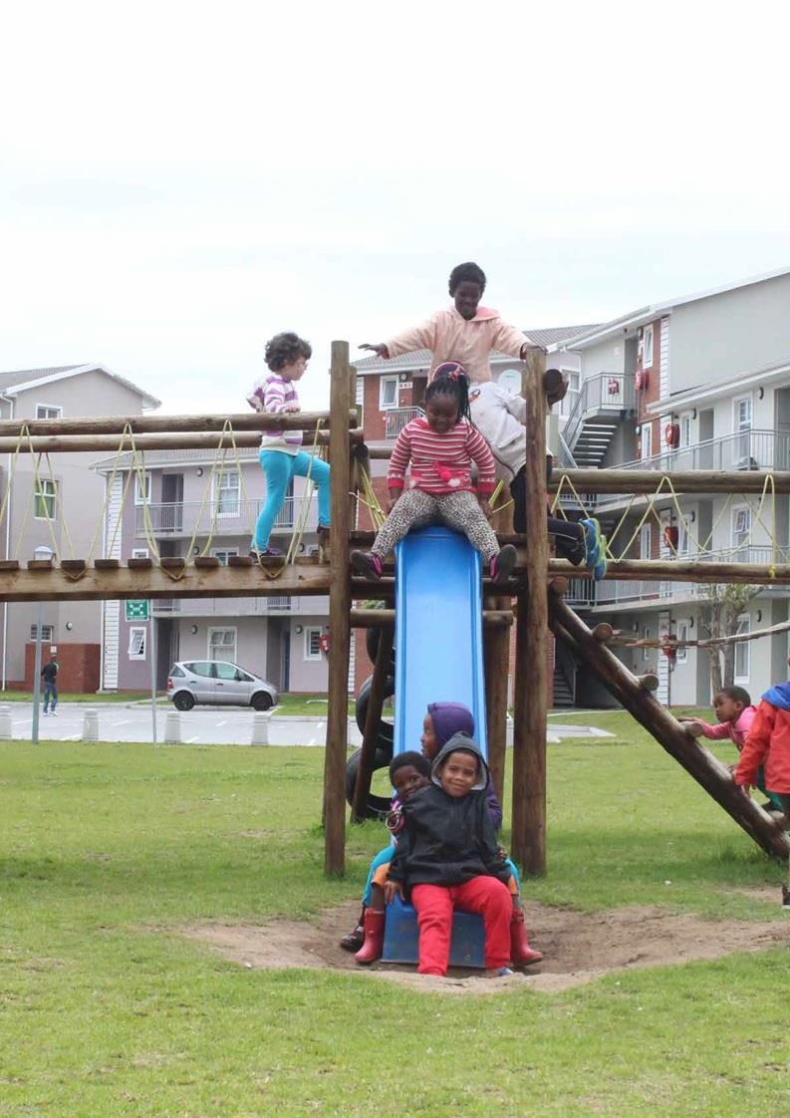
A new
dawn for people’s housing
28
In 2017/18 the NHFC, its partners and beneficiaries look towards an exciting new chapter in the corporation’s history. Of course this chapter has yet to be written but we know that it will entail an enlarged new entity, the Human Settlements Development Bank (HSDB), which will be able to draw on greater human and financial resources – to put even more people into decent housing in which they can raise their families and prosper.
Our business has never been about
bricks, mortar or plumbing; rather it has always been about people, those South African citizens who deserve the opportunity to live in dignified, secure spaces.

Slide 31
Thank you!!
31

