Slide 1
Department of Higher Education and Training
2018/19 Annual Performance Plan and Budget
Presentation to the Joint Meeting of the Portfolio Committee on Higher Education and Training and Select Committee on Education and Recreation
18 April 2018

Slide 2
Outline of the Presentation
Strategic Overview
Programme Level Performance Plans for 2018/19
2018/19 Budget by the Chief Financial Officer
Risk Analysis and Mitigation
Presentation by the Audit Committee Chairperson

Slide 3
Programme: University Education
Purpose
Develop and coordinate policy and regulatory frameworks for an effective and efficient university education system. Provide financial and other support to universities, the National Student Financial Aid Scheme and national institutes for higher education
Core Programmes (Chief Directorates)
University Planning and Institutional Funding
Institutional Governance and Management Support
Higher Education Policy Development and Research
Teaching and Learning Development
Priorities over the 2018 MTEF
Develop regulations for institutional types (universities, university colleges and higher education colleges) in terms of the Higher Education Amendment Act (2016)

Slide 4
Programme: University Education
Provide support to strengthen and transform the public higher education system through the full implementation of the University Capacity Development Programme
Develop systems to pilot the Central Applications Service and establish the service
Develop a fee regulatory framework and policy for student funding to ensure affordable higher education fees and effective funding of students
Pilot and finalise an expanded financial assistance and support model (PPP)
Ensure public funds are effectively utilised for the purpose intended (monitoring)

Slide 5
Programme: University Education
Targets in the 2018/19 APP:
14 Annual oversight reports focusing on the implementation of various steering and funding mechanisms across the higher education sector: (1) HEAIDS programme (2) financial health of universities (3) foundation provision grant (4) Implementation of the University Capacity Development Programme (5) research outputs (6) infrastructure and efficiency grant (7) new universities earmarked grant (8) Ministerial enrolment targets (9) institutional governance (10) International Scholarships Programme (11) PHEIs compliance with the regulations (12) BRICS partnerships (13) teaching and learning development capacity improvement programme (14) Student leadership capacity development programme
A Cohort study report on higher education
Note:
Over the five year Strategic Plan a number of steering mechanism have been developed. The focus in 2018/19 is implementation and oversight. Ongoing monitoring and evaluation of the programmes that are in place and annual reports on the utilisation of the funds, identifying the successes and challenges, and identifying areas for improvement and/or intervention

Slide 6
Annual Financial Health Report
Universities are required to submit Annual reports (by July each year) in terms of the Reporting Regulations published under the Higher Education Act. The Department analyses the reports and checks for compliance
The most important aspect is the analysis of the financial health of the system against a set of indicators. The purpose is to identify institutions requiring support / intervention. The annual financial heath report provides insight into the financing and sustainability of institutions and the sector
The annual report produced in the 2017/18 financial year showed that:
22 of the 26 universities received unqualified audit opinions from their external auditors
Total revenue in the sector increased from R63.981 billion in 2015 to R69.145 billion in 2016, representing an 8.1% increase
Expenditure increased from R59.476 billion in 2015 to R66.055 billion in 2016, representing an 11.1% increase
7 universities incurred operating deficits on their total operating funds

Slide 7
Annual Financial Health Report
Income sources
All universities derive their income from at least three sources of funding: state grants, tuition fees and third-stream income as shown in the Table below. The latter category includes a number of subcategories such as interest income, donations, consultancy fees and research grants
Source of income | 2016 | 2015 | 2014
 | R’000 | R’000 | R’000
State subsidies | 27 202 248 | 23 878 441 | 22 702 279
Tuition and accommodation fees | 22 302 356 | 22 224 385 | 19 428 315
Third stream income | 19 640 471 | 17 878 546 | 16 913 536
Total | 69 145 075 | 63 981 372 | 59 044 130
As a percentage of income
State subsidies | 39.3% | 37.3% | 38.4%
Tuition and accommodation fees | 32.3% | 34.7% | 32.9%
Third stream income | 28.4% | 27.9% | 28.6%

Slide 8
Annual Financial Health Report
Student Debt
Gross student debt before impairment as a percentage of tuition and accommodation fees amounts to 37.6% in 2015 (2014: 31.7%)
Net student debt after impairment is 14.8% (2015: 14.2%) and increased from R3.146 billion in 2015 to R3.309 billion in 2016
Line item | 2016 | 2015 | 2014
 | R’000 | R’000 | R’000
Student debt before provision for doubtful debt | 8 378 243 | 7 037 451 | 6 188 464
Provision for doubtful debt | -5 068 728 | -3 890 986 | -3 503 504
Net student debt | 3 309 516 | 3 146 465 | 2 684 960
Student debt ratio:
Tuition and accommodation fees | 22 302 356 | 22 224 385 | 19 428 315
Student debt as a percentage of tuition and accommodation fees (before impairment) | 37.6% | 31.7% | 31.9%
Student debt as a percentage of tuition and accommodation fees (after impairment) | 14.8% | 14.2% | 13.8%

Slide 9
University Infrastructure
Infrastructure and efficiency grant was introduced in 2007/08. Allocated in 3 year funding cycles to support infrastructure development plans. Utilization of funds is monitored and progress with respect to infrastructure development of the system is assessed and reported annually
Since the inception, R20.158 bn has been disbursed to universities. Major infrastructure development has occurred across the system at all institutions with the largest amounts being provided to HDIs to help redress past inequality. The amount earmarked for 2018/19 to 2020/21 is R8.5 bn
A total investment of R3.823 bn has been allocated to the New Universities Project (UMP and SPU) for the period 2011/12 to 2017/18. A further R3.145 bn is earmarked for 2018/19 to 2020/21
In 2015 institutions developed campus master plans and undertook maintenance and disability compliance audits. Out of this a Macro Infrastructure Framework has been developed. The MIF is an IT platform and management tool. For the 2018/19 – 2020/21 cycle all institutions have uploaded proposals on the MIF
Capacity to monitor and ensure effective use of funds is critical; the Department plans to develop an Infrastructure Development Support Unit building on the capacity built for developing the two new universities

Slide 10
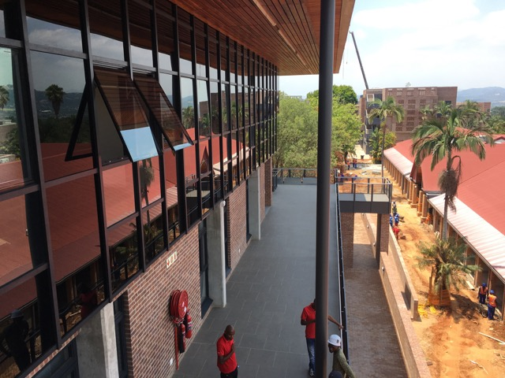
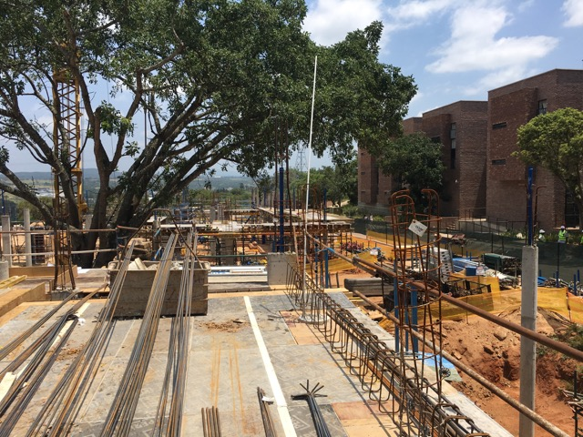
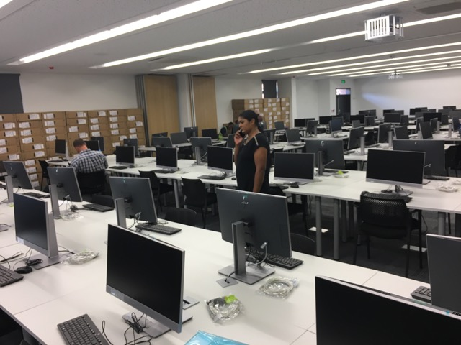
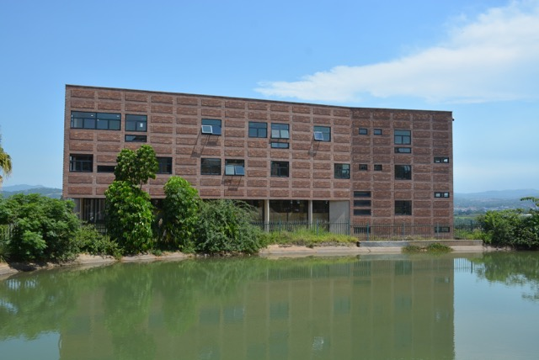
New Universities - UMP

Slide 11
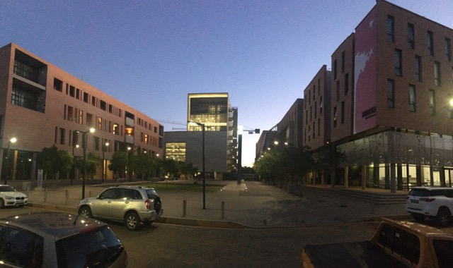
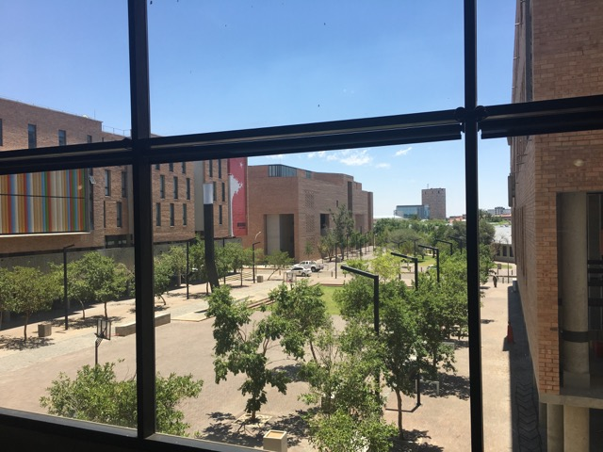
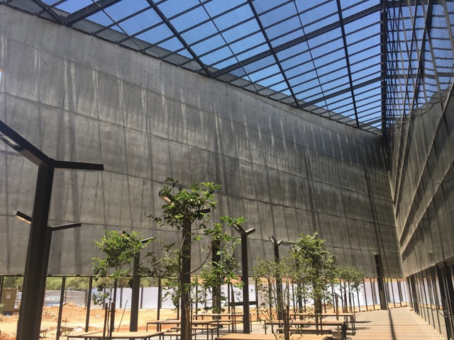
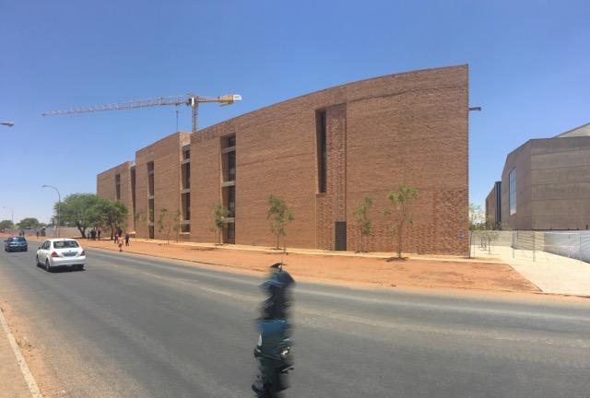
New Universities - SPU

Slide 12
Student Housing Infrastructure Programme
Student housing is also funded through the IEG
Ministerial report on student housing (2012) let to the publications of the Norms and Standards for Student Housing in 2015
Since 2012, R7.431 bn of the IEG has been allocated to student housing across all institutions with a focus on HDIs
Expectations are high and supply of university owned or managed student housing is insufficient. Government alone cannot provide sufficient affordable housing for students who require spaces
Student Housing Task Team looks into alternative funding models
Infrastructure Investment Programme of South Africa (IIPSA) is funding feasibility studies to the value of R30 million across selected universities and TVET colleges. Government Technical Advisory Centre in the National Treasury was involved in developing terms of reference and assisting with steering the process
10 universities and 2 TVET colleges are part of the feasibility studies (6 through the IIPSA programme and 6 through the Task Team)
Plan is to development 300 000 beds over the next 10 years

Slide 13
Cohort Report
An annual cohort report is produced
Tracks through put of students across the university system utilising audited student enrolment and success data
In 2018/19 the cohort report will be updated with the audited 2017 data.
Over time the cohort study for 3 to 6 year undergraduate qualifications has shown an improvement in drop out rate from 31.5% in 2000 to 15.9% in 2015 for 1st year dropouts (contact and distance)
Throughput rate has improved over a 10 year period from 45.9% for the 2000 cohort to 55.6% for the 2008 cohort (contact and distance)
Throughput rate has improved over a 10 year period from 55.2% for the 2000 cohort to 67.9% for the 2008 cohort for the contact mode of study
Throughput for students studying through the distance mode of study remains a challenge with only 19.4% of the 2008 cohort having graduate within 10 years. However, this is an improvement from the 2000 cohort which had a throughput rate after 10 years of 11.6%
First time entering students who enter a 4 or more year undergraduate degree perform better than those in 3 years degrees and 3 year diplomas
Importance of effective financing, academic and psychosocial support for first generation university students cannot be over emphasized

Slide 15
Research Outputs Report
Annually the Department evaluates research outputs against the research outputs policy. The implementation of the policy has resulted in improvements year-on-year with respect to the quantity of research outputs. The focus going forward will be on improving the processes of evaluation and the quality of outputs. The Department has established a collaborative project in conjunction with CREST at SUN to enable improved capacity for managing research outputs and ensuring quality.

Slide 16
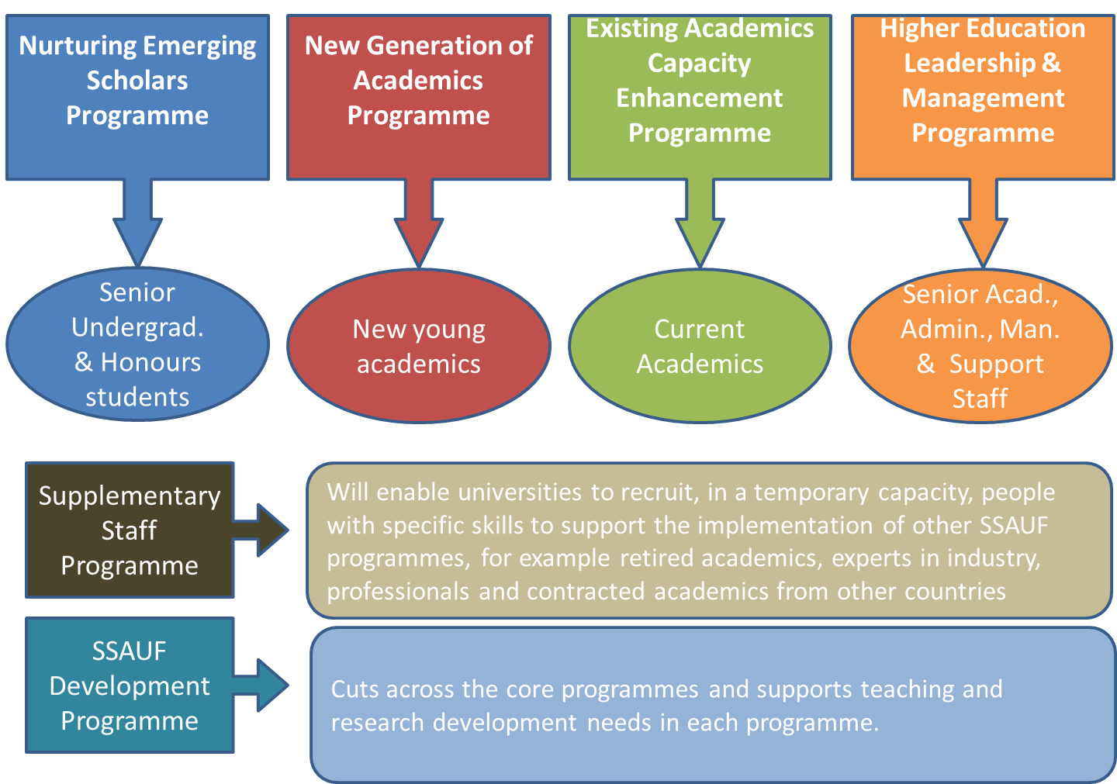
Staffing South Africa's Universities’ Framework
A comprehensive programme for transforming and developing university staff from recruitment to retirement; focused on teaching, researching and leading; report annually on progress, development and challenges. Critical for system success.

Slide 17
SSAUF Annual Progress Report
Introduced in 2015/16 with the nGap. In 2016/17 extended to 3 programmes (nGAP, HELMP and SSAUF)
The New Generation of Academics Programme (nGAP) Three phases (cohorts) are on board:
99 lecturers are participating in the Phase 1 cohort. (45 male, 54 female, all black)
95 lectures are participating as part of the Phase 2 cohort. (44 male, 51 female, 93 black, 2 white)
71 lecturers were appointed as part of the Phase 3 cohort (to date 45 in place, 28 females, 17 males)
The Future Leaders Initiative (FLI) implemented as part of the HELMP:
54 emerging leaders (51 from universities and 3 from the Department) are studying towards a Doctorate in Business Administration in Higher Education Management and Leadership through a programme offered by Bath University (UK) and Nelson Mandela University (SA)
The profile of the participants is as follows: 26 African, 15 Coloured, 5 Indian, 5 White, 33 Females, 21 Males

Slide 18
SSAUF Annual Progress Report
Partnerships established to support the implementation of the SSAUF:
Partnership with National Research Foundation to provide research development grants for lecturer research development
Partnership with Newton Fund for mobility opportunities in the UK for nGAP
Plans for the SSAUF going forward:
From 2018 SSAUF fully implemented as part of UCDP
Recruitment of at least 100 new nGAP lecturers every year. In 2018, 111 new academics funded
From 2018 the University Staff Doctoral Programme (USDP) will be implemented as part of the Existing Academics Capacity Enhancement Programme (EACEP). In the first phase of the USDP collaboration between SA universities and US universities under the ambit of the US-SA Higher Education Network will support 144 university academics to achieve doctorates over a 4 year period
The HELMP will be substantially up-scaled and implemented through a partnership with Universities South Africa (USAf)
The entrepreneurship development in higher education (EDHE) programme will be scaled up in partnership with USAf
A range of other partnerships will be put in place to support SSAUF

Slide 19
University Capacity Development Programme
RESEARCH DEVELOPMENT GRANT
THE UNIVERSITY CAPACITY DEVELOPMENT GRANT: A CONTRIBUTION
TO RESOURCING
THE SYSTEM
FOR SUCCESS
Staff development
Programme development
Student development/ success
TEACHING DEVELOPMENT GRANT
But also:
OTHER DHET & GOVT FUNDING MECHANISMS
UNIVERSITY CONTRIBUTIONS
COLLABORATIONS & PARTNERSHIPS
THE UNIVERSITY CAPACITY DEVELOPMENT PROGRAMME: GEARING THE SYSTEM FOR SUCCESS
Full implementation starting in the 2018 academic year. Annual report a 2018/19 target

Slide 20
University Capacity Development Programme
Activity Types | Fund allocation as per ministerial statement on funding (R‘000)
 | 2018 | 2019 | 2020
Individual university capacity development plans (26) | 630 000 | 653 625 | 667 824
University and nationally-led collaborative projects | 45 650 | 72 665 | 73 226
Nationally led project: nGAP | 250 000 | 250 000 | 250 000
Nationally led project: HELMP | 8 100 | 8 400 | 8 873
Total | 933 750 | 984 690 | 999 923
3 year total | 2 918 363
Notes: The amounts above are allocations as per the Ministerial Statement on University Funding for 2018-2020. The value for the outer year (2020) is a an estimate There are substantial other funds that support the implementation of the UCDP, derived from a range of partnerships that the Department has established

Slide 21
Collaborative Projects Initiated for 2018-2020
Name of Project | Lead University | Amount Allocated
1. Future Leaders Initiative | NMU | R34 400 000
2. South Africa-Sweden University Forum | UP | R5 500 000
3. New academics transitions into HE | UCT | R5 870 582
4. Building a student advisory system | UFS | R8 865 000
5. Building the capacity of HELTASA | UCT | R2 079 732
6. Learning from the National Benchmark Tests | UCT | R4 421 596
7. Establishment of a Centre for African Languages Teaching at the University of Johannesburg | UJ | R12 000 000
8. UCDP Monitoring and Evaluation Project | SUN | R7 566 000

Slide 22
UCDP Nationally-led collaborative projects
Name of Project | Lead | Amount Allocated
New Generation of Academics Programme | DHET | R750 000 000
US – SA Higher Education Network University Staff Doctoral Programme | DHET | R51 119 236
PSET Research Chairs Programme | DHET | R97 774 944
Higher Education Leadership and Management Programme | USAf | R25 373 000
Entrepreneurship Development in Higher Education | USAf | R17 970 639
Study into cost of producing university graduates | USAf | R4 680 000

Slide 23
Teaching and Learning Development Capacity Improvement Programme (TLDCIP)
The goal of the TLDCIP programme is to strengthen teacher education at universities to support the whole education system (ECD, Basic Education, TVET, CEC)
The programme is implemented with the support of the European Union (R200 million)
Key achievements thus far:
10 universities are developing qualification programmes for birth - 4 educators
13 universities are developing qualification programmes for TVET college lecturers
8 universities are developing qualification programmes CET college lecturers
The establishment and strengthening of 3 centres for special needs education are being supported, at Wits the focus is on Deaf Studies, at UP the focus is on Visual Impairment and at UJ the focus is on education of learners with neuro-developmental challenges

Slide 24
Teaching and Learning Development Capacity Improvement Programme (TLDCIP)
All universities involved in Primary Initial Teacher Education are working together to develop standards, curriculum frameworks, courses and materials for the development of primary mathematics and language /literacy teachers
A process to develop a protocol to support the implementation of teaching practice in initial teacher education programmes has been initiated
A task team has been established to examine initial teacher education through distance, with a focus on UNISA

Slide 25
Private Higher Education Institutions
The Department monitors the compliance of Private Higher Education Institutions (PHEIs) with the regulations published in terms of the Higher Education Act; ensuring institutions are operating legally in the system and only offering accredited programmes
The sector has grown consistently since the initial registration of PHEIs in 2000. Accreditation and re-accreditation remains a challenge
PHEIs contribute by providing programmes in niche areas such as Design, IT and Business, and at the Higher Certificate level which has grown from + 119 941 student enrolments at +100 institutions in 2013 to 167 408 student enrolments at122 institutions in 2016
There are 292 PHEI campuses across the country, with greatest number in Gauteng (140) followed by Western Cape (63)
Greatest challenge is the emergence of Illegal/fly-by-night colleges. The Department has instituted measures to exercise greater control and oversight over partnership agreements (enabled by the review of the HE Act), and awareness campaigns in densely populated areas.
In 2017/18, 80 Bogus Colleges (2018) and 2 registered PHEIs were identified purporting to offer unregistered programmes. Issued 18 warning letters

Slide 26
Private Higher Education Institutions

Slide 27
Private Higher Education Institutions

Slide 28
Programme: TVET
Purpose: To plan, develop, implement, monitor, maintain and evaluate national policy, programme assessment practices and systems for Technical and Vocational Education and Training
Challenge: Underfunding of the TVET colleges
2018/19 Budget Allocation: The TVET System has received a new baseline adjustment totaling R5.3 Billion from 2018/19 as indicated in the table below:
Funding | Amount (R’000)
Increase in TVET Subsidies | 2 714 000
- 80% Programme funding | 1 414 000
- Infrastructure and efficiency grant | 1 300 000
NSFAS | 2 585 000
- Tuition fees | 509 000
- Travel and accommodation | 2 076 000
Total | 5 300 000

Slide 29
TVET 2018/19 Budget Allocation
In terms of the above table, the TVET 80% programme funding has been increased by R1.4 billion from R7.453 billion to R8.867 billion which represents an 18.8% increase in baseline funding
It is estimated that the current programme funding level of 54% will be increased to approximately 69% in 2018/19, 73% in 2019/20 and 76% by 2020/21, also known as the “phased-in-approach for free education”
Thus, funding at the required level of 80% should be reached in year 4 (by 2021/22) and therefore expansion of the TVET system can only be considered in 5 years time
Thus, the current enrolment plans (for ministerial approved programmes) must remain constant without any increase in numbers for the next 4 to 5 years while the new funding will increase the funding level to the required 80%funding level
This process will ensure that quality provisioning is possible at the required standards as sufficient funds will be available to fund at the full programme cost for ministerial approved programmes

Slide 30
Challenges and Targets for Infrastructure
Challenges:
Poor condition of TVET facilities related to repair and maintenance
Increased access required for students
2018/19 Allocation: R1.3 Billion
The allocation of the first tranche (April 2018) to colleges will consist of a conditional allocation of 35% advance (dedicated bank accounts) amounting to R9.1 million per TVET
The allocation of the balance of the tranches for 2018 will be made on the basis of “as is condition assessments” to priority areas:
Bulk Services; Statutory Compliance; Sanitation; Building repairs; and Student Accommodation repairs
The allocation for the next 2 years will be based on the condition assessment which is about to commence at TVET colleges
Performance target - Produce oversight reports on:
Functioning of the newly built TVET college campuses
Progress on the roll-out plan for the construction of the remaining 9 of the 12 new campuses
Infrastructure maintenance

Slide 31
Approval Process of New Infrastructure Grant
The following steps are to be utilized to approve expenditure of the 1st tranche of 2018:
Colleges complete a costed maintenance plan utilizing the DPW National Infrastructure Asset Maintenance Management Standard
The priority for 2018 is to establish bulk services, statutory compliance and to deal with all critical and urgent maintenance issues that are threatening to health, life and or the life cycle of the infrastructure
The plan has detailed costing estimates with supporting motivations, proof of requirement and a Criticality & Priority Assessment
The plan is assessed by the Department for validity and base costing. If approved college can commence procurement and implementation
College reports on completed work as part of overall monitoring by Department and site verification

Slide 32
Allocation of New Infrastructure Grant
The remaining 2 years of allocations will be made on the basis of the findings of the Audit of TVET Infrastructure which will be conducted by professionals utilizing the NIAMMS:
Assessment to building / component level
Establishing a national college infrastructure database with costed and prioritized needs
Annual Maintenance Plans
It must be noted that the new infrastructure and efficiency grant is earmarked for repairs and maintenance relating to current sites of delivery with regards to teaching and learning
Student accommodation will only be able be considered when the current infrastructure maintenance backlog has been addressed

Slide 33
Sites Due for Contract Award
The following are sites which have been considered for contract awards for the construction of 9 new TVET college campuses and / or refurbishment of 2 existing ones
The internal processes for awarding are ongoing. Handover is expected by end April 2018
No. | Main TVET College | Sites | *TCV Excl VAT | 14% VAT | 1% VAT (Additional as at 1 April 2018) | *TCV @ 15% VAT
1 | Ikhala TVET | Aliwal North | R 101 676 139.60 | R 14 234 659.54 | R 1 016 761.40 | R 116 927 560.54
2 | Gert Sibande TVET | Balfour | R 95 108 771.93 | R 13 315 228.07 | R 951 087.72 | R 109 375 087.72
3 | Letaba TVET | Giyani | R 96 074 283.54 | R 13 450 399.70 | R 960 742.84 | R 110 485 426.08
4 | Eastcape Midlands TVET | Graaff-Reinet | R 94 009 580.22 | R 13 161 341.23 | R 940 095.80 | R 108 111 017.25
5 | uMgungundlovu TVET | Greytown | R 98 824 377.81 | R 13 835 412.89 | R 988 243.78 | R 113 648 034.48
6 | Mthashana TVET | KwaGqikazi (refurbishment) | R 88 293 207.46 | R 12 361 049.05 | R 882 932.07 | R 101 537 188.58
7 | uMgungundlovu TVET | Msinga | R 113 308 187.23 | R 15 863 146.21 | R 1 133 081.87 | R 130 304 415.31
8 | Ingwe TVET | Ngqungqushe | R 135 840 661.99 | R 19 017 692.68 | R 1 358 406.62 | R 156 216 761.29
9 | Mthashana TVET | Nongoma (refurbishment) | R 109 454 288.32 | R 15 323 600.36 | R 1 094 542.88 | R 125 872 431.56
10 | Ikhala TVET | Sterkspruit | R 133 376 359.07 | R 18 672 690.27 | R 1 333 763.59 | R 153 382 812.93
11 | Esayidi | Umzimkhulu | R 92 105 263.16 | R 12 894 736.84 | R 921 052.63 | R 105 921 052.63
Total |  |  | R 1 158 071 120.32 | R 162 129 956.85 | R 11 580 711.20 | R 1 331 781 788.37
*TCV means Total Contract Value

Slide 34
Performance Targets for Institutional Support
Challenges:
TVET data system compatibility between TVETMIS and institutions. Comprehensive review and upgrading of TVETMIS to be undertaken to ensure collection, generation and provision of quality and reliable data through directives
Various sources of performance data, need for a single framework / model. A comprehensive performance evaluation framework will be developed
Measurement of College Council performance
Policies on the compensation of Council members and evaluation of performance of Council members developed for full implementation in 2019
Nomination and appointment of Council members in 28 TVET colleges before the expiry of their five-year term of office in October 2018
Performance target
Produce oversight reports on governance of TVET colleges
Facilitating implementation of :
policy directives for TVET College Information Technology Systems
the revised TVET colleges monitoring, evaluation and support model

Slide 35
Targets for Programmes and Qualifications
Challenges:
Low pass, throughput and certification rates of students
Implementation of the teaching and learning plan
Implementation of the student support plan
Development of the CPD framework
Pre-vocational learning programme piloted and reviewed for implementation in 2019
Disbursement of NSFAS grants
Task team to resolve outstanding claims
Consideration of 100% tuition grant for TVET students
Development of Partnerships
Continued work on establishment of SAIVCET
Performance target
Produce oversight reports on:
academic performance of students
student support services and teaching and learning support
throughput rate for TVET college students
Stakeholder engagement (SAIVCET)
Guidelines for standardized implementation of Occupational Programmes

Slide 36
Challenges and Targets for Examinations
Challenges:
Examinations system outdated and unable to provide reliable and comprehensive reports. New IT system is being developed and tested for implementation in 2019
Certification backlog. Although we believe that there is no further NC(V) certification backlog. Continuous monitoring is taking place, also further work is being undertaken with regards to Nated certificates
Exam irregularities including leakages, distribution and marking. Improve conduct and monitoring of examinations to avoid any irregularities and improve the quality of examinations
Performance target
Produce oversight reports on:
the conduct of public TVET college examination centres during national examinations and assessments
eradication of certification backlog
functioning of the IT examination services system

Slide 37
Programme: Skills Development
Purpose
To promote and monitor the national skills development strategy [developed in terms of the principal Act, Skills Development, 97 of 1998
Develop skills development policy and regulatory framework for an effective skills development system
2018/19 priorities
In addition to specific targets in the APP, the branch will focus on the following strategic initiatives:
National Skills Development Plan approved for implementation
Conduct strategy, policy and systems analysis to inform the implementation of the NSDP

Slide 38
Factors Influencing 2018/19 Targets
SETAs Grant Regulations which came into effect on 1 April 2013 directs that SETAs must spent 80% of their 49.5% levy on Professional, Vocational, Technical and Academic Learning (PIVOTAL)Programmes
Section 10A of the Skills Development Act (Act 97 of 1998) (as amended) directs SETAs to conclude SLAs with the Department which ensures that skills development interventions required by the economy are incorporated in the skills delivery of SETAs
SETA audit reports show significantly improvement from 4 SETAs achieving clean audits in the financial year 2013/14 to 8 in the financial year 2016/17

Slide 39
Factors Influencing 2018/19 Targets
In the last three years of the Medium Term Strategic Framework (MTSF) (2015, 2016 and 2017), the national artisan production numbers have steadily increased from 16 114 in 2015/16 to 21 188 in 2016/17
The need to improve trade test pass rate from low levels (40%) in the previous years
More than 148 000 workplace based learning opportunities were recorded in 2016/17, through SETAs
A study in 2016/17 on artisans employed or self-employed through Swiss-South African Cooperation Initiative (SSACI) found that 79% of artisans in completion of their apprenticeship programmes found employment, whilst 6% of this 79% were in self-employment

Slide 40
2018/19 Performance Targets
A report on the implementation of the revised SETA landscape developed and approved by the Director-General by 31 March 2019
Produce oversight reports on:
the implementation of the National Skills Development Strategy by SETAs (quarterly)
the implementation of good governance standards by SETAs by 31 March 2019
Targeting 80 days average lead time from qualifying trade test applications received until trade test is conducted
Develop a national artisan development information management system

Slide 41
2018/19 Skills Development System Targets
Performance Indicators | 2018/19 Targets
Number of work based learning opportunities. | 135 000
National artisan learners trade test pass rate. | 61%
Percentage of National artisan learners employed or self-employed. | 75%
Percentage of SETAs meeting standards of good governance. | 65%
Number of new artisan learners qualified. | 22 188
Number of new artisan learners registered | 28 750

Slide 42
Programme: CET
Purpose
To plan, develop, implement, monitor, maintain and evaluate national policy, programme assessment practices and systems for community education and training
Policy Mandates
National Development Plan
The Department of Higher Education and Training proposes establishing Community Education and Training Centres which will incorporate the current public adult learning centres. These institutions, combined with enrolment in workplace-based programmes, should meet the target of 1 million learners (NDP)

Slide 43
Programme: CET
White Paper of Post-school Education and Training
The introduction of community colleges will take a phased approach and will be preceded by a pilot process to help inform further development of the concept and its roll-out throughout the country. It is envisaged that the community colleges will have a headcount enrolment of one million by 2030, as compared to the 265 000 in the PALCs in 2011 (WP-PSET)
National Policy on Community Colleges
The mandate is to provide access to and ensure success of the out-of-school youth and adults in second chance education, training and development opportunities to raise the base of their learning to enable them to progress to further learning opportunities and or skilling for sustainable livelihoods

Slide 44
CET System Challenges
System inefficiency and underperformance
Infrastructure Limitation and the impact on time-on-task and the quality of training
Slow pace of programme diversification to realise the innovation in terms of the White Paper
System underfunding and consequential effects
Lecturer supply, demand and utilisation
Capacity of governances structures and management
Slow pace of student certification

Slide 45
2018/19 Performance Targets
Report on the CET college implementation of governance policies (4): monitoring implementation and compliance with relevant policies and legislation
Monitoring and evaluation report (Q1): (System efficiency and performance)
Increase access:
Headcount enrolment target: 320 000 - consistent with SP targets
Certification rates: 40% - consistent with SP target
2 Reports on the implementation of teaching and learning plan (Q2&4) (extent to which teaching and learning interventions are implemented by CET college to improve system performance
Report on the implementation of the strategy for partnership (Q4): This sector cannot achieve its mandate if CET colleges do not enter into partnership for, inter alia:
(a) infrastructure utilisation
(b) programme diversification
(c) lecturer training and development

Slide 46
2018/19 Performance Targets
Report on infrastructure maintenance (Q4): the extent which the infrastructure that is own by colleges is maintained
Based on the approved Ministerial framework, draft norms and standards for funding CET colleges will be developed (Q4) to ensure equitable allocation of funding
Run capacity-building workshops for Councils, management and student leadership (Q3)
Develop robust financial management systems at CET colleges (Q4)
Jointly with SITA and PED Exam system administrators, eliminate the GETC backlog (Q2)
Develop a National Framework for the development of the Constitutions for CET college SRCs

Slide 47
Achievements in Relation to the Strategic Plan
Fully established management
Fully established councils
Fully developed policy and legislative environment to established a common legal and policy code for the system

Slide 48
Programme: Administration
Purpose
To provide overall management and administration of the Department
Key targets for 2018/19
Filling 90% of approved positions per annum
Resolving all (100%) disciplinary cases within 90 days per annum
Reducing the average number of days to fill an advertised position to 180 days per annum
Pay creditors within 30 days of receipt of valid invoices
Achieve a clean audit
Improve network connectivity uptime

Slide 49
Programme: Administration
2018/19 Priorities
Approve and implement the organisational structure
Finalise the Post Provisioning Norms and Post Distribution Model for TVET and CET college staff
Implement SANRen Connectivity at TVET colleges and the Department
Facilitate the construction of new Head Office and acquisition of regional office accommodation
Implement in-house employee verification and vetting system
Implement policies and systems to instil ethical culture and conduct in the department
Implement system to improve efficiency and overall performance in the Department

Slide 50
Programme: Planning, Policy and Strategy
Purpose
To provide strategic direction in the development, implementation and monitoring of Departmental policies and the human resource development strategy for South Africa
Key focus areas for 2018/19
Implement National Policy for Integrated Career Development System - across all spheres of government
Finalise Open Learning Policy Framework for PSET
Improve implementation of the NQF by taking forward the findings of the NQF evaluation
Improve responsiveness of PSET system to the needs of the economy and society by advocacy and dissemination of List of Occupations in High Demand to inform enrolment planning, bursary allocations, career advice

Slide 51
Key Focus Areas for 2018/19
Provide management information reports in support of planning :
Report on skills supply and demand
PSET statistics
Macro indicator trends
Monitor and report on the implementation of various policies:
Articulation policy
Strategic Disability Policy Framework
Policy Framework for the Realisation of Social Inclusion
Implement international relations agreements as follows:
Southern African Development Community (SADC): Co-host with the Department of Science and Technology and the Department of Basic Education the annual Joint Meeting of SADC Ministers responsible for Education and Training and Science, Technology and Innovation and report on progress on the implementation of the Regional Indicative Strategic Development Plan

Slide 52
Key Focus Areas for 2018/19
Brazil, Russia, India, China and South Africa (BRICS): Hosting the BRICS Senior Officials and Ministers of Education meeting and BRICS Network University Conference in July 2018
G20: Participate in the Education Working Group Meetings and the Education Ministerial meeting. The Working Group will be deliberating on the current and future skills needed by the labour market within the global arena. This is a new initiative by the G20 and fits well with our own research agenda
On the bilateral front, the Department will pursue relations with priority countries through Ministry to Ministry meetings, joint commissions and exchanges. The visits will enable the identification of specific opportunities such as scholarships that will benefit our sector as well as cementing institutional linkages especially with our previously disadvantaged institutions

Slide 53
Key Focus Areas for 2018/19
The legislative programme for 2018/19
One piece of legislation is scheduled to be introduced in Parliament during the 2018 legislative programme, namely the National Qualifications Framework Amendment Bill, 2016 (NQF Amendment Bill)
Summary of litigation matters that the Department is currently involved in:
There are currently 46 legal cases, ranging from application to review proceedings
Some of the cases have become dormant as the applicants or plaintiffs seem to have either lost interest in the matters or cannot meet certain requirements or directives by the court before they can pursue matters
Litigation reports are updated monthly to monitor the activity of each litigation matter and for proper maintaining of contingent liabilities records on all these matters

Slide 54
Financial Information
The financial information of the Department is presented as follows:
An explanation of the Department’s budget structure and budget trends over the 2018 MTEF period
A summary of the allocations over the 2018 MTEF
A summary of the allocations for the 2017/18 financial year

Slide 55
Budget Structure
The budget for the Department is distributed between six Programmes as follows:
1) Administration
The Ministry, Director-General and Departmental support functions
2) Planning, Policy and Strategy
Mainly responsible for the development, implementation and monitoring of Departmental policies and the HRD strategy for South Africa
3) University Education
Mainly responsible for the university sector, NSFAS, CHE and national institutes for higher education
4) Technical and Vocational Education and Training
Mainly responsible for the TVET sector
5) Skills Development
Mainly responsible for the skills sector, including the national skills development strategy, skills development policy and the management of the skills levy
6) Community Education and Training
Mainly responsible for the Community Education and Training sector

Slide 56
Budget Trends
Post-School Education and Training increases by 9.2% over the 2018 MTEF, the largest growing budget within Government
This increase represents the biggest landscape change within the Post-School Education and Training system since the Department became operational on 1 April 2010
The Department’s baseline adjustments (additional allocations) over the 2018 MTEF amount to R12.364 billion in 2018/19, R25.334 billion in 2019/20 and R29.548 billion in 2020/21
These additional funds are mainly for the roll-out of fee-free higher education for qualifying poor and vulnerable students as well as increased subsidies for universities and TVET colleges
The Department wishes to acknowledge the contribution and efforts of the Portfolio Committee during the budget process

Slide 57
Budget Trends
The increased baseline is a positive outcome of the Department’s bids for additional funding since its establishment such as for the support of students, increases to the baseline subsidies of universities and TVET colleges as well as the funding of examination services
The emphasis of the increased baseline is primarily for the funding of our poor students. This has resulted in a substantive increase in NSFAS funding of R34.5 billion over the 2018 MTEF period
NSFAS is also receiving an additional R105 million over the MTEF aimed at supporting and improving its administration to enable the effective management of the increased funding
The increased subsidies of universities is a strong push towards improved baseline funding of institutions and a substantive drive towards the sector’s funding as a percentage of GDP, an improvement of 16% (from 0.67% in 2017/18 to an average of 0.78% over the 2018 MTEF)

Slide 58
Budget Trends
The TVET sector also benefits substantially from the additional allocation. Institutional subsidies have more than doubled and the sector has also been allocated an infrastructure grant of more than R4.4 billion over the MTEF
The funding of the Higher Education HIV and Aids programme is now centralised at the Department with the funding shift from the Department of Health totalling R27.7 million for the 2018 MTEF
The Department has also received a baseline adjustment for examination services that will result in a considerable impact on the services provided by this section
The following slide provides more detailed information pertaining to the additional funds per financial year

Slide 59
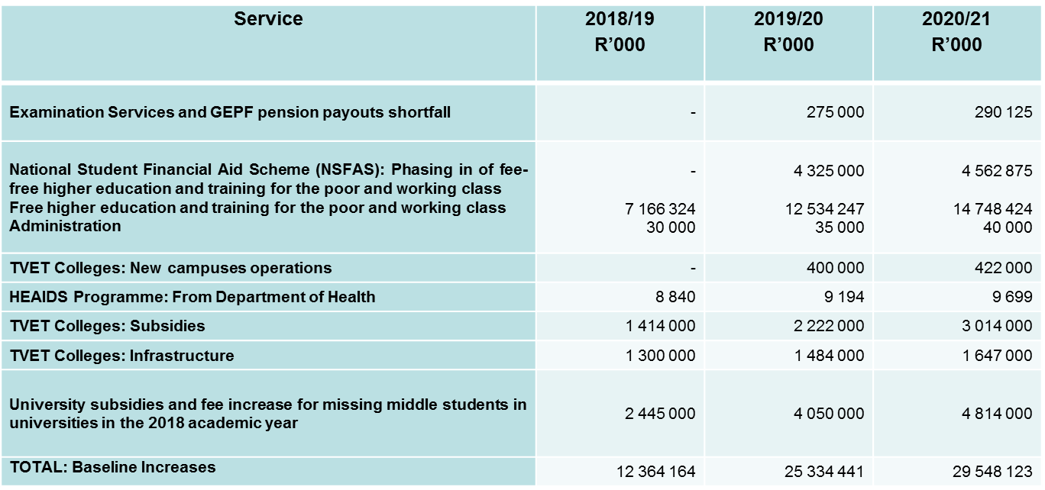
Budget Trends
The increased baseline can be summarised as follows:

Slide 60
Budget Trends
In view of Government’s cost containment measures, the Department has also received a baseline reduction on its normal operational costs. This amounts to R28.272 million over the 2018 MTEF. Although this may have a substantial impact on the operations of the Department, the Department managed to accommodate this reduction within the allocations pertaining to the administration costs per programme
Budget cuts were also effected on the allocations of the Department’s Public Entities to the amount of R20.455 million over the MTEF period
The estimates regarding the collection of the Skills Levy reflect a decline of R1.051 billion over the MTEF with a concomitant impact on the allocations for the National Skills Fund and the various SETAs

Slide 61
Budget Trends
Allocation | 2017/18 | 2018/19 | 2019/20 | 2020/21
 | R'million | R'million | R'million | R'million
Total Higher Education and Training | 68 949.10 | 89 950.000 | 107 938.500 | 118 670.100
Year-on-year growth | 6.65% | 21.64% | 20.00% | 9.94%
GDP | 4 741 000 | 5 025 400 | 5 390 100 | 5 808 300
% of GDP | 1.45% | 1.79% | 2.00% | 2.04%
Consolidated Government Expenditure | 1 563 127 | 1 671 190 | 1 802 955 | 1 941 948
Year-on-year growth | 8.16% | 7.27% | 7.88% | 7.71%
% Consolidated Expenditure | 4.41% | 5.38% | 5.99% | 6.11%
Total Education Expenditure | 310 129 | 351 121 | 385 436 | 413 066
Year-on-year growth | 8.50% | 8.68% | 9.77% | 7.17%
% Education Expenditure | 22.23% | 25.62% | 28.00% | 28.73%
Total University Funding | 31 606.841 | 38 597.859 | 42 237.891 | 45 102.225
Year-on-year growth | 11.52% | 22.12% | 9.43% | 6.78%
% of GDP | 0.67% | 0.77% | 0.78% | 0.78%

Slide 62
Budget Trends - Skills Levy
The “direct charges” reflected in the budget consist of the direct commitment from the National Revenue Fund namely the skills levy revenue collected by SARS for the SETAs and NSF
For the 2018 MTEF period, the skills levy increases from R15.8 billion (revised estimated levy collections by National Treasury) in 2017/18 to reach R19.8 billion in 2020/21
The skills levy allocations based on the revised collection trend over the 2018 MTEF are as follows:
2018/19: SETAs R13.544 billion
NSF R3.386 billion
2019/20: SETAs R14.640 billion
NSF R3.660 billion
2020/21: SETAs R15.856 billion
NSF R3.964 billion

Slide 63
Budget Trends
When excluding the skills levy, the Department’s budget increases from R52.3 billion in 2017/18 to R98.9 billion in 2020/21
The allocation for 2018/19 (R73.021 billion) is an increase of R20.713 billion (a nominal increase of 39.6 per cent) on the 2017/18 allocation
The Department’s budget is dominated by Programme 3: University Education, which represents 81% of the budget in 2018/19
This is mainly as a result of the subsidy payments to universities and the National Student Financial Aid Scheme
The budget as a result is also dominated by transfer payments in terms of the economic classification of expenditure

Slide 64
Allocations per Budget Programme
Programme | Adjusted Appropriation | Medium-Term Expenditure Estimate R’000
 | 2017/18 | 2018/19 | 2019/20 | 2020/21
Administration | 400 356 | 432 277 | 462 149 | 493 703
Planning, Policy and Strategy | 68 298 | 80 154 | 86 116 | 93 891
University Education | 41 931 721 | 59 147 097 | 73 295 671 | 80 666 222
Technical and Vocational Education and Training | 7 460 198 | 10 739 739 | 12 982 479 | 14 585 138
Skills Development | 249 357 | 262 579 | 279 815 | 297 027
Community Education and Training | 2 197 709 | 2 358 797 | 2 532 820 | 2 714 703
Subtotal | 52 307 639 | 73 020 643 | 89 639 050 | 98 850 684
Skills Levy | 15 770 554 | 16 929 383 | 18 299 472 | 19 819 455
Total | 68 078 193 | 89 950 026 | 107 938 522 | 118 670 139

Slide 65
Allocations per Economic Classification
Economic classification | Adjusted Appropriation | Medium-Term Expenditure Estimate R’000
 | 2017/18 | 2018/19 | 2019/20 | 2020/21
Compensation of Employees | 8 282 307 | 8 956 964 | 9 637 693 | 10 360 520
Goods and Services | 387 337 | 434 527 | 733 024 | 773 228
Transfers and subsidies (Refer to next slide for detail) | 43 628 444 | 63 620 522 | 79 259 068 | 87 707 037
Payments for capital assets | 9 551 | 8 630 | 9 265 | 9 899
Subtotal | 52 307 639 | 73 020 643 | 89 639 050 | 98 850 684
Skills levy | 15 770 554 | 16 929 383 | 18 299 472 | 19 819 455
Total | 68 078 193 | 89 950 026 | 107 938 522 | 118 670 139

Slide 66
Detail of Transfer Payments
Economic Classification Detail of Transfer Payments | Adjusted Appropriation | Medium-Term Expenditure Estimate R’000
 | 2017/18 | 2018/19 | 2019/20 | 2020/21
National Student Financial Aid Scheme | 10 143 091 | 20 334 391 | 30 829 474 | 35 321 406
Public entities (SAQA, CHE, QCTO, PSETA) | 243 566 | 251 251 | 265 322 | 279 914
ETDPSETA: Training contribution | 15 158 | 17 949 | 18 957 | 19 991
Universities | 31 606 841 | 38 597 859 | 42 237 891 | 45 102 225
TVET Colleges | 1 495 749 | 4 287 538 | 5 768 665 | 6 837 112
Community Education Training Colleges | 103 898 | 109 924 | 116 080 | 122 464
Universities South Africa (HEAIDS) | 8 581 | 17 919 | 18 781 | 19 813
Commonwealth of Learning and IBSA | 3 489 | 3 691 | 3 898 | 4 112
Leave gratuities | 8 071 | - | - | -
Total | 43 628 444 | 63 620 522 | 79 259 068 | 87 707 037

Slide 67
2018/19 Budget
Within the Department the funding distribution is as follows:
 |  |  | R’million
Total Voted Funds |  |  | 89 950
Less: Direct Charges (Skills levy to SETAs and NSF) |  |  | 16 929
Balance of Voted funds |  |  | 73 021
Less: Transfers: | Universities |  | 38 598
(R63.621 million) | NSFAS |  | 20 334
 | Public Entities |  | 269
 | TVET Colleges |  | 4 288
 | CET Colleges |  | 110
 | Other |  | 22
Less: Compensation of Employees |  |  | 8 957
Less: Earmarked funds |  |  | 69
Balance available for operational costs |  |  | 374

Slide 68
2018/19 Budget
For 2018/19, compensation of employees amounts to R8.957 billion (95.3 %) of Departmental operations as follows:R’000
Departmental: R1 036.370 million
TVET colleges: R5 711.631 million
CET colleges: R2 013.817 million
Examiners and Moderators: R195.146 million
The amount of R374 million for operational expenditure is limited funding for the operations of the Department, especially taking into account that the amount for 2017/18 was R366 million
The operational budget increases to R649 million during 2019/20 and R664 million during 2020/21 due to the increased allocations for examination services
The key challenge would be to ensure that operations of the Department are innovative and efficient as well as ensuring the required monitoring, evaluation and control of the system as a whole

Slide 69
Strategic Risks
Strategic risks are risks that affect the strategy of the Department and are linked with the vision, mission and strategic objectives
The primary responsibility for management of strategic risks lies at the Branch / business level
All Branch Heads have a responsibility to ensure that all the identified risks within their respective areas are continuously managed
Management of risks start with the Identification and assessment processes that follow planning processes
This enables the branches to know and own the risks for incorporation into Work Plans and Operational Plans for effective implementation

Slide 70
Strategic Risks
Below are the common / main contributing factors for risks that remained high even after implementation of controls:
Capacity constraints within the Department as a result of the current structure that is not approved and lack of funding for the unfunded posts
No voted funding for some of the core functions putting high reliance on the National Skills Fund for funding of operational costs and filling of positions
Non-availability of proper financial management systems in the TVET colleges
Aged IT infrastructure and poor services by SITA on procurement of IT services
Inadequate interfacing and integration of internal processes / systems
Inadequate physical infrastructure

Slide 71
High Level Strategic Risks
Risk Description:
1) Unsustainable organizational Structure.
Risk Category: Structure.
Root Causes:
Delayed approval of the revised structure.
Lack of funding that puts high reliance on the National Skills Fund (NSF) to support key priority areas and inevitably filling of posts for a number of core functions within the Department.
Risk status:
Inherent Risk
Residual Risk
Current Mitigation Strategies
Interim funding through National Skills Fund.
Critical posts identified and prioritised for filling.
Continuation of existing contract appointments for critical business areas.
Planned Mitigation Strategies
Approval of the revised organizational structure & concurrence by the MPSA.
Engagements with the National Treasury in ensuring that there is voted funding for the entire staff establishment.
Assessment of utilization levels of existing capacity and Skills audit.
.
H
Unsatisfactory Reduction of risk levels
H

Slide 72
High Level Strategic Risks
Risk Description:
2) Insufficient management of increased baseline allocations
Risk Category: Funding
Root Causes:
Since inception, the Department was not fully funded.
Marginal increases on the operational budget.
Increased legislated compliance requirements.
The large number of entities reporting to the Department .
Risk status:
Inherent Risk
Residual Risk
Current Mitigation Strategies
Regular cash-flow monitoring and reporting .
Compliance monitoring.
Institutional Grants allocated for monitoring & evaluation.
Planned Mitigation Strategies
Dedicated funding to ensure institutional capacity.
Improved analysis of reports submitted by institutions/ entities.
Review of the transfer payment schedule to improve the management of transfers.
H
Existing Controls effectively implemented
M

Slide 73
High Level Strategic Risks
Risk Description:
3) Implementation challenges with policies (e.g. RPL Coordination, Articulation, National Policy on Integrated Career Development System & Disability Management).
Risk Category: Policy Implementation
Root Causes:
Unfunded mandates.
Funding only provided for operational costs for CDS.
Limitations on the implementation of Disability Policy
Risk status:
Inherent Risk
Residual Risk
Current Mitigation Strategies
Using capacity building programmes with external providers/funding to extend capacity for implementation
Regular engagements with/ reporting to oversight structures (i.e. DG through Senior Management & the Minister; Inter-departmental NQF Steering Committee (IDNQFSC).
NSF funding for CDS.
NSFAS guidelines on the provision of funding for people with disability.
Planned Mitigation Strategies
Establishment of the RPL Reference group & Articulation Appeals Body.
Development of a cost sharing model for CDS.
Support on the implementation of the policy
H
Unsatisfactory Reduction of inherent risk level
H

Slide 74
High Level Strategic Risks
Risk Description
4) Student Protests
Risk Category:
Student Support
Root Causes:
Concerns about the pace of transformation in institutions of higher learning (universities).
Student funding (NSFAS) and fees matters.
Student housing-related protests
Political disputes and concerns on corruption/maladministration
Risk status:
Inherent Risk
Residual Risk
Current Mitigation Strategies
Minister’s intervention in cases of maladministration or poor governance of institutions.
Communication, reporting, oversight and other mechanisms of engagement which allow the Department to monitor universities/ student matters.
Capacity support for council members and for student leadership
Planned Mitigation Strategies
Plans are in place in a range of areas that assist in reducing student protests in the university sector.
H
Unsatisfactory Reduction of inherent risk level
H

Slide 75
High Level Strategic Risks
Risk Description:
5) Irregular conduct of National Examinations
Root Causes:
Non-compliance with Examination Conduct Policy
Inadequate Examination Conduct Policy
Lack of funding for the site visits and a resource for development/review.
Risk status:
Inherent Risk
Residual Risk
Current Mitigation Strategies
National conduct policy
National conduct guidelines used.
Principals have been appointed as Chief Examination Officers
Regular/ quarterly reporting on the conduct of the colleges on examinations (All exam cycles are covered.
Planned Mitigation Strategies
Revision and implementation of the monitoring tool, auditing tool and National Conduct guideline.
Training workshops with the Principals and the Deputy Principals.
H
Unsatisfactory Reduction of inherent risk level
H

Slide 76
High Level Strategic Risks
Risk Description:
6) Lack of readiness of CET colleges to receive and manage their own funds.
Risk Category:
Management systems
Root Causes:
No proper financial management systems in the colleges.
Risk status:
Inherent Risk
Residual Risk
.
Current Mitigation Strategies
Memorandum of agreements signed with the TVET colleges.
Budget for goods and services retained by DHET and SCM processes centralised to DHET HQ.
Planned Mitigation Strategies
To partner with SAICA for the financial management support to be provided to the CET colleges until 2021 (Through NSF funding).
H
Unsatisfactory Reduction of inherent risk level
H

Slide 77
High Level Strategic Risks
Risk Description:
7) Incoherent and inconsistent teaching and learning practices in the 50 TVET colleges
Risk Category:
Teaching and Learning
Root Causes:
Lack of proper planning
Insufficient lecturer capacity.
Lack of management focus on teaching and learning.
Risk status:
Inherent Risk
Residual Risk
.
Current Mitigation Strategies
Standardized planning templates and checklists implemented.
Annual teaching and learning plans submitted by the 50 Colleges.
Implementation monitored by the regional offices and sample monitoring done by the National Office.
Planned Mitigation Strategies
Lecturer development programme.
Student academic support and success programme.
Management of student centered model for bursary funding.
Student governance and leadership matters. Standardized planning templates and checklists
To Bid for Fiscus Funding through the National Treasury processes.
Annual reporting implemented.
National Workshops to be hosted with regards to students with disabilities.
H
Existing Controls effectively implemented
M

Slide 78
High Level Strategic Risks
Risk Description:
8) Inability of the Department to standardize conditions of services for lecturers at CET colleges.
Risk Category:
Funding and Capacity
Root Causes:
Inconsistent application of the conditions of services across the provinces.
Insufficient incentives which are benefits to retain staff.
Risk status:
Inherent Risk
Residual Risk
Current Mitigation Strategies
Currently implementing college based conditions of services (which are not uniform).
Planned Mitigation Strategies
Development and implementation of the standardised staffing norms for the colleges (Funds needed for this). Thus far the draft staffing norms have been developed, a report has been tabled to SMM and has been sent to the Minister to explain the requirements and what is needed for the norms to be finalised.
H
Slow Reduction of inherent risk level
H
78

Slide 79
High Level Strategic Risks
Risk Description:
9) Inadequate infrastructure for the TVET & CET colleges as well as for Artisan Development.
Risk Category:
Infrastructure
Root Causes:
Non-availability of voted funding for infrastructure development and maintenance.
Risk status:
Inherent Risk
Residual Risk
Current Mitigation Strategies
School facilities used for the CET colleges as the system does not have its own infrastructure.
Sourcing of funds from the SETAs for recapitalisation of INDLELA (for the Trade Tests).
Facilities maintenance reports for the TVET colleges.
Planned Mitigation Strategies
Engagements with the CFO to motivate for funding (voted funding for infrastructure development).
H
Unsatisfactory Reduction of inherent risk level
H
79

Slide 80
High Level Strategic Risks
Risk Description:
Instability/ disruptiveness at universities and colleges due to student protests
Risk Category:
Inefficiencies at entities and poor institutional management
Root Causes:
Ineffective administration by NSFAS of student financial aid.
Interference by private providers in the provision of student accommodation
Politically-motivated disruptions to teaching and learning
Risk status:
Inherent Risk
Residual Risk
Current Mitigation Strategies
Department and Ministry in serious engagement with NSFAS to improve management of student financial aid.
Structured Private Public Partnerships initiatives to deal with student accommodation
Planned Mitigation Strategies
Conflict resolution capacity development for both student leadership and management
H
Unsatisfactory Reduction of inherent risk level
H

Slide 81
Success by the Audit Committee
Auditor General place reliance on the Audit Committee as independent advisory body to the Department
Department received an unqualified audit opinion since the establishement of the Department
No material adjustments to the financial statements resulting from the audit in the 2016/17 financial year
Good working relationship between Audit Committee and the management of the Department
Good working relationship with the Auditor-General

Slide 82
Focus Areas of the Audit Committee
Continued sound financial management and governance in the Department
Focus on compliance with legislation and regulation
Follow up on previous Auditor-General findings.(special meeting February)
Special attention to HR matters
Prevention of and action taken on irregular expenditure

Slide 83
2018/19 Actions for the Audit Committee
Quarterly reporting by CFO to the Audit Committee on financial activities
Auditing of interim and year-end financial statements by Internal Audit
Quarterly reporting by Branches to the Audit Committee on performance
Auditing of performance information by Internal Audit
Review of the strategic and operational risk register
Quarterly reporting by the Risk Management unit on the management of risks
Reporting by Branches on the implementation of action plans to the Audit Committee on audit findings
Follow up audit by Internal Audit on implementation of action plans on audit findings

Slide 84
Thank you

