Slide 1
Portfolio Committee on Communications
Analysis of Annual Performance Plans 2018 – 2019

Slide 2
Purpose of Annual Performance Plans
Sets out what the institution intends doing in the upcoming financial year and during the Medium Term Expenditure Framework (MTEF) to implement its Strategic Plan.
Sets out performance indicators and targets for budget programmes, and sub-programmes where relevant, to facilitate the institution realising its goals and objectives set out in the Strategic Plan.
Where appropriate, the plan should include a quarterly breakdown of performance targets for the upcoming financial year

Slide 3
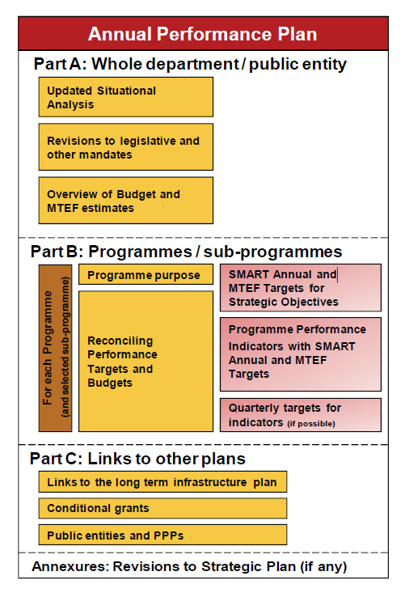
Structure of Annual Performance Plan

Slide 4
Programme Performance Information
Programme performance information focuses on information that is collected by government institutions in the course of fulfilling their mandates and implementing government policies. This information is vital in enhancing transparency, accountability and oversight.
National and provincial treasuries make use of programme performance information for assessing the value-for-money of government activities.
The S.M.A.R.T principle becomes an important criterion when setting out programme performance information.
S.M.A.R.T goal setting brings structure and trackability into your goals and objectives. Instead of vague resolutions, S.M.A.R.T goal setting creates verifiable trajectories towards a certain objective, with clear milestones and an estimation of the goal's attainability.

Slide 5
Programme Performance Information (cont.)
In order for goals or objectives to be clear and reachable, each one should be:
Specific (simple, sensible, significant).
Measurable (meaningful, motivating).
Achievable (agreed, attainable).
Relevant (reasonable, realistic and resourced, results-based).
Time bound (time-based, time limited, time/cost limited, timely, time-sensitive).

Slide 6
Relationship between legislation, plans and budgets
When developing Strategic Plans and Annual Performance Plans it is also useful to conduct a situational analysis on the sectors or spheres of responsibility that fall within the institution’s mandate, the present delivery environment and the state of the institution itself, taking into account relevant government policies and long term plans.
Strategic Plans and Annual Performance Plans should include a description of how institutions give effect to their statutory obligations, powers and responsibilities. In this regard the hierarchy of the different legal instruments should be noted

Slide 7
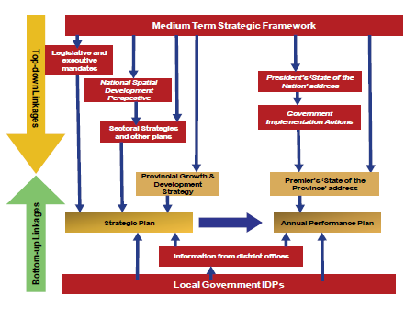
Relationship between legislation, plans and budgets (cont.)

Slide 8
Relationship between legislation, plans and budgets (cont.)
The Constitution of South Africa, 1996 is the highest law of our country, and applies to all institutions. The Constitution prevails over any other legislation, regulations and directives. Following the Constitution, departments are then required to comply with other legislation, Money Bills, regulations; as well as directives and agreements issued in terms of the legislation.
If there are any specific court rulings that have a significant ongoing impact on operations or service delivery obligations, the Executive is under obligation to give effect to these.
In addition, some departments’ activities may be subject to a regulatory body. A regulatory body is a public authority or government agency responsible for exercising autonomous authority over and monitoring some area of government activity in a regulatory or supervisory capacity.

Slide 9
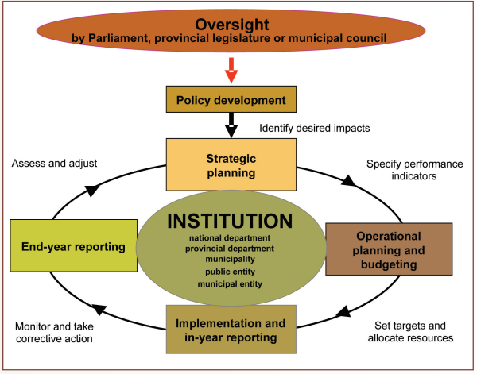
The Committee needs to endeavor to ensure that it regularly reviews Quarterly financial and non-financial performance of the Department and entities.

Slide 10
Timeframes
The Annual Performance Plan covers the upcoming financial year and the MTEF period.
Departments should aim to table their Annual Performance Plan within a month after the tabling of the budget in respect of the year to which it relates. Public entities must submit the plan to their executive authorities and responsible departments by the end of January prior to the start of the first financial year covered in the plan.

Slide 11
Department of Communications APP
The DoC has set itself 3 strategic goals which will be achieved when implementing the mandates:
Effective and efficient strategic leadership, governance and administration
A responsive communications policy regulatory environment and improved country branding
Transformed communications sector
In order to meet its mandate; the department’s functions are divided into 4 programmes namely (i) Administration; (ii) Communications Policy, Research and development; (iii) Industry and Capacity development; and (iv) Entity Oversight

Slide 12
Programme 1: Administration
The purpose of this programme is to provide strategic leadership, management and support services to the department. Under this programme the department has ten sub programmes with annual targets
Human Resource Management and Development (HRM&D), Information and Technology management (IMT), Facilities and Security management services; Communications, Legal Services, Strategic planning and Performance Monitoring, Financial management, Accounting and Administration; Supply Chain Management, Risk Management and Internal Audit.

Slide 13
Programme 1: Administration
The Department remains with unfunded posts, which form part of the departmental approved organizational structure.

Slide 14
Programme 2: Communications Policy, Research and Development
The purpose of this programme is to conduct research and develop communications and broadcasting policies. The programme has three sub-programmes with four annual targets. The three sub-programmes are Broadcasting Policy, Media Policy and Technology and Engineering Level.
The number of targets in this programme for the financial year 2018/19 have decreased from ten to four.
During the medium term, the programme will focus on legislation and policy overhaul in order for policy and legislation to meet the changing needs of the sector as a result of the convergence and rapid advances in technology.

Slide 15
Programme 2: Communications Policy, Research and Development
Budget allocated for Media Policy sub-programme is combined with the budget for sub-programme Broadcasting Policy for this financial year
Broadcasting Amendment Bill must be expedited. Of importance, the Bill will address the many (public) contradictions that have taken place in the past regarding the process for the appointment of Board members and a need to clarify whether the Broadcasting Act or the Companies Act applies

Slide 16
Programme 3: Industry and Capacity Development
The purpose of this programme is to manage enterprise development, digital migration, and industry research and analysis.
Furthermore, it’s to ensure the implementation of a structured programme of engagement with stakeholders in support of the department’s programmes and projects.
This programme has four sub-programmes with a total of 4 annual targets.

Slide 17
Department of Communications APP
Programme 3: Industry and Capacity Development
The department’s flagship project with budget allocation of R48 062 000
R6.6bn to successfully complete the implementation of the broadcasting digital migration policy before the worldwide June 2019 deadline.

Slide 18
Programme 4: Entity Oversight
The purpose of this programme is to monitor the implementation of policies by SOEs and regulatory institutions, and provide guidance and oversight on their governance matters. There are four sub-programmes under this programme with 5 annual targets.

Slide 19
Programme 4: Entity Oversight
Stable Leadership
and
Strengthening the Oversight over troubled entities

Slide 20
Issues for the Committee to consider
Funding of the department has been the major challenge (since 2014) Office of the Chairperson is engaging the Parliament Budget Office on strategies to resolve the challenge Approved unfunded posts Questions the capacity of the DoC to deliver on its legislative mandate DTT Deadline Planned Colloquium will assist PCC to assess the state of readiness for RSA and the impact of proliferation of technology into the government BDM Policy Accountability of Entities (MDDA, FPB, ICASA, SABC)

Slide 21
Issues for the Committee to consider BRRR Recommendations
The Committee recommends that the Minister should ensure that: the Department and entities present their plans to mitigate AGSA findings; the Department’s Entity Oversight Directorate plays its role on overseeing entities; the Department and entities consistently respond to issues raised by the Committee; broadcasting services are made available to the people living with disabilities, particularly the deaf community; the Department provides a list of international trips undertaken during the year under review; the Department presents the Performance Management System of ICASA Councillors;

Slide 22
Issues for the Committee to consider BRRR Recommendations (cont.)
The Committee recommends that the Minister should ensure that: the FPB presents to the Committee comprehensive reports leading to the pay-out of senior managers before the end of 2017/18 financial years; the Department presents to the Committee an entity oversight strategy before the end 2017/18 financial year. The Committee further recommends that the Minister should provide a detailed report responding to all recommendations within 30 working days after the adoption of this report by the House.
the Minister must also present a report regarding the underfunding of the Department so that the Committee can engage other relevant institutions such as the National Treasury

Slide 23
END

