Slide 1


Slide 2


Slide 3
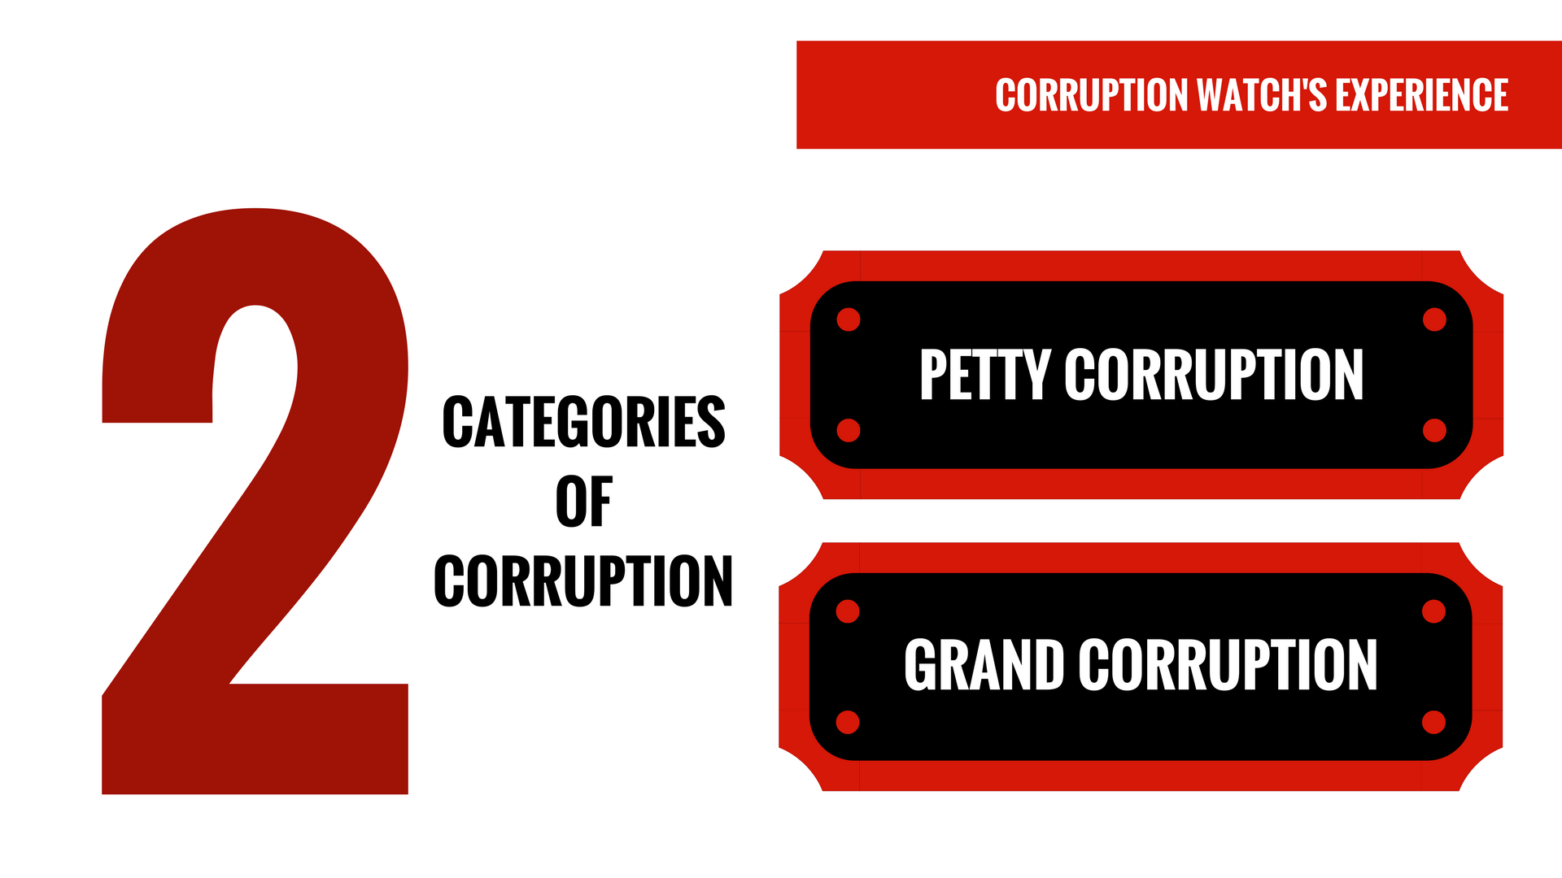
Two categories of corruption
Petty
Grand

Slide 4


Slide 5

RAISING THE VOLUME OF REPORTS + RECOMMENDATION 1

Slide 6


Slide 7


Slide 8
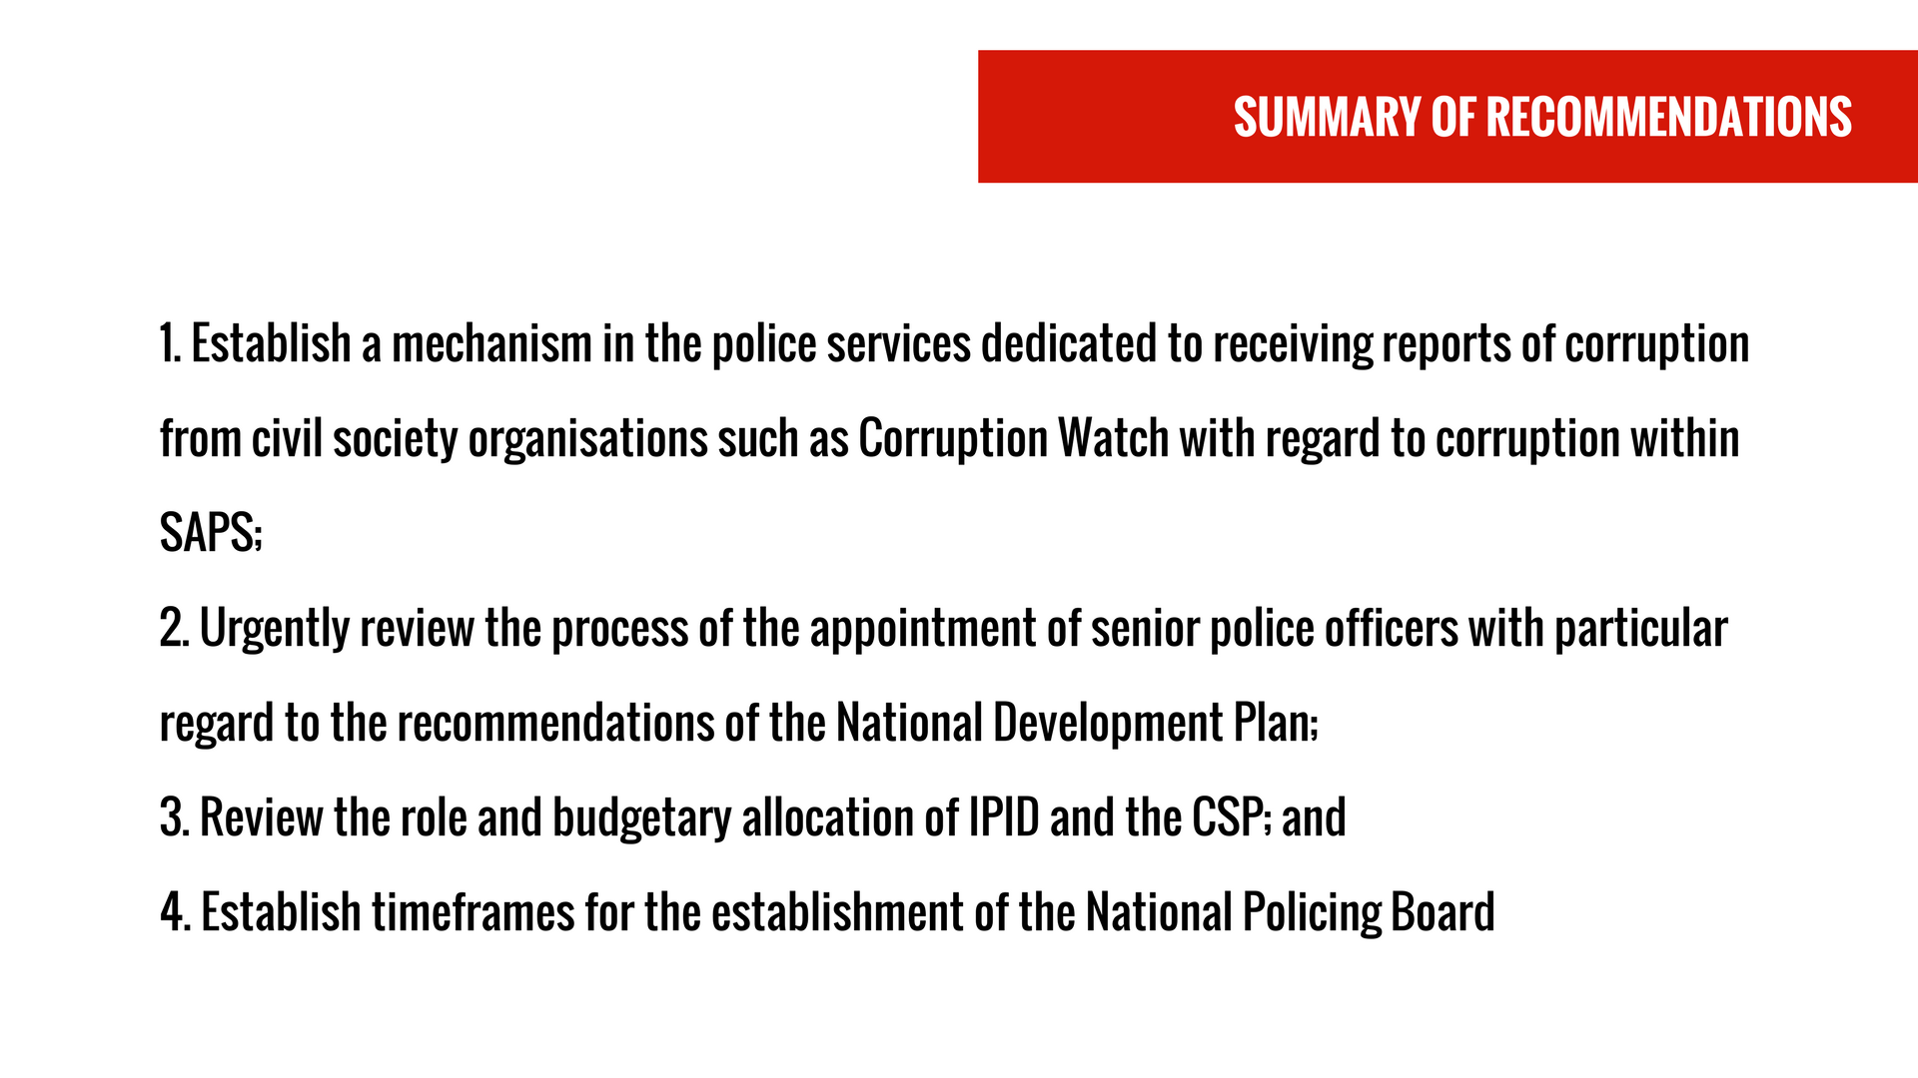

Slide 9


