Slide 1

2018/19 – 2020/21 CORPORATE PLAN
- Presentation PCoT-
17 April 2018

Slide 2
Structure and Format:
2018/19 – 2020/21 Corporate Plan
The PRASA Mandate
Rail: The Back-bone of Public Transport
Driving the Corporate Plan
Budget and Capital Programme
Annual Performance Plan

Slide 3
THE PRASA MANDATE

Slide 4
PRASA Mandate
PRASA, as the implementing arm of the Department of Transport, the sole shareholder, is primarily focused on the mandate contained in the Legal Succession Act of South African Transport Services (SATS) Act of 1989, as amended.
The main objective and main business of PRASA is to:
Ensure that, at the request of the Department of Transport, rail commuter services are provided within, to and from the Republic in the public interest, and
Provide, in accordance with the Department of Transport, for long haul passenger rail and bus services within, to and from the Republic in terms of the principles set out in section 4 of the National Land Transport Transition Act, 2000 (Act No. 22 of 2000)
The second objective and secondary business of PRASA is that:
PRASA shall generate income from the exploitation of assets acquired by it, which include real estate and property portfolio.
Importantly in carrying out its objectives and business, PRASA shall have due regard for key Government, social, economic and transport imperatives and policy objectives.

Slide 5
PRASA Mandate
As a public entity, the PRASA Corporate Plan finds expression through legislation, government policies and strategies such as:
National Transport Policy
National Development Plan
Legislation such as the National Land Transport Act
Public Finance Management Act
National Rail Policy Green Paper
Public Transport Strategy
Economic Strategy and Job creation initiatives

Slide 6
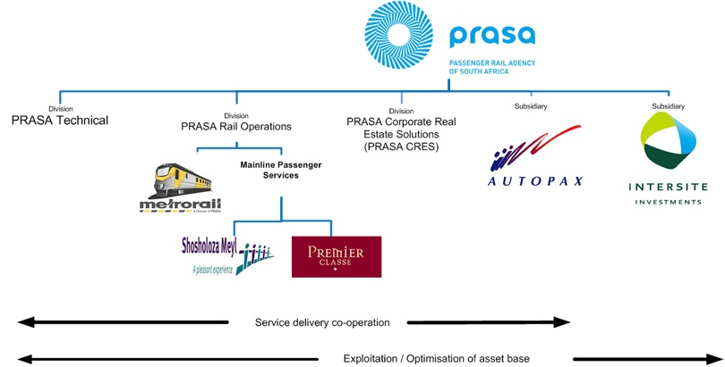
Legal Operating Structure

Slide 7
RAIL: THE BACKBONE OF PUBLIC TRANSPORT

Slide 8
Responding to the Rate of Urbanisation
Urbanisation progressing at breakneck speed, particularly in developing countries
  3% of earth’s population lived in Cities in the 1800s
  30% by 1950
  50% today
  60-65% (two out of three people) by 2030. Additional 2 billion people
Effective / sustainable transport, energy etc. solutions required
Rail as the backbone of public transport address
Need for safe, efficient, reliable, affordable and customer focused public transport;
Reduction of congestion on SA roads and encourage modal shift toward rail;
Expand passenger rail and bus services and
Develop a modern integrated public transport service

Slide 9
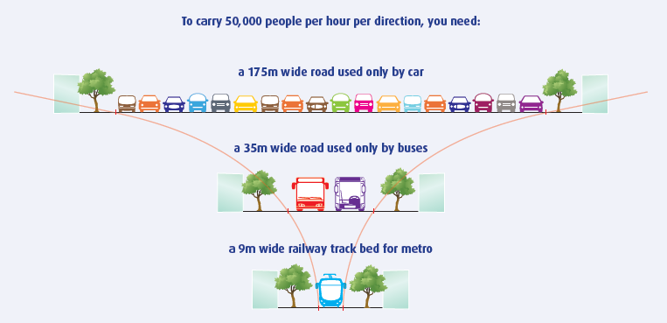
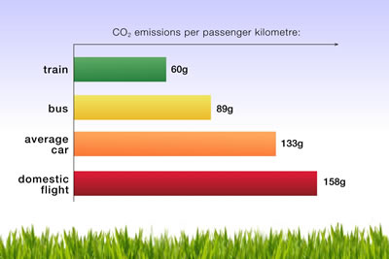
Benefits of Rail
Rail benefits cannot be ignored; capacity, environmental, less land required, reduce car & fuel reliance etc.

Slide 10
Responding to the National Development Plan (NDP)
The Corporate Plan responds to NDP which calls for Integrated, holistic, long-term perspective on all transport networks informed by growth priorities, the environment, inclusivity and access.
PRASA has noted from the NDP the following strategic focus areas and planning priorities focusing on the creation of workable urban transit solutions that will streamline an effective urban transport system, thus contributing to:
Increasing investment in public transport and resolving existing public-transport policy challenges
Provision of affordable, faster, reliable and safe transport
Transport plans that are aligned with spatial development
Devolving transport management to local government
Providing incentives for public transport use
Renewing the commuter train fleet
Broadband Connectivity

Slide 11
Aligning with DoT National Strategic Plan (MTSF)
The PRASA Corporate Plan is aligned to the White Paper on National Transport policy which seeks to provide safe, reliable, effective, efficient, and fully integrated transport operations and infrastructure which will best meet the needs of passenger whilst improving levels of service and cost in a fashion which supports Government strategies for economic and social development whilst being economically and environmentally sustainable.
The Corporate Plan also contributes to resolving prevalent problem areas as identified by the DoT within its next Medium Term Strategic Framework (MTSF), as identified below:
Improving the level of integration of transport infrastructure network and operations
Decreasing accidents and incidents (and fatalities) across all transport modes.
Improving infrastructure, access and mobility in rural and peri-urban areas.
Ensuring reliability, affordability, accessibility, efficiency, effectiveness and safety of public transport.

Slide 12
Aligning with PRASA National Strategic Plan
The Corporate Plan continues to advance PRASA’s National Strategic Plan (NSP) which is aligned with the National Transport Masterplan 2050 and has a long-term horizon that is implemented on various phases of the MTEF Period(s).
The implementation and the roll-out of PRASA’s National Strategic Plan is dependent on agreements to be signed with the relevant transport authorities as articulated in the National Transport Policy.
The PRASA NSP focuses on the following.
A prioritized list of rail service and network expansion interventions that:
provide more capacity to accommodate forecast growth,
transform the rail product on many corridors,
seek to make better use of the network, and
propose corridor extensions to new or growing settlement.

Slide 13
Driving the Corporate Plan

Slide 14
Corporate Plan Context
Overarching question for PRASA
  “How does PRASA plan on working towards Retaining and Recovering customers whilst Gaining new business”
This is informed by
  Current state of the business performance and operational challenges in delivering on PRIMARY MANDATE and
  PRASA’s commitment that rail ultimately become the backbone of public transport & mode of choice.
Respond to the
  Decline in passenger patronage and thus decline in revenues.
Turnaround plan aim
  To improve customer satisfaction to 80% over five years
  Realisation of at least R1bn by 2021 in exploitation & pursuit of secondary mandate

Slide 15
Corporate Plan Context
This plan does not replace current strategy.
A better articulation of how each Division, Subsidiary and Support functions will contribute to:
  A marked improvement in customer service excellence;
  A rail operation that is efficient, reliable, safe, predictable and sustainable;
  A viable and sustainable long-distance bus service;
  A Secondary mandate that clearly respond to Primary mandate;
  An efficient and effective organisation that assist the business in achieving its objectives;
  A modernisation programme that prepares the business for future needs of commuters and passengers.

Slide 16
Board Oversight and Performance Monitoring
Objectives to assist BOC to monitor business plans and measurable action plans of Divisions, Subsidiaries and Support Functions
BOC to introduce measures to strengthen performance & development of Divisions and Subsidiaries.
  Introduce Professionalism anchored on Commitment to Discipline and Performance.
  Where necessary restructure certain functions including ensuring job fit for each official tasked with carrying out key functions.
  Enabling Supply Chain Management
    Review SCM policy to streamline procurement
    Revise procurement delegations
    Procurement plan aligned to business demand plans
    Efficient contract management lifecycle
    Improvement in efficiency of procurement from specification to award
    SCM architecture to enhance business

Slide 17
MTEF Strategic Objectives
Core of the Corporate Plan against which BOC will monitor PRASA’s achievement:
Improve the Customer Experience focusing on safety & security of passengers, customer satisfaction & end-to-end passenger journey.
Improve Rail System performance over the MTEF by increasing revenue by 10%, raise train performance (88% on time trains; < 6% trains cancelled in peak) & improve customer satisfaction to 80%.
Realign support functions to achieve an efficient Rail and Bus business through integration of divisions, departments & subsidiaries, long-distance transport services, cost containment through efficiencies.
Modernise the Rail System through investment programme of R173 billion aimed at Rolling Stock Fleet Renewal, Re-signaling, and corridor modernization.
Expand Rail network and services through regional / provincial corridor expansions.
Exploit assets to generate revenue through real estate and other non-core assets.

Slide 18
Principles for Indicator Targets for 2018/19
Achieve stabilisation i.e. Stop in decline before increasing targets in subsequent financial years.
Baseline take into consideration trend in performance from previous 2 – 5 years (Forecasting principles).
Application of a range target where it addresses NT’s Framework for Managing Programme Performance requirement “dichotomy” of realistic yet challenging targets.
Realistic
Challenging
Challenging
Realistic

Slide 19
Objective 1: Improving Customer Experience
Rail as the backbone of public transport supported by an efficient bus service requires a deep commitment to customer centric superior performance.
Action plans that drive the improvement in customer experience are:
Functional communication platforms such as Integrated website(s), Smartphone Applications (APPs), Social Network, Public Address systems and Loudhailers
Integration of Railcom / ISAMS to provide commuters with real time service level information
Establishment of Customer Desks at Key Stations
Integration of Call Centers for Metrorail/MLPS and Autopax
Driving the total station management programme that ensures accountability at a frontline level for service performance.

Slide 20
Objective 2: Improve Rail System Performance
Rail Operations true custodian of mandate to deliver commuter rail services & long-distance rail services:
Stabilising the rail system require drastic interventions.
Two areas of focus:
  Curbing a further decline in passenger patronage whilst
  Endeavouring to recover lost customers;
Premised on successful implementation of the Engineering Division’s plan to improve the availability and reliability of Rolling Stock and Infrastructure.
PRASA Rail Action Plans contribute to
  Marked improvement in operational performance to restore to the 2008/09 levels of performance
  Marked improvement in financial performance and sustainability
  Marked improvement in passenger safety

Slide 21
Objective 2: Improve Rail System Performance
Rail Operations

Slide 22
Objective 2: Improve Rail System Performance
Rail Engineering crucial to ensure Availability, Reliability and Safety of Rolling Stock and Infrastructure.
Key Interventions address low performance of Infrastructure and Rolling stock
Recovery of coaches out of service (OOS) due to refurbishment, vandalism wrecks or due to maintenance
  Use Refurbishment contractors and rotating machine contracts to recover coaches.
  Deliver reliable coaches from Refurbishment programme back into service
Improve reliability of the coaches in service.
  Revise maintenance regime
  Re-establish modern, integrated maintenance management system

Slide 23
Objective 2: Improve Rail System Performance
Reducing Infrastructure Faults
  Signals & Telecoms through
    Contractors to supplement internal capacity;
    Migrate from copper to fibre on control systems,
    Reconditioning and replacement of back-up power supplies,
    Provide safety critical spares,
    Vandal proof signal equipment.
  Electrical Overhead Equipment and Substations through
    Rehabilitation with Rail-Road Vehicles,
    Contractors for rehabilitation of substations and power supply,
    Improve substation reliability
  Perway (track) and Perway speed restrictions through
    Procurement of on-track machine resources, rails and rail components,
    Rehabilitate foundations and drainage,
    Track condition monitoring, rail defects tests, tamping and ballast screening.

Slide 24
Objective 2: Improve Rail System Performance
Engineering (PRASA Technical)

Slide 25
Objective 2: Improve Rail System Performance
PRASA CRES

Slide 26
Objective 3: Re-align Support Functions to Achieve an Efficient Rail Business
Integration of divisions, departments & subsidiaries
  Consolidation of real estate entities
  Design and develop an organisational structure and operating model through business rationalisation that right sizes PRASA.
Long-distance transport services to focus on
  Route, Asset, Cost, Control and Procurement Optimisation
  Customer Centricity
Cost containment through efficiencies
  Business Rationalisation

Slide 27
Objective 4: Modernise the Rail System through investment programme of R173 billion
Key programmes in Modernisation of PRASA in multi-year implementation phase:
Rolling Stock Fleet Renewal
  Train Manufacturing
  Local Factory Development
Signaling Programme
  Gauteng, KZN and Western Cape.
Depot Modernisation
  5 Depots to be modernised (2 in Gauteng, 2 in KZN and 1 in Western Cape)
120km/H Perway Programme
  In support of new Rolling Stock for Metrorail.

Slide 28
Objective 4: Modernise the Rail System through investment programme of R173 billion

Slide 29
Objective 5: Expand Rail network and services
Expansions are through regional / provincial corridor expansions and introduction of new services that are in line with Cities Integrated Public Transport Networks(IPTN;s) & Integrated Transport Plans (ITP’s).
Securing the future business of PRASA through the PRASA Strategic Plan (2050) for transformational, integrated and holistic approach to Rail.
Planning for Growth:
Western Cape: Blue Downs Rail Link & Cape Town International Airport Rail Link
KZN: King Shaka Airport and Northern Links as well as Bridge City
Eastern Cape: Motherwell Rail Link
Gauteng: Daveyton-Etwatwa Rail Corridor; Hammanskraal and Moloto Corridor
Product Development:
Light Rail solutions
High-Speed Rail
Integrated Ticketing

Slide 30
Objective 6: Exploit assets to support the primary mandate
The second objective is that PRASA shall generate income from the exploitation assets acquired by the organisation. The focus is to generate revenue through:
Real Estate
Commercialisation
Acquisition of development leases
Development of PRASA properties
3rd Party Real Estate Development and Investment
Station Improvements and Upgrades
Telecommunications Infrastructure Commercialisation
Leasing of Optic Fibre
Commercialisation of Telecoms Towers
ICT Value Added Services
  Wi-Fi Solutions
Alternative Energy Generation
Renewable Energy exploitation

Slide 31
Objective 6: Exploit assets to support the primary mandate

Slide 32
Budget and Capital Programme

Slide 33
Financial Position
PRASA Group is faced with
Cost challenges
  Operating costs increase at rate higher than revenue generated & subsidy
  Revenue decline as result of decline in paying passengers due to lack of maintenance, vandalism and theft of assets and closing of rail corridor (floods, safety status due to theft of assets and staff safety)
PRASA is by nature a Cash business & great part of costs are fixed.
Major part of cost increases subject to approval of regulatory bodies (Energy, Security, Municipal Councils) and negotiations with labour.
VAT increase result in additional costs as PRASA is VAT Exempt.
  PRASA is not subject to a primary tax. It delivers a service that is exempt (passenger fares)
  I.t.o. VAT cannot claim an input tax credit like normal companies do on this secondary tax.
  Significant impact on PRASA’s cash flows as about 40% of operational costs and 95% of capital costs are subject to VAT.
  The VAT increase of 1% is estimated at R52m for 2018/19.
Estimated Operating Cash Shortfall of R6,7bn over MTEF.

Slide 34
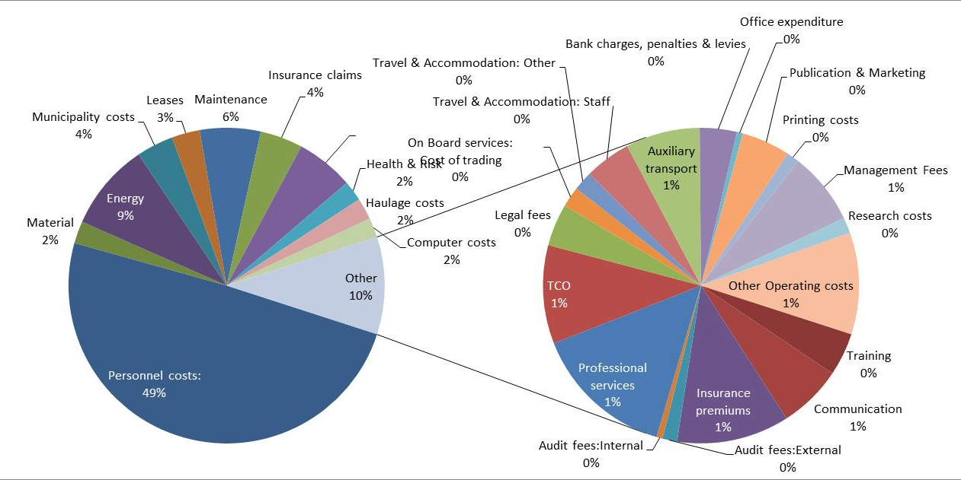
Expenditure Distribution

Slide 35
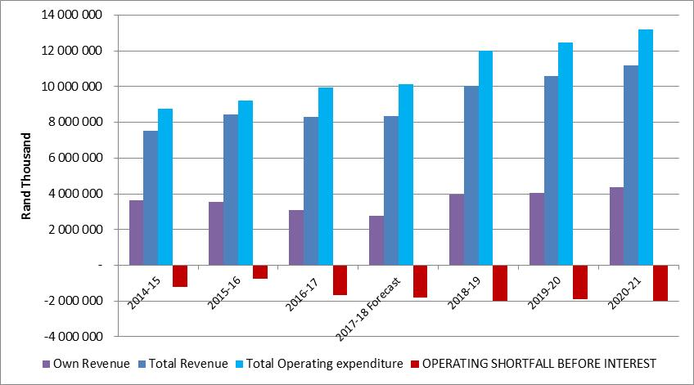
Operational Performance Historical and MTEF

Slide 36
Capital Allocation :

Slide 37
