Slide 1
OVERVIEW PACOFS
DIRECTOR-GENERAL: ARTS AND CULTURE
DATE: 17/04/2018

Slide 2
PRESENTATION OUTLINE
Strategic overview
Review of performance
Non-financial
Financial
Audit improvement plan
Governance
Challenges and interventions

Slide 3
THE STORY LINE
VISION The icon of arts in south Africa
MISSION Develop, promote and preserve the arts and African heritage
OUTCOME ORIENTED GOALS
Organisation Transformation to high performance |  | Artistic Programming | Talent development and promotion of the Arts | Partnering , funding and Sponsorship | Optimise PACOFS facilities
STRATEGIC OBJECTIVES
To ensure good corporate governance | To produce artistic programmes |  | Identify talent in the Free state across all disciplines through auditioning, mentoring, training, placement programme and talent pool identification | Approach potential business partners/sponsors | Maintain technical and operational excellence of our facilities
Change staff perceptions and commitment to PACOFS | Innovatively and significantly raise PACOFS visibility and use of its facilities to retain customers |  | Conduct development showcases | Create a value adding proposition to potential business partners and sponsors

Slide 4
ALIGNMENT TO DAC GOALS
DAC OUTCOME ORIENTED GOAL | ENTITY STRATEGIC OBJECTIVES | KEY OUTPUTS AND TARGETS FOR 2018/19
A transformed, coherent and development-focused Sector | To identify talent in the Free State across all disciplines Conduct Development Showcases | 4 talent pool identification programmes 26 developmental productions showcased
An effective and efficient ACH Sector | To ensure good cooperate governance To map and implement a business improvement programme To align information technology infrastructure and applications to support operations and business process | Unqualified audit outcome and action plan implemented Departmental business process manuals developed ICT governance framework developed and approved
A professional and capacitated ACH Sector | Produce Artistic Programmes Significantly raise the standard of our whole system of delivery (customer experience) | 12 artistic programmes of excellence presented 4 training workshops conducted for arts practitioners

Slide 5
LINKS TO THE 10-DAC PRIORITIES
DAC PRIORITY AREA | KEY OUTPUTS AND TARGETS FOR 2018/19 | BUDGET ALLOCATION PER OUTPUT/TARGET
Nation Building and Social Cohesion and dealing with the challenges which includes racism, xenophobia, racial intolerances, hate speech and others. | Produce Artistic Programmes of Excellence (through staging productions from diverse racial and cultural backgrounds in order to attract a diverse audience) | R1 300 000
2. Community Arts Development programme | Capacity Building Programme targeting developmental artists from the 5 Districts of the Free State | R 1000 000
3. Skills audit | Develop technical and managerial skills for PACOFS employees. | R382 000
4. Improving Reporting and Compliance | Environment with efficient and effective governance and reporting systems to sound financial management of all PACOFS revenue sources and safeguard the assets. | R0

Slide 6
INITIATIVES CONTRIBUTING TO THE NELSON MANDELA CENTENARY
INITIATIVE | RATIONAL AND PURPOSE | DATE AND LOCATION
Artistic Ensemble in partnership with the DSACR: FS. Mandela Theme to be designed; Poetry Recitals: Participants will be selected from the 5 districts of the FS province A poetry recital session from the Artistic Programme on Nelson Mandela Day in partnership with the DSACR Commission a professional Artistic Ensemble made up of choirs, Dancers, Actors, Narrators; Singers; Poets; Painters; Comedians; Music; Bands; Multi-Media; | A production comprising musicians, poets, dancers and actors to celebrate the life of Nelson Mandela A poetry show in honour and celebration of the life of Nelson Mandela | Performances in all the theatres, e.g. Welkom, Sasolburg, Kroonstad, Thaba Nchu, etc Dates to be confirmed after consultations with stakeholders 18 July 2018 at PACOFS PACOFS in December 2018

Slide 7
REVIEW OF PERFORMANCE

Slide 8
THREE YEAR PERFORMANCE OVERVIEW
 | 2015/16 | 2016/17 | 2017/18 (1st to 3rd quarter)
Targets achieved | 39% | 40% | 58%
Targets not achieved | 61% | 60% | 42%

Slide 9
REASONS FOR NON-ACHIEVEMENT OF TARGETS
REASON | CORRECTIVE ACTION
Due to instability to leadership, artistic production activities could not be carried out | A full constituted Council that has established all the mandatory Committees. Council has approved all the outstanding Policies Council is filling the vacant Executive management posts to stabilise the entity
The policies that were earmarked for review and approval could not be done
The skills audit work plan could not be concluded, due to absence of the HR Capacity
Some of the audit findings could not be cleared as a result they were carried over and the audit outcome regressed.

Slide 10
THREE YEAR INCOME AND EXPENDITURE TRENDS
NAME OF ENTITY | 2016/17 (Audited) | 2017/18 (Budgeted) | 2018/19 (envisaged)
 | R’000 | R’000 | R’000
Income | 48 974 | 50 089 | 48 056
Government Grant | 41 513 | 47 589 | 45 322
Other Income | 7 461 | 2 500 | 2 734
Expenditure | 46 346 | 50 089 | 48 056
Surplus / (Deficit) | 2 628 | 0 | 0

Slide 11
THREE YEAR STATEMENT OF FINANCIAL POSITION
NAME OF ENTITY | 2015/16 | 2016/17 | 2017/18
 | R’000 | R’000 | R’000
Current Assets | 22 102 | 56 282 | Not yet available due to vacancy of the CFO
Non-Current Assets | 63 568 | 62 805
Total Assets | 85 670 | 119 087
Current Liabilities | 64 784 | 50 427
Total Liabilities | 73 597 | 105 297
Net Asset Value (NAV) | 12 073 | 13 789

Slide 12
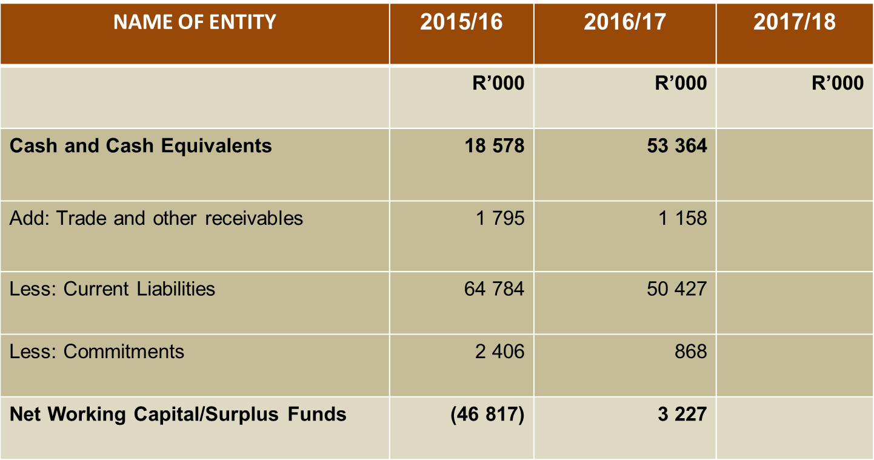
ANALYSIS OF CASH AND CASH EQUIVALENTS
Not yet available

Slide 13
AUDIT IMPROVEMENT PLAN

Slide 14
AUDIT OUTCOMES
PACOFS | 2014/15 | 2015/16 | 2016/17
Audit Outcome | Unqualified | Qualified | Adverse
The analysis of Audit Improvements Plans revealed that the most frequent audit findings relate to the lack of accurate and complete financial and performance reports supported by the relevant verification sources, material misstatements of the Annual Financial Statements, non-compliance with Supply Chain Management prescripts
The analysis performed by the Department based on PACOFS third quarter reports revealed that out of 126 audit findings received by PACOFS in the 2016/17 financial year, 8 audit findings were resolved. This translates into 6% of the total audit findings. Although some of the audit findings are expected to be achieved before 31 March 2018, the progress reported by PACOFS in addressing their audit findings is not satisfactory.
Audit findings received by various entities formed part of Entities Management site visits deliberations. More site visits were directed to entities that received qualified and adverse audit opinions. Technical advices were provided by Entities Management officials where applicable with a view to improve financial management in DAC aligned entities and to prevent recurrence of similar audit findings in the 2017/18 audit year.
Furthermore, audit outcomes are constantly discussed at the Chief Financial Officer’s Forum. Through this platform the Chief Financial Officers share tips on how to achieve improved audit outcomes.

Slide 15
DETAILS OF IRREGULAR EXPENDITURE
DETAILS | PRESCRIPT REGULATING ACTIVITY | AMOUNT | ACTION TAKEN
Non compliance with Laws and regulations (opening balance from 2015/2016). The prior years opening balance (R57 006 990 and the 2016/2017 amount of R3 958 324) | PFMA Treasury regulations AND Practice notes | R60 965 314 | Under investigation
Non Compliance with laws and regulations for 2017/2018 financial year | PFMA, Treasury regulations and practice notes | R2 016 586 | Under investigation
Notes: The large amount of the Irregular expenditure is based on the CAPEX projects which the forensic investigation has just been concluded and consequence management would take effect.

Slide 16
DETAILS OF FRUITLESS AND WASTEFUL EXPENDITURE
DETAILS | PRESCRIPT REGULATING ACTIVITY | AMOUNT | ACTION TAKEN
Non compliance with Laws and regulations (opening balance from 2015/2016). The prior years opening balance (R2 464 003 and the 2016/2017 amount of R86 108 | PFMA, Treasury Regulations AND Practice notes | R2 550 111 | Under investigation
2017/2018 Fruitless and wasteful expenditure | PFMA, Treasury Regulations and Practice Notes | R14 804 | Under investigation
Notes: The fruitless and wasteful expenditure is largely caused by travel and accommodation, from the previous financial year to date. Due to financial limitation the bid for the travelling and accommodation would be entered into this financial year.

Slide 17
GOVERNANCE

Slide 18
COMPOSITION OF COUNCIL
NAME OF COUNCIL MEMBER | EXPERTISE | GENDER | RACE
Ms Afrika Msimang | Business Administration and Governance | Female | African
Mr Abia Litheko | Arts and Theatre Management | Male | African
Ms Tina Mnumzana | Arts and Theatre | Female | African
Ms Thoko Nogabe | Performing Arts | Female | African
Ms Maleshini Naidoo | Finance and Audit | Female | Indian
Mr Haramraj Brijlal | Human Resources And Labour | Male | Indian
Advocate Khaya Thango | Legal and Governance | Male | African
Mr Nkosana Sifumba | Information Technology and Economics | Male | African
Mr Hubert Matlou | Broadcasting and Arts and Culture | Male | African
Note: To ensure that governance is effective, the newly appointed Council went through a 2-day Induction workshop to address governance issues and was followed by the entity specific induction where DAC was also represented.

Slide 19
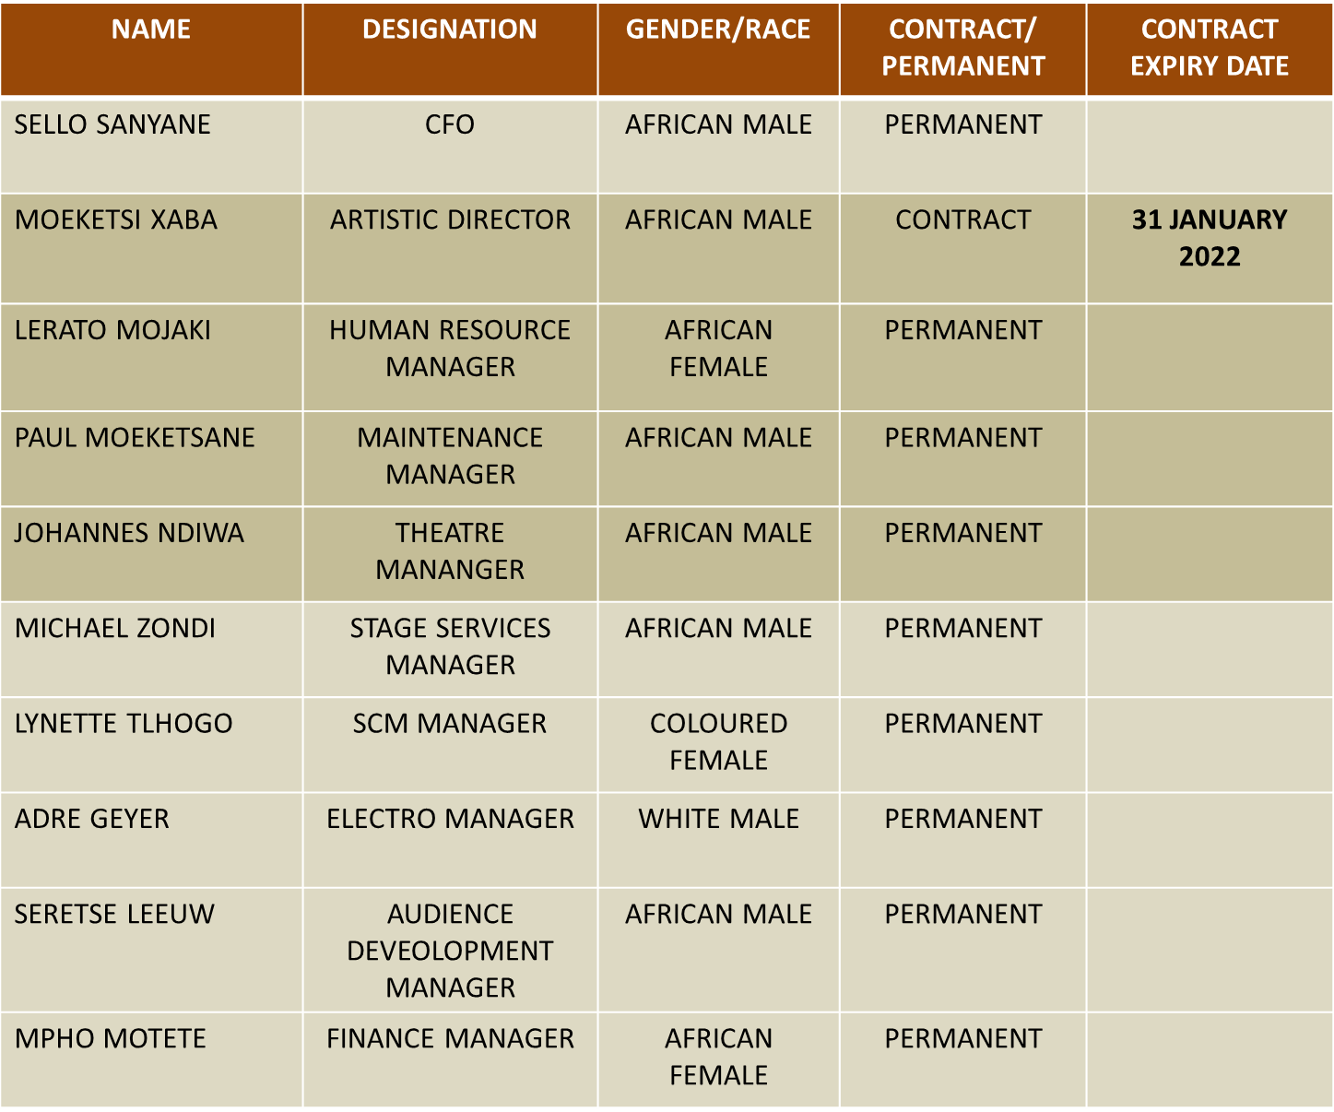
COMPOSITION OF MANAGEMENT

Slide 20
COMPOSITION OF STAFF
TOTAL STAFF COMPLEMENT | GENDER |  | RACE
 | Male | Female | B | C | I | W
75 | 46 | 29 | 66 | 3 | 0 | 6

Slide 21
OVERSIGHT ACTIVITIES
 | 2014/15 | 2015/16 | 2016/17 | 2017/18
Number of Council members | 7 | 7 | 8 | 9
Number of Council meetings | 2 | 6 | 8 | 8
Number of Council committee meetings | 4 | 2 | 7 | 12
Attendance rate of Council meetings | 75% | 85% | 80% | 90%
Number of Audit Committee meetings | 2 | 1 | 2 | 7
Number of Management meetings | 18 | 8 | 8 | 4
Number of Staff meetings | 7 | 11 | 10 | 5
.

Slide 22
CHALLENGES
The biggest threat at this entity is the on going labour issues that leads to litigation which continue to bear a negative impact on the entity’s constrained budget which is perpetuated by the failure to follow correct labour procedural processes.

Slide 23
THANK YOU

