Slide 1
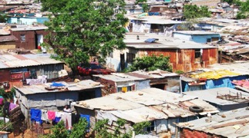
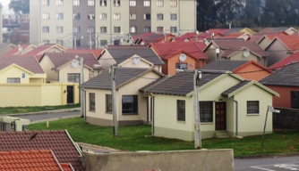
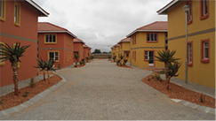
Proposed Departmental Responses - SONA 2018
24th April 2018

Slide 2
SONA Impact On Human Settlements
Although no specific references to the Human Settlements and Housing was made by the President in SONA 2018, it is important to note that given the integrated, collaborative and coordinated work of the State and Government – The Department plays a key role in a number of the strategic areas highlighted by the President.
Key areas of work being udertaken as part of the Department mandate impacts on the overall strategic objectives of government related to the eradication of poverty, inequality and unemployment as well as socio-economic transformation.
The policies, legislation and implementation frameworks of the Department are designed to ensure that the key mandates of government are integrated into the oututs and outcomes achieved.

Slide 3
Human Settlements Measures In Support of SONA
4. The Human Settlements Development Grant and Urban Settlements Development Grant Frameworks ensure that the key priorities are addressed and these include
4.1. Monitoring and reporting on set asides related to procurement awards to women, youth, military veterans and persons with disabilities
4.2. Investment in socio-economic infrastructure which takes steps to eradicate asset and infrastructure inequality and this includes building of libraries, fire stations, community centres, energy, roads and transport infrastructure
4.3. Ring-fenced funding for Distressed Mining Towns and Labour Sending Areas
4.4. In the City of Cape Town USDG funds have been allocated to assist mitigation measures related to the drought.
4.5. The objective of the title deeds programme is to promote and foster an increase in household wealth which promotes eradication of poverty and inequality.

Slide 4
Human Settlements Measures In Support of SONA
5. The Department is in the process of finalising a concept framework on the matter of ensuring a contribution to student accommodation. However following to be noted:
5.1. Department has faciltated the provision of bulk and link services through the USDG allocation to Ethekwini to allow for the Mangosotho University of Technology to commence with the expansion of its student residences.
5.2. Social and Rental Funding has provided for the upgrading of buildings in Braamfontein through both the SHRA and GPF which has provided the impetus for private sector investment into the area for Social and Rental Housing.

Slide 5
Human Settlements Measures In Support of SONA
6. The Department is through the Catalytic Projects Programme, Distressed Mining Towns Intervention and the Employer Assisted Housing Programme ensuring the private sector funding is crowded in therefore promoting public-private partnerships to encourage into government programmes.
7. The Director-General has directed that the Department improves its Youth and Women Empowerment Programmes by ensuring it is underpinned by a clear strategy with concrete outcomes within the clear coordination framework – Prensently programmes include the EAAB One Learner – One Agency Partnership, the NHBRC Training Academy, the Scholarship Programme, the Youth Brigades but Provincial and Municipal Programmes are excluded and therefore much is being done but it is disparate and uncoordinated.

Slide 6
Human Settlements Measures In Support of SONA
8. In order to assist in improving the sustainability of SMME’s, the Department has already initiated monitoring mechanisms to ensure payment within the required 30 day period as provided in the PFMA – The Department presents to MinMec a Provincial overview of compliance.
9. In support of ensuring matters related to land and property as a resource is utilised as a measure of socio-economic transformation, a Joint Coordinating Committee was established in 2010 consisting of representation of Public Works, Public Enterprises, Rural Development and Land Reform and CoGTA – Its terms of reference includes state land is sourced and released for purposes of housing and human settlements and report is being prepared for Minister to present to Cabinet on progress as well as measures for improvement – HDA is being positioned to provide assistance to Deparment and Sector in relation to the identification and acquisition of urban land and property.

Slide 7
Human Settlements Measures In Support of SONA
10. Focus of Departmental Catalytic Projects Programme is to eradicate the stubborn effects of the inherited racial, class and I ncome spatial planning patterns within housing and human settlements – Imperative that this programme is supported by a progressive and radical land and property transformation agenda which will ensure that state is able to fund and implement projects.

Slide 8
Discussion

