Slide 1
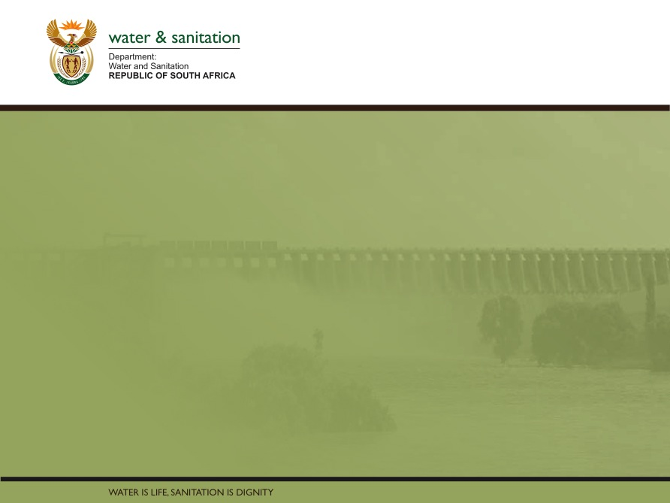
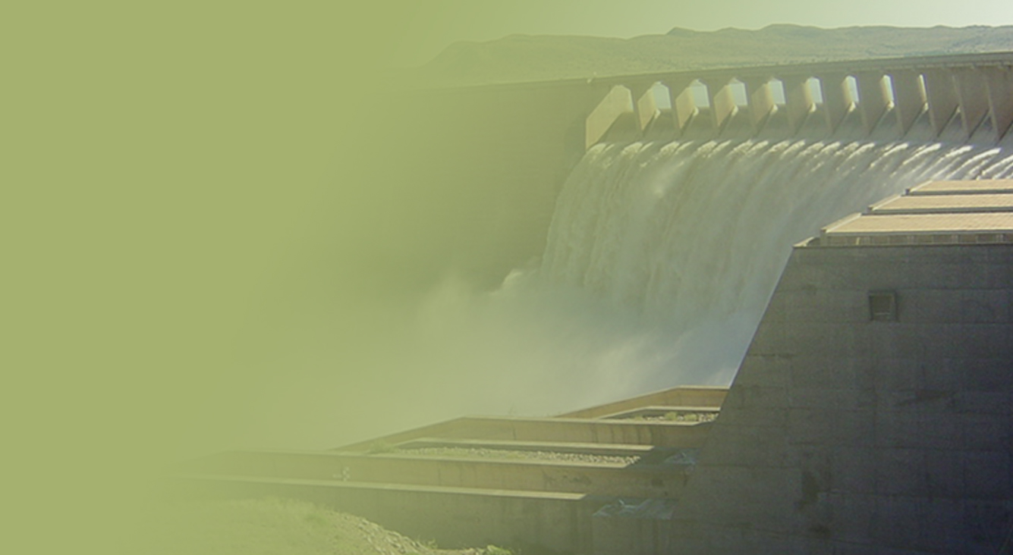
REGIONAL BULK INFRASTRUCTURE IMPACT ON SERVICE DELIVERY
Date: 26 March 2018
PRESENTATION TITLE
Presented by:
Name Surname
Directorate
Date

Slide 2
Table of Content
RBIG Background and Progress
Projects Completed and impact per region
RBIG projects Implemented during 2017/18
Projects that require Co-Funding from Municipalities
Impact to APP on 2017/18 target
Impact of Funding on Bulk Projects
Impact on service delivery
Proposed Solutions

Slide 3
RBIG Background and Progress
The programme started in 2007/8 financial year, as schedule 7 which was subsequently changed to schedule 6 of Division of Revenue Act (DoRA)
A total of 67 projects has been completed since inception until the end of 2016/17 financial year (below is the breakdown per financial year and project list completed)
R3.9 billion was spend by the programme to complete the 67 projects
For 2017/18 financial 97 projects are implemented with 26 projects planned for completion at the end of financial year
5 projects has been completed up to the end of quarter 3 (December 2017)

Slide 4
Projects Completed in EC and Impact
Province & Name of
Total Project
Year
Project Description/beneficiaries/ Location
Scheme
cost
(million)
completed
Eastern Cape
Tsomo Northern B
ulk
R
9
.
701
20
12
/
W
ater
S
upply
13
The project supplied
water (benefitted) to some 1,046 households
in the rural villages in Ward 3, 17 and 19, IntsikaYethu Local
Municipality
(Chris Hani DM)
Kwahange, Gwadela, Mission F, Gxwalimbomvu, Matintela C,
Mission C, Ngwemnyama G, Emzantsi A,
Jara A, Ngcongcolorha A
Coffee Bay B
ulk
W
ater
R93.951
2011/12
The project provided services (benefitte
d) at RDP level to a total of
S
upply
3,388 households
in 32 villages
(O.R.Tambo DM)
Kukham, Erini, Bakaleni, Lutshini, Lalini, Qhogi, Magcalekeni,
Ekhohlo, Chibini, KuXwangu, Qulu, Lulaleni, Mthaleni, Kulogusha,
Kwangxala, Nyandeni, Xhibeni, Ntilini, Nqayiya, Gxojeni,
Kugqwangushe, Jumistile, Macelwini, Kubhuba, Gumeni,
Zithandele, Bunene, Manangeni, Mzongwaneni, Zinkawu, Kwakiti,
2015/16
Zidindi, Hole in th
e wall
Quick
-
Mount Ayliff Bulk Water
R188. 752
wins were identified for the project for the short to medium
Supply Scheme
term by identifying 4 weirs and pipeline to the current Mount Ayliff
water infrastructure. The sources of water were identified as the
Siroqobeni, Ndikini and Nkanji rivers to the North Wes
t of the town
in the Ntsizwa Mountains. A total of 5110 household (
Alfred Nzo
DM
)
Ibika Water supply
R64. 796
2015/16
The primary focus of this project is to make potable water services
(Phase 1)
available to the residents of the project area by means of providing
bulk services. Design and construction of a water supply scheme
covering the villages located on the right
-
hand
-
side o
f N2 national
route bounded by the Xhobani River on the west and Gosaxi River
on the east all the way down to the Indian Ocean and also to
Centane town and its surrounding rural settlements. A total of
6515 household (
Amathole
DM
)
Mncwasa Bulk Water
R125. 539
2015/16
The purpose of this project is to supply water to an area which
S
upply
stretches 15 km inland from the Wild Coast belt and used to be
part of the former Transkei area. There is very little urban
development with no towns within this area
which consists of 54
rural coastal type villages. Water for domestic use in the area was
drawn from surface water sources, i.e. streams, rivers and other
open water sources. There was generally no existing water
infrastructure in the rural villages within
the project area. A total of
6063 household (
Amathole DM
)
Steytlerville Water Supply
R93.251
2016/17
The project aims was to increase the capacity of the water supply and
Scheme
to provide a water treatment works for the town of Steytlerville
(
Sarah
Baartman
DM
). A total of 1676
household
is benefiting
from the project.

Slide 5
Projects Completed in FS and Impact
Province & Name of
Total Project
Year
Project Description/beneficiaries/ Location
Scheme
cost
(million)
completed
Free State
Edenville B
ulk
W
ater
R14.710
2011/12
This project suppli
ed water (benefitted) to some 880 households
in
S
upply (Ngwathe)
the Edenville area
(
Fezile Dabi DM)
Jagersfontein/
R75.771
2012/13
Phase 1 suppli
ed water (benefitted) to some 2,690 households
in
Fauresmith B
ulk
W
ater
the Jagersfontein, Fauresmith and surrounding villages
(
Xhariep
S
upply
Phase 1
DM)
Tokologo Regional Water
R123.496
2013/14
The project provided services (benefitted) at RDP level to a total of
Supply Phase1
2
,240 households in
Hertzogville
(Lejweleputswa DM)
Dihlabeng Bulk Water
R73.488
2013/14
The project provided services (benefitted) a
t RDP level to a total of
Supply
2,828 households in
Paul Roux and
Fateng
-
tse
-
Ntsho
(
Thabo
Mofutsanyane DM)
Sterkfontein Dam Bulk
R272.146
2013/14
The project provided services (benefitted) a
t RDP level to a total of
Water Supply Scheme
48,321 households in
Maluti
-
a
-
Phofung
LM
(
Thabo Mofutsa
nyane
Phase 1 and 2
DM)
Tshiame A,B,C&D, Mokgholokweng, Diyatalawa, Uniqwa, Ha
-
Rankopane, Mphatlatlatsane, Phutaditjhaba, Phamong, Kestell
A&B, Tlhlolong, De Bult, Bluegum Bosch,
Makwane, Matshekgeng
,
Lusaka, Tebang, Pereng, Qholoqhwe
Moqhaka Bulk Sewer
R105. 000
2015/16
The aim of the project was to upgrade and the rehabilitation of the
waste water treatment works in Kroonstad
. A total of
2222
households
(
Fezili Dabi
DM
)
Wesselsbron
R45.999
2016/17
The project entails the
construction of a new 4,5M?/day waste
/Monyakeng ( Nala)
water treatment works
.
A total of
6871
households
(
Lejweleputswa
DM
Bulk Sewer
)

Slide 6
Projects Completed in GP and Impact

Slide 7
Projects Completed in KZN and Impact
Province & Name of
Total Project
Year
Project Description/beneficiaries/ Location
Scheme
cost
(million)
completed
KwaZulu Natal
Middledrift (Nkandla)
R29.363
2013/14
The project provide services (benefitted) a
RDP level to a total of
Water Treatment Works
2,600 households in
Nkandla/ uMlalazi
LM’s
(uThungulu DM)
Hhalambo, Izindlozi, Magwaza, Mangidini, Ezilozini, Ntolwane,
Hlwehlwe 1, Hlwehlwe 2. Mathwasana, Silambo, Sonani,
May’thanqaza, Stilo
Driefontein Complex Bulk
R123.853
2014/15
The project provide services (benefitted) a
t RDP level to a total of
Water
Scheme
20,633 households in
Emnambithi
LM
(uThukela DM)
Watershed, Driefontein, Randjieslaagte, Kleinfontein, Doornhoek,
Watermeet, Klipfontein, Klipriver NU,
Burford, Kirkentulloch, Peace
Town, Hobsland, Nkunzi, Matiwane
Emadlangeni Regional
R50.994
2012/13
The project provided services (benefitted) a
t RDP level to a total of
Bulk Water Scheme
12
,6
67
households in
Emadlangeni
LM
(Amajuba DM)
Newcastle:
Johnstown, Leslie,
Jackalspan, Claremont, Witteklip,
Dicks Halt, Majorisu, Soul City.
Utrecht:
Amatungwa, Berouw,
Utrecht Town, 1000 new sites
Hlabisa Bulk Water
R198.945
2014/15
The project provided services (benefitted) at RDP level to a total
of
Supply
1
4,00
7 households
in Hlabisa and Ezibayeni
.
(uMkhanyakude
DM)
Greater Eston Water
R
204
Greater Eston Project provide 41 240
.
87
2
2015/16
people with an assured supply of potable water. The scheme will
Scheme
cover four (4) wards in the Mkhambathini LM and two (2) wards in
the Richmond LM. This project forms part of the UMDM’s ISDP and
WSDP and aims to make a huge impact alleviating in the water
supply backlog within the rural areas of UMDM
.
A total of 2
556
households
(
Umgungundlovu
DM
)
Greater Bulwer
R343.
337
2015/16
This Emergency Intervention includes
the construction of a weir
Donnybrook Emergency
(which would have been part of the Bulwer (Stephen Dlamini) Dam
Phase 1
implementation), a package water treatment plant and pump
station, as well as a bulk pipeline feeding Bulwer Town and a 2 M?
reservoir which are also part of the Gre
ater Bulwer Donnybrook
Regional Bulk Water Supply Scheme.
A total of 25 265 households
(
Harry Gwala
DM
)

Slide 8
Projects Completed in LP and Impact
Province & Name of
Total Project
Year
Project Description/beneficiaries/ Location
Scheme
cost
(million)
completed
Limpopo
Groblersdal / Luckau
R30.580
2010/11
The project supply water (b
enefitted) to some 21,905 households
BWS
to several communities situated on the road from Groblersdal to
Nebo. The project covers Tafelkop and other villages such as
Legolaneng, Maruleng, Kga
-
Phamadi, Motsephiri, Luckau,
Sephaku, Vlakfontein, Maretheng and Nkadimeng
(Greater
Sekhukhune DM)

Slide 9
Projects Completed in MP and Impact

Slide 10
Project Completed in NC and Impact
Province and Name of the Scheme/Project Name | Total Project Costs(million) | Year Completed | Project Description/Beneficiaries/Location
Northern Cape
Replacement of Namakwa Bulk Water Supply Phase 1 | 648 312 | 2016/17 | The primary primary problem on the complete system is age and lack of extensive maintenance over a long period of time. The main supply system is now in excess of 30 years old and has reached the end of its economic lifecycle.
Tsantsabane Waste Water Treatment Works and Water Supply | 45 439 | 2011/2012 | The project supplied services (benefitted) to some 5,617 households in the towns and settlements of Jenhaven, Postmasburg, Groenwater (Metsimatala) and Skeyfontein
Riemvasmaak BWS | 3 069 | 2011/2012 | The project supplied water (benefitted) to some 343 households in the Riemvasmaak and Sending areas
Colesberg Waste Water Treatment Works Oranje river - Colesberg Bulk Water Supply | 15 592 120 878 | 2012/2013 2014/15 | The project provided sanitation and water services (benefitted) at RDP level to a total of 4,773 households in Ward 3, Ward 4 and Ward 5 2,354 stands in the Ouboks Development Umsobomvu LM

Slide 11
Project Completed in NC and Impact
Province and Name of the Scheme/Project Name | Total Project Costs(million) | Year Completed | Project Description/Beneficiaries/Location
Northern Cape
Norvaispont Bulk Water Supply | 12 611 | 2016/17 | The proposed bulk water supply scheme includes four components namely to upgrade the abstraction works on the banks of the Orange River, replace the existing asbestos cement pipeline upgrade of the WTW and to the increase capacity and elevation of the bulk storage facility
Riemaak Bulk Water Supply | 3 069 | 2011/2012 | The project supplied water (benefitted) to some 343 households in the Riemvasmaak and Sending areas
Strydenburg Groundwater Project | 21 018 | 2015/2016 | The project is for exploitation of groundwater in Strydenburg to maximum potential, additional 377 m³ / day, and supplement with surface water if necessary. A total of 976 households
Niekerkshoop Bulk Water Supply | 9 424 | 2014/2015 | The project provided services (benefitted) at RDP level to a total of 444 households in Niekerkshoop in the Siyathemba LM

Slide 12
Project Completed in NC and Impact
Province and Name of the Scheme/Project Name | Total Project Costs(million) | Year Completed | Project Description/Beneficiaries/Location
Northern Cape
Kathu Waste Water Treatment Works | 17 584 | 2014/2015 | The project provided sanitation services (benefitted) at RDP level to a total of 1 0714 households in Kathu and Sesheng in the Gamagara LM( John Taola Gaetsewe DM)
Noupoort Bulk Water Supply | 67 232 | 2016/17 | augment the existing groundwater by developing additional boreholes to provide adequate potable water to Noupoort Eurekaville and Kwazamuxolo and upgrading of the existing Noupoort bulk water supply network to meet the 2030 water
Kalahari East to Mier Water Pipeline Phase 1 | 172 647 | 2016/17 | The first phase of the implementation of the North Western extension of the Kalahari East Water Supply Scheme will supply water through the construction of a 161 km gravity main pipeline from the existing Kalahari East Scheme connection point to Philanders bron including branch pipelines to supply the towns of Askham, Andriesvale, Groot Mier, Klein Mier, Loubos and Rietfontein. A total of 976 households is due for benefiting

Slide 13
Project Completed in NC and Impact
Province and Name of the Scheme/Project Name | Total Project Costs(million) | Year Completed | Project Description/Beneficiaries/Location
Northern Cape
Heuningvlei / Moshaweng Bulk Water Supply | 142 340 | 2015/2016 | Heuningvlei is a multi use scheme that supplies water to both rural communities and stock farmers. The scheme was constructed 30 years ago and lacks a sufficient source. The project entails the identification of a sustainable source, the rehabilitation of the existing infrastructure, the construction of new boreholes reservoirs and the extension of the bulk and reticulation lines. total of 2 596 households is due to benefit
Thembelihle Bulk Water Supply | 27 714 | 2014/2015 | The project provided services (benefitted) at RDP level to a total of 2 902 households in the towns and surrounding suburbs of Hopetown, Strydenburg and Oranjerivierstasie , Thembelihle LM

Slide 14
Projects Completed in NW and Impact

Slide 15
Projects Completed in WC and Impact

Slide 16
RBIG Projects implemented in 2017/18
Schedule 5B
Region | Number of Municipalities
Eastern Cape | 3
Free State | 5
Gauteng | 0
KwaZulu Natal | 6
Limpopo | 1
Mpumalanga | 2
Northern Cape | 3
North West | 1
Western Cape | 2
Total | 23

Slide 17
RBIG Projects implemented in 2017/18
Schedule 6B
Region | Number of projects funded
Eastern Cape | 13
Free State | 15
Free State - BEP
Gauteng | 4
KwaZulu Natal | 1
Limpopo | 7
Mpumalanga | 5
Northern Cape | 7
North West | 7
Western Cape | 2
Total | 61

Slide 18
Projects that require Co-Funding from Municipalities

Slide 19
Scheme | Water Services Authority | Region | Project Status | Household | Co-funding Amount
Greytown Regional Bulk Scheme | Umzinyathi | KZN | Construction | 11 340 | 33 198 655
Ngcebo Regional Bulk (Lower Tugela) | iLembe | KZN | Construction |  | 527 324 000
Pongolapoort Bulk Water Scheme (Jozini) | uMkhanyakude | KZN | Construction | 16 200 | 717 523 000
Kuruman Bulk Water Supply | Ga-Segonyana | NC | Construction | 11 399 | 109 806 000
Kalahari East to Mier pipeline | Mier | NC | Construction | 2 421 | 298 730 777
Renosterberg BWS | Renosterberg | NC | Construction | 1 400 | 5 567 121
Noupoort BWS | Umsobomvu | NC | Construction | 2 217 | 21 038 763
Windsorton to Holpan Bulk Water Supply | Dikgatlong | NC | Construction |  | 12 183 817
Loeriesfontein BWS | Hantam | NC | Construction |  | 8 274 000
Upington WWTW | DawidKruiper | NC | Tender |  | 13 807 000
Greater Mamusa BWS | Dr Ruth Mompati | NW | Construction | 25 494 | 180 307 000
Taung/ Naledi BWS | Dr Ruth Mompati | NW | Construction | 37 227 | 232 563 000
Wolmaransstad WWTW | Maquassi Hills | NW | Construction | 12 700 | 35 831 000

Slide 20
Scheme | Water Services Authority | Region | Project Status | Household | Co-funding Amount
Greater Bulwer Donnybrook Water Scheme | Harry Gwala | KZN | Construction | 23 729 | 164 337 984
Balf/Siyat/Greyl/Willem/Nthor BWS | Dipaleseng | MP | Designs | 12 636 | 59 070 927
BWS to Brandvlei (Hantam) | Hantam | NC | IRS |  | 9 340 000
Windsorton to Holpan Bulk Water Supply | Dikgatlong | NC | IRS |  | 11 865 977
Moretele South Bulk Water Supply | Moretele | NW | Construction | 39 022 | 189 041 000
Vanrhynsdorp Raw Water | Matzikama | WC | IRS |  | 45 282 241
Klawer Bulk Water | Matzikama | WC | IRS |  | 8 008 989
Graaf-Reinet Emergency WSS | Camdeboo | EC | Construction | 13 399 | 18 600 000
Westonaria WWTW (Zuurbekom) | Westonaria | GP | Construction | 45 000 | 948 480 482
Driekoppies Upgrading | Nkomazi | MP | Design |  | 39 764 634
Northern Nzikazi Bulk Water Supply | Mbombela | MP | Construction | 42 995 | 110 185 800
Sibange BWS | Nkomazi | MP | Design |  | 10 865 694
Upgrade of Delmas Waste Water | Victor Khanye | MP | Construction | 13 403 | 7 567 600

Slide 21
Scheme | Water Services Authority | Region | Project Status | Household | Co-funding Amount
Upgrade of Botleng Waste Water | Victor Khanye | MP | Construction | 12 998 | 5 765 800
Warrenton Water treatment works | Magareng | NC | Tender |  | 11 447 316
Bulk water supply to Porth Nolloth | Richtersveld | NC | Tender |  | 15 037 723
Ritchie BWS | Sol Plaatje | NC |  |  | 8 547 000
Warrenton Water treatment works | Magareng | NC | Tender |  | 14 751 230
Marydale BWS | Siyathemba | NC | IRS |  | 1 210 000
Douglas WTW | Siyancuma | NC | Design |  | 11 097 000
Kathu BWS | Gamagara LM | NC | IRS |  | 42 987 000
Madibeng Bulk Water Supply | Madibeng | NW | Construction | 75 373 | 208 000 000
Calitzdorp & Ladismith WWTW | Kannaland | WC | IRS |  | 6 808 692
Kannaland Dam Relocation | Kannaland | WC | IRS |  | 50 104 082
Clanwilliam WTW | Cederberg | WC | IRS |  | 21 374 917
Beaufort West Bulk Water | Beaufort West | WC | IRS |  | 14 282 864
Total |  |  |  | 398 953 | 4 229 979 085

Slide 22
Bulk Projects without Reticulation

Slide 23
List of Bulk Projects without Reticulation
Province | No. of Projects | List of Projects
Limpopo | Seven (7) | Nebo Bulk Water Scheme (Sekhukhune DM) Moutse Bulk water Scheme (Sekhukhune DM) Mogalakwena Bulk Water Scheme (Waterberg DM) Sinthumule Kutama Bulk Water Augmentation (Vhembe DM) Mametya Sekororo Water Resources Development Project (Mopani DM) Olifants River Water Resources Development (Sekhukhune DM) Nkambako/Bambanana Bulk Water Project (Mopani DM)
Northern Cape | Four (4) | Namakwa Bulk Water Supply (Namakwa DM) Kuruman Bulk Water Supply (John Tsaolo Gaetsewe DM) Noupoort Bulk Water Supply (Pixley Ka Seme DM)- new project added Douglas Bucket Eradication Project (Pixley Ka Seme DM)

Slide 24
List of Bulk Projects without Reticulation
Province | No. of Projects | List of Projects
Eastern Cape | Six (6) | Mbizana Regional Bulk Water Supply (Alfred Nzo DM) Xhora Bulk Water Supply (Mbashe LM) Ibika Bulk Water Supply (Amathole DM) Cluster 4 Bulk Water Supply (Chris Hani DM) Cluster 6 Bulk Water Supply (Chris Hani DM) Water Supply to Mthata (OR Tambo DM)
KZN | Two (2) | Pongolapoort Bulk Water Supply (UMkhanyakude DM) Hlabisa Bulk Water Supply (UMkhanyakude DM)

Slide 25
List of Bulk Projects without Reticulation
Province | No. of Projects | List of Projects
North West | Eight (8) | Upgrade of Huhudi Waste Water Treatment Plant (Dr Ruth Segometsi Mompati DM) Matlosana Bulk Water Supply Upgrade (Dr Kenneth Kaunda DM) Groot Marico Waste Water Treatment Plant Upgrade (Ngaka Modiri Molema DM) Mamusa Bulk Water Supply (Dr Ruth Segometsi Mompati DM) Pilanesberg Bulk Water Supply (Bojanala Platinum DM) Moretele North Bulk Water Supply (Bojanala Platinum DM) Madibeng Bulk water Supply (Bojanala Platinum DM) Ratlou Bulk Water Supply (Ngaka Modiri Molema DM)

Slide 26
IMPACT ON APP 2017/18 TARGETS

Slide 27
Projects in the APP affected by reprioritisation – (Construction)
EASTERN CAPE - 13 PROJECTS
NDLAMBE BLK WAT SUP (RWSS)
XHORA EAST BLK WAT SUPPLY
GRAFF-REINET EMG WT SUP SCH
SUNDAYS RIVER BK WT SUP(PAT
MATATIELE BLK WAT SUPPLY
NOOITGEDAGT BLK WAT SUPPLY
SUNDWANA WAT SUPPLY
JAMES KLEYNHANS BULK WATER SUPPLY
BELMONT WASTE WAT TREAT WRK
MAYFIELD WASTE WAT TRET WRK
MOUNT AYL BK PER URB WT SUP
-MAKANA BLK SEWER
NGQAMAKWE WAT SUPPLY

Slide 28
Projects in the APP affected by reprioritisation - (Construction)
Free State - 15
TOKOLOGO REG WAT SUPLY (P2)
DIHLABENG BLK WAT SUP (PH2)
-MATHJABENG BLK SWR(WELKOM)
-WELBEDACHT PIPELINE
ROUXVILLE OUTFALL SEWER
JAGERSFONT /FAURESMTH:BW(P2)
PHUMELELA BLK WAT SUP PHAS2
MOQHAKA BW(STRYN KRNS WT P1
TSWELOPELE BLK WAT SUP PH1
MALUTI-A-PHOFU BK WT SUP P2
MAFUBE BLK SEWER PHASE 1
MASILONYANA BK SEW (BRNDFRT&WNBR
MANTSOPA BLK SWR(LADYBRAND)
NKETOANA BLK WAT SUP PHAS 1
NGWATHE BLK SEWER PHASE 2

Slide 29
Projects in the APP affected by reprioritisation - (Construction)
Gauteng - 4
MEYERTON WSTEWT TRE WRKS P1
SEDIBENG BULK REGIONAL SEWR
SEBOKENG WST TRE WRKS PH1&2
WEST/RANDF REG BWT(ZUURBKM)

Slide 30
Projects in the APP affected by reprioritisation - (Construction)
Limpopo - 7
GIYANI BW REL P1(NANDN NSAM
SINTHUMULE KUT BK WT AUG P3
MOUTSE BLK WAT SUPP PHAS1-5
MAMETYA SEKOR BLK WT SUP P1
MOGALAKWENA BLK WT SUP PH 1
MOOIHOEK/TUBATSE BLK WTER S
NEBO BULK WATER SUPPLY

Slide 31
Projects in the APP affected by reprioritisation - (Construction)
Mpumalanga - 7
NORTH NZIKAZI BLK WT SUP P1
EMALAHLENI BLK WAT SUP PH 2
THEMBISILE WAT SCHM(LOSKOP)
SIBANGE BLK WAT SUP PHASE 1
DRIEKOPPIES BLK WAT SUP UPG
UPG DELMAS WASTWT TR WRK P2
UPGR BOTLENG WASTEWT TR WRK

Slide 32
Projects in the APP affected by reprioritisation - (Construction)
Northern Cape - 9
BREIPAAL PUMPSTATION (NEW)
LOUISVALE PUMPSTATION (NEW)
LOUISVALE PUMPSTATION (REFURB)
KAKAMAS WASTEWAT TREAT WRK
WINDSORTON-HOLPN BS P1 (PLN
MARYDALE BLK WAT SUPPLY
UPINGTON WASTEWAT TREAT WRK
WARRENTON WAT TREATMENT WRK
DOUGLAS WAT TRETM WRK UPGR

Slide 33
Projects in the APP affected by reprioritisation- (Construction)
North West (9
MADIBENG BLK WAT SUP PHAS 2
MORETELE BK WT SUP P1(KLPD)
MAFIKENG STH BW P2(UPG WTW)
RATLOU BLK WT SUP P1(SETLAG
WOLMARANSSTD WASTWT TR WRK
TOKWE - POTCH WATER TREATMNT WRKS UPGR
MORETELE BLK WAT SUP(NORTH)
KOSTER WASTEWAT TRET WRK UP
VENTERSDORP BLK WAT SUPPLY

Slide 34
Projects in the APP affected by budget cuts- (Due for Completion)
Region | Projects
Eastern Cape | (2) Xonxa BWS
 | Matatiele BWS
Limpopo | (9) Sekhukhune BWS Phase 7,8,9,10,11, 12 & 15 (i.e 7 Phases)
 | Moutse BWS Phase 1 and 5 (i.e 2 Phases
North West | (4) Ratlou BWS phase 2 (Madibogo)
 | Mafikeng South BWS Phase 2 (upgrade WTW)
 | Wolmaransstad WWTW
 | Tlokwe WTW Phase 1 (Potchefstroom)

Slide 35
Projects in the APP affected by budget cuts- (Due for Completion)
Region | Project Name
Free State | (2) Maluti-a- Phofung BWS Phase 2 of 4
 | Mafube Bulk Sewer Phase 1 of 2 (Frankfort)
Western Cape | (1) Paarl Bulk Sewer Phase 3 of 3

Slide 36
IMPACT OF FUNDING ON BULK PROJECTS
Inadequate funding for RBIG projects
Budget cuts over last two financial years , delays the implementation and prolonged completion of projects which impacts on the APP
Emergency interventions including ministerial projects initially not budgeted for has a negative impact on the budget for planned projects.
Budget/funding reprioritised and re-allocated from RBIG to Bucket eradication programme impact on programme performance
Increase of accruals on the new financial year(vicious cycle)
Inability of municipalities to co-fund infrastructure projects
Misalignment of Bulk and reticulation
Delays by municipalities in implementing projects
Lack of operation and maintenance by the municipalities resulting in projects dilapidating
Unforeseen interventions(drought)

Slide 37
IMPACT ON SERVICE DELIVERY
Possible litigations due contractors vacating site
Community unrests
Standing time resulting in fruitless and wasteful expenditure
Project cost escalations
Delayed completion of projects
Vandalism of infrastructure
Budget shortfall over the MTEF

Slide 38
PROPOSED SOLUTIONS
The departments should focus on its mandate
Alignment of government infrastructure programmes to accelerate service delivery
Finalisation of the Water and Sanitation master plan
Strengthen the Departmental Leadership and Regulatory role within the Sector
Engage NT and COGTA to explore funding model for Operations and Maintenance for local government
Institutional reform at local government

Slide 39
THANK YOU

