Slide 1

2018 Division of Revenue Bill
Select Committee on Appropriations
.
x
Presenters: Malijeng Ngqaleni, Wendy Fanoe, Dumebi Ubogu, Steven Kenyon and Sadesh Ramjathan
Intergovernmental Relations, National Treasury
20 March 2018

Slide 2
Outline of the Presentation
Overview
Division of Revenue for the MTEF | Responds to SeCOA recommendation on the possibility of structural changes to LG revenue
Changes since the MTBPS
Rural and urban investment
Responding to disasters | Additional information requested by Chairperson
Capacity building and improving municipal performance | Responds to several SeCOA recommendations for improved capacity building
Changes to clauses of the Bill | Responds to FFC and SALGA recommendations
Provincial allocations | Responds to SeCOA recommendation on PES review
Local government allocations
Local government budgets and debts | Responds to SeCOA recommendations on municipal debt and budget oversight and request from the Chairperson for debt owed by each province
Responses to Recommendations
Annexures | More detailed responses to SeCOA & SCOA recommendations; technical changes to clauses; additional information on municipal debts

Slide 3












Consultation process before the Division of Revenue Bill is tabled (summarised)
Parliamentary Recommendations
Budget Council
Finance Minister & Finance MECs
Budget Forum
Budget Council members plus
Ministers’ Committee on the Budget
FFC
Recommendations
Mandate Paper
Political-level meetings
Technical meetings
Extended Cabinet
Meetings with national sector departments
Function groups
Discussion across programmes delivering related functions
MTBPS tabled in October - Includes proposed DoR and substantial changes to grants
Intergovernmental Technical Committees
National Treasury and Provincial Treasury officials and SALGA officials
Parliamentary hearings and recommendations on the MTBPS
MinComBud, Budget Council, Budget Forum and Cabinet consider
post-MTBPS changes
MinComBud Technical Committee
Senior officials from center of govt. departments
Division of Revenue Bill tabled on Budget Day in February

Slide 4
2018 MTEF Division of Revenue
Average annual growth is above inflation for all three spheres over the 2018 MTEF

Slide 5
2018 MTEF Division of Revenue
In the 2018 Budget Speech the Minister of Finance noted the following about the allocations to each sphere through the Division of Revenue:
  “Of course, we would like to be able to allocate more to each sphere for service delivery, and a larger share to local government, but the reality is that the rising cost of serving our national debt leaves less resources available to invest in services across all three spheres of government.”

Slide 6
The impact of debt-service costs on the Division of Revenue over the last 20 years
As debt-service costs declined in the 2000s fiscal space opened up, increased LG allocations were a major beneficiary
As debt service costs rise again, allocations to all 3 spheres are under pressure

Slide 7
Shares of the DoR including own revenues
The Division of Revenue is presented at the level of the “Main Budget” and does not reflect the substantial own revenues raised by municipalities and provinces
If these are included, local government accounts for about a quarter of the total revenue raised by the 3 spheres
Between 2013/14 and 2018/19, the local government’s share of all revenues raised by the three spheres fluctuates between 22% and 25%

Slide 8
Summary of changes to the Division of Revenue since the 2017 MTBPS
Baseline reductions by sphere of government, before funding fee-free higher education and training
R85 billion over 3 years reduced from expenditure announced in the MTBPS
  R18.4 billion from provincial transfers and R13.9 billion from local government
  This is before funding for free-fee higher education and training is added to the budget (for national)
Reductions as a percentage of total allocations is small: provinces = -1% and LG = -3.5% (before accounting for LG own revenues)

Slide 9
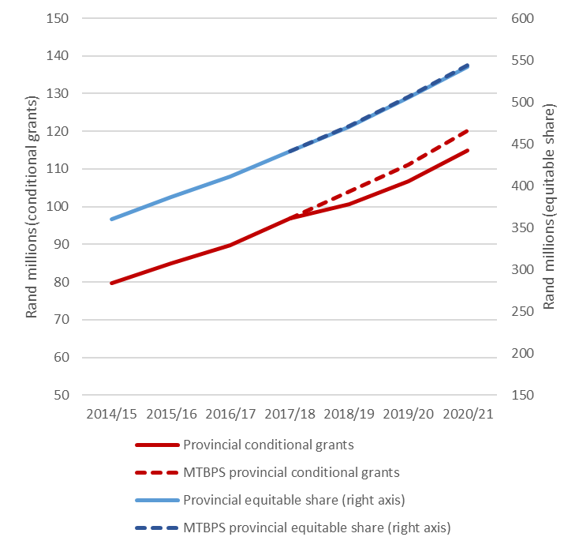
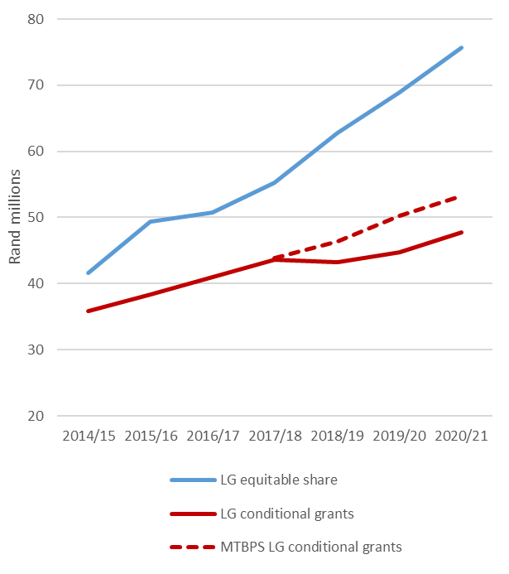
Perspective on the scale of changes since the 2017 MTBPS
Provincial transfers
Local government transfers
Equitable share (right axis)
MTBPS
Equitable share
Budget
MTBPS
Conditional grants
Budget
Conditional grants
Biggest impact of reductions is on conditional grants
Over the MTEF conditional grants still grow (but from a lower base than previously planned)

Slide 10
Which DoR transfers were reduced, and which were not?
Main impact of reductions was on infrastructure grants – will result in some delays to rollout of planned projects
Smaller reductions to provincial equitable share and current grants
Reduced
Provincial equitable share – reduction of 0.3%, provinces expected to reduce goods and services
Education Infrastructure Grant and School Infrastructure Backlogs Grant
Human Settlements Development Grant
Smaller provincial grants, including for libraries and the EPWP
Municipal Infrastructure Grant, Urban Settlements Development Grant, Public Transport Network Grant, Integrated National Electrification Grant
Water and sanitation specific grants – reduced by smaller proportions than other grants
Other local government grants including Financial Management Grant, EPWP etc.
Not reduced
Local government equitable share – fully funded to provide free basic services for 9.8 million households
National School Nutrition Programme Grant – provides meals to 9 million poor learners
Comprehensive HIV, Aids and TB Grant
Public Transport Operations Grant – funds bus subsidies for commuters
Learners with Profound Intellectual Disabilities Grant - to preserve access for intellectually challenged scholars
Human Papillomavirus vaccine grant reduces the incidence of cervical cancer in women
Some local government grants including the Energy Efficiency Demand Side Management Grant

Slide 11
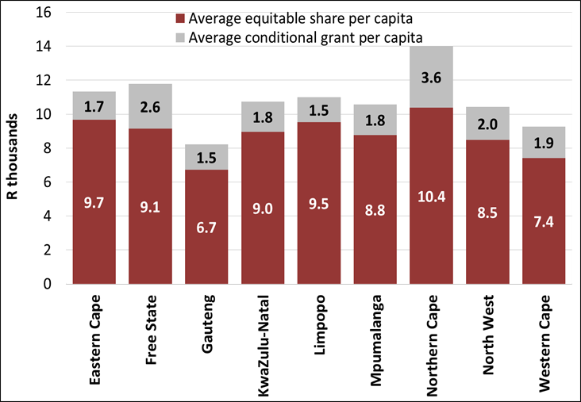
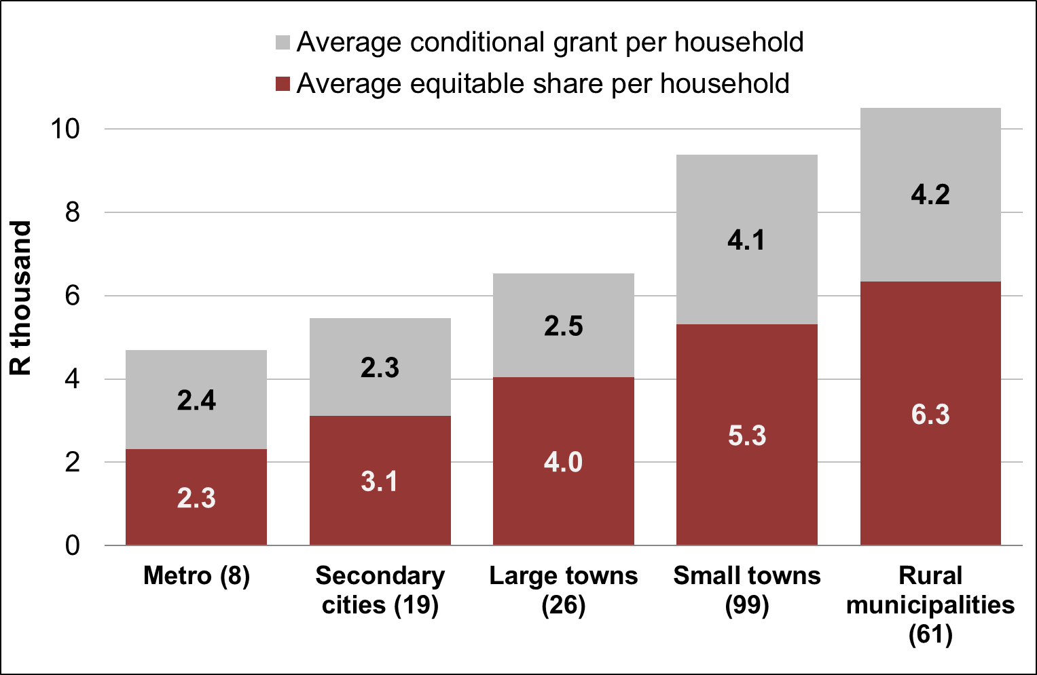
DoR remains highly redistributive in favour of rural areas
Provincial transfers per capita, 2018/19
Local government transfers per household, 2018/19
South Africa’s tax base is concentrated in urban areas
However, the allocations through the Division of Revenue transfer higher per capita/per household amounts to rural areas
  Allocations to rural municipalities of R10 500 per HH is more than twice as much as to metros (R4 700), due to metros’ higher own revenue raising abilities
  This indicates a division of revenue that is highly responsive to rural development even after reductions to some grants

Slide 12
Responding to disasters
Severe drought conditions are affecting several provinces (including the Western Cape, Northern Cape and Eastern Cape) and has now been declared a national disaster
Flood damage in KwaZulu-Natal also needs to be repaired, other disasters may occur
Provisions for disaster response in the 2018 Budget include:
  A provisional allocation of R6 billion in 2018/19 for drought relief and to augment public investment projects supported by improved infrastructure planning.
  Disaster relief grants for provinces and municipalities worth R423 million in 2017/18 and R479 million in 2018/19 can be rapidly released to assist in an emergency.
  The Division of Revenue Act allows for other conditional grant funds to be reallocated for disaster relief.
  If agricultural employment is seriously destabilised, government can temporarily increase intake on the Working for Water programme.
  New grants to fund emergency housing provision in the aftermath of a disaster.
South Africa is a water-scarce country. Given the risks associated with climate change, the country must reduce consumption and make greater use of groundwater and desalination. Municipalities need to reduce leakages from their reticulation networks
Consumers will have to adjust to paying tariffs that reflect the value of water as a precious resource

Slide 13
How disaster response funding will be allocated
Provincial and Municipal Disaster Relief Grants
Available for immediate release upon application to the National Disaster Management Centre (NDMC) who verify disaster assessments and request the release of funds from National Treasury
R74.9 million was allocated from these grants for drought relief in the Western Cape in August 2017
NT has approved the release of a further R348.8 million in drought relief funding for EC, NC and WC in 2017/18 (for ground water augmentation and agriculture). NDMC will transfer funds in March 2018
R472.8 million is available in these grants in 2018/19 (R84.7 million is already approved for agricultural drought relief in NC)
Disaster recovery allocations
  Infrastructure damaged in a disaster that must be repaired or rebuilt is funded either from the contingency reserve or through reprioritisations (allocated in the adjustment or main budget)
  Funds for provinces are usually ring-fenced within sector grants, municipal allocations are transferred through the Municipal Disaster Recovery Grant
  For example: flood damage in KwaZulu-Natal will be assessed for this funding
Funds from the provisional allocation
  Not all R6 billion announced in the Budget Speech is for drought-related projects, funds will also be allocated to other infrastructure projects assessed through the new Budget Facility for Infrastructure
  Will fund infrastructure needed to ensure the sustainability of long-term water supplies
  Section 6(1)(b) of the Appropriations Bill, 2018, allows for provisional allocations to be spent before the adjustments budget (but only once this Bill is enacted)

Slide 14
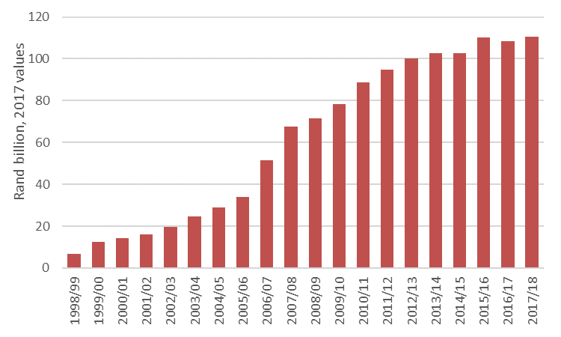
Improving the impact of transfers to municipalities
Transfers to local government have grown dramatically, 1998/99 to 2017/18 (real values)
Capacity support to municipalities is worth nearly R2 billion a year
Local government equitable share provides subsidies for the delivery of free basic services to 9.8 million households
Infrastructure grants fund the rollout of services to the poor (R41bn in 2018/19)
Are these investments translating into improved lives for poor South Africans?
The 2018 Budget Review highlights that some of the municipalities that gained the most from the new LGES formula introduced in 2013/14 seem to have invested more of their increased resources on increased salaries rather than expanded services
Increases for some DMs from RSC seem to have mostly been spent on salaries
We need to change what is happening within municipalities so that more of the benefit from national transfers reaches the residents in each municipality

Slide 15
Assisting the worst performing municipalities to turn around
Municipal failures include collapse of services and the inability to pay creditors
In the 2017 MTBPS government announced that we would introduce a new funding mechanism to support the implementation of recovery plans for municipalities in financial crisis
A new Municipal Restructuring Grant may be introduced from 2019/20:
  to support for the implementation of financial recovery plans
  municipalities must demonstrate commitment to implement necessary reforms before they access funding (including contain employee related costs, limiting non-priority spending, increasing revenue collection and adopting funded budgets)
  it will not bail out municipalities
If necessary, government may place municipalities under intervention
National Treasury will work with all stakeholders during 2018 to design the details of this programme, and ensure alignment of other capacity support

Slide 16
Division of revenue Bill clauses

Slide 17
Policy Changes in the bill clauses (1 of 2)
Municipal borrowing
National Treasury encourages the responsible use of municipal borrowing. We are currently reviewing the municipal borrowing policy.
The MFMA only allows municipalities to engage in long-term borrowing for capital spending, and does not allow national government to guarantee or bail out municipal debts
To promote better alignment with the MFMA, and in line with the FFC’s recommendation to “improve access to credit for large cities by allowing them to use their infrastructure grant funding allocations to leverage private capital” the following change is proposed:
  Clause 8(4) is changed to remove the approval of “pledges” against conditional grants
  Instead, credit-worthy municipalities can borrow in terms of the processes, criteria and safeguards set out in the MFMA, including public disclosure and requiring Council approval for loans
  The redrafted clause 8(4):
    In addition to the consultation already required in the MFMA, the transferring officer and provincial treasury must be consulted on any borrowing that includes grant funds
    Gives National Treasury the authority to prescribe how grant funds that have been borrowed against should be reported on
    Removes the effective 2-year limit on borrowing that includes grant funds, allowing for longer-term financing for infrastructure investment
  This is a small step to improve municipal borrowing. More measures will be set out once the review of municipal borrowing policy is complete

Slide 18
Policy changes in the bill clauses (2 of 2)
Addressing “underfunded mandates”
  Municipalities and SALGA frequently raise the problems of “unfunded mandates” and “underfunded mandates” which occur when a responsibility for performing a function is assigned/transferred to a municipality, without sufficient sources of funding
  Changes to the 2018 DoR Bill attempts to address one aspect of this problem:
  Often municipalities accept the responsibility to perform a function on behalf of a province and sign a service level agreement or memorandum of agreement that specifies how the province should compensate the municipality for performing the function, but the province does not follow through on transferring the agreed amounts
  A new clause 30(2)(d) requires that provincial treasuries must ensure that transfers to municipalities listed in the provincial budget must be aligned with the terms of any agreements between the province and municipality
  Clause 30(2)(a)(i) is also amended to note that the provisions in this section apply to functions funded through provincial own funds and conditional grants
Technical changes to 2017 Act
A number of technical changes are also made in the Bill. These are done largely to improve administration and other incidental matters, such as listing names of new grants; amending timeframes, etc. Details in the annexures to the presentation

Slide 19
Provincial allocations

Slide 20
Provincial Fiscal Framework: Summary
2 New grants and 1 augmentation
Title deeds backlog restoration grant to improve property market by eradicating long-standing backlog in title deeds registration associated with past beneficiaries of state-subsidised housing
Provincial emergency housing grant which should allow national government to respond to emergency housing situations quickly and flexibly
Community health services
Is lifted for integration into health services platform
New component into Comprehensive HIV, AIDS and TB grant is a step towards integrating community health care into the health services provision platform
  Over 2018 MTEF the equitable share grows at an average of 7.1%

Slide 21
Correction to the Early Childhood Development Grant framework
There is an error in the Early Childhood Development grant framework, where the threshold for the income-based means test was not updated to reflect the increase in the Child Support Grant from R380 to R405.
The reason is that the amendment of the Child Support Grant was only announced mid-February after the conditional grant framework process was already concluded.
Given the increase in the Child Support Grant, the income threshold in the grant framework needs to be changed from R45,600 for single parents and R91,200 for two parents to R48,700 for single parents and R97,200 for two parents.
  The error does not affect allocations per province, however it affects the number of children that are eligible for the Early Childhood grant subsidy
  National Treasury requests the Standing and Select Committees on Appropriations to recommend that the conditional grant framework be corrected as part of the gazette that will be issued in terms of section 16 once the Bill is enacted

Slide 22






Horizontal Division of Revenue: Provincial Equitable Share (PES) Formula
Education: 48%
Health: 27%
Basic: 16%
Institution: 5%
Poverty: 3%
Economic: 1%
Census 2011: school-age population (ages 5-17)
School Enrolment
Risk Adjustment: 75%
Hospital: 20%
Primary Health Care: 5%
Mid-year population estimates
Equally divided among provinces
Poor population: bottom 40% of 2010/11 IES & Midyear population
Regional GDP across provinces
The PES is a blunt budget allocation tool and should not be considered as prescriptive. In other words, because education is 48% of the formula does not mean it should translate to 48% of the budget.
Provinces are still responsible for roads and that is not in the formula.
The tool helps divide allocations to provinces while considering provincial responsibilities in order to allocate EQUITABLY AND FAIRLY USING RELIABLE, VERIFIED, AND OFFICIAL DATA.
PES Review continues in 2018/19
Notes:
The

Slide 23
Equitable Share formula review: Change implemented on Education Component
Education: 48%
2018: implementation of first recommendations from the PES review process
Education component consists of two subcomponents
  School Enrollment numbers & 5 – 17 Age cohort numbers
DBE has upgraded its approach to collecting school enrollment numbers
  Old approach of SNAP survey is replaced by the LURITS database
New data from LURITS is additionally phased over 2018 MTEF
Census 2011: school-age population (ages 5-17)
School Enrolment
SNAP Survey
  Education component previously used a survey to account for school enrollment numbers
  The survey was conducted on the 10th day after the start of a school year.
  DBE acknowledges this approach was prone to manipulation as there was no provision for easy tracking of scholars.
Learner Unit Record Information Tracking System (LURITS)
  Is an administration system that tracks scholars throughout their entire public schooling career
  It uses information from the SA School Administration and Management Systems used by public schools.
  This approach improves on accuracy, is less prone to manipulation and promotes easy detection of duplicates
  Envisioned work under the PES review for 2018
  Rural colloquium to address the urban–rural tension and how (if) it should bridge the contention in the equitable share (FFC leading efforts)
  Assessing the alignment of education subcomponents with sector policy
  Substantial revisions to health formula done in 2011. Data sources and weightings of subcomponents informed by NHI work will be the focus

Slide 24
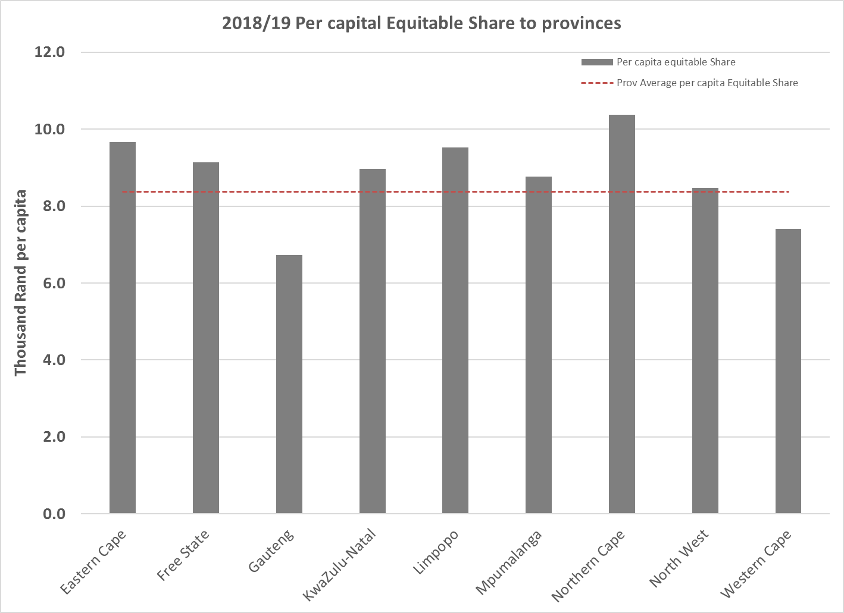
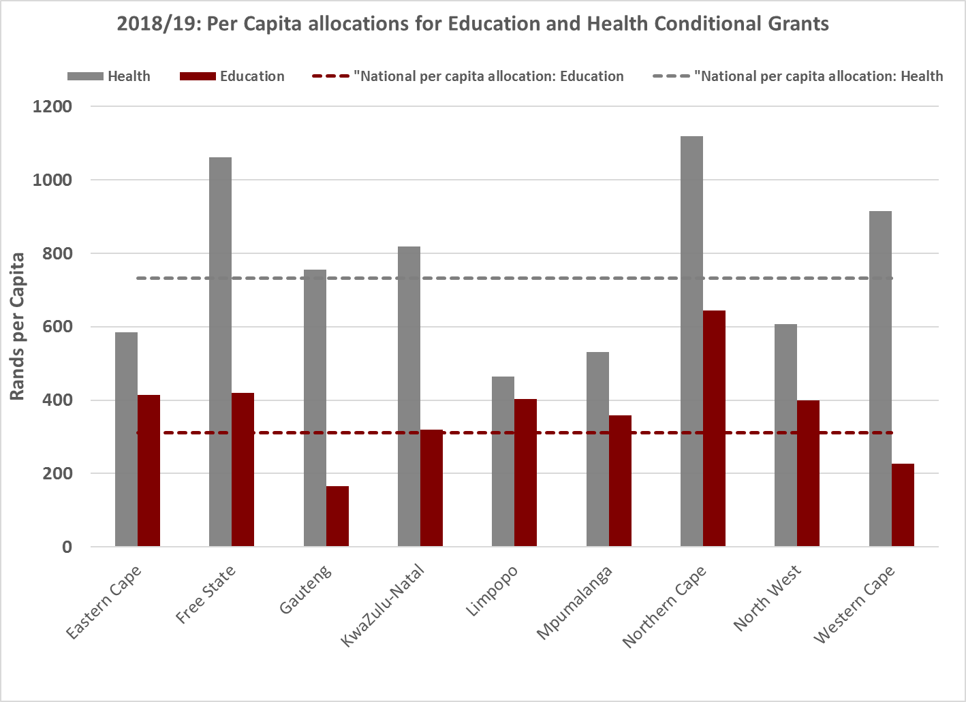
Pro-poor spending within the provincial fiscal framework
Education grants total R56 billion
The National School Nutrition Programme Grant provides meals to learners within the quintile 1-3 band. The NSNP and MST grants target those in quintiles 1-3 schools and the Learners with Profound Disabilities grant targets a specific marginalised group of learners with special needs.
Health grants total R133.8 billion
Delivery of health services is complex and therefore need a higher degree of national coordination. In addition, the burden of disease each province faces differs. As users of the public health sector are generally lower income households, health allocations are by nature pro-poor.
  Comprehensive HIV, AIDS and TB grant has allocations that are largely driven by relative HIV burden.
  The National Tertiary Services Grant allocations are concentrated in Gauteng and Western Cape.
    This level of care is more developed in urban areas and the grant compensates these hospitals for providing care to patients referred from more rural provinces.
Notes:
Comprehensive HIV and AiDS grant allocations are pro-poor as there is a well-established correlation between HIV and poverty.

Slide 25
Local Government allocations

Slide 26
Transfers to local government: summary
Additions to the local government equitable share over the 2018 MTEF (and in previous budgets) result in average annual growth of 10.4%
Reductions to grants mean a slight decline in allocations in 2018/19, but a return to growth over the MTEF
The net effect is that total transfers grow at an average annual rate of 6.9% over the MTEF

Slide 27
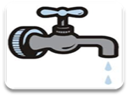



How the local government equitable share formula allocates funds
Allocated through a formula to ensure fairness for all 257 municipalities
The formula is updated annually :
  cost data to account for price increases (R500m in 2019/20 and R1 billion in 2020/21 remains unallocated to provide for possible further increases in bulk costs)
  estimates of household growth (in 2018/19 this data is based on the 2016 Community Survey)
The formula is fully funded to account for HH growth and cost increases over the MTEF
Unconditional transfer means that municipalities are accountable for ensuring free basic services are provided to their residents
How the local government equitable share formula works
Free basic services
R45.1 billion
R383 per month for a package of free basic services for the 59% of SA households with an income of less than 2 old age pensions per month
These funds are only allocated to poorer municipalities (some cities can fund these from own revenues)
Institutional
R4.7 billion to assist with administration costs
Community Services
R7 billion to fund community services

Slide 28
Supporting development in intermediate cities
Urban development reforms are moving beyond metropolitan municipalities into intermediate cites
  These cities face many spatial development challenges similar to metros
  Their economies have potential for more investment of own revenues in infrastructure
As part of the Integrated Urban Development Framework, the Department of Cooperative Governance is providing a programme of support to these cities
From 2019/20 we will introduce a new Integrated Urban Development Grant:
  Cities can apply to join the grant, and must meet minimum criteria (some cities may choose not to apply)
  There will be an incentive component to reward good performance (aligned to the FFC’s recommendations)
  The grant will be monitored against an integrated capital investment programme (rather than project-specific approvals required in MIG
  This will enable more integrated planning, and blending of own funding
  The grant will initially be funded through a repriotisiation of existing MIG allocations
In 2018/19 this approach is being piloted through a window in the MIG for 2 cities (uMhlathuze and Polokwane)

Slide 29
Other changes to local government grants
Public Transport Network Grant
Revised formula for this grant provides more stable allocations for smaller cities
Reductions over the MTEF will require an assessment of the viability of the design of some systems (the need for this was also recommended by the FFC)
A performance incentive component will be introduced in 2019/20
Bucket Eradication Programme
The programme to eradicate bucket systems in formal areas (as confirmed in 2015) will be completed in 2018/19. Just over R1 billion is ring-fenced for this within the indirect Water Services Infrastructure Grant and the Regional Bulk Infrastructure Grant
Municipal Demarcation Transition Grant
This grant ends in 2017/18 (in line with the FFC recommendation for a 3 year grant). A close out report will be submitted to Parliament by the Department of Cooperative Governance after the end of the financial year. Some funds for the completion of transition work have also been made available in the Municipal Systems Improvement Grant (indirect)

Slide 30
Local Government budgets & Debts

Slide 31
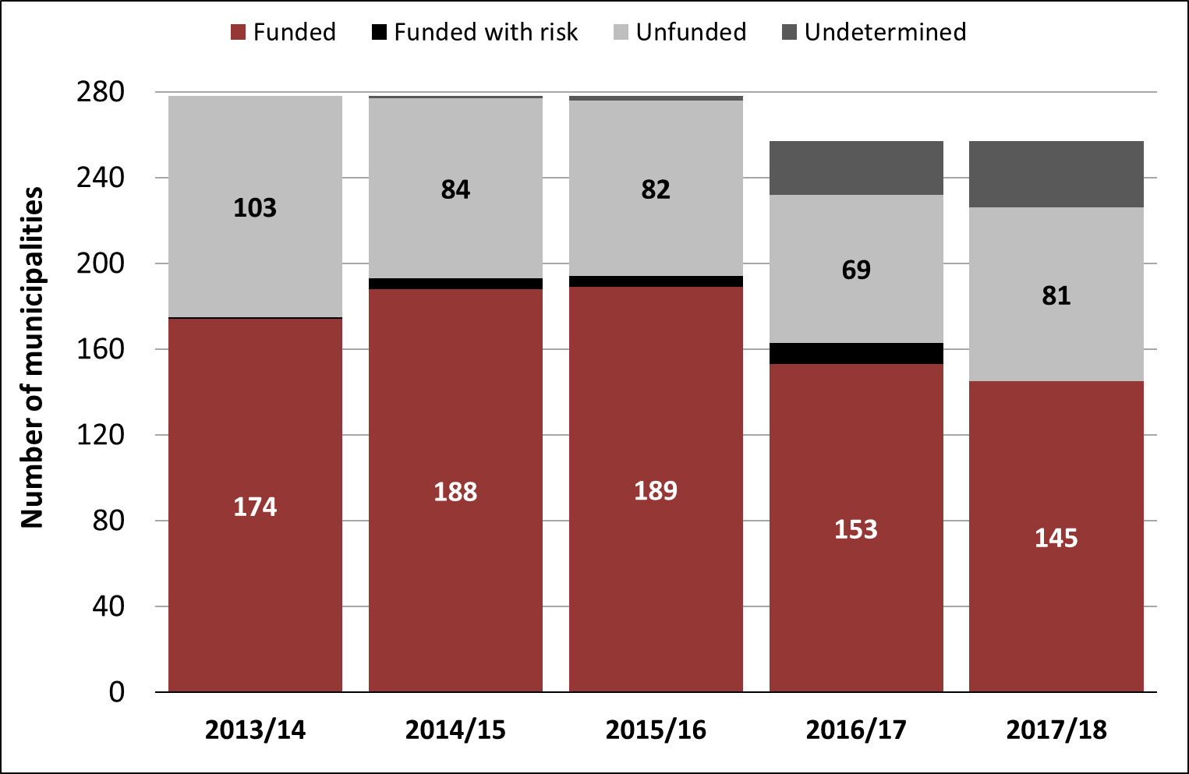
Unfunded municipal budgets
Municipal councils continue to adopt unfunded budgets
In 2017, only 125 munics tabled funded budgets, but after going through the budget benchmarking process with treasuries, the number increased to 145
But the problems run deeper. In 2017/18, 81 municipal councils voted to adopt budgets that they knew were not funded, making some form of financial distress inevitable.
Because local government is autonomous, elected councils are responsible for adopting credible budgets
Funded and unfunded municipal budgets*
*Based on assessment of adopted budgets. Where budget schedules are incomplete, assessments are reflected as “undetermined.” The number of municipalities decreased to 257 from 278 in 2016

Slide 32
Monies owed by municipalities for bulk supply
Political office bearers have been tasked to take this matter forward:
  IMC (Inter Ministerial Committee) – Political; chaired by Minister of COGTA
      decision-making on matters pertaining to electricity bulk supply
  The IMC is supported by an Inter Ministerial Task Team (IMTT) on technical level (DCoG, SALGA, DPE, DOE, NERSA, ESKOM chaired by DG: DCOG)
      attends to matters relevant to Constitutional, systemic and structural challenges with electricity reticulation
The MFMA S71 report as at 31 Dec 2017 shows that municipalities:
  Owe Eskom R16.2 billion (R16.0 billion as at 30 June 2017); and
  Owe water boards R7.3 billion (R6.9 billion as at 30 June 2017)
While the non-payment of municipal creditors continues to present a challenge the IMC and IMTT’s mandate has been expanded to include non-payment of water bulk supply

Slide 33
Monies owed by government to municipalities
To date, debts totaling R4 billion have been verified and departments have settled R1.6 billion of outstanding debts
MFMA Section 71 reports as at 31 December 2017:
  Provincial government owed R3,7 billion, a small decrease on the R4.0 billion reported as at 30 June 2017
  National government owed R2,9 billion, a small increase on the R2.5 billion reported as at 30 June 2017
It is recognised that the “culture of non-payment” threatens municipal financial sustainability
While progress is being made in reducing the total outstanding debt, this must be accelerated. The Minister of Finance, in his 2018 Budget Speech advised that NT’s DG “will issue a directive to all government departments and public institutions, instructing them to pay suppliers on time, or be charged with financial misconduct.”
National Treasury is collaborating with local government stakeholders to focus on efforts that will positively impact achieving municipal financial sustainability in the longer term

Slide 34
Debts to municipalities owed by each province
Free Sate has the highest debt owed to municipalities (as well as the largest amount over 1 year), followed by KwaZulu-Natal and the Northern Cape

Slide 35
Responses to recommendations on the Division of revenue

Slide 36
Responses to SeCOA recommendations on the 2017 DoRAB and MTBPS
Full responses to SeCOA and SCOA recommendations are provided in Annexure A to the Budget Review, and a summary in the annexures to this presentation
This presentation has already provided updates on recommendations for improved capacity building and oversight of municipal budgets, the review of the provincial equitable share formula and municipal debt
Other recommendations included:
  NT should ensure rollovers leave time for funds to be spent
    Rollovers are processed within 3 months, leaving 9 months for spending
  NT should review the policy of withholding, stopping and reallocating grants
    Stopping and reallocation are only used as a last resort after all efforts to assist a province/municipality have been exhausted. Reallocations help to reduce underspending
  NT and DCoG should develop an action plan for filling vacant senior management posts in municipalities
    NT agrees on the importance of filling these positions to ensure a proper chain of accountability. NT is available to provide further briefings on this issue
  National Treasury must respond to FFC Recommendations
    Responses are summarised on next slides

Slide 37

Responses to FFC Recommendations
The FFC annually makes recommendations on the division of revenue (DoR) and Government responds to these recommendations in Annexure W1 of the Budget Review
  Government responses in Annexure W1 only contain those that are directly or indirectly related to the Division of Revenue (DoR) (as per requirements of Intergovernmental Fiscal Relations Act)
  Other recommendations have been formally forwarded to the relevant departments for them to respond to the Commission
The FFC’s recommendations for 2018/19 focused on urban development issues, after their 2017/18 recommendations focused on rural development
Government agrees with the broad themes and general thrust of the FFCs recommendations that relate to the DoR and we agree to many of the specific recommendations, however there are some areas where government can only partially agree with the proposals made by the FFC

Slide 38
Summary of FFC recommendations and responses (1 of 5)
Government broadly agrees with FFC’s recommendations related to DoR (areas where recommendations are partially agreed to are shown in purple)
Urban spatial transformation recommendations
To enhance the impact on urban development, the Commission recommends that government consolidate urban development grants
  Government is committed to grant consolidation for urban municipalities as a long-term objective, while acknowledging that in the near-term several sector-specific grants, will need to remain separate in order to fund specific programmes within cities
To achieve compaction in South African metropolitan cities, the Commission recommends that government introduces an incentive grant specifically targeted at city compaction
  Government agrees on the need for incentives in the grant system to encourage targeted spatial densification that supports urban spatial restructuring. This is already identified as a key measure in the fiscal framework, which has been confirmed by the Local Government Infrastructure Grant Review process. The Integrated City Development Grant is a small incentive grant that includes incentives for these objectives

Slide 39
Summary of FFC recommendations and responses (2 of 5)
Public Transport recommendations
The Department of Transport should pilot the consolidation of public transport functions in a well-capacitated city, identifying the most appropriate legal and institutional structures and options for arrangements outside of large urban municipalities
  Government acknowledges the need to consolidate functions, as defined in the National Land Transport Act. Pilot projects are being considered in uMhlathuze and/or Lephale
To enhance urban transport efficiency and mobility, the Commission recommends the development of approaches to Integrated Public Transport Networks that support financial sustainability
  Government agrees with this recommendation. Municipalities are encouraged to implement innovative integrated public transport networks that are appropriate for their environments. Several cities in the PTNG operate quality bus services, and at least 6 cities are exploring options to integrate minibus taxi services. The grant rules and national policy allow for this
The FFC recommends reviewing the PTNG, cities retaining more locally-earned fiscal revenue and ring-fencing the fuel levy sharing allocation for public transport use
  Government agrees that Cities should be encouraged to maximise their use of existing own revenue sources, and to prioritise more of their own resources towards investment in public transport. However, given that the sharing of the general fuel levy replaces a former municipal own revenue source (RSC levies), and was introduced as an unconditional transfer, it cannot be ring-fenced by national government for a particular purpose retrospectively

Slide 40
Summary of FFC recommendations and responses (3 of 5)
  Demographics and planning recommendations
  To match housing supply to the needs of the growing urban population, the Commission recommends that government aligns infrastructure delivery plans to new human settlements developments
  Government agrees with this recommendation. To facilitate the coordination of infrastructure delivery, provincial treasuries have established Infrastructure Medium Term Expenditure Committee forums as part of their budget processes
  Incorporate weighted learner socio-economic profiles into the education component of the provincial equitable share formula as an additional indicator of education needs
  The review of the provincial equitable share formula is on-going and will take place over a number of years. Subsequent phases of the review will consider this proposal
  Account for demographic forecasts in planning for the Education Infrastructure Grant
  Government agrees on the importance of accounting for demographic changes. The User Asset Management Plans used in education infrastructure planning account for demographic changes and the geographic distribution of schools

Slide 41
Summary of FFC recommendations and responses (4 of 5)
  Public employment
  The FFC recommends redesigning the EPWP Integrated Grant for Municipalities so that secondary cities access a larger portion of the grant
  Government agrees on the importance of labour intensive implementation of many programmes in cities, not only EPWP grant funded projects. Cities participate in a reference group that monitors plans to expand the EPWP in cities. Large cities access a substantial proportion of the grant and we would not want to reprioritise grant funds away from rural municipalities to increase allocations to cities with substantial own revenue bases.
  Capacity building
  Recommendations that the Financial Management Grant be used to fund:
    mSCOA implementation
    PPP units in cities
    developing land land value capture capacity in cities
  Government agrees on the importance of these issues, however the Financial Management Grant is not the appropriate vehicle to fund them. This is a small grant that is already heavily subscribed for municipal capacity building. Cities can fund more of their own capacity building

Slide 42
Summary of FFC recommendations and responses (5 of 5)
  Municipal borrowing
  Improve access to credit for cities by allowing them to use their infrastructure grants to leverage private capital
  Government agrees. This recommendation has been implemented through changes to section 8(4) of the DoR Bill (as discussed above)
  Economic diversification
  Establish an economic diversification plan as part of its objective to support cities in promoting spatial transformation and economic growth and ring-fence funds within existing grants linked to growth and spatial transformation of cities
  Government agrees on the importance of economic diversification. However, government does not agree that ring-fencing grants to cities is the appropriate way to achieve this. Industrial policy is a mandate of national government. The main roles of local government in economic development are provision of municipal infrastructure and services that support growth. Also, build partnerships with local businesses

Slide 43


Thank you
For additional information on national and provincial budgets, please visit our new budget data portal: https://vulekamali.gov.za
For information on local government finances, please visit: https://municipalmoney.gov.za
South Africa has been RANKED FIRST, alongside New Zealand, on the 2017 Open Budget Index.
The survey evaluates 115 countries on the transparency of their budgets, across a range of measures.

Slide 44
annexureS
Responses to SeCOA recommendations on the 2017 Division of Revenue Amendment Bill and proposed division of revenue and the conditional grant allocations to provincial and local spheres of government (as contained in Annexure A to the 2018 Budget Review)
Responses to SCOA recommendations on the 2017 Division of Revenue Amendment Bill
Technical changes to the bill clauses
Additional information on municipal debt

Slide 45
SeCOA recommendations on 2017 DoRAB
(1 of 4)
Committee Recommendations | Minister’s Response
Timely approval of rollover funds
NT should effectively manage rollovers and approve them in time for the receiving provinces or municipalities to spend without compromising service delivery | Approved rollovers for provinces are communicated to provinces within the first three months of every financial year, so provinces have the rest of the year to spend and deliver services for which rollovers have been approved. For municipalities, in the 2016/17 municipal financial year, the rollover funding process was concluded in the middle of October 2017, which is three months after the start of the new municipal financial year.
Resolving debt owed to Eskom by municipalities and provinces
Department of Planning Monitoring and Evaluation (DPME), NT, South African Local Government Association (SALGA), DCoG and Eskom should prioritise resolving the debt owed to Eskom by municipalities and provinces; develop an action plan with timeframes, and report to the committee on their progress within three months of this report | This recommendation has been referred to the Minister of DCoG, who is the chairperson of the Inter-Ministerial Task Team on constitutional matters relating to electricity reticulation, distribution and supply. The task team already has a work programme that addresses Eskom’s outstanding debt.
.

Slide 46
SeCOA recommendations on 2017 DoRAB
(2 of 4)
Committee Recommendations | Minister’s Response
Eliminating unfunded municipal budgets
NT and DCoG should exercise effective fiscal oversight over municipal budgets. Ministers from these departments must provide strategic political intervention, implement consequences for unfunded budgets and provide an intervention plan with timeframes for improvement. | Revenue estimates are often not based on realistic revenue assumptions, resulting in cash flow difficulties. The Constitution and the MFMA mandate provinces to intervene and place a municipality under administration if there is a financial crisis. In cases where expenditure exceeds revenue, the provinces may decide whether or not an intervention is appropriate. Government will introduce a new Municipal Restructuring Grant in the 2018 MTEF
Strengthening delivery of timely, high-quality services
The state needs to enhance the timely delivery of quality services. NT and DCoG should strengthen support provided to provinces and municipalities for expenditure of conditional grants and report their progress to the committee. | NT and sector departments provide capacity-building conditional grants and technical support through grants and institutions like The Municipal Infrastructure Support Agency (MISA). Over the MTEF, government will review the efficiency of these multiple allocations and improve how they affect the actual capacity of provincial departments and municipalities.
.

Slide 47
SeCOA recommendations on 2017 DoRAB
(3 of 4)
Committee Recommendations | Minister’s Response
Improving spending on the Municipal Infrastructure Grant
NT should also review the policy of withholding conditional grants and their reallocation to other municipalities as the stopping and reallocation could have unintended consequences. | The provisions for reallocating funds are not meant to be punitive. They are the final step after all efforts to assist an underperforming municipality have been exhausted. The reallocation of funds facilitates service provision by ensuring that municipalities with registered projects that are ready for implementation are prioritised. In some cases, if a local municipality underperforms, then its funds can be transferred to the district municipality to complete the local municipality’s project.
Supporting municipalities in spending and service delivery
NT, provincial treasuries and DCoG should provide comprehensive support to underperforming municipalities that lack the capacity to spend their allocated budgets. | The recommendation is supported. In addition to existing support provided, government intends to introduce a conditional grant in the outer years of the 2018 MTEF to help municipalities facing financial crises. The grant will be made available to municipalities that have demonstrated a strong commitment to undertake reforms.
.

Slide 48
SeCOA recommendations on 2017 DoRAB
(4 of 4)
Committee Recommendations | Minister’s Response
Filling municipal managerial vacancies
NT and DCoG should develop action plans for addressing vacant municipal manager and chief financial officer positions in municipalities | NT is available to provide a briefing on dates nominated by the committee. Filling these vacancies should be fast-tracked with competent managers. Accountability is weaker in municipalities where the position of municipal manager is vacant or occupied by an acting incumbent, as an acting manager is less inclined to make decisions. The absence of a suitably competent chief financial officer presents a risk to sound financial management.
Responding to recommendations from the Financial and Fiscal Commission
The National Treasury should respond to and, where applicable, implement the Financial and Fiscal Commission’s recommendations. | The Constitution requires that the commission’s recommendations be considered before tabling the division of revenue. Government’s responses to the relevant recommendations are provided in part 3 of Annexure W1 of the Division of Revenue Bill, 2018.
.

Slide 49
SeCOA recommendations on the proposed division of revenue and the conditional grant allocations to provincial and local spheres of government
(1 of 2)
Committee Recommendations | Minister’s Response
Supporting municipalities to collect debt and deliver basic services
NT, SALGA and other relevant stakeholders should help municipalities to implement their debt-collection policies effectively so they can deliver basic services. NT and SALGA must provide a progress report to the committee in the first quarter of 2018. | NT, SALGA and DCoG are available to provide further briefings on dates nominated by the committee. NT and DCoG support municipalities with revenue management programmes and workshops with provincial treasury officials to build capacity in municipal billing and revenue collection improvements so that they can fulfil their minimum responsibilities as articulated in section 95 of the Local Government: Municipal Systems Act (2000).
Accelerating reviews of the provincial and the local government equitable shares
NT should accelerate the provincial equitable share and the local government equitable share review processes to compensate for conditional grant and transfer losses incurred by provinces and municipalities so that they can continue to provide much-needed services. | The conditional grants are not intended to compensate for shortfalls in the equitable shares. The provincial equitable share formula review is underway and extensive consultations are taking place. Outcomes of the review will be implemented in future MTEFs. The current formula for local government’s equitable share was introduced in 2013/14, following an extensive review. It ensures that municipalities with the least ability to raise own revenues get the largest per household allocations.
.

Slide 50
SeCOA recommendations on the proposed division of revenue and the conditional grant allocations to provincial and local spheres of government
(2 of 2)
Committee Recommendations | Minister’s Response
Improving audit outcomes in municipalities
NT, provincial treasuries, SALGA and DCoG should increase support to municipalities to improve their audit outcomes in 2018, and report on their plans within 3 months of the adoption of this report. | Government is rolling out a customised provincial support and capacity-building programme to address the needs of each province. NT’s Municipal Finance Improvement Programme advisors will also support the chief financial officer and the municipal manager in overseeing and reporting progress to the municipal council, which is ultimately responsible for the audit outcome.
Structural increases in municipal expenditure
NT should also indicate if there are any prospects for structural increases in expenditure to be matched by structural increases in revenue in local government. | Although there is scope for local government to maximise its existing revenue streams and improve its revenue collection rate, the full extent of service delivery needs cannot always be met through the existing local government fiscal framework. NT is exploring a broader package of financing sources for municipalities to help them meet their developmental mandate. This includes reviewing the municipal borrowing policy framework, setting rules for levying development charges and exploring the introduction of appropriate local taxes.
.

Slide 51
SCOA recommendations on 2017 Division of Revenue Amendment Bill (1 of 2)
Committee Recommendations | Minister’s Response
In-year revision of conditional grant frameworks
National Treasury (NT) must effect the proposed corrections to the conditional grant frameworks that were submitted together with the bill, in accordance with section 16(4) of the 2017 DoRA. | The corrections were implemented as recommended by Parliament.
Developing and monitoring targets for municipal compliance
NT and Department of Cooperative Governance (DCoG) should develop explicit targets, with timelines, and submit quarterly reports on progress with addressing the asymmetric allocation of powers and functions, overlap between the Municipal Systems Act (MSA) and the Municipal Finance Management Act (MFMA), non-compliance with legislation and report on matters pertaining to improvements in municipal audit outcomes and related financial management. | DCoG is reviewing the functional arrangements of district municipalities. The alignment of legislation to minimise overlaps between the MFMA and the MSA is underway, informed by the roles and responsibilities of the respective departments. The Directors-General of the NT and DCOG have been mandated to finalise this process. The Municipal Regulations on Financial Misconduct Procedures and Criminal Proceedings address financial misconduct and mismanagement, including processes for reporting, investigating and disciplining misconduct.
.

Slide 52
SCOA recommendations on 2017 Division of Revenue Amendment Bill (2 of 2)
Committee Recommendations | Minister’s Response
Ring-fencing funding for and accelerating sanitation programmes
The Minister of Water and Sanitation and the Minister of Finance (MoF) should ensure that the Department of Water and Sanitation and NT ring-fence funding for sanitation programmes, accelerate sanitation programmes and enhance capacity to deliver the bucket eradication programme (BEP). | Water and sanitation are inextricably linked and thus the funding should not be split. BEP is expected to be concluded by end-March 2019. Over R1 billion has been reprioritised within the Water Services Infrastructure Grant and the Regional Bulk Infrastructure Grant in this regard. The Municipal Infrastructure Grant includes conditions to prioritise funding reticulation for BEP.
Reversing the culture of non-payment across government and improving revenue collection
MoF and the Minister of CoGTA should ensure that their departments and relevant stakeholders consult broadly and develop initiatives to reverse the culture of non-payment across the three spheres of government and come up with mechanism to improve revenue collection | The Presidential Coordinating Committee is discussing the culture of non-payment across the three spheres of government, and possible measures to reverse the trend. NT and the provincial treasuries will be rolling out a project to assist municipalities with appropriate tariff-setting and effective collection systems. Through this intervention, technical advisors for revenue management will be deployed to provincial treasuries.
.

Slide 53
Technical changes to the bill clauses
  Several changes are made to to provide for the creation of the new emergency housing grants in Schedule 7 of the Bill (Changes include adding a definition of housing emergencies, adding housing emergencies to the description of Schedule 7, and providing for conversion between municipal and provincial allocations)
  The requirement that the Urban Settlements Development Grant cannot be transferred to metros that do not submit Built Environment Performance Plans now also applies to the Integrated City Development Grant (Clause 9)
  Requirement for a “final draft” report in 13(1)(g) is dropped, only a final report is required
  The requirement in 17(2) for National Treasury to approve the payment schedule for the onward payment of funds from a Schedule 5 grant to another organ of state is removed
  Several changes to the planning and reporting requirements for provincial infrastructure in clause 27 to better align with the agreed planning processes in the sectors
  A new sub-clause 27(5) sets out the submissions that are required from local municipalities applying for entry into the new Integrated Urban Development Grant in 2019/20
  Clause 33 on irregular expenditure is re-drafted to improve its alignment with the Public Finance Management Act (PFMA) and the Municipal Finance Management Act (MFMA)

Slide 54
Municipal Debt

Slide 55
Municipal Debt

