Slide 1
SELECT COMMITTEE ON APPROPRIATIONS
20 March 2018
Cape Town

Slide 2
Introduction
SALGA in fulfilling it’s mandate of lobbying and advocating for local government;
participated in the Budget Forum (September 2018) that contributed in the crafting of the MTBPS as required
SALGA has also contributed in the consolidation of what became the 2018 DORB through our mandatory comments on the Bill
The technical canvassing of the issues between NT, DCOG, FFC and SALGA does assist in clarifying issues even if we do not necessarily agree on everything
SALGA welcomes the endorsement by the Budget Forum of the establishment of a “Technical Budget Forum” (TBF) to act as a technical platform to support the Budget Forum.

Slide 3
Budget Speech
In the 2018 budget, National Treasury is forecasting an improved economic outlook for the country, and has revised higher its projections for economic growth.
The government now sees the South African economy growing by an average of 1.65% during 2018-19 compared to an estimate of only 1.3% reported some five months ago in the Medium-Term Budget Policy Statement (MTBPS).
Similarly, the South African Reserve Bank (SARB) revised upward its economic growth projections to 1.5% for 2018-19 in its January monetary policy statement.
These upward adjustments are premised partly on a perceived improvement in business and investor confidence over the past few months. We remain cautiously optimistic about these projections.

Slide 4
Budget Speech
In the 2018 budget, National Treasury is forecasting an improved economic outlook for the country, and has revised higher its projections for economic growth.
The government now sees the South African economy growing by an average of 1.65% during 2018-19 compared to an estimate of only 1.3% reported some five months ago in the Medium-Term Budget Policy Statement (MTBPS).
Similarly, the South African Reserve Bank (SARB) revised upward its economic growth projections to 1.5% for 2018-19 in its January monetary policy statement.
We remain cautiously optimistic about these projections and note that the last time local government ES total percentage increase was during the mid 2000, a period of high GDP increase
Against the other proposals, the speech highlighted the interest of national treasury to assist the local government sphere in improving revenue collection strategies and methods. This will not only create a situation where LG might be less reliant on the National fiscus through own revenue but also improve creditworthiness of municipalities. SALGA welcomes this proposal.

Slide 5
DORB Allocations
The national treasury announced that local government will be allocated approximately 9,2% of the total budget of around R1.2 trillion, 43% going to provincial government and the remaining 48% to national government.
However, the sharing of these scarce resources shows that local government, despite being the constitutional conduit for service delivery closest to the communities of our country, still receive, and by quite some margin, the smallest share of the national fiscus.
Accordingly, we want to reiterate our call for a review of the vertical division of resources in the equitable share formula
We also repeat our call for municipalities to be given more revenue generating instruments in order to finance the ever increasing service delivery needs
It also remains to be seen whether government’s compensation bill can be limited to average increases of 7.3% per year over the next three years, while the additional allocation to National Health Insurance (NHI) is modest and does not yet reflect the potential cost if the programme is fully implemented.
Spending on higher education is the fastest growing component of the Budget. We agree that Human capital development is critical to lift South Africa’s growth potential and the adjustment to incorporate fee-free higher education (R57 billion over the next three years) is in keeping with this objective.

Slide 6
Impact of Infrastructure Cuts & VAT Increase
Another concerning aspect of the budget are the proposed cuts to government infrastructure spending, especially at local government level.
We, as SALGA believe infrastructure spend to be one of the core components to address economic growth and in so doing alleviate poverty and inequality which has plagued our local communities. More work will have to be undertaken to assess the possible impact on macroeconomic growth.
The cut therefor of approximately R3, 5b in conditional grants, including the Municipal Infrastructure Grant specifically, is of great concern.
The cut on infrastructure grants also skews the budget in favor of social services at the expense of economic services. This could have a detrimental effect on the endours to stimulate and grow the economy
One of the outstanding features of Budget 2018 is the decision to raise the VAT rate by 1%, which nets the fiscus an additional R22.9 billion in 2018/19.
Obviously, from a SALGA point of view, there are concerns regarding the effect of the increased rate on lower income earners and the subsequent impact this may have on municipal revenues and the greater dependence on free basic services.
This could increase municipal household debt and put more strain on municipal revenues and ability to deliver services
The impact of Vat increase on the already large number of indigent households would also need to be closely monitored.

Slide 7
DORB 2018
SALGA welcomes the following clauses as amended in the DORB;
Municipal borrowing against conditional grants
Clause 8(4)(a) amended to replace National Treasury approval of pledging of grants with the requirement that any borrowing against expected future grant transfers must be done in terms of the processes and criteria set out in the MFMA
By removing the requirement that NT must approve grant pledging, this will enable municipalities to expand their use of borrowing
Clause 8(4)(b) gives National Treasury the authority to prescribe how grant funds that have been pledged should be reported on
Ensuring transfers from provinces to municipalities are aligned to SLAs
Clause 30(2)(a)(i) is amended to note that the provisions in this section apply to functions funded through provincial own funds and conditional grants
New clause 30(2)(d) provides for a new responsibility for provincial treasuries to ensure that funds are aligned with existing service level agreements between the province and municipality

Slide 8
DORB 2018
SALGA made the following comments in support of the recommendations by the FFC:

Slide 9
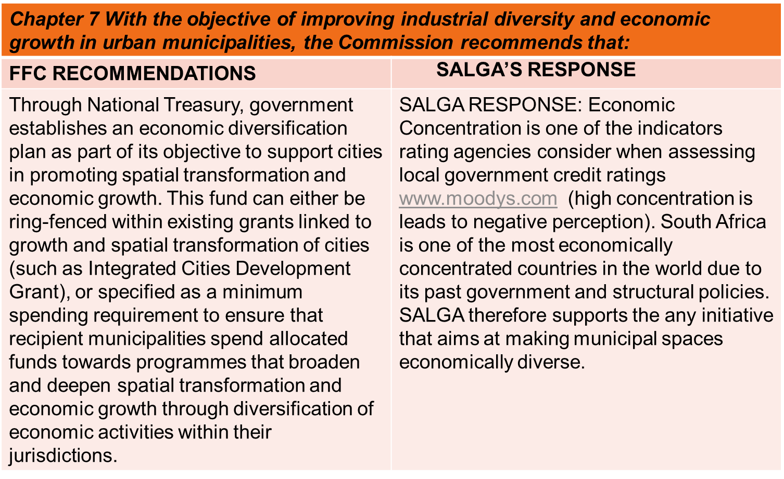
DORB 2018
SALGA made the following comments in support of the recommendations by the FFC:

Slide 10
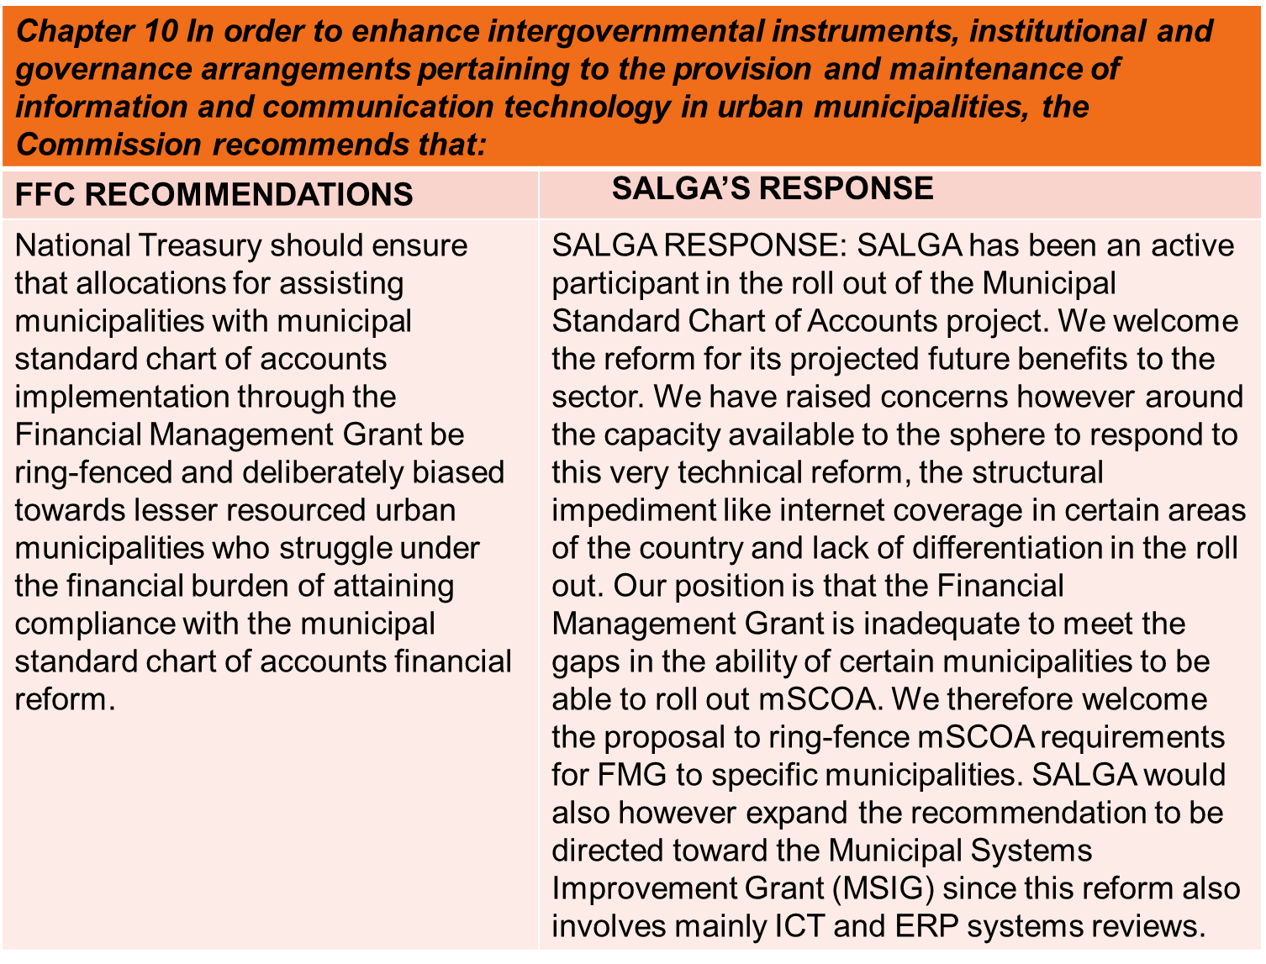
DORB 2018
SALGA made the following comments in support of the recommendations by the FFC:

Slide 11
DORB 2018
SALGA made the following comments in support of the recommendations by the FFC:

Slide 12
DORB 2018 - New Emergency Housing Grant
We support the creation of provincial and municipal emergency housing grant to address the need to rapidly provide temporary housing in cases of disasters.
However its noted that the grant is not designed to address other situations covered by the Housing Code’s Emergency Housing Programme, namely situations where evictees must be provided with alternate accommodation. Municipalities face a critical funding gap in this respect.
Therefore SALGA will be undertaking research to develop recommendations on the most appropriate funding mechanisms for temporary housing for those rendered homeless by an eviction.
These recommendations must be incorporated in a larger review of the HS grant framework which is to be undertaken this year.
A bullet point should be inserted under “Responsibilities of National Government” which indicates that national department must assist and/or facilitate access to land for emergency housing and resettlement purposes where required

Slide 13
DORB 2018 – Housing Grants
Informal Settlement Upgrading
We welcome the planned review of spending on urban informal settlement upgrades, but would advise that we must avoid creating a new conditional grant for this purpose, given that reversing the proliferation of grants which LG must contend with was one of the key agreed principles of the Local Government Infrastructure Grant Review underway.
Working more closely across spheres, we can ensure adequate allocation to the top priority of informal settlement upgrading without contributing to complexity and burdensome reporting requirements of multiple grants.
Urban Settlements Development Grant
When under expenditure and under performance is identified, the department may shift funds between municipalities in line with DORA processes and requirements and with the concurrence of donor and receiving municipalities.
We must raise caution that both National Treasury and the National Department must ensure strict adherence to Section 18 requirements and due process in effecting these shifts, including adequate notice and opportunity for municipalities to respond.

Slide 14
DORB 2018 – Housing Grants
Gazetting of HSDG funds to accredited municipalities:
As per section 12(6)b, provinces must gazette the amount of planned HSDG expenditure per municipality accredited at Level 1 and Level 2, and specify the amount to be transferred to the municipality and the amount to be spent by the province. Our SALGA research has showed that only in 2017/18 did all nine provinces finally comply with the requirement to gazette, but none of the provinces yet comply with the requirement to disaggregate. National Treasury and NDHS must properly enforce DORA. If provinces do not comply, Section 10(10) must be activated.

Slide 15
Proposals - Funding Gaps for Waste Management
Differentiated approach to funding of waste infrastructure and specialist equipment
The Waste Sector currently has a backlog of approximately 30% in terms of provision of services. Throughout the whole value chain process of waste management (collection, transportation, storage and disposal) specialist infrastructure and equipment is required.
The onus to fund this infrastructure is through LGES and municipal own revenue. SALGA has identified 27 high priority district municipalities with high indigent profiles, budgetary constraints and limited borrowing capabilities that place a burden on their ability to procure these products.
It’s estimated that at it costs a municipality the average of at least R 8,5 million to procure the equipment that covers the whole waste management value chain (Collection, transportation, storage and disposal)
SALGA hereby proposes a process of applying a differentiated approach towards funding of waste equipment and infrastructure for these 27 priority municipalities (e.g. realignment of MIG). This process will allow for seamless unlocking and improvement of waste management services in these region.

Slide 16
Proposals - Funding Gap For Environmental Performance
Based on current reporting, “Environmental Protection” (the new mSCOA based reporting category for Environmental Management provided by National Treasury) is a very small part of the entire municipal budget, accounting for around 1% of total municipal expenditure in all municipal categories.
There appear to be LMs in particular, who could internally reallocate funds within their existing municipal budgets with very small improvements in efficiency in the Governance and Administration function. To illustrate the point, it would require only an average 0.8% improvement in governance and administration (G&A) efficiency (and equivalent reduction in G&A expenditure, with zero impact on other services) to double the average current LM levels of expenditure on EM.
While operational resources appear to be adequate, funds to implement are a key gap. Coastal Management planning and implementation is a prime example among DMs of inadequate funding.

Slide 17
Proposals - Funding Gap For Environmental Performance
Where fees for EM services are gazetted, municipalities become constrained in their ability to cover their costs. For example, regulations prescribing Atmospheric Emission licence fees were published in March 2016 .
Unfortunately, many municipalities have noted that these fees are lower than either costs, or in some cases the fees that municipalities were already charging. It is unclear how municipalities are expected to fund the shortfall given the presence of these prescribed fees, which limit their ability to recover their costs.

Slide 18
Research Work
The Financial and Fiscal Repercussions of Eskom’s Role in the Electricity Distribution Industry on Local Government
Cost of Free Basic Services Study – Impact on the Local Government Equitable Share
We will promote the processing of the following through this legislature;
a bill on the writing off of household debts to municipalities
Amendments of the Tax Administration Act to allow for access of non financial data to improve municipal billing and the proposal of payment of municipal debts before tax refunds are made.
The amendments in the Municipal Systems Act schedule 10 to extend its provisions to all employees and POB benefiting from the fiscus.

