Slide 1
VBS Mutual Bank
Presentation to Parliament
March 2018

Slide 2
Agenda
1. Overview & background (operational and financial)
2. Major issues of concern raised by SARB
3. Municipality deposits at VBS Mutual Bank
4. Key events leading up to curatorship
5. Curatorship
2

Slide 3
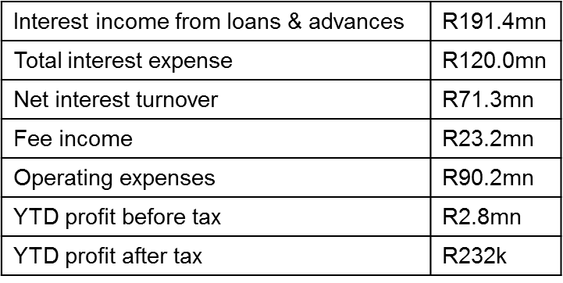
Overview and background
Background
Established: 1982 (initially operated as Venda Building Society).
Granted permanent Mutual Bank license on 11 October 2000.
Products and services: savings, fixed and notice deposits, mortgage, short-term loans, investment loans and fuel and contract financing.
Funding: main source of funding is savings, deposits and fixed and notice deposits.
Clients: 22 051 depositors, 1 105 loan accounts.
Branches: 6 operational, 1 not yet operational
Head office: Makhado; Corporate office: Rivonia.
Shareholders: Vele Investments (58.85%), PIC (27.63%), Dyambeu (4.60%), General Public (8.93%).
Employees: 140.
Auditors: KPMG.
Financial information - Jan’18*
(*As submitted to SARB)
Total assets - R2.04bn
Total loans & advances - R1.78bn
Total funding related to the public - R1.54bn
Capital and Reserves - R 476mn
Total Off-balance-sheet size – R185.2mn
Profitability
3

Slide 4
Major issues of concern raised by SARB
Inadequate and questionable governance and risk management practices.
A deficient compliance function and culture.
Aggressive growth strategy in balance sheet amidst funding challenges.
Weak asset and liability management practices (high liquidity risk).
Sectorial depositor concentration risk (Municipalities were 32 days, 3, 6 and 12 months maturations).
Possible illegality of municipality deposits accepted by the bank and the legal developments in that regard.
Volatility in financial performance as well as regular and significant losses caused by high operating expenses due to aggressive infrastructure expansion plans.
The negative impact of these losses on capital.
Venture into new products and services without commensurate investment in the enhancement of internal controls.
Negative media coverage of the bank (reputational risk).
Lack of proactive communication with the regulator on significant developments and delayed responses by management to crises.
Poor quality of regulatory reports and other information submitted to the regulator.
4

Slide 5
Municipality deposits at VBS Mutual Bank
February 2015 – First municipality deposit appears on list of largest depositors.
From Sep 2015 – VBS was warned against reliance placed on 10 largest depositors (of which municipality was largest).
From Sep 2016 – VBS warned against increasing sectorial concentration of municipalities and worsening liquidity mismatch position.
18 August 2017 – VBS alerted SARB to court application against National Treasury and possible illegality of deposits from municipalities.
29 August 2017 – VBS was advised to seek alternative liquidity contingency plans in the event of total municipality deposits outflow.
Reports from 5 September 2017 – 2 March 2018
Municipalities increased from 12 to 16
Total deposits increased from R1.06bn to R1.58bn
Total inflows – R1.18bn
Total outflows – R714.63mn
Net movement – R517,50mn.
VBS continued to accept municipality deposits up to and including 2 March 2018.
(*As submitted to SARB)
5

Slide 6
Key events leading up to curatorship (1)
16 Feb ‘18 – VBS failed to settle on the South African Multiple Option Settlement system – BankservAfrica intervened and SARB began to closely monitor VBS to ensure daily settlement.
20 Feb ‘18 – SARB sent a letter to the Chairman of the Board of VBS requesting a detailed action plan to remediate the liquidity distress event.
21 Feb ‘18 – VBS indicated that it was negotiating assistance from the PIC.
22 Feb ‘18 – VBS was officially non-compliant with SARB requirements for minimum General and Non-Distributable Reserves and Liquid Asset Reserves to be held by the bank. VBS submitted Liquidity Recovery Action Plan which was not satisfactory to ensure correction of immediate liquidity shortage. SARB submitted a letter to the Minister of Finance notifying of VBS’s liquidity distress and intervention by the regulator.
26 Feb ‘18 – VBS submitted its application to convert to a commercial bank. SARB and National Treasury met with VBS’s largest shareholders (PIC and Vele) to discuss a viable way forward.
2 March ‘18 – SARB’s Heads of Department met to discuss possible options of actions the SARB could take in respect of VBS’s liquidity distress in the event that the shareholders cannot provide the necessary liquidity funding to resolve the immediate shortage. VBS received R50 million, also said to be from a municipality.
6

Slide 7
Key events leading up to curatorship (2)
6 March ‘18 – SARB met with representatives from National Treasury to discuss possible solutions to the VBS liquidity crisis.
8 March ‘18 – SARB and National Treasury met with VBS’s Board and Executive Management to discuss the bank’s failure to obtain a viable solution to the liquidity distress event, and to communicate the regulator’s intent to recommend that the bank be placed under curatorship.
The Board of VBS requested an extra day to allow for final decision of PIC application for funding, which the Registrar granted.
The Board acknowledged that in the event of a failure to source funding from the PIC to relieve the current liquidity crisis, the Registrar may place the bank under curatorship and remove the management and the Board as he sees fit.
The Registrar advised the Board and management that if the SARB does not have written confirmation of a commitment of funds by the PIC, then by close of business on 12 March 2018, he would recommend to the Minister of Finance that the bank be placed under curatorship.
10 March ‘18 – Media coverage began to emerge which indicated that VBS was “about to go bust” headlined by a letter from the Chairman of the Board of VBS.
11 March ‘18 – The Registrar of Banks recommended that the Minister of Finance place VBS under curatorship, which the Minister approved. The SARB held a press conference to announce the placing of VBS under curatorship and answer queries by the press.
7

Slide 8
Curatorship
VBS was placed under curatorship with effect from 17:00, Sunday 11 March 2018.
SizweNtsalubaGobodo was appointed as curator of the bank with Mr Anoosh Rooplal as the representative.
VBS Board and management failed to manage the bank’s rapid growth and its funding and liquidity position. The Board of Directors and executive management of the bank have been relieved of their powers and these are now vested in the curator.
Mr Rooplal has been deployed to the Offices of VBS to conduct his assessment and investigation.
Retail deposits at VBS amounting to R50 000 per depositor are guaranteed. Other depositors were also informed that the curator will act in the best interest of all creditors.
VBS will remain open for business.
Curator will ensure that all loans due are collected as part of the normal collections processes, but also importantly, that lending and transactional banking services continue.
Curatorship presents the most suitable and most effective mechanism to facilitate the orderly management of the bank, and gives SARB the legal means to implement a resolution plan which will seek to ensure the sustainability of VBS.
8

