Slide 1
OUTA PRESENTATION TO Standing Committee on Finance (National Assembly) - public hearings on draft carbon tax bill
14 MARCH 2018

Slide 2
TABLE OF CONTENTS
Introduction
Contextual Background
Our Concerns
Case Studies – Carbon Tax
Recommendations
Concluding Remarks

Slide 3
INTRODUCTION
OUTA is a proudly South African non-profit civil action organisation, supported and funded by the public who are passionate about improving the prosperity of our nation.
OUTA was established to hold to account, those in authority who abuse their power w.r.t. Tax Payers money.

Slide 4
CONTEXTUAL BACKGROUND
As a civil society organization, OUTA understands and appreciates the need to reduce the carbon emissions and to reduce the energy intensity of our economy.
South Africa is an emerging economy.
Historically, evidence dictates that industrialisation was propelled by extensive use of fossil fuels in the majority of the developed countries.
Timing of the imposition of carbon is imperative.
Implementation readiness.
Shortcomings of introducing carbon tax.

Slide 5
CONTEXTUAL BACKGROUND (Cont…)
Global emissions of carbon dioxide were recorded to be at 32.1 billion tonnes in 2015, having remained essentially flat since 2013. The IEA reported that electricity generation data by renewables played a critical role, having accounted for around 90% of new electricity generation in 2015; wind alone produced more than half of new electricity generation. In parallel, the global economy continued to grow by more than 3%, offering further evidence that the link between economic growth and emissions growth is weakening.

Slide 6
South Africa’s GHG Emissions per Sector remains dominated by electricity generation sector
Source: National Treasury Carbon Policy Paper, 2013

Slide 7
CONTEXTUAL BACKGROUND (Cont…)
The two largest emitters, China and the United States, both registered a decline in energy-related CO₂ in 2015. In China, emissions declined by 1.5%, as coal use dropped for the second year in a row. The economic restructuring towards less energy-intensive industries and the government’s efforts to decarbonise electricity generation pushed coal use down.
In 2015, coal generated less than 70% of Chinese electricity, ten percentage points less than four years ago (in 2011). Over the same period low-carbon sources jumped from 19% to 28%, with hydro and wind accounting for most of the increase. In the United States, emissions declined by 2%, as a large switch from coal to natural gas use in electricity generation took place.

Slide 8
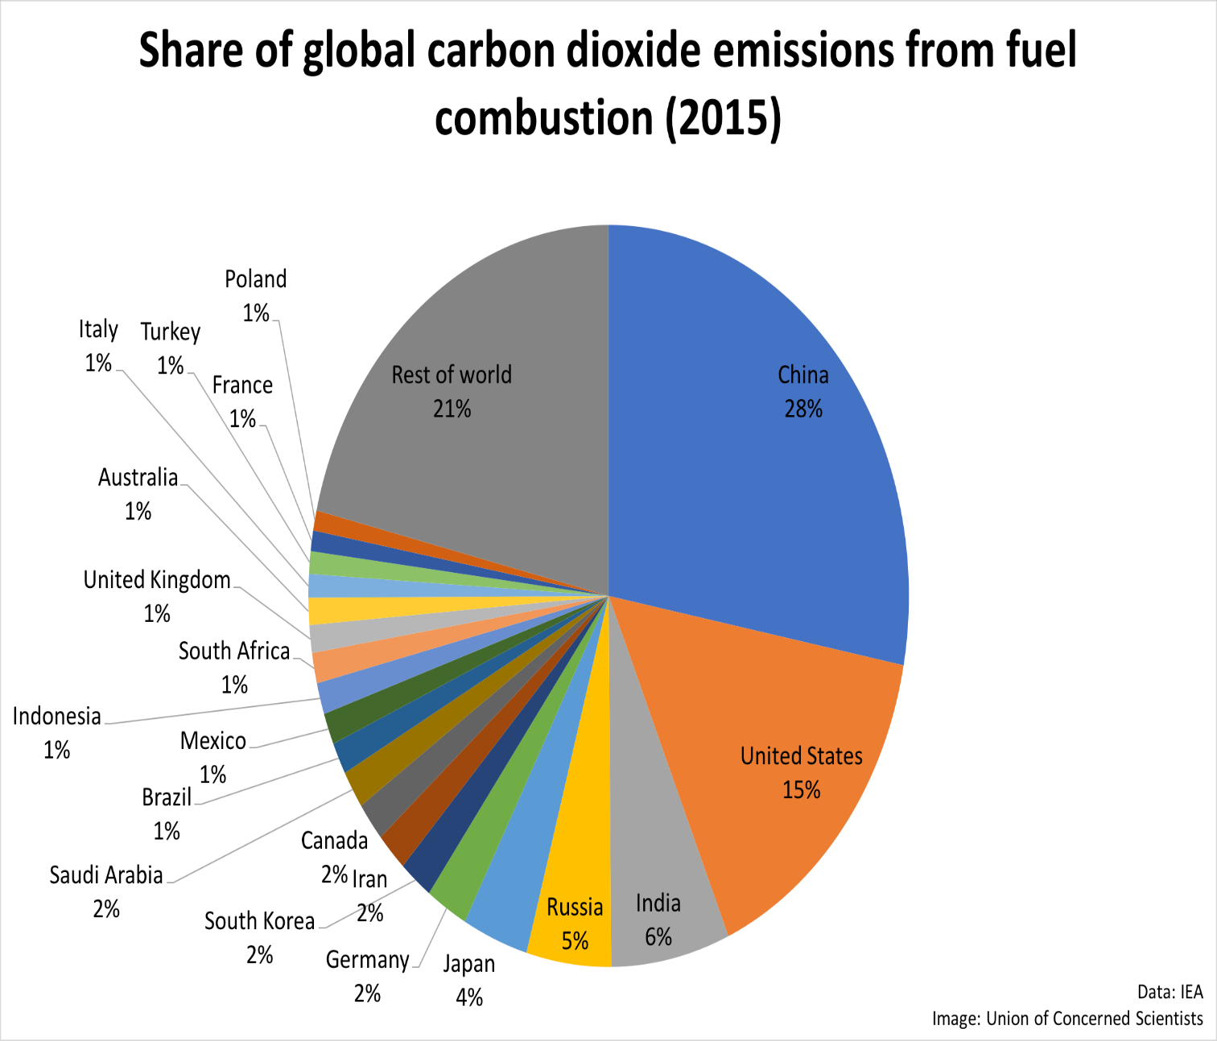
GLOBAL CO2 FROM FUEL COMBUSTION

Slide 9
World Primary Energy Supply & CO2 Emissions – 2015
Source: IEA Statistics 2017 - CO2 emissions from fuel combustion – Highlights

Slide 10
OUR CONCERNS
Emissions Baseline data has not been collected and normalised (standardised) per industry.
No substantive rationale that this will lead to behaviour change by polluters.
Quantification and costing of the administrative burden has not been unpacked (complexities not clarified).
Diverse economic scenarios and implications have not been thoroughly modelled only a few implications were analysed.

Slide 11
OUR CONCERNS (Cont…)
Research data/input parameters seems incomplete
Davis Tax Commission was not provided with comprehensive data to make proper/draw proper conclusions and recommendations
The impact of high electricity prices since 2010 has not been factored into the carbon content equation of our sectors.
No assurance that the tax revenues raised will be ring-fenced and used like how France introduced its carbon tax, where the funds are dedicated to create green jobs as part of trade-offs, between tax imposition and promoting the renewables energy sector.

Slide 12
REAL INTENT FOR CARBON TAX
Key Findings of OUTA Research Study
Policy Intent: What is the true intention of introducing a carbon tax?
Is this a just or an irrational tax?
Is this another revenue stream for the fiscus?
Accrued Benefits: What will the payers of tax gain?
Will this tax contribute to their bottom lines?
Will efficiencies increase in operations?
Economic Imperatives: How will this tax contribute to enhance economic development?
Will the tax have a direct impact on the electricity intensity of our economic sectors?
Will this tax serve as an enabler in our quest to maximise economic development or what’s the outlook from modelling undertaken?
Are there thresholds (rewards for low emissions?) - If one is a carbon neutral company, are you rewarded for your behaviour?

Slide 13
REAL INTENT FOR CARBON TAX (Cont…)
Behaviour change: Will this tax help in the behavioural change of society and business?
What are the underlying assumptions and input parameters in the modelling exercise relating to possible shifts in society and industrial behaviour likely to take place when this tax is implemented?
Are there any core drivers that will foster actual behaviour change for both individuals and business enterprises?
Has the risk and potential for a “tax stressed” pool been factored into the equation – has the prospects for high levels of a tax avoidance or even a tax-revolt been taken into account? (Government should look at the introduction of electronic tolling (eTolls) by Sanral as a case in point in the SA context).
Has other alternatives for possible behaviour change for organisations to lower carbon emissions (other than taxing them) been taken into account?

Slide 14
CASE STUDIES OF CARBON TAX
Finland
In 1990, Finland became the first country to implement a carbon taxation policy for the purpose of curbing its carbon emissions. The tax was designed as a component of Finland’s excise tax on fossil fuels used for transportation and heating. The policy scheme covered the utilization of all transport fuels, coal, and natural gas and included the heating, electricity generation, and transportation sectors.
Sweden
As of 2016, the carbon tax rate in Sweden is applied at 137 US dollars per metric ton. This makes the Swedish carbon tax rate the highest in the world by a wide margin.
France
For the year 2014, the revenues collected by the tax amounted to 452 million US dollars. The revenues are intended to be used in energy transition plans with the main target of boosting employment in the green energy sector.

Slide 15
CASE STUDIES OF CARBON TAX (Cont…)
Australia 1st Country to Cancel (Repeal) Carbon Tax
As the country with the highest per capita GHG emissions in the world, the mitigation needs of Australia are considerable. In 2012, A carbon tax policy was implemented in the country to address this problem.
However, the carbon tax experiment in the country has been short lived as the tax only stayed operational for a period of two years. The tax was introduced in 2012 and was repealed in 2014, making Australia the first and only country to abolish a carbon tax.

Slide 16
CASE STUDIES OF CARBON TAX (Cont…)
Repealing the carbon tax and the Clean Energy Package was designed to:
Reduce the cost of living - modelling by the Australian Treasury suggests that removing the carbon tax in 2014-15 will leave average costs of living across all households around $550 lower than they would otherwise be in 2014-15.
Lower retail electricity by around 9 per cent and retail gas prices by around 7 per cent than they would otherwise be in 2014-15 with a $25.40 carbon tax.
Boost Australia’s economic growth, increase jobs and enhance Australia’s international competitiveness by removing an unnecessary tax, which hurts businesses and families.
Reduce annual ongoing compliance costs for around 370 liable entities by almost $90 million per annum.
The repeal was intended to ensure that lower prices are passed through end users.

Slide 17
RECOMMENDATIONS
OUTA strongly recommends that:
the proposed Carbon Tax MUST NOT be implemented in the current economic conditions, however, South Africa must first be on course to sustainable economic recovery and the socio-economic challenges be under control, prior to the introduction of the carbon tax.
government must first get its house in order by providing sustainable economic solutions to meet the day-to-day needs of the economically active citizens by creating an enabling environment for investors to inject the most required foreign direct investments, which in turn will enable people to find meaningful employment and the economy be on a positive strong growth trajectory prior to introducing a carbon tax.
the carbon tax is at this point in time contrary to the socio-economic objectives of SA and will unfortunately increase the cost of doing business should not be imposed.

Slide 18
RECOMMENDATIONS (Cont…)
OUTA recommends further that:
According to STATSSA recent report that the latest gross domestic product (GDP) results provide some cautious cheer. The South African economy grew by 1,3% in 2017, exceeding National Treasury’s expectation of 1,0% growth announced during the National Budget Speech in February 2018, however, we are far from effectively addressing the scourge of unemployment and low economic growth, hence, the country doesn’t need the implementation of an additional tax burden.
We should specifically take note of South Africa’s ranking on the Global Competitiveness Index. All of the aforementioned must to be taken into account prior to imposing a Carbon Tax on a society which is already over-burdened with tax (tax-fatigue), considering the recent 1% VAT hike announced in the 2018 Budget Speech.
National Treasury cannot with absolute certainty assure the public that SARS, Department of Environmental Affairs and organized business are ready both administratively and technically to meet the compliance requirements to start reporting on carbon tax, therefore, our readiness is in doubt.

Slide 19
RECOMMENDATIONS (Cont…)
Comprehensive due diligence be undertaken to determine the levels of readiness at it believes that South Africa has not not been reached from both tax collection and comprehensive emission data banking the necessary capabilities, hence, the timing remain ill-conceived if it is executed in urgency.
National Treasury cannot with absolute certainty assure the public that SARS, Department of Environmental Affairs and organized business are ready both administratively and technically to meet the compliance requirements to start reporting on carbon tax.

Slide 20
CONCLUSIONS
If South Africa introduces a carbon tax it will be the first developing country to introduce such a tax, do we really have to do this at the current economic climate? OUTA construes any attempt to impose this tax burden as a move that will put South Africa at a significant competitive disadvantage relative its competitors. It is envisaged that such a move would also make South Africa behave like it is economically well-positioned better than many developed countries, most notably the United States. “Not a wise move.”
Government must conduct a state of readiness assessment subsequent to a comprehensive due diligence on each key players’ role and capabilities such as SARS, Department of Environmental Affairs, large pullers (i.e. Eskom & Sasol) and a further consultation process that provides all interested and affected parties to engage in the final phase of preparations must be initiated.
Comprehensive modelling still need to be undertaken to ensure that all options are factored into the final scenarios and better rational choices are made.

Slide 21
THANK
YOU!!!
Ronald Chauke
OUTA Energy Portfolio Manager
ronald.chauke@outa.co.za

