Slide 1

LOCAL GOVERNMENT MANAGEMENT IMPROVEMENT MODEL (LGMIM)
State of Management Practices in 41 Municipalities for 2016/17

Slide 2
What this presentation covers:
LGMIM Concept
216/17 Enrolments
2016/17 Heat maps
LGMIM findings per KPA
Improvement Planning
2017/18 enrolments
Conclusion

Slide 3



WHAT LGMIM DOES?
Management practices
Workplace capabilities
Desired Results:
Quality of service delivery & productivity
  Considers and focuses on the managerial practices of a municipality. That is to determine what the organisation does and how it approaches its tasks to achieve the desired results
  How?
  By analysing how the organisation works & assesses this against agreed management performance standards and criteria

Slide 4
How is performance measured?
Level | Description
Level 1 | Municipality is non-compliant with legal, regulatory and prescribed best practice requirements – NEEDS SERIOUS ATTENTION
Level 2 | Municipality is partially compliant with legal, regulatory and prescribed best practice requirements – OPPORTUNITY TO BE FULLY EFFECTIVE
Level 3 | Municipality is fully compliant with legal, regulatory and prescribed best practice requirements – FULLY EFFECTIVE
Level 4 | Municipality is fully compliant with legal, regulatory and prescribed best practice requirements and doing things smartly/innovatively -

Slide 5
The LGMIM Journey
LGMIM launch
Self assessment
Moderation
Feedback
Improve

Slide 6
Benefits for the Municipalities
Management information tool to:
Reflect on management practices and processes.
Assist in identifying areas of concern where improvements may be needed
The standards as set out provides guidance in respect of what the logical steps might be to improve
Outlines a set of key management practices that if regularly measured, monitored and improved upon will impact positively on service delivery and productivity
Could inform the Performance Agreements of senior managers

Slide 7
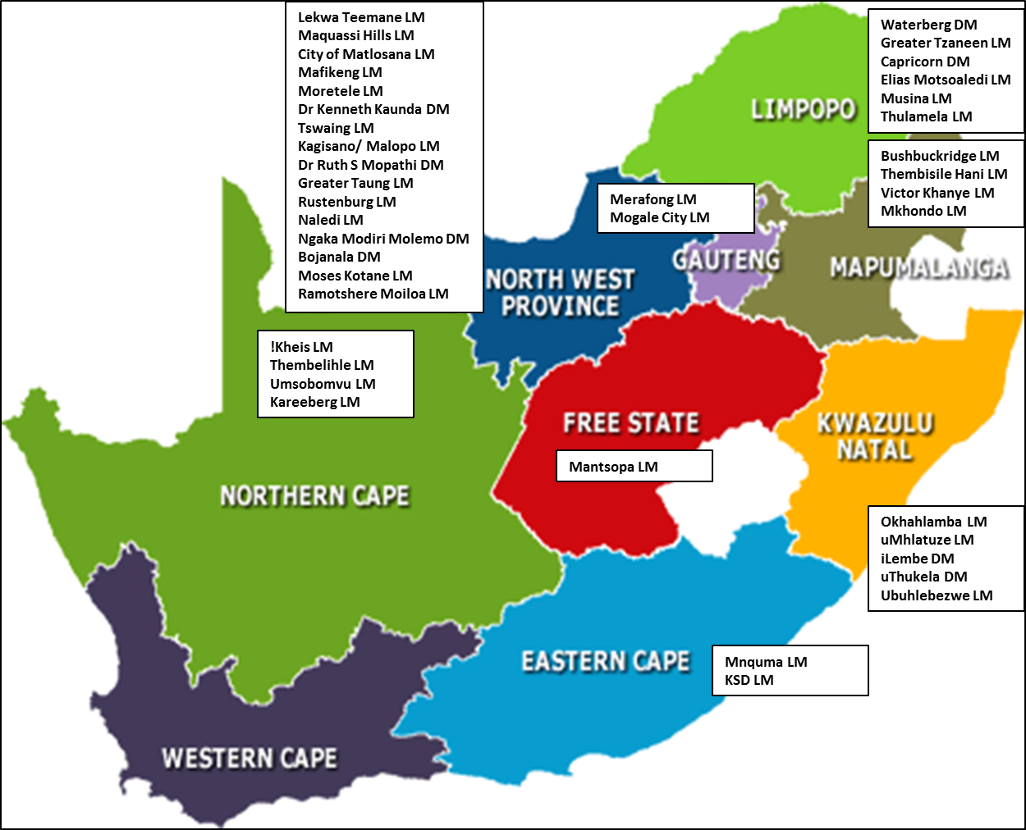
2016/17 LGMIM Enrolments:

Slide 10
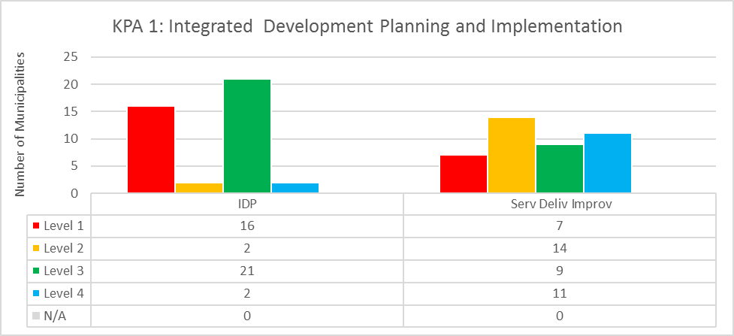
KPA 1: Integrated Development Planning and Implementation
This KPA comprises of two standards namely:
Standard 1.1: Integrated Development Planning
Standard 1.2: Service Delivery Implementation, Monitoring and Reporting

Slide 11
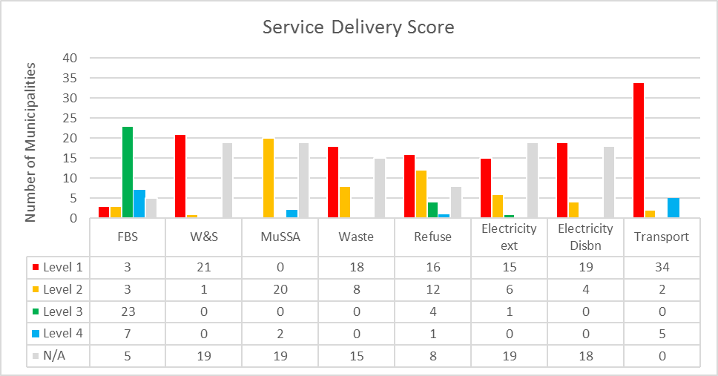
KPA 2: SERVICE DELIVERY
The Service Delivery KPA is monitored through eight standards dealing with the planning, project packaging, budgeting and monitoring of:
Standard 2.1: Access to free basic services
Standard 2.2: Extension of water and sanitation services/facilities (only 22 of the 41 municipalities are WSAs)
Standard 2.3: Moderated Performance against Municipal Strategic Self-assessment (MuSSA)
Standard 2.4: Waste handling
Standard 2.5: Refuse removal
Standard 2.6: Extension of electricity
Standard 2.7: Distribution, operation, maintenance and refurbishment of the municipal electricity infrastructure
Standard 2.8: Municipal road system

Slide 12
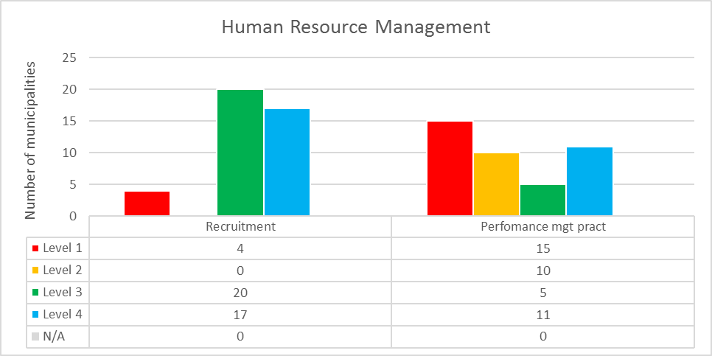
KPA 3: HUMAN RESOURCE DEVELOPMENT
The Human Resource Management KPA is monitored through two standards:
Standard 3.1: Application of Prescribed Recruitment Practices
Standard 3.2: Implementation of prescribed Performance Management Practices for the Municipal Manager (MM) and Section 56 Managers (Managers reporting directly to the MM).

Slide 13
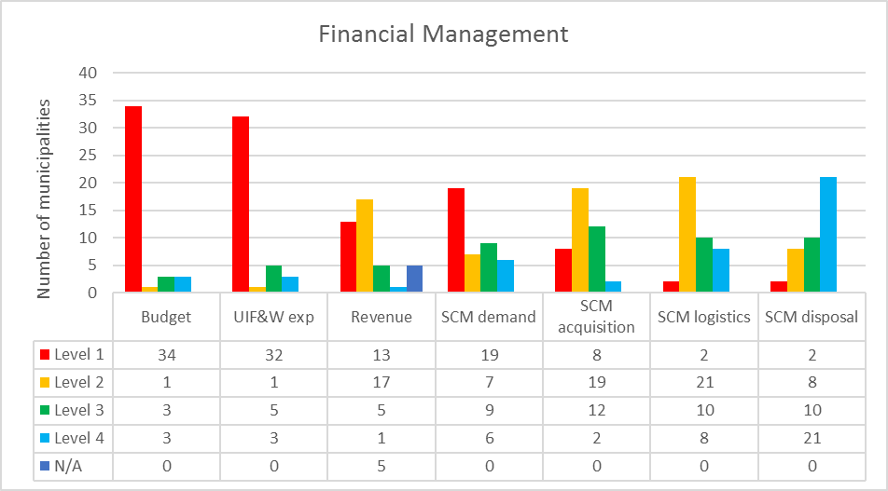
KPA 4: FINANCIAL MANAGEMENT
The Financial Management KPA is monitored through seven standards dealing with:
Effective Budget Planning and Management
Management of Unauthorised, Irregular and/or Fruitless and Wasteful Expenditure
Revenue Management
SCM: Demand Management
SCM: Acquisition Management
SCM: Logistics Management
SCM: Disposal Management
Notes:
The Financial Management KPA is monitored through seven standards dealing with:
Effective Budget Planning and Management
Management of Unauthorised, Irregular and/or Fruitless and Wasteful Expenditure
Revenue Management
SCM: Demand Management
SCM: Acquisition Management
SCM: Logistics Management
SCM: Disposal Management
In respect of performance against the standards making up this KPA, municipalities seem to have challenges with adhering to management practices as prescribed in legislation, regulation and/or that is considered best practice especially in Standards 4.1: Budget Planning and Management, Standard 4.2 Management of unauthorised, irregular and/or fruitless and wasteful expenditure, as well as in the Supply Chain Management components of demand management (Standard 4.4.1) and acquisition management (Standard 4.4.2). In respect of Standard 4.3: Revenue management, most municipalities seem to be facing challenges in maintaining a collection rate of at least 95% in line with the national norm prescribed in National Treasury’s MFMA Circular 71.
In relation to Disposal Management (Standard 4.4.4) Moderators noted that despite the good scores awarded, the extracts of the asset registers provided often only indicated when assets were purchased - it did not indicate the current condition or even when last the condition was verified. It was acknowledged that this could have been caused by municipalities not selecting the appropriate fields indicating the condition of assets when preparing extracts of their asset registers to upload onto the LGMIM web system as evidence. This uncertainty often resulted in municipalities being given the benefit of the doubt (giving rise to the much higher scores being awarded in this component of SCM than the remaining three components). To avoid future repeat of this occurrence as well as addressing the weighting of SCM against the other financial management related standards, the four (4) components of SCM will be assessed through a single combined standard for the coming cycle.

Slide 14
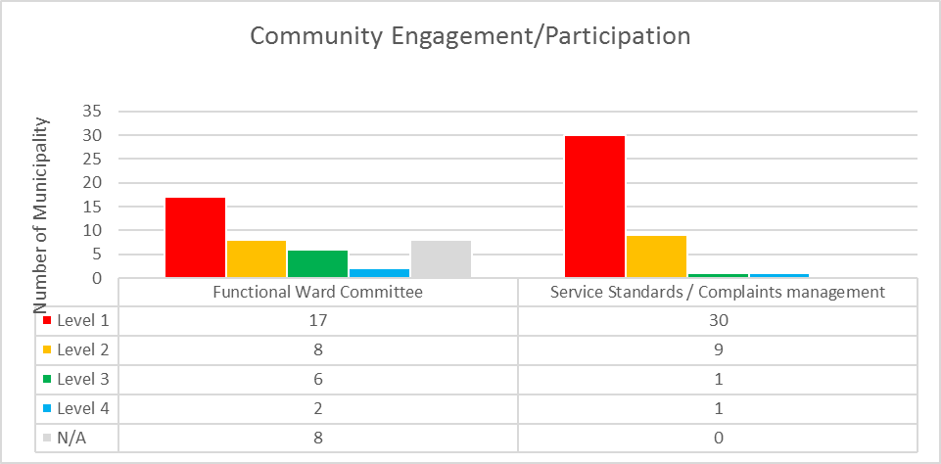
KPA 5: COMMUNITY ENGAGEMENT/PARTICIPATION
The Community engagement/participation KPA is monitored through two standards:
Standard 5.1: Functional Ward Committees
Standard 5.2: Service Standards and Complaints Management respectively

Slide 15
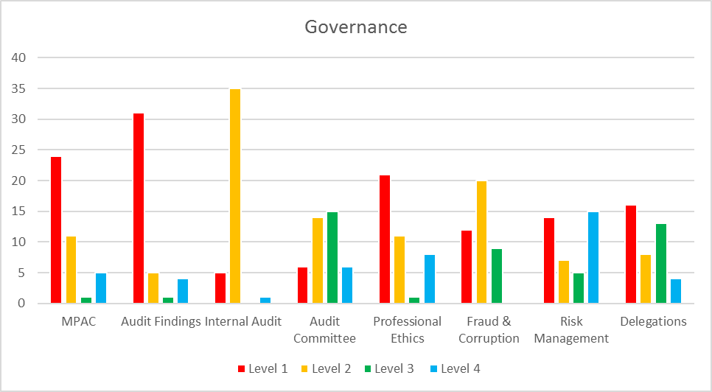
KPA 6: GOVERNANCE
The Governance KPA is monitored through eight standards dealing with:
Assessment of Accountability Mechanisms: MPAC
Assessment of responses to External Audit Findings
Assessment of Internal Audit
Assessment of the Audit Committee
Assessment of Policies and Systems to ensure Professional Ethics
Prevention and combatting of Fraud and Corruption
Risk Management
Administrative and Financial Delegations

Slide 16
Improvement Planning
Completing an assessment is just one step in the LGMIM process. Key is how the assessment is used to identify the root causes of the underperformance and what must be done by who and when to address the root causes
DPME has designed an improvement planning guide and provides training for municipalities and provinces on how to prepare an improvement plan using the LGMIM assessment results.
In addition, DPME is directly working with 5 municipalities; 4 of whom have completed their improvement plans. Implementation is being monitored by the provincial CoGTA and DPME
Our expectation is that all participating provinces support municipalities to develop improvement plans. However, not all provinces have been forthcoming in this regard.

Slide 17
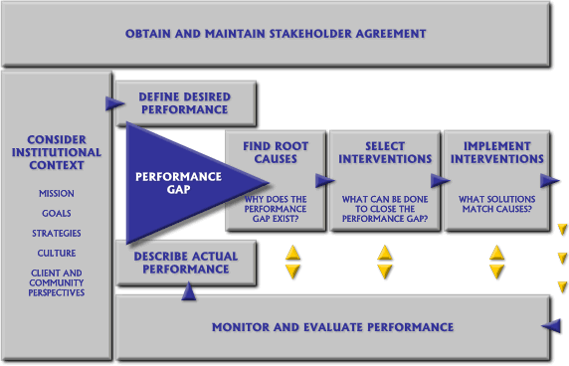
Improvement planning process flow

Slide 18
Conclusion
Dedicated managers and leaders value organisational assessments and diagnostics as a source of valuable insights into the health of their organisations.
For the benefit and potential of LGMIM to be realised, municipalities must be willing to utilise the results of the LGMIM as critical management information and develop improvement action plans and strategies in the areas where performance gaps were observed.
Provincial departments responsible for Local Government for their part will have to step up their involvement and support municipalities in this regard.
Should the above requirements be met, indications are that the LGMIM can serve as a powerful management information tool for the municipal leadership to reflect on how the municipality approaches its tasks in key management areas with a view to shaping management and administrative practices to deliver quality services.

Slide 19





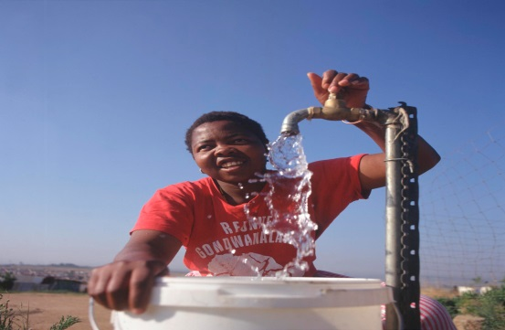
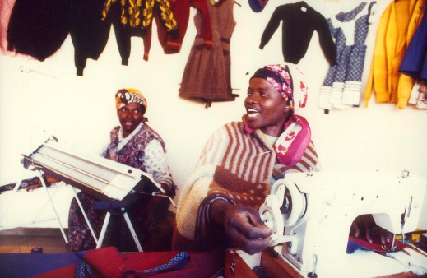

Ke ya leboga Ke a leboha
Ke a leboga Ngiyabonga Ndiyabulela Ngiyathokoza Ngiyabonga Inkomu Ndi khou livhuha Thank you Dankie

