Slide 1
Second draft Carbon Tax Bill - published 14 December 2017
14 March 2018

Slide 2
Eskom comments on the second draft Carbon Tax Bill (1/2)
Eskom and the National Treasury have been engaging regarding the proposed carbon tax since 2010. There are 2 main categories of issues that we have discussed.
A. Alignment with the Department of Environmental Affairs Greenhouse Gas management processes.
Two particular areas of alignment were sought:
with the mandatory GHG reporting regulations (not yet tested as first submission is due 31 March 2018) and
the company-level carbon budgets (expected to be mandatory from 1 January 2021).
With respect to the company-level carbon budgets, the World Bank-sponsored study recommended that a “tax enforce budget” option be adopted post-2020 whereby “entities pay a tax on those emissions in excess of their budget”.
It is proposed that instead of implementing one form of the carbon tax in 1 January 2019; efforts should be directed at delivering the fully-integrated “tax enforces budget” option from 1 January 2021 instead.

Slide 3
Eskom comments on the second draft Carbon Tax Bill (2/2)
The integrated “tax enforces budget” option should be considered as it meets the alignment imperative and given that South Africa’s GHG emissions (inventoried in 2010 and 2012 (draft)) remain at 518MtCO₂eq which is within the benchmark trajectory range, expressed in SA’s nationally-determined contribution for 2025 and 2030. Electricity sector emissions have declined consistently since 2013/14 down to 211 MtCO₂ in 2016/17. National GHG emissions can be expected to be even lower than in 2012.
B. Electricity Price impact
The Integrated Resource Plan 2010 and 2016 (draft) also already includes a greenhouse gas emissions cap on the electricity sector. The cap constrains what type of new capacity must be built and by when.
National Treasury have committed to minimising the impact on the price of electricity in the initial phase.
However, the “renewables rebate” previously granted in recognition of the “renewables premium” already built into the electricity tariff; has been limited in this second draft to 31 Dec 2022 (compared with REIPPPP contracts from bid windows 1 to 3.5 which continue to 2038).
This will result in an abrupt increase in the electricity tariff from 1 July 2023 in order or recover an approximately R13 billion per annum in addition to the current levy.

Slide 4
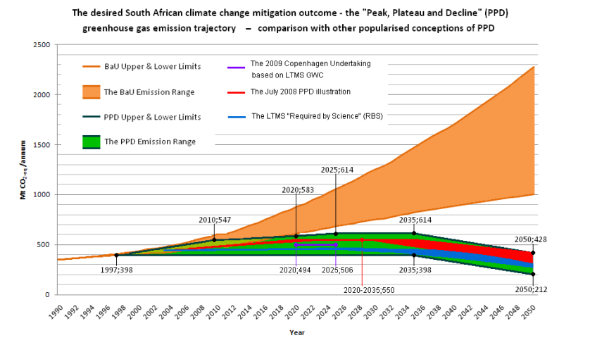
South Africa’s commitment is to peak, plateau and decline
Source: DEA
3
3

