Slide 1

2017/18
DEPARTMENT OF DEFENCE
3rd Quarterly Performance Status
Presentation to the PCD&MV of 14 March 2018

Slide 2

Aim
To present the Department of Defence (DOD)
3rd Quarter
(01 October 2017 - 31 December 2017) Performance Status
(Non-Financial and Financial)
for the FY2017/18 to the
Portfolio Committee of Defence and Military Veterans (PCD&MV)

Slide 3
Legislative Requirements
In terms of Section 38(1)(a)(i) and (ii), of the Public Finance Management Act (PFMA), Act 1 of 1999 as amended, the “Accounting Officer for a department must ensure that the department has and maintains effective, efficient and transparent systems of financial and risk management and internal control; and a system of internal audit under the control and direction of an audit committee”.
The Treasury Regulations, par 5.3.1 states that, “the accounting officer of an institution must establish procedures for quarterly reporting to the executive authority to facilitate effective performance monitoring, evaluation and corrective action”.

Slide 4
Legislative Requirements
The Framework for Strategic Plans and Annual Performance Plans, states that the quarterly report “provides the Accounting Officer with an opportunity to indicate measures that will be taken to ensure that implementation of the Annual Performance Plan remains on track” and that quarterly reports must be submitted to the National Treasury and the Auditor-General for auditing purposes.
DPME in the Presidency’s guideline on the “Preparation of Quarterly Performance Reports” dated May 2017 indicates that preliminary information must be submitted within 30 days after the end of each quarter and actual information must be submitted with preliminary data of the next quarter.

Slide 5
Presentation Structure
Non-Financial Performance Information
Analysis of DOD Performance Indicators (PInds)
Analysis of DOD Targets per Main Programme
DOD Validated Q2 Programme Performance
DOD Q3 Programme Performance
- DOD Selected PInds
- DOD YTD Performance: Mandate Achievement
- DOD Q3 Target Performance Summary
DOD YTD Performance Status
Refer to Appendix A to DOD QPR3 “DOD Detailed 3rd Quarterly Performance Report (Preliminary) on Performance against Plan for the FY2017/18 over the period 01 Oct 2017 to 31 Dec 2017” for information on all DOD PInds.

Slide 6
Presentation Structure
Financial Performance Information
Summary of State of Expenditure as on 31 Dec 2017
Summary of State of Expenditure per Programme as on 31 Dec 2017
Summary of State of Expenditure per Economic Classification as on 31 Dec 2017

Slide 7
Non-Financial Performance Information

Slide 8
Analysis of DOD Performance Indicators
The DOD reports on the following PInds on a quarterly basis:
DOD Selected Performance Indicators
  Derived from the Defence mandate.
  Represents the largest cost drivers in the DOD.
  Basis of DOD budget allocation from National Treasury.
  Included in the Estimate of National Expenditure.
Programme Performance Indicators
  Instituted across all budget programmes.
  Enable performance monitoring and control.
  Identifies how challenges should be addressed and
  successes replicated.
Link to various MTSF Outcomes

Slide 9
Analysis of DOD Performance Indicators
DOD Performance Indicators per Main Programme: FY2017/18
Excluding 14 Classified Targets

Slide 10
Analysis of Q3 DOD Performance Indicators
DOD Performance Indicator Q3 Targets: FY2017/18
Excluding 14 Classified Targets

Slide 11
Analysis of DOD Targets per Main Programme
Programme | Q1 | Q2 | Q3 | Q4 | Total
Administration | 19 | 24 | 14 | 63 | 120
Force Employment | 4 | 4 | 4 | 7 | 19
Landward Defence | 2 | 2 | 2 | 2 | 8
Air Defence | 1 | 1 | 1 | 2 | 5
Maritime Defence | 1 | 1 | 1 | 2 | 5
Military Health Support | 2 | 2 | 2 | 2 | 8
Defence Intelligence | 3 | 3 | 3 | 6 | 15
General Support | 4 | 4 | 4 | 9 | 21
Total (excluding classified targets) | 36 | 41 | 31 | 93 | 201

Slide 12
DOD Q2 Programme Performance

Slide 13
DOD Validated Q2 Performance Status
DOD Quarterly Target Achievement: FY2017/18

Slide 14
DOD Q3 Programme Performance

Slide 15
DOD Selected Performance Indicators

Slide 16
DOD Selected Performance Indicators
Defence Foreign Relations Output Details for FY2017/18
MTSF Outcome to which it contributes: Outcome 11
Output: Employ the SANDF
Performance Indicator | Analysis
Total number of Defence Attaché Offices | Target (Annual, Q4) 44 Progress towards Annual Target 44
Comment
SADC – 10 offices. Angola, Botswana, DRC, Lesotho, Mozambique, Namibia, Swaziland, Tanzania, Zambia and Zimbabwe.
Rest of Africa – 13 offices. Algeria, AU, Burundi, Côte d’Ivoire, Egypt, Ethiopia, Ghana, Kenya, Nigeria, Senegal, South Sudan, Sudan and Uganda.
Rest of the World – 21 offices. Argentina, Belgium, Brazil, Cuba, France, Germany, India, Italy, Malaysia, Pakistan, PRC, Russia, Saudi Arabia, Spain, Sweden, Turkey, UAE, UK, UN, USA and Vietnam.

Slide 17
DOD Selected Performance Indicators
Human Resources Support Services Output Details for FY2017/18
MTSF Outcome to which it contributes: Outcome 5
Output: Provide professional and supported DOD Human Resources
Performance Indicator | Analysis
Number of Military Skills Development Members in the System per Year | Target (Annual, Q4) 3 651 Progress towards Annual Target 3 182

Slide 18
DOD Selected Performance Indicators
Human Resources Support Services Output Details for FY2017/18
MTSF Outcome to which it contributes: Outcome 3
Output: Provide professional and supported DOD Human Resources
Performance Indicator | Analysis
Number of reserve force man-days | Target (Annual, Q4) 1 817 104 Progress towards Annual Target 1 759 779

Slide 19
DOD Selected Performance Indicators
Force Employment Output Details for FY2017/18
MTSF Outcome to which it contributes: Outcome 11
Output: Provide mission ready Defence capabilities
Performance Indicator | Analysis
Percentage compliance with the Southern African Development Community Standby Force Pledge | Target (Annual, Q4) 100% Progress towards Annual Target 100%
Comment
The SANDF force structure elements deployed in peace missions constituted part of the SANDF’s contribution to the Standby Force. These pledges were not additional to SANDF force requirements.

Slide 20
DOD Selected Performance Indicators
Force Employment Output Details for FY2017/18
MTSF Outcome to which it contributes: Outcome 11
Output: Conduct ordered defence commitments in accordance with Government policy and strategy
Performance Indicator | Analysis
Percentage compliance with number of ordered commitments (external operations) | Q3 Target 100% Q3 Actual 100%
Comment
Op MISTRAL. Participation in the UN Peace Support Operation in the DRC (MONUSCO).
Op COPPER. The Offshore Patrol Vessel, SAS MAKHANDA, with a Maritime Reaction Squadron contingent on board, was deployed.

Slide 21
DOD Selected Performance Indicators
Force Employment Output Details for FY2017/18
MTSF Outcome to which it contributes: Outcome 3
Output: Support to the People
Performance Indicator | Analysis
Percentage compliance with number of ordered commitments (internal operations) | Q3 Target 100% Q3 Actual 100%
Comment
SANDF forces prepared for four internal operations:
Op PROSPER (Support to Government departments, mainly SAPS [ie Safety and Security Support]).
Op CHARIOT (Disaster Aid and Relief [Humanitarian Assistance]).
Op ARABELLA (Search and Rescue).
Op CORONA (Border Safeguarding).

Slide 22
DOD Selected Performance Indicators
Force Employment Output Details for FY2017/18
MTSF Outcome to which it contributes: Outcome 11
Output: Employ the SANDF
Performance Indicator | Analysis
Number of joint, interdepartmental, interagency and multinational military exercises conducted per year | Q3 Target 1 Q3 Actual 1
Comment
The following Exercise took place during the period under review:
Ex OXIDE. A Joint, Multi-National exercise to test the maritime defence capabilities between the French Forces from La Reunion (FAZSOI) and the RSA. France was the host and lead nation and the exercise was conducted over the period 16 November 2017 to 15 December 2017 at La Reunion.

Slide 23
DOD Selected Performance Indicators
Force Employment Output Details for FY2017/18
MTSF Outcome to which it contributes: Outcome 3
Output: Support to the People
Performance Indicator | Analysis
Number of landward sub-units deployed on border safeguarding per year | Q3 Target 15 Q3 Actual 15
Comment
The SANDF deployed 15 sub-units to execute Op CORONA (Border Safeguarding) in Limpopo, Mpumalanga, KwaZulu-Natal, Free State, Eastern Cape, Northern Cape and North West Provinces.
*See next slide for detailed quarterly operational successes.

Slide 24
DOD Selected Performance Indicators
Force Employment Output Details for FY2017/18
Number of landward sub-units deployed on border safeguarding per year
Operational Successes | Q1 | Q2 | Q3 | YTD
Weapons Recovered | 8 | 9 | 5 | 22
Illegal Foreigners Apprehended | 3 841 | 2 612 | 2 153 | 8 606
Criminals Arrested | 181 | 131 | 109 | 421
Stolen Vehicles Recovered | 34 | 23 | 34 | 91
Dagga Confiscated (per kg) | 2 467kg | 2 548kg | 1 908kg | 6 923Kg
Live-stock Recovered | 874 | 406 | 292 | 1 572
Contraband Goods Confiscated | R 10 200 000.00 | R 8 890 000.00 | R 3 750 000.00 | R 22 840 000.00

Slide 25
DOD Selected Performance Indicators
Air Defence Output Details for FY2017/18
MTSF Outcome to which it contributes: Outcome 11
Output: Conduct ordered Defence commitments in accordance with Government policy and strategy
Performance Indicator | Analysis
Number of force employment hours flown per year | Target (Annual, Q4) 5 000 Progress towards Annual Target 3 200.2 Force Employment: 2 800.7 VVIP: 399.5
Comment
Force Preparation flying hours are not measured at present as part of this performance indicator.
70% of the planned Force Employment (4 000) hours have been flown for the year-to-date.
40% of the planned VVIP (1 000) hours have been flown for the year-to-date.
64% of the overall planned flying (5 000) hours have been achieved for the year-to-date.

Slide 26
DOD Selected Performance Indicators
Maritime Defence Output Details for FY2017/18
MTSF Outcome to which it contributes: Outcome 11
Output: Conduct ordered Defence commitments in accordance with Government policy and strategy
Performance Indicator | Analysis
Number of hours at sea | Target (Annual, Q4) 12 000 Progress towards Annual Target 3 733.87
Comment
Hours at sea includes Force Employment as well as Force Preparation hours.
31% of the planned hours at sea have been utilised for the year-to-date.

Slide 27
DOD YTD Performance: Mandate Achievement

Slide 28
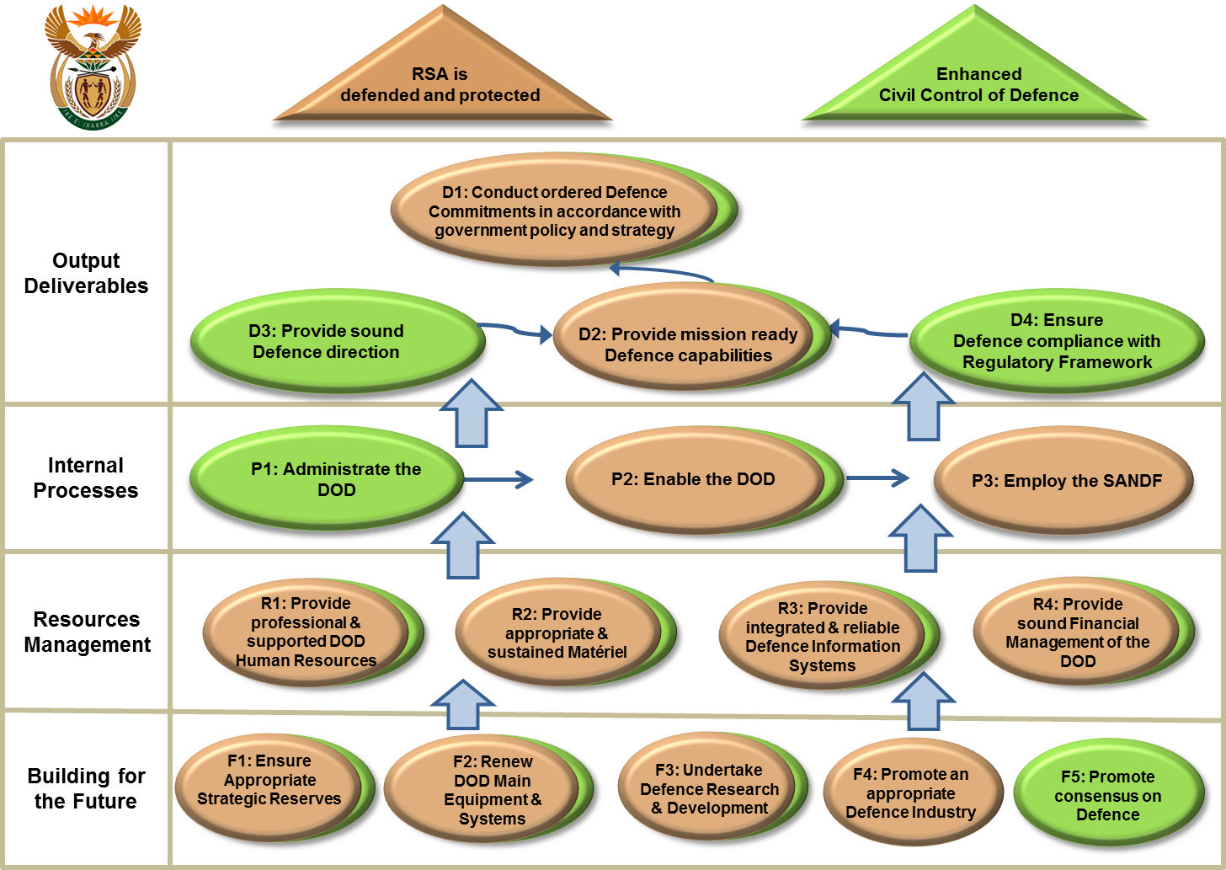
Analysis of DOD Targets per Strategy Map

Slide 29
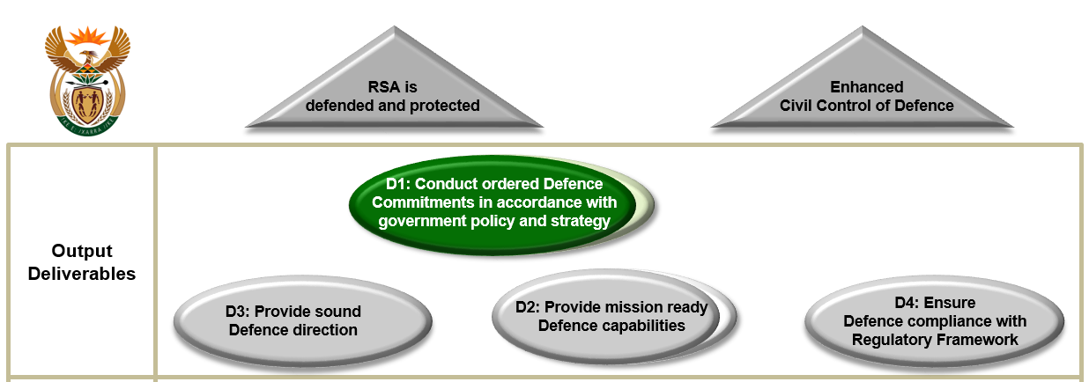
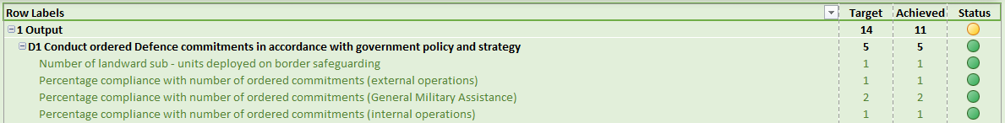
Achievement of Targets on Output Deliverables

Slide 30
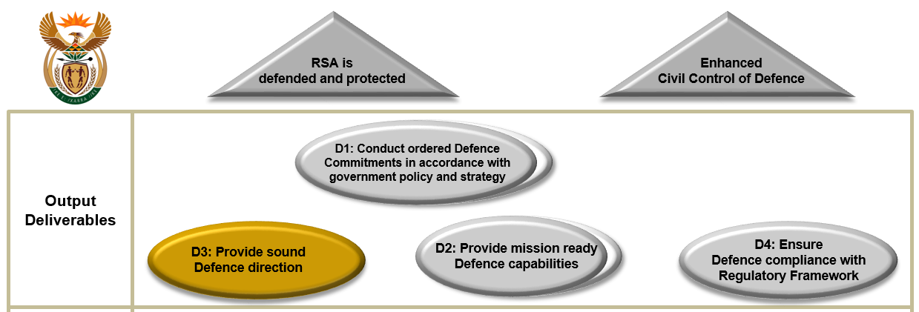
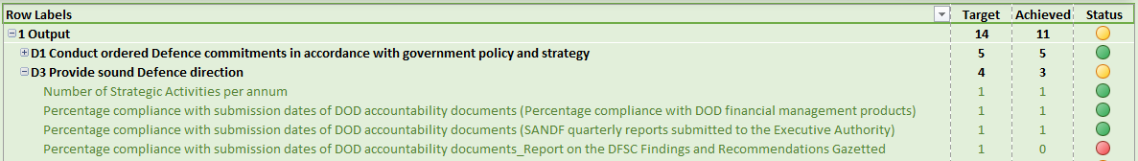
Achievement of Targets on Output Deliverables

Slide 31
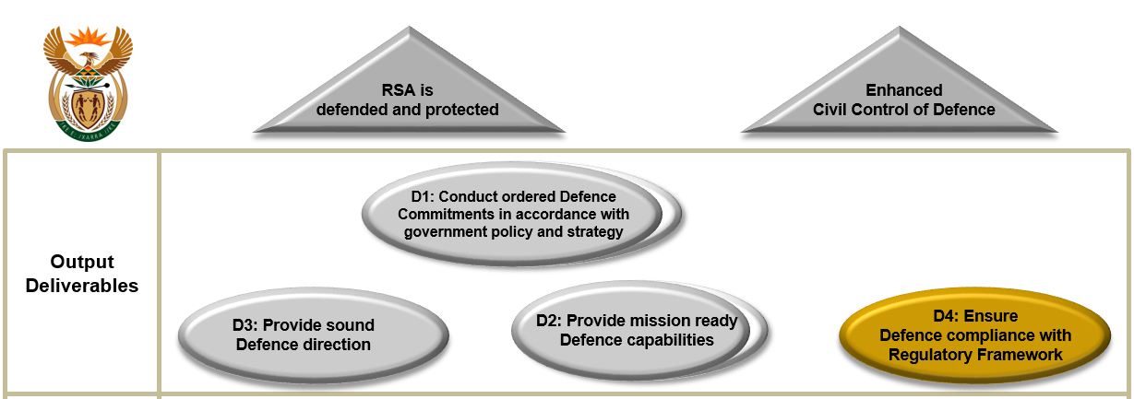
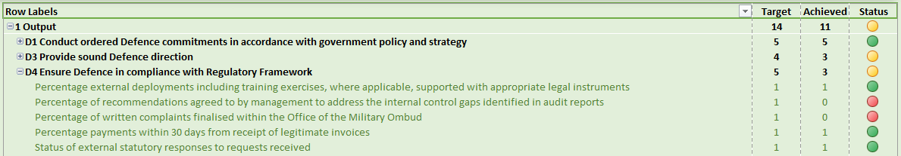
Achievement of Targets on Output Deliverables

Slide 32
Q3 Target Performance Summary
YTD Performance per Main Programme: FY2017/18

Slide 33
Q3 Target Performance Summary
Performance Indicator Owner | Achieved | Not Achieved | Total
MOD and Organs of State | 0 (0%) | 2 (100%) | 2
Defence Secretariat | 5 (62.5%) | 3 (37.5%) | 8
SANDF | 14 (67%) | 7 (33%) | 21
Total (Excluding Classified Targets) | 19 (61%) | 12 (39%) | 31

Slide 34
YTD Performance Status
 | Q1 | Q2 | Q3 | Q4 | YTD Status
Achieved | 27 (75%) | 30 (73%) | 19 (61%) | - | 76/108 (70%)
Not Achieved | 9 (25%) | 11 (27%) | 12 (39%) | - | 32/108 (30%)
Total | 36 | 41 | 31 | 93 | 201

Slide 35
Financial Performance Information

Slide 36
Summary of State of Expenditure as on 30 Sept 2017
Summary of State of Expenditure as on 31 Dec 2017
DOD Planned Expenditure: 72.4%
 | R’000
Budget Allocation | 48,999,560
Less: Expenditure | 35,517,017
Total Amount Available | 13,482,543
Percentage Expenditure (Paid) | 72.5%

Slide 37
Summary of State of Expenditure as on 31 Dec 2017

Slide 38
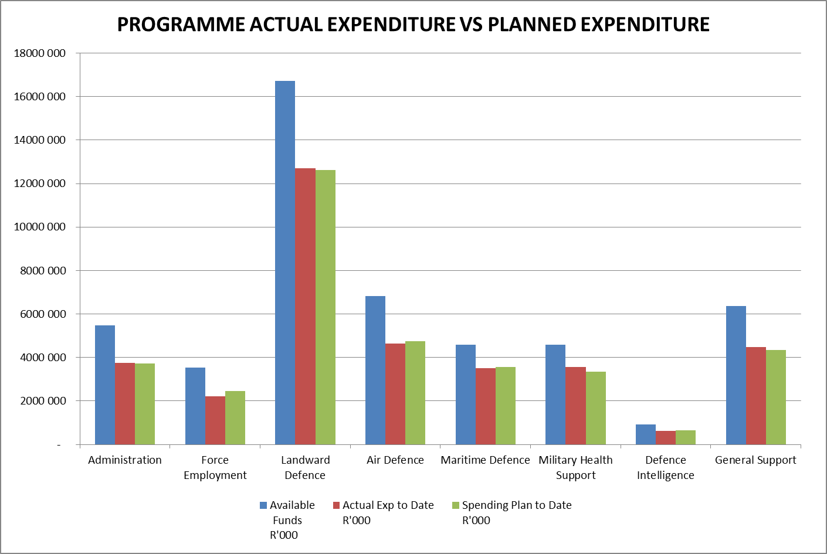
Summary of State of Expenditure as on 31 Dec 2017

Slide 39
Summary of State of Expenditure as on 31 Dec 2017
  A contributing factor to negative or positive balances of more than 8% of actual drawings per Programme is as follow:
  Force Employment. The under expenditure of R228.123 million (9.3%) was mainly due to protracted procurement processes regarding containers and other prime mission equipment to address the UN MOU’s specifications.

Slide 40
Summary of State of Expenditure per Economic Classification as on 31 Dec 2017

Slide 41
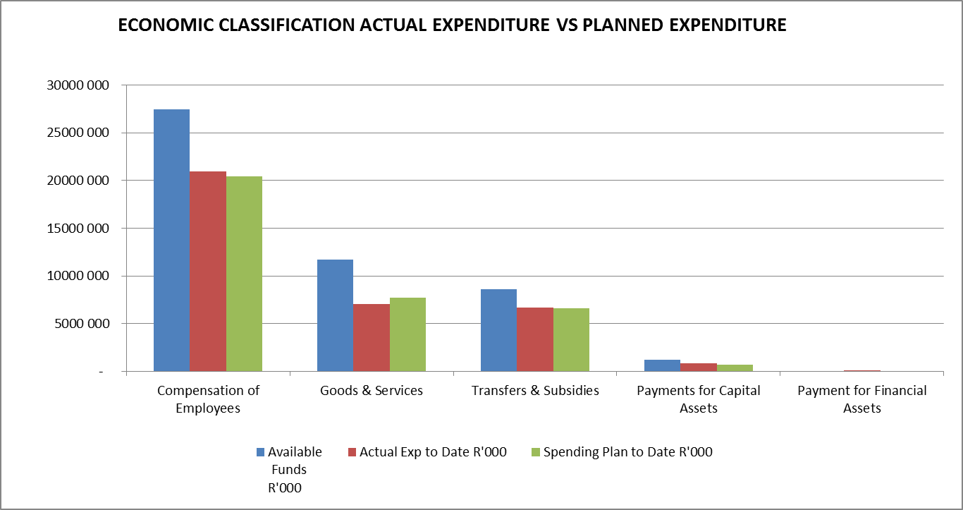
Summary of State of Expenditure per Economic Classification as on 31 Dec 2017

Slide 42
Comments on State of Expenditure per Economic Classification as on 31 Dec 2017
  Contributing factors to negative or positive balances of more than 8% of actual drawings per economic classification are as follows:
    Goods and Services. The under expenditure of R630.111 million (8.2%) was mainly due to savings within the accommodation charges portfolio and protracted procurement process. Savings would be utilised for unfunded priorities within capital expenditure.
    Payments for Capital Assets. The over expenditure of R136.642 million (19.0%) was mainly due to expenditure on Software and Intangible assets such as the implementation of the North Atlantic Treaty Organisation (NATO) Compliant Codification System and the Electronic Document Management System.
    Payment for Financial Assets. The over expenditure of R1.253 million (100%) was mainly due to transactions that create or increase outstanding debtors’ amounts as well as foreign exchange losses, thefts and other losses, etc.

Slide 43

Thank you…

