Slide 1
BRIEFING THE PORTFOLIO COMMITTEE ON POLICE REGARDING FIXED ESTABLISHMENT OF THE SAPS
BY MPHO KWINIKA
PRESIDENT OF THE SOUTH AFRICAN POLICING UNION (SAPU)
13 MARCH 2018

Slide 2
OUTLINE OF THE PRESENTATION
Introduction
The process of determining Human Resource requirements
An approved Organisational Structure of the SAPS [as on 31/12/2015]
The filling of posts at Top Management level
Observations by SAPU
Recommendations
Conclusion

Slide 3
Introduction
The Chairperson of the Portfolio Committee on Police,
Honourable members of the Committee,
Distinguished and invited guests,
Ladies and gentlemen,
First and foremost, we would like to pay our respect to the members of the SAPS who lost their life in the line of duty, including the five ambushed at Ngcobo. May their soul rest in eternal peace.
May I, on behalf of my organisation, the South African Policing Union (SAPU) express our sincere gratitude to this Committee for extending an invitation to us to make our submissions regarding the process of establishment of fixed at station level in the SAPS.

Slide 4
The process of determining Human Resource requirements
As a point of departure, we support the tried and tested process highlighted in determining the human resource in the South African Police Service (SAPS).
As indicated previously, we shall always support management in order to ensure success.
In doing so, we shall constructively point out the issues that negatively affect the SAPS as a whole.

Slide 5
An approved Organisational Structure of the SAPS
The structure that is presented in slide 8 of the SAPS document was approved on 31 December 2015.
There is no other approved replacement structure that has been consulted with the unions as required by agreements.
Let me show the unsigned version of the same structure which I am about to highlight certain aspects.

Slide 6
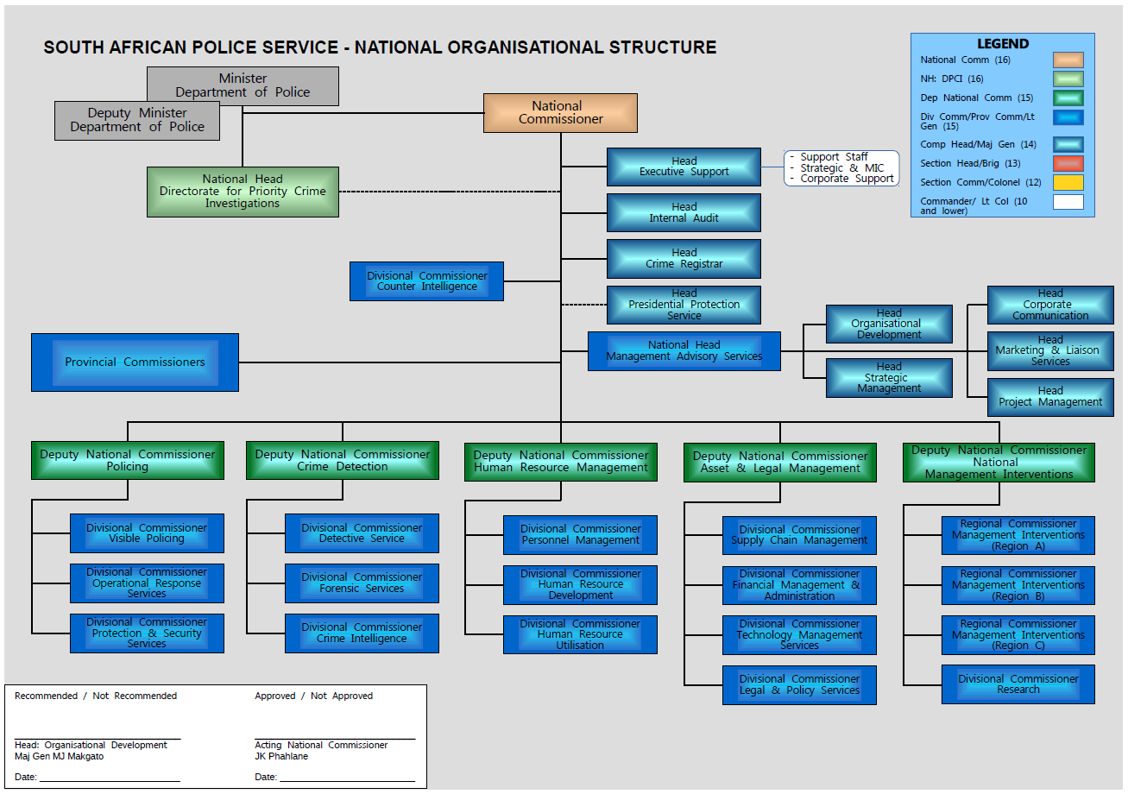

Slide 7
SUBSTITUTION OF REGULATION 8 OF THE REGULATIONS BY MINISTER OF POLICE HLEKO,MP ON 24/05/2016 with effect from 01/06/2016 REGULATION 8(1) of the SAPS as on 1 June 2016.pdf
Regulation 8 of the Regulations has been amended by the substitution of the following:
"RANKS 8. (1) The ranks in the Service, in order of precedence, are as follows:
General (appointed as National Commissioner) Lieutenant General (appointed as Deputy National Commissioner, Divisional Commissioner, Regional Commissioner or Provincial Commissioner) Major General, Brigadier, Colonel, Lieutenant Colonel, Captain, Warrant Officer, Sergeant, Constable
(2) The National Commissioner may, in individual cases, determine a rank which is not included in subregulation (1) and provide that a particular member shall hold such rank: Provided that the National Commissioner shall simultaneously determine that the rank shall for all purposes be equivalent to a rank included in subregulation ( 1 ).

Slide 8
An approved Organisational Structure of the SAPS
Section 24 of the South African Police Service Act 68 of 1995 (Police Act), empowers the Minister to make Regulations.
Regulation 8(1) of the South African Police Service Regulations, 1964 determines the ranks in the SAPS.
The Structures in the SAPS must follow the Regulations.
The current structure was approved on 31/12/2015 and the Regulations on which the new ranks were established were promulgated on 24/05/2016 and came into effect on 01/06/2016.
Surprisingly, the Regulations followed the ranks, which is totally wrong.

Slide 9
The filling of posts at Top Management posts
In this structure, the post of National Head, Directorate for Priority Crime Investigation (DPCI) is not allocated any rank but only salary level 15.
Section 17C(2)(a) of the Police Act as amended by the South African Police Service Amendment Act 57 of 2008, read: South African Police Service Amendment Act of 2008 31857_84.pdf
The Directorate comprises of the Head of the Directorate, who shall be a Deputy National Commissioner appointed by the Minister in concurrence with Cabinet.
The result was that the appointment of Anwa Dramat as Deputy National Commissioner, a clearly regulated rank, was within the law.

Slide 10
The filling of posts at Top Management posts
In this approved structure, the position of National Head, Management and Advisory Services is pitched at what is termed Lieutenant General.
But when the Regulations were passed six months later, they did not make provision for the rank of Lieutenant General.
When this post is filled, the incumbent is appointed as Lieutenant General (appointed as Deputy National Commissioner).
This DNC becomes the only DNC without Divisional Commissioners. It happens to be a Major General who has now jumped the rank of Lieutenant General (Appointed as Divisional Commissioner) and without competitive selection process as directed by the National Development Plan (NDP).

Slide 11
The filling of posts at Top Management posts
The Police Act was further amended in terms of the South African Police Service Amendment Act 10 of 2012. In terms of this amendment, section 17CA(1) reads: South african Police Service Amendment Act of 2012 35663_gon729-1.pdf
“The Minister, with the concurrence of Cabinet, shall appoint a person who is (a) South African citizen, and (b) a fit and proper person, with due regard to his or her experience, conscientiousness and integrity, to be entrusted with the responsibilities of the office concerned, as the National Head of the Directorate for a non-renewable fixed term of not shorter than seven years and not longer than 10 years.”
Based on this law, attempts to appoint Major General Ntlemeza was chaotic, to say the least. The Minister announced his appointment as Major General but in few days time he was addressed as Lieutenant General which was only settled by court.

Slide 12
The filling of posts at Top Management posts
Now, the post has been advertised with an indication that it is on salary level 15. Once again, no rank is mentioned in the advert.
The Police Act and Regulation 8(1) are deafeningly silent about the rank to be held by the incumbent. Seniority of the post is not mentioned.
Unless police management advise the Minister to amend the Regulations, the confusion will continue reign.
The same argument goes to the Deputy National Head, whose rank is not determined as reflected in section 17CA(4) of the Police Act. The current incumbent is called “Lieutenant General” which is not an existing rank.

Slide 13
Observations by SAPU
There is an excessive number of police officials at National Head Office [Slide 34].
Some posts are unnecessary and could be phased out which will release the much needed resources at production level.
We are of the view that the post of Deputy National Commissioner, Management Interventions (slide 18) is unnecessary. There are five posts on salary level 15 and many other senior managers who can better placed elsewhere.

Slide 14
Observations by SAPU
Observations by SAPU
It is clear from several misnomers that Top Management is not familiar with the names of its structures. The name of DPCI is repeatedly cited incorrectly as Directorate for Priority Crime Investigations instead of Directorate for Priority Crime Investigation [Slides 18, 19, 27].
Similarly, Top management calls its Detective Service as Detective Services, a practice that exacerbate the confusion [slide 15].
It is important that the number of satellites police stations and contact points be reflected [Slide 3] as they compete for the 120 000 posts at police stations.

Slide 15
Observations by SAPU
Observations by SAPU
The columns reflecting the number of posts reflected, such as DNC 4,4,5, and 5 does not tally and therefore not making sense as to whether they refer to the number of office bearers or the number of posts under that office bearer [Slides 27-28].
In any event, the reflection of 5 DNCs posts is misleading as there are 6 posts of DNCs.
It is unclear as to why management is presenting the 2016/2017 structures that has been abandoned and not presenting structures as on 31/01/2018. This suggests that management acknowledges that there is no approved structure in which the 6th DNC is reflected.

Slide 16
Observations by SAPU
With regard to manpower, the DPCI is under capacitated. It is undisputed that they have to investigate complex cases that generate extreme public interest. They ought not be failed by under-capacitation.
Similarly, the Detective Service is understaffed and attention should be paid to it.
It is observed that the post of Component Head Counter Intelligence has been elevated to Divisional Commissioner’s level and removed from Crime Intelligence Division and placed directly under the National Commissioner. The laws governing intelligence structures (next slide) will be upset by this move.

Slide 17
Observations by SAPU
This move tramples the Intelligence Services Oversight Act 40 of 1994. [s1, 2(1)(a), 3(a)(i) and 6(2) regarding definition, oversight, financial statement and reporting of the Joint Standing Committee on Intelligence (JSCI) and to Parliament respectively]. IntelServicesOversightAct40of1994.pdf
The Inspector General of Intelligence (IGI) will also be hampered in its oversight.
The move further undermines the National Strategic Intelligence Act 39 of 1994 which recognises Crime Intelligence Division of the SAPS as the only recognised entity defined in the Services and further recognises the Divisional Commissioner of Crime Intelligence as a member of National Intelligence Coordinating Committee (NICOC) [s4(1)(f)]. National Strategic Intelligence Act 39 of 1994.pdf

Slide 18
Observations by SAPU
It does not make sense to have the Provincial Head responsible for Communications, Liaison and Marketing as one person on the level of Brigadier but have separates post for Communication and Liaison, and Marketing at Head Office held by Major Generals.
These structures were created during General Phiyega’s era where a Component Head was elevated to a post level of “Lieutenant General”, which is non-existing rank and the Brigadiers post below elevated to Major Generals.
With the normalisation of the Component Head on Major General level, the other Major General posts that were created ought to revert to Brigadiers.

Slide 19
Observations by SAPU
Slide 26 misrepresent itself because it speaks of funded posts whereas it includes unfunded posts. It would appear that there are 4 unfunded posts on the level of DNC which is unclear as there are 5 DNCs.

Slide 20
Observations by SAPU
It is worrisome to observe that there are two civilians on the salary of Director General (National Commissioner) [slide 25].
Our concerns regarding the top heavy structure has been negated.
The composition on salary level 6 and 7 demonstrate an abnormal organisational composition where there are more personnel on level 7 than level 6 [slide 25].
This is an indication that management has dragged its heels on elevating members from level 5 to fill the gaps in level 6. The salaries that are unnecessarily spent at levels 14 and 15, could go a long way in normalising this anomaly.

Slide 21
Recommendations
We urge Top Management to urgently advice the Minister to amend Regulation 8(1) to incorporate the ranks of the National Head DPCI and its Deputy as follows:
"RANKS 8. (1) The ranks in the Service, in order of precedence, are as follows:
General (appointed as National Commissioner) Lieutenant General (appointed as National Head of the Directorate for Priority Crime Investigation, Deputy National Commissioner, Deputy National Head of the Directorate for Priority Crime Investigation, Divisional Commissioner, Regional Commissioner or Provincial Commissioner) Major General, Brigadier, Colonel, Lieutenant Colonel, Captain, Warrant Officer, Sergeant, Constable

Slide 22
Recommendations
We further urge the National Commissioner to refrain from unscientifically elevating the post of Component Head to the level of Deputy National Commissioner.
We specifically points that the post of National Head: Management Advisory Services that was created on 31/12/2015 with a non-existing rank of Lieutenant General and unilaterally and irregularly elevated to Deputy National Commissioner [Slide 27] should be de-elevated to Divisional Commissioner.
This act has created a post of DNC which, unlike all others, does not have Divisional Commissioner under it.
That abnormality points that the post should have, at least, been elevated from Component Head to Divisional Commissioner and the National Commissioner is called upon to correct that error.

Slide 23
Recommendations
Management should urgently fill the gaps in salary level 6 [Slide 25] as this is a production level.
Top Management should advise the Minister to amend section 6 of the Police Act and align it with the NDP as well as section 17CA(12)(a) which directs that the Deputy National Head of DPCI shall be appointed to act in the absence of the Head.
Never, and never again, should we be subjected to an experiment where a Divisional Commissioner is appointed as acting National Commissioner in the presence of Deputy National Commissioners.
It is even worse to have a Major General acting as National Commissioner, as these anomalies tramples the Regulations, Standing Orders and National Instructions that deals with Command, Control and Discipline.

Slide 24
Recommendations
We recommend that the post of Divisional Commissioner that resorts under the National Commissioner should be scrapped and the post continue as Component Head under Crime Intelligence Division.
The post of DNC Management Interventions and all the 4 posts resorting under it should be phased out.
We do not have Regions and the Provincial Commissioner are statutorily accountable to the National Commissioner and not Regional Commissioner.
The post of Divisional Commissioner, Research was created by General Phiyega as Head: Research Institute with the sole purpose of demoting one of her Deputies into that post. Research belong in the Component Head: Organisational Development.
The post of Human Resource Utilisation Division should be a Component within the Personnel Management Division.

Slide 25
Conclusion
The processes utilised by the SAPS to determine Human Resource are supported [slides 5 and 6-12].
The increase in personnel at station level from 62.78% to 65% is supported [slide 23].
To get it right at station level, you need to get it right at the top.
To achieve the above objectives, the recommendations submitted should be considered.
We are, as always, offer our contributions to Police leadership.
I thank you.

