Slide 1
QUARTERLY PERFORMANCE
PRESENTATION
QUARTER 2 AND 3
presentation to THE Portfolio Committee on Home Affairs
06 MARCH 2018

Slide 2
CONTENT
1. Vision, Mission and Value Statement.
2. Supporting the Priorities and Outcomes of Government.
3. DHA Outcomes and Strategic Objectives.
4. Progress against objectives : July – Dec 2017.
5. Major challenges : July – Dec 2017.
6. Performance Per Branch.
7. Performance Per Programme.
8. Budget vs Actual Expenditure as at December 2017.

Slide 3
VISION, MISSION AND VALUES
VISION
A safe, secure South Africa where all of its people are proud of, and value, their identity and citizenship
MISSION
The efficient determination and safeguarding of the identity and status of citizens and the regulation of immigration to ensure security, promote development and fulfil our international obligations
Value Statement
The Department of Home Affairs is committed to being:
• People-centred and caring;
• Patriotic;
• Professional and having
integrity;
• Corruption free and ethical;
• Efficient and innovative;
• Disciplined and security
conscious

Slide 4
SUPPORTING GOVERNMENT PRIORITIES
The DHA contributes directly to four of the 14 Outcomes of Government:
Quality basic education.
A long and healthy life for all.
All people in South Africa are and feel safe.
Decent employment through inclusive economic growth.
Skilled and capable workforce to support an inclusive growth path.
An efficient competitive and responsive economic infrastructure network.
Vibrant equitable sustainable rural communities contributing to food security for all.
Sustainable human settlements and improved quality of household life.
Responsive accountable effective and efficient local government system.
Protect and enhance our environmental assets and natural resources.
Create a better South Africa a better Africa and a better world.
An efficient effective and development oriented public service.
Social protection.
Nation building and social cohesion.

Slide 5
DHA OUTCOMES AND STRATEGIC OBJECTIVES
Outcome 2:
Secured and responsive immigration system.
Strategic Objectives:
Refugees and asylum seekers are managed and documented efficiently.
Movement of persons in and out of the country regulated according to a risk based approach.
Enabling documents issued to foreigners efficiently and securely.
Outcome 3:
Services to citizens and other clients that are accessible and efficient.
Strategic Objectives:
Secure, effective, efficient and accessible service delivery to citizens and immigrants.
Good governance and administration.
Ethical conduct and zero tolerance approach to crime, fraud and corruption.
Collaboration with stakeholders in support of enhanced service delivery and core business objectives..
Outcome 1:
Secured South African citizenship and identity.
Strategic Objectives:
All eligible citizens are issued with enabling documents relating to identity and status.
An integrated and digitised National Identity System (NIS) that is secure and contains biometric details of every person recorded on the system..

Slide 6
PERFORMANCE ANALYSIS OVER TWO QUARTERS
The Department had a total of 32 targets planned for the quarter 2 of 2017/18 financial year. 22 targets were achieved representing a 69% achievement rate, and 10 (31%) targets were not achieved.
The Department had a total of 32 targets planned for the quarter 2 of 2017/18 financial year. 22 targets were achieved representing a 69% achievement rate, and 10 (31%) targets were not achieved.
The Department had a total of 33 targets planned for the quarter 3 of 2017/18 financial year. 22 targets were achieved representing a 67% achievement rate, and 11 (33%) targets were not achieved.
6

Slide 7
PERFORMANCE ANALYSIS OVER THREE QUARTERS

Slide 8
PROGRAMME 1: ADMINISTRATION
Strategic objectives Supported by the targets | 1.2: An integrated and digitised National Identity System (NIS) that is secure and contains biometric details of every person recorded on the system.
 | 1.3:Ensure that systems are in place to enable the capturing of biometric data of all travellers who enter or exit SA legally.
 | 3.1: Secure, effective, efficient and accessible service delivery to citizens and immigrants.
 | 3.2 Good governance and administration.
 | 3.3 Ethical conduct and zero tolerance approach to crime, fraud and corruption.
 | 3.4 Collaboration with stakeholders in support of enhanced service delivery and core business objectives.

Slide 9
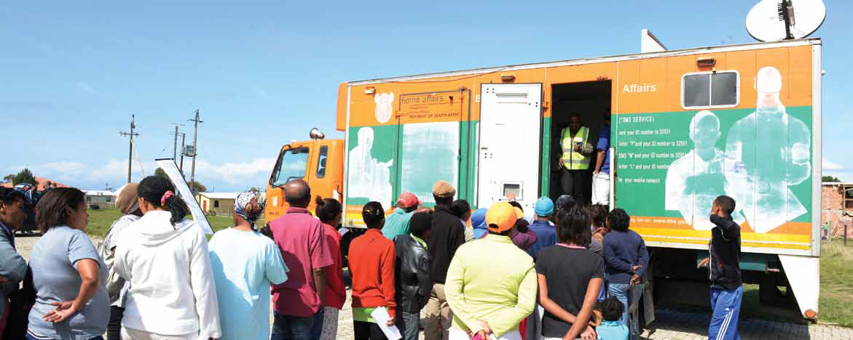
PROGRAMME 1: ADMINISTRATION

Slide 10
PROGRAMME 1: ADMINISTRATION
Strategic Objective 1.2: An integrated and digitised National Identity System (NIS) that is secure and contains biometric details of every person recorded on the system
Annual Target | Q2 Target (2017/18) | Q3 Target (2017/18)
Citizenship and Amendment processes developed onto live capture. | Business requirement specifications for Citizenship and Amendments approved by DDG: CS . | Technical specifications for Citizenship and Amendments approved by DDG: IS .
ACTUAL PER QUARTER | Not Achieved Business requirements for Citizenship and Amendments not approved. | Not Achieved Business requirements specifications concluded awaiting DDG: CS approval.

Slide 11
PROGRAMME 1: ADMINISTRATION
Strategic Objective 1.2: An integrated and digitised National Identity System (NIS) that is secure and contains biometric details of every person recorded on the system
Annual Target | Q2 Target (2017/18) | Q3 Target (2017/18)
Impact analysis report signed off by DDG:CS and DDG: IMS (AFIS). | Service provider appointed. | N/A
ACTUAL PER QUARTER | Achieved Service provider appointed. | N/A

Slide 12
PROGRAMME 1: ADMINISTRATION
Strategic Objective 1.3:Ensure that systems are in place to enable the capturing of biometric data of all travellers who enter or exit SA legally
Annual Target | Q2 Target (2017/18) | Q3 Target (2017/18)
EMCS (full biometric scope) piloted at one port of entry. | N/A | EMCS (full biometric scope) developed.
ACTUAL PER QUARTER | N/A | Not Achieved Technical specifications approved and development has commenced.

Slide 13
PROGRAMME 1: ADMINISTRATION
Strategic Objective 3.1: Secure, effective, efficient and accessible service delivery to citizens and immigrants
Annual Target | Q2 Target (2017/18) | Q3 Target (2017/18)
300 managers (junior, middle and senior) trained in leadership and management development programmes to improve performance. | 90 managers (junior, middle and senior) trained in leadership and management development programmes to improve performance. | 75 managers (junior, middle and senior) trained in leadership and management development programmes to improve performance.
ACTUAL PER QUARTER | Achieved A total of 688 Managers were trained: 11 Senior Managers, 145 Middle Managers and 532 Junior managers were trained on leadership and management development programmes (EMDP and Case Management Systems). | Achieved A total of 229 Managers were trained: 26 Senior Managers, 67 Middle Managers and 135 Junior Managers were trained on leadership and management development programmes (EMDP, AMDP, Mentoring, Project Management, Operations Management and Performance Management.

Slide 14
PROGRAMME 1: ADMINISTRATION
Strategic Objective 3.1: Secure, effective, efficient and accessible service delivery to citizens and immigrants
Annual Target | Q2 Target (2017/18) | Q3 Target (2017/18)
Draft White Paper submitted to Minister for approval. | Consolidated report on inputs from Discussion Paper consultations presented to EXCO. | First draft of White Paper submitted to Minister for comment.
ACTUAL PER QUARTER | Not Achieved 11 July - National Policy Dialogue – Launched by Minister. 13 July - First Change Management Workshop. 19 July - ESEID (Economic Cluster). 26 July - Western Cape Road Show. 10 Aug - North West Road Show. 14-15 Aug - Workshop with HR to launch the Change Management project. 22 Aug - Limpopo Road Show. 30 Aug - Northern Cape (Office of the Premier) Exco meeting . 12 - 15 Sept - Change Management Workshop in North West. 14 Sept - Mpumalanga Road Show. 20 Sept - Eastern Cape Road Show. 29 Sept - National Colloquium. In addition: important bilaterals were held with SSA structures and with the DTPS. | Not Achieved

Slide 15
PROGRAMME 1: ADMINISTRATION
Strategic Objective 3.2: Good governance and administration
Annual Target | Q2 Target (2017/18) | Q3 Target (2017/18)
Vacancy rate maintained at 10% or below by 31 March 2018. | Vacancy rate maintained at 10% or below. | Vacancy rate maintained at 10% or below.
ACTUAL PER QUARTER | Achieved Department vacancy rate recorded at - 31 July 2017 - 6.1% 31 August 2017 - 6.1% 30 September 2017 - 5% | Achieved Department vacancy rate recorded at - 31 October 2017 – 5.5% 30 November 2017 – 5.5% 31 December 2017 – 5.4%

Slide 16
PROGRAMME 1: ADMINISTRATION
Strategic Objective 3.2: Good governance and administration
Annual Target | Q2 Target (2017/18) | Q3 Target (2017/18)
Request for Qualification (RfQ) issued to the market. | Draft Request for Qualification document approved by BMA PMO. | Request for Qualification document submitted to National Treasury for approval.
ACTUAL PER QUARTER | Not Achieved A draft RfQ has been prepared however, key consultations need to be concluded in order for the RfQ to be finalised. The draft RfQ will be submitted to NT for approval before it is issued to the market. | Not Achieved A final draft RfQ has been prepared. Final comments have been requested from the Transaction Advisor, DHA's senior management and National Treasury’s Public-Private Partnership (PPP) Unit.

Slide 17
PROGRAMME 1: ADMINISTRATION
Strategic Objective 3.3: Ethical conduct and zero tolerance approach to crime, fraud and corruption
Annual Target | Q2 Target (2017/18) | Q3 Target (2017/18)
20 of awareness initiatives on ethics, fraud prevention and counter corruption. | 5 of awareness initiatives on ethics, fraud prevention and counter corruption conducted. | 5 of awareness initiatives on ethics, fraud prevention and counter corruption conducted.
ACTUAL PER QUARTER | Achieved 18 awareness initiatives on ethics, fraud prevention and counter corruption conducted. | Achieved 7 awareness initiatives on ethics, fraud prevention and counter corruption conducted.

Slide 18
PROGRAMME 1: ADMINISTRATION
Strategic Objective 3.3: Ethical conduct and zero tolerance approach to crime, fraud and corruption
Annual Target | Q2 Target (2017/18) | Q3 Target (2017/18)
66 % of reported case investigations finalised within 90 working days. | 66 % of reported case investigations finalised within 90 working days. | 66 % of reported case investigations finalised within 90 working days.
ACTUAL PER QUARTER | Not Achieved 62.9 % of reported cases finalised investigated and finalised within 90 working days. Received 105 Finalised 92 66 finalised within 90 days Pending 13. | Achieved 83 % of reported cases investigated and finalised within 90 working days. Received 83 Finalised 75 Pending 8

Slide 19
PROGRAMME 1: ADMINISTRATION
Strategic Objective 3.3: Ethical conduct and zero tolerance approach to crime, fraud and corruption
Annual Target | Q2 Target (2017/18) | Q3 Target (2017/18)
2 detection reviews / security evaluations on processes conducted to identify possible vulnerabilities to fraud, corruption and security breaches in business processes (approved by DDG:CCSS and reports submitted to affected business units for implementation of recommendations) . | 1 review report signed off by DDG: CCSS and submitted to affected business unit for implementation of recommendations. | Plan (research and information gathering) approved by DDG:CCSS for first business process to be reviewed.
ACTUAL PER QUARTER | Achieved 1 process review conducted on Smart ID Card and report signed off by A/DG and submitted to affected business unit for implementation of recommendations. | Achieved 1 process review conducted on Marriage and report signed off by DG and submitted to affected business unit for implementation of recommendations .

Slide 20
PROGRAMME 1: ADMINISTRATION
Strategic Objective 3.3: Ethical conduct and zero tolerance approach to crime, fraud and corruption
Annual Target | Q2 Target (2017/18) | Q3 Target (2017/18)
80 Threats and Risk Assessments (TRAs) conducted in accordance with the requirements of Minimum Information- (MISS) and / or Physical Security Standards (MPSS. | 20 Threats and Risk Assessments (TRAs) conducted in accordance with the requirements of Minimum Information- (MISS) and / or Physical Security Standards (MPSS). | 20 Threats and Risk Assessments (TRAs) conducted in accordance with the requirements of Minimum Information- (MISS) and / or Physical Security Standards (MPSS).
ACTUAL PER QUARTER | Achieved 27 Threats and Risk Assessments (TRAs) conducted in accordance with the requirements of Minimum Information- (MISS) and / or Physical Security Standards (MPSS). | Not Achieved 19 Threats and Risk Assessments (TRAs) conducted in accordance with the requirements of Minimum Information- (MISS) and / or Physical Security Standards (MPSS).

Slide 21
PROGRAMME 1: ADMINISTRATION
Strategic Objective 3.3: Ethical conduct and zero tolerance approach to crime, fraud and corruption
Annual Target | Q2 Target (2017/18) | Q3 Target (2017/18)
572 vetting file finalised and referred to State Security Agency (SSA). | 156 vetting files finalised and referred to State Security Agency (SSA). | 130 vetting files finalised and referred to State Security Agency (SSA).
ACTUAL PER QUARTER | Achieved 209 (119 confidential and 90 secret and top secret files) vetting fieldwork investigations finalised and referred to State Security Agency (SSA). | Achieved 144 vetting files finalised and referred to State Security Agency (SSA).

Slide 22
PROGRAMME 1: ADMINISTRATION
Strategic Objective 3.3: Ethical conduct and zero tolerance approach to crime, fraud and corruption
Annual Target | Q2 Target (2017/18) | Q3 Target (2017/18)
70% of reported misconduct cases submitted to a presiding officer for consideration. | 70% of reported misconduct cases submitted to a presiding officer for consideration. | 70% of reported misconduct cases submitted to a presiding officer for consideration.
ACTUAL PER QUARTER | Not Achieved 44 of 473 cases were submitted to presiding officer for consideration. Thus 9% of cases were submitted to presiding officer for consideration. | Not Achieved 32 of 429 cases were submitted to presiding officer for consideration. Thus 7% of cases were submitted to presiding officer for consideration.

Slide 23
PROGRAMME 1: ADMINISTRATION
Strategic Objective 3.4: Collaboration with stakeholders in support of enhanced service delivery and core business objectives
Annual Target | Q2 Target (2017/18) | Q3 Target (2017/18)
Communication strategy and action plan implemented with a focus on Corporate Communication Services, Media Relations and Public Awareness Engagements,(Annual Targets 4 publication of Ikhaya Internal newsletter 28 media engagements 6 Ministerial Imbizo 1 Budget Vote Communication event 11 Ministerial Home Affairs Today 8 Notes from the DG’s desk 2 Campaign | 1 publication of Ikhaya Internal newsletter . | 1publication of Ikhaya Internal newsletter.
 | Achieved 1 publication of Ikhaya Internal newsletter produced. | Achieved 1 publication of Ikhaya internal newsletter produced.
 | 7 media engagements. | 7 media engagements.
 | Achieved 8 Media engagements organised. | Achieved 12 Media engagements organised.

Slide 24
PROGRAMME 1: ADMINISTRATION
Strategic Objective 3.4: Collaboration with stakeholders in support of enhanced service delivery and core business objectives
Annual Target | Q2 Target (2017/18) | Q3 Target (2017/18)
Communication strategy and action plan implemented with a focus on Corporate Communication Services, Media Relations and Public Awareness Engagements,(Annual Targets 4 publication of Ikhaya Internal newsletter 28 media engagements 6 Ministerial Imbizo 1 Budget Vote Communication event 11 Ministerial Home Affairs Today 8 Notes from the DG’s desk 2 Campaign | 3 Ministerial Home Affairs Today. | 3 Ministerial Home Affairs Today.
 | Achieved 3 Ministerial Home Affairs Today produced. | Achieved 3 Ministerial Home Affairs Today produced.
 | 2 Ministerial Imbizo. | 2 Ministerial Imbizo.
 | Achieved 1 Ministerial Imbizo organised in the Free State at Welkom on 26 August 2017. 1 Ministerial engagement with stakeholders on White Paper on International Migration at Wits Club University on the 20 September 2017 organised. | Achieved 1 Ministerial Imbizo organised at Plettenberg Bay, Cape Town on the 04 December 2017. 1 Ministerial engagement with community members at Azzandville Ahmed Timol Secondary School on the 02 December 2017 organised.

Slide 25
PROGRAMME 1: ADMINISTRATION
Strategic Objective 3.4: Collaboration with stakeholders in support of enhanced service delivery and core business objectives
Annual Target | Q2 Target (2017/18) | Q3 Target (2017/18)
Communication strategy and action plan implemented with a focus on Corporate Communication Services, Media Relations and Public Awareness Engagements,(Annual Targets 4 publication of Ikhaya Internal newsletter 28 media engagements 6 Ministerial Imbizo 1 Budget Vote Communication event 11 Ministerial Home Affairs Today 8 Notes from the DG’s desk 2 Campaign | 2 Notes from the DG’s desk. | 2 Notes from the DG’s desk.
 | Achieved 4 Notes from the DG’s desk produced. | Achieved 4 Notes from the DG’s desk produced.
 | N/A | 1 Campaign.
 | N/A | Achieved 2 Campaigns conducted: -1 Birth Registration Campaign -1 Smart ID Card Campaign.

Slide 26
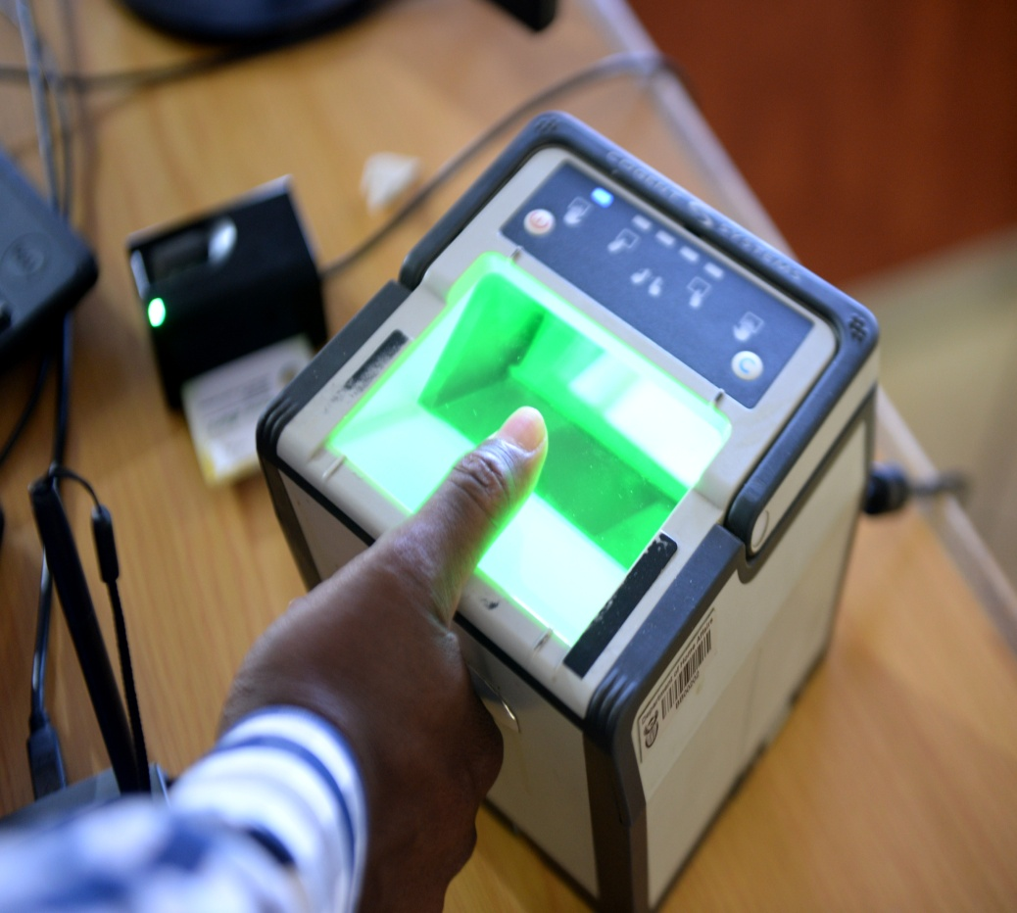
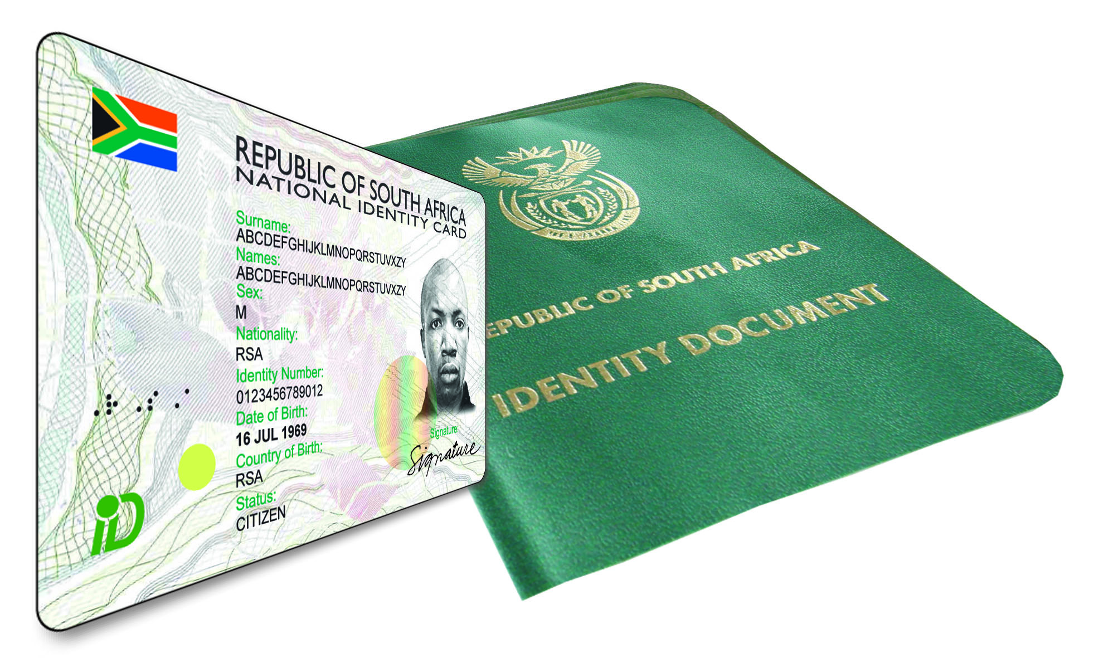
PROGRAMME 2: CITIZEN AFFAIRS
Strategic objectives Supported by the targets | Strategic Objective 1.1: All eligible citizens are issued with enabling documents relating to identity and status.

Slide 27
PROGRAMME 2: CITIZEN AFFAIRS
Strategic Objective 1.1: All eligible citizens are issued with enabling documents relating to identity and status
Annual Target | Q2 Target (2017/18) | Q3 Target (2017/18)
750 000 Births registered within 30 calendar days. | 190 564 births registered within 30 calendar days. | 170 106 births registered within 30 calendar days.
ACTUAL PER QUARTER | Achieved 194 811 births were registered within 30 calendar days. | Achieved 182 248 births were registered within 30 calendar days.
3 million ID Smart cards issued to citizens 16 years and above. | 750 000 ID Smart cards issued to citizens 16 years and above. | 690 000 ID Smart cards issued to citizens 16 years and above.
ACTUAL PER QUARTER | Not Achieved 622 299 ID Smart cards were issued to citizens 16 years and above. | Achieved 694 319 ID Smart cards were issued to citizens 16 years and above.

Slide 28
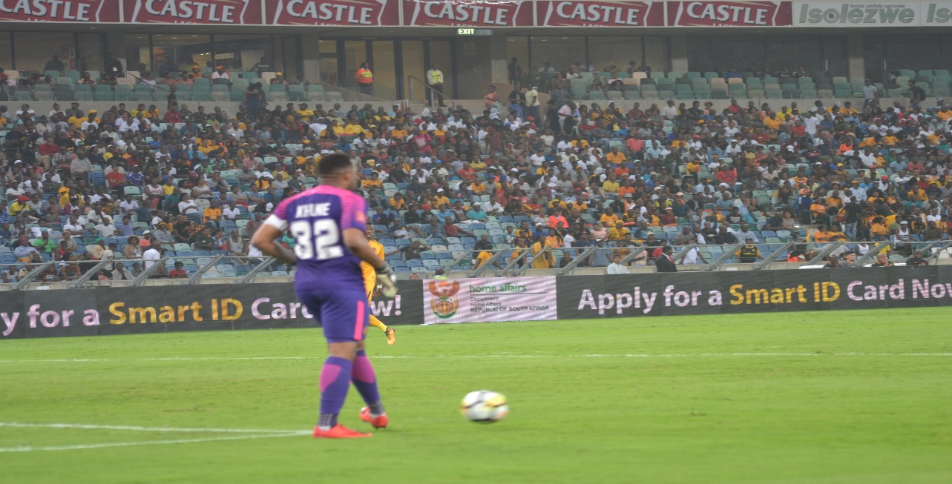
PROGRAMME 2: CITIZEN AFFAIRS

Slide 29
PROGRAMME 2: CITIZEN AFFAIRS
Strategic Objective 1.1: All eligible citizens are issued with enabling documents relating to identity and status
Annual Target | Q2 Target (2017/18) | Q3 Target (2017/18)
Strategy for “Discontinuation of the Green Barcoded Identity Document” approved by Minister. | The strategy document was signed-off by the acting DDG:IS. | Strategy presented to EXCO and MMM (internal stakeholders) and SABRIC, JCPS and G&A clusters (external stakeholders) .
ACTUAL PER QUARTER | Achieved The strategy document was signed-off by the acting DDG: CS on 29 September 2017. | Not Achieved Strategy presented to EXCO and SABRIC, however it was distributed to MMM, JCPS and G&A clusters due to postponements from the three stakeholders.
Mobile solution for live capture piloted in 9 offices. | Technical specifications signed off by DDG: IS. | Mobile live capture solution developed.
ACTUAL PER QUARTER | Achieved The technical specifications were duly signed off by acting DDG: IS. | Achieved The mobile live capture solution developed N.B: Live Capture solution is deployed in the mobile truck and able to capture non-paying re-issues.

Slide 30
PROGRAMME 2: CITIZEN AFFAIRS
Strategic Objective 1.1: All eligible citizens are issued with enabling documents relating to identity and status
Annual Target | Q2 Target (2017/18) | Q3 Target (2017/18)
90% of machine readable passports (new live capture system) issued within 13 working days for applications collected and processed within the RSA (from date of receipt of application until passport is scanned at office of application. | 90% of machine readable passports (new live capture system) issued within 13 working days for applications collected and processed within the RSA (from date of receipt of application until passport is scanned at office of application. | 90% of machine readable passports (new live capture system) issued within 13 working days for applications collected and processed within the RSA (from date of receipt of application until passport is scanned at office of application.
ACTUAL PER QUARTER | Not Achieved 86,10% of machine readable passports (new live capture system) were issued within 13 working days. | Achieved 90,91% of machine readable passports (new live capture system) were issued within 13 working days.

Slide 31
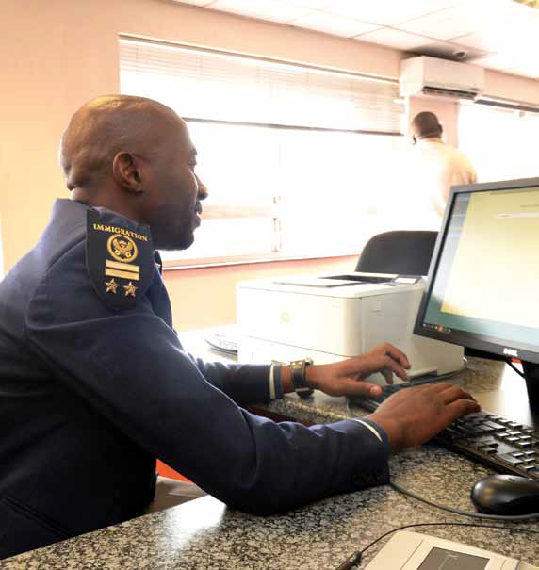
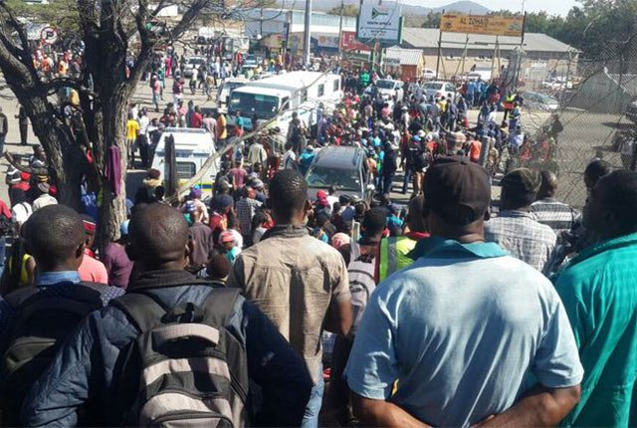
PROGRAMME 3: IMMIGRATION SERVICES
Strategic objectives supported by the targets | 2.1 Refugees and asylum seekers are managed and documented efficiently.
 | 2.2 Movement of persons in and out of the country managed according to a risk-based
 | 2.3 Enabling documents issued to foreigners efficiently and securely.

Slide 32
PROGPROGRAMME 3: IMMIGRATION SERVICES
RAMME 3: IMMIGRATION AFFAIRS
Strategic Objective 2.1: Refugees and asylum seekers are managed and documented efficiently.
Annual Target | Q2 Target (2017/18) | Q3 Target (2017/18)
Feasibility report submitted to National Treasury for TAI approval. | Option analysis performed by service provider and report submitted to DG. | Affordability, risk transfer and value for money analysis demonstrated by Transaction Advisor and report submitted to DG.
ACTUAL PER QUARTER | Not Achieved In June 2017 a letter requesting the registration of the Lebombo Processing Centre was signed by DG for transmission to National Treasury. Lebombo has since been registered as a project with the NT. Meetings to discuss the scope of engagement and terms of reference delayed until 24 August 2017. Way forward was agreed up and necessary documents developed. Project was then presented at the BAC on 30 August 2017 asking for the establishment of both the Bid Specification and Bid Evaluation Committees. In this phase further delays occurred in trying to get all committee members seating. | Not Achieved The target was not achieved as the preferred Service Provider will only be appointed mid January 2018 and expected to start with feasibility in February 2018. The Bid Adjudication was only concluded in December 2017. There were delays at the BAC and in placing the advert at DPW.

Slide 33
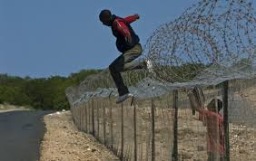
PROGRAMME 3: IMMIGRATION SERVICES
PROGRAMME 3: IMMIGRATION AFFAIRS

Slide 34
PROGRAMME 3: IMMIGRATION SERVICES
PROGRAMME 3: IMMIGRATION AFFAIRS
Strategic Objective 2.2: Movement of persons in and out of the country regulated according to a risk-based approach
Annual Target | Q2 Target (2017/18) | Q3 Target (2017/18)
100 law enforcement operations / inspections conducted to ensure compliance with immigration and departmental legislation. | 25 law enforcement operations / inspections conducted to ensure compliance with immigration and departmental legislation. | 25 law enforcement operations / inspections conducted to ensure compliance with immigration and departmental legislation.
ACTUAL PER QUARTER | Achieved 49 inspections/operations were conducted. | Not Achieved 20 inspections/operations were conducted.

Slide 35
PROGRAPROGRAMME 3: IMMIGRATION SERVICES
MME 3: IMMIGRATION AFFAIRS
Strategic Objective 2.2: Movement of persons in and out of the country regulated according to a risk-based approach
Annual Target | Q2 Target (2017/18) | Q3 Target (2017/18)
BMA Road Map approved by Minister. | 1st Draft of BMA Road Map presented at EXCO and Minister’s Management Meeting (MMM). | 2nd Draft of BMA Road Map presented at EXCO and MMM.
ACTUAL PER QUARTER | Not Achieved An initial draft BMA Road Map was presented to DHA’s EXCO in May 2017 where after, the Road Map was reviewed and aligned to the inputs provided by EXCO. At the meeting, EXCO endorsed the submission of the Road Map to Minister’s Management Meeting (MMM). It should be noted that the resulting draft Road Map was considered the 1st draft of the BMA Road Map. The 1st draft BMA Road Map was submitted to MMM but was reprioritised. However, the draft has been submitted to the Minister and a briefing was provided to the Office of the Minister in September 2017. | Not Achieved The 1st draft BMA Road Map was submitted to MMM but was reprioritised. A copy of the draft has been submitted to the Office of the Minister.

Slide 36
PROGRAMME 3PROGRAMME 3: IMMIGRATION SERVICES
IMMIGRATION AFFAIRS
Strategic Objective 2.2: Movement of persons in and out of the country regulated according to a risk-based approach
Annual Target | Q2 Target (2017/18) | Q3 Target (2017/18)
Implementation of Integrated Border Management Strategy monitored by BMA (Action Plans of various organs of state) . | Monitoring conducted through quarterly IBMS implementation progress reports submitted to Minister . | Monitoring conducted through quarterly IBMS implementation progress reports submitted to Minister.
ACTUAL PER QUARTER | Not Achieved The 2nd Quarter Report on the implementation of the IBMS was not submitted to the Minister of Home Affairs because Implementation reports have not been forthcoming from organs of state despite requests for reports by the BMA PMO. The BMA PMO convened a Workshop in September 2017 to solicit inputs from organs of state. It was agreed at the Workshop that organs of state would provide inputs in early October in order for the BMA PMO to consolidate a 2nd quarter report on the implementation of the IBMS for submission to Minister. | Achieved A 3rd Quarter progress report has been submitted to Minister. It should be noted that the Report was finalised and submitted in January 2018 as organs of state were requested to provide inputs by early January 2018 due to the festive season break.

Slide 37
PROGRAMMEPROGRAMME 3: IMMIGRATION SERVICES
Strategic Objective 2.2: Movement of persons in and out of the country regulated according to a risk-based approach
Annual Target | Q2 Target (2017/18) | Q3 Target (2017/18)
Immigration and Refugees Bills approved by Minister for submission to Cabinet. | 1.Immigration Amendment Bill drafted and approved by DDG: IMS . 2.Refugees Amendment Bill drafted and approved by DDG: IMS . | 1.Immigration Amendment Bill submitted to EXCO for consideration. 2.Refugees Amendment Bill submitted to EXCO for consideration.
ACTUAL PER QUARTER | 1.Achieved 2.Achieved | Not Achieved 1.Submission for approval of preliminary analysis returned by Minister for redrafting. 2.Redrafted submission prepared and forwarded to Minister .

Slide 38
PROGRPROGRAMME 3: IMMIGRATION SERVICES
AMME 3: IMMIGRATION AFFAIRS
Strategic Objective 2.2: Movement of persons in and out of the country regulated according to a risk-based approach
Annual Target | Q2 Target (2017/18) | Q3 Target (2017/18)
6 selected ports of entry with either improved residential or improved office accommodation or both as per set standards. | Improvements at 1 port of entry | Improvements at 2 ports of entry.
ACTUAL PER QUARTER | Achieved Selected ports have been completed and finalised that allows for the roll out as per quarterly target. | Achieved 2 Selected Ports of Entry (Ramatlabama and Kopfontein completed) have been improved. Groblers Bridge was scheduled for Q4 but was completed during this quarter. APP Target for the year has been achieved.

Slide 39
PROGRAMMPROGRAMME 3: IMMIGRATION SERVICES
E 3: IMMIGRATION AFFAIRS
Strategic Objective 2.3: Enabling documents issued to foreigners efficiently and securely
Annual Target | Q2 Target (2017/18) | Q3 Target (2017/18)
85%of permanent residence applications adjudicated within 8 months for applications collected within the RSA(from date of receipt of application until outcome is received at the office of application) (Above applications refer to : critical skills (s27b), general work (s26a) and business (s27c) only). | 85%of permanent residence applications adjudicated within 8 months for applications collected within the RSA. | 85%of permanent residence applications adjudicated within 8 months for applications collected within the RSA.
ACTUAL PER QUARTER | Achieved 98% (1 594 out of 1 617) of permanent residence applications adjudicated within 8 months for applications collected within the RSA. | Achieved 96% (1 984 out of 2 067) of permanent residence applications adjudicated within 8 months for applications collected within the RSA.

Slide 40
PROGRAMME 3: IMMIGRATION SERVICES
Strategic Objective 2.3: Enabling documents issued to foreigners efficiently and securely
Annual Target | Q2 Target (2017/18) | Q3 Target (2017/18)
90% of business and general work visas adjudicated within 8 weeks for applications processed within the RSA (from date of receipt of application until outcome is in scan at VFS Centre Office of Application). | 90% of business and general work visas adjudicated within 8 weeks for applications processed within the RSA. | 90% of business and general work visas adjudicated within 8 weeks for applications processed within the RSA.
ACTUAL PER QUARTER | Achieved 99% (351 out of 355) of business and general work visas adjudicated within 8 weeks for applications processed within the RSA. | Achieved 97.5% (391 out of 401) of business and general work visas adjudicated within 8 weeks for applications processed within the RSA.

Slide 41
PROGRPROGRAMME 3: IMMIGRATION SERVICES
AMME 3: IMMIGRATION AFFAIRS
Strategic Objective 2.3: Enabling documents issued to foreigners efficiently and securely
Annual Target | Q2 Target (2017/18) | Q3 Target (2017/18)
80% of critical skills visas adjudicated within 4 weeks for applications processed within the RSA (from date of receipt of application until outcome is in scan at VFS Centre - Office of Application). | 80% of critical skills visas adjudicated within 4 weeks for applications processed within the RSA (from date of receipt of application until outcome is in scan at VFS Centre - Office of Application). | 80% of critical skills visas adjudicated within 4 weeks for applications processed within the RSA (from date of receipt of application until outcome is in scan at VFS Centre - Office of Application).
ACTUAL PER QUARTER | Achieved 89% (1 446 out of 1 627) of critical skills visas adjudicated within 4 weeks for applications processed within the RSA (from date of receipt of application until outcome is received at the office of application. | Achieved 90% (1 602 out of 1 781) of critical skills visas adjudicated within 4 weeks for applications processed within the RSA (from date of receipt of application until outcome is received at the office of application.

Slide 42
Strategies to ensure the achievement of the core targets of the Department: Civic Services and Immigration Services
Annual Target : 3 million smart ID cards issued to citizens 16 years of age and above
Provinces will be evaluated continuously and be provided with the requisite support.
Inviting learners and Government institutions to apply for Smart ID Cards on Saturdays; designated offices.
Collaboration with Communication Branch where advertisement for Smart ID Card will be displayed at identified Airports.
Continous application of the War room approach for the early detection of processing hiccups at various stages within the system.
Mobile units are piloted to strengthen the issuance of smart ID cards.
42

Slide 43
Strategies to ensure the achievement of the core targets of the Department: Civic Services and Immigration Services
Annual Target : Strategy for “Discontinuation of the Green Barcoded Identity Document” approved by Minister
A slot has been secured to present the strategy to the JCPS and G&A clusters for consultation.
Preparation of submission to the Minister for approval of the strategy.
Annual Target : 100 law enforcement operations / inspections conducted to ensure compliance with immigration and departmental legislation
During quarter 4 , the Department will target specific weeks for inspections and will be able to meet/exceed the target.
Annual Target : Immigration and Refugees Bills approved by Minister for submission to Cabinet
The drafting of new Bill has been completed and to be presented to Minister by March 2018.
43

Slide 44
Strategies to ensure the achievement of the core targets of the Department: Civic Services and Immigration Services
Annual Target : Feasibility report submitted to National Treasury for TAI approval
Service Provider has been appointed and the project deliverables will be closely monitored over the remaining period.
Annual Target :Request for Qualification (RfQ) issued to the market (BMA)
A request for approval for the RFQ has been submitted to National Treasury.
Annual Target : BMA Road Map approved by Minister
BMA Road Map has been approved by the Minister.
44

Slide 45
Strategies to ensure the achievement of the overall targets of the Department
Constant monitoring of the targets at risk i.e. presentation of progress reports at all the EXCO meetings.
Close relationship and swift responses to the preliminary findings raised by the Auditor General.
Filling of strategic posts in the Department.
45

Slide 46
DEPARTMENTAL PERFORMANCE AS AT 31 DECEMBER 2017

Slide 47
ANNUAL PERFORMANCE PROJECTION
.
2017/18 FYI: NOT ACHIEVED TARGETS
EMCS (full biometric scope) piloted at one port of entry.
3 million ID Smart cards issued to citizens 16 years and above.
70% of reported misconduct cases submitted to a presiding officer for consideration.
47

Slide 48
DEPARTMENTAL PERFORMANCE: PROJECTION OF 2017/18 YEAR END

Slide 49
Budget vs Actual Expenditure
BUDGET VERSUS ACTUAL AS AT 31 DECEMBER 2017

Slide 50
TABLE OF CONTENTS
Expenditure as at 31 December 2017
Per Programme
Per Economic classification
Per Branch
Self Financing
Revenue

Slide 51
EXPENDITURE AS AT 31 DECEMBER 2017 2017
PER PROGRAMME | CURRENT BUDGET | EXPENDITURE | AVAILABLE | % SPENT
 | R'000 | R'000 | R'000 | %
ADMINISTRATION | 2,587,891 | 1,499,045 | 1,088,846 | 57.9%
CITIZEN AFFAIRS | 4,598,886 | 3,587,933 | 1,010,953 | 78.0%
IMMIGRATION AFFAIRS | 1,215,562 | 847,539 | 368,023 | 69.7%
PROVINCES |  |  |  | 0.0%
TOTAL | 8,402,339 | 5,934,517 | 2,467,822 | 70.6%
EARMARKED FUNDS
ELECTORAL COMMISSION | 1,299,912 | 1,040,125 | 259,787 | 80.0%
REPRESENTED POLITICAL PARTIES FUND | 141,204 | 105,903 | 35,301 | 75.0%
TOTAL | 1,441,116 | 1,146,028 | 295,088 | 79.5%
WHO AM I ON LINE (WAIO) | 518,915 | 313,124 | 205,791 | 60.3%
DHA VOTE ONLY | 5,371,508 | 3,653,394 | 1,966,943 | 68.0%
SELF FINANCING
COUNT CORRUP SELF FINANCING | 16,500 | 4,603 | 11,897 | 27.9%
PROPERTY SELF FINANCING | 108,900 | 66,803 | 42,097 | 61.3%
SELF FINANCING | 879,400 | 750,059 | 129,341 | 85.3%
WAIO SELF FINANCING | 66,000 | 506 | 65,494 | 0.8%
GRAND TOTAL | 1,070,800 | 821,971 | 248,829 | 76.8%

Slide 52
EXPENDITURE AS AT 31/12/2017 – PER ECONOMIC CLASSIFICATION
PER ECONOMIC CLASSIFICATION | CURRENT BUDGET | EXPENDITURE | AVAILABLE | % SPENT
 | R'000 | R'000 | R'000 | %
COMPENSATION OF EMPLOYEES | 3,198,176 | 2,376,574 | 821,602 | 74.3%
DEPARTMENTAL AGENCIES & ACCOUNTS | 1,441,140 | 1,146,034 | 295,106 | 79.5%
GOODS AND SERVICES | 3,540,543 | 2,296,848 | 1,163,969 | 67.1%
HOUSEHOLDS (HH) | 4,643 | 12,193 | (7,550) | 262.6%
MACHINERY AND EQUIPMENT | 180,730 | 71,356 | 109,374 | 39.5%
PROVINCIAL AND LOCAL GOVERNMENTS | 1,848 | 806 | 1,042 | 43.6%
BUILDINGS AND OTHER FIX STRUCTURES | 2,258 | 1,939 | 319 | 85.9%
SOFTWARE & INTANGIBLE ASSETS | 33,001 | 28,767 | 4,234 | 87.2%
TOTAL | 8,402,339 | 5,934,517 | 2,388,096 | 70.6%

Slide 53
EXPENDITURE AS AT 31/12/2017 – PER PROGRAMME
PER SUB PROGRAMME | CURRENT BUDGET | EXPENDITURE | AVAILABLE | % SPENT
 | R'000 | R'000 | R'000 | %
ADMINISTRATION | 2,587,891 | 1,499,045 | 1,088,846 | 57.9%
CORPORATE SERVICES | 782,362 | 473,919 | 308,443 | 60.6%
COMMUNICATION | 41,780 | 28,987 | 12,793 | 69.4%
COUNTER CORR & SEC SERV | 161,359 | 117,097 | 44,262 | 72.6%
COUNTER CORR & SEC SERV SELF FIN | 16,500 | 4,603 | 11,897 | 27.9%
FINANCIAL SERVICES | 320,921 | 157,235 | 163,686 | 49.0%
PROPERTY SELF FINANCING | 108,900 | 66,803 | 42,097 | 61.3%
HUMAN RES & DEVELOPMENT | 132,902 | 99,194 | 33,708 | 74.6%
MANAGEMENT SUPPORT SERVICES | 225,764 | 152,827 | 72,937 | 67.7%
BORDER MAN AGENCY | 21,925 | 8,876 | 13,049 | 40.5%
DIRECTOR-GENERAL | 23,230 | 12,042 | 11,188 | 51.8%
INSTITUTIONAL PLAN & SUP | 180,609 | 131,909 | 48,700 | 73.0%
MINISTRY | 38,371 | 21,588 | 16,783 | 56.3%
DEPUTY MINISTER | 12,151 | 7,584 | 4,567 | 62.4%
MINISTER | 26,220 | 14,004 | 12,216 | 53.4%
OFFICE ACCOMMODATION | 389,371 | 352,884 | 36,487 | 90.6%
DHA OFFICES | 97,294 | 138,723 | -41,429 | 142.6%
PRIVATE LEASES | 241,962 | 186,329 | 55,633 | 77.0%
STATE OWNED LEASES | 50,115 | 27,832 | 22,283 | 55.5%
TRANSVERSAL INFOR TECH MAN | 1,152,023 | 497,827 | 654,196 | 43.2%
IS OPERATIONAL | 567,108 | 184,197 | 382,911 | 32.5%
WAIO SELF FINANCING | 66,000 | 506 | 65,494 | 0.8%
TRANSVERSAL IT PROJECTS | 518,915 | 313,124 | 205,791 | 60.3%

Slide 54
EXPENDITURE AS AT 31/12/2017 - PER PROGRAMME
PER SUB PROGRAMME | BUDGET | EXPENDITURE | AVAILABLE BUDGET | % SPENT
 | R'000 | R'000 | R'000 | %
CITIZEN AFFAIRS | 4,598,886 | 3,587,933 | 1,010,953 | 78.0%
CITIZENS AFFAIRS MANAGEMENT | 42,400 | 15,341 | 27,059 | 36.2%
ELECTORAL COMMISSION | 1,299,912 | 1,040,125 | 259,787 | 80.0%
REPRESENTED POLITICAL PARTIES FUND | 141,204 | 105,903 | 35,301 | 75.0%
IDENTIFICATION SERVICES | 251,043 | 207,786 | 43,257 | 82.8%
STATUS SERVICES | 86,429 | 57,845 | 28,584 | 66.9%
SELF FINANCING | 879,400 | 750,059 | 129,341 | 85.3%
PROVINCES | 1,898,498 | 1,410,874 | 487,624 | 74.3%
IMMIGRATION AFFAIRS | 1,215,562 | 847,539 | 368,023 | 69.7%
ADMISSION SERVICES | 720,245 | 547,092 | 173,153 | 76.0%
ASYLUM SEEKERS | 166,193 | 127,559 | 38,634 | 76.8%
IMMIGRATION AFFAIRS MANAGEME | 94,232 | 3,667 | 90,565 | 3.9%
IMMIGRATION SERVICES | 234,892 | 169,221 | 65,671 | 72.0%
GRAND TOTAL | 8,402,339 | 5,934,517 | 2,467,822 | 70.6%

Slide 55
EXPENDITURE AS AT 31/12/2017 – PER PROGRAMME
PER SUB PROGRAMME | CURRENT BUDGET | EXPENDITURE | AVAILABLE | % SPENT
PROVINCES | 1,898,498 | 1,410,874 | 487,624 | 74.3%
EASTERN CAPE | 257,386 | 184,496 | 72,890 | 71.7%
FREE STATE | 136,302 | 101,325 | 34,977 | 74.3%
GAUTENG | 423,319 | 317,315 | 106,004 | 75.0%
KWAZULU-NATAL | 237,516 | 177,040 | 60,476 | 74.5%
LIMPOPO | 231,419 | 175,256 | 56,163 | 75.7%
MPUMALANGA | 160,427 | 120,629 | 39,798 | 75.2%
NORTH WEST | 163,009 | 124,768 | 38,241 | 76.5%
NORTHERN CAPE | 105,136 | 74,814 | 30,322 | 71.2%
WESTERN CAPE | 183,984 | 135,231 | 48,753 | 73.5%
Note:
Spending for Provinces is within the 2% threshold.

Slide 56
SELF FINANCING EXPENDITURE AS AT 31/12/2017
SELF FINANCING | CURRENT BUDGET | EXPENDITURE | AVAILABLE | % SPENT
 | R'000 | R'000 | R'000 | %
COUNT CORRUP SELF FINANCING | 16,500 | 4,603 | 11,897 | 27.9%
PROPERTY SELF FINANCING | 108,900 | 66,803 | 42,097 | 61.3%
SELF FINANCING | 879,400 | 750,059 | 129,341 | 85.3%
WAIO SELF FINANCING | 66,000 | 506 | 65,494 | 0.8%
GRAND TOTAL | 1,070,800 | 821,971 | 248,829 | 76.8%
Note:
Funding was only appropriated on the 08 January 2018 after the appropriation bill has been signed. The self financing funds was also captured on the Basic Accounting System

Slide 57
REVENUE COLLECTED AS AT 31/12/2017
 | As at end December 2017 | Total Revenue Collected
 | R'000 | R'000
FINES | 103 | 1,395
INTEREST | 12 | 318
PENALTIES | 705 | 6,472
REVENUE: FINANCIAL ASSETS | 619 | 5,242
SALE GOODS&SERV PRODUCED BY DEPT | 28,702 | 454,328
SALES:MACHINERY & EQUIPMENT | - | -
SALES:SCRAP,WASTE,OTH GOODS | - | 20
GRAND TOTAL | 30,141 | 467,775

Slide 58
2017 AENE
VOTE 5: HOME AFFAIRS | 2017/18
 | R'000
SHIFTING OF FUNDS FROM OTHER DEPARTMENT | 264 000
Upgrading of the Automated Biometric Information System | 264 000
BUDGET REDUCTION | (100 000)
Declared unspent funds on (WAIO) | (100 000)
Reversal | 100 000
SELF FINANCING AMOUNTS | 1 070 800
ROLL OVERS | 12 000
Implementation of VOIP and Video Conferencing | 12 000
TOTAL ADJUSTMENT ESTIMATE | 1 346 800

Slide 59
DHA would like to thank the Committee for their support and guidance
Ndiyabulela
Thank you
Ke a leboha
Ngiyabonga
Inkomu
Dankie
Kea leboga
Ndo livhuwa

