Slide 1
Urban Settlements Development Grant (USDG) PERFORMANCE REVIEW
Presented to the Parliamentary Portfolio Committee on Human Settlements - 13 March 2018

Slide 2
USDG: 2017/18 FINANCIAL PERFORMANCE

Slide 3
USDG FINANCIAL PERFORMANCE as at 07 March 2018
Directorate | Department | Budget FY2018 | Actual Expenditure as at 31 January 2018 | Actual Expenditure to Date | Expenditure % FY2018
Energy | Electricity Generation & Distribution | 135 101 291 | 23 463 747 | 29 998 987 | 22,2%
Informal Settlements, Water & Waste Services | Informal Settlements & Backyarders | 158 449 707 | 64 666 606 | 87 171 349 | 55,0%
 | Water & Sanitation | 457 099 709 | 110 560 325 | 151 546 848 | 33,2%
Safety & Security | Fire Services | 15 351 407 | 0 | 0 | 0,0%
Social Services | City Health | 29 843 188 | 8 038 001 | 9 368 961 | 31,4%
 | Recreation & Parks | 61 537 832 | 6 599 220 | 8 871 391 | 14,4%
Transport & Urban Development Authority | Asset Management & Maintenance | 2 000 000 | 129 910 | 129 910 | 6,5%
 | Built Environment Management | 243 605 909 | 80 979 672 | 96 988 101 | 39,8%
 | Human Settlement Implementation | 226 037 163 | 43 378 221 | 50 748 564 | 22,5%
 | Urban Integration | 3 589 355 | 305 193 | 407 296 | 11,3%
Various | 3% OPSCAP | 40 487 221 | 13 670 089 | 20 934 394 | 51,7%
Finance | Circular 58 Vat | 180 184 348 | 43 024 468 | 46 129 082 | 25,6%
 |  | 1 553 287 130 | 394 815 453 | 502 294 882
 |  |  | 25,4% | 32,3%

Slide 4
USDG Expenditure to date vs Planned Cash Flow per Service per Directorate

Slide 5
USDG: Planned vs Actual Expenditure (7 March 2018)

Slide 6
USDG Expenditure Trends as at 07 March 2018

Slide 7
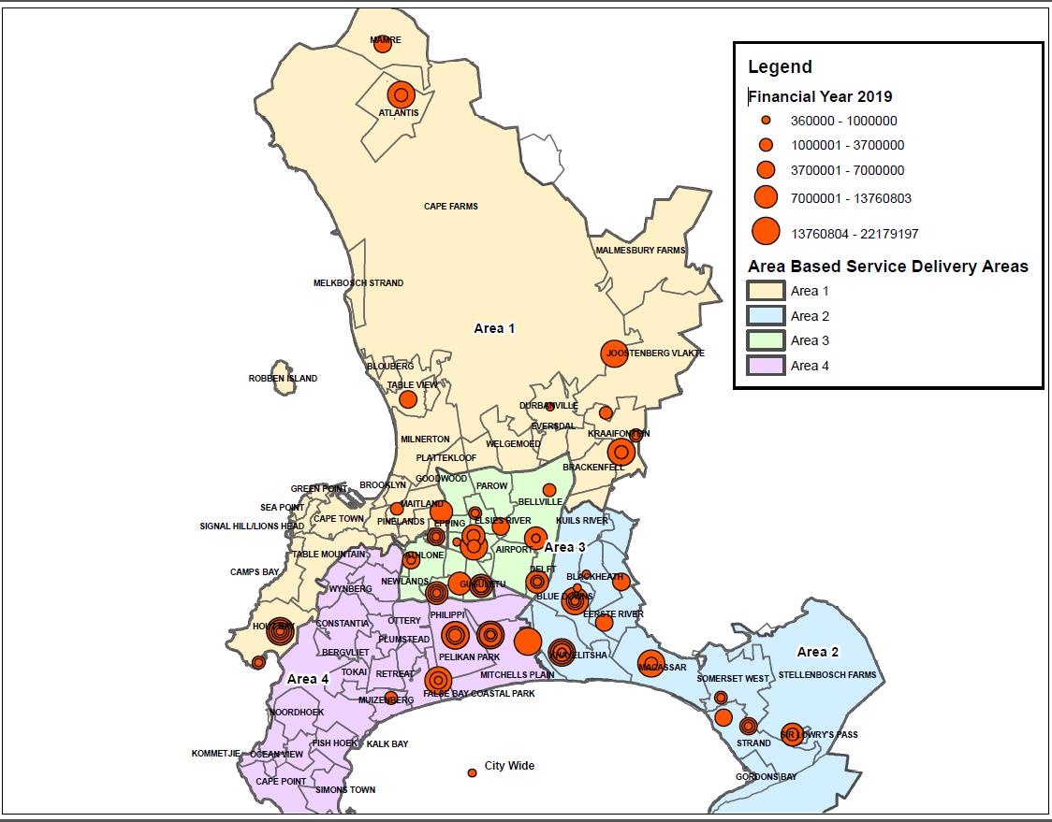
USDG Project Geographic Spread: All Projects

Slide 8
USDG: performance update by directorate / department

Slide 9
Social Services : Challenges and Solutions
Challenges
Poor Contractor Performance - Impact R3,5m
Water Resilience Programme impacted on procurement - Impact R7,0m
Project Management Capacity, Staff leaving - Impact R 5m
Total value of budget at risk due to challenges is estimated at R15,5 m
Planned Remedial Action
R15,5m budget at risk will be channeled to other projects as follows:
Heideveld ECD – EFF funded, proposal USDG funding - R5,5m
New Pelican Park Clinic performing better - R6m
New Informal Settlements Hub Project - R2,3m
Movement of funds to other performing projects - R1,7m
Total funds to be viremented total to R15,5 million
Programme Expenditure Synopsis (Excluding VAT)
Annual Budget | 91 381 020
Actual Expenditure as at 07/03/2018 | 18 240 351
Planned expenditure by 07/03/2018 | 32 809 876
Value of underspending as at 07/03/2018 | 14 569 525
Confirmed Expenditure Projection to 30 June 2018 | 91 381 020

Slide 10
Human Settlements Implementation: Challenges and Solutions
Challenges
Poor performance by contractor on Delft resulting to the termination of contract by the City.
Gang violence on the Valhalla Park project also resulting to the termination of contract by the City.
Relocation and negotiations with non-qualifiers on the Morkel’s Cottage site delayed the project
Tender submissions received on small projects exceeded Subsidy Quantum
Planned Remedial Actions
Funds in under performing projects are being transferred to performing projects
Appointment of a Panel of Home Building Contractors for Housing Developments
Compiling a security plan upfront for projects in gang violent areas.
One of the 3 categories of the Home Building Contractors is for the Construction of 25 to 199 units to assist emerging and smaller companies.
Programme Expenditure Synopsis (Excluding VAT)
Annual Budget | 229 748 363
Actual Expenditure as at 07/03/2018 | 53 775 152
Planned expenditure by 07/03/2018 | 99 542 479
Value of underspending as at 07/03/2018 | 45 767 327
Confirmed Expenditure Projection to 30 June 2018 | 229 748 363

Slide 11
Safety and Security : Challenges and Solutions
Implementation Plan and Status
There are no major implementation challenges in this programme.
The USDG funds will be utilized to co-fund the construction of 2 New Fire Stations in Masiphumelele and Lwandle vicinities.
Contractors for both fire stations were appointed on the 11 December 2017.
Programme Expenditure Synopsis (Excluding VAT)
Annual Budget | 15 351 407
Actual Expenditure as at 07/03/2018 | 0
Planned expenditure by 07/03/2018 | 4 000 000
Value of underspending as at 07/03/2018 | 4 000 000
Confirmed Expenditure Projection to 30 June 2018 | 15 351 407

Slide 12
Informal Settlements and Backyarders: Challenges and Solutions
Challenge
Surrounding community resistance (NIMBY) towards the upgrading of certain informal settlements e.g. Tambo Square
Constant threat of land invasions on construction sites – all projects affected
Gang and criminal related violence towards the contractor and community e.g. 8ste Laan Valhalla Park
Planned Remedial Actions
Funds in under performing projects are being transferred to performing projects
Continued political engagements and deployment of additional security on site
Deployment of Law enforcement to protect the contractor while he is working on site.
Pro active reallocation of funds during budget adjustment undertaken to reduce budget as a result of contractor not being able to work during Quarter 1 and 2
Programme Expenditure Synopsis (Excluding VAT)
Annual Budget | 163 933 792
Actual Expenditure as at 07/03/2018 | 89 302 829
Planned expenditure by 07/03/2018 | 94 067 627
Value of underspending as at 07/03/2018 | 4 764 798
Confirmed Expenditure Projection to 30 June 2018 | 163 933 792

Slide 13
Built Environment Management: Challenges and Solutions
Challenges
Heideveld Area 5 project was terminated by the City due to inadequate/poor contractor performance.
Bishop Lavis concrete road project underperforming as the main contractor is experiencing liquidation.
Total value of budget at risk due to challenges is estimated at
R31 772 211.
Remedial Action
R31, 7m budget at risk will be channeled to other projects as follows:
Upgrading of Prince George project - R18,2m
R3.5 million to Gugulethu concrete road project - R3,5m
Acquisition of Land and other projects - R10 million
Programme Expenditure Synopsis (Excluding VAT)
Annual Budget | 245 811 251
Actual Expenditure as at 07/03/2018 | 99 171 828
Planned expenditure by 07/03/2018 | 114 861 431
Value of underspending as at 07/03/2018 | 15 689 603
Confirmed Expenditure Projection to 30 June 2018 | 245 811 251

Slide 14
Urban Integration : Challenges and Solutions
There are no major implementation challenges in this programme.
Programme Expenditure Synopsis (Excluding VAT)
Annual Budget | 3 589 355
Actual Expenditure as at 07/03/2018 | 407 296
Planned expenditure by 07/03/2018 | 854 521
Value of underspending as at 07/03/2018 | 447 225
Confirmed Expenditure Projection to 30 June 2018 | 3 589 355

Slide 15
Water and Sanitation : Challenges and Solutions
Challenges
Emergency Water projects related to drought
Taking priority
Impacted on procurement processes
Impacted on project management capacity
Drought project Cape Flats Aquifer (Budget R111,7m) progressing well. May experience challenges which cannot be foreseen
USDG funds for Stormwater Rehabilitation will have a R2,5m underspent. Funds cannot be Viremented between Rates funded and tariff funded projects.
Planned Remedial Actions
Prioritise spending on USDG portion of projects.
Borchards Quarry and Athlone WWTW can be fast-tracked.
Programme Expenditure Synopsis (Excluding VAT)
Annual Budget | 459 043 981
Actual Expenditure as at 07/03/2018 | 152 097 140
Planned expenditure by 07/03/2018 | 135 981 618
Value of overspending as at 07/03/2018 | -16 115 522
Confirmed Expenditure Projection to 30 June 2018 | 459 043 981

Slide 16
Electricity Generation and Distribution: Challenges and Solutions
Challenges
Poor performance by contractor on Delft and impacts on street light installation.
Gang violence on the Valhalla Park project. Contractor opted to terminate contract due to dangerous circumstances. – R5,5 milllion (streetlights and reticulation)
CTCHC experienced challenges with contractor appointed.
Masiphumelele and Lourensia Park experienced challenges appointing contractors
Forest Village contractor delay – R7,0 million
Morkels Cottage – savings in estimated cost – R4,7 million
Community not moving in IY, court order pending – R3,0 million
Challenges with civil contractor appointment - R1,64m (Edward Avenue)
Planned Remedial Actions
Funds transferred to performing projects where possible
Edward Avenue funds
moved to performing project
in Mpetha Square and KTC 4.
Value at risk = R26 792 942
Programme Expenditure Synopsis (Excluding VAT)
Annual Budget | 135 101 291
Actual Expenditure as at 07/03/2018 | 29 998 987
Planned expenditure by 07/03/2018 | 36 397 904
Value of underspending as at 07/03/2018 | 6 398 917
Confirmed Expenditure Projection to 30 June 2018 | 108 308 349

Slide 17
Overall Challenges
DORA S2(b) – Predictability and Certainty
TIMELINE - WITHOLDING / REDUCING OF TRANCHES
Jun-17 | Letter received from NDHS to withhold first Tranche of R 278.2m
Jul-17 | Received Tranche 1 as per approved payment schedule
Nov-17 | Letter received from NDHS to reduce second tranche by R175.8m
Nov-17 | Received reduced tranche amount of R89m with revised payment schedule
Jan-18 | Received remaining portion of Tranche 2 (R175.8m) after numerous correspondence to both NT and NDHS and after the City’s Adjustment Budget period had closed.
Feb-18 | Letter received from NDHS to reduce allocation by R175.8m

Slide 18
Overall Challenges
MFMA S28(2) – Municipal Adjustments Budget
Changes in respect of USDG funds can only be adjusted during the January Adjustments budget, 7 months after the start of the financial year.
This process deals with approved rollovers as well as transfers from non-performing to performing projects.
Funds Transfers outside of the adjustments budget are limited to the virement policy, which only allows for transfers within Directorates.
This means that the City can only transfer USDG funds (in –year) between Directorates once a year.

