Slide 1






Standing Committee on Public Accounts
06 March 2018

Slide 2

Eskom delegation is as follows:
  Ms Sindi Mabaso-Koyana - Board Audit & Risk Committee Chair
  Mr Phakamani Hadebe - Interim Group Chief Executive
  Ms Ayanda Noah - Group Executive Customer Services
  Mr Louis Maleka - Senior General Manager Distribution

Slide 3
From the PFMA Related to Public Entities
The following sections of the Public Finance Management Act (PFMA) refer:
S 50. Fiduciary duties of accounting authorities.—(1) The accounting authority for a public entity must —
(a) exercise the duty of utmost care to ensure reasonable protection of the assets and records of the public entity;
(b) act with fidelity, honesty, integrity and in the best interests of the public entity in managing the financial affairs of the public entity;
(d) seek, within the sphere of influence of that accounting authority, to prevent any prejudice to the financial interests of the state.
S 51 General responsibilities of accounting authorities.—(1) An accounting authority for a public entity—
(b) must take effective and appropriate steps to —
(i) collect all revenue due to the public entity concerned; and
(c) is responsible for the management, including the safeguarding, of the assets and for the management of the revenue, expenditure and liabilities of the public entity;

Slide 4
Conditions of Licence (ERA Sec 15(1))
Electricity Regulations Act (ERA) section 15, Conditions of licence:
15. ( 1 ) The Regulator may make any licence subject to conditions relating to:
  (a) the establishment of and compliance with directives to govern relations between a licensee and its or end users, including the establishment of or end user forums;
  (b) the furnishing of information, documents and details that the Regulator may require for the purposes of this Act;
  (c) the period of validity of the licence in accordance with section 21;
  (d) the setting and approval of prices, charges, rates and tariffs charged by licensees;
  (e) the methodology to be used in the determination of rates and tariffs which must he imposed by licensees

Slide 5
Tariff Principles (ERA S 16(1))
16. ( 1 ) A licence condition determined under section 15 relating to the setting or approval of prices, charges and tariffs and the regulation of revenues -
  (a) must enable an efficient licensee to recover the full cost of its licensed activities, including a reasonable margin or return;
  (b) must provide for or prescribe incentives for continued improvement of the technical and economic efficiency with which services are to be provided;
  (c) must give end users proper information regarding the costs that their consumption imposes on the licensee's business;
  (d) must avoid undue discrimination between customer categories; and
  (e) may permit the cross-subsidy of tariffs to certain classes of customers.
(2) A licensee may not charge a customer any other tariff and make use of provisions in agreements other than that determined or approved by the Regulator as part of its licensing conditions.
(3) Notwithstanding subsection (2), the Regulator may, in prescribed circumstances, approve a deviation from set or approved tariffs.

Slide 6
Conditions Under which the Supply may be terminated or reduced (ERA S 22(5))
Sec 22(5) A licensee may not reduce or terminate the supply of electricity to a customer, unless -
  (a) the customer is insolvent;
  (b) the customer has failed to honour, or refuses to enter into, an agreement for the supply of electricity; or
  (c) the customer has contravened the payment conditions of that licensee

Slide 7
Typical Conditions of Licence of a Municipality
5.2 Financial Conditions
5.2.1 The licensee shall maintain separate electricity distribution business affairs from the licensee’s other affairs so that revenues, assets, liabilities, reserves and provisions for the electricity business are separately identifiable in the books of the licensee from those of any other business.
5.2.6 The licensee shall pay the bulk supplier from whom it purchases electricity

Slide 8
Comparison between January 2017 SCOPA and January 2018 SCOPA
Overdue Municipal Debt has increased by R3.81bn in 12 months
January 2017
  77% of Overdue Debt is older than 90 Days
January 2018
  85% of Overdue Debt is older than 90 days
  Generally the debt in all categories has grown
  Debt older than 15 Days has reduced due to the implementation of 30 Days payment period in July 2017. Only Metros are now required to pay in 15 Days
Total overdue
Days
>15 days
>30 days
>60 days
>90 days
Rm
552
932
715
7 328
9 527
Total overdue
Days
>15 days
>30 days
>60 days
>90 days
Rm
16
1 075
886
11 359
13 337

Slide 9
Municipal Overdue Debt continues to increase
SCoA
IMTT
Debt overview
Total overdue debt as at 31 Jan 2018 (Rm)
SCOPA
Provincial Split
  FS R6.3bn
  MP R3.3bn
  NW R0.88bn
  GP R0.87bn
  NC R0.81bn
  LP R0.57bn
  EC R0.41bn
  KZN R0.25bn
  WC R0.007bn
Top 10 Municipalities R 9.3bn
Top 20 Municipalities R10.8bn
70 x Municipalities > R10mil individually and Total R13.26bn
3 of the Top 5 are in the FS
  Maluti (FS) R2.57bn
  Matjhabeng (FS) R1.69bn
  eMalahleni (MP) R1.51bn
  Ngwathe (FS) R0.89bn
  Emfuleni (GP) R0.67bn
CoGTA
CoGTA
13 522
13 337
12 973
13 030
IMC
12 428
11 454
11 245
11 074
10 223
10 453
9 604
9 674
9 774
9 827
9 527
9 406
9 180
7 342
6 012
6 005
5 589
Sep-15
Dec-15
Mar-16
Jun-16
Sep-16
Oct-16
Nov-16
Dec-16
Jan-17
Feb-17
Mar 17
Apr 17
May 17
Jun 17
Jul 17
Aug 17
Sep 17
Oct 17
Nov 17
Dec 17
Jan 18

Slide 10
Overview of Municipal Debt Situation
Total Municipal Overdue Debt at end of January 2018 was R13.337bn a significant increase from R9.527bn at the end of January ’17 (R3.81bn Increase)
  Top 10 overdue municipalities are overdue by R9.2bn (R3.2bn Increase from January 2017)
  Top 20 overdue municipalities are overdue by R10.8bn vs R7.39bn in January 2017
  There are 70 munics that are overdue by more than R10mil vs 66 munics in January 2017.
  90 municipalities had overdue debt in excess of R500k vs 91 municipalities in January 2017
  Only 16 Payment Arrangements (PAs) Fully Honored out of a total of 57 signed PAs
Since September 2017, supply has been interrupted to a total of 15 municipalities in five provinces for non-payment of current accounts and/or non-adherence to the terms of the payment arrangements entered into between Eskom and the relevant municipalities.
Three Provinces contributing R10.43bn
  FS R6.26bn (14 Municipalities > R10mil)
  MP R3.30bn (12 municipalities > R10mil)
  NW R0.87bn (10 municipalities > R10 mil)
.
Notes:
Provincial contributions

Slide 11
Provincial Contribution to Overdue Debt (R)
Province | >30 Days | > 60 Days | > 90 Days | Overdue Balance
FREE STATE | 129 481 391 | 206 606 586 | 5 919 932 043 | 6 256 628 864
MPUMALANGA | 253 812 700 | 241 601 660 | 2 799 686 307 | 3 302 382 422
NORTH WEST | 111 764 356 | 67 214 322 | 694 723 204 | 874 864 560
GAUTENG | 141 544 619 | 145 541 451 | 580 964 214 | 869 243 893
NORTHERN CAPE | 78 930 333 | 36 216 015 | 693 787 239 | 809 094 856
LIMPOPO | 155 356 730 | 134 506 916 | 279 773 239 | 570 159 952
EASTERN CAPE | 136 656 562 | 42 351 673 | 222 603 065 | 405 977 361
KWAZULU NATAL | 67 912 333 | 11 969 837 | 167 714 046 | 248 324 751
WESTERN CAPE | 256 805 | 95 974 | 182 244 | 739 292
Grand Total | 1 075 715 828 | 886 104 435 | 11 359 365 601 | 13 337 415 952

Slide 12
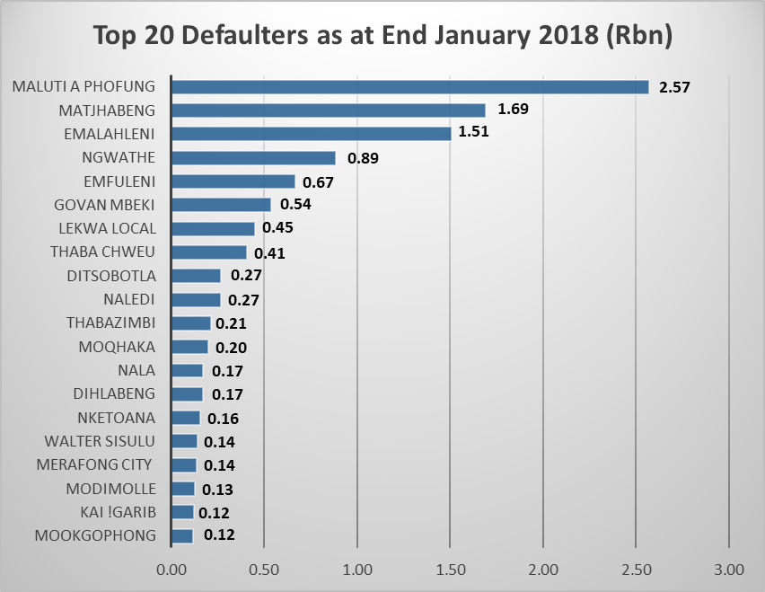
The Top 20 Defaulters have a combined overdue debt of R 10.8bn

Slide 13
Eskom’s Response to the Challenges
Development and Implementation of the “concessions” (Refer next slide for progress)
Continuous engagement with Stakeholders
  Government Departments (National and Provincial)
  SALGA
  NERSA
  Business Community
Active participation in IMTT mandated provincial interactions, facilitated by CoGTA, with Municipalities
Reviewing of payment arrangements
Providing assistance to municipalities (technical and non technical)
Initiation of the Promotion of Just Administration Act (PAJA) Process
Interruption of supply as the last resort

Slide 14
Progress Feedback on Implementation of Eskom Concessions as Committed in March 2017
Rationalisation of Eskom’s Municipal Tariffs (Reducing tariff options from 11 to 3)
Decrease the Interest Rate charged on overdue balances from Prime plus 5% to Prime plus 2.5%
Changing the payment period on Municipal Bulk accounts from 15 Days to 30 Days
Changing the payment allocation policy to allocate payments to capital first and then interest
Allow municipalities to pay connections charges over period at relevant interest rate in stead of Cash up Front
Eskom submitted proposal to NERSA for Consideration during 2017
  Implementation expected by July 2019
Implemented on 01 July 2017 to all Municipal Bulk accounts used for Re-distribution
Implemented on 01 July 2017 for all Municipalities but reverted to 15 Days on 01 December 2017 for Metros
Implemented on 01 July 2017 for all Municipal Bulk Accounts used for Re-distribution
Final Revised Proposal still to be approved by Board Committee
Notes:
Provincial contributions

Slide 15
Municipalities Interrupted since 21 September 2017 up to 28 February 2018
Province | Municipality | List of Towns Affected
EC | Walter Sisulu | Aliwal North, Burgersdorp and Steynsburg
FS | Tokologo | Seretse, Boshof, Dealsville
 | Masilonyana | Brandfort, Theunissen, Verkeerdevlei, Windburg
 | Nala | Bothaville, Wesselsbron
 | Dihlabeng | Bethlehem, Paul Roux, Rosenekal, Fateng-Tse-Ntsho
 | Moqhaka | Kroonstad, Steynsrus, Viljoenskroon
 | Ngwathe | Parys, Heilbron, Edinville, Koppies
 | Tswelopele | Bultfontein, Hoopstad
LP | Thabazimbi | Thabazimbi, Ipelegeng, Regorogile X5&6
 | Lim 368 | Modimole, Mookgopong, Vaalwater
MP | Mkhondo | Piet Retief and Armsterdam
 | Thaba Chweu | Lydenburg, Sabie, Graskop, Pelgrims Rest and Mashishing
 | Govan Mbeki | Secunda, Bethal, Emzinoni & Embalenhle
 | Dipaleseng | Grootvlei, Balfour& Newspring Colleriers
NC | Siyathemba | Prieska
 | Renosterberg | Van der Kloof, Phillipstown and Petrusville
 | Thembelihle | Hopetown and Strydenburg
 | Dikgatlong | Barkley West, Windsorton, Delporton
 | Magareng | Warrenton

Slide 16
Current and Planned Interruptions dates
(as at 28 February 2018)
Province | Municipality | List of Towns Affected | Planned Dates
FS | Nketoana | Reitz, Lindley, Petrus Steyn | 13-Mar-18
 | Tokologo | Seretse, Boshof, Dealsville | 21-Feb-18
 | Masilonyana | Brandfort, Theunissen, Verkeerdevlei, Windburg | 28-Feb-18
 | Nala | Bothaville, Wesselsbron | 23-Mar-18
 | Dihlabeng | Bethlehem, Paul Roux, Rosenekal, Fateng-Tse-Ntsho | 23-Mar-18
 | Moqhaka | Kroonstad, Steynsrus, Viljoenskroon | 23-Mar-18
 | Maluti A Phofung | Harrismith, Kestell, Phuthaditjhaba | 23-Mar-18
 | Matjhabeng | Welkom, Virginia, Odendaalsrus, Henneman, Ventersburg | 23-Mar-18
GP | Emfuleni | Vereeniging and Vanderbijlpark | 08-Mar-18
MP | Thaba Chweu | Lydenburg, Sabie, Graskop, Pelgrims Rest and Mashishing | Interdict
 | Emalahleni | Witbank | Interdict
 | Victor Khanye | Delmas | 23-Apr-18
 | Lekwa | Standerton, Morgenzon, Sakhile | Interdict
NC | Renosterberg | Van der Kloof, Phillipstown and Petrusville | 19-Mar-18
 | Kai Garib | Kakamas, Keimoes and Kenhardt | 19-Mar-18
 | Ubuntu | Richmond, Loxton | 19-Mar-18
NW | Ditsobotla | Lichtenburg, Coligny and Boikhutso | Interdict

Slide 17
Our Strategy going forward
Increasing interruption times
  move from current 4.5hrs to 6.5hrs for the first week
  then 14 hrs (if no improvement in payment)
Developing additional incentives to encourage Municipalities to pay off their debt
Continue with Piloting of Revenue Collection Service to municipalities
  Phumelela (FS) (Warden and Ezenzeleni)
  Raymond Mhlaba (EC) (Adelaide, Bedford)
Offering Active Partnering assistance where possible based on capacity and specific requests
Notes:
Provincial contributions

Slide 18
Phumelela Pilot Project: Pre-Paid Metering
  Critical Activity / Next Steps
  1. Project temporarily stopped due to severe community
  unrest
  2. Awaiting municipal stakeholder engagement for
  Ezenzeleni roll out
  Progress:
  771 meters installed (210 in Ezenzeleni and 561 in Warden Town - 5 x 3 phases left)
  R1.8 m paid by Phumelela Municipality towards the project
  R 2.2 m paid by Phumelela Municipality towards arrear debt during December
  Second invoice of R1.4 million (excluding vat) raised – (not paid yet)
  Bulk Account reconciliation completed for October to January 2018
  1072 meters at Senekal
  1258 meters at test lab
  Sales from 17 October to 20 February 2018 - R958 598
  Risks / Challenges / Support required:
    Slow progress with the installation of meters by Municipal contractor
    Resistance from Customers not previously metered
    FBE indigent list outstanding
    Delay in refunding of credits on old meters

Slide 19
Conclusions
Municipal Debt remains a huge challenge to Eskom’s sustainability
Ratings Agencies and Lenders are concerned about Eskom’s inability to collect revenue
As an organization Eskom has a duty to keep the South African Economy alive and cannot allow the trend of non payment to continue
The Board has a fiduciary duty and the PFMA requires Eskom to collect all revenue due to it
Engagements and reviewing payment arrangements with the assistance of CoGTA and Treasury are not delivering the desired results
The Interruption of Electricity supply to the municipalities is our measure of last resort
Eskom is committed to continue participating in the IMTT to find solutions in the interest of Eskom, the country and the customers
Notes:
Provincial contributions

