Slide 1
SCHOOL INFRASTRUCTURE
MARCH 2018

Slide 2
PROVINCIAL INFRASTRUCTURE PROGRAMME

Slide 3
Total Infrastructure Expenditure – Jan 2018
Total Infrastructure Spending As At End January 2018
PROVINCE
 | Allocated Budget 2017/18 ('000) | Adjustments ('000) | Total Adjusted Budget ('000) | Total Spent as at end January 2018 ('000) | % Spent of Adjusted Budget
Eastern Cape | 1,636,750 | 22,000 | 1,658,750 | 1,356,185 | 82%
Free State | 679,913 | 198,081 | 877,994 | 722,722 | 82%
Gauteng | 1,742,829 | 382,011 | 2,124,840 | 1,368,395 | 64%
KwaZulu-Natal | 2,308,147 | 106,687 | 2,414,834 | 1,885,031 | 78%
Limpopo | 810,523 | 41,816 | 852,339 | 839,456 | 98%
Mpumalanga | 1,165,781 | -80,000 | 1,085,781 | 690,775 | 64%
North West | 1,076,331 | 0 | 1,076,331 | 983,586 | 91%
Northern Cape | 623,578 | 0 | 623,578 | 494,886 | 79%
Western Cape | 1,614,044 | 146,509 | 1,760,553 | 1,264,110 | 72%
TOTAL | 11 657 896 | 817 104 | 12 475 000 | 9 605 146 | 77%

Slide 4
Education Infrastructure Grant – Jan 2018
Education Infrastructure Grant Expenditure As At End January 2018
PROVINCE
 | Allocated Budget 2017/18 ('000) | Adjustments ('000) | Total Adjusted Budget ('000) | EIG Transfers to PEDs ('000) | Total Spent as at end January 2018 ('000) | % Spent of EIG Transferred as at end January 2018 | % Spent of Adjusted Budget
Eastern Cape | 1,581,750 | 22,000 | 1,603,750 | 1,581,752 | 1,330,090 | 84% | 83%
Free State | 661,635 | 191,281 | 852,916 | 661,635 | 706,739 | 107% | 83%
Gauteng | 1,468,146 | 0 | 1,468,146 | 1,468,147 | 1,122,838 | 76% | 76%
KwaZulu-Natal | 1,993,146 | 0 | 1,993,146 | 1,993,147 | 1,845,035 | 93% | 93%
Limpopo | 810,523 | 33,586 | 844,109 | 810,523 | 839,456 | 104% | 99%
Mpumalanga | 750,184 | 0 | 750,184 | 656,411 | 538,305 | 82% | 72%
North West | 1,074,331 | 0 | 1,074,331 | 1,074,331 | 974,863 | 91% | 91%
Northern Cape | 612,267 | 0 | 612,267 | 612,267 | 483,860 | 79% | 79%
Western Cape | 1,093,580 | 55,531 | 1,149,111 | 1,093,581 | 854,309 | 78% | 74%
TOTAL | 10 045 562 | 302 398 | 10 347 960 | 9 951 794 | 8 695 495 | 87% | 84%

Slide 5
Project Pipeline – Jan 2018
Prov | No. of Projects | PROGRESS
 |  | Planning | Construction | Practical Completion | Close-out
EC | 2,583 | 1,269 | 646 | 592 | 76
FS | 169 | 30 | 139 | 0 | 0
GT | 330 | 187 | 87 | 54 | 2
KZ | 3,224 | 2106 | 713 | 404 | 1
LP | 660 | 59 | 459 | 129 | 13
MP | 562 | 94 | 294 | 174 | 0
NC | 328 | 110 | 119 | 92 | 7
NW | 339 | 158 | 143 | 33 | 5
WC | 153 | 51 | 43 | 59 | 0
TOTAL | 8,348 | 4,064 | 2,643 | 1,537 | 104
 |  | 49% | 32% | 18% | 1%

Slide 6
Nature of investment
Total Infrastructure Budget & Expenditure per Nature of Investment January 2018
Nature of Investment
 | Maintenance/Renovations/ Rehabilitation & Refurbishments |  |  | New or Replaced Infrastructure |  |  | Upgrading and Additions |  |  | TOTAL Allocation for 2017/18 ('000) | TOTAL Expenditure as at end January 2018 ('000) | % Spent of the Total Allocation
 | Budget | Expenditure | % of the Allocation | Budget | Expenditure | % of the Allocation | Budget | Expenditure | % of the Allocation
Eastern Cape | 341,659 | 442,092 | 21% | 54,402 | 56,387 | 3% | 1,262,689 | 857,706 | 76% | 1,658,750 | 1,356,185 | 82%
Free State | 364,412 | 274,927 | 42% | 180,135 | 257,768 | 21% | 333,447 | 190,027 | 38% | 877,994 | 722,722 | 82%
Gauteng | 722,127 | 287,610 | 34% | 676,161 | 361,449 | 32% | 726,552 | 719,336 | 34% | 2,124,840 | 1,368,395 | 64%
KwaZulu-Natal | 875,982 | 597,923 | 36% | 347,716 | 205,120 | 14% | 1,191,136 | 1,081,988 | 49% | 2,414,834 | 1,885,031 | 78%
Limpopo | 144,236 | 242,472 | 17% | 12,708 | 5,531 | 1% | 695,395 | 591,453 | 82% | 852,339 | 839,456 | 98%
Mpumalanga | 78,759 | 92,494 | 7% | 577,958 | 272,666 | 53% | 429,064 | 325,615 | 40% | 1,085,781 | 690,775 | 64%
North West | 115,807 | 76,867 | 11% | 642,332 | 570,441 | 60% | 318,192 | 336,278 | 30% | 1,076,331 | 983,586 | 91%
Noerthern Cape | 145,202 | 72,199 | 23% | 206,380 | 223,326 | 33% | 271,996 | 199,361 | 44% | 623,578 | 494,886 | 79%
Western Cape | 626,751 | 484,837 | 36% | 639,019 | 487,720 | 36% | 494,783 | 291,553 | 28% | 1,760,553 | 1,264,110 | 72%
TOTAL | 3 414 935 | 2 571 421 | 27% | 3 336 811 | 2 440 408 | 27% | 5 723 254 | 4 593 317 | 46% | 12 475 000 | 9 605 146 | 77%

Slide 7
Maintenance
Prov | No. of Maint’nce Projects in 2017/18 FY | Overall Adjusted Infrastructure Budget ('000) | Maint’nce Budget ('000) | Total Expenditure as at end January 2018 ('000) | %ge Expenditure on Maint’nce Relative to Maint’nce Budget
Eastern Cape | 372 | R 1,658,750 | R 341,659 | R 442,092 | 129%
Free State | 66 | R 877,994 | R 364,412 | R 274,927 | 75%
Gauteng | 922 | R 2,124,840 | R 722,127 | R 287,610 | 40%
KwaZulu-Natal | 3277 | R 2,414,834 | R 875,982 | R 597,923 | 68%
Limpopo | 89 | R 852,339 | R 144,236 | R 242,472 | 168%
Mpumalanga | 77 | R 1,085,781 | R 78,759 | R 92,494 | 117%
North West | 258 | R 1,076,331 | R 115,807 | R 76,867 | 66%
Northern Cape | 96 | R 623,578 | R 145,202 | R 72,199 | 50%
Western Cape | 68 | R 1,760,553 | R 626,751 | R 484,837 | 77%
TOTAL | 5,225 | R 12,475,000 | R 3,414,935 | R 2,571,421 | 75%

Slide 8
Progress: New and Replacement Schools
SUMMARY OF PROJECTS COMPLTED FOR THE 2017/18 FINANCIAL YEAR
Province | TARGET 2016/17 | NEW SCHOOLS |  |  |  |  | TARGET 2016/17 | REPLACEMENT SCHOOLS |  |  |  |  | TOTAL SCHOOLS TARGETED | TOTAL COMPLETED | PROGRESS
 |  | FIRST QUARTER | SECOND QUARTER | THIRD QUARTER | FOURTH QUARTER | TOTAL |  | FIRST QUARTER | SECOND QUARTER | THIRD QUARTER | FOURTH QUARTER | TOTAL
Number of Schools
Eastern Cape | 0 | 0 | 0 | 0 |  | 0 | 8 | 2 | 1 | 3 |  | 6 | 8 | 6 | 75%
Free State | 1 | 0 | 0 | 0 |  | 0 | 0 | 0 | 0 | 0 |  | 0 | 1 | 0 | 0%
Gauteng | 12 | 0 | 0 | 1 |  | 1 | 1 | 0 | 0 | 2 |  | 2 | 13 | 3 | 23%
Kwazulu Natal | 7 | 1 | 0 | 2 |  | 3 | 3 | 0 | 1 | 0 |  | 1 | 10 | 4 | 40%
Mpumalanga | 1 | 0 | 0 | 0 |  | 0 | 7 | 0 | 3 | 0 |  | 3 | 8 | 3 | 38%
Limpopo | 5 | 0 | 2 | 0 |  | 2 | 1 | 0 | 1 | 0 |  | 1 | 6 | 3 | 50%
Northern Cape | 0 | 0 | 0 | 0 |  | 0 | 0 | 0 | 0 | 0 |  | 0 | 0 | 0 | 0%
North West | 6 | 0 | 0 | 0 |  | 0 | 7 | 0 | 3 | 0 |  | 3 | 13 | 3 | 23%
Western Cape | 2 | 0 | 0 | 2 |  | 2 | 6 | 0 | 1 | 2 |  | 3 | 8 | 5 | 63%
Total Number of schools | 34 | 1 | 2 | 5 |  | 8 | 33 | 2 | 10 | 7 |  | 19 | 67 | 27 | 40%

Slide 9
PROGRESS ON DELIVERY: 2017/18 FINANCIAL YEAR
PROGRAMME | COMPLETED PROJECTS
 | EC |  |  |  | FS |  |  |  | GP |  |  |  | KZN |  |  |  | MP
 | Target | Q1 | Q2 | Q3 | Target | Q1 | Q2 | Q3 | Target | Q1 | Q2 | Q3 | Target | Q1 | Q2 | Q3 | Target | Q1 | Q2 | Q3
Provision/replacement of Sanitation | 273 | 225 | 14 | 14 | 10 | 0 | 0 | 0 | 13 | 0 | 18 | 0 | 150 | 17 | 58 | 7 | 121 | 1 | 9 | 0
Provision/upgrade of Water | 188 | 225 | 14 | 14 | 0 | 0 | 0 | 0 | 13 | 0 | 149 | 149 | 150 | 17 | 89 | 11 | 77 | 1 | 4 | 0
Provision/upgrade of Electricity | 107 | 0 | 1 | 1 | 8 | 8 | 0 | 0 | 13 | 0 | 69 | 69 | 150 | 5 | 5 | 1 | 7 | 0 | 1 | 0
Maintenance Projects | 37 | 0 | 6 | 6 | 56 | 0 | 5 | 5 | 750 | 184 | 321 | 321 | 300 | 80 | 57 | 0 | 72 | 6 | 11 | 0
Libraries Project | 50 | 0 | 0 | 0 | 3 | 0 | 1 | 0 | 13 | 0 | 0 | 0 | 20 | 2 | 7 | 2 | 6 | 0 | 1 | 0
Laboratories Projects | 67 | 0 | 0 | 0 | 12 | 0 | 0 | 0 | 13 | 0 | 0 | 0 | 20 | 1 | 2 | 3 | 0 | 0 | 0 | 0
School Halls | 0 | 0 | 0 | 0 | 6 | 4 | 1 | 0 | 13 | 0 | 0 | 0 | 0 | 0 | 0 | 0 | 0 | 0 | 0 | 0
Technical Workshops | 0 | 0 | 0 | 0 | 0 | 0 | 0 | 0 | 0 | 0 | 0 | 0 | 0 | 0 | 0 | 0 | 1 | 0 | 1 | 0
Nutrition Centres | 0 | 0 | 0 | 0 | 1 | 0 | 0 | 0 | 13 | 0 | 0 | 2 | 20 | 1 | 4 | 2 | 4 | 0 | 1 | 0
Additional Classrooms | 586 | 69 | 117 | 117 | 61 | 0 | 4 | 0 | 572 | 0 | 241 | 326 | 400 | 150 | 92 | 70 | 62 | 0 | 34 | 0
Grade R Classrooms | 98 | 0 | 0 | 0 | 12 | 0 | 3 | 0 | 473 | 0 | 134 | 146 | 120 | 8 | 13 | 1 | 3 | 0 | 1 | 0
Administration Blocks | 0 | 0 | 0 | 0 | 1 | 0 | 0 | 0 | 13 | 0 | 0 | 2 | 20 | 1 | 5 | 2 | 7 | 0 | 3 | 0
Provision/upgrade of fence | 0 | 2 | 29 | 29 | 0 | 0 | 0 | 0 | 0 | 0 | 1 | 2 | 50 | 19 | 26 | 1 | 6 | 0 | 3 | 0
Provision/upgrade of sport field | 0 | 0 | 0 | 0 | 0 | 0 | 0 | 0 | 13 | 0 | 0 | 2 | 2 | 0 | 0 | 0 | 2 | 0 | 2 | 0
Special Schools | 0 | 2 | 0 | 0 | 0 | 0 | 0 | 0 | 2 | 0 | 0 | 1 | 0 | 0 | 0 | 0 | 3 | 0 | 0 | 0
Natural Disasters Projects | 0 | 8 | 13 | 13 | 8 | 0 | 0 | 0 | 53 | 0 | 0 | 0 | 150 | 0 | 69 | 2 | 61 | 0 | 15 | 0
Guard House | 0 | 0 | 0 | 0 | 0 | 0 | 0 | 0 | 13 | 0 | 0 | 2 | 20 | 1 | 3 | 2 | 6 | 0 | 1 | 0
Boarding Schools | 0 | 0 | 0 | 0 | 1 | 0 | 0 | 0 | 0 | 0 | 0 | 0 | 1 | 1 | 0 | 0 | 0 | 0 | 0 | 0

Slide 10
PROGRESS ON DELIVERY: 2017/18 FINANCIAL YEAR
PROGRAMME | COMPLETED PROJECTS
 | LP |  |  |  | NC |  |  |  | NW |  |  |  | WC
 | Target | Q1 | Q2 | Q3 | Target | Q1 | Q2 | Q3 | Target | Q1 | Q2 | Q3 | Target | Q1 | Q2 | Q3
Provision/replacement of Sanitation | 101 | 26 | 26 | 0 | 13 | 3 | 8 | 11 | 50 | 0 | 4 | 0 | 0 | 0 | 0 | 0
Provision/upgrade of Water | 58 | 13 | 13 | 0 | 32 | 2 | 4 | 0 | 20 | 0 | 3 | 0 | 0 | 0 | 0 | 0
Provision/upgrade of Electricity | 0 | 0 | 0 | 0 | 8 | 1 | 1 | 2 | 0 | 0 | 2 | 0 | 0 | 0 | 0 | 0
Maintenance Projects | 151 | 11 | 11 | 0 | 50 | 5 | 8 | 8 | 26 | 0 | 3 | 0 | 71 | 3 | 0 | 0
Libraries Project | 3 | 0 | 0 | 0 | 1 | 0 | 0 | 0 | 13 | 0 | 2 | 0 | 0 | 0 | 0 | 0
Laboratories Projects | 4 | 0 | 0 | 0 | 0 | 0 | 0 | 0 | 13 | 0 | 3 | 0 | 11 | 0 | 3 | 6
School Halls | 0 | 0 | 0 | 0 | 1 | 0 | 1 | 0 | 6 | 0 | 0 | 0 | 10 | 0 | 4 | 3
Technical Workshops | 12 | 0 | 0 | 0 | 0 | 0 | 0 | 0 | 1 | 0 | 0 | 0 | 0 | 0 | 0 | 0
Nutrition Centres | 729 | 0 | 0 | 0 | 1 | 0 | 0 | 0 | 6 | 0 | 2 | 0 | 0 | 0 | 0 | 0
Additional Classrooms | 9 | 0 | 0 | 0 | 38 | 0 | 3 | 0 | 248 | 0 | 0 | 0 | 47 | 0 | 0 | 10
Grade R Classrooms | 41 | 0 | 0 | 0 | 8 | 0 | 0 | 4 | 12 | 0 | 6 | 0 | 15 | 0 | 5 | 0
Administration Blocks | 34 | 0 | 0 | 0 | 3 | 0 | 0 | 1 | 13 | 0 | 2 | 0 | 0 | 0 | 0 | 0
Provision/upgrade of fence | 0 | 0 | 0 | 0 | 33 | 1 | 2 | 4 | 9 | 0 | 2 | 0 | 26 | 0 | 4 | 22
Provision/upgrade of sport field | 1 | 0 | 0 | 0 | 0 | 1 | 0 | 1 | 24 | 0 | 0 | 0 | 5 | 0 | 1 | 0
Special Schools | 132 | 0 | 0 | 0 | 0 | 0 | 0 | 0 | 1 | 0 | 0 | 0 | 1 | 0 | 0 | 1
Natural Disasters Projects | 5 | 0 | 0 | 0 | 0 | 0 | 0 | 0 | 0 | 0 | 0 | 0 | 0 | 0 | 0 | 0
Guard House | 0 | 0 | 0 | 0 | 0 | 0 | 0 | 0 | 6 | 0 | 0 | 0 | 0 | 0 | 0 | 0
Boarding Schools | 0 | 0 | 0 | 0 | 0 | 0 | 0 | 0 | 0 | 0 | 0 | 0 | 0 | 0 | 0 | 0

Slide 11
EDUCATION INFRASTRUCTURE GRANT
Provinces | Column A | Column B
 | Allocation | MTEF Estimates
 | 2018/19 | 2019/20 | 2020/21
 | R'000 | R'000 | R'000
Eastern Cape | 1 479 828 | 1 394 253 | 1 547 060
Free State | 755 337 | 643 932 | 714 506
Gauteng | 1 373 073 | 1 283 691 | 1 424 381
KwaZulu-Natal | 1 866 435 | 1 794 644 | 1 991 333
Limpopo | 1 011 680 | 1 068 836 | 1 275 292
Mpumalanga | 838 551 | 730 112 | 810 132
Northern Cape | 568 766 | 450 709 | 500 106
North West | 1 002 988 | 900 412 | 999 095
Western Cape | 1 021 076 | 919 146 | 1 019 882
Unallocated |  | 1 128 423 | 1 184 844
Total | 9 917 734 | 10 314 159 | 11 466 632

Slide 12
EIG Reduction – 2018 MTEF
Funding |  | 2018 MTEF Allocation
 |  | 2018/19 FY | 2019/20 FY | 2020/21 FY
Education Infrastructure Grant | Alloocation | 10,917,734 | 11,564,159 | 12,800,632
 | Reduction | (1,000,000) | (1,250,000) | (1,334,000)
 | Revised Allocation | 9,917,734 | 10,314,159 | 11,466,632
Over the 2018 MTEF, the Education Infrastructure Grant has been reduced by a total of R 3. 584 billion (R 1 billion in the 2018/19 financial year, R 1. 250 billion in the 2019/20 financial year and R 1. 334 billion in the 2020/21 financial year).

Slide 13
ACCELERATED SCHOOL INFRASTRUCTURE DELIVERY INITIATIVE

Slide 14
PROGRESS - ASIDI
Province | Inappropriate Structures | Water | Sanitation | Electrification
EC | 141 | 271 | 171 | 202
FS | 12 | 53 | 12 | 50
GP | 0 | 0 | 14 | 2
KZN | 0 | 201 | 101 | 58
LP | 3 | 94 | 75 | 5
MP | 5 | 36 | 38 | 45
NW | 2 | 5 | 13 | 2
NC | 1 | 3 | 10 | 0
WC | 25 | 3 | 19 | 8
Total | 189 | 666 | 453 | 372

Slide 15
INAPPROPRIATE STRUCTURES
PROGRESS
Provinces | Implementing Agents (IA) | Projects being Implemented | Design & | Construction Progress |  |  |  | Projects in Construction | No of Projects Completed
 |  |  | Procurement | <25% | 25%-49% | 50%-74% | >75%
 | DBSA | 114 | 6 | 9 | - | 1 | 4 | 14 | 94
 | IDT | 31 | 3 | 10 | 4 | 2 | - | 16 | 12
EC | CDC | 31 | 5 | 3 | - | 1 | 1 | 5 | 21
 | DRPW | 16 | 0 | - | - | - | 2 | 2 | 14
 | NDPW | 20 | 4 | 16 | - | - | - | 16 | -
 | DBE# 29 | 29 | 29 | - | - | - | - | 0 | -
 | DBE# 57 | 57 | 40 | 17 | - | - | - | 17 | -
Sub-Total | - | 298 | 87 | 55 | 4 | 4 | 7 | 70 | 141
FS | IDT | 6 | 0 | - | - | - | 2 | 2 | 4
 | DBSA | 19 | 0 | - | 6 | 3 | 2 | 11 | 8
 | FSDoE | 5 | 0 | 5 | - | - | - | 5 | -
Sub-Total | - | 30 | 0 | 5 | 6 | 3 | 4 | 18 | 12
KZN | Adopt-A-School | 3 | 0 | - | - | - | 3 | 3 | -
WC | WCED | 25 | 0 | - | - | - | - | - | 25
MP | DBSA | 5 | 0 | - | - | - | - | - | 5
NW | DBSA | 2 | 0 | - | - | - | - | - | 2
NC | DBSA | 1 | 0 | - | - | - | - | - | 1
LP | DBSA | 3 | 0 | - | - | - | - | - | 3
Total |  | 367 | 87 | 60 | 10 | 7 | 14 | 91 | 189

Slide 16
SANITATION
PROGRESS
PROVINCES | No of Projects being implemented | No of Projects Completed | No of projects at Planning, Design & Procurement | No of projects under Construction | No of projects with construction progress <25 % | No of projects with construction progress at 25% - 49% | No of projects with construction progress at 50% - 74% | No of projects with construction progress of more than >75%
EC | 298 | 171 | 102 | 25 | 11 | 1 | 4 | 9
FS | 39 | 12 | 0 | 27 | 0 | 0 | 0 | 27
GP | 14 | 14 | 0 | 0 | 0 | 0 | 0 | 0
KZN | 116 | 101 | 11 | 4 | 0 | 0 | 4 | 0
LP | 437 | 75 | 31 | 331 | 240 | 2 | 3 | 86
MP | 38 | 38 | 0 | 0 | 0 | 0 | 0 | 0
NC | 13 | 13 | 0 | 0 | 0 | 0 | 0 | 0
NW | 18 | 10 | 8 | 0 | 0 | 0 | 0 | 0
WC | 19 | 19 | 0 | 0 | 0 | 0 | 0 | 0
TOTALS | *992 | 453 | 152 | **387 | 251 | 3 | 11 | 122
* 741 is the baseline number of projects as per initial scope of ASIDI
* Due to changes in the scope, the number of projects has increased to 992
** The projects under construction are planned to be completed in the 2018/19 FY.

Slide 17
WATER
PROGRESS
PROVINCES | No of Projects being implemented | No of Projects Completed | No of projects at Planning, Design & Procurement | No of projects under Construction | No of projects with construction progress <25 % | No of projects with construction progress at 25% - 49% | No of projects with construction progress at 50% - 74% | No of projects with construction progress of more than >75%
EC | 548 | 271 | 126 | 151 | 22 | 24 | 5 | 100
MP | 36 | 36 | 0 | 0 | 0 | 0 | 0 | 0
FS | 67 | 53 | 0 | 14 | 0 | 0 | 0 | 14
GP | 0 | 0 | 0 | 0 | 0 | 0 | 0 | 0
KZN | 214 | 201 | 11 | 2 | 0 | 0 | 2 | 0
LP | 364 | 94 | 0 | 270 | 222 | 2 | 4 | 42
NC | 5 | 5 |  | 0 | 0 | 0 | 0 | 0
NW | 15 | 3 | 11 | 1 | 0 | 0 | 0 | 1
WC | 3 | 3 |  | 0 | 0 | 0 | 0 | 0
TOTALS | *1252 | 666 | 148 | **438 | 244 | 26 | 11 | 157
* 1120 is the baseline number of projects as per initial scope of ASIDI
* Due to changes in the scope, the number of projects has increased to 1252
** The projects under construction are planned to be completed in the 2018/19 FY.

Slide 18
ELECTRICITY
PROGRESS
Province | IA | No of schools being implemented | No. of schools at planning, design procurement (IDMS) | Construction | No. of schools with progress <25 % | No. of schools with progress at 25% - 49% | No. of schools with construction | No. of schools with construction progress at >75% | No. of schools at PC
 |  |  |  |  |  |  | progress at 50% - 74%%
EC | Eskom | 210 | 0 | 8 | 0 | 0 | 0 | 8 | 202
FS | FS DoE | 55 | 0 | 5 | 0 | 0 | 0 | 5 | 50
GP | GP DoE | 2 | 0 | 0 | 0 | 0 | 0 | 0 | 2
KZN | Eskom | 63 |  | 5 |  |  |  | 5 | 58
LP | Eskom | 5 | 0 | 0 | 0 | 0 | 0 | 0 | 5
MP | Eskom | 48 | 0 | 3 | 0 | 0 | 0 | 3 | 45
NW | Eskom | 2 | 0 | 0 | 0 | 0 | 0 | 0 | 2
NC | N/A | 0 | 0 | 0 | 0 | 0 | 0 | 0 | 0
WC | WC DoE | 8 | 0 | 0 | 0 | 0 | 0 | 0 | 8
Total |  | 393 | 0 | 21 | 0 | 0 | 0 | 21 | 372
* 916 is the baseline number of projects as per initial scope of ASIDI
* Due to changes in the scope, the number of projects has decreased to 393
**DBE is in the process of verifying FS_DoE and Eskom electricity projects.

Slide 19
TOTAL BAS EXPENDITURE (1)

Slide 20
TOTAL BAS EXPENDITURE (2)

Slide 21
TOTAL BAS + NOT PROCESSED +
ACCRUALS (2)

Slide 22
SCHOOL INFRASTRUCTURE BACKLOGS GRANT
Provinces | Column A | Column B
 | Allocation | MTEF Estimates
 | 2018/19 | 2019/20 | 2020/21
 | R'000 | R'000 | R'000
Eastern Cape | 1 133 512 | 1 075 327 | 828 591
Free State | 73 257 | 49 466 | -
Gauteng | - | - | -
KwaZulu-Natal | - | - | -
Limpopo | 113 046 | 44 689 | -
Mpumalanga | - | - | -
Northern Cape | - | - | -
North West | 976 | - | -
Western Cape | - | - | -
Unallocated | 151 035 | 157 566 | 140 445
Total | 1 471 826 | 1 327 048 | 969 036
BUDGET 2018 MTEF R3 767 910

Slide 23
SIBG Reduction – 2018 MTEF
Funding |  | 2018 MTEF Allocation
 |  | 2018/19 FY | 2019/20 FY | 2020/21 FY
Schools Infrastructure Backlogs Grant | Alloocation | 2 471 826 | 2 577 048 | 2 288 036
 | Reduction | (1,000,000) | (1,250,000) | (1,319,000)
 | Revised Allocation | 1 471 826 | 1 327 048 | 969 036
Over the 2018 MTEF, the Schools Infrastructure backlogs Grant has been reduced by a total of R 3. 569 billion (R 1 billion in the 2018/19 financial year, R 1. 250 billion in the 2019/20 financial year and R 1. 319 billion in the 2020/21 financial year).

Slide 24
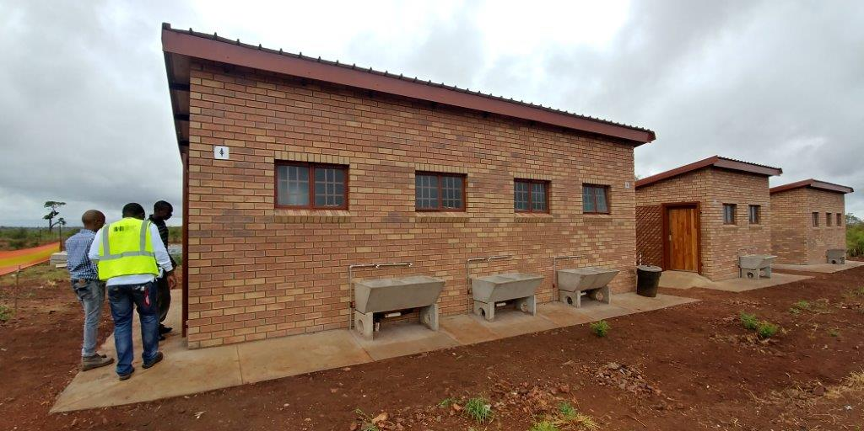
Titirheleni PS - LP

Slide 25
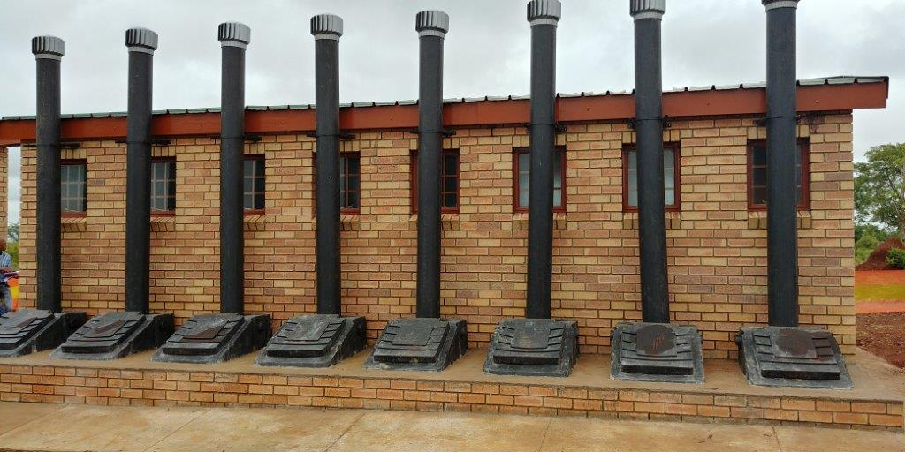
Continued…
Titirheleni PS - LP

Slide 26
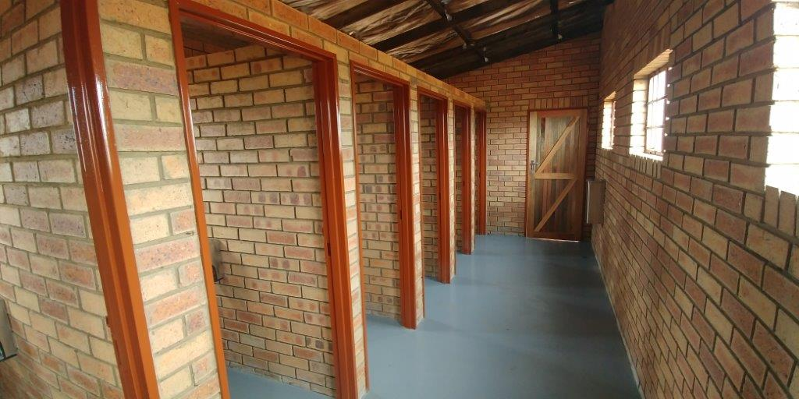
Continued…
Titirheleni PS - LP

Slide 27
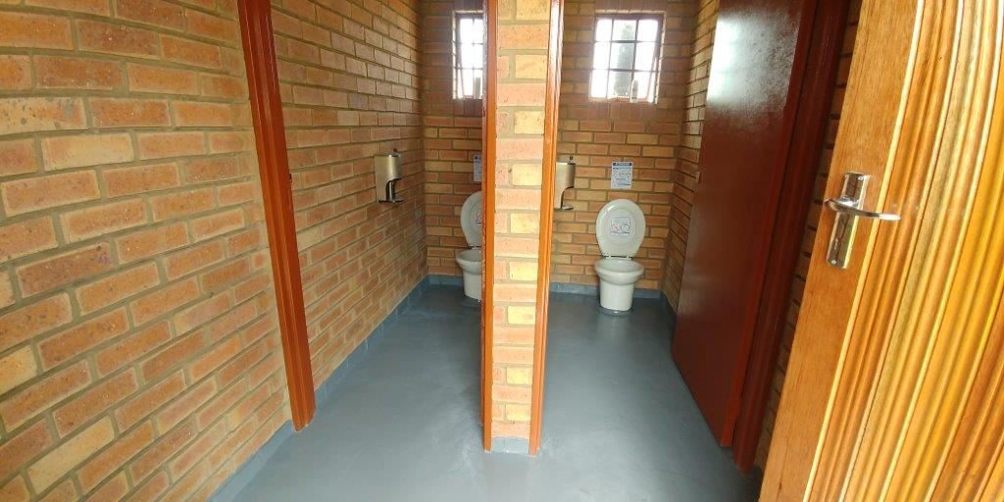
Continued…
Tinyiko PS - LP

Slide 28
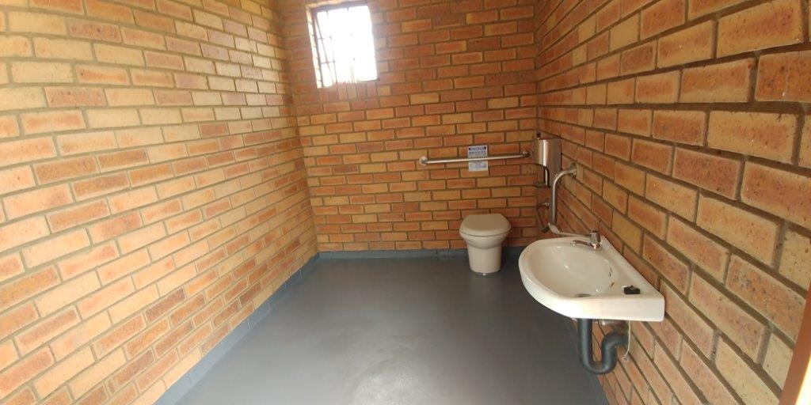
Continued…
Tinyiko PS - LP

Slide 29
Cluster B Projects in EC
Hlathikulu PS - EC

Slide 30
Continued…
Masizakhe PS - EC

Slide 31
Continued…
Zibuthe PS - EC

