Slide 1
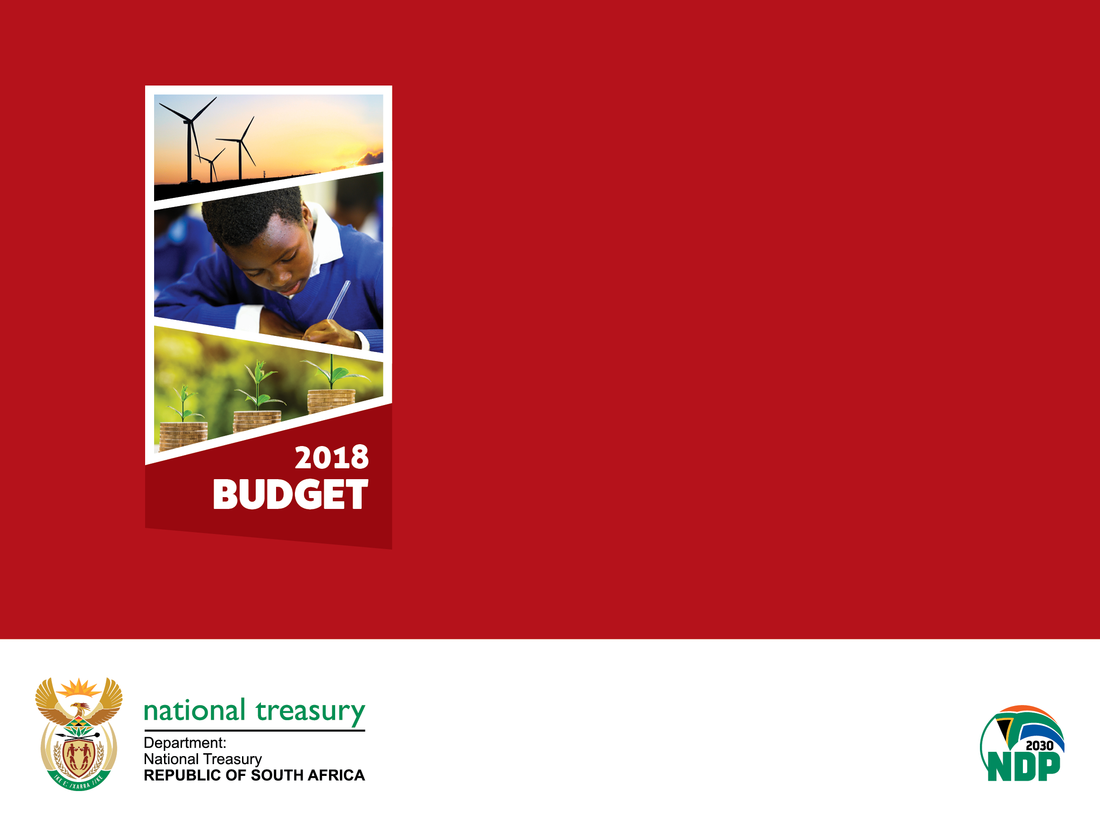
Response to public hearings on the 2018 fiscal framework and revenue proposals

Slide 2
National Treasury officials
Ismail Momoniat – DDG Tax and Financial Sector Policy
Ian Stuart – Acting DDG Budget Office
Debra Makwiramiti – Acting Director, Fiscal Analysis
Chris Axelson – Acting CD Economic Tax Analysis
Mpho Legote – Director: Indirect Taxes

Slide 3
Main comments from public hearings
The increase in VAT is regressive and, along with fuel levy increases, will hurt the poor the most. VAT increase should be rejected
There are numerous other options to raise revenue, including
  An increase in wealth taxes (inheritance tax, estate duties, etc.), higher taxes on the rich through personal income taxes, increases in the corporate income tax rates and higher ad-valorem excise duties
  Personal income tax, corporate income tax and property taxes are all low
Needed a higher increase in social grants, doesn’t fully compensate for VAT increase as not all poor households receive a grant (old age, child support and disability grants only)
Zero-rating of food items does not protect the poor as they consume many products that are not zero-rated (such as school uniforms, soap, white bread, etc.).
  The zero-rating basket should be expanded to include more items consumed by the poor
There should be a luxury VAT rate on some foods and expensive items

Slide 4
Main comments from public hearings
There has been insufficient time for public consultation on such large changes that will wide reaching impacts, and NT should provide more information on proposals
Government should be reducing their wage bill – too high when compared with other countries
Government should not be increasing taxes as South Africa is already one of the highest tax countries in the world
Instead of tax increases, should rather be cutting down on wasteful and fruitless expenditure and stopping corruption and sorting out SOEs
Rate of reduction of deficit is worrying, should be quicker
Zero-rating will only benefit businesses who will pocket the difference, need new instruments to target assistance to the poor
Should be more policies and incentives to help SMMEs and manufacturing
Revenue administration needs to be tightened to increase collections (illicit tobacco)

Slide 5
The domestic economic outlook takes into account the fiscal measures and improves since the 2017 MTBPS
Macroeconomic outlook
The economy has benefited from strong growth in agriculture, higher commodity prices and, in recent months, improving investor sentiment.
The SACCI business confidence index reached its highest level since October 2015, while the Absa PMI is at its highest level since January 2010
Growth projection is closely aligned with other institutions and consensus estimates. National Treasury has modelled three alternative scenarios quantifying some of the risks to the baseline economic forecast (see page 21 of Budget Review)

Slide 6
Alternative scenarios quantifying some of the risks to the baseline economic forecast
Scenario 1
Moody’s downgrades local-currency debt further.
Risk premium increases by 100 basis points before returning to the baseline average in 2020
Higher borrowing costs, and lower investment and consumption
Growth slows to 0.7 per cent in 2018, 1.3 per cent in 2019 and 2 per cent in 2020
Scenario 2
Risks in the SOC sector materialise, prompting a fiscal crisis and a local-currency downgrade
Borrowing costs increase by an average of 2.4 percentage points over the medium term
GDP growth contracts by 3.1 per cent and 0.3 per cent in 2018 and 2019, respectively, before recovering to 1.1 per cent by 2020
Scenario 3
Increase in business confidence is maintained
Global growth improves by an annual average of 0.5 percentage points
Lower risk premium and bond yields by an average of 50bps and 70 basis points, respectively
Higher income growth promotes stronger consumption and investment demand
GDP growth accelerates to 2.1 per cent in 2018, 2.9 per cent in 2019 and 3.2 per cent by 2020

Slide 7
Potential impact of selected NDP reforms on GDP growth

Slide 8
Gross national debt stabilises over the coming decade
Gross debt-to-GDP

Slide 9
Main budget primary deficit closes over the medium term
Main budget non-interest revenue and spending*
*Excluding financial transactions
Main budget revenue grows from 25.4 per cent of GDP in the current year to 26.6 per cent of GDP in 2020/21
Main budget non-interest expenditure remains stable at 26.6 per cent of GDP

Slide 10
National government debt-service costs

Slide 11
Risks to the economy and fiscus
Growth outlook and associated tax buoyancies
Financial position of Eskom and several other large entities
Public-service wage bill outlook
Uncertain implementation costs of fee-free higher education and training
Sub-investment downgrade for local- and foreign-currency debt by Moody’s
Deteriorating financial position of the Road Accident Fund

Slide 12
Spending reallocations
In total, over the next three years, major spending adjustments include:
  Reduce MTBPS baselines expenditure by R85 billion
  Allocate R57 billion for fee-free higher education and training
  Set aside an additional R10 billion for the contingency reserve
  Allocate R4.2 billion for national health insurance
  Allocate R2.6 billion for above-inflation increase to social grants
  Provisional allocation in 2018/19 of R6 billion for drought relief, assistance to the water sector, and public infrastructure projects
After taking account of the spending reductions and reallocations, the expenditure ceiling has been revised down marginally over the medium term.

Slide 13
Baseline reductions
National government absorbed the majority of the reductions, in order to protect frontline services at provincial and local levels
Large programmes with budgets of more than R1 billion in 2018/19 – all health and education-related programmes were excluded.
Administration – an across the board 2 per cent reduction on programme administration for all national and provincial departments.
Public entity cuts – a 5 per cent reduction on transfer to all entities receiving more than R300 million in 2018/19. Research councils, health entities and entities that are already in financial distress (like PMTE and WTE), were excluded from the cuts.
Conditional Grants – a 5 per cent reduction of all provincial and local conditional grants, except for health and social development grants. In a number of instances cuts of more than 5 per cent were introduced for slow spending grants
Details can be found in the overview chapter of the Estimates of National Expenditure

Slide 14
Consolidated spending in 2018/19 by function
The national budget is strongly aligned with constitutional imperatives
About two-thirds of the 2018 Budget is allocated to functions dedicated to realising constitutionally mandated social rights – including education, healthcare, social security and housing

Slide 15
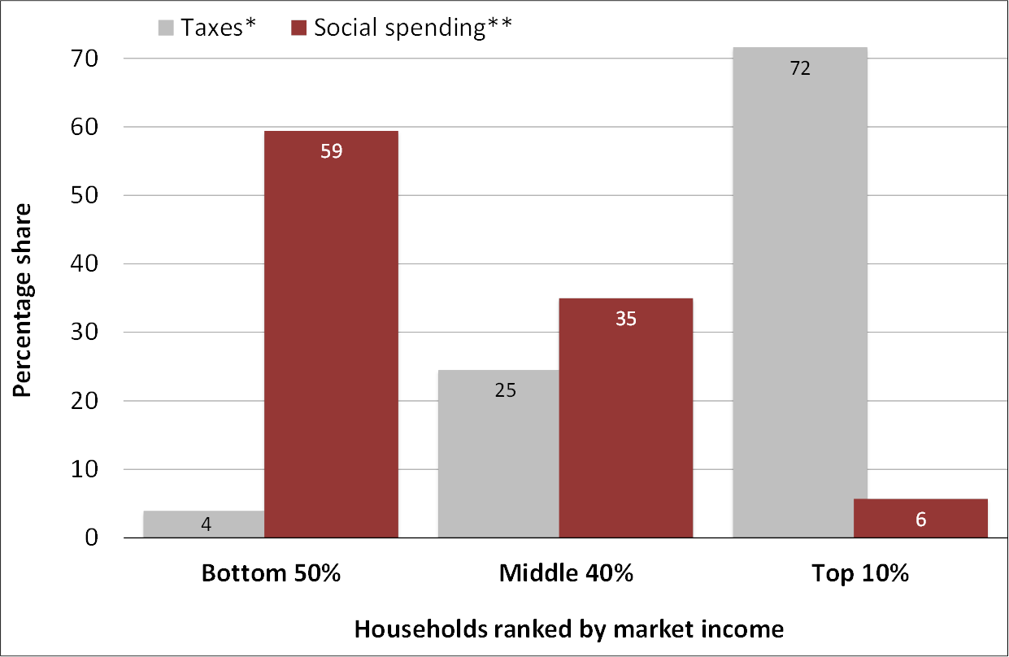
The budget redistributes income to poor and working families
The budget plays a central role in transformation by promoting redistribution and directing scarce resources towards catalytic investments in human and physical capital.
But the budget depends on the economy to generate the resources to finance these investments, and South Africa has had several years of very low growth.
Distribution of taxes and spending by household income
Based on Statistics South Africa’s income and expenditure survey, 2010/11
*Includes personal income tax, value-added tax, fuel levies and excise **Includes social grants, free basic electricity and water, health and education budgets, Source: Inchauste et al. (2015), Distributional Impact of Fiscal Policy in South Africa, World Bank

Slide 16
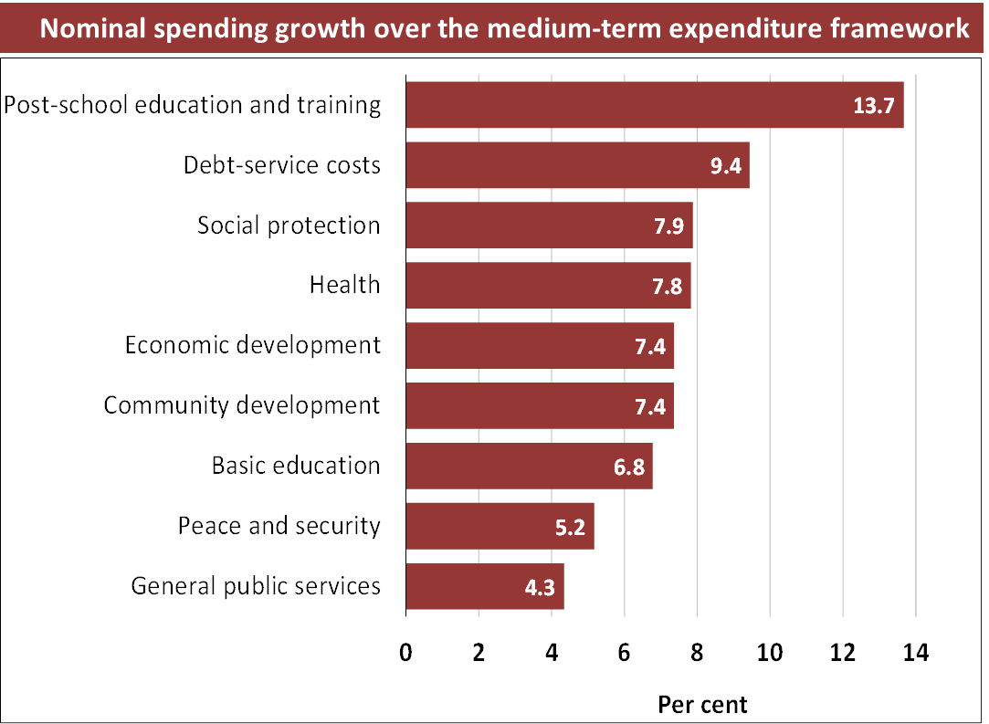
Summary of spending adjustments in Budget 2018
Budget 2018 reduces:
  Large programmes
  Administration
  Transfers to public entities
  Conditional grants
And reallocates towards:
  Fee-free higher education
  Higher contingency reserves
  National health insurance
  Drought relief
  Social grants
The fastest-growing areas of expenditure include post-school education and training, social protection, health, economic development and community development and basic education

Slide 17
Division of revenue
Reductions to provincial and local government transfers focus primarily on infrastructure grants, which will result in some delays in infrastructure rollout
Services have been protected, including grants funding school meals, bus subsidies and medicines
Local and provincial government equitable share grows at over 10 per cent and 7 per cent a year, respectively
Over the MTEF, total provincial allocations are reduced by 1 per cent and local government by 3.5 per cent
Division of revenue

Slide 18
The budget redistributes resources to the rural poor
The division of revenue redistributes substantial resources from the urban economy to fund services in rural areas. It also subsidises services to millions of poor households in towns and cities through considerable allocations to urban municipalities and provinces.
Metropolitan municipalities account for 70 per cent of personal income tax revenue, but receive only 31 per cent of local government transfers. The 61 mostly rural local municipalities also receive 31 per cent of transfers to local government, but account for only 5 per cent of personal income tax revenues.
Per capita allocations to provinces
Per household allocations to municipalities

Slide 19
Compensation as a share of total consolidated expenditure
In the 2016 Budget, government reduced the compensation ceilings of national and provincial departments by R10 billion in 2017/18 and R15 billion in 2018/19.
The compensation baselines in the 2018 Budget maintain this status quo, meaning that the R85 billion baseline reductions exclude compensation of employees.
As a result of these adjustments, and a generally tighter fiscal environment, total national and provincial headcount growth has declined.

Slide 20
Consolidated spending in 2018/19 by economic classification

Slide 21
Road Accident Fund
Financial position of social security funds
Of the 52c/l increase in fuel levies, 30c goes towards the Road Accident Fund to stabilise short-term liabilities (i.e. claims finalised but not yet paid) at about R8.5 billion per year
Nevertheless, actuarial estimates of the total liability grow to R355 billion by 2020/21
The Road Accident Benefit Scheme was approved by Cabinet and the Minister of Transport tabled it in Parliament in June 2017.

Slide 22
Key features of a good tax system
The tax system should be considered in its entirety:
  Taxes should be structured to meet overall spending needs and the earmarking of revenues for particular purposes should be avoided.
  Not all taxes need to address all objectives.
  Not all taxes need to be progressive as long as the overall system is.
  Generally, the right tools for achieving distributional objectives are direct personal taxes and benefits/spending.
  PIT can be designed to achieve the desired degree of progressivity; other aspects of the tax system can be focused on achieving efficiency.
  Source: Institute for Fiscal Studies (IFS), 2011. Mirrlees Review: Reforming the tax system for the 21st century, Tax by Design

Slide 23
Tax-to-GDP ratio in global context
Tax-to-GDP ratio (OECD, 2015)

Slide 24
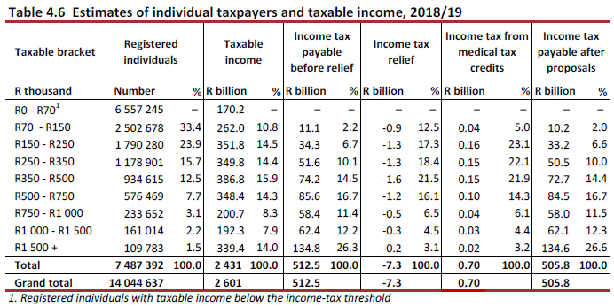
Income distribution of personal income tax payers
The personal income tax system is progressive. About 50 per cent of personal income tax is paid by 500 000 people
In addition, Budget 2018 adds a further R6.8 billion to PIT, partly through zero per cent inflation relief for the top four income tax brackets
Estimates of individual tax payers and taxable income, 2018/19

Slide 25
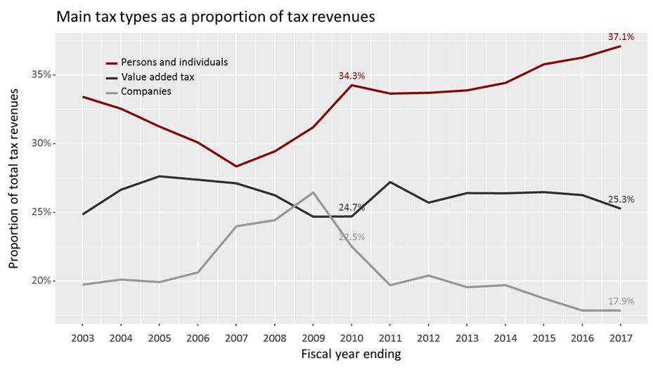
Revenues increasingly reliant on personal income taxes
Main tax types as a proportion of tax revenue

Slide 26
Personal income taxes have been increased substantially over the past four years
1 percentage point increase in 2014/15 across all the brackets
4 percentage point increase in the top bracket, from 41 per cent to 45 per cent, for 2016/17
Minimal relief for bracket creep in 2013/14 (3.5 per cent), 2016/17 (1.8 per cent) and 2017/18 (1 per cent)
Compared to a scenario where the personal income tax tables had been increased by inflation over the past five years,
  an individual earning R350 000 now pays an extra R6 200 per annum in tax
  while an individual earning R2 million pays an extra R50 000 in tax in real terms
Progressive changes to the personal income tax system in recent years include
  moving from a medical tax deduction to a medical tax credit
  limiting the deduction available for retirement fund contributions
  increasing the effective capital gains tax rate from 10 per cent to 18 per cent

Slide 27
The scope for substantial revenues from the top are limited
The current estimate is that PIT revenues will fall short by R21.1 billion, contributing over 40 per cent of the total expected shortfall of R48.2 billion
Given the relatively small income tax base at the top end of the distribution, increases in the top marginal tax rate are not expected to yield significant revenues
  The increase from 41 per cent to 45 per cent this year was expected to generate an additional R4.4 billion, however this is looking unlikely to be realised as PIT revenues are the biggest underperforming tax category this year
  Increasing the top rate to 50 per cent may bring in around R5 billion, but behavioural effect is difficult to judge and could lead to a lot less (which is what appears to have happened this year)
With much higher rates individuals may increase avoidance or evasion, through the use of greater deductions or structuring or through evasion
Real impact on work effort and economic activity as additional returns are diminished

Slide 28
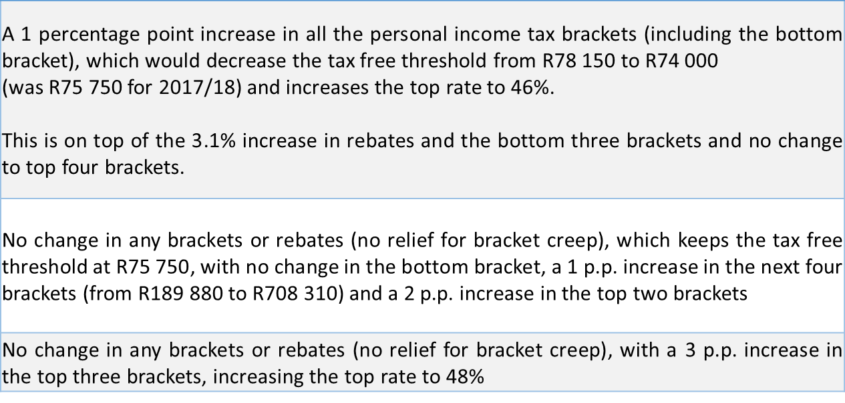
To raise large revenues for PIT, need to tax lower brackets
To raise an additional R22.9 billion, on top of the increase of R6.81 billion, options included:
Personal income tax alternative options

Slide 29
Raising revenue from corporate income taxes
If wanting to improve progressivity and tax capital owners more, raising the CIT rate may sound desirable, but this objective is unlikely to be met:
CIT rate is one of the aspects investors consider (in addition to political/policy certainty and others) when making investment decisions, which affect economic growth
340 companies have taxable income > R200mn and contribute 56% of total CIT revenue
With a 28% rate for the past decade, SA is a high-tax country and is becoming an outlier
The global trend in CIT rates is downward, resulting in a growing gap relative to key trading and investment partners – UK (19%), Netherlands & US (21%), China (25%), Mauritius (15%)
Why do global CIT rates matter?
  The bigger the gap, the more incentive to shift profits out of South Africa, resulting in less CIT revenue (base erosion and profit shifting – BEPS)
  More than 40% of CIT revenue is generated by SA subsidiaries of foreign MNEs
  SA has implemented a number of proposals to counter BEPS, but needs specialised skills to enforce the proposals, legislation alone will not be effective
Would business/capital owners actually bear the burden of a rate increase?
  No, business/capital owners are not likely to bear the full burden (DWT can proxy)
  Companies can pass on higher taxes to employees (lower wages) and/or consumers (higher prices) – study in Canada found a large impact on workers

Slide 30
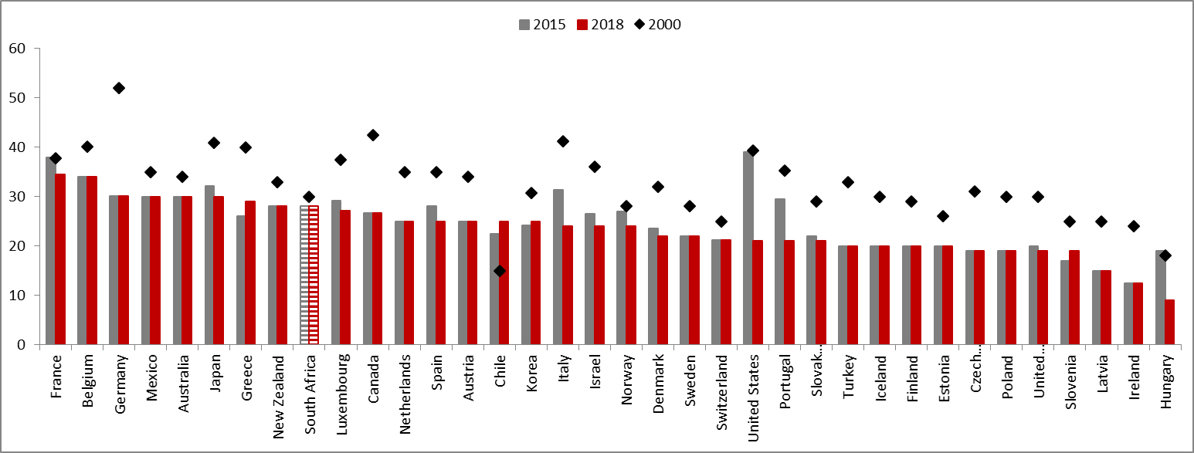
Global trend in CIT rates is downward
Change in headline corporate income tax rates for OECD countries between 2000 and 2018
Source: OECD
Notes:
We are becoming an outlier

Slide 31
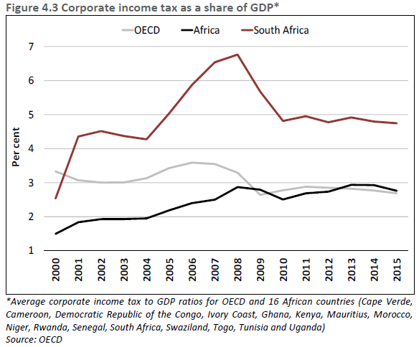
CIT/GDP exceeds that in most countries
Corporate income tax as a share of GDP*
Notes:
While some African countries have similar or slightly higher tax rates, these are often effectively reduced with incentives and/or tax holidays.
Cannot only focus on rates.. The tax base is the equally important. Use cheese analogy ☺. The broader the base, the lower the rate. We have been expanding our base over time, plus our rate is high. With respect to base protection measures, we are continually monitoring what needs to be implemented. However, legislation is meaningless without adequate enforcement capacity.
What’s interesting is that the OECD rates have been falling, but CIT/GDP has remained constant. They are planning on doing more work to understand this – part of it will be similar to the decomposition exercise I did. Their initial suspicion is that the share of profits in the national accounts has been growing. But I’m not sure I buy this. The statement referenced a 2008 paper, but the trend in NOS/net value add since then has actually flattened out. Ours has decreased (COE has increased).

Slide 32
OECD (2010): CIT & PIT more harmful to growth than VAT
The Budget Review states that “Increasing the VAT rate by one percentage point is estimated to have the least detrimental effects on economic growth and employment over the medium term.”
The OECD (2010) reports:
  growth-oriented tax systems seek not only to minimise the distortions of market signals by the tax system, but also to create as few obstacles as possible to investment, innovation, entrepreneurship and other drivers of economic growth.
  The empirical analysis in this report suggests a “tax and economic growth” ranking order according to which corporate income taxes are the most harmful type of tax for economic growth, followed by personal income taxes and then consumption taxes, with recurrent taxes on immovable property being the least harmful.
  a growth-oriented tax reform would, therefore, shift part of the tax burden from income to consumption and/or residential property.
OECD (2010), Tax Policy Reform and Economic Growth, OECD Tax Policy Studies, No. 20, OECD

Slide 33
BER (2016): Higher inflation, but limited GDP impact
The Bureau for Economic Research(2016) stated that:
  “The most immediate result of a VAT rate hike is higher inflation. Consumer spending responds negatively to the inflation lift.
  VAT hike raises the cost of imported goods and weighs on import volume growth. This limits the adverse GDP impact stemming from a VAT hike
  Combined with the need for a more balanced SA tax structure, in our view these results support arguments in favour of a moderate VAT hike.
  It will provide fairly significant tax revenue with contained downside GDP growth impacts. Given Treasury’s dual focus on fiscal consolidation and improving SA’s long-term growth potential, from a credit ratings perspective, this should be a win-win situation.”
  Research does note, however, that economic impact would be worse if companies could not afford higher nominal wages, or employment suffers more than expected
  Also reference that VAT increase tipped Japan into a recession, but had little impact in the UK
The macroeconomic impact of raising the Value Added Tax (VAT) rate in South Africa, Note Research No 2016 | No 2

Slide 34
DTC (2015): Impact of VAT less severe than PIT or CIT
The Davis Tax Committee modelled the impact of raising R45bn from PIT, CIT & VAT and concluded:
  “An increase in VAT would be inflationary in the short-run since the prices of most consumer items would rise overnight. In contrast, an increase in personal or corporate tax rates would have a smaller impact on inflation.
  While there would be a negative impact on real GDP and employment, particularly in the short term, the impact of a VAT increase on these two variables would be less severe than that of a rise in PIT or CIT.
  It is thus clear that from a purely macroeconomic standpoint, an increase in VAT is the least distortionary.”
It is clear that there is a trade-off between efficiency and equity. Raising VAT will have a (albeit very small) negative impact on inequality, but will be much more efficient than an increase in direct taxes. It is also important to consider the longer-term: increases in direct taxes dampen growth, which in turn leads to reductions in tax revenues and constrains the ability of the state to reduce inequality through the expenditure side of the budget.

Slide 35
VAT will have the least harmful impact on growth
VAT is an efficient, certain source of revenue provided that its design is kept simple
Increasing the VAT rate by one percentage point is estimated to have the least detrimental effects on economic growth and employment over the medium term
VAT was last adjusted in 1993, and is lower than the global and African average.
Comparative standard VAT rates by country*
*Rates are for 2017 & 2018. The OECD rate refers to an unweighted average
Source: International Bureau of Fiscal Documentation

Slide 36
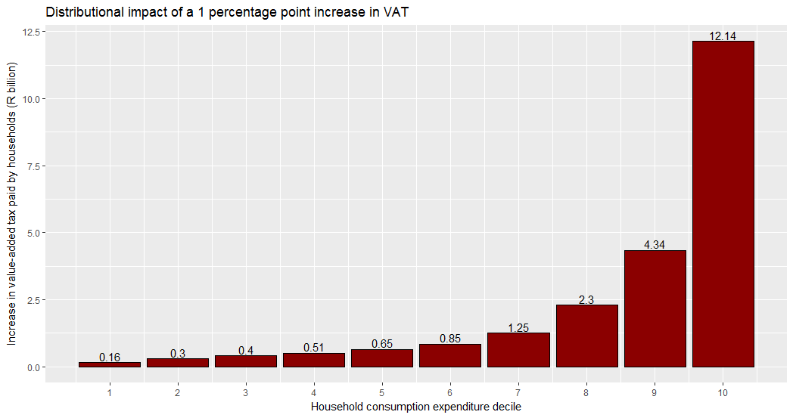
Around R1.8 billion in extra VAT paid by bottom 4 deciles
Distribution of 1% VAT increase across consumption expenditure deciles

Slide 37
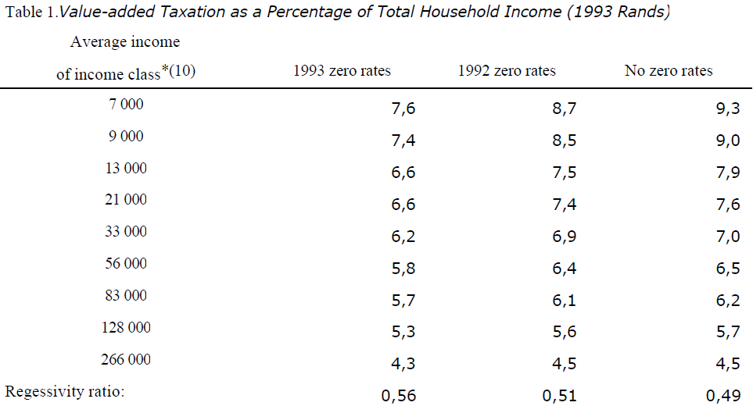
Academic results on the regressivity of VAT are mixed
Earlier research suggested that VAT was regressive (poorer households have a higher VAT burden as a proportion of income)
Research stated that “the VAT burden is significantly reduced by zero-rating”
Value-added taxation as a percentage of total household income (1993 Rands)
Source: Fourie, F & Owen, A (1993) “Value-added tax and regressivity in South Africa”, South African Journal of Economics, 61(4)

Slide 38
Academic results on the regressivity of VAT are mixed
Most recent research suggested that VAT was “mildly progressive” (as was the fuel levy)
Without zero-rating, VAT would be regressive
Excise duties (such as those on alcohol and tobacco) are clearly regressive
  Budget did not change policy on excise duties, which has a targeted tax burden of the retail average weighted selling price of 11%, 23%, 36% and 40% for wine, beer, spirits and tobacco
BUT “cost of living will increase for all households”, whether or not progressive
Source: Fourie, F & Owen, A (1993) “Value-added tax and regressivity in South Africa”, South African Journal of Economics, 61(4)

Slide 39
What about a new luxury VAT rate?
Margo Commission (1987) stated:
"We are satisfied that to charge different rates of indirect tax on different goods and services is a most wasteful and ineffective way of trying to redistribute income. That task is best achieved by well-designed public expenditure programmes, supplemented at the top of the range of income and wealth by a progressive expenditure (income) tax. Measures on the indirect tax side complicate the system, give increased scope for evasion and accomplish little in the way of redistribution.“
Katz Commission (1994): “the disadvantages of multiple VAT rates outweigh the possible redistributive gains available from this option”
Davis Tax Committee (2016) also argued against multiple VAT rates:
  High rates generally apply to a small proportion of total consumption
  “Luxury goods” already bear an ad valorem excise charge, upon which VAT is once again levied
Multiple VAT rate structures may lead to:
Increased administration and compliances costs
Legal uncertainty, which opens up opportunities for lobbying and unwarranted tax planning or avoidance.

Slide 40
BUT ad-valorem duties could be increased on luxury goods
Davis Tax Committee recommendations:
  “Importantly, high rates generally (except possibly in the case of motor vehicles) apply to goods that account for a relatively small proportion of total consumption.
  In addition, the question of multiple rates cannot be divorced from the issue of excise duties. The fact of the matter is that a number of so-called “luxury goods” (including passenger motor vehicles, cell phones, perfume, photographic equipment, etc.) presently bear an ad valorem excise charge, upon which VAT is once again levied.
  In essence, the imposition of ad valorem excise duties on a number of so-called luxury items addresses to some degree the equity concerns.
The DTC conclude that the adoption of multiple rates “is not recommended”
Determining NEW items for luxury goods and implementing this in the legislation would not be possible by 1 April 2018.
Considering these recommendations, the 2018 Budget proposed:
  An increase in the ad-valorem rate from 7% to 9%
  An increase in the maximum cap on motor vehicles from 25% to 30%
  A progressive rate on high end cell phones, increasing the top rate to 15% from 7%
But revenue gains are limited, expected to be around R1 billion

Slide 41
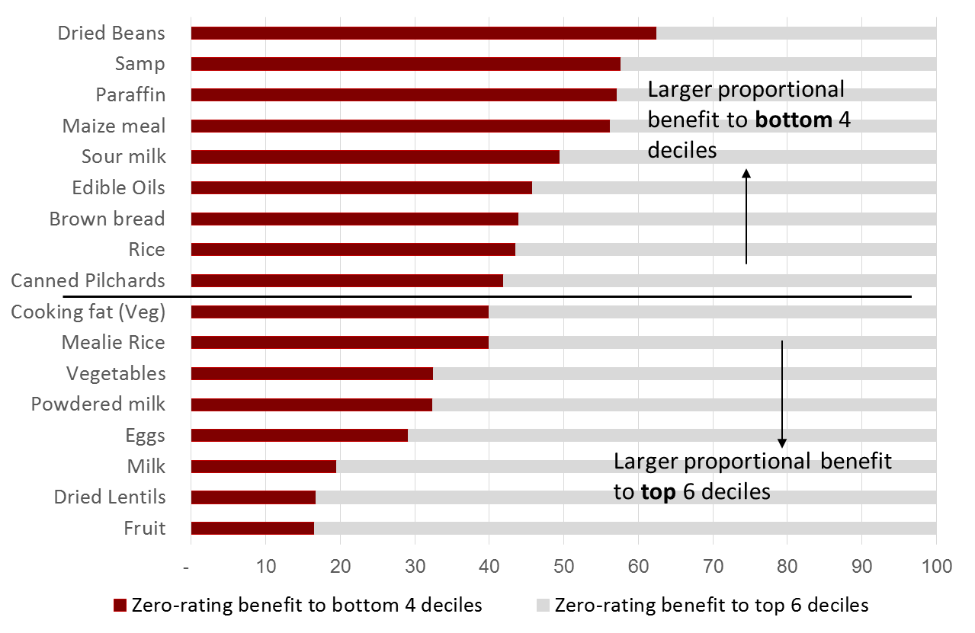
Zero-rating does help, but some benefit the wealthy more
Source: Jansen A & Calitz E. 2015. Reconsidering the effectiveness of zero-rating of value-added tax in South Africa. REDI3x3 Working Paper 9.

Slide 42
Potential for review of zero-rating
“The best sales tax (VAT) with respect to both efficiency and administration is undoubtedly one with a single uniform rate applied to all taxable transactions”. World Bank (2005)
“Our strong recommendation is, however, that no further zero-rated food items should be considered”. Davis Tax Committee (2015)
VAT is a blunt instrument in dealing with distributional issues :
  Higher income households generally turns to benefit more from zero-rating, in absolute terms, than poorer households for which the policy would have been intended
  Targeted poverty relief measures (i.e. direct transfers) are better suited to address the possible regressive effects of VAT than exemptions or zero-rating
Increasing the list of zero-rated food items will further erode the VAT base and reduce the revenue potential of a future VAT increase.
HOWEVER, due to concerns around the impact of the VAT increase it is proposed that
  NT will convene a panel of independent experts to investigate the potential for expansion / review of the zero-rated basket of goods.
  Aim to have public hearings on this research by the middle of the year, to then feed potential proposals into any ministerial committees.

Slide 43
Conclusion
The 2018 Budget accelerates government’s efforts to narrow the budget deficit and stabilise debt, laying the foundation for faster growth in the years ahead.
It sets out a series of proposals to bolster the public finances by raising taxes and adjusting expenditure – decisions that involve difficult trade-offs.
Major steps include a one percentage point increase in the value-added tax (VAT) rate in 2018/19 and large-scale spending reallocations over the medium term.
In combination with the improved growth outlook, the 2018 Budget proposals will result in a considerably narrower budget deficit than was presented in October, and a clear path to debt stabilisation.
Despite these positive signs, significant risks remain to economic and fiscal projections. Government is working to boost economic growth, promote more rapid investment to create employment, and stabilise the precarious finances of state-owned companies.

Slide 44
Thank you
The Budget Review – together with all data for tables and graphs – is online here:
http://www.treasury.gov.za/documents/national%20budget/2018/budgetReview.aspx
For additional information on the budget, please visit out new budget data portal:
https://vulekamali.gov.za
For information on local government finances, please visit:
https://municipalmoney.gov.za

Slide 45
Annex: Related research on the economic impact of VAT/PIT/CIT
Lee, Y., & Gordon, R. H. (2005). Tax structure and economic growth. Journal of public economics, 89(5-6), 1027-1043.
  “We find that statutory corporate tax rates are significantly negatively correlated with cross-sectional differences in average economic growth rates, controlling for various other determinants of economic growth, and other standard tax variables.”
Acosta‐Ormaechea, S., Sola, S., & Yoo, J. (2012). Tax Composition and Growth: A Broad Cross‐country Perspective. German Economic Review.
  “In the context of revenue-neutral reallocations, we find that increasing consumption and property taxes while reducing income taxes boosts long-term growth. Among income taxes, we find that social security contributions and personal income taxes tend to have a stronger negative association with growth relative to corporate income taxes.”
Myles, G. D. (2009). Economic growth and the Role of Taxation-disaggregate data. OECD Economic Department Working Papers, (715), 0_1
  “A change in the tax mix that increases the importance of consumption taxes relative to income taxes will raise growth. The theoretical mechanism through which this argument works is very clear. Income taxes distort the choice between consumption and saving by reducing the return on saving. This raises the effective price of consumption tomorrow relative to consumption today. An increase in saving raises the rate of increase of the capital stock. The effect is apparent in the aggregate tax regressions and is implicit in the disaggregated empirical results.”

Slide 46
Annex: Related research on the economic impact of VAT/PIT/CIT
Brys, B., Perret, S., Thomas, A., & O'Reilly, P. (2016). Tax design for inclusive economic growth. OECD Taxation Working Papers, (26), 0_1.
“.. result is consistent with the strong theoretical case for consumption taxes. In particular, pure consumption taxes do not affect the return on savings decisions or the choice between different savings vehicles, although consumption taxes will still impact labour supply decisions in the same manner as income taxes.
Furthermore, as exports are zero-rated, with immediate refund of VAT on purchased business inputs, a pure VAT will not affect international competitiveness.
The underlying design of a VAT can minimise the ability for fraud making it an effective mechanism for collecting tax in most OECD countries. A broad-based VAT will also avoid distorting consumption choices and minimise compliance and administrative costs.”
The new distributional evidence above strengthens the case for a shift in the tax mix towards VAT, even if the equity implications of a tax shift towards VAT also depend on other factors.
VAT is a comparatively efficient source of tax revenue and the distributional impacts are less significant than has previously been considered to be the case for a large majority of taxpayers.”

