Slide 1
LEPELLE NORTHERN WATER BOARD ANNUAL REPORT 2016/17
28 February 2018

Slide 2
Contents
ANNUAL REPORT 2016/17
Part 1: Overview of financial performance
Part 2: Overview of non-financial performance

Slide 3
annual report 2016/17 Part 1: overview of financial performance

Slide 4
FINANCIAL PERFORMANCE
FINANCIAL PERFORMANCE FOR THE YEAR ENDED 31 June 2017
 | Audited Outcome 2016/17 | Audited Outcome 2015/16 | Variance
 | R'000 | R'000 | %
Revenue
Revenue from exchange transactions ( Primary) | 474 747 | 459 199 | 3%
Revenue from non-exchange transactions ( Secondary) | 145 019 | 189 388 | -23%
Expenditure
Employee benefit costs | 172 662 | 201 601 | -14%
Operating expenditure | 399 032 | 381 968 | 4%
Fair value adjustments | 663 | 4 238 | 84%
Finance cost | 3 660 | 11 126 | 67%
Depreciation, amortisation and impairment | 29132 | -20 243 | 144%
Loss on disposal of fixed assets | 0.00 | 0.00
Surplus/(deficit)from operating activities | 39 764 | 112 346 | 32%

Slide 5
STATEMENT OF FINANCIAL POSITION FOR THE YEAR ENDED 31 JUNE 2017
 | 2017 | 2016 | VARIANCE
 | R'000 | R'000 | %
ASSETS
Current Assets
Cash and cash equivalents | 152 319 | 79 575 | 91%
Receivables from exchange transactions | 860 019 | 563 031 | 53%
inventory | 6 097 | 6 145
Non-Current Assets
Property, Plant and Equipment | 697 931 | 634 911 | 10%
Intangible assets | 2 845 | 3 611 | -21%
Investments | 72 143 | 68 228 | 6%
Total assets | 1 791 354 | 1 355 501
LIABILITIES
Current Liabilities
Payables from exchange transactions | 667 167 | 273 048 | 144%
Employee benefits | 67 528 | 65 558 | 3%
Finance lease liability
Financial liabilities:
Non-Current Liabilities
Total liabilities
Total net assets
NET ASSETS
Reserves ( Equity) | 458 156 | 458 156 | 0%
Accumulated surplus | 598 503 | 558 739 | 7%
Pumping cost reserve ( Reserve)
Net assets ( Equity) | 1 791 354 | 1 355 501

Slide 6
Ratios
 | 2017 | 2016
Gross profit | 44% | 47%
Current ratio | 1.5 | 2.4
Liquidity ratio | 0.2 | 0.3
Net profit margin | 7% | 25%
Analysis of the ratio The cash and cash equivalent at the end of the year amounted to R152,3m The ratio on return on assets is 2%. This illustrates the entity’s effectiveness in using its investment in assets. During the period under review, the debtor days’ analysis reflected an increase to 661 days . This is due continuous non-payment by our major customer The assessment is that LNW will maintain liquidity, viability and sustainability for the financial year 2017-18. This assertion is based on our review of the cash flow projection until June 2018, which reflects a healthy cash balance of R150 million. These assertions are further supported by management’s appetite to continuously implement strategies that are geared towards safeguarding of the margin of safety ratio to ensure that it remains above 1.0 month as an absolute worst case scenario

Slide 7
Expenditure outcome: 31 June 2017
Programme (R'000) | Budget | Expenditure | Variance | % Spent
Administration | 563 139 | 506 770 | 56 369 | 9%
Water Sector Management
Water Infrastructure Management
Regional Implementation and Support
Water Sector Regulation
International Water Cooperation
Total
Compensation of employees
Goods & services on operating expenses
35%
65%
Analysis of current payments

Slide 8
Irregular, Unauthorised, fruitless and wasteful expenditure
DESCRIPTION | 2015/16 | 2016/17 | Variance | % Variance
 | R'000 | R'000 | R'000
Unauthorised expenditure | 0.00 | 0.00 | 0 | 0%
Narratives
There were no unauthorised expenditure report in the financial year 2017.
0% overspend
0% not within purpose of vote

Slide 9
Irregular expenditure
Extension of expired contract
Non-compliance with panel selection criteria
Deviation no in line with treasury guidelines
Non-compliance with local content treasury procurement guideline

Slide 10
Fruitless and wasteful expenditure
 | 2016/17 | 2015/16
 | R'000 | R'000
Opening balance | 36 | 0.00
Fruitless and wasteful expenditure – relating to current year | 347 | 36
Fruitless and wasteful expenditure awaiting resolution | 0.00 | 0.00
Recovery | 0.00 | 0.00
Closing Balance | 383 | 36

Slide 11
Reduction of fruitless & wasteful expenditure
Late payments to suppliers mainly SARS resulted in
Interest and penalties. (refer to previous slide)
This is a results of cash flow constraints because of significant portion of debtors not settling their accounts timely as well as pre funding of projects implemented on behalf of DWS.

Slide 12
Commitment analysis

Slide 13
Accruals
 |  |  | 2016/17
 |  |  | R’000
Listed by economic classification
 | 30 Days | 30+ Days | Total
Goods and services | 4,458 | 0 | 4,458
Capital assets | 10,402 | 0 | 10,402
Total | 14,860 | 0 | 14,860

Slide 14
CONTIGENT LIABILITIES AND ASSETS
 | 2016/17 | 2015/16 | Variance | % Variance
 | R'000 | R'000 | R'000
Contingent Assets | 0.00 | 9 200 | 9 200 | 100%
Total
Contingent Liabilities | 0 | 500 | 500 | 100%
Total |  | 8 700 | 8 700
Notes Legal claim : A service Provider was ordered to pay R3.5 plus interest with legal costs to LNW in respect of lost assets within the organization. The board is of the opinion that this claim is probable to be met in full in the near future. Land claim : LNW purchased a farm in 2003 which became a subject of successful land claim . The value of the farm was R2.7m. Land claim Commissioner took possession of the farm in 2005and did not pay any money to LNW . The latter is currently under legal dispute.

Slide 15
Analysis: matters relating the audit report per year
2012/13 | 2013/14 | 2014/15 | 2015/16 | 2016/17
Unqualified | Unqualified | Unqualified | Unqualified | Qualified
The accounting authority did not take effective steps to collect all money due to the Lepelle Northern Water, as required in terms of section 51(1)(b)(i) of the PFMA, as 80% of total accounts receivable was provided as doubtful debt. | The accounting authority did not take effective steps to collect all money due to the Lepelle Northern Water, as required in terms of section 51(1)(b)(i) of the PFMA, as 80% of total accounts receivable was provided as doubtful debt. | The accounting authority did not take effective steps to collect all money due to the Lepelle Northern Water, as required in terms of section 51(1)(b)(i) of the PFMA, as 80% of total accounts receivable was provided as doubtful debt. | The accounting authority did not take effective steps to collect all money due to the Lepelle Northern Water, as required in terms of section 51(1)(b)(i) of the PFMA, as 80% of total accounts receivable was provided as doubtful debt. | The accounting authority did not take effective steps to collect all money due to the Lepelle Northern Water, as required in terms of section 51(1)(b)(i) of the PFMA, as 80% of total accounts receivable was provided as doubtful debt. That the entity did not componentise significant part of infrastructure assets and building in order to depreciate them separately

Slide 16
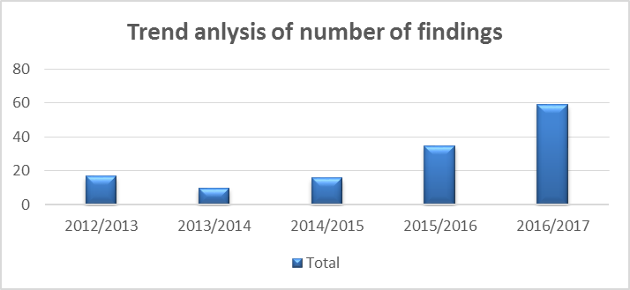
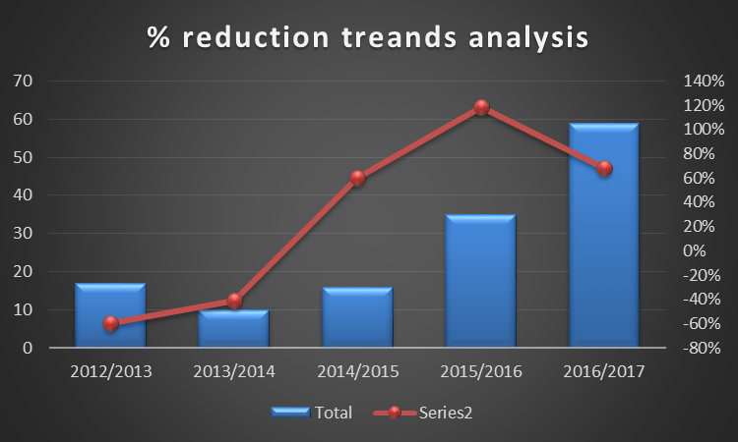
Trend analysis: Matters related to audit report

Slide 17
Comparative analysis

Slide 18
Action plan
Major Finding | Root Cause | Action
Assets register was not unbundled as per IFRS standards | The assets unbundling exercise already started. | A service provider has been appointed to assist with the exercise and would be completed by end April 2017
Performance information did not meet the SMART criteria for certain objectives (SO1 & SO2) | The entity didn`t have a guiding tool that clearly defined its objectives and measurements | A guiding tool has been developed
Poor Payment history of debtors | Poor collection of outstanding debt from municipalities | Continuous engagement are happening with respective municipality in an attempt to improve collection
No processes to avoid or detect irregular , wasteful and fruitless expenditure | Non alignment of interpretation and understanding of irregular expenditure | The board is improving on their submission as well as training to avoid misinterpretation

Slide 19
Part 2: OVERVIEW OF NON- FINANCIAL PERFORMANCE

Slide 20
Explanatory notes
PPI no | Milestones that were not achieved | Comments on deviations | Remedial measures
1 | Tolerable organisational Residual Risk | Certain risks identified during the review required budget and was not available at the point in time but allocated for next financial year. | Implementation of Risk Management related action plans
2 | Capital projects | Financial constraints negatively affected the rollout of the capital projects. i.e: Non payment by DWS and WSA’s leads to cash flow constraints Poor performance by contractors which leads to cancelation of contracts | Implementation of repayments SLA’s with Municipalities Monitoring of performance by contractors
3 | Debtors day (661) | Mopani’s old debt still a challenge. | Implementation of repayments SLA’s with Municipalities
4 | Compliance to DWS effluent general standards | Sekhukhune District Municipality did not approve the budget that was meant to upgrade some of the wastewater works’ capacity to match the high volumes of the influent. | Continuous engagements with municipalities
Notes:
Strategy to overcome under performance
PPI no 1 on attendance of planned training : The strategy to overcome under performance will be to develop a pre-selection of institutions to ensure that training works better.
PPI no 2 on vacancy rate for engineers and scientists:
PPI no 5b on expenditure of departmental budget:
PPI no 6 internal audit plan:

Slide 21
LNW INTERNAL PROJECTS
Project | Summary scope | Design Progress | Construction progress | Completion date
UPGRADING OF FLAG BOSHIELO WATER SCHEMES | Upgrading of the Flag Boshileo WTP from 8Ml/day to 16Ml/day and refurbishment of the existing plant. | 100% | 10% (Civil works Phase 3 contractor is progressing well.) Electro-Mech Works Phase 2 (70% completed) High lift Phase 1(100% completed | The overall projects will be completed by 31st July 2018
DOORNDRAAI PACKAGE PLANT | Design, Manufacture, Supply and Installation of an additional packaged plant capacity by 5Ml/Day | 100% | 5% (Manufacturing of Plant) | 21st June 2018
DOORNDRAAI 500mm RAW WATER PIPELINE | Construction of a new Raw Water Pipeline from the dam to the plant | 100% | 85% (Final assembly and Installation) | 15th December 2017
POLITSI WATER SCHEME UPGRADE –POLITSI ELECTRICAL AND MECHAICAL WORKS | Upgrade of the Pump Station at Politsi Plant | 100% | 95% (Connections, Commissioning and Testing) | 15th December 2017

Slide 22
LNW INTERNAL PROJECTS
Project | Summary scope | Design Progress | Construction progress | Completion date
POLITSI WATER SCHEME UPGRADE –POLITSI PACKAGE PLANT | Design, Manufacture, Supply and Installation of an additional packaged plant capacity by 5Ml/Day | 100% | 95% (Connections, Commissioning and Testing) | 15th November 2017
OLIFANTSPOORT – REPLACEMENT OF SPECON PIPELINE | Replacement of the rising main pipeline from the Olifantspoort Plant to the Specon Reservoir (Emergency) | 100% | 10% (Project is progressing well) | 31st July 2018
OLIFANTSPOORT – REPAIR OF THE HAGING PIPE | Repair of the Olifantspoort Hanging pipe and supporting of the pipe on the PS 2 rising main. | 100% | 100% | 1st April 2017
OLIFANTSPOORT – SLUDGE LAGOONS | Construction of Sludge Lagoons, Supernatant Pump Station and Pipeline at Olifantspoort Plant | 100% | 0% (Project Handed over to the Contractor) | 25th August 2017
OLIFANTSPOORT PACKAGE PLANT | Design, Manufacture, Supply and Installation of an additional packaged plant capacity by 10Ml/Day | 100% | 95% (Connections, Commissioning and Testing) | 15th December 2017

Slide 23
DWS INTERVENTION PROJECTS
Project | Summary scope | Design Progress | Construction progress | Completion date
MOOIHOEK WTW PLANT: REPAIR & REFURBISHMENT OF WATER TREATMENT WORKS | The purpose of this project is to Repair & Refurbish Mooihoek WTW to supply water to the Southern Supply Zone of the Lebalelo Community via storage Reservoirs SC (2ML), SD (0.8ML) and BF (2ML) supplying Burgersfort and Environs. | 100% | 100% (Completed) | 30th June 2017
NANDONI – NSAMI BULK WATER PROJECT | Conveying potable water from Nandoni Dam to Giyani | 100% | 36% | Under review and anticipated to be in next 12 months
GIYANI PROJECT – PIPELINES (Emergency/ Medium term projects) |  | 100% | Overall 91% | Revised to June 2018

Slide 24
GIYANI PROJECT – OTHER PROJECT MILESTONES
Project | Summary scope | Design Progress | Construction progress | Anticipated completion date
Boreholes | Revitalization of existing 154 boreholes (with package plants) – Augmentation to the water scheme while the Bulk Pipelines in progress. | 100% | 97% | 28 March 2018
Operations and maintenance support | Repairs on existing lines ± 270 km’s Pump stations = 9 Reservoirs = 14 | As and when required | Finalization of Institutional arrangements in progress | Finalization of Institutional arrangements in progress between DWS, MDM and LNW.

Slide 25
THANK YOU

