Slide 1
Highlights of SoNA 2018: Implications for CoGTA & 2018 Budget: Local Government Highlights
CoGTA Presentation to the Portfolio Committee
28 February 2018

Slide 2
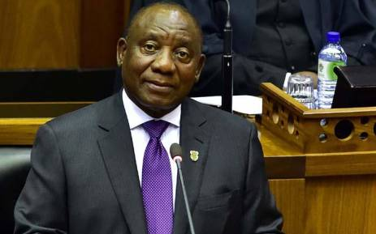
IMPLICATIONS OF SONA AND BUDGET SPEECH ON THE LOCAL GOVERNMENT SECTOR - COGTA

Slide 3
Highlights of SoNA 2018 - The Speech – A new dawn is upon South Africa
President Ramaphosa began by invoking the legacies of Nelson Mandela and Albertina Sisulu to call the nation together under a unified vision.
He instructed South Africans to:
‘… put behind us the era of diminishing trust in public institutions and weakened confidence in leaders. We should put all the negativity that has dogged our country behind us because a new dawn is upon us.”
South African’s new goal:
Build a society defined by decency and integrity that does not tolerate the plunder of public resources, nor the theft by corporate criminals of the hard-earned savings of ordinary people.”

Slide 4
Highlights of SoNA 2018 - A new dawn is upon South Africa
At numerous points in his speech, the President emphasised unity, and the goal of a South Africa for all its citizens that is characterised by its state-corporate collaboration.
The President placed the recovery of the battered economy at the centre of his State of the Nation Address.
A jobs summit, investment conference, and youth working group are some of the proposed initiatives.
He assured South Africans that change is on the way, and stated that this change includes:
Land expropriation without compensation, and
Efforts to reform the economy with youth at its core.

Slide 5
Highlights of SoNA 2018 – Main priorities
Economic Policy | Appoint a Presidential Economic Advisory Council. It will draw on the expertise and capabilities that reside in labour, business, civil society and academia.
Jobs, especially for youth | Jobs Summit within few months Investment Conference within next three months. Launch Youth Employment Service Initiative next month to place unemployed youth in paid internships in companies across the economy. Create a million such internships in the next three years. Establish Youth Working Group to ensure that policies and programmes advance their interests.

Slide 6
Highlights of SoNA 2018 – Main priorities
Re-industrialise/stimulate manufacturing | Strategic use of incentives and other measures. Localisation programme for products designated for local manufacturing – clothing, furniture, water metres etc. via our public procurement interventions.
Transformation | Support black industrialist – to build a new generation of black women producers that are able to build enterprises of significant scale and capability. Use competition policy to open markets to new black entrants. Invest in the development of township and rural enterprises.

Slide 7
Highlights of SoNA 2018 – Main priorities
Infrastructure | Assemble team to speed up implementation of new projects, particularly water projects, health facilities and road maintenance.
Mining | Intensify engagements with all stakeholders on the Mining Charter. Finalise the MPRDA Amendment Bill before by end of the first quarter this year. Stakeholder engagement to deal with mining fatalities.
Small business, co-ops, township enterprises | Honour 30% of procurement allocation to these enterprises. Invest in SME incubation. Welcome SME fund initiative by corporate sector

Slide 8
Highlights of SoNA 2018 – Main priorities
Land and agriculture | Accelerate our land redistribution programme and make more land available. Expropriate land without compensation, our approach taking into account food security, agricultural production and growth of the sector. There will be a process of consultation on modalities.
Fourth industrial revolution | Digital lndustrial revolution commission to be established. Allocation of spectrum to reduce barriers to entry.

Slide 9
Highlights of SoNA 2018 – Main priorities
National Minimum Wage | Introduce NMW by May 1 benefiting more than 6 million South Africans.
Health and NHI | Scale up our testing and treating campaign by initiating an additional two million people on antiretroviral treatment by December 2020 The NH/ Bill is now ready to be processed through Government structures and will be submitted to Parliament in the next few weeks.

Slide 10
Highlights of SoNA 2018 – Main priorities
Social Grants | Urgently take decisive steps to comply with the all directions of the Constitutional Court. Take action to ensure no person in Government is undermining implementation deadlines set by the court.
Education | This year free higher education and training will be available to first year students from households with a gross combined annual income of up to R350,000. All public schools have begun offering an African language. First National Senior Certificate examination on South African Sign Language, which will be offered to deaf learner’s at the end of 2018

Slide 11
Highlights of SoNA 2018 – Main priorities
Social Sector/Civil Society | Convene a Social Sector Summit during the course of this year to recognise the critical role they play in society
State/governance | Review the funding model of SOEs and other measures. Change the way that boards are appointed. Remove board members from any role in procurement.

Slide 12
Highlights of SoNA 2018 – Main priorities
Corruption/state capture | The commission of inquiry into state capture to commence its work shortly. The Commission should not displace the regular work of the country's law enforcement agencies in investigating and prosecuting any and all acts of corruption. Urge professional bodies and regulatory authorities to take action against members who are found to have acted improperly and unethically. Urgently attend to the leadership issues at the National Prosecuting Authority to ensure that this critical institution is stabilised and able to perform its mandate unhindered.

Slide 13
SoNA implications for Local Government
The SoNA did not directly address local government, but there are a number of COGTA programmes which need to strongly support the direction of government as set out by the President.
Radical economic transformation
Municipalities have an important role to play in promoting radical economic and social transformation through managing municipal spaces.
CoGTA has a key role to play in implementing the Back to Basics programme to improve the functionality of the local government sphere. The B2B programme’s 2nd phase include a number of aspects aimed at strengthening radical economic transformation, including transforming develop-mental and spatial planning, implementing the IUDF and revitalising LED.

Slide 14
SoNA implications : Radical economic transformation
Revitalising LED: National conference
The national LED conference committed itself to the implementation of the revised National Framework for Local Economic Development and the following principles of the LED Framework:
Collaborative Partnerships
Integrated place development that recognises marginalised territories such as townships, informal settlements, peri-urban areas, and rural settlements
Inclusive economy that prioritises those that are marginalised such as youth, women, and the informal sector
Sustainable development
Enhance and upscale enterprise development and support
Ensure effective leadership and proper governance
State-led, private sector driven, community based development
Innovation-driven economic development and growth

Slide 15
SoNA implications : Good governance and anti-corruption
The President called for corruption to be dealt with across the whole society, including the tide of corruption in our public institutions.
Through the second phases B2B Plan, CoGTA is committed to:
Strengthening good governance through enforcing consequences for corruption and implementing forensic reports.
Strengthening financial management and financial viability of municipalities through implementing Revenue Enhancement Programmes and addressing municipalities consistently receiving Disclaimer Audit Opinions.

Slide 16
SoNA implications : Institutional efficiency
The President commanded public servants to adhere to the principles of Batho Pele, of putting our people first and that everyone in the public service should undertake their responsibilities with efficiency, diligence and integrity. He called on all public servants to become agents for change.
The 2nd phase of B2B emphasises the need for both a positive municipal interface with communities and institutional capability and efficiency.
CoGTA will support the enhancement of positive community experiences through:
Improvement of complaints management systems and municipal frontline offices; and
Regular feedback to communities on progress with service delivery.
CoGTA will promote the building of institutional capabilities through:
Strengthening of IGR;
Strengthening the roles of District Municipalities;
Strengthening the provincial CoGTA’s; and
Monitoring compliance with the requirements for the appointment of senior managers in Municipalities.

Slide 17
SoNA implications: Infrastructure supporting the economy
The President highlighted the importance of infrastructure investment to support the productive economy ("to grow the economy, create jobs, empower small businesses and provide services to our people").
The second phase B2B plan also prioritizes the continued focus on basic service delivery and infrastructure through:
Prioritising Capacity for Service and Infrastructure Delivery;
Maintenance of existing infrastructure;
Increasing access to quality, reliable and sustainable basic levels of service in 27 prioritised districts; and
Making municipal infrastructure procurement more efficient and effective.
CoGTA has intervened in cases of non-performance of municipalities by stopping MIG allocations, through evoking Section 19 of the DoRA.

Slide 18
SoNA implications : Disaster management
The President referred to the fact that the country remains gripped by one of the most devastating drought’s severe impact on SA’s economy, social services and agricultural production.
He confirmed that the drought situation in the WC, EC and Northern Cape has been elevated to a national state of disaster. This gives National Government the authority to manage and coordinate a national response with support from all provinces.
The second phase B2B plan has emphasised the need to strengthen resilience and adaptation to environmental changes through ensuring Disaster Risk Planning and Reduction.
A classification of a national disaster designates the primary responsibility to coordinate and manage the disaster to the national executive, in close cooperation with provincial and local government, the private sector and civil society, using the applicable contingency plans and existing legislative mechanisms at its disposal to effectively deal with the effects of the disaster.

Slide 19
Budget 2018: Local government Highlights
Division of Revenue
Over the next 3 years, 48 per cent of nationally raised funds are allocated to National Government, 43 per cent to provincial government and 9 per cent to local government.
The Minister of Finance indicated that although the Government would like to allocate more to each sphere for service delivery, and a larger share to local government, the reality is that the rising cost of servicing the national debt leaves less resources available to invest in services across all three spheres of government

Slide 20
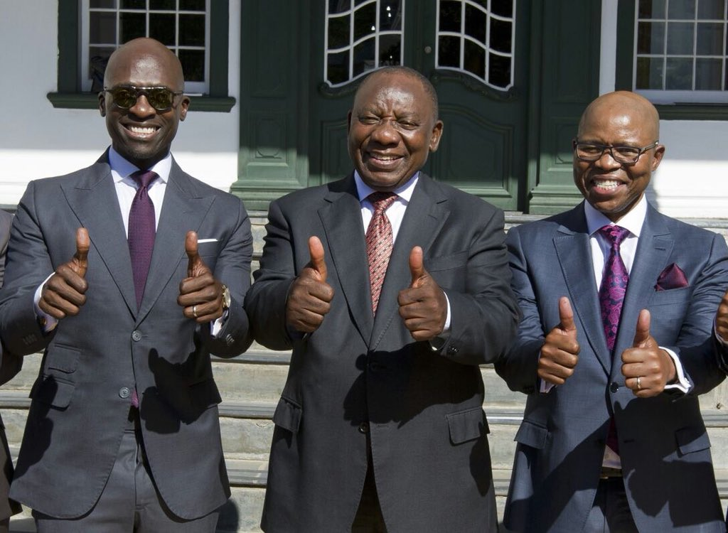
Budget Speech and Budget Review 2018: Municipal revenue
The Budget Review indicated that allocations to the local government equitable share will continue to grow over the next 3 years, alongside a significant reduction in conditional grants. Total direct allocations to local government grows at an annual average rate of 7.5 per cent over the MTEF period.
An amount of R3.4 billion is added to the local government equitable share over the medium term. This fully covers the increased municipal costs of providing FBS to a growing number of households, and takes account of likely above-inflation increases in the costs of bulk water and electricity. The additions also allows for faster increases in allocations to poorer and rural municipalities through the redistributive components of the equitable share formula.

Slide 21
Budget Speech and Budget Review 2018: Municipal revenue
Indirect grants to local government have been reduced by an additional R2.2 billion. The most substantial reduction has been applied to the largest grant – the MIG. However, the structure of the formula used to allocate this grant reduces the impact of reductions on smaller municipalities.
Smaller cities are eligible for a new integrated urban development grant from 2019/20. Cities that meet planning and performance criteria qualify to receive the grant, which will be funded through a shift of funds from the MIG.

Slide 22
Budget Speech and Budget Review 2018: Municipal borrowing
Municipalities have the potential to increase their investments in infrastructure to support growth, despite reductions to infra-structure grants. They can do this by leveraging their own-revenue sources through borrowing.
Though the total value of outstanding long-term municipal debt increased to R66.3 billion in the first quarter of 2017/18, the proportion of municipal capital budgets funded from borrowing has fallen from 24 per cent in 2008/09 to 15 per cent in 2016/17.
Regulatory changes can help municipalities make better use of their own-revenue potential. Government will table amendments to the Municipal Fiscal Powers and Functions Act (2007) to clarify rules for levying these charges, so that developers pay the full costs of the additional infrastructure needed to supply them with municipal services.

Slide 23
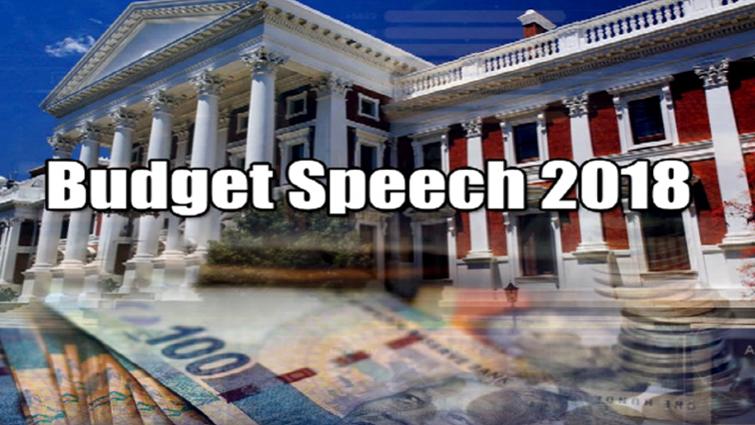
Budget Speech and Budget Review 2018: Municipal borrowing
National Treasury is updating the policy framework on muni-cipal borrowing. Changes to clauses of the Division of Revenue Bill (2018) remove provisions that only allowed municipalities to borrow against future grant transfers for 3 years and required an onerous approval process. Instead, municipalities will be able to borrow against all their future revenues, subject to the requirements of the Municipal Finance Management Act.

Slide 24
Budget Speech and Budget Review 2018: Local government financial management
The Minister highlighted financial management and governance challenges facing municipalities, including:
Too many municipalities do not charge tariffs that reflect the full cost of the services they deliver, in particular for water services.
Many municipalities do not collect the funds that are owed to them, and do not adopt credible budgets. Thus, they are unable to pay their own creditors.
Although National Government already provides extensive capacity support to municipalities, the effectiveness of these different support measures will be reviewed and a new instrument will be introduced designed to assist the turnaround of some of the most troubled municipalities.

Slide 25
Budget Speech and Budget Review 2018: Local government financial management - cont
The Minister highlighted financial management and governance challenges facing municipalities, including:
According to the Budget Review, many municipalities continue to face financial and institutional problems that result in breakdowns in service delivery and mounting debts.
At the end-September 2017, the 20 municipalities with the largest outstanding commitments owed creditors R17.4 billion, but had only R1.7 billion of cash on hand. Most of these debts are owed to Eskom and water boards.
Protracted non-payment undermines the financial sustainability of these utility state-owned entities. National and provincial departments also owe municipalities, and the Department of Public Works is working to verify and settle these debts. To date, debts totalling R4 billion have been verified and departments have paid R1.6 billion owed.

Slide 26
Budget Speech and Budget Review 2018: Local government financial management
Non-payment of creditors is a symptom of deeper underlying problems. These include weaknesses in revenue collection, and underinvestment in maintenance and renewal. Too many municipalities also fail to adopt credible budgets, meaning that even if they stick to their budgeted plans, they will not be financially sustainable.
In 2017, only 125 municipalities tabled funded budgets. After the budget benchmarking process with treasuries, the number increased to 145. In 2017/18, 81 municipal councils voted to adopt budgets that they knew were not funded, making some form of financial distress inevitable.
The causes of municipal financial crises are complex, and the response needs careful consideration. Government spends nearly R2 billion a year on municipal capacity support. National and provincial treasuries, and other departments, provide oversight and support through the system of cooperative governance.

Slide 27
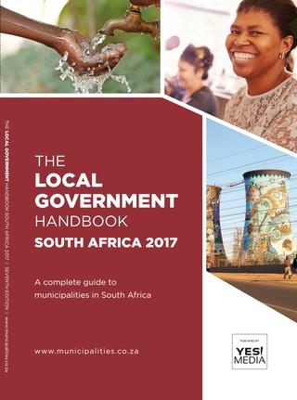
Budget Speech and Budget Review 2018: Local government financial management
Where municipalities consistently fail to achieve their mandates, the Constitution provides that provinces and/or national government must intervene.
Government will introduce a conditional grant in the outer years of the 2018 MTEF to help municipalities facing financial crises. It will only be available to local governments that have demonstrated the political will to implement reforms necessary to turn themselves around. The grant, accompanying support and intervention measures under section 139 of the Constitution, will be designed and consulted on during 2018.

Slide 28
Budget Speech and Budget Review 2018: Public auditing, preferential procurement and payment of suppliers
The Minister highlighted the need to amend the Public Audit Act to effectively address the rising trend in unauthorised, irregular, fruitless and wasteful expenditure.
The Minister encouraged the use of public procurement as a critical lever to support black economic empowerment, women and youth and support industrialisation and development of small businesses.
The DG of National Treasury will issue a directive to all government departments and public institutions, instructing them to pay suppliers on time, or be charged with financial misconduct.
This must be monitored by accounting officers, and National Treasury will strengthen oversight mechanisms in this regard.

Slide 29
Budget Speech and Budget Review 2018: Urban renewal and spatial transformation
The Minister emphasised the importance of cities in the national economy and their potential to drive economic renewal and inclusive growth. South Africa’s eight metros are home to 39 per cent of our population but account for half of all employment (formal and informal) and 57 per cent of the country’s economic output.
The Integrated Urban Development Framework sets out government’s policy commitment to improving the productivity of South Africa’s urban areas. By revitalising township economies and reconfiguring urban centres, SA is radically transforming the unequal spatial planning of its cities.
To better respond to the urban development challenges of intermediate cities, the Budget proposes to introduce a new, more flexible grant funding arrangement for these cities. Cities may opt to join this new grant, which will require more integrated long-term planning and a greater contribution to infrastructure investment form their own resources.

Slide 30
Budget Speech and Budget Review 2018: Urban renewal and spatial transformation
According to the Budget Review, the Cities Support Programme has worked across national departments and metropolitan municipalities on a programme to strengthen the metros as enablers of faster, more inclusive economic growth. To date, there has been significant progress in:
Aligning metropolitan plans to spatially targeted investment programmes that supports transit-oriented urban development.
Preparing a portfolio of catalytic projects in each metro that will support higher density and integrated land development.
Revising public transport and housing financing arrangements to scale up delivery of specific programmes, such as bus rapid transit systems and informal settlement upgrading programmes.
Streamlining regulatory approvals to reduce the cost of doing business.

Slide 31
Budget Speech and Budget Review 2018: Drought
Government is working with municipalities to respond to the water crisis, and is ready to provide financial assistance where necessary:
A provisional allocation of R6 billion has been set aside in 2018/19 for several purposes, including drought relief and to augment public infrastructure investment.
The potential job losses in vulnerable farming communities is a concern, therefore the option of partially mitigating losses by temporarily increasing intake in the Working for Water programme, is considered.
Allocation for drought-response-funds-for-water infrastructure projects and EPWP will be made in the Adjustment Budget.
To provide short term assistance, the budget includes disaster relief grants for provinces and municipalities worth R473 million in 2018/19. Conditional grants can also be reprioritized if necessary.

Slide 32
