Slide 1



South Africa Works because of Public Works
Presentation to the Portfolio Committee
on Public Works
27 FEBRUARY 2018

Slide 2

INDEX
PROGRESS UPDATE ON THE 1997 & 1999 PUBLIC WORKS WHITE PAPERS REVIEW TOWARDS THE PUBLIC WORKS ACT
Slide1

Slide 3
PURPOSE
The purpose of this presentation is for the PORTFOLIO COMMITTEE to note:
  The progress on the Public Works White Papers Review
  The challenges that have hindered the effective delivery of the Project
  Remedial measures undertaken and results thereof
  Critical success factors that will ensure sustainability of achievements towards full implementation of the Project.
Slide 2

Slide 4
CONTENTS
INTRODUCTION Slide 4 - 10
TARGETS, PROGRESS TO DATE & CHALLENGES Slide 11 - 14
REMEDIAL MEASURES & RESULTS Slide 15 - 26
WAY FORWARD Slide 27 - 29
Slide 3

Slide 5
A.
INTRODUCTION
Slide 4

Slide 6
1. BACKGROUND
  In the 1st five years of democracy, two Public Works White Papers developed –
  Public Works towards the 21st Century (1997); and
  Creating an Enabling Environment for Reconstruction Growth and Development in the Construction Industry (1999).
  The two Public Works White Papers have two different, yet interlinking focus:
  The 1997 White Paper articulates DPW’s mandate in the context of the Reconstruction and Development Programme (RDP).
  The 1999 White Paper reflects Government’s vision for the Construction Industry still within the RDP context and the future.
Slide 5

Slide 7
2. POLICY INTERVENTIONS TIMELINE
Reconstruction and Development Programme | Public Works towards the 21st Century | Creating an Enabling Environment for Reconstruction, Growth and Development in the Construction Industry | CIDB, CBE & BEPC Acts | Growth & Development Summit | Expanded Public Works Programme, Phase 1 | Government Immovable Asset Management Act | Built Environment Policy* | Expanded Public Works Programme, Phase 2 | National Development Plan: a Vision for 2030 | Presidential Infrastructure Coordinating Commission & National Infrastructure Plan | Expanded Public Works Programme, Phase 3 | Property Management Trading Entity (PMTE) Agrément South Africa Act, 2015 Review of 1997 & 1999 Public Works White Papers (and subordinate instruments) and drafting of a Public Works Act initiated | Immovable Asset Register (IAR) Expropriation Bill | Property Management Empowerment Policy
1994 | 1997 | 1999 | 2000 | 2003 | 2004 | 2007 | 2008 | 2009 | 2010 | 2012 | 2014 | 2015 | 2016 | 2017
Slide 6

Slide 8
3. NEED FOR PUBLIC WORKS ACT
In the Minister of Public Works’ Five year Policy Statement and Vision for 2014-2019, he stated as follows –
“… we have to embark on a thorough policy review. We have to go through the White Paper process culminating in a Public Works Act by the end of this Administration … to refresh and clarify our mandate and to establish a platform for sustainable development.”
In its 2014-2019 Strategic Plan, the Department stated its intent to review the White Papers over the MTEF period –
“In reviewing and revising the current White Papers, the Department will inter-alia, explore strengthening the regulatory role of the Department in the … (Construction and Property Sectors), while furthering transformation and paving the way for the development of the Public Works Act during the current MTEF period.”
Slide 7

Slide 9
4. PROBLEM STATEMENT
The Department of Public Works has two existing white papers developed in 1997 and 1999. The development of both these Papers was premised on the then overarching “Reconstruction and Development” policy. Changes in the social, political, and economic landscapes, nationally and internationally necessitate the revision of the 2 White Papers.
Furthermore, the Department of Public Works does not have a comprehensive Act that defines its mandate, but rather relies on various pieces of Legislation, Cabinet instructions, and historical practices.
Policy-practice gaps and inhibitors - Concerns about the impact and sustainability of public works as an instrument for meeting socio-economic development agenda;
Slide 8

Slide 10
4. PROBLEM STATEMENT
Weak/poor regulation of the construction and property industries leading to stifled growth and competition within the cited industries;
Unacceptable slow pace of transformation within the construction and property industries;
Lack of effective mechanisms to address conflict in the construction industry.
Slide 9

Slide 11
5. PROJECT PURPOSE
DPW’s 2015-20 Strategic Plan prioritizes the review of the Department's White Papers:
to define the Department's role in a developmental State
(through promulgation of a Public Works Act)
to reinforce DPW’s role in driving transformation in the construction and property sectors.
to review and update policy goals and approaches to address current events within the context of the local and global construction and property sectors.
Slide 10

Slide 12
B.
TARGETS, PROGRESS TO DATE & CHALLENGES
Slide 11

Slide 13
6. TARGETS IN TERMS OF THE 2014-19 PLAN
Time Horizon | Deliverables
Year 5 (2018/19) | Public Works Act promulgated
Year 4 (2017/18) | Public Works Bill
Year 3 (2016/17) | Draft Public Works Bill submitted to Cabinet for approval to publish for public Comment
Year 2 (2015/16) | Draft Public Works White Paper gazetted for public comments
Year 1 (2014/15) | Draft Public Work Paper developed
Related targets | Draft amendments to CIDB, CBE Act and 6 BEPCs Acts Agre’ment SA Bill Draft IDT Bill Revised construction and property sector codes submitted to DTI for approval
Slide 12

Slide 14
7. PERFORMANCE: 2014/15 – Q3 2017/18
2014/15 | 2015/16 | 2016/17 | 2017/18 | 2018/19 | 2019/20
Draft Public Works White Paper developed (Not Achieved) | Draft Public Works White Paper gazetted for public comments (Not Achieved) | Draft Public Works White Paper gazetted for public comments (Not Achieved) | Draft Public Works White Paper gazetted for public comments (Not going to be Achieved) | Draft Public Works Bill gazetted for public comments | Public Works Act promulgated
Project Conceptualization (Actual Deliverable) | Efforts to procure external expertise (Actual Deliverable) | Efforts to procure external expertise (Actual Deliverable) | Project institutionalization including in-housing expertise. Internal Discussion document produced and circulating (Actual Deliverables)
Slide 13

Slide 15
9. HISTORICAL CHALLENGES
Original project concept - Focus was to outsource delivery Inadequate in-house expertise in research, policy analysis and evaluation, and policy project management Challenges in sourcing of requisite expertise.
Slide 14

Slide 16
C.
REMEDIAL MEASURES AND RESULTS
Slide 15

Slide 17
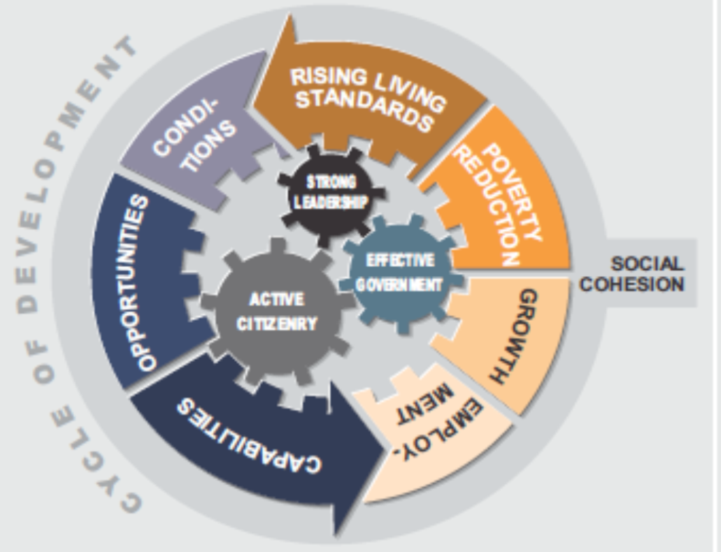
10. REMEDIAL MEASURES
(Definition of Policy Drivers)
Democratic Government’s policy focus remains the same: Build an equal society by (1) creating and sustaining conducive conditions (2) building capacity, and (3) providing opportunities.
Source: Vision 2030 (NPC, 2011)
Slide 16

Slide 18
10. REMEDIAL MEASURES
(Definition of Policy Drivers)
Public Works policy related imperatives remain unchanged, namely:
Properly define and locate the mandate and oversight role of DPW.
Public Works sector that provides infrastructure which –
  has a fitness of purpose;
  provides value for money over its service life;
  is safe, reliable and efficient;
  is affordable taking into account life cycle costs; and
  is as far as is possible delivered within the budget.
Ensure that there is an alignment of interest between those who design and construct infrastructure and those who subsequently occupy, use or manage it;
Provide infrastructure in the right quantity and quality, in the right places, at the right time, and in accordance with legislative mandates, strategic priorities, accepted norms and standards (planning guidelines) and which is affordable;
Slide 17

Slide 19
10. REMEDIAL MEASURES
(Definition of Policy Drivers)
Efficiently managing the asset life-cycle of immovable assets under the Department’s custodianship:
  Ensure that optimal utilisation is made of existing infrastructure as demand patterns shift over time;
  Enable immovable assets to be maintained so that they remain fit for purpose in use;
Provide expert advice to all three spheres of Government and parastatals on immovable assets;
Contribute to the national goals, in particular:
  Job creation;
  Skills development;
  Poverty alleviation;
  Transformation; and
Provide strategic leadership to the Construction and Property Industries.
Slide 18

Slide 20
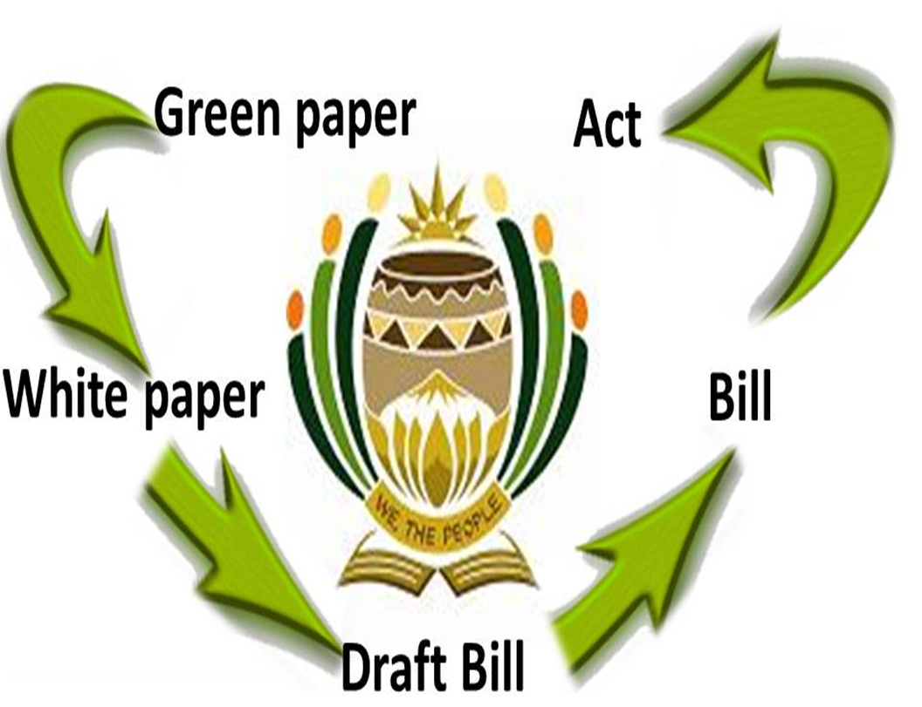
10. REMEDIAL MEASURES
(High Level Project Conceptualisation)
Handout 1: Project Concept
Source: https://www.parliament.gov.za
Slide 19

Slide 21
10. REMEDIAL MEASURES
(High Level Project Map)
JUSTIFY NEED FOR PUBLIC WORKS POLICY REVIEW/ PUBLIC WORKS ACT
IMPLEMENTATION SUPPORT & EVALUATION
PROJECT INSTITUTIONALISATION
Consultations, Monitoring & Review
PARLIAMENTARY PROCESS
REVIEW OF PUBLIC WORKS POLICY
(& LEGISLATIVE) FRAMEWORK
Handout 2: Legislative Process
Handout 3: Project Implementation Plan
FORMULATION OF DRAFT PUBLIC WORKS BILL
Slide 20

Slide 22
10. REMEDIAL MEASURES
(Mapped Resources/Expertise)
Slide 21
No. | Expertise | Status | Key Deliverables
1. | Senior Construction Policy Specialist | In-house | Policy analysis and drafting
2. | Senior Property Policy Specialist | In-house
3. | Facilities Management | In-house | Discussion paper inputs Subject area analysis (i.e. analysis of interventions with area of expertise) Formulation of policy proposals
4. | Labour-based Methods | In-house
5. | Enterprise and Supplier Development | In-house
6. | Human Resources Development & Transformation | In-house
7. | Public Sector Procurement & Contracts Management | In-house
8. | Safety, Health, Environment & Quality Management | In-house
10 | Public Sector Institutional Development/Design | In-house

Slide 23
10. REMEDIAL MEASURES
(Mapped Resources/Expertise)
No. | Expertise | Status
11. | Legal | In-house | Constitutional law interpretation Legislative Drafting
12. | Construction Policy Specialist | In-house | Construction and Property Industry analysis Benchmarking Workstreams secretariat
13. | Property Policy Specialist | In-house
14. | Project Manager | In-house (DDG Policy) | Project management and delivery
15. | Project Secretariat (1) | In progress | Project administration
16. | Project Workstreams Secretariat (x2) | In progress | Project Workstreams administration
Slide 22

Slide 24
10. REMEDIAL MEASURES
(Project Workstreams)
Technical work undertaken through 2 core work streams.
  Construction Work-stream
  Construction Policy Unit
  Construction Policy Specialist: CD
  Construction Policy Specialist: Director
  Construction Projects Management
  Professional Services
  Supply Chain Management
  CIDB
  CBE
  IDT
  ASA
  CSCC
  Property Work-stream
  Property Policy Unit
  Property Policy Specialist: CD
  Property Policy Specialist: Director
  Real Estate Management Services
  Real Estate Investment Services
  Real Estate Asset Registry Services
  Facilities Management
  CBE
  PSCC
Slide 23

Slide 25
10. REMEDIAL MEASURES
(Stakeholder Consultation Strategy)
Slide 24

Slide 26
10. REMEDIAL MEASURES
(Project Institutionalisation)
Slide 25
Project Governance
Project Owner
- Minister
Expert Reference Group
Project Champion - DG & Project Steering Committee
PMO
Project Execution
Project Director – A/DDG: Policy
Project Manager
Secretariat
Construction Workstream Leads
Property Workstream Leads
Work streams
Secretariat
DPW Technical Support
Secretariat
Workstream members
Workstream members
Workstream members
Workstream members
Intergovernmental Advisory Group
Multi-Stakeholder Consultative Forum

Slide 27
11. PROJECT STATUS
(As of 23 February 2018)
Slide 26
Q2 2017/18
Q3 2017/18
Q4 2017/18
Q1 2018/19
Q2 2018/19
Q3 2018/19
Q4 2018/19
Reconceptualise Project
Review Project Plan
Constitute Project Structures: PMO, Work streams, PSC, MERG, ICF, MCF
Stakeholder Mapping
Conduct initial Socio-economic Impact Assessment
Project Initiation, Institutionalisation & SEIAs
Recruit additional Experts
Stakeholder Consultation
Circulate & Refine Discussion document
Develop and circulate (draft) Public Works Bill
Produce Policy Review Report
Develop Public Works Bill
Conduct Socio-economic Impact Assessment
Public Works Bill Drafting Initiated
Present Policy Review Report and Draft Public Works Bill to Minister for Gazetting for public comments
Revised Project Concept
Internal Discussion Document Produced & Circulated
Discussion Document Circulated to Multi Stakeholders
Final SEIAs Report
Policy Review Report Submitted to Minister
Consolidated Stakeholder Consultation Report
Key Deliverables & Milestones
Fully operational project structures
Stakeholder Consultation Report
Stakeholder Consultation Framework
Initial SEIAs Report
Draft Bill Presented to Minister to gazette for Public comments
Project Structures Activated & Stakeholders informed

Slide 28
D.
WAY FORWARD
Slide 27

Slide 29
13. WAY FORWARD
Ongoing strategic leadership and support Insourcing required skills & capacity Dedicated Project Management Office (PMO) Co-operation by all parties in the public works sector Active operation of key referral and/or advisory groups: Expert Reference Group Intergovernmental Advisory Group Multi-Stakeholder Consultative Forum Adequate funding Diligence and timely feedback by all parties Results-based Project Management
Slide 28

Slide 30
14. RECOMMENDATIONS
It is therefore submitted and recommended that the PORTFOLIO COMMITTEE notes:
  The progress on the Public Works White Papers Review;
  The challenges that have hindered the effective delivery of the Project;
  Remedial measures undertaken and results thereof; and
  Critical success factors that will ensure sustainability of achievements towards full implementation of the Project.
Slide 29

Slide 31
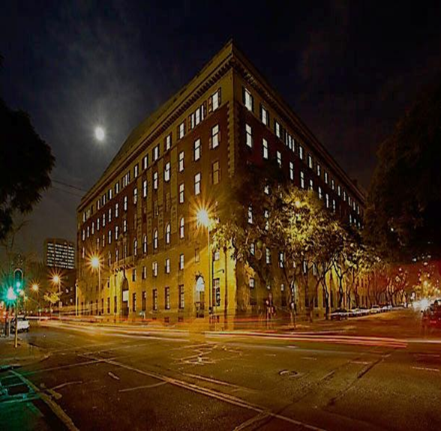
THANK YOU ALL
National Department of Public Works
Head Office: Public Works
CGO Building
Cnr. Bosman and Madiba Streets
Pretoria Central
Private Bag
X65
Pretoria
0001
Website: http://www.publicworks.gov.za

