Slide 1
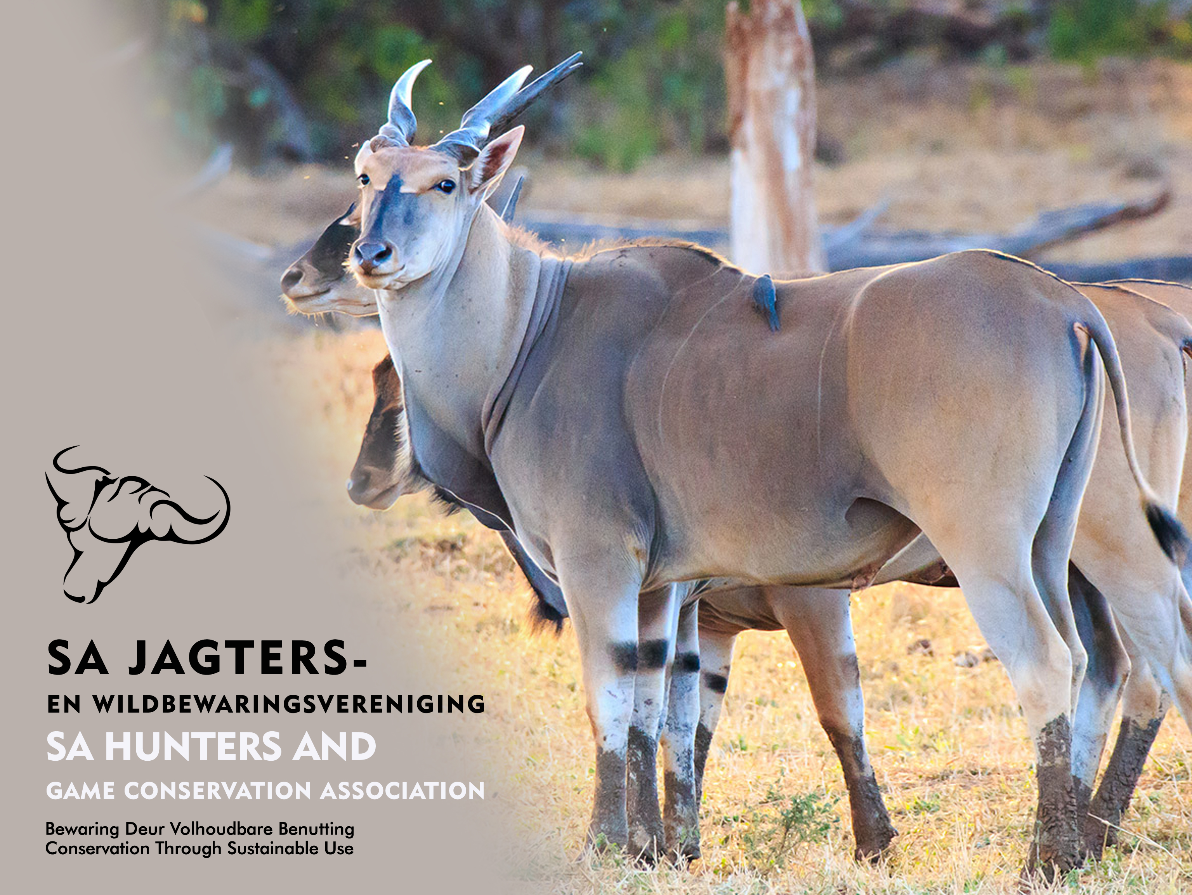
HUNTING – ITS CONTRIBUTION TO SOUTH AFRICA
PARLIAMENTARY COLLOQUIUM
BIODIVERSITY ECONOMY
February 2018
Lizanne (E.J.) Nel
Conservation Manager
Lizanne@Sahunt.co.za

Slide 2
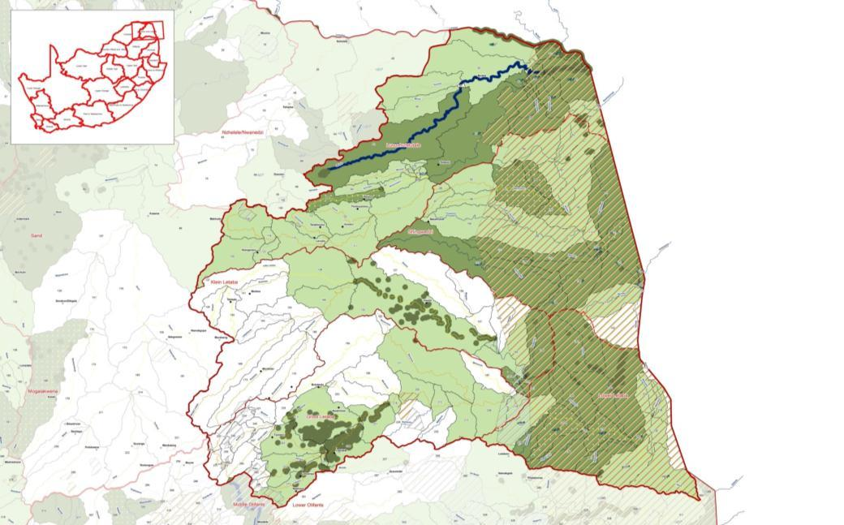
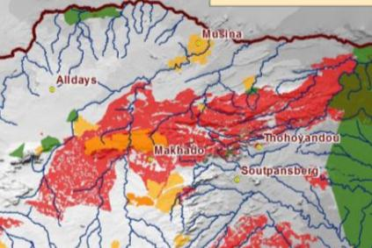
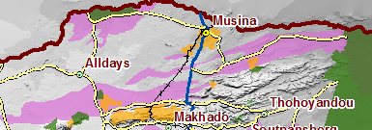
SOCIO-ECONOMIC CHALLENGES
Trade-off?
FEPA
Mining
CBA’s

Slide 3

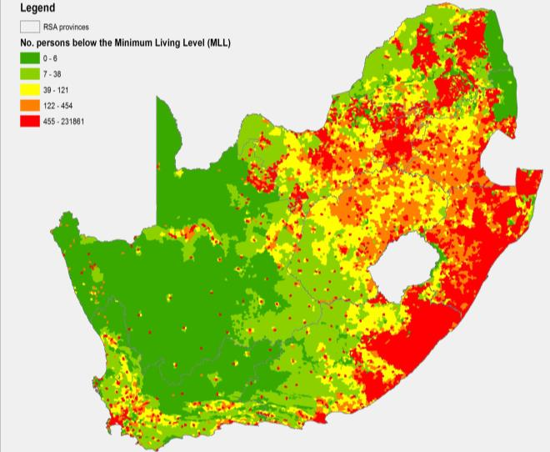
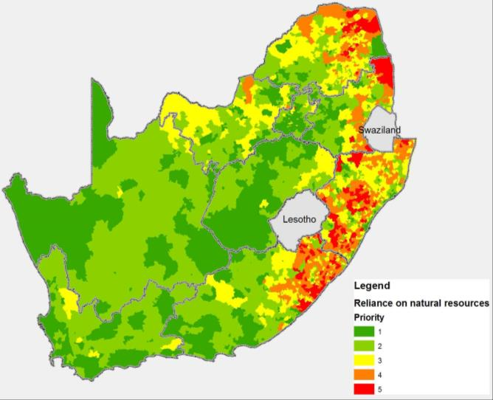
SOCIO-ECONOMIC CHALLENGES
32.9% in SA below poverty line

Slide 4
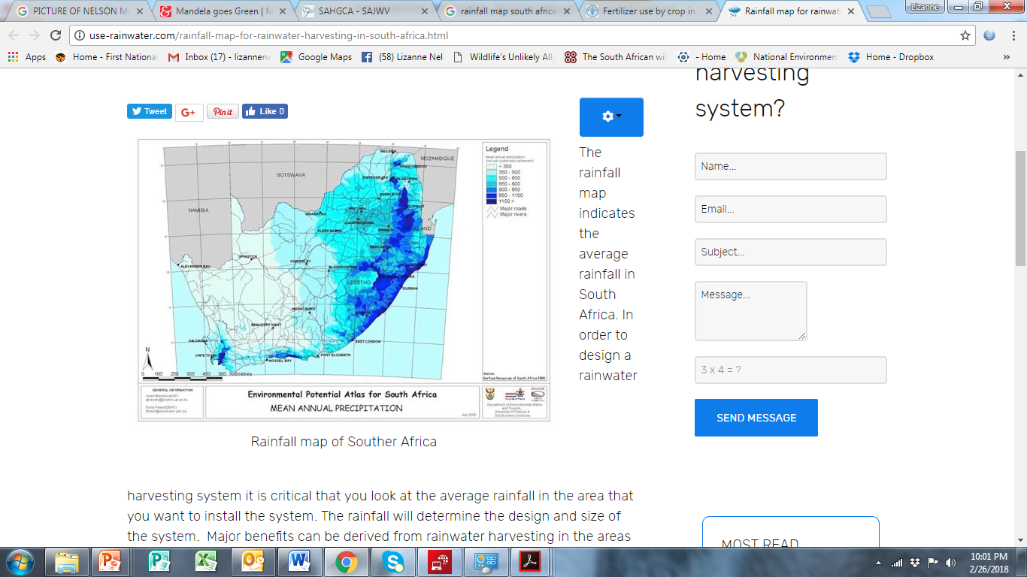

Slide 5
Model behind Sustainable Use Approach
(developed by Greg Stuart-Hill and Chris Brown)

Slide 6
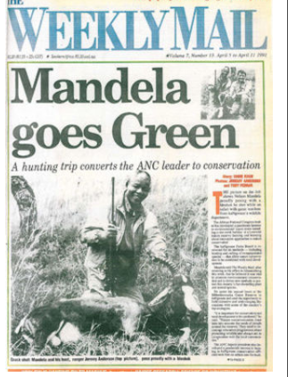
"It is important for conservation and rural development to be combined”, he said.
WBT 20% of world tourism market
Generated 9% in global GDP
Growing 3x faster than general tourism (10%)
Contribute to ecosystem services worth R73 billion or 3% of GDP
Ranch lands > 2.2x that of protected areas
Wildlife-based tourism, including hunting – most feasible strategy for rural economic development.
Achieve conservation, economic and social targets.

Slide 7
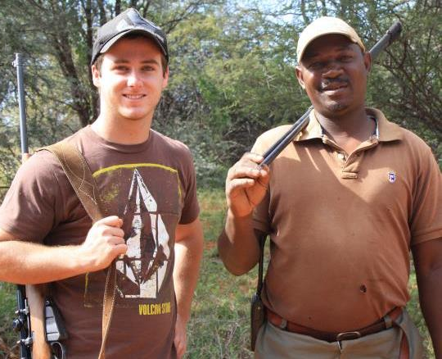
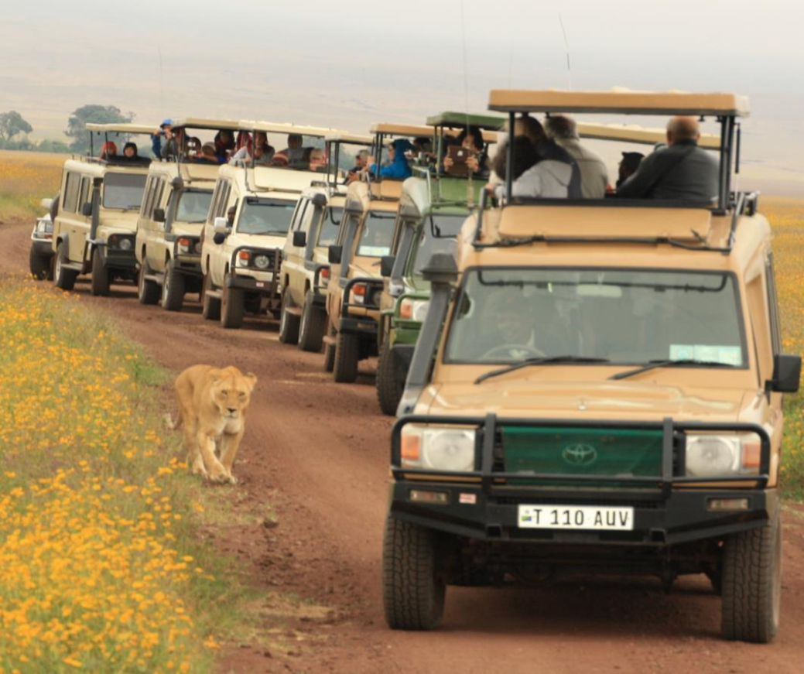
PHOTOGRAPHIC & HUNTING TOURISM
Privately owned protected area
Photographic Tourists / @
24,000 photographic tourists
17% of the total income
Hunting
54 hunters
61% of the total income
Money that 1 hunter brings in = 1,600X that of photographic tourist
Environmental footprint of Photographic Tourism much higher
Not all areas suited for Photographic Tourism

Slide 8
HUNTING: DRIVER IN RURAL ECONOMIES
48%
1
3
51%
32.9% in SA below poverty line
18%
11%
2

Slide 9
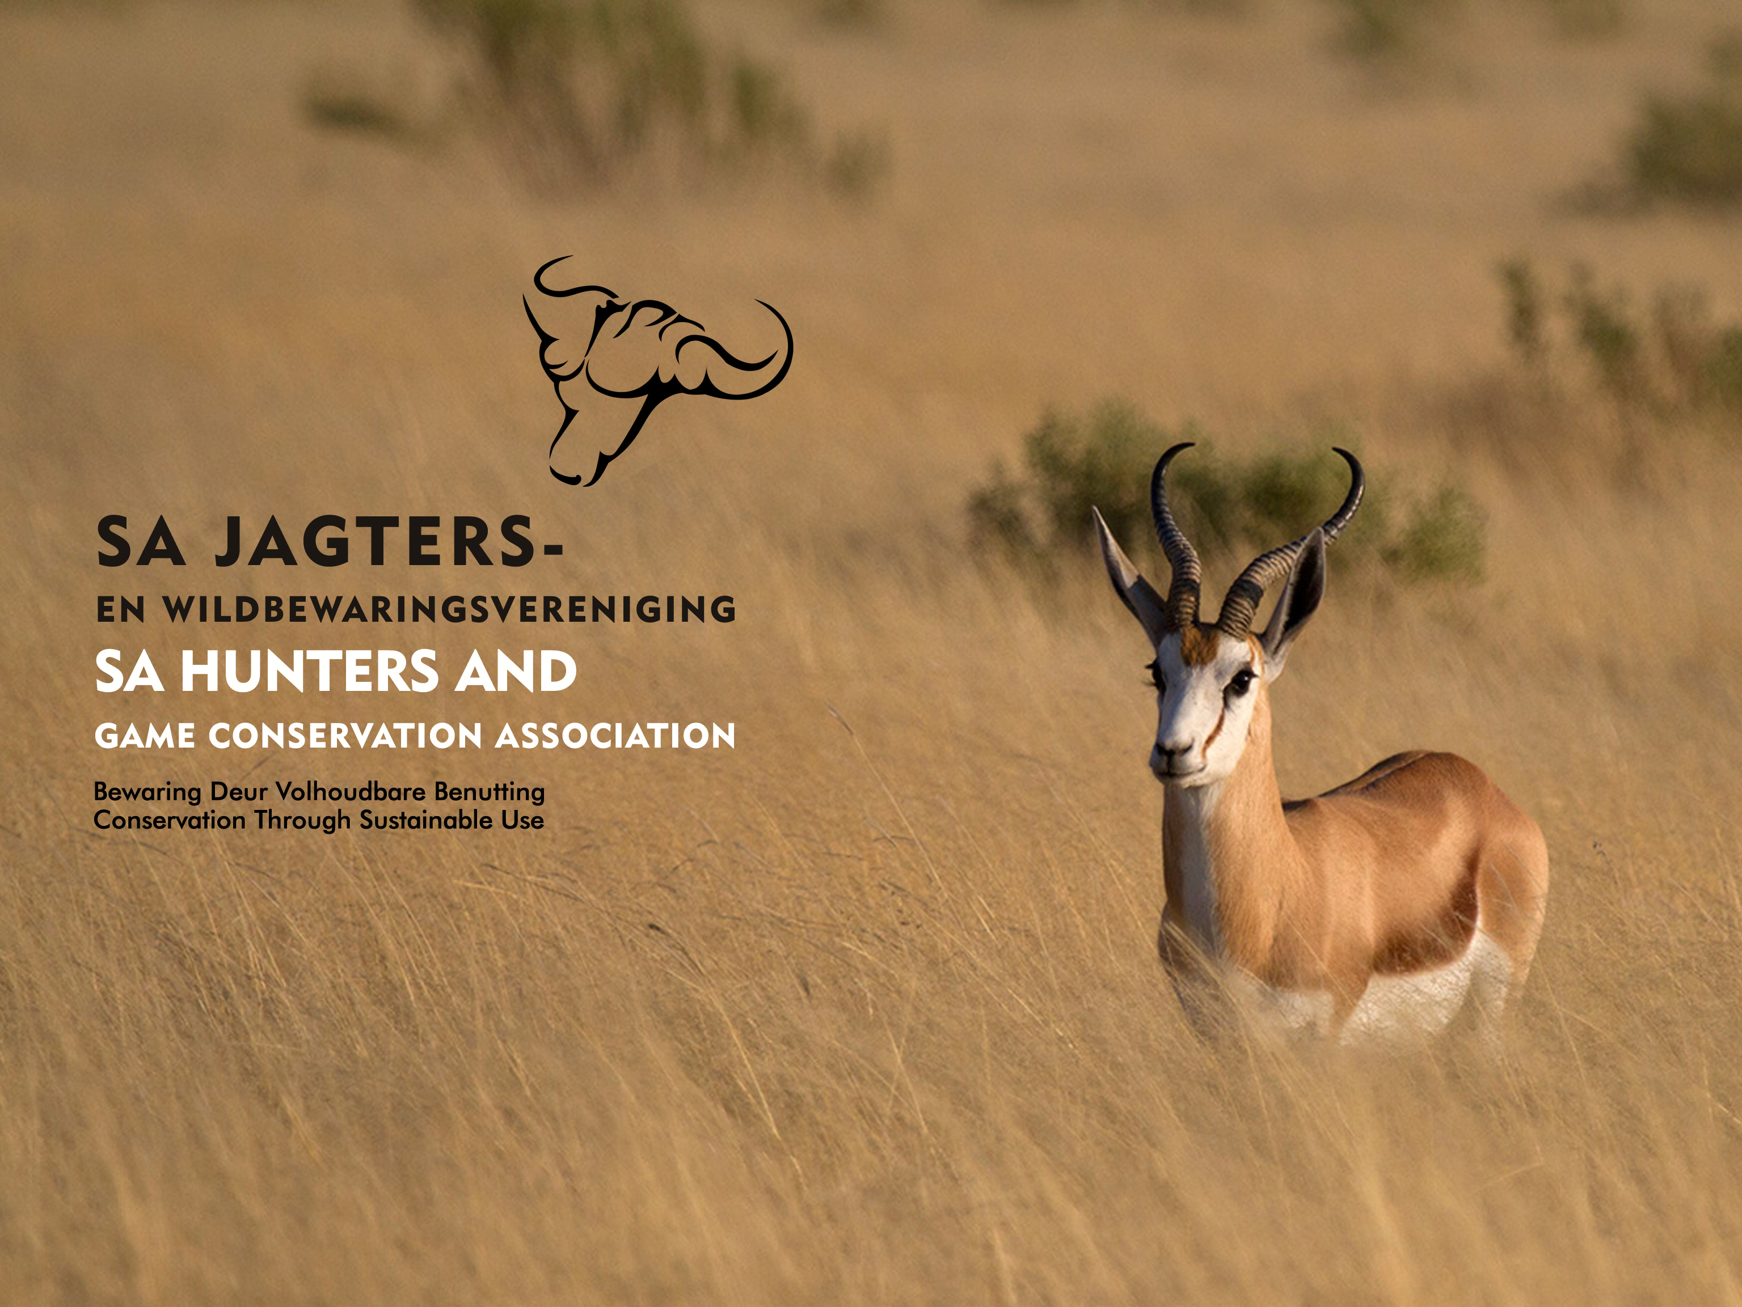
HUNTING SECTOR
Major role player in the sector
~ 300 000 hunters
30 Accredited Associations
~ 75 000 hunters - members of Associations
Economic value: Consumptive hunting R8.6b - Trophy hunting R1.8b
46% & 68% paid for the game hunted
Most important income stream for (30%) of ranch lands
CONSERVATION TARGETS
ECOSYSTEM SERVICES
WILDLIFE ECONOMY
SOCIO-ECONOMIC DEVELOPMENT

Slide 10
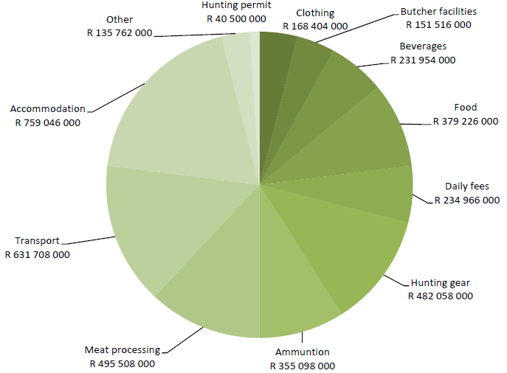

Slide 11
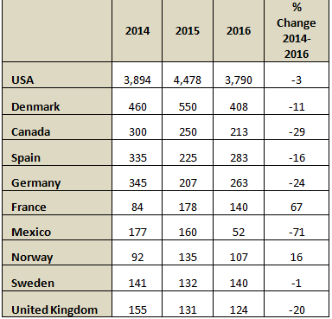

Slide 12
RISKS
Shift in production systems, extensive to intensive and selective - Fair chase to tame hunting
6% - > 20% Intensification (mean camp size 50ha)
REPUTATIONAL RISK (Business of biodiversity)
Perceived irresponsible and unsustainable practices in....
Management of source populations
Utilisation

Slide 13
RESPONSIBLE & SUSTAINABLE HUNTING WHEN........
Biologically sustainable;
Not substantially alter processes of natural selection and ecosystem function;
Maintain wild populations with adaptive gene pools;
Not contribute to substantially manipulating ecosystems or their component in ways incompatible with the objective of supporting the full range of native biodiversity;
Ensure a net conservation benefit for wildlife habitat where the cost of management and conservation of biological resources are internalized within the area of management;
Generate benefits for retention and rehabilitation of habitats; and
Business practices that promote long-term economic sustainability.

Slide 14
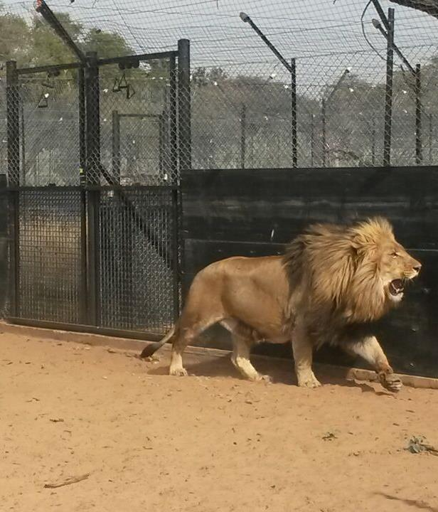
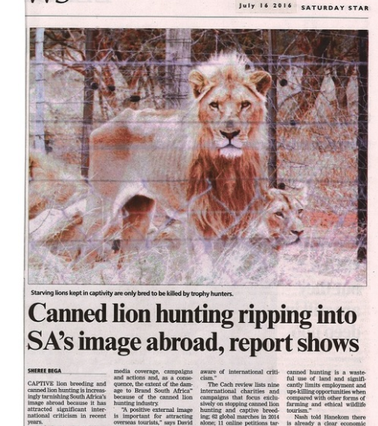
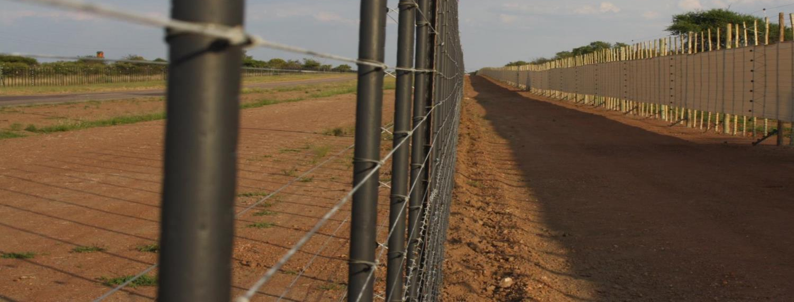
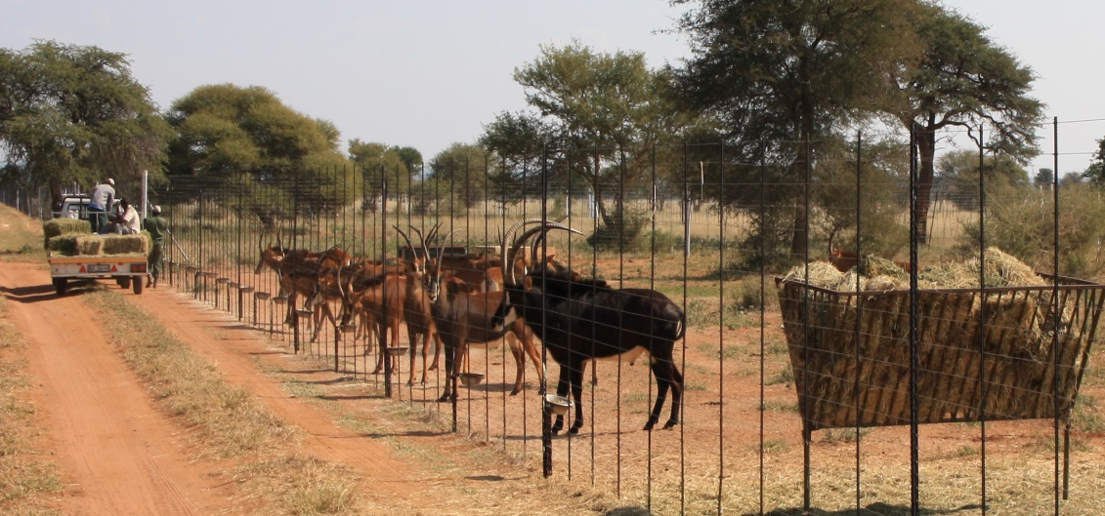
For Landholder (Financial values)
INTENSIVE
BREEDING
EXTENSIVE
Tourism
Economic output
Hunting
Meat
Meat
Child, B. 2013 Presentation to the Scientific Authority
Ecological inputs
International hunting community – distance from practice
International trade bans (USA, 60% of hunters – 9 mnths lost 320 hunts – R78 mi, 660 jobs, welfare incidents)
28% decrease in visiting hunting tourists (2011-2016) – 43% decrease in Lions hunted (2014-2016) Consumptive hunting 35% increase (2013-2015)

Slide 15
HUNTING ≠ POACHING
HUNTING ≠ THREAT DECLINING POPULATIONS
CHALLENGING LEGISLATIVE ENVIRONMENT (9+1)
LACK OF RELIABLE, UP TO DATE MARKET INFORMATION
ABSENCE OF WELL REGULATED RESPONSIBLE & SUSTAINABLE HUNTING.......
Poaching ⬆
Illegal bushmeat trade ⬆
Reduction in contribution to trade deficit
Ability to manage wildlife populations ⬇

Slide 16
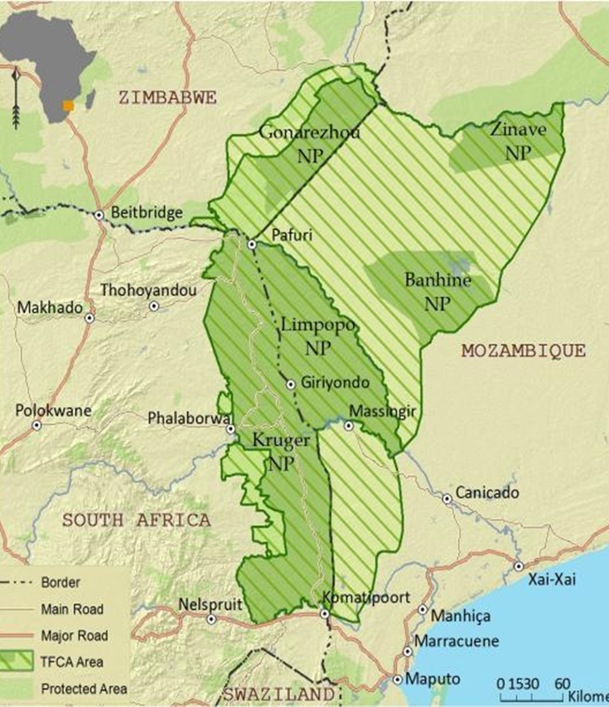
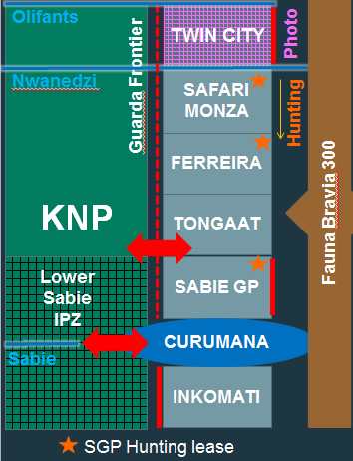

Slide 17
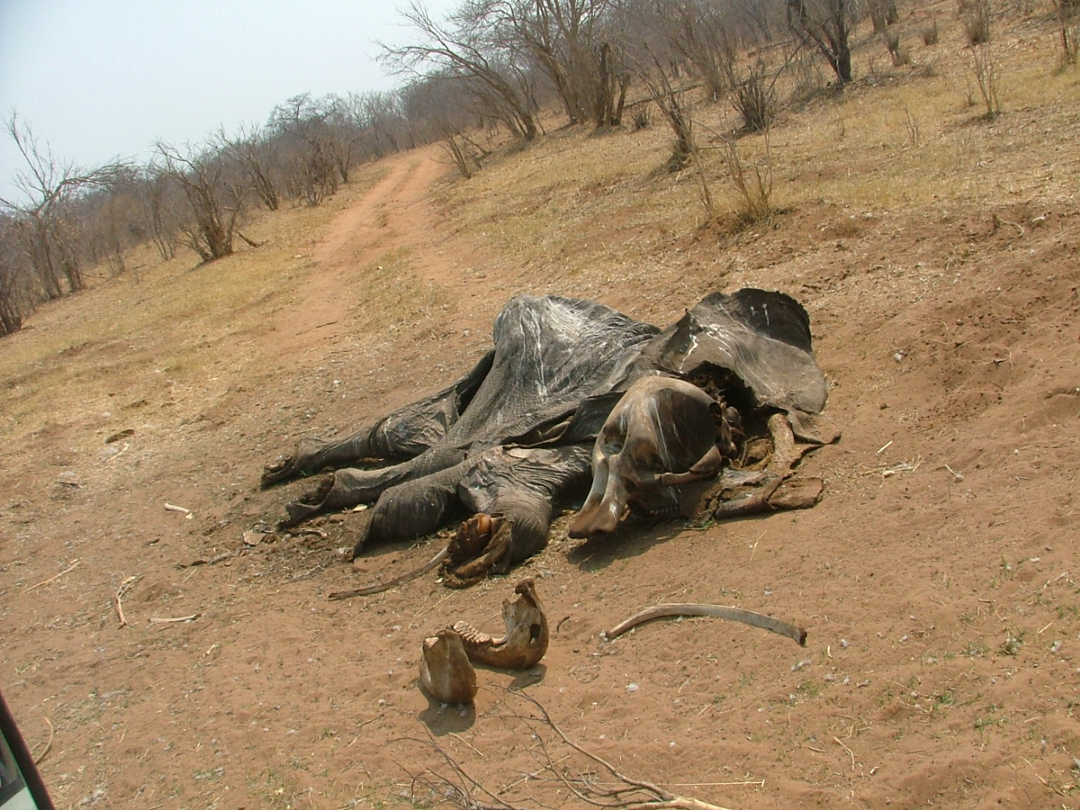
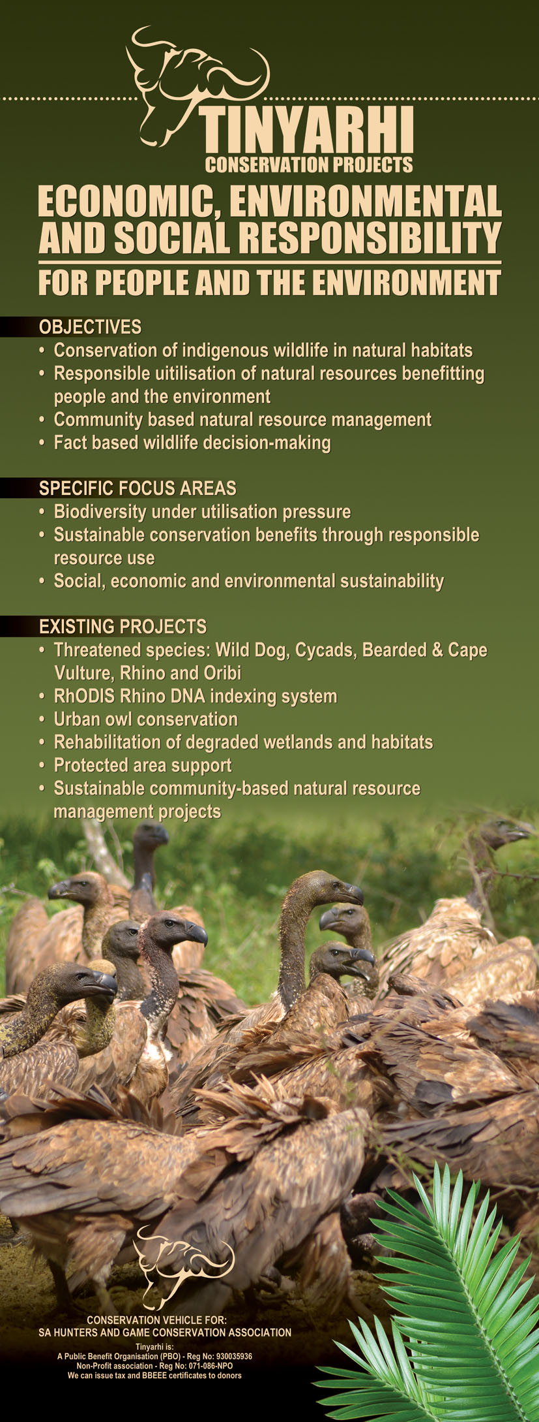
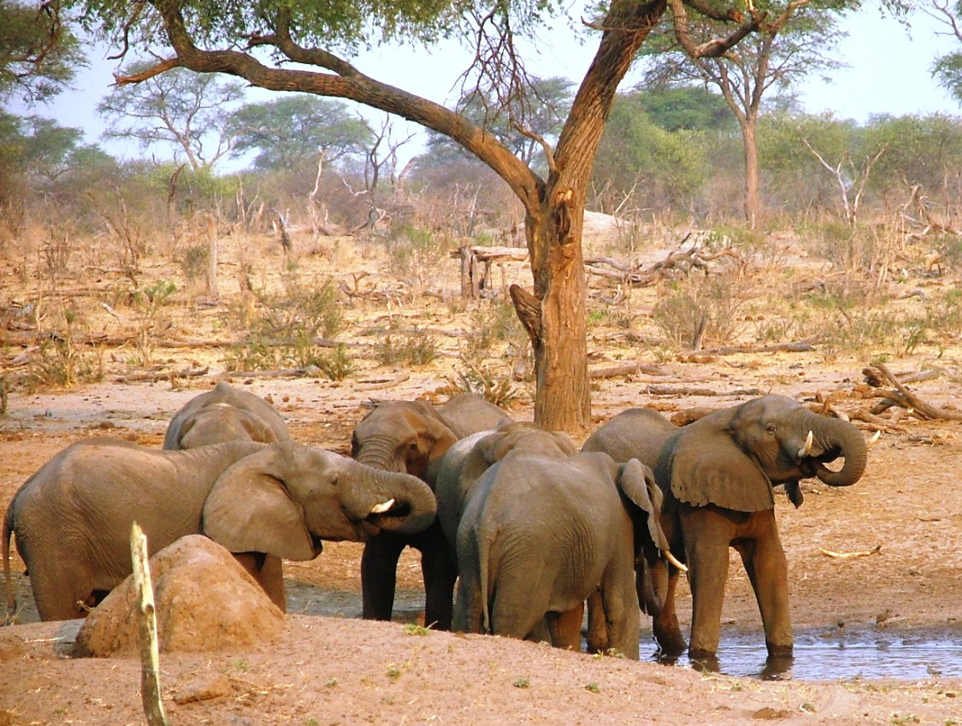
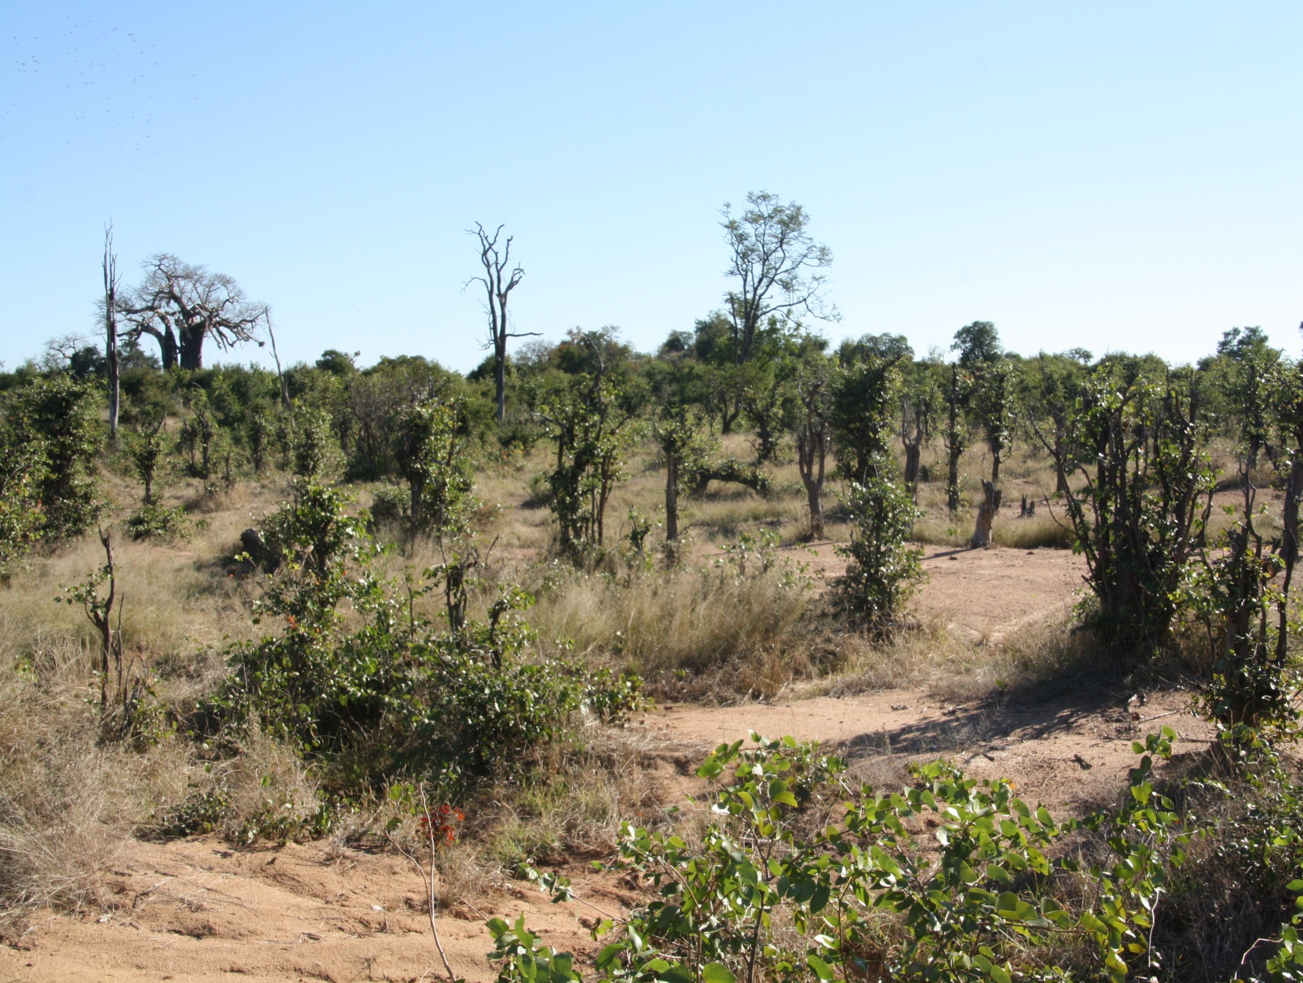
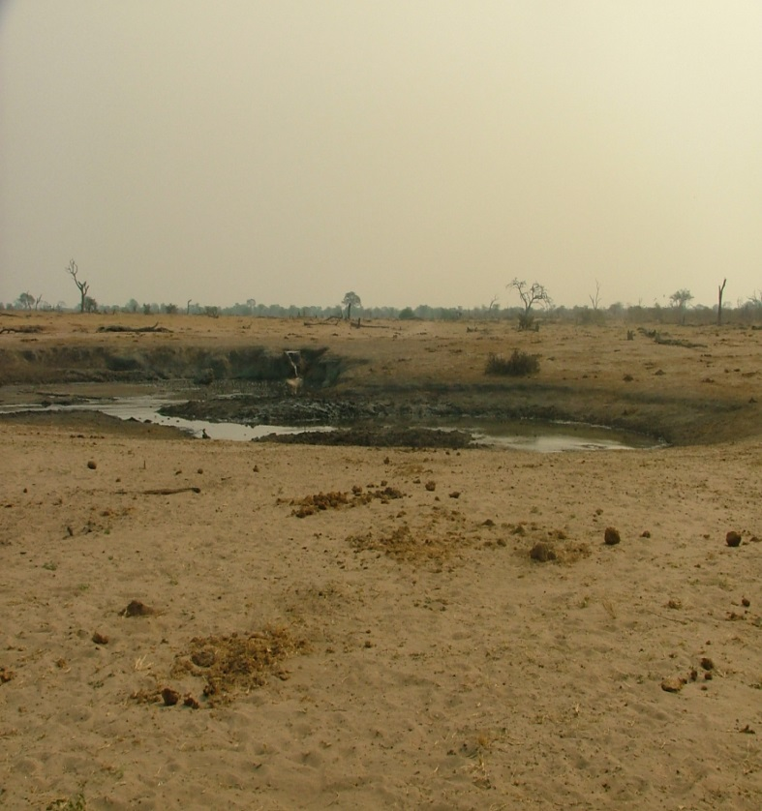

Slide 18
ABSENCE OF WELL REGULATED HUNTING
Income to communities/ranchers⬇ (50–90% of net revenues from hunting are generally allocated to local entities and communities - community-based forum in Okavango Delta lost R9.4 million and 200 jobs due to the hunting ban)
Food security ⬇ (31 000 - 87 000;120 000-150 000 tonnes game meat/@, 30% decrease in red meat sales, communities)
Viability of ranch lands⬇ (49% do trophy hunting; 46% meat hunting; 30% NB income)
Incentive for conservation ⬇ - shift in landuse
Photographic tourism not always suitable - footprint much bigger
Cost to government to achieve TARGETS ⬆ (conservation + economic development)

Slide 19
INTERVENTIONS REQUIRED
RESOURCE CONSERVATION
Extensive areas
Healthy wild populations
Transformation
LEGAL
National framework for hunting
Self- admin licence system
SUSTAINABLE
HUNTING
CODE OF PRACTISE LINKED TO CERTIFICATION

