Slide 1
City of Johannesburg Bus procurement Rea Vaya

Slide 2
Number of busses and Value
134 Busses were purchased during 2013/2014 for the Rea Vaya Phase 1b project
41 Articulated buses (18 meters) and 93 Rigid buses (12 meters)
Total value of tender – R326 169 772.64

Slide 3
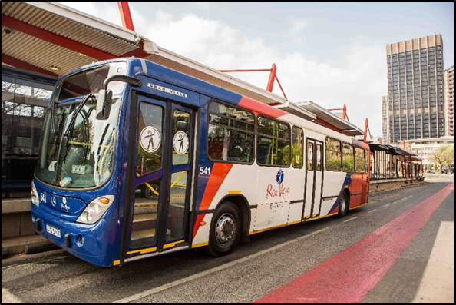
Timeframes
Procurement of bus bodies
From date of order to final delivery takes under normal conditions up to 12 months

Slide 4
Other bus procurement
The City of Johannesburg is in the process of procuring more busses for the Rea Vaya Phase 1C(a) project
This will include 141 busses
109 Articulated busses (18 meters) and 32 Rigid busses (12 meters)
Procurement process in the Bid Evaluation stage
80% local content was also a condition in the tender document.

Slide 5
Challenges
There are no challenges finding suppliers to meet the agreed targets for the City
However, in the Bus Industry, there are not many local suppliers that can supply the necessary parts
Some industries only have one or two suppliers, which will effect pricing

Slide 6
Local content requirements
The City of Johannesburg have met the target with the 2012/2013 bus tender
The target as required that was stipulated in the tender document, was 80% local content
The tender was awarded to Sandown Motor Holdings (Pty) Ltd, part of Mercedes Benz SA for the chassis, and to Marcopolo SA (Pty) Ltd for the bus body

Slide 7
Local content achievements
The following percentage local content was achieved –
80.73% on the Articulated busses, and
80.80% on the Rigid busses
Certificates were issued by the SABS in Parliament in 2014 to Sandown Motor Holdings (Pty) Ltd, for the chassis, and to Marcopolo SA (Pty) Ltd for the bus body

Slide 8
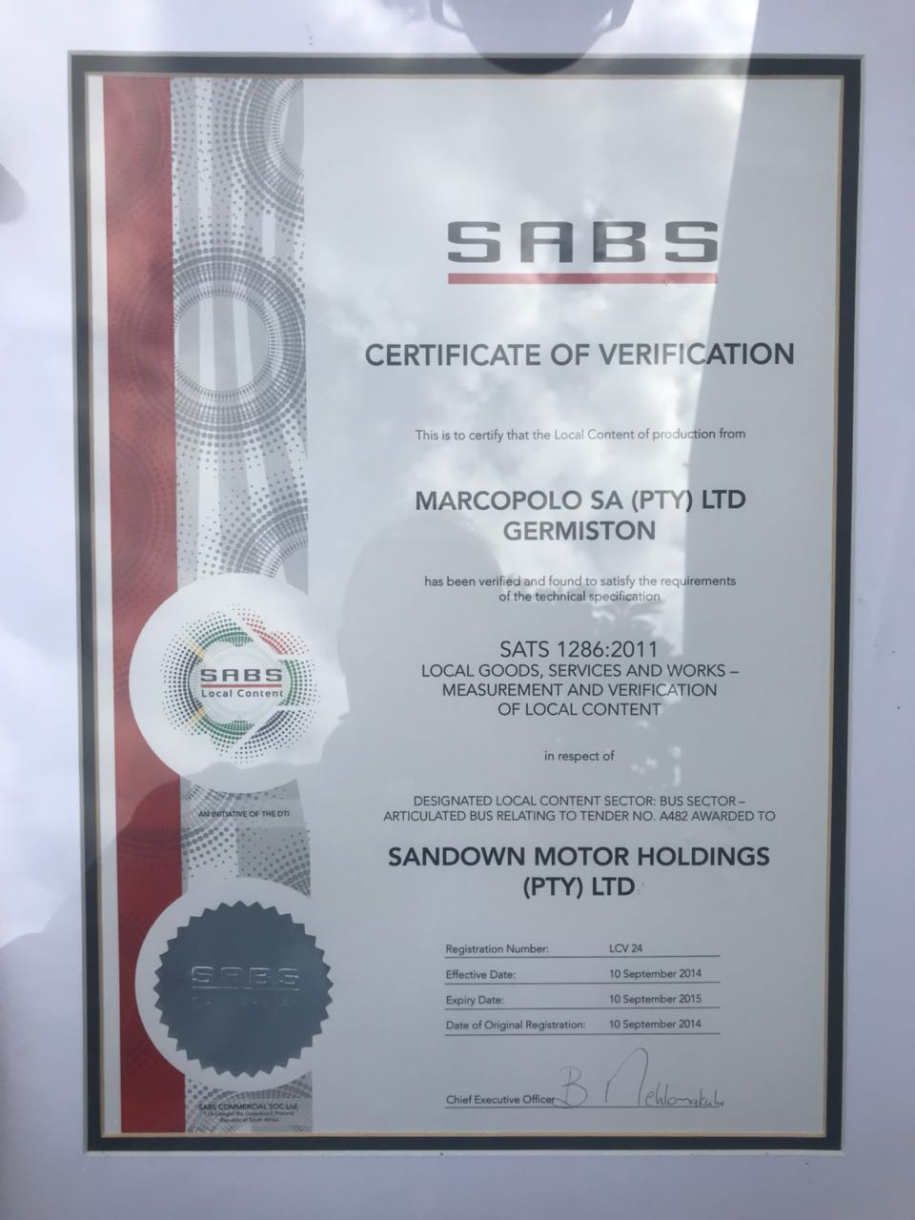
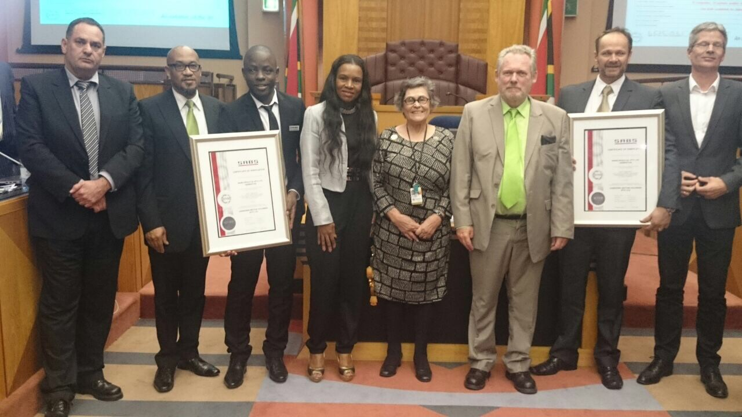
Local content achievements (1)

Slide 11
Busses in build
Pictures of Rea Vaya busses being build at Marcopolo in Germiston Gauteng

Slide 12
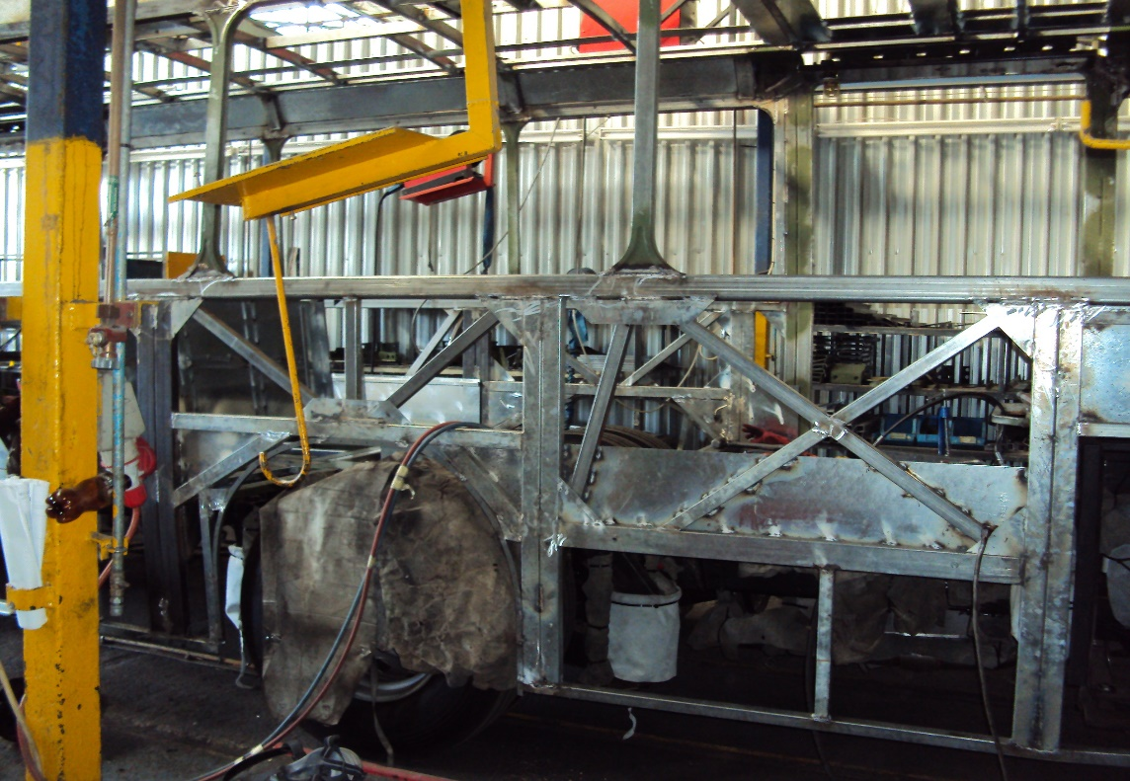
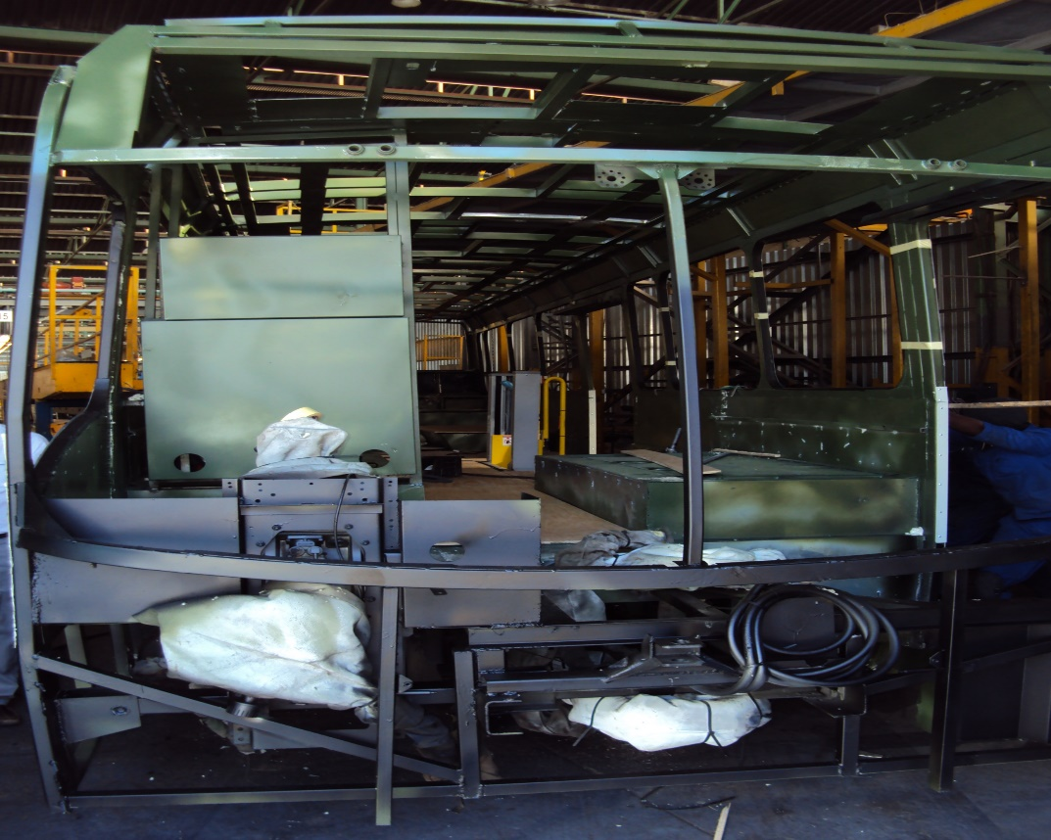
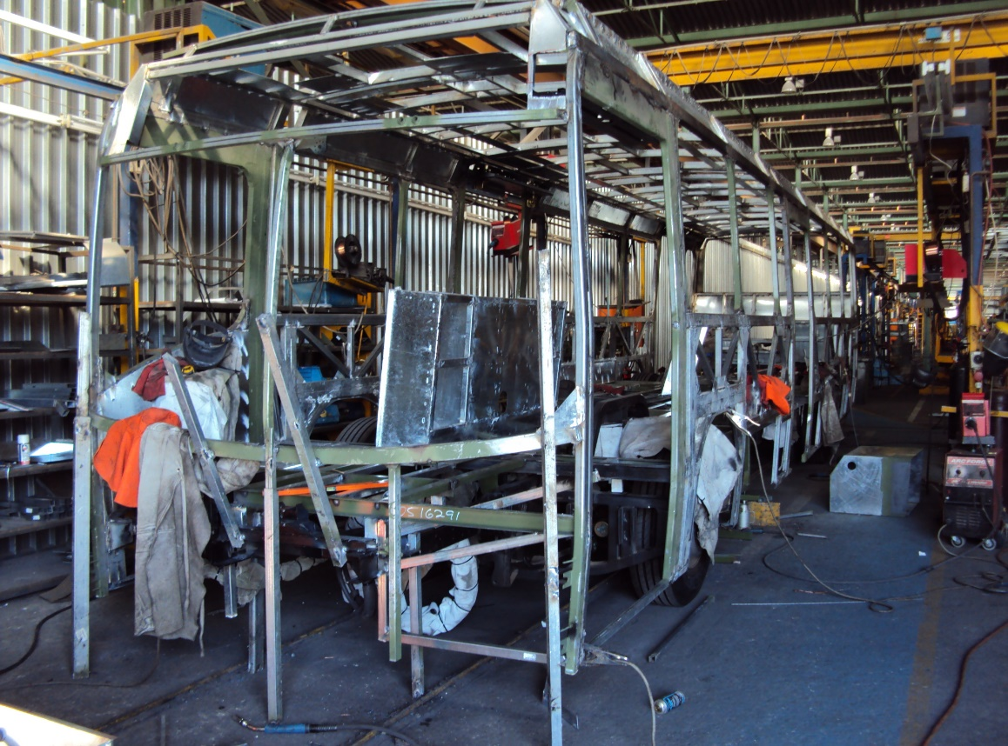

Slide 13
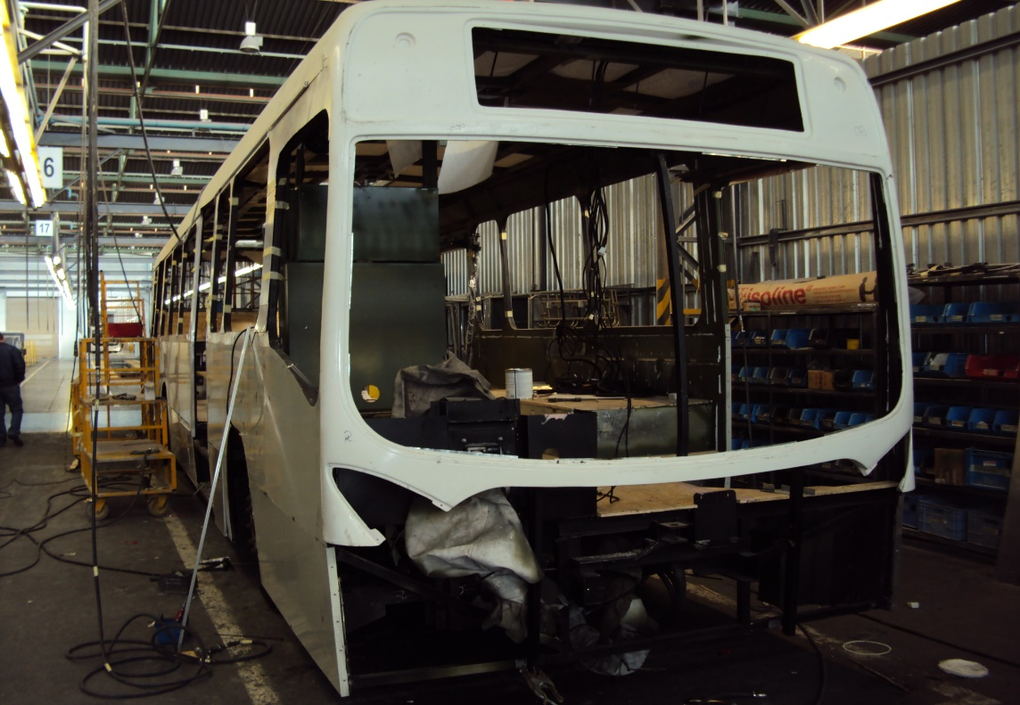
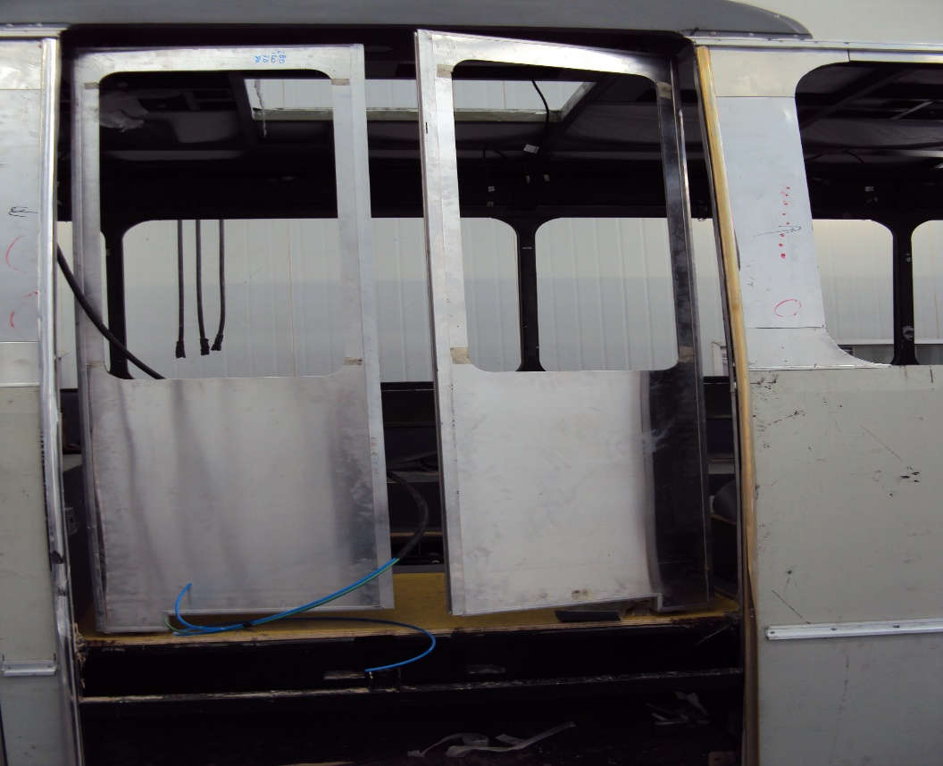
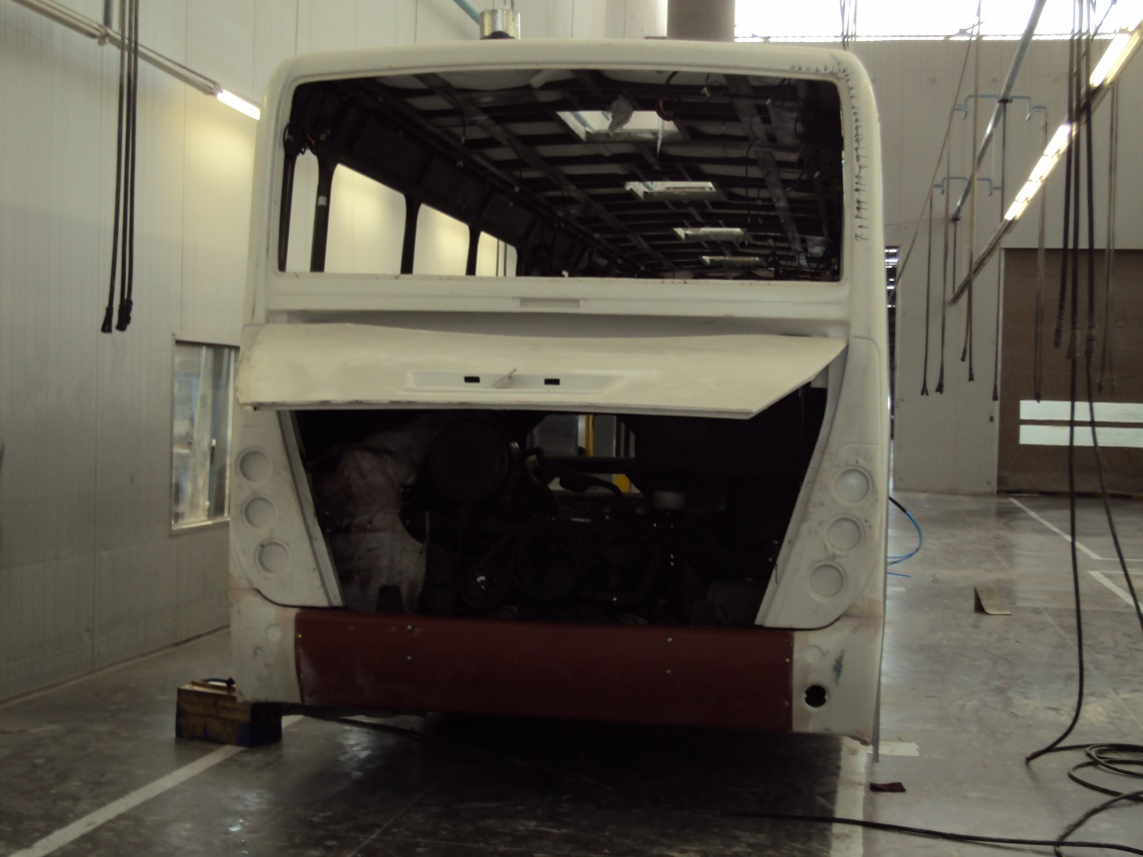

Slide 14
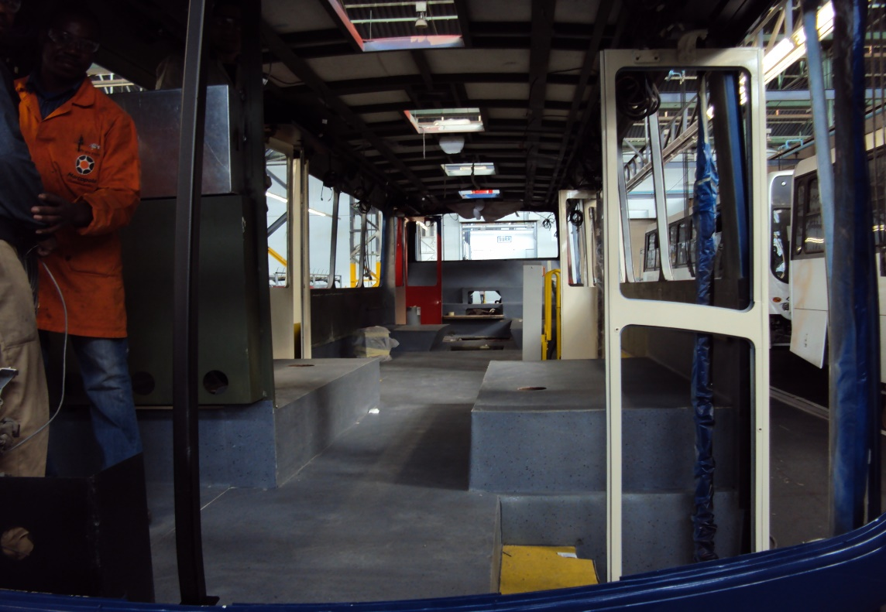
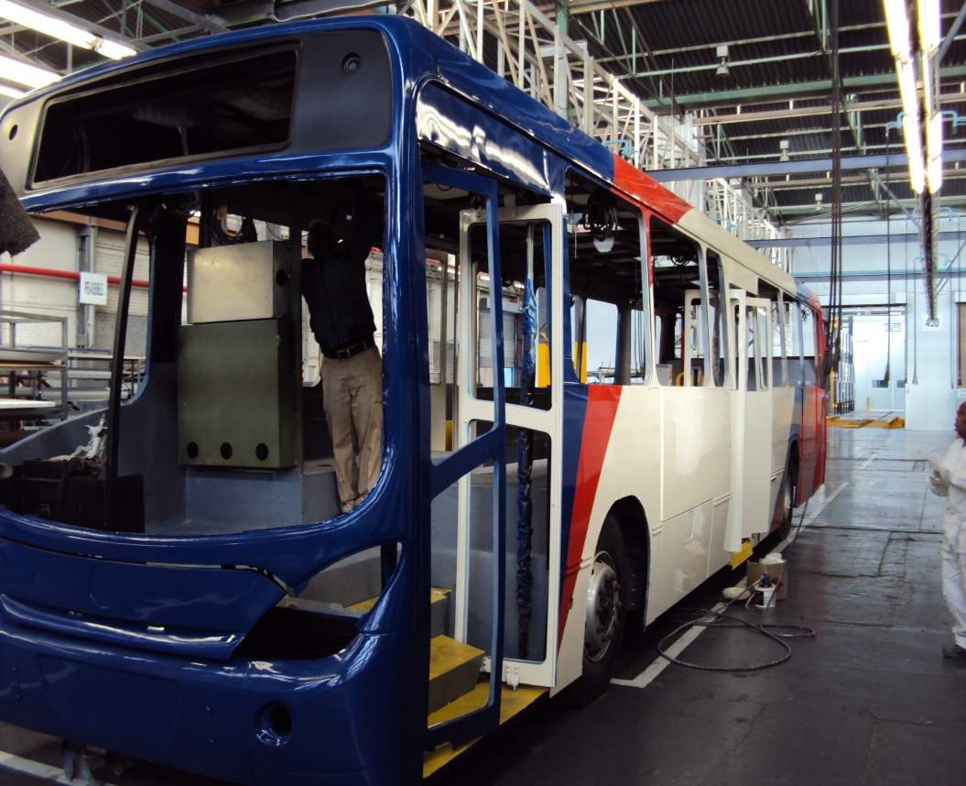
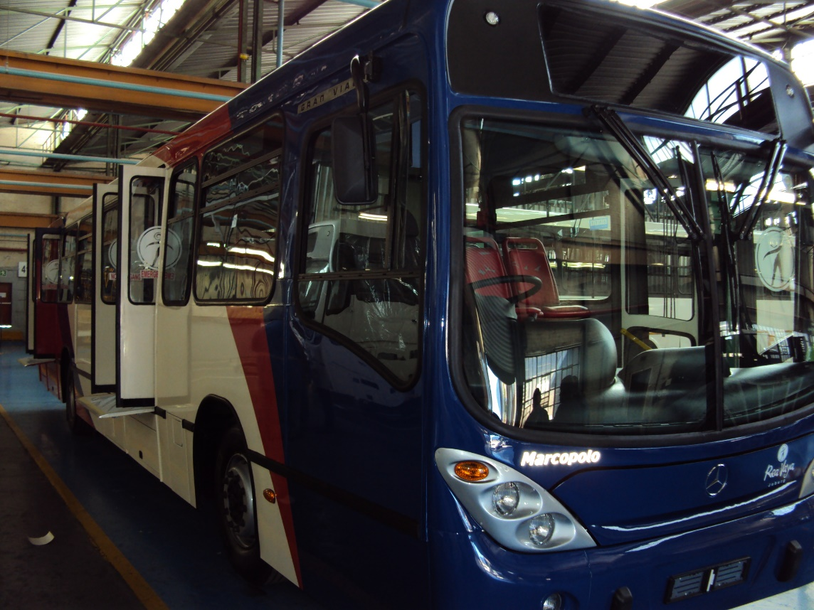

Slide 15
Verification process (local content)
The Department of Trade and Industry (DTI) determines the regulations
SABS will be appointed to monitor and audit the process and to verify compliance

Slide 16
Process - Localisation targets
Target was met in the Rea Vaya 2013/2014 procurement bus tender
The City of Johannesburg will comply to the Preferential Procurement Framework Act (No. 5 of 2000), administered by the National Treasury in all future bus procurement processes

Slide 17
Thank you

