Slide 1
Water security programme
Brief to Portfolio Committee on Health
Committee Room 1
21 February

Slide 2
Water Security Programme
21 February 2018
Purpose
To mitigate the risk of service disruption due to lack of water at health facilities in the Western Cape
Strategy
To reduce water consumption at health care facilities
To be prepared for the possibility of water rationing
To be prepared for the total loss of municipal water supply

Slide 3
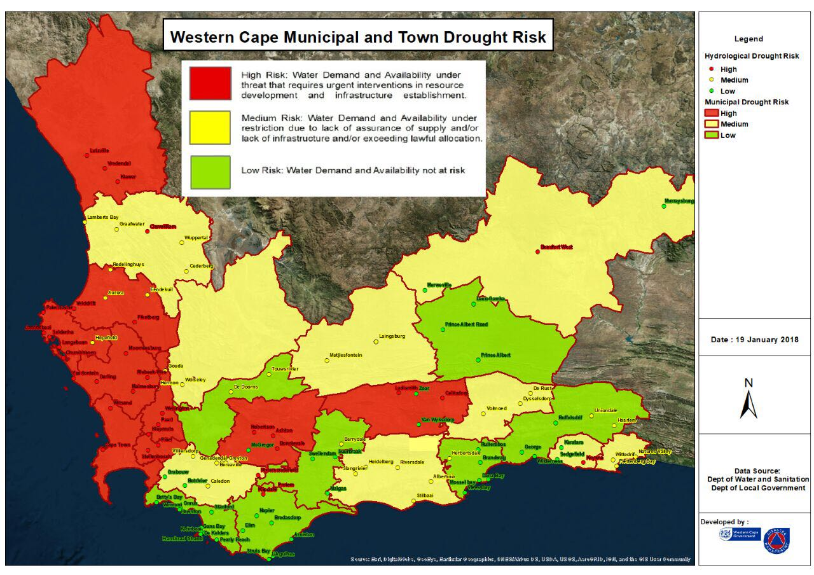

Slide 4
Strategy
Circ. 158/2017 Water Supply Preparedness Plan (28 Nov 2017)
Elements of the Water Security Strategy
Reduce water consumption and supply of potable water
Augment availability of water
Disaster Response
Health impacts of Drought (Circ. H146 of 2017)
Governance structure
Command and Control
Activation of the Plan
Clinical Service Prioritisation
Risks: potential increase in water borne diseases (e.g. dysentery, cholera, diarrheal disease, typhoid, hepatitis A), civil unrest, etc.

Slide 5
Conserve Water

Slide 6
Managing and Monitoring of Water Utilisation
Monitored as Provincial Performance Indicator since 2014/15
Year | Target | Performance
Indicator: Percentage of selected hospitals utilising more water than the provincial benchmark
2014/15 | 51.9% (14 of 27 hospitals) | 37.0% Over-performance: Only 10 hospitals exceeded benchmark and not 14 as forecasted
2015/16 | 45.7% (16 of 35 hospitals) | 40.0% Over-performance: Only 14 hospitals exceeded the benchmark and not 16 as forecasted
2016/17 | 50.0% (25 of 50 hospitals) | 34.0% Over-performance: Only 17 hospitals exceeded the benchmark and not 25 as forecasted
Provincial Benchmark | 2015/16 – 2017/18
Hospital type | Litres / bed / day
District | 440
Regional, TB, Psychiatric, Tertiary | 600
Central | 1,000

Slide 7
Managing and Monitoring of Water Utilisation
Monitored as Provincial performance indicator since 2014/15
Year | Target | Estimated Performance
Indicator: Percentage of selected hospitals achieving the provincial benchmark for water utilisation
2017/18 | 54.0% (27 of 50 hospitals) | 66.0% Over-performance estimated: Quarter 3 results reflect 33 of 50 hospitals achieved the benchmark and not only 27 as being forecasted
Provincial Benchmark | 2015/16 – 2017/18
Hospital type | Litres / bed / day
District | 440
Regional, TB, Psychiatric, Tertiary | 600
Central | 1,000

Slide 8
Managing and Monitoring of Water Utilisation
Revised Provincial Benchmark for 2018/19
Provincial Benchmark | 2018/19
Hospital | Litres / bed / day
Alexandra Valkenberg Brooklyn Chest DP Marais Harry Comay Malmesbury ID Sonstraal | 220
Ceres Citrusdal Clanwilliam False Bay George Helderberg Hermanus Khayelitsha Knysna Ladismith Laingsburg Mitchell’s Plain Mossel Bay Mowbray Maternity New Somerset Otto du Plessis Paarl Radie Kotze Stellenbosch Swartland Swellendam Victoria Vredendal WCRC | 350
Eerste River Montagu Murraysburg Oudtshoorn Prince Albert Stikland Uniondale Vredenburg | 400
Riversdale Robertson Wesfleur | 450
Beaufort West Brewelskloof Caledon Worcester | 500
Karl Bremer Lentegeur Red Cross War Memorial Children’s | 600
LAPA Munnik | 800
Groote Schuur | 900
Tygerberg | 1,000

Slide 9
Managing and Monitoring of Water Utilisation
Comments
Information supplied by local municipalities unreliable – often estimations only
Frequent, accurate water meter readings essential
Reliable data results in improved monitoring and response
Sensitising of users must be maintained (not only during time of crisis)
Targets should be set per facility and not per facility type
Maintenance and response time (e.g. leaks, pipe bursts) critical
Feedback to and engagement with facilities managers wrt excessive use essential
Way forward
Installation of smart meters at hospitals (enabling constant monitoring of water consumption)
Continuous monitoring and reporting on utilisation at all levels
Revised water utilisation indicator included in 2018/19 Annual Performance Plan, utilising facility specific targets

Slide 10
Conserve Water
Minimum water requirement for each facility – usage target
Focus Interventions
Behaviour change
Surgical scrubs
Use of alcohol hand sanitizers
Bottle water for drinking
Awareness campaign to reduce water consumption
Only severely soiled linen to be sent to the laundries
Engineering interventions
Maintenance reticulation and leak minimisation interventions (eliminate leaks)
Shutting off of basin taps (use of hand sanitizers)
Installation of low flow sanitary fixtures
Installation of waterless urinals
Installation of Water Efficient Equipment and Systems
Re-use of treated water

Slide 11
Augment availability of water
Focus Interventions for reducing the demand on municipal water
Use of ground water for large facilities (Hospitals and some CDCs and CHCs)
Use of ground water for large facilities
Reinstatement of existing boreholes
New boreholes
Storage tanks
Engineering work for connection to water reticulation system
Water treatment technologies
Programme planned and funded by Health and implemented by Transport & Public Works
Sites have been prioritised for implementation in stages:
Groundwater programme Part A: 17 sites
Groundwater programme Part B: 32 sites
Groundwater programme Part C: 23 sites

Slide 12
Best Practice: Groote Schuur Hospital
Conserve water good practice
Historical Interventions
In the past 7 years Groote Schuur Hospital has halved its water consumption.
The reduction in consumption has been the result of good maintenance rather than new technologies. This emphasises the need for good maintenance.
Focus Interventions
The hospital is re-cycling autoclave water in the CSSD resulting in a saving of 5 million litres of water per year.
The hospital has recently installed heat pumps that cool water from the air conditioning system prior to the main chillers. This not only saves substantial electrical energy, but reduces the water required by the cooling towers.
It is planned to use waste water from theatre autoclaves, reverse osmosis plants, and rain water harvesting for toilet flushing. At present the New Main Hospital Building uses 70 million litres of water per-year to flush toilets. With water recycling and rain water harvesting in place none of this need be potable water.

Slide 13
Augment availability of water

Slide 14
DEMAND AND SUPPLY SIDE INTERVENTIONS
OBJECTIVE: WCG Water BCP focusses on how and which service delivery requirements of the WCG can continue to be met when there is constrained or no municipal water in a geographic area i.e. dry taps, including WCG effects to contribute to avoiding a dry taps situation arising.
Collaborative effort between the WCG Department of Health and Department of Transport and Public Works (including with DTPW and all 13 departments and 4 entities of the WCG)
The Water BCP has two focus areas:
Demand management interventions to reduce water consumption at all WCG facilities in order to contribute to avoiding a “dry-taps” scenario in any areas of the Province
Supply-side interventions to not only reduce municipal water consumption but also to ensure that there are essential supplies of drinking water, for hygiene as well as for fire safety purposes in key facilities to secure vital facilities.
Supply side interventions at WCG critical service delivery areas:
49 provincial health facilities (38 hospital sites and 11 PHC sites)
9 Social Development CYCC facilities
Water Securing various WCG command and control office facilities:
WCGH – CoCT Green Building Bellville and other available office facilities at Karl Bremer, Lentegeur precinct and Tygerberg (Provincial Disaster Management Centre)
Some WCED schools (existing boreholes and further strategic boreholes)

Slide 15
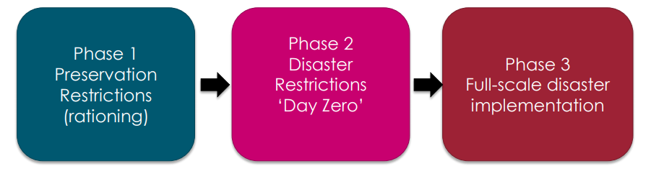
Structure of the WCG Water Disaster Response
Largest part of the WCG service delivery and facilities in the CoCT Metro area
Response structure to correspond with phasing of CoCT disaster response
Phase 1: the purpose is to avoid escalation to Phase 2: Disaster Restrictions
Phase 1 characterised by reducing demand, water rationing through limiting supply and advanced pressure management which severely limits available water supply in the system per day
Phase 2 is triggered at 13.5% surface water levels of the WCWSS 6 largest dams
Purpose of phase 2 is to Avoid escalation to Phase 3 (Full-scale disaster implementation)
Phase 2 characterised by water rationing aimed at maintaining human life and critical services.
City of Cape Town has confirmed that all private, public and military health facilities in the Metro area will remain with Municipal water supply at phase 2
WCG Water BCP focussed on Demand reduction (to avoid phase 2 and 3) and Supply side interventions for critical facilities in the event of a potential phase 3

Slide 16
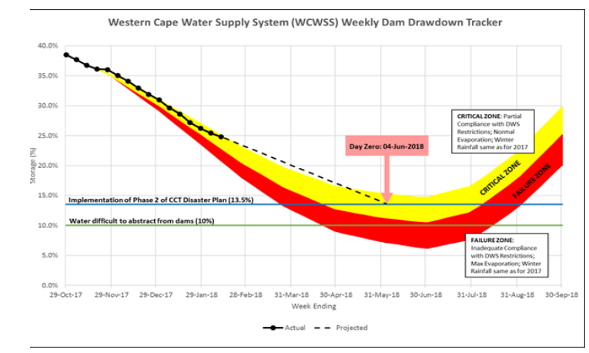
Metro – day zero

Slide 17
TRIGGER MECHANISM
Triggers - phased progression and activation of plans by the WCG
The Director-General of the Province is the trigger authority, in accordance with the provisions of the overhead WCG Water BCP
Announcements by municipalities of “Day Zero” or escalation of phases or a facility running out of water DOES NOT of itself trigger implementation of any WCG Water BCPs
These and other facts and circumstances are inputs to any trigger decision
Decisions trigger plans in accordance with the decision structure and communication system set out in the WCG Water BCP and the respective Departmental Water BCPs
The trigger to implement level plans at a specific facility will therefore be made by the DG and communicated to the applicable Accounting Officer(s) and/or CEO(s)
[The trigger will therefore not necessarily be for entire Departments or Entities or areas]
The communication structures of each Departmental and Entity Water BCP will be activated and utilised

Slide 18
WATER SECURITY and WATER QUALITY
Aspects of water security:
Sanitation (waste removal) [cf hygiene (i.e. cleansing)]
Fire safety (water or alternative non water solutions)
Potable drinking water (including water from air technology, treatment of water, humanitarian effort, distribution of packaged water)
Categories of water quality:
SANS 241-2015
Salinity – Reverse Osmosis
Chlorination and Stabilitisation are standard across all designs
Water Services intermediary (CoCT)

Slide 19
Progress: Groundwater (as at 18 February 2018)
To water secure these critical sites, the DTPW has procured, on an emergency basis, a framework of contractors for geohydrology, drilling, yield testing, quality testing, equipping, treatment, storage and reticulation to various identified sites.
Packages of contractors have been parceled together to focus on:
38 provincial hospital sites
11 Community Day Centers and Community Health centers (24 hours),
9 Social Development CYCC facilities and
10 key office facilities.
Initial site establishment and the first drilling commenced on 6 November 2017 and, to date, sufficient ground water has been secured at 41 facilities (as at 18 February 2018). Once drilling is complete, we confirm yields and water quality as well as conclude the designs for treatment and reticulation to site.
103 Boreholes have been drilled in the programme as at 18 February 2018 and
80 of the boreholes (either existing or new) have already been pump tested to verify yields, sustainable pump rates and to determine recovery rates.
8 Engineering solutions designed and approved for implementation
Boreholes loggers have been procured for installation in the WCG boreholes to ensure diligent use of the ground water resource and to provide the requisite data for our boreholes.

Slide 20
WCG Groundwater Programme – WCGH Progress (PART A)
Health Facilities (PART A: highest priority facilities at greatest risk)
Central and Tertiary
Tygerberg Hospital Estate
Groote Schuur Hospital Estate
Red Cross WMC Hospital Estate
Metro
Lentegeur Regional Laundry
New Somerset Hospital
Mowbray Maternity Hospital
Mitchell’s Plain Hospital
Karl Bremer Hospital
Stikland Hospital
Rural
Caledon Hospital
Vredendal Hospital
Ladismith Hospital
Worcester Hospital
Paarl Hospital
Beaufort West Hospital
Brewelskloof Hospital
Stellenbosch Hospital
Knysna Hospital
Sufficient ground water secured at:
– New Somerset Hospital
– Tygerberg Hospital
– Stikland Hospital
– Tygerberg Hospital
– Karl Bremer Hospital
– Red Cross Children’s Hospital
– Mowbray Maternity Hospital
– Knysna Hospital
– Vredendal Hospital
– Beaufort West Hospital
– Paarl Hospital
– Stellenbosch Hospital
– Lentegeur precinct (Hospital, Laundry, Mitchells Plain Hospital)
– Brewelskloof Hospital
– Caledon Hospital
– Worcester Hospital & Brewelskloof Hospital
Timeline: Ground water to be utilised in Part A facilities by 31 March 2018
Municipal infrastructure solutions: Ladismith
Water solutions in progress: GSH

Slide 21
WCG Groundwater Programme – WCGH Progress (PART B)
Health Facilities (PART B: priority 3 and 4 facilities at high risk)
Metro
Victoria Hospital
Khayelitsha Hospital
Helderberg Hospital
Eerste River Hospital
False Bay Hospital
Stikland Hospital
Wesfleur Hospital
Alexandra Hospital
Lentegeur Hospital
Valkenberg Hospital
Brooklyn Chest Hospital
DP Marais Hospital
Heideveld CHC & EC
Khayelitsha (Site B) CHC
Mitchell’s Plain CHC
Delft CHC
Michael Mapongwana CDC
Kraaifontein CHC
Vanguard CHC
Elsies River CHC
Retreat CHC
Gugulethu CHC
Sufficient ground water secured at:
– Sonstraal Hospital
– Michael Mapongwana Hospital
– Kraaifontein CHC
– Eerste River Hospital
– Piketberg Hospital
– False Bay Hospital
– Mitchells Plain CHC
– Khayelitsha CHC
– Khayelitsha Hospital
– Michael Mapongwana CDC
– Alexandra Hospital
– Elsies River CHC
– Victoria Hospital
Timeline: Ground water to be utilised
in Part B facilities by 30 June 2018
Municipal infrastructure solutions:
Vredenburg
Rural
Ceres Hospital
Piketberg Hospital
Montagu Hospital
Murraysburg Hospital
Prince Albert Hospital
Robertson Hospital
Swartland Hospital
Vredenburg Hospital
Malmesbury ID Hospital
Sonstraal Hospital

Slide 22
WCG Groundwater Programme – WCGH PLAN (PART C)
Health Facilities (PART C: high risk PHC facilities)
Facilities to be included
Metro
Kleinvlei CDC
Hanover Park CDC
Nolungile CDC
Bishop Lavis CDC
Du Noon CDC
Lotus River CDC
Crossroads CDC
Heideveld CDC
Macassar CDC
District Six CDC
Lady Michaelis CDC
Mfuleni CDC
Dr Abdurahman CDC
Gustrow CDC
Delft Symphony Way CDC
Goodwood CDC
Nomzamo Ikhwezi
Ravensmead CDC
Grassy Park CDC
Timeline: drilling and engineering to seamlessly proceed from Part B; delivery date still to be determined
Rural
Hermanus CDC
TC Newman CDC
Worcester CDC
Grabouw CDC
Water will be connected from borehole directly to be used for flushing toilets and washing facilities – no potable water is required (water bottles)

Slide 23
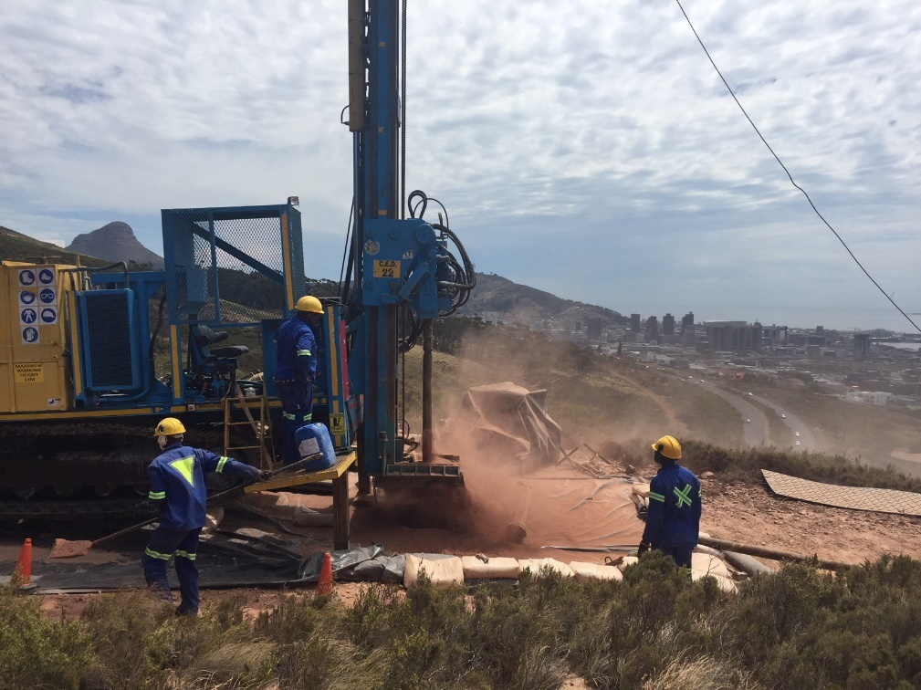
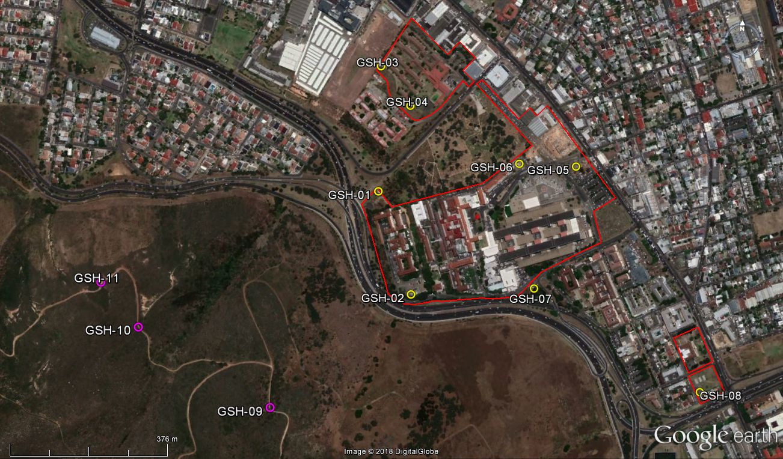
Challenges at GSH
Groote Schuur is located in difficult and low yielding geohydrology – alternative solutions to ground water are also being investigated
8 new Boreholes drilled – 7 l/s achieved, deficit of 2.8 l/s
Permission granted to explore for water on SANParks land
Potentially to drill 3 new boreholes

Slide 24
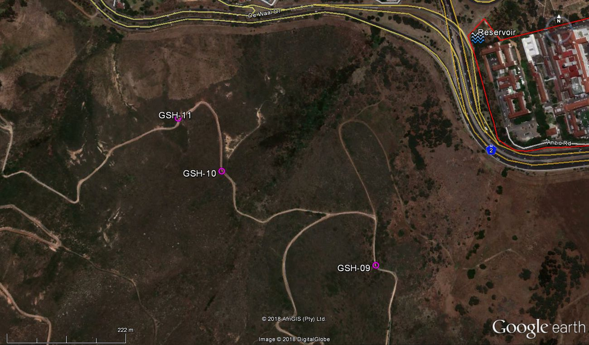
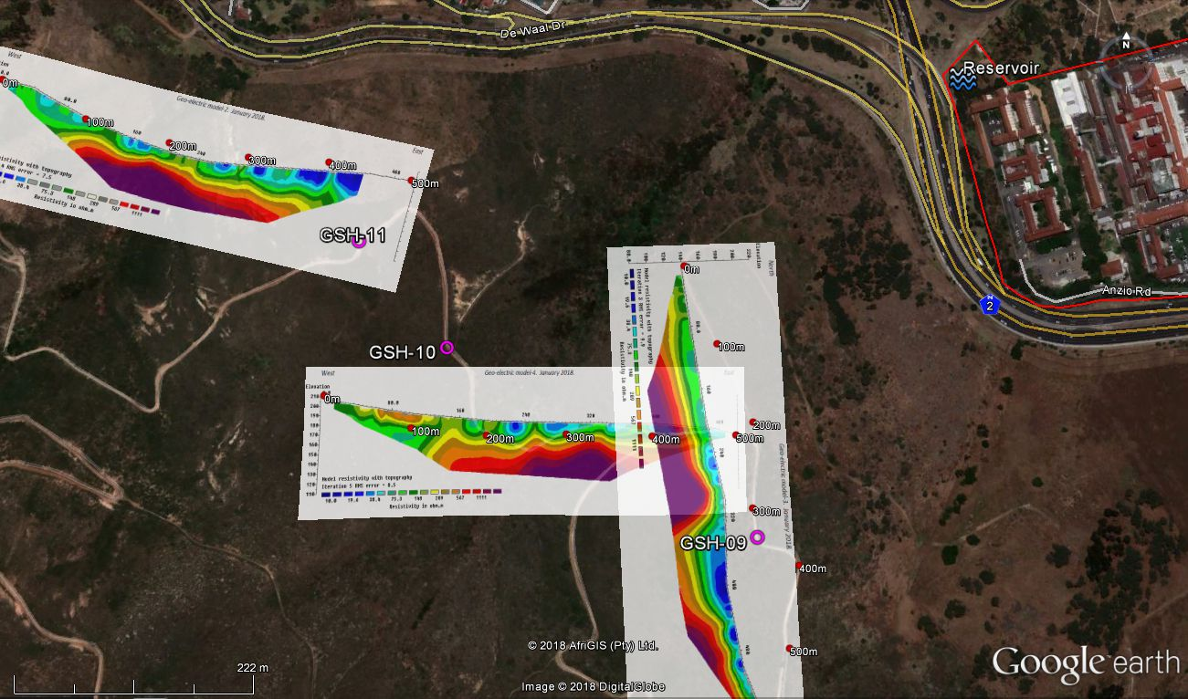
Groote Schuur Hospital

Slide 25
Challenges and Risks
Challenges (experienced and overcome/resolved):
Getting private sector ground water service providers to accept work from government at short notice and in the current demand environment
Engineering challenges:
Uncertainty around water demand and the potential role of water demand management
The physical location of pipes
Old pipes and the low pressure at which groundwater can be inserted into the system
The location and / or number of municipal connections
The delay in getting the chemical results and assessment of the need for treatment
A standard approach regarding the volume of water to be held in storage (i.e. 24 hrs)
Ladismith – hospital situated in poor hydrogeology and drilling is not viable; the water security solution relies on municipal infrastructure support and/or implementation. A non drought related technical problem: Hospital supply from town reservoir addressed through direct pipe and pump
Somerset Hospital – poor geohydrology anticipated but only 1 of 4 holes dry; 3.6 l/s achieved, surplus of 1.4 l/s
Caledon Hospital – 1 boreholes drilled in difficult terrain with a very low yield. Permission then achieved to drill on adjacent municipal land approval achieved from TWK Municipality. Different type of drilling rig deployed to site – 3 boreholes drilled 1.2 i/s achieved, 0.5 required, busy with 4th hole
Brewelskloof / Worcester hospitals – 600 ms/m EC
GSH - RO plant from ImproChem (AECI)
Prince Alfred – using single borehole, municipal supply sufficient, no second hole to be drilled
CMD – measuring volume and quality of basement water as plan A
Risks (still current):
Groote Schuur Hospital – as per previous slide
Vredenburg – three boreholes drilled and all are dry; alternative ground water sites being sought plus municipal infrastructure support

Slide 26
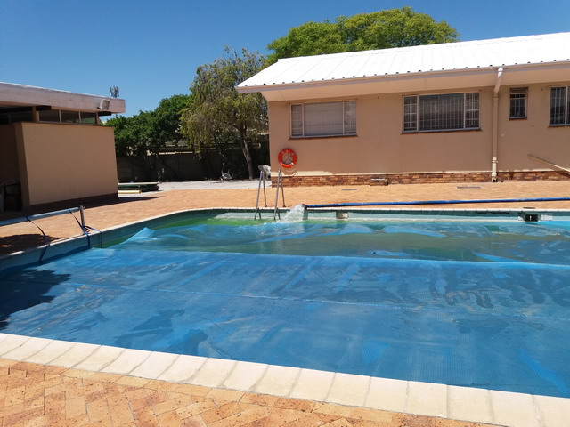
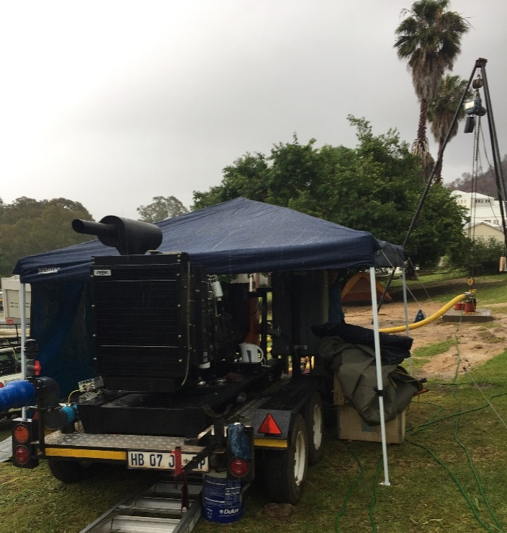
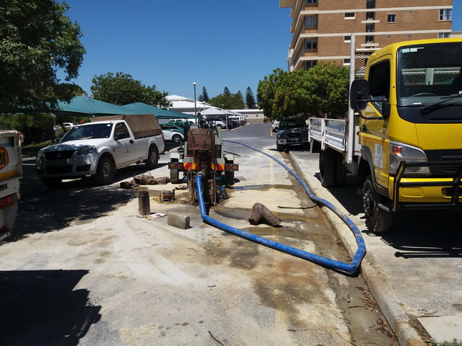
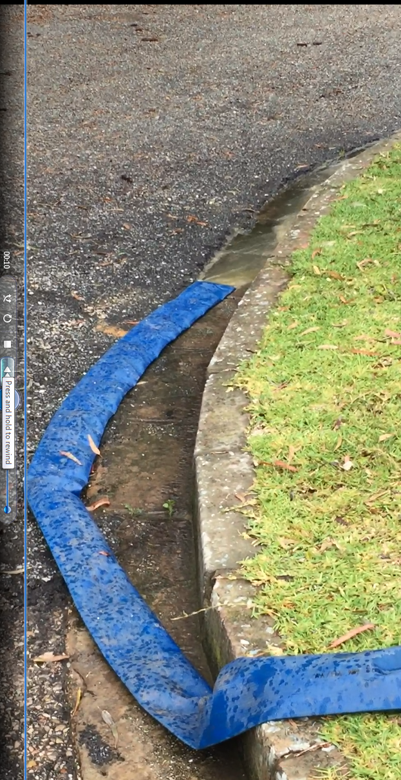
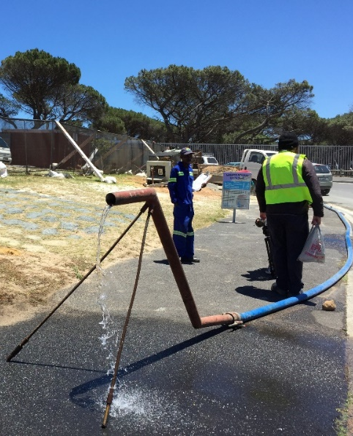
Risks (public perception)
Pump testing: apparent water wastage
Social Media – public/community perception
Mitigation:
DG letter of explanation and support has assisted
Alternative use of this waste water

Slide 27
Disaster Response

Slide 28
Disaster Response
Command and Control
2010 World Cup Legacy
Health Response in terms of Major Incidents and Disasters is as per the International MIMMS System (Major Incident Medical Management and Support system)
State Health , Private Healthcare and South African Military Health Services all work to this command system, as it pertains to the health response in such incidents.
Tested system
- November 2013 – complete evacuation of of Vergelegen Medi-Clinic
- Eskom load shedding 2015/16 – as pertaining to continuation of healthcare
- February 2016 – Tygerberg Hospital without water for 3 days
- March 2017 – evacuation Swartland Hospital due to a fire
- June 2017 Medical management of Knysna Fire – including relocating Knysna Hospital to a sports complex

Slide 29
Command and Control
(NDOH)
(PDMC)
(ProvJOC)
Centre
(DDMC)
Provincial Health Operations Centre (PHOC)
Gold
DHOC / DMC
Silver
Hospitals & Support Services (FPS, Labs etc.)
Bronze

Slide 30
Integrated Planning and Response
Recognition of inter-dependency across sectors
WCG Department of Health engagement :
Private Healthcare Sector
NHLS and Private Laboratories
Pharmaceutical Society of South Africa
South African Military Health Services
Western Province Blood Transfusion Services
Local Authority Heath Services
Comprehensive Communicable Disease Plan – in conjunction with Local Authority CDC Response Teams and the NICD
Key understanding, is that we need an Integrated Response from the Healthcare Sector
A failure within in any one sector, will impact all.

Slide 31
Strategic Partnership with CoCT
Health Facilities will be protected at Day Zero
Agreement reached with CoCT, water will not be shut off at Health Facilities (public and private) at Day Zero (reaching CoCT Phase 2)
Part A of Groundwater Security Programme will be completed before Day Zero, and it will effectively reduce the water demand of nine Metro Hospitals (including the two central hospitals)
CoCT Phase 3 will imply the shut off of water provision to healthcare facilities too. Such date cannot be established at this point.
Part B will be completed by end of June.
Part C project plan will be compiled by T&PW in the next week

Slide 32
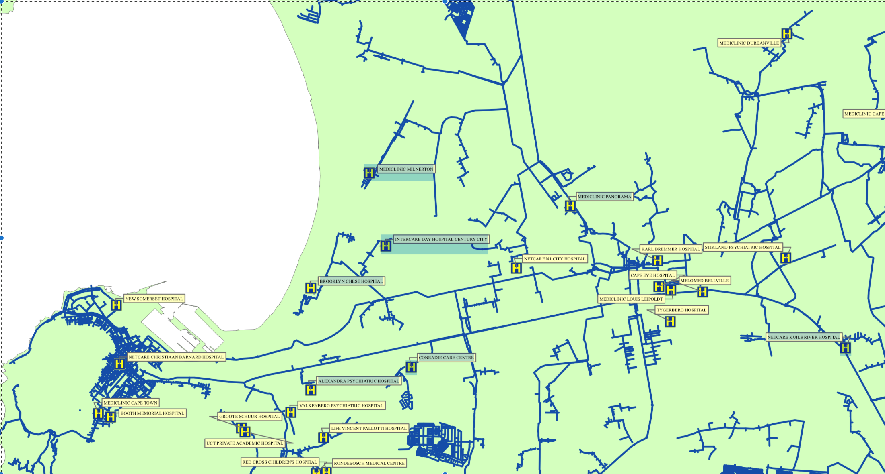
Strategic Partnership with CoCT– Hospitals
Working with the City of Cape Town and other local authorities to ensure health facilities remain serviced with municipal water.

Slide 33
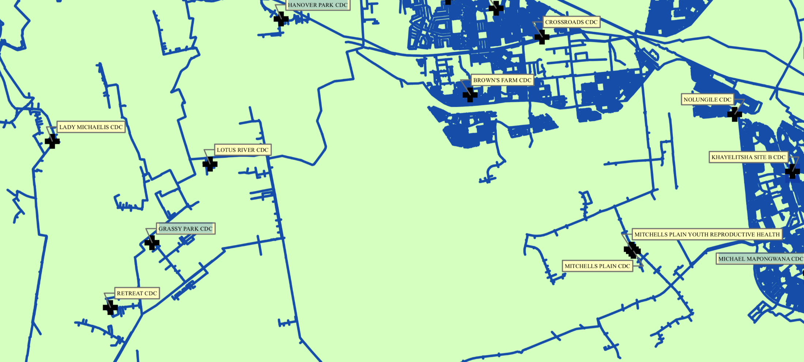
Strategic Partnership with CoCT– Clinics
Working with the City of Cape Town and other local authorities to ensure health facilities remain serviced with municipal water.

Slide 34
Clinical Service Priorities
Every attempt will be made to keep all facilities open
Scaling down of elective (non-emergency) services may need to be considered, should the water availability have a direct impact on heath facilities.
A minimum package of care has been agreed upon, should the scenario as outlined above occur.
Child health services, (sick children) and immunization
Womens Health – (maternal and obstetrics services)
Sexual reproductive health
TB and HIV services
Chronic care
Wound care
Trauma and emergency services
Substance abuse
Medicines supply

Slide 35
Clinical Service Priorities
Circular H158/2017 – Water Supply Preparedness Plan
Phase 2 (Day Zero) – water is still provided to Health Facilities
To minimise further the use of municipal water
Outpatients to be closed and elective surgery is stopped as per level 1
Laundry: only severely soiled laundry is replaced and sent for cleaning
Phase 3 – municipal water can only be obtained by means of tankers
Facilities with groundwater will provide limited service
Facilities without adjunt water supply will need to Shelter in Place
Patients may need to be moved across the platform.
Some PHC facilities (clinics) will be closed: patients will be accomodated in other PHC facilties (with water storage capacity)

