Slide 1
Cybersecurity Operations & the Cybersecurity Hub Briefing to Parliament 13 February 2018

Slide 2
Introduction
01
Making South Africa a Global Leader in Harnessing ICTs for Socio-economic Development

Slide 3
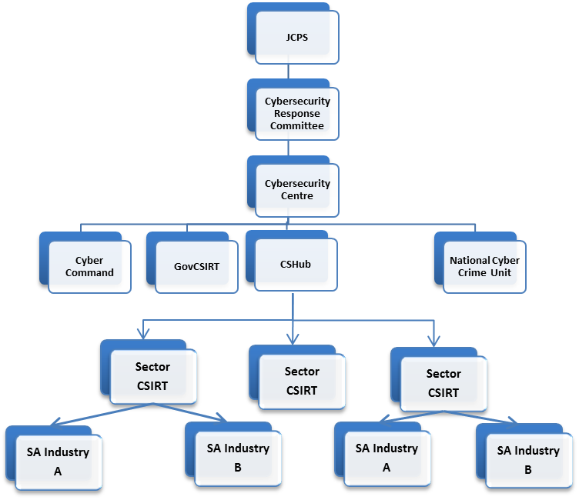
National Cybersecurity Computer Security Incident Response Teams (CSIRTs)
"Cybersecurity Hub" means a CSIRT established to pool public and private sector threat information for the purposes of processing and disseminating such information to relevant stakeholders including the Cybersecurity centre.
Cybersecurity Hub
Acts as National point of contact for the coordination of Cybersecurity incidents
Receives and analyses Cybersecurity incidents, trends, vulnerabilities and threats
Facilitates the establishment of sector, regional and continental CSIRT’s
Disseminates alerts and warnings to its constituents
Initiate national Cybersecurity awareness campaigns
Making South Africa a Global Leader in Harnessing ICTs for Socio-economic Development

Slide 4
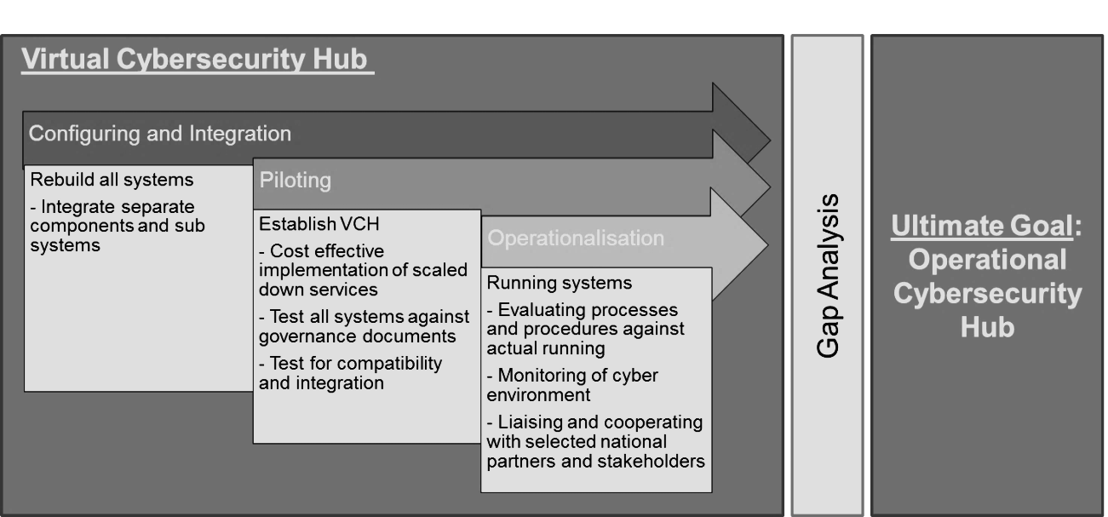
Cybersecurity Hub Implementation
The DTPS has been mandated by NCPF to establish a National CSIRT (Cybersecurity Hub) in consultation with the Justice Crime Prevention and Security (JCPS) cluster departments, the private sector and civil society as well as the sector CSIRTs
Basic Cybersecurity Hub
- Phase 1
- Phase 2
Ultimate Goal
Fully Capacitated Cybersecurity Hub
Phase 3
Making South Africa a Global Leader in Harnessing ICTs for Socio-economic Development

Slide 5
Cybersecurity Hub Responsibilities as per NCPF
Sector CSIRT Establishment, public-private partnerships, increasing collaboration, Coordinate Responses to threats at a national level and Resolve (1)
6. 3.1 Coordinate general Cybersecurity activities; identifying stakeholders and developing public-private relationships and collaborating with any sector CSIRTs that may be established. 6.3.6.1 Be a point of contact for that specific sector. 6.3.6.2 Coordinate Cybersecurity incident response activities within that sector
Information Dissemination, Best practice Guidelines, Audits, Readiness Exercises, Standards Compliance (2)
6.3.2; 6.3.6.3 and 6.3.6.4 Disseminate relevant information to sector CSIRTs, vendors, technology experts. 6. 3.3 and 6.3.6.8 Provide best practice guidance on ICT security for Government, business and civil society. 6.3.5 and 6.3.6.5 Promote compliance with standards, procedures and policy and best practices. 6.3.6.7 Conduct Cybersecurity audits, assessments and readiness exercises for the sector
Cybersecurity Awareness (3)
6.3.4 Initiate Cybersecurity awareness campaigns
Making South Africa a Global Leader in Harnessing ICTs for Socio-economic Development

Slide 6
National CSIRTs Services
"Computer Security Incident Response Team (CSIRT)” Team of dedicated information security specialists that prepares for and responds to Cybersecurity breaches or Cybersecurity incidents. Over the years CSIRTs extended their capacities and increase their service offerings. CSIRTs go from being a reaction force to a complete security service provider.
REACTIVE SERVICES
PROACTIVE SERVICES
QUALITY MANAGEMENT SERVICES
Alerts and warnings
Incident handling
Vulnerability handling
Artifact handling
Announcements
Technology watch
Security audits or assessments
Configuration and maintenance of tools, applications
Development of security tools
Intrusion detection services
Security-related information dissemination
Risk Analysis
Business continuity and disaster recovery planning
Security consulting
Awareness building
Education training
Product evaluation or certification
Making South Africa a Global Leader in Harnessing ICTs for Socio-economic Development

Slide 7
FIRST Membership
1
2
FIRST membership initiative is currently underway with the CSIR being the strategic partner
Infrastructure upgrades are being undertaken to the Cybersecurity Hub, which ism physically housed at the CSIR
Policies and Standards Operating Procedures (SOPs) are being validated and verified.
The Cybersecurity Hub’s network is being upgraded in line with FIRST requirements
Application for membership will be made in the 2017 calendar year
Facilitates trusted interactions amongst security teams to exchange ideas & best practices
Allows access to International CSIRTs (369 Members)
Validates processes, policies and technologies
Facilitates responses to transnational threats
3
4
Making South Africa a Global Leader in Harnessing ICTs for Socio-economic Development

Slide 8
Incident Analysis
02
Making South Africa a Global Leader in Harnessing ICTs for Socio-economic Development

Slide 9
The Cybersecurity Hub’s Incident Handling process
The Cybersecurity Hub’s Incident Handling process
Report and Registration
Verification and Classification
01
03
05
Prioritization and Assignment
02
04
06
Notification
Resolution
Closure

Slide 10
Incident management
Cyber Threat Class | Count | Cybercrime Types | Number Detected
Abusive content | 0 | Spam | 0
 |  | Cyber bullying | 0
 |  | Cyber stalking | 0
 |  | Child pornography | 0
 |  | Violence | 0
Malicious code | 18 | Virus | 11
 |  | Worm | 0
 |  | Trojan | 0
 |  | Spyware | 7
 |  | Dialler | 0
Information gathering | 18 | Scanning | 0
 |  | Sniffing | 0
 |  | Social engineering | 2
 |  | Phishing | 11
 |  | Spoofing | 5
 |  | Pharming | 0
Intrusion attempts | 1 | Exploitation of known vulnerabilities | 0
 |  | Login attempts | 1
 |  | New attack signature | 0
Intrusions | 0 | Privileged account compromise | 0
 |  | Unprivileged account compromise | 0
 |  | Application comprise | 0
Availability | 94 | Denial of Service | 94
 |  | Distributed denial of service | 0
 |  | Sabotage | 0
Information security | 0 | Unauthorised access to information | 0
 |  | Unauthorised modification of information | 0
Fraud | 0 | Unauthorised use of resources | 0
 |  | Copyright | 0
 |  | Masquerade | 0
Vulnerability | 0 | Potential for exploitation | 0
TOTAL | 131
Monthly Incident management
February 2018
Making South Africa a Global Leader in Harnessing ICTs for Socio-economic Development

Slide 11
Incident management
Quarterly Incident management
July-September 2017
Making South Africa a Global Leader in Harnessing ICTs for Socio-economic Development

Slide 12
Incident management: 2016/2017 Annual Stats
Annual Incident management
 | Apr-16 | May-16 | Jun-16 | Jul-16 | Aug-16 | Sep-16 | Oct-16 | Nov-16 | Dec-16 | Jan-17 | Feb-17 | Mar-17 | Total per Incident Type
Abusive content | 157 | 235 | 320 | 155 | 215 | 249 | 220 | 242 | 154 | 138 | 238 | 229 | 2552
Malicious code | 238 | 154 | 446 | 291 | 142 | 247 | 672 | 634 | 549 | 591 | 554 | 469 | 4987
Information gathering | 273 | 253 | 260 | 225 | 258 | 270 | 350 | 469 | 323 | 391 | 392 | 313 | 3777
Intrusion attempts | 25 | 68 | 89 | 9 | 3 | 22 | 0 | 5 | 0 | 4 | 1 | 1 | 227
Intrusions | 19 | 97 | 55 | 10 | 25 | 36 | 0 | 0 | 0 | 0 | 0 | 0 | 242
Availability | 110 | 376 | 358 | 256 | 180 | 496 | 592 | 300 | 323 | 196 | 139 | 1513 | 4839
Information security | 15 | 58 | 65 | 56 | 45 | 32 | 0 | 528 | 0 | 0 | 0 | 0 | 799
Fraud | 50 | 67 | 209 | 96 | 32 | 43 | 27 | 39 | 30 | 29 | 51 | 30 | 703
Vulnerability | 250 | 356 | 365 | 327 | 322 | 379 | 395 | 661 | 265 | 296 | 225 | 439 | 4280
Total per Month | 1137 | 1664 | 2167 | 1425 | 1222 | 1774 | 2256 | 2878 | 1644 | 1645 | 1600 | 2994 | 22406
Making South Africa a Global Leader in Harnessing ICTs for Socio-economic Development

Slide 13
Incident management: 2016/2017 Annual Stats
Making South Africa a Global Leader in Harnessing ICTs for Socio-economic Development

Slide 14
Coordination & Consultation
03
Co-ordination
Coordinate general Cybersecurity activities; identifying stakeholders and developing public-private relationships and collaborating with any sector CSIRTs that may be established
Consultation
The Cybersecurity Hub needs to ensure appropriate consultation between the JCPS cluster departments, the private sector and civil society regarding Cybersecurity matters
Making South Africa a Global Leader in Harnessing ICTs for Socio-economic Development

Slide 15
Sector CSIRTs Establishment
"Cybersecurity Hub" means a CSIRT established to pool public and private sector threat information for the purposes of processing and disseminating such information to relevant stakeholders including the Cybersecurity centre.
Making South Africa a Global Leader in Harnessing ICTs for Socio-economic Development

Slide 16
Sector CSIRTs as at end 2015-2016 financial year
SSA Cyber Response Committee
Cybersecurity Hub
TELECOMMS SECTOR-CSIRT
RETAIL
SECTOR-CSIRT
FINANCE SECTOR-CSIRT
LOGISTICS
SECTOR-CSIRT
HEALTH
SECTOR-CSIRT
SECTOR-CSIRT
…
SABRIC CSIRT
PASA CSIRT
ASISA CSIRT
FMI CSIRT
SAIA
Other Finance CSIRTs
At the end of the 2015-2016 financial year, the Finance sector was well represented with respect to sector-based CSIRTs with at least four active CSIRTs, with others being planned.
The Higher education sector also has an effective CSIRT responsible for universities, museums and research councils
LEGEND
SABRIC: South African Banking Risk Information Centre
ASISA: Association of Savings and Investments South Africa
PASA: Payments Association of South Africa
SAIA: South African Insurance Association
FMI: Financial Markets Institutions (JSE, Reserve Bank, Bankserv, STRATE)
Making South Africa a Global Leader in Harnessing ICTs for Socio-economic Development

Slide 17
Sector CSIRT Establishment
SSA Cyber Response Committee
Cybersecurity Hub
TELECOMMS SECTOR-CSIRT
RETAIL
SECTOR-CSIRT
FINANCE SECTOR-CSIRT
LOGISTICS
SECTOR-CSIRT
HEALTH
SECTOR-CSIRT
…
SECTOR-CSIRT
Internet Service Providers Association sector-CSIRT
Consumer Goods Retail sector-CSIRT
Since April 2017 two new sector-based CSIRTs are in the process of being established
The retail sector CSIRT being spearheaded by the Consumer Goods Council (CGC)
The Consumer Goods Council represents the interests of more than 12, 000 member companies engaged in the manufacture, retail, wholesale and distribution of consumer goods, which has a combined value of R707 billion
The Internet Service providers CSIRT being spearheaded by the Internet Service Providers Association (ISPA).
ISPA currently has many members, comprised of large, medium and small Internet service and access providers in South Africa.
Making South Africa a Global Leader in Harnessing ICTs for Socio-economic Development

Slide 18
Establishment of a CSIRT Forum
Established what has been termed the CSIRT Forum in April 2017 in response to increasing number of sector-based CSIRTs being established
Made up of representatives from the established and soon-to-be established CSIRTs
The intention of the CSIRT forum is to coordinate activities amongst the various CSIRTs.
Initiatives identified at the launch included:
Information Sharing between sector-CSIRTs
Skills Development / Capacity Building
Promoting of uniform Standards
…
TELECOMMS SECTOR-CSIRT
RETAIL
SECTOR-CSIRT
FINANCE SECTOR-CSIRT
ISP CSIRT
RETAIL
CSIRT
SABRIC CSIRT
PASA CSIRT
ASISA CSIRT
FMI CSIRT
SAIA
Other Finance CSIRTs
Making South Africa a Global Leader in Harnessing ICTs for Socio-economic Development

Slide 19
Improved Consultation
Member of Justice and Crime Prevention and Security (JCPS) Cluster’s Cybersecurity Response Committee(CRC)
Seven member NCAC advices the Minister on Policy, Technical and any other matters pertinent to Cybersecurity…”
Member of JCPS lead Cybersecurity Response Committee (CRC)
Member of the CRC Secretariat and of the Technical sub-committee
Increased consultation between the JCPS cluster and the other national CSIRTs as mandated by the NCPF
The National Cybersecurity Advisory Council
New members of the NCAC in the process of being appointed
Over thirty applications were received
Making South Africa a Global Leader in Harnessing ICTs for Socio-economic Development

Slide 20
Improved Consultation
Regular interactions with various Stakeholders including:
The South African Communications Forum
The Consumer Goods Council
Financial Sector Continuity Forum Cyber and Information Security Working Group (Reserve Bank, STRATE, Banserv, JSE).
National ICT Forum Working Group on Cybersecurity
Vendors (Microsoft, CISCO, INTEL, Kaspersky)
Research institutions
South African Bureau of Standards
Making South Africa a Global Leader in Harnessing ICTs for Socio-economic Development

Slide 21
Cybersecurity Incident Response ‘War Room’: Improving coordination
Stakeholders
Real Time Response
Tools
Proof of Concept
Imperative to be able to engage with all stakeholders when responding to Threats and Incidents at a National level
The ‘War Room’ will give the Hub the ability to respond in real-time and to coordinate responses to Cybersecurity threats and incidents
A set of secure collaborative communications tools
A Business Intelligence (BI) capability that allows stakeholders to take decisions to resolve threats
‘Proof of Concept’ are being undertaken by various vendors
The processes and workflow that support the ‘War Room’ are being developed in conjunction with Law Enforcement Agencies and other constituents
Use of Skype for Business and open-source collaborative tools
Request for the appointment of service providers is being finalised
Making South Africa a Global Leader in Harnessing ICTs for Socio-economic Development

Slide 22
Investigate the development of ‘home-grown’ Cybersecurity tools
Initiated a research project to get a baseline understanding of the Cybersecurity sector in South Africa.
Problem Statement:
Investigate the cyber security landscape within South Africa for the private and public sector and determine the cyber related software applications, tools and other capabilities that are being developed and available respectively.
Rationale for the Study:
Cybersecurity is a national imperative for countries, and is largely reliant on the use of software tools in order to identify and resolve cybersecurity incidents and threats.
The need for locally developed tools have become an imperative for many countries
In South Africa there is an urgent need for the establishment of sector CSIRTS / SOCs and for the promotion of public-private partnerships in order to counter cybersecurity breaches and incidents.
South Africa also has an associated strategic objective of encouraging the local software development sector.
Expected Outputs (November 2017):
Overview of the Cyber security landscape of South Africa and expected growth trajectory
A report which identifies the various in-house developed or developing cyber security related software applications and tools within the private and public sector in South Africa.
Making South Africa a Global Leader in Harnessing ICTs for Socio-economic Development

Slide 23
Dissemination of Information
04
Disseminate Information
Disseminate relevant information to sector CSIRTs, vendors, technology experts.
Making South Africa a Global Leader in Harnessing ICTs for Socio-economic Development

Slide 24
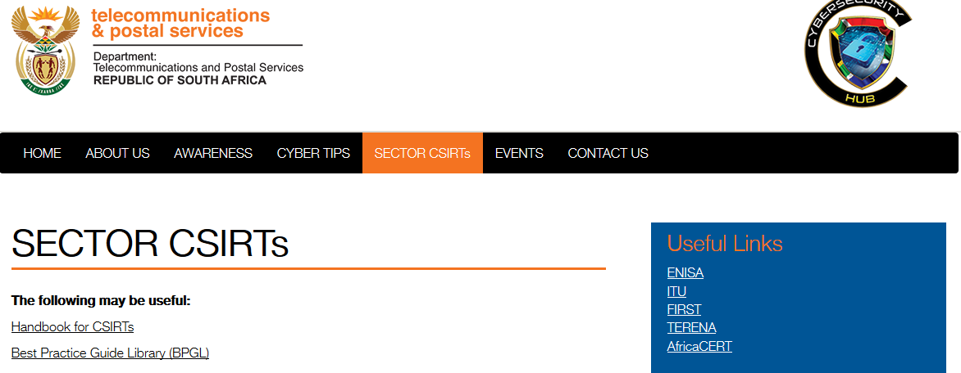
Communicating with Sector-CSIRTs
Communicate with our Stakeholders and Sector-based CSIRTs via the Cybersecurity Hub website using secure logins.
Provide relevant documentation and security directives via the Website
Making South Africa a Global Leader in Harnessing ICTs for Socio-economic Development

Slide 25
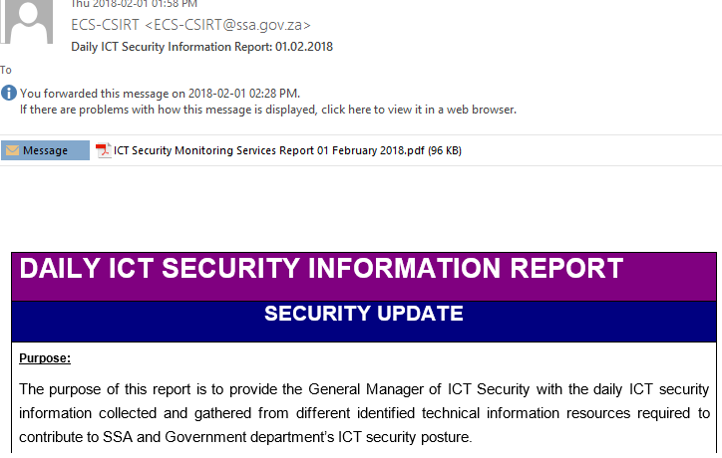
Global Ransomware attacks & Security Directives
Making South Africa a Global Leader in Harnessing ICTs for Socio-economic Development

Slide 26
Global Ransomware attacks & Security Directives
In 2017 two global ‘ransomware attacks were reported, WannaCry and Petya.
The WannaCry attack began on Friday, 12 May 2017, and within a day was reported to have infected more than 230,000 computers in over 150 countries, including the United Kingdom's National Health Service (NHS) causing it to run some services on an emergency-only basis during the attack
The Petya ransomware exploits a vulnerability in Microsoft and takes over computers and demands $300, paid in Bitcoin.
WannaCry Ransomeware
May 2017
Petya
Ransomeware
June 2017
What is ransomware?
Ransomware is a type of malware that blocks access to a computer or its data and demands money to release it.
How does it work?
When a computer is infected, the ransomware encrypts important documents and files and then demands a ransom, typically in Bitcoin, for a digital key needed to unlock the files.
Making South Africa a Global Leader in Harnessing ICTs for Socio-economic Development

Slide 27
Global Ransomware attacks & Security Directives
Alert Name | Petya Ransomware Security Advisory
Overview of vulnerability | There is an outbreak of a ransomware attack called Petya already making chaos worldwide, with massive disruption in countries such as Europe, Unites States (US), India, France, and Russia. This ransomware infects Windows systems by encrypting the hard drive’s master file table (MFT) and renders the master boot record (MBR) inoperable. The MRB is then replaced with the Petya’s malicious code that displays the ransom note and leaves the computer unable to boot. The ransomware takes over computers and demands $300, paid in Bitcoin, which is a cryptocurrency. The Petya ransomware spreads rapidly across an organization once a computer is infected using the EternalBlue vulnerability in Microsoft Windows. Unlike the recent WannaCry, this attack is very persistent in nature and has better spreading mechanisms; it tries one option and if it doesn’t work, it tries another one. The Cybersecurity Hub advices the infected users not to pay the ransom.
Date | 27 June 2017
Systems affected | Microsoft Windows
Risk (Risk e.g. in terms of simple rating (low, medium, high). | High | X | Medium |  | Low
 | The risk for this attack is high.
impact/ potential damage | High | X | Medium |  | Low
 | The severity for this ransomware is high; organisations could lose a lot of money by paying the ransom.
Recommendations | All Microsoft Windows users are advised to do the following: Install required Windows updates (MS17-10): https://technet.microsoft.com/en-us/library/security/ms17-010.aspx Turn of SMB1: https://support.microsoft.com/en-us/help/2696547/how-to-enable-and-disable-smbv1-smbv2-and-smbv3-in-windows-and-windows It is also advised to block the execution of «PSEXEC.EXE» software on potentially compromised machines and block remote access to WMI.
References | http://thehackernews.com/2017/06/petya-ransomware-attack.html https://www.theguardian.com/technology/2017/jun/27/petya-ransomware-cyber-attack-who-what-why-how http://www.wired.co.uk/article/petya-malware-ransomware-attack-outbreak-june-2017
The Hub had knowledge of the attacks and raised the alarm with its Stakeholders.
The Hub developed and released Security Directives aimed at countering these attacks, which were distributed to our Stakeholders.
Key to this was the use of the recently established CSIRT forum for dissemination of information
The Security Directives were both technical in nature for the consumption by the CSIRTs and a general Awareness directive for the general public
No large-scale breaches were reported in South Africa
Making South Africa a Global Leader in Harnessing ICTs for Socio-economic Development

Slide 28
Piloting of a Business Intelligence solution
Piloting a Business Intelligence (BI) solution
The BI solution is meant to develop a capacity to identify threats prior to them turning into actual incidents
Inputs various open-source and proprietary threat feeds, and also incidents from the CSIRTs in order to develop trends and patters of incidents
Requested threat information from stakeholders including Microsoft, Kaspersky, Intel and CISCO
Output will be a South Africa specific Incident and Threat feed which will be distributed to Stakeholders
Making South Africa a Global Leader in Harnessing ICTs for Socio-economic Development

Slide 29
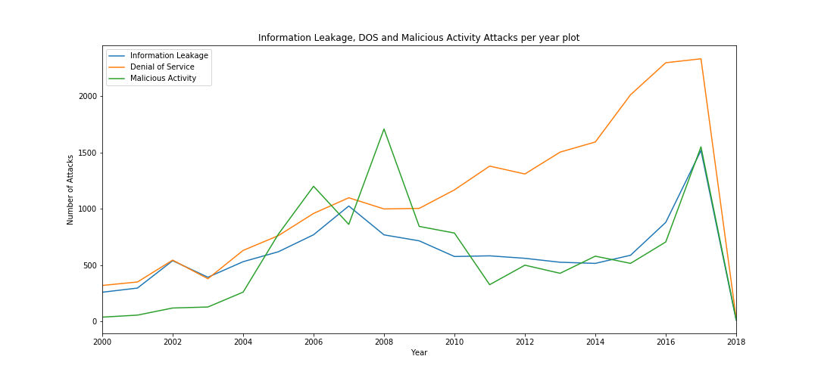
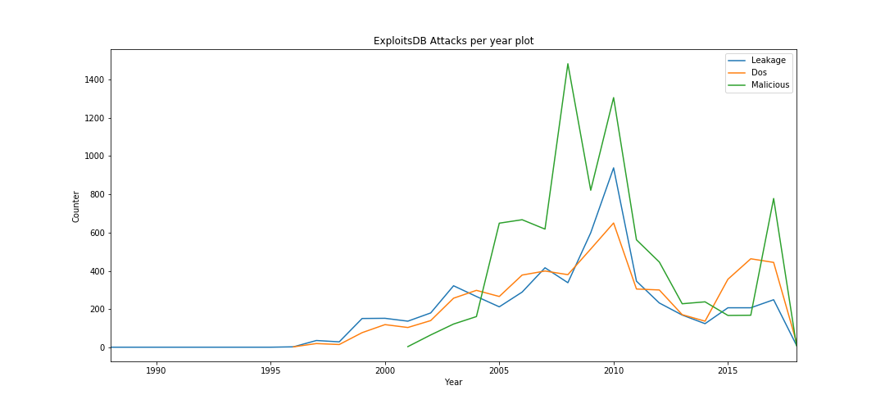
Business Intelligence Pilot: Examples of Visualisations
Making South Africa a Global Leader in Harnessing ICTs for Socio-economic Development

Slide 30
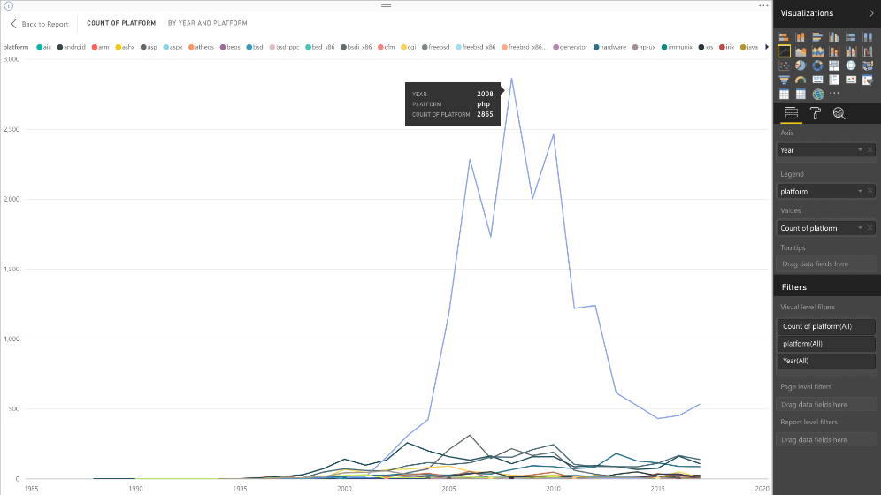
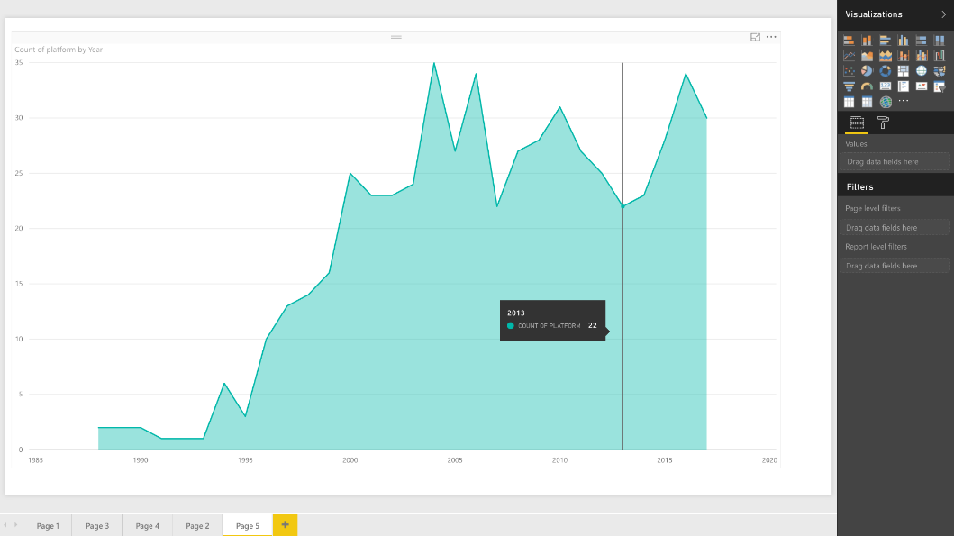
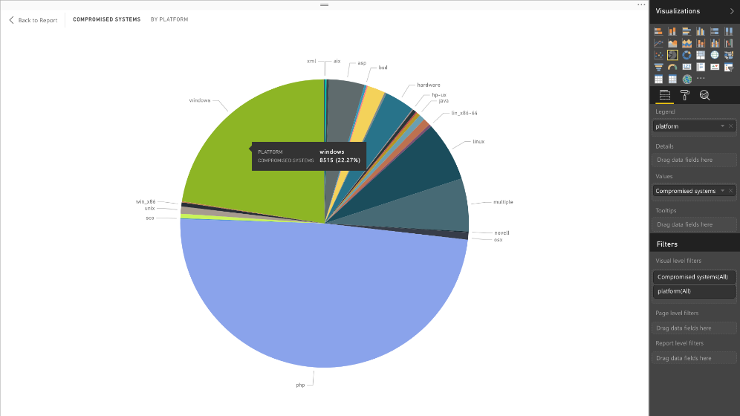
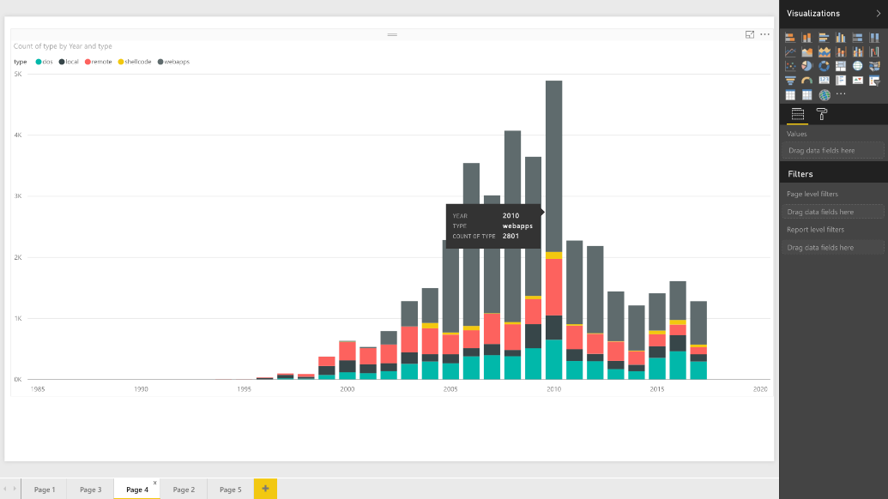
Business Intelligence Pilot: Examples of Visualisations
Making South Africa a Global Leader in Harnessing ICTs for Socio-economic Development

Slide 31
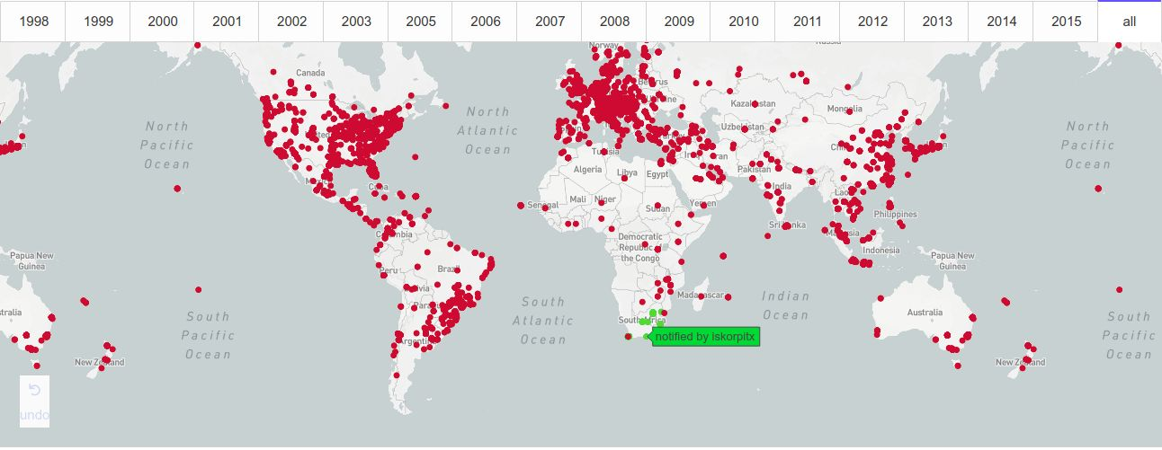
Business Intelligence Pilot: Examples of Visualisations
Making South Africa a Global Leader in Harnessing ICTs for Socio-economic Development

Slide 32
Provide Guidance, Promote Compliance
05
Provide Guidance
Provide best practice guidance on ICT security for Government, business and civil society
Promote compliance
Promote compliance with standards, procedures and policy and best practices
Making South Africa a Global Leader in Harnessing ICTs for Socio-economic Development

Slide 33
Sector-specific Readiness Survey Current Initiative
The National Readiness survey was the first national survey aimed at understanding:
The status of strategic Cybersecurity plans within organisations;
Governance relating to the Cybersecurity function within organisations;
Potential Cybersecurity vulnerabilities and risks which have been identified within organisations;
The capability of organisations to respond and recover after a Cybersecurity related attack.
The survey closed at the end of July and analysis is currently under way
The results and the report will be available in October 2017
Sectors that responded included
Higher education
State-owned enterprises
The IT Sector
The finance sector including the banks, investment houses
and the FMIs
Making South Africa a Global Leader in Harnessing ICTs for Socio-economic Development

Slide 34
Sector-specific Readiness Survey Current Initiative
- 37% of organisations have discussed and will implement it in the future
- 29% have a fully functional plan
- 18% developing a plan and aim for implementation in the next 6-12 months.
7% have no plan in place
8% uncertain about their organisations current cyber security plan/strategy
Making South Africa a Global Leader in Harnessing ICTs for Socio-economic Development

Slide 35
Sector-specific Readiness Survey Current Initiative
Cybersecurity Reporting Function
Making South Africa a Global Leader in Harnessing ICTs for Socio-economic Development

Slide 36
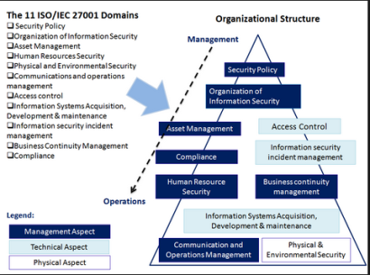
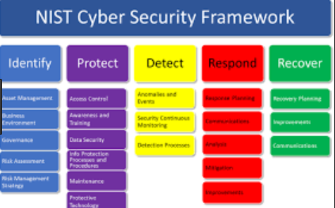
Development of National Standards and Guidelines
Development of national standards and guidelines
Assist in the standardization and in the exchange of threat and vulnerability information
Assist in developing a minimum levels of operations for CSIRTs
Include
National Cybersecurity Standards e.g. ISO, NIST, CoBIT
Threat Information Standardisation
Identification of open source and proprietary tools
Maturity Models in order to evaluate CSIRT maturity
Making South Africa a Global Leader in Harnessing ICTs for Socio-economic Development

Slide 37
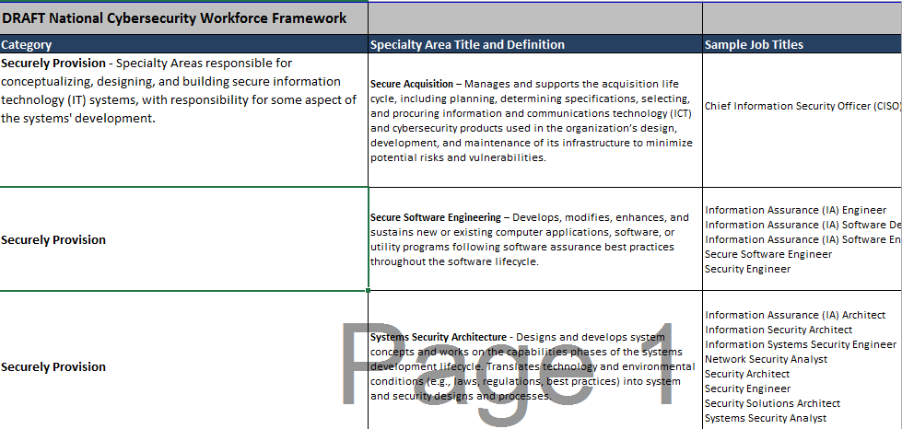
Development of a national Cybersecurity Skills framework
Developed a national Cybersecurity Skills Framework
Based on international best practice model - National Initiative for Cybersecurity Education (NICE)
Customised for South Africa
Developed in collaboration with SABRIC and the BANK SETA
Has been socialised with various other SETAs
Development of Organising Framework for Occupations (OFO) Codes in progress
Once OFO codes have been registered and the framework finalised, standardised curriculum content can be developed
The development of the national Skills Framework, once finalised, is a significant breakthrough in addressing the issue of the shortage of Cybersecurity skills
Making South Africa a Global Leader in Harnessing ICTs for Socio-economic Development

Slide 38
National Awareness Strategy
06
Making South Africa a Global Leader in Harnessing ICTs for Socio-economic Development

Slide 39
Development of National Awareness Strategy
National Awareness Strategy has three elements
Awareness Portal, hosting of Regional Hackathons, translation of Awareness material into all official language
Mass Media Strategy
Mass-media strategy involves developing content and relationships with community radio stations, television, newspapers, magazines etc.
This strategy is currently under development
Provincial visits will include meetings with academia, school visit, traditional leaders
Making South Africa a Global Leader in Harnessing ICTs for Socio-economic Development

Slide 40
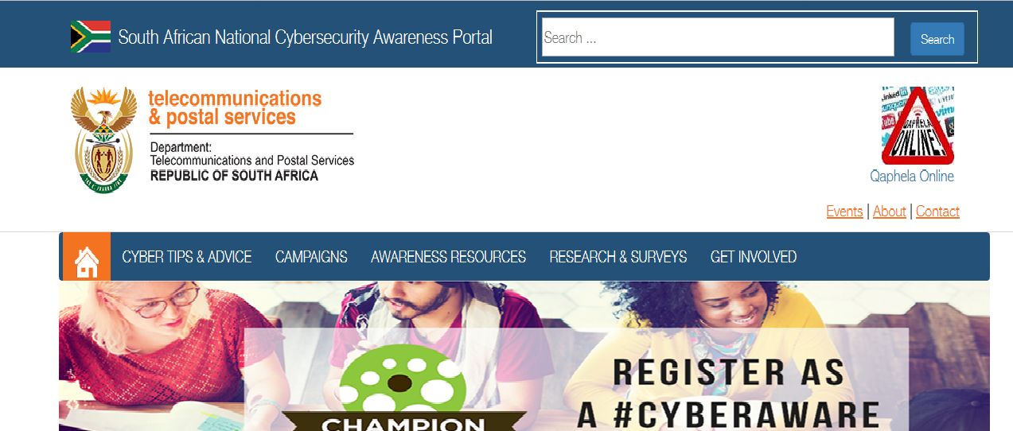
Development of a national Awareness Portal
Awareness Portal officially launched in October 2017
Cybersecurity is a shared responsibility
Regular cybersecurity campaigns e.g. Cyberbullying will be run jointly with Stakeholders e.g. CISCO, SABRIC, Reserve Bank, SITA, ISPA, Microsoft etc.
Making South Africa a Global Leader in Harnessing ICTs for Socio-economic Development

Slide 41
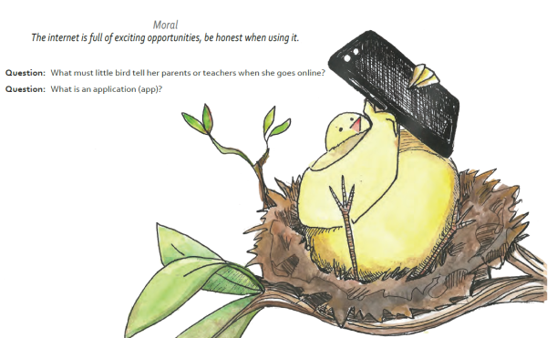
Awareness Initiatives
Hackathons are intensive software development events, usually around a theme
Working NEMISA
Translation content into all official languages
Making South Africa a Global Leader in Harnessing ICTs for Socio-economic Development

Slide 42
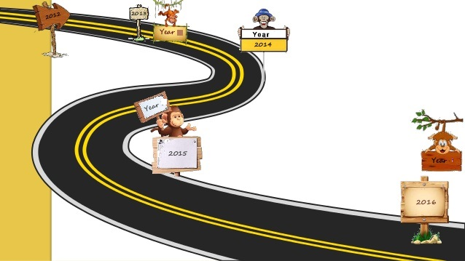
Thank You!

