Slide 1
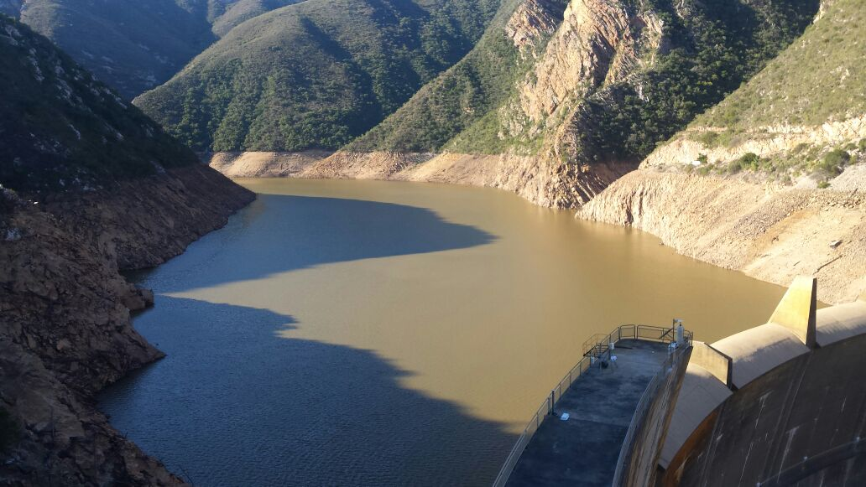

KOUGA LOCAL MUNICIPALITY
DROUGHT CRISIS
January 2018
Kouga Dam

Slide 2
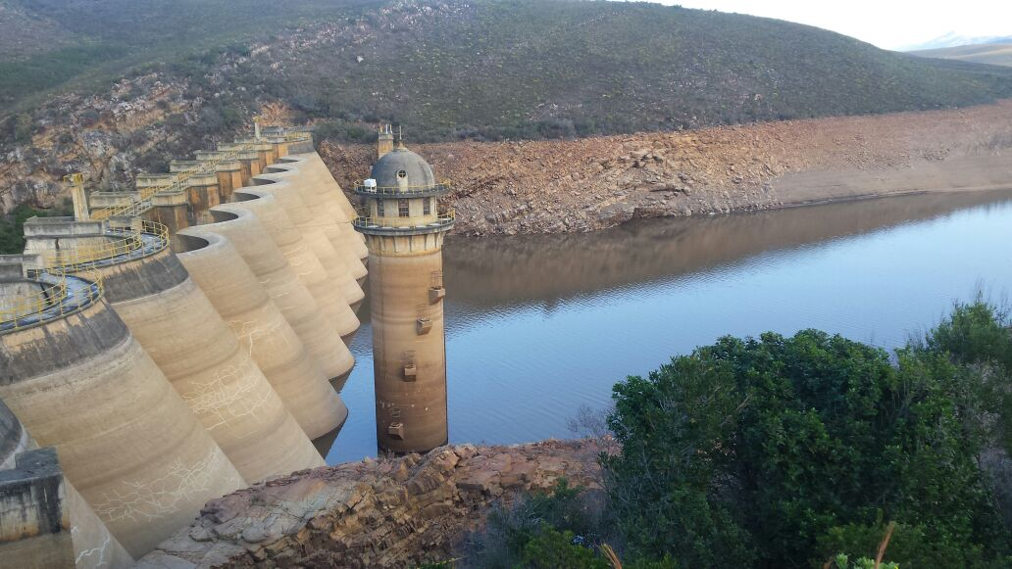
KOUGA LOCAL MUNICIPALITY
DROUGHT CRISIS
Churchill Dam at 18.9% of full capacity on 5 Feb 2018

Slide 3
KOUGA LOCAL MUNICIPALITY
LOCATED WITHIN THE SARAH BAARTMAN DISTRICT MUNICIPALITY

Slide 4

KOUGA LOCAL MUNICIPALITY
RAINFALL PREDICTION FOR GAMTOOS CATCHMENT
Patensie – Historical Statistics
Summary of number of days between 50 mm events
Average | 428
Maximum | 2293 (29-Nov-55 to 10-Mar-62)
Last Event | 1-Sept-15

Slide 5
KOUGA LOCAL MUNICIPALITY
RAINFALL PREDICTION FOR GAMTOOS CATCHMENT
The forecast period ends in June 2018 and up until then the rainfall will be normal to below normal.

Slide 6
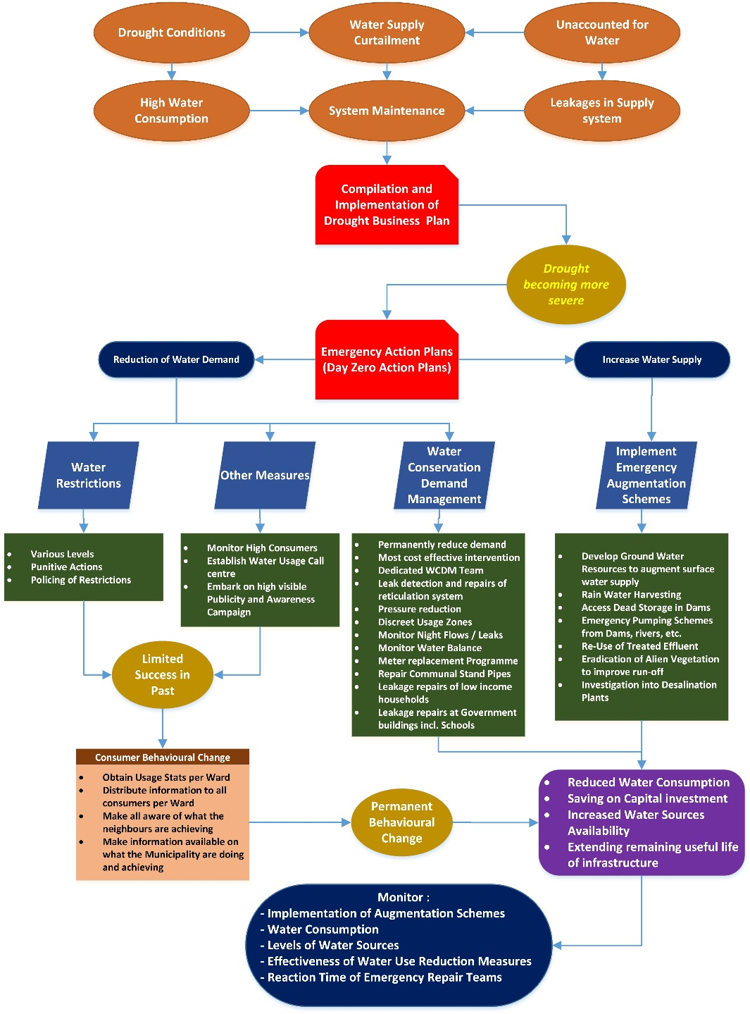
KOUGA LOCAL MUNICIPALITY
DROUGHT CRISIS
Drought Intervention Measures - Methodology

Slide 7
KOUGA LOCAL MUNICIPALITY
DROUGHT CONDITIONS – STATUS QUO
Western part of EC in the grip of a severe drought – worst drought in 100 years
Kouga was declared a drought disaster area in May 2017
Water level in Kouga Dam dropped to lowest level ever (7.1%)
Day Zero for Hankey & Patensie: 31 March 2018

Slide 8
KOUGA LOCAL MUNICIPALITY
DROUGHT CRISIS
Intergovernmental liaison
Member of Algoa Water Supply System (AWSS) Restrictions Monitoring Committee – Monthly with DWS and By-weekly with NMBM
Participated in drought intervention w/shop hosted by SBDM and attended by Disaster Management Teams (Provincial & National) on 22 Sept 2017
Stakeholder: DWS AWSS Reconciliation Study - Quarterly
Met with Gamtoos Irrigation Board (DWS Implementing Agency) on 30 January 2018
Met with DWS officials on 31 January 2018

Slide 9
KOUGA LOCAL MUNICIPALITY
DROUGHT CRISIS
Challenges experienced
Lack of funding by DWS (ACIP & RRU Programmes have been terminated)
CoGTA only declared a Provincial Disaster in December 2017
Drought intervention Business Plan submitted by SBDM to CoGTA in July 2017 has not been approved
Three local authorities are dependent on water from the Kouga River Catchment
Two local authorities are dependent on water from the Kromme River Catchment
No RBIG funding from DWS for Kouga projects

Slide 10
KOUGA LOCAL MUNICIPALITY
DROUGHT CRISIS
Achievements to date
Funds from capital projects (R21m) diverted to drought intervention initiatives
PSP & Contractor appointed for groundwater development
Five new production boreholes drilled since November 2017 (Oyster Bay & Jeffrey’s Bay)
An emergency action plan for Hankey & Patensie (to avoid Day Zero) has been drafted and workshopped with the GIB and DWS (to obtain their input)
Several short, medium and long term strategies for the Kouga area have been included in the SBDM Drought Intervention Business Plan
Level C water restrictions are being enforced

Slide 11
KOUGA LOCAL MUNICIPALITY
DROUGHT CRISIS
Proposed Intervention Measures – short term

Slide 12
KOUGA LOCAL MUNICIPALITY
DROUGHT CRISIS
Proposed Intervention Measures – medium/long term

Slide 13
Proposed Intervention Measures – Hankey & Patensie
KOUGA LOCAL MUNICIPALITY
DROUGHT CRISIS

Slide 14
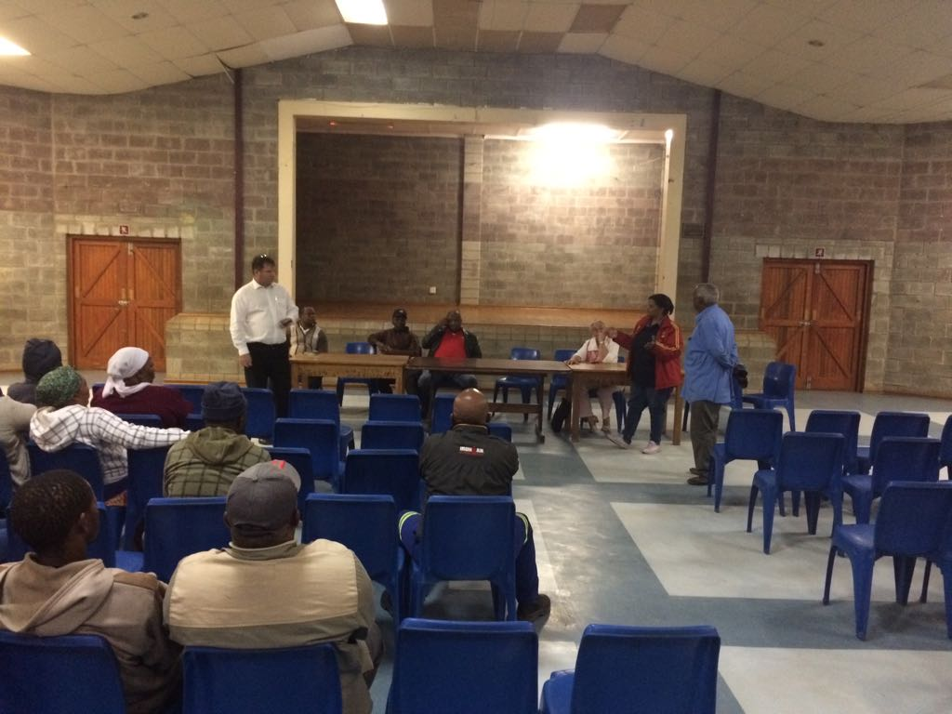
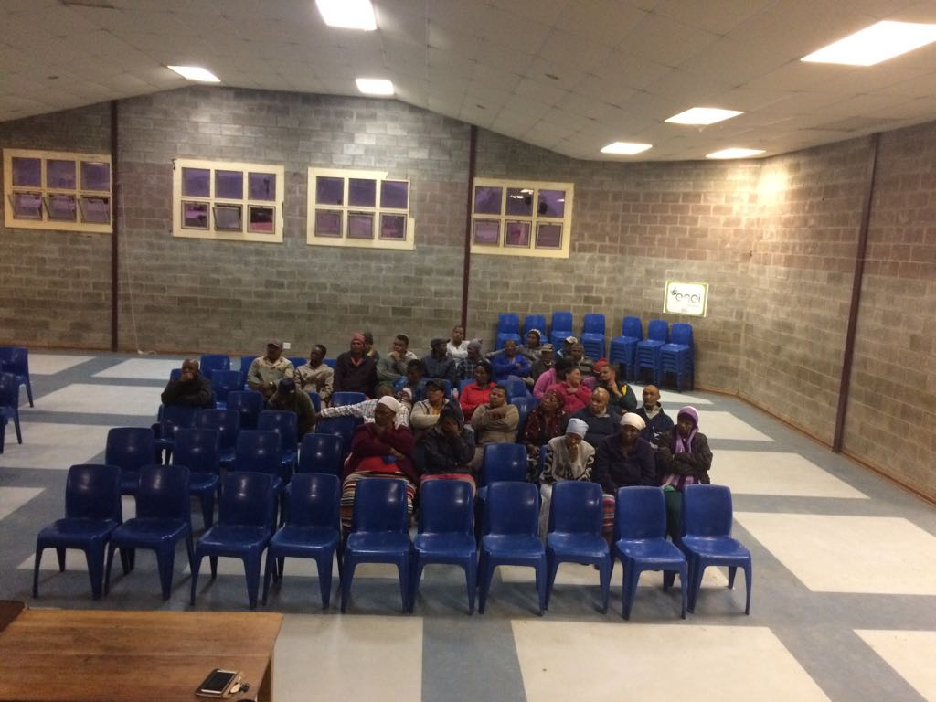
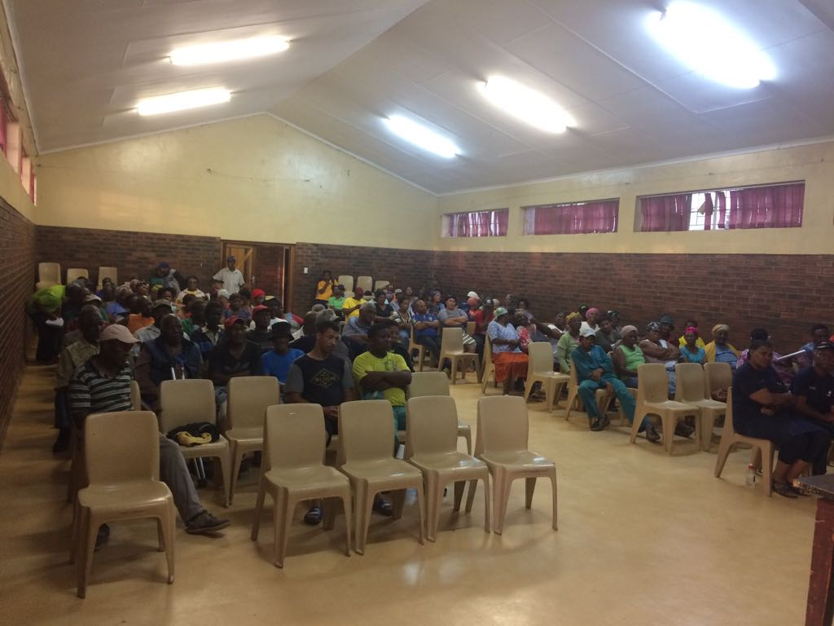
Community Drought Information Sessions
KOUGA LOCAL MUNICIPALITY
DROUGHT CRISIS

Slide 15
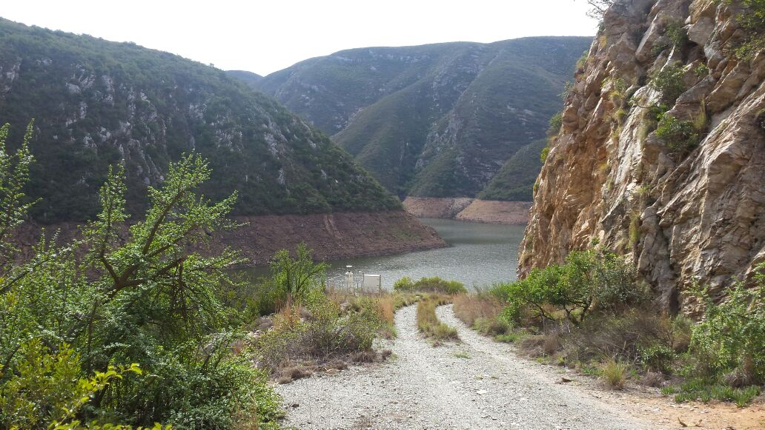
KOUGA LOCAL MUNICIPALITY
DROUGHT CRISIS
QUESTIONS

