Slide 1
Drought collaboration plan
Portfolio Committee on Water and Sanitation
7 February 2018

Slide 2
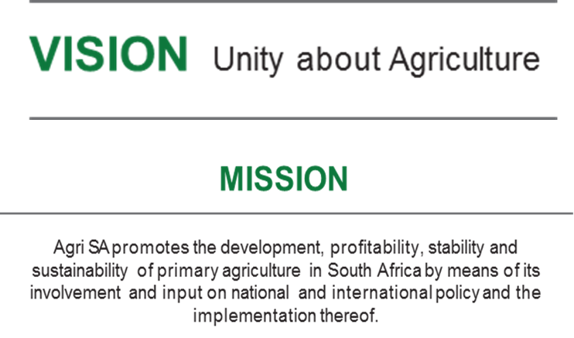
Who is Agri SA?
Agri SA is a federation of agricultural organisations
Agri SA has 9 provincial and 24 commodity organisations, 22 cooperate members
Through its affiliated membership, represents a diverse grouping of individual farmers regardless of gender, colour or creed
For 2016/17, a total of 104 710 emerging farmers benefitted from development programs such as training courses, mentorship programs, recapitalisation projects and social development initiatives
Notes:
Total 29509 farmers

Slide 3
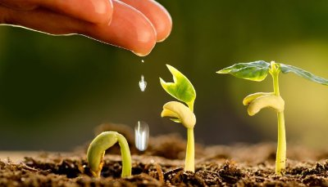
Economic importance of agriculture
Agriculture creates strong demand for goods and services, especially in rural areas
The impact of agriculture on other sectors in terms of forward and backward linkages is considerable, with the impact of irrigated agriculture being relatively large
Backward linkages
Purchases of goods such as fertilizers, chemicals and implements
Forward linkages
Supply of raw materials to industry and the food supply chain in general
Approximately 70 percent of agricultural output is used as intermediary products in other sectors
3

Slide 4
Economic importance of agriculture
It is important to note Agriculture’s importance for food security, economic development and employment:
Agriculture is 3.2 times better at reducing poverty than non-agriculture
1% in GDP due to agriculture, increases income of the poorest by more than 6%
Agriculture has substantial multiplier effects such as job creation potential though extensive linkages with the rest of the economy
Agriculture has the potential to create economic opportunities in rural and peri-urban areas
Source: Barclays, (2016), Agricultural workstream

Slide 5
Support for Agriculture
The Producer Support Estimate (PSE) is shown as a % of gross farm receipts. The OECD defines Agricultural support as “the annual monetary value of gross transfers to agriculture from consumers and taxpayers arising from government policies that support agriculture, regardless of their objectives and economic impacts.”
Source: Agricultural Policy Monitoring and Evaluation, OECD (2017)

Slide 6
Drought
In recent years, droughts have become a more prevalent challenge to agriculture in South Africa
The Western Cape is a key example where drought conditions have reached dire proportions, placing agriculture under severe strain
The Northern and Eastern Cape are also affected by drought conditions that could escalate
In addition, should drought conditions spread further, there needs to be a plan and resources in place to implement mitigation and support measures across all provinces

Slide 7
Drought collaboration plan
Agri SA proposes a drought collaboration plan (SA Inc strategy), consisting of the following
components:
A national drought funding allocation in the 2018 national budget:
Currently, there is no comprehensive data on the national level needs of farmers affected by drought conditions. Within this context, Agri SA proposes a collaboration effort on a SA Inc dimension, involving all key stakeholders, to conduct further research to produce a SA Inc research report that can be used to inform the use of funds allocated in the national budget
The establishment of an implementation panel, to be formed under the auspices of the Land Bank and the National Treasury:
The implementation panel will be responsible to evaluate requests for support
Given the short timeline until the budget speech, scheduled for 21 February, an initial allocation amount should be requested to secure support capacity within the national budget:
The allocation and use of these funds can be informed by the SA Inc research report and the implementation panel
Notes:
To produce the SA Inc report, Agri SA proposes collaboration with its members, Agbiz, BFAP, commercial banks, the Land Bank, crop insurance providers, the National Disaster Management Centre (NDMC), the Department of Water Affairs (DWA), Department of Agriculture, Forestry and Fisheries (DAFF) and other relevant government departments. Agri SA aims to perform a facilitating role to bring together all stakeholders to produce the SA Inc research report.
The implementation panel will be responsible to evaluate requests from agricultural businesses, banks and other financiers with respect to individual cases to be considered, obviously with the consent of the latter

Slide 8
Drought collaboration plan
The SA Inc strategy should evolve from co-operation between stakeholders including: Agri SA, Agbiz, BFAP, commercial banks, the Land Bank, crop insurance providers, the National Disaster Management Centre, the DWA, DAFF and other relevant government departments.
The first crucial step is to secure funding in the national budget. Informed by the SA Inc research report and the implementation panel, as examples, the funding could be used towards the following:
State guarantee scheme aimed at outstanding debt
Interest rate subsidy on carry-over debt
Farm worker support subsidy
Interest rate subsidy on new production credit
Soft loans aimed at herd rebuilding

Slide 9
Drought collaboration plan
Considering that the impact of drought conditions on farmers will vary according to the unique circumstances of each farmer, it is difficult to provide an exact estimate of the total funding requirement. However, any funding from the national budget will only be used according to strict criteria to be agreed upon by the implementation panel
To date the ongoing drought has caused an estimated R14 billion worth of damages to the agricultural sector of the Western Cape. Considering this cost as a starting point, a national drought budget allocation of R1 billion would equate to 7% of this loss
Considering the national level importance of agriculture and using the negative impact of R14 billion as a yardstick, a national drought allocation of R1 billion would be conservative. As a further yardstick, farming debt in 2016/17 amounted to R151.3 billion. A R1 billion national drought funding allocation would be conservative relative to this figure
Notes:
An estimated R14 billion worth of damages: An initial estimate from Agri Western Cape. Note that this amount could still escalate

Slide 10
Drought collaboration plan
Based on the outcome of weather conditions during the rest of 2018, the drought funding allocation could be reviewed in September 2018, to consider if further funding will be needed in the 2019 budget.
If so, this can be considered in the October Medium Term Budget Policy Statement (MTBPS).
Should farming and drought conditions have improved sufficiently, any unused funding could be re-evaluated and returned to the National Treasury

Slide 11
Contact Details
Requier Wait, PhD
Head: Economics & trade centre of excellence
T I +27 (0) 12 643 3400
C I +27 (0) 73 304 0932
E I requier@agrisa.co.za

