Slide 1
Status of compliance with Minimum Emission Standards
Portfolio Committee on Environmental Affairs
6 February 2018
Prof. Eugene K. Cairncross

Slide 2
Air quality in the Priority Areas remains poor and unhealthy
All Eskom’s coal power stations operate in the three priority areas, and are major contributors to air pollutant emissions in these areas
Comparison of the DEA’s MES with other countries
Focusing on Eskom’s SO2 emissions; aggregate emissions, and emissions intensities of each plant
SO2 abatement – options, effectiveness and costs
Possible pathways to achieving compliance and reducing impacts
Notes:
Overview of the presentation: The background of poor and unhealthy air quality in the Priority Areas, the location of all of Eskom’s coal power stations in these areas, and that Eskom coal power stations are the major contrbutors to pollutant emissions in these areas. I will then focus on the Minimum Emissions Standards (for coal power stations) and Eskom’s SO2 emissions, the main focus of this meeting.

Slide 3
Air quality in the Priority Areas, and adjacent areas, remains poor and unhealthy
Notes:
The three Priority Areas surround the densely populated metros of Ekhuruleni, Johannesburg and Tshwane, with a combined population in excess of 10 million (Census2011). Since air pollution does not recognise administrative boundaries, we may expect that the emissions from the tall stacks of the power stations located in the Priority Areas impact these metropolitan areas. (PM2.5 pollution levels in these metros are generally higher than in the priority areas.)(PM2.5: Particulate Matter less than 2.5 micro-grams per m³)

Slide 4
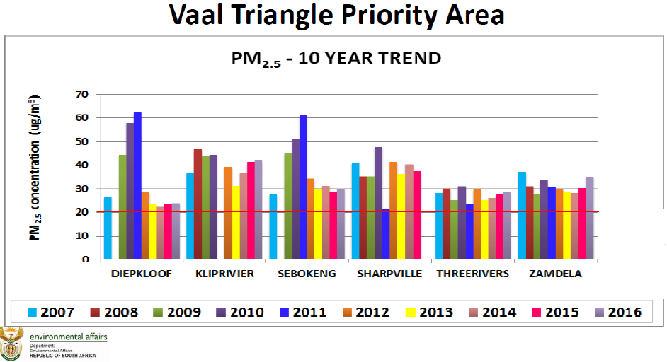
Air quality in the Priority Areas remains poor and unhealthy
SA NAAQS
WHO guideline
Notes:
Measured annual average PM2.5 levels in the Vaal Triangle Priority Area exceed the lenient National Ambient Air Quality Standard of 20 micro-grams per m³, and far exceed the more health protective WHO guideline value of 10 micro-grams per m³.

Slide 5
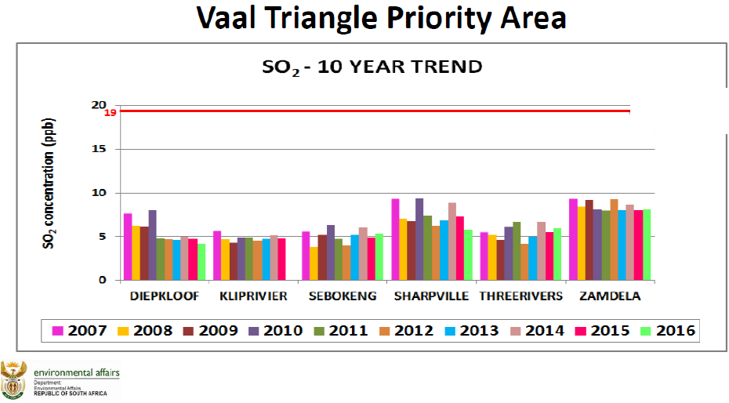
Air quality in the Priority Areas remains poor and unhealthy
SA NAAQS
WHO guideline
Notes:
Annual average SO₂ (sulphur dioxide) concentrations are compliant with the extremely lax South African standard of 19 ppb (parts per billion)(50 micro-grams per m³) but exceed the WHO guideline of 7.4 ppb (20 micro-grams per m³) in Sharpville and Zamdela.

Slide 6
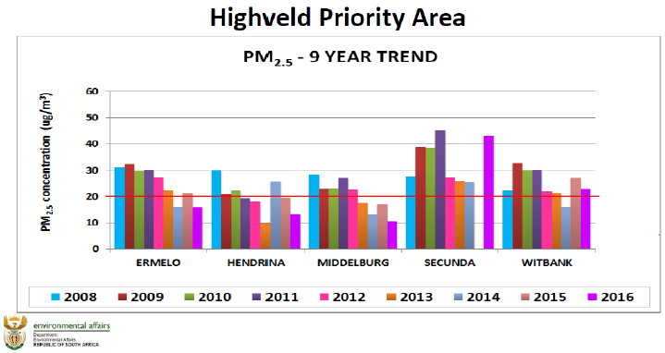
Air quality in the Priority Areas remains poor and unhealthy
SA NAAQS
WHO guideline
Notes:
As in the case of the Vaal Triangle, the annual average PM2.5 levels in the Highveld Priority Priority Area exceed the lenient National Ambient Air Quality Standard of 20 micro-grams per m³, and far exceed the more health protective WHO guideline value of 10 micro-grams per m³.

Slide 7
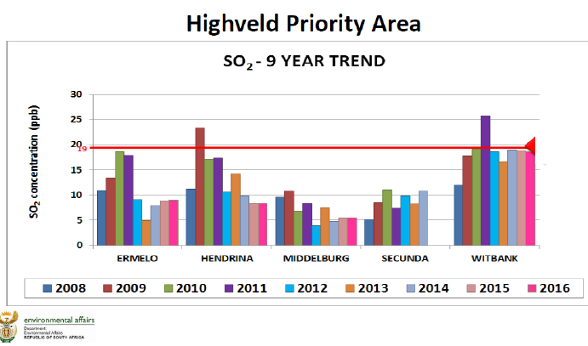
Air quality in the Priority Areas remains poor and unhealthy
SA NAAQS
WHO guideline
Notes:
In the HPA, annual average SO₂ levels exceed the SA standard in Witbank and Hendrina, and exceed the WHO guideline at four of the five stations.

Slide 8
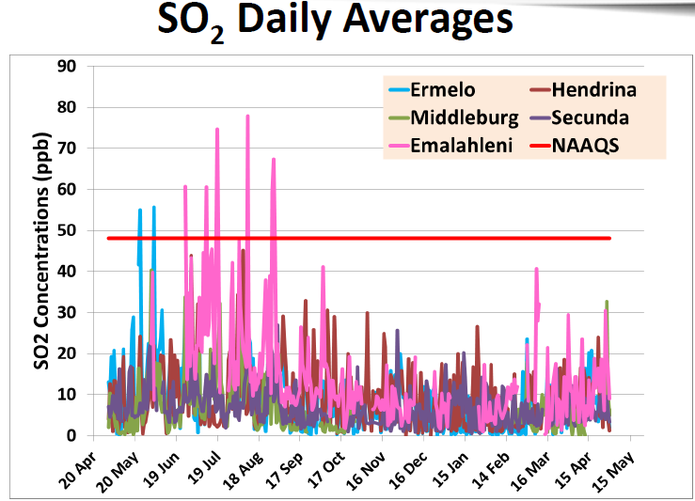
The SA daily SO₂ standard is extremely lenient
2016 to 2017 data
(May 2017 MSRG report)
SA NAAQS
WHO guideline
Notes:
The WHO daily average guideline of 7.4 ppb is exceeded on what appears to be most days during the one year period, at all five stations.
The health implications for the population exposed to SO2 pollution are described by the WHO.
“Health effects
SO₂ can affect the respiratory system and the functions of the lungs, and causes irritation of the eyes. Inflammation of the respiratory tract causes coughing, mucus secretion, aggravation of asthma and chronic bronchitis and makes people more prone to infections of the respiratory tract. Hospital admissions for cardiac disease and mortality increase on days with higher SO₂ levels.” (emphasis added)
http://www.who.int/mediacentre/factsheets/fs313/en/
The WHO also noted that these effects may occur at levels below its guideline values, and that there is no observed safe or ‘no effect’ level.

Slide 9
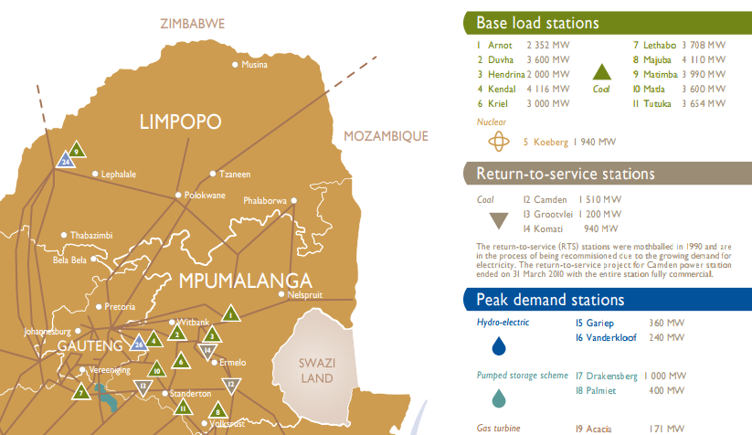
Location of Eskom’s 15 coal power stations
14. Medup
15. Kusile
Notes:
Note the cluster of 13 power stations in the HPA/ VTPA, with only Matimba and Medupi located in the Waterberg-Bojanala Priority Area.

Slide 10
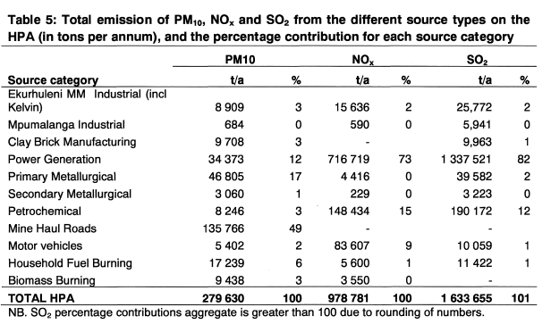
HPA: Pollution sources
Data source: HPA AQMP
Notes:
Note that in the HPA, power generation is responsible for more than 80% of total SO2 emissions, with industrial sources being the other major contributor. Household fuel burning is responsible for only 1% of SO2 emissions.
(For PM10, power generation is responsible for 12% and mine haul roads, mainly on coal mines, are responsible for 49% of emissions; households responsible for 6% only.)

Slide 11
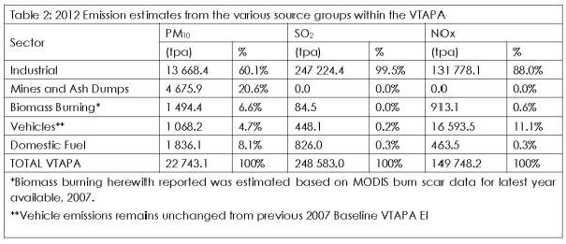
VTPA: Pollution sources
Data source: VTPA AQMP: Mid-term review
Notes:
In the VTPA, industrial emissions – combined power generation and other industrial sources, is responsible for 99.5% of SO2 emissions.

Slide 12
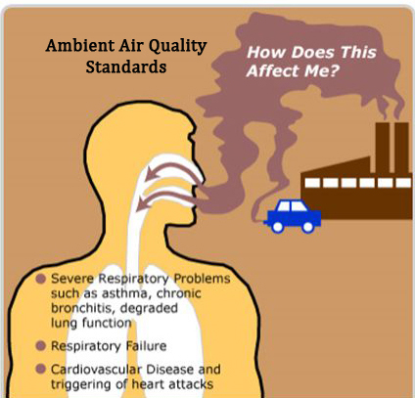
The MES: the key to achieving substantial improvements in air quality
It should be common cause that pollutant emissions are the root cause of poor air quality, although factors such as meteorology and seasons affect short-term variations in concentration.
Reminder: Ambient PM2.5 is the result not only of the direct emissions of PM2.5 from various sources, but also the result of secondary PM2.5 formation. That is, the conversion of the precursors SO2 and NOx to PM2.5 through chemical and physical processes in the atmosphere.
40 to 60% of ambient PM2.5 is the result of secondary PM2.5 formation
It is not possible to reduce PM2.5 to the required levels without reducing the emission of SO2 and NOx (and PM) at the same time
It should be obvious: without significantly reducing pollutant emissions at source, a significant reduction in ambient concentrations cannot be expected.
MES
NAAQS
Notes:
The MES (Minimum Emission Standards for Listed Activities) regulates (mainly) stack emissions; the NAAQS’s regulate ambient air quality.

Slide 13
SA’s MES are extremely lax compared with international practice!
Ref.: http://www.iea-coal.org.uk/documents/83882/9684/Emission-standards-and-control-of-PM2.5-from-coal-fired-power-plant,-CCC/267
Notes:
We are faced with Eskom’s non-compliance, in many cases, with the 2015 ‘existing plant’ standards of the MES regulations, and Eskom’s multiple applications for postponement of the 2020 ‘new plant’ standards. In the case of SO2, Eskom appears to be applying (with the exception of Kusile) for exemption from the 2020 MES. The question arises – are the SA MES standards exceptionally strict and ‘unaffordable’?
To compare South Africa’s emission standards for coal plants with those of the selected countries, including four comparable middle income countries, in the tables, based on International Energy Agency data.
South Africa’s ‘existing plant’ emission standard for SO2 is higher (more permissive) than all the countries listed, 17 times higher than the standards of China, Germany and the European Union. SA’s ‘new plant’ standards are also considerably more lenient, up to 14 times, than those of China, Germany, India and the EU.

Slide 14
Eskom’s SO2 emissions
Total SO2 emissions: 1.76 million tons; power generated: 200 893 GWh (2016/17)(Eskom data)
Average SO2 emissions intensity is about 8.8 tons of SO2 per GWh generated; based on limited data, the range 6.0 to 11.4 tons of SO2 per GWh generated
SO2 emissions from all of Eskom’s coal plants are uncontrolled. There are no emission control systems in place
Emissions are essentially a function of coal sulphur content, coal quality, and energy efficiency
Based on limited data available, Matimba SO2 emissions are only marginally compliant or non-compliant with the existing plant standard of 3500 mg/Nm3
The most emissions-intensive plants are Matimba, Camden, Hendrina, Tutuka
To meet the new plant MES, SO2 emission reductions of 80% to 90% on all Eskom coal stations required
Notes:
Eskom’s coal plants are clustered in two areas, and its cumulative emissions must be considered. In order to develop a roadmap to compliance with the SO2 MES, a number of factors have to be considered. Some of these factors may include – the emissions intensity (SO2 emitted per unit of power generated) of each plant, the sulphur content of the coal, the age of each plant. Two plants – Medupi and Matimba appear to be non-compliant with our extremely lax ‘existing plant’ standard; all plants would have to reduce SO2 emissions by 80%-90% to meet the 2020 MES.

Slide 15
Options for controlling SO₂ emissions
Reducing sulphur levels in coal, and blending to reduce day-to-day variability in sulphur content
Direct injection of a dry sorbent (limestone) into the furnace, such as suggested by the World Bank (capable of about a 50% (or possibly higher) SO2 reduction)
Wet, semi-dry or dry Flue Gas Desulphurisation (capable of up to 98% SO2 reduction)
How to obtain credible and objective costs estimates, given the history of large cost and time over-runs on the Medupi and Kusile projects? Rigorous competitive tender? An objective techno-economic study?
Notes:
There are a range of technical options for controlling SO2 emissions.

Slide 16
Possible pathways to achieve compliance and aggregate SO2 emission reductions
Accelerate the shut-down and decommissioning of the oldest plants (Grootvlei, Komati and Hendrina)(Kriel and Camden are also candidates) that are already underutilised, and will become increasingly redundant as the most recent rounds and future rounds of the REIPPP come on-stream, within the next two to four years. This clearly requires a transparent and properly negotiated process to mitigate the social and labour impacts of the decommissioning of these plants.
Evaluate and expedite the installation of DSI (Direct Sorbent Injection) on both Medupi and Matimba; expedite the installation of FGD on both Medupi and Matimba.
Develop a plan to bring the rest of Eskom’s coal plants into compliance with all 2020 MES by 2025, or to decommission them on an accelerated basis, based on maintaining security of power supply
Eskom should consider embarking on its own Renewable Energy build program, both to enable an accelerated decommissioning program and to take advantage of the considerably lower generation costs of modern wind and solar plants.
Notes:
Hendrina and Camden are in any case among the most SO2 emissions intensive plants.
With respect to security of supply, an overall compliance plan (or roadmap) must obviously consider demand (grid demand has been declining over the last several years, and may continue to do so for a period), and new capacity already committed to under the REIPPP.

Slide 17
Thank you

