Slide 1

Status of compliance with Minimum Emission Standards
Portfolio Committee on Environmental Affairs
6 February 2018
Centre for Environmental Rights

Slide 2

Discourage investment in new coal-fired power stations and mines;
Accelerate the retirement of South Africa’s coal infrastructure; and
Enable a just transition to renewable energy systems for the people.

Slide 3
Background
No dispute that air pollution in the priority areas (PAs) is above safe levels, with regular exceedances of our national ambient air quality standards (NAAQS) – despite SA standards being weak and significantly more lax than the 2005 World Health Organisation guidelines.
SA minimum emission standards (MES) are also substantially less stringent than elsewhere in the world, including other developing countries. Multinational companies like Sasol comply with these stricter standards in other jurisdictions.
SA also does not have relevant standards for various other harmful pollutants like mercury.
Industrial emissions, including coal-fired power generation, are, by far, the largest sources of air pollution in the PAs, and in SA as a whole
Devastating health impacts and violations of constitutional rights result from these high levels of air pollution. These health impacts have significant economic impacts. Where pollution is not addressed, these costs are externalised onto society and the government.

Slide 4
Notes:
Main findings: Pollution is a massive, overlooked cause of disease, death and environmental degradation. To address the neglected problem of pollution, we formed the Lancet Commission on Pollution and Health. The goals were to raise awareness of pollution’s great magnitude, end neglect of pollution-related disease (PRD), and mobilize the resources and political will needed to control pollution and prevent PRD.
Pollution was responsible in 2015 for 9 million premature deaths – three times as many deaths as caused by AIDS, tuberculosis and malaria combined. 92% of PRD occurs in low and middle-income countries (LMICs), and in the hardest hit countries, PRD is responsible for more than 1 death in 4. Household air and water pollution, the traditional forms of pollution, are decreasing, and deaths from pneumonia and diarrhea are down. But ambient air, chemical and soil pollution are all on the rise, and non-communicable diseases (NCD) caused by these forms of pollution are increasing. Pollution and climate change are closely linked; both arise from the same sources, and both can be controlled by similar solutions. PRD causes great economic losses
Pollution and PRD are not the unavoidable consequences of economic development. The notion that LMICs must pass through a phase of pollution and disease as they grow is obsolete data and not well substantiated. Proven, cost-effective pollution control strategies are available today to countries at every income level. These solutions are based on law, policy and technology, and the most effective eliminate pollution at source.
Pollution control and PRD prevention will require that affected countries, international agencies, major foundations, research institutions, and civil society make pollution prevention a high priority; to set firm targets for PRD reduction; to establish data systems for monitoring pollution and PRD; and to end the externalization of pollution by enforcing the ‘polluter pays’ principle. The donor community can provide much needed technical and financial support. Advocacy for the issue is also critical, and the upcoming UN Environmental Assembly is an ideal forum to move pollution into the center stage. Pollution control is a winnable battle.

Slide 5
Lancet Commission on Pollution and Health
Lancet 2018; 391: 462–512, http://www.thelancet.com/journals/lancet/article/PIIS0140-6736(17)32345-0/fulltext
In 2015, pollution was responsible for an estimated 9 million premature deaths — 16% of all deaths worldwide — as well as for 268 million disability-adjusted life-years.
The number of deaths due to pollution was 3 times greater than the number due to AIDS, tuberculosis, and malaria combined, and 15 times more than the number resulting from all wars and other forms of violence.
In the most severely-affected countries, pollution-related disease (PRD) is responsible for more than 1 death in 4.
Household air and water pollution are decreasing, but ambient air, chemical, and soil pollution are all on the rise, and non-communicable diseases caused by these forms of pollution are increasing.

Slide 6
Air pollution was responsible for 6.4 million deaths – 2.8 million from household air pollution and 4.2 million from ambient air pollution.
PRD causes great economic losses. Pollution and PRD are not the unavoidable consequences of economic development.
Pollution can no longer be viewed as an isolated environmental issue, but is a transcendent problem that affects the health and wellbeing of entire societies.
Pollution control and PRD prevention will require a concerted effort to make pollution prevention a high priority; to set firm targets for PRD reduction; to establish data systems for monitoring pollution and PRD; and to end the externalisation of pollution by enforcing the “polluter pays” principle.

Slide 7
SA health reports
Multiple SA reports, including ones commissioned by Eskom itself, highlight the health impacts of coal-fired power stations (CFPSs) in SA; the most recent report being Dr Mike Holland’s 2017 report on the health impacts of Eskom’s CFPSs.
The research found that air pollution from Eskom’s CFPSs kills more than 2,200 South Africans every year, and causes thousands of cases of bronchitis and asthma in adults and children annually from PM_{2.5} exposure alone.
This costs SA more than R30 billion annually, through premature deaths, hospital admissions, and lost working days.

Slide 8
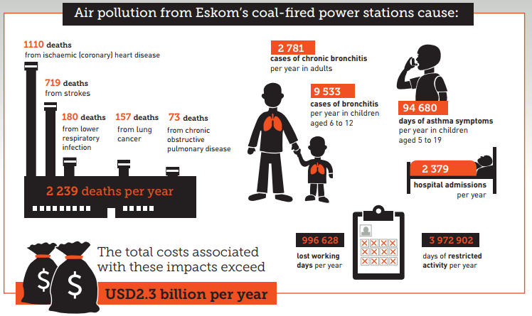
“Health impacts of coal fired power plants in South Africa”, 2017 https://cer.org.za/news/air-pollution-from-coal-power-stations-causes-disease-and-kills-thousands-of-south-africans-every-year-says-uk-expert

Slide 9
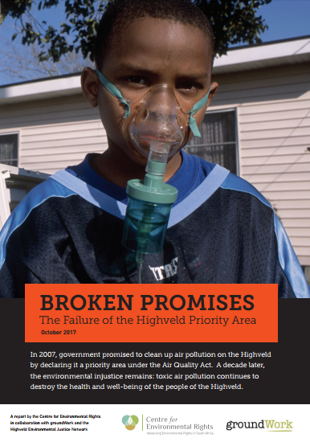

Slide 10
“Broken Promises”, 2017 https://cer.org.za/news/broken-promises-the-failure-of-south-africas-priority-areas-for-air-pollution-time-for-action
Broken Promises was launched on 2 October 2017, and highlights these health impacts, and many other problems with the PAs (with a focus on the Highveld Priority Area (HPA)).
The report makes a number of key recommendations that authorities should implement to demonstrate that improving air quality in the PAs is, in fact, a priority for government. These measures are the minimum steps required for the state to meet its constitutional obligations in terms of the environmental right and for all authorities to meet their obligations under the Air Quality Act.
For eg, calls for: HPA facilities to comply with the MES, with the National Air Quality Officer (NAQO) to review the MES postponements that were granted; no further MES postponements being permitted (or other atmospheric emission licence (AEL) variations that allow exceedances of emission limits), and for AEL licensing authorities to suspend the issuing of all new AELs in the HPA, until there is consistent compliance with all NAAQS.
4 months later, no response from the Department of Environmental Affairs (DEA).

Slide 11
More Eskom MES postponements
Eskom has now applied for a further postponement of MES compliance for Tutuka for the 2015 PM limit. Although it was already granted a postponement for almost 5 years, Eskom seeks a further 5 year postponement of the PM 2015 MES: instead of complying with 100mg/Nm³ by 15 April 2015, it now seeks to do so only by 2025. Its current licensed emission limit is already exceptionally lenient - 3.5 times the 2015 MES; and from 2019, will be double the MES. It is clear that Eskom has not taken sufficient steps in the interim to ensure compliance with the postponed limits.
Eskom will also “shortly be starting a programme to apply for postponement for most of their coal fired power stations, for a variety of pollutant types”. We have asked for a schedule as to when to expect which postponements, but have not yet received this.

Slide 12

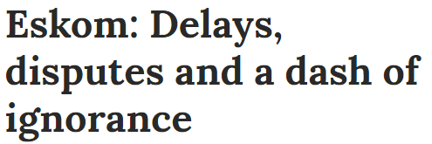
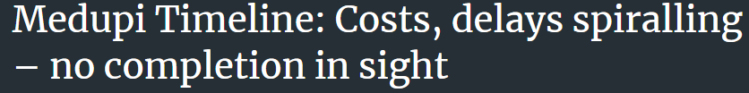




SO2 and Medupi

Slide 13
Eskom only intends to meet the 2020 MES for Kusile (which has flue gas desulphurisation (FGD) integrated into its design, and for Medupi – which will have FGD retrofitted onto each unit).
Eskom’s loan agreement with the World Bank (WB) states that it is required to retrofit FGD within 6 years of each of Medupi’s 6 units being commissioned.
The environmental impact assessment (EIA) process for authorisation to retrofit FGD has been stalled for years. The draft environmental impact report is awaited for comment. As a result, the retrofitting of the first unit is still some way from commencement.

Slide 14
Since 2014, given the delays in Eskom’s overall construction programme, we have argued that FGD should be integrated into the design and construction of as many units as possible (as it is for Kusile). Eskom has refused to do this, for reasons that are not clear.
The massive delays in its construction programme clearly provide the opportunity for Eskom to integrate FGD into the last 3 units of Medupi. There is also sufficient water to do so, and this approach could result in some cost savings - compared with retrofitting FGD.
Eskom has identified wet FGD as the most effective means to abate SO₂ emissions. Although a specialist study revealed that a flue gas cooler would reduce water consumption by up to 30% (and would be cost-neutral), Eskom has yet to confirm that this cooler will be implemented, eventually indicating at the end of 2016 that this would be included in the next report as a design alternative.

Slide 15
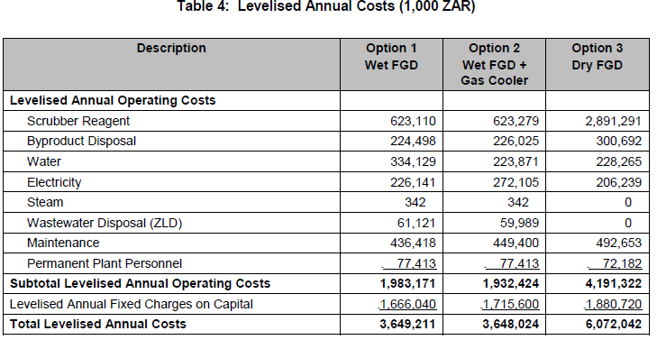
This table, from this Technology Selection Study, shows the costs of wet FGD, with and without the cooler, and of dry FGD.

Slide 16
Eskom had re-applied for postponement of the SO₂ 2015 MES for Medupi and Matimba, despite its previous application being rejected in 2015. The outcome remains outstanding.
A joint African Development Bank (AfDB) and WB Mission in early 2017 expressed concern about Medupi’s non-compliance with the 2015 MES for SO₂. “The Mission again suggested that Eskom seriously consider an interim strategy to control SO2 emissions for the next six years before the SO2 scrubbers (FGD) are operational. Previous suggestions have included the consideration to adopt a direct furnace limestone injection program which has been tested in the USA and in Europe and shown to reduce SO2 emissions by up to 50%. A field testing program with this technology on Unit #6 or 5 to obtain technical confidence had been suggested earlier, which the Mission reiterated for Eskom's serious consideration” (our emphasis).
Eskom has told us that it has considered this option, but provided no information as to why it has not implemented it.
We call upon Eskom to: integrate FGD into as many of the outstanding units’ design and construction as possible; ensure the use of the flue gas cooler; and adopt a direct furnace limestone injection programme to reduce SO₂ emissions in the interim. If Eskom will not implement these measures, it should provide a detailed justification for this refusal to DEA, this committee, and interested and affected parties.

Slide 17
MES postponement requirements not met
Among other requirements:
  postponement applications are only permitted to be made “provided [NAAQS] in the area are in compliance and will remain in compliance even if the postponement is granted”;
  applicants must be able to “demonstrate” that the “facility’s current and proposed air emissions are and will not cause any adverse impacts on the surrounding environment”; and
  MES exemptions are illegal. “Rolling postponements” – reapplying for postponements until eventual decommissioning (Eskom’s plan for at least 2020 SO₂ MES for all stations except Medupi and Kusile) – are equivalent to unlawful exemptions.
Eskom and Sasol should not be permitted to apply for postponements. All of their operations are in PAs where NAAQS are out of compliance - primarily as a direct result of Eskom and Sasol’s emissions in those areas. And there is a wealth of research and evidence – including health impact reports Eskom itself have commissioned – that starkly demonstrates the enormous health impacts of its operations.

Slide 18
Costs and “offsets”
We are aware of Eskom’s significant financial and other challenges. In order to survive, Eskom will have to restructure its operations significantly. Ideally, it should transform itself to become the owner of significant renewable energy assets and promote clean, healthy, affordable energy for all South Africans.
It is also correct that compliance with the new plant MES for SO₂ is significantly more expensive than, for example, interventions towards better management of waste-burning and veld fires, cleaner-burning heating and/or cooking devices, or better-insulated homes (some air quality “offsets” Eskom and Sasol have proposed).
These are all important measures that must be taken – and should have been done many years ago, but the dire impacts of industrial emissions on human health cannot and will not be “offset” in this way. Air pollution from CFPSs and large industrial plants travel hundreds of kilometres, affecting millions of people. It is not scientifically possible to “cancel out” industrial emissions through “offsets”. Protecting human health is government’s own constitutional responsibility. Good RDP homes and proper waste and fire management should not be outsourced to corporates as an alternative to meeting the MES.

Slide 19
Economic benefits of compliance
The Environmental Protection Agency (EPA) weighed the costs of compliance against the benefits of air emissions standards for CFPSs in its 2016 mercury and air toxics standards (MATS) for power plants: 81 Fed. Reg. 24421 (April 25, 2016).
EPA found that the benefits of MATS are substantial, and that for every dollar spent to reduce toxic pollution from power plants, the American public would see up to 9 dollars in health benefits. EPA estimated that the final MATS would “yield total annual monetized benefits of between $37 billion to $90 billion using a 3-percent discount rate and $33 billion to $81 billion using a 7-percent discount rate in addition to many categories of unquantified benefits in comparison to the projected $9.6 billion in annual costs:” 81 Fed. Reg. 24421.
The EPA has also emphasised that basing decisions on formal cost-benefit analysis would be inconsistent with the purposes of the Clean Air Act because “there are many societal values — such as protecting the most vulnerable” that “could never be reduced to a monetary value”: Supplemental Finding, 81 Fed. Reg. at 24,430 (April 25, 2016).

Slide 20
Eskom’s plans for its CFPSs
We understand the reluctance to spend vast sums of money retrofitting stations that will be decommissioned in the near future. However, since we are dealing with ongoing violations of constitutional rights, simply granting continuous postponement applications and allowing such toxic levels of pollution to continue to be emitted is in conflict with the state’s constitutional obligations.
Where Eskom cannot comply with the MES, it must expedite the decommissioning of its stations, particularly as it already has a surplus of generating capacity. Eskom has consistently maintained that no decision on the possible decommissioning of CFPSs has been made, and that it has no decommissioning plans or funding for the EIAs required for decommissioning. In fact, it is investigating extending their lives (despite the fact that the CFPSs have 50 year design lifespans and SA’s international climate change commitments assume their decommissioning after 50 years).
In fact, a 2017 “socio-economic study” commissioned by Eskom, reveals that “renewing the stations” for another 50 years – by demolishing and rebuilding them – is also under investigation.

Slide 21
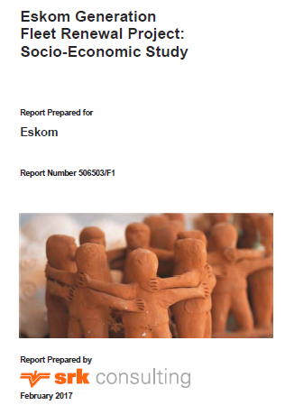

Slide 22
“Eskom Generation Fleet Renewal Project: Socio-Economic Study”, 2017 https://cer.org.za/wp-content/uploads/2018/02/Final-SIA-ReportEskom-SRK-severed-print.pdf
SRK’s socio-economic study, evaluates options to: “refurbish” (extending life by 20 years), “demolish and rebuild” (extending life by 50 years), or decommission 4 of its oldest plants: Hendrina, Arnot, Komati, and Camden. The report concludes that refurbishment and demolition and rebuilding (which both apparently assume the installation of FGD) were the preferred options in that “their implementation would lead to continued maintenance of current employment (of 2243 Eskom employees), as well as creating new employment opportunities into the future”.
This report has serious flaws – for eg, it does not include any cost analysis of any of the options, nor their climate change implications, and ignores the fact that Eskom already has a significant surplus in capacity (capacity: 49 222 MW, average demand: 26 000 MW and peak demand: 34 122 MW (Eskom Integrated Report 2016/17) and that there is little or no demand for power from these CFPSs. There will not be significant future job opportunities in coal. In keeping with the global move away from coal, Eskom should be actively planning, together with its workers, for a just transition to renewable energy, rather than risk stranding the workforce, along with redundant CFPSs.

Slide 23
“Eskom’s financial crisis and the viability of coal-fired power in South Africa”, 2017 http://meridianeconomics.co.za/wp-content/uploads/2017/11/Eskoms-financial-crisis-and-the-viability-of-coalfired-power-in-SA_ME_20171115.pdf
Meridian Economics study: without an impact on security of supply, Eskom should accelerate the decommissioning of Hendrina, Grootvlei, and Komati, and curtail the completion of Kusile units 5 and 6 in order to save up to R17 billion. These estimates exclude additional large savings in the impact on human health, local environment, and climate change that will result.
Part of the savings realised could be used to cushion the impacts on workers and communities, and provide support for, for eg, retraining, skills development, and relocation.

Slide 24
Conclusion and recommendations
We make the following urgent calls (in addition to those in Broken Promises):
for Eskom, at Medupi, to confirm that:
  it will integrate FGD into as many units’ design and construction as possible;
  it will ensure that the flue gas cooler is used;
  it will adopt a direct limestone injection programme to reduce SO₂ emissions in the interim; and
  if it does not implement these measures, it will provide a detailed justification for this refusal to DEA, this committee, and interested and affected parties;
for Eskom and Sasol to produce a plan for expedited closure of their coal-based plants, including Medupi and Kusile;
for Eskom and Sasol to provide a complete list – to us, to the DEA and to this committee – of all postponement applications they intend to make (for which stations and units, for which pollutants, and for which periods) and by when;
for Eskom and Sasol to provide full details – to us, to the DEA, and to this committee – of all instances in which they do not foresee ever meeting the MES ; and
for the DEA to provide a comprehensive response to the Broken Promises report.

Slide 25
Centre for Environmental Rights
Pollution & Climate Change Programme
Tel: 021 447 1647
Email: rhugo@cer.org.za
Web: www.cer.org.za
Facebook: @CentreEnvironmentalRights
Twitter @CentreEnvRights

