Slide 1
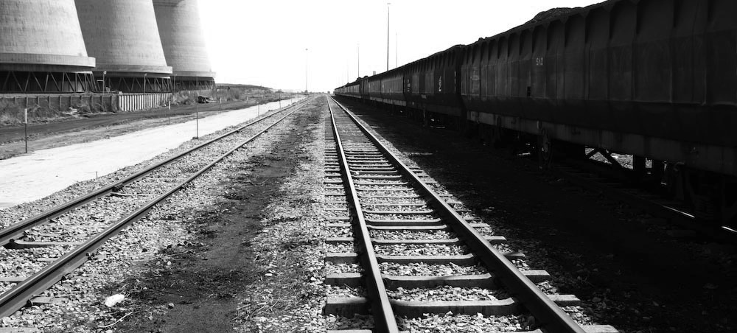
PRESENTATION TO PORTFOLIO COMMITTEE ON POLICE
ON CRITICAL INFRASTRUCTURE PROTECTION BILL, 2017
30 January 2018

Slide 2
INDEX
AGENDA
1. HIGH LEVEL GAUTRAIN PUBLIC PRIVATE PARTNERSHIP STRUCTURE
2. IMPLICATIONS OF CRITICAL INFRASTRUCTURE PROTECTION BILL IN RELATION TO GAUTRAIN PPP
  RECOMMENDED SOLUTION
4. INTERACTIVE ENGAGEMENT
© Gautrain Management Agency

Slide 3
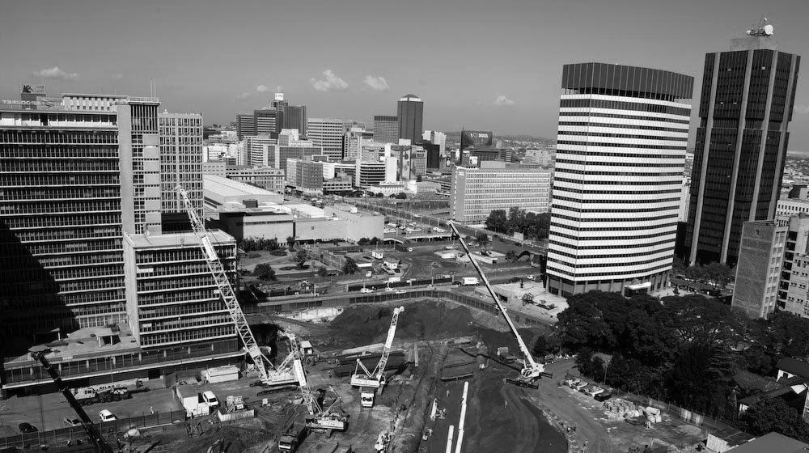
HIGH LEVEL GAUTRAIN PUBLIC PRIVATE PARTNERSHIP STRUCTURE

Slide 4

HIGH LEVEL GAUTRAIN PUBLIC PRIVATE PARTNERSHIP STRUCTURE
Gauteng Province is the Public Partner in Concession Agreement.
Gautrain Management Agency is mandated, amongst others, to:
Bombela Concession Company (“the Concessionaire”) was appointed to design, build, operate, maintain, and partially finance the Gautrain project.
Funds and owns the Gautrain System.
Act on behalf of the Gauteng Province in managing the relationship between Province and the Concessionaire;
Ensure that the interests of the Province are protected;
Manage assets relating to the Gautrain project, and promote their preservation and maintenance; and
Exercise the rights and perform the duties of the Province in terms of the Concession Agreement.

Slide 5
HIGH LEVEL GAUTRAIN PUBLIC PRIVATE PARTNERSHIP STRUCTURE
The Operator is subcontracted by the Concessionaire to operate and maintain the Gautrain System.
Mega Express is contracted by the Operator to run the Gautrain Dedicated Feeder and Distribution Service (bus shuttle service).

Slide 6
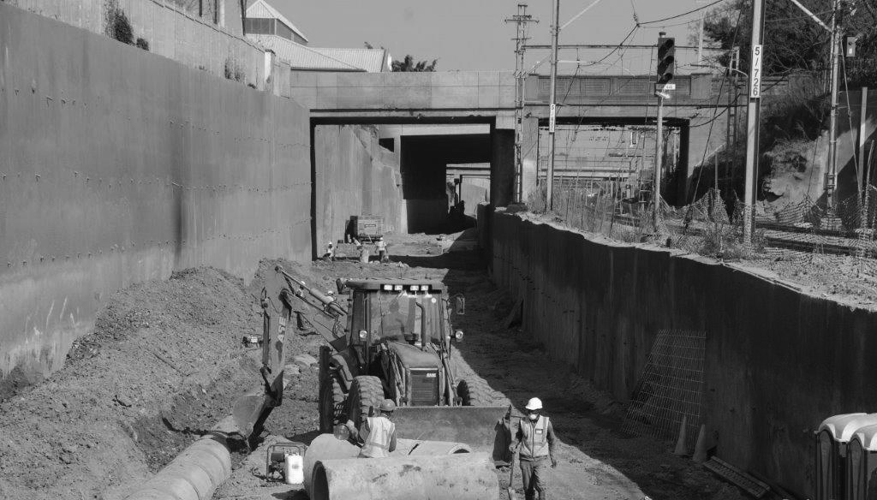
IMPLICATIONS OF CRITICAL INFRASTRUCTURE PROTECTION BILL IN RELATION TO GAUTRAIN PPP

Slide 7

IMPLICATIONS OF CRITICAL INFRASTRUCTURE PROTECTION BILL IN RELATION TO GAUTRAIN PPP
Owner of Gautrain System
Is an agent of the Gauteng Provincial Government, and is responsible for the administration (oversight and management) of the Gautrain System as per the GMA Act
Possesses and is in control of the Gautrain System through the Concession Agreement
Responsible for the operation and administration of the Gautrain System through the Operating Contract
Possesses Gautrain buses, and responsible for the maintenance of the Gautrain Dedicated Feeder Service Distribution Service infrastructure as per agreement with BOC
© Gautrain Management Agency

Slide 8
IMPLICATIONS OF CRITICAL INFRASTRUCTURE PROTECTION BILL IN RELATION TO GAUTRAIN PPP
The Bill defines a “person in control of critical infrastructure” as, amongst others, “the owner”; a person who “occupies, possesses, is in control of, or is responsible for the operation or administration” of critical infrastructure; or “the head of any organ of state who occupies, possesses, is in control of, or is responsible for the operation or administration of a critical infrastructure”.
Against the background outlined in previous slides, the practical connotations of the above definition are that:
  either the Gauteng Provincial Government, the Gautrain Management Agency, Bombela Operating Company, Bombela Operating Company, or Mega Express could unilaterally apply for declaration of Gautrain infrastructure, they are responsible for, as critical infrastructure;
  despite any of the said parties not having been consulted, by the other, prior to an application for declaration as critical infrastructure being lodged, a party could be held responsible for the implementation of security measures prescribed in clauses 24 and 25 of the Bill; and
  similarly, a tenant could, given the current definition, apply for declaration of rented infrastructure as critical infrastructure, without the prior consent of the landlord.
© Gautrain Management Agency

Slide 9
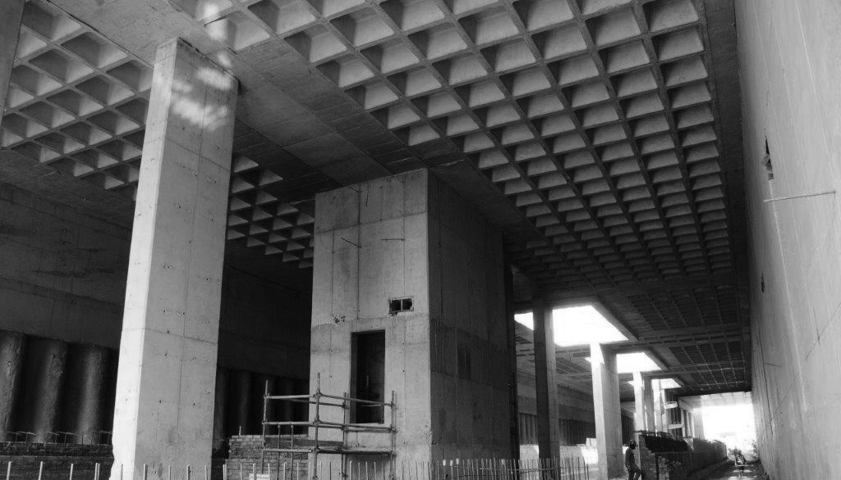
RECOMMENDED SOLUTION

Slide 10
RECOMMENDED SOLUTION
Insertion of a proviso, in a new clause 24(9) of the Bill, to the effect that in a Public Private Partnership, the private partner is responsible for the discharge of the duties prescribed in clause 24 of the Bill, which reads:
“(9) To the extent that a Concession Agreement, or similar arrangement, exists in respect of critical infrastructure, the Concessionaire, or its equivalent, shall be responsible for the discharge of the responsibilities prescribed in this section and section 25”.
Insertion of a proviso, in clause 18(1) of the Bill, to the effect that an application for declaration of infrastructure, that is subject to a Public Private Partnership, as critical infrastructure, may only be lodged by a head of an organ of state which owns, is in control of, or is responsible for the administration of that infrastructure. The following wording is proposed:
© Gautrain Management Agency

Slide 11
RECOMMENDED SOLUTION
“18. (1) A person in control of an infrastructure may, in the prescribed manner and format, lodge with the National Commissioner an application contemplated in section 16(1) to have such infrastructure declared as critical infrastructure; provided that, in case of infrastructure in respect of which a Concession Agreement or similar arrangement exists, only the head of an organ of state that owns, is in control of, or is responsible for the administration of the infrastructure may lodge such an application ”.
A proviso similar to the above is recommended in respect of leased infrastructure the owner of which is not an organ of state.
© Gautrain Management Agency

Slide 12
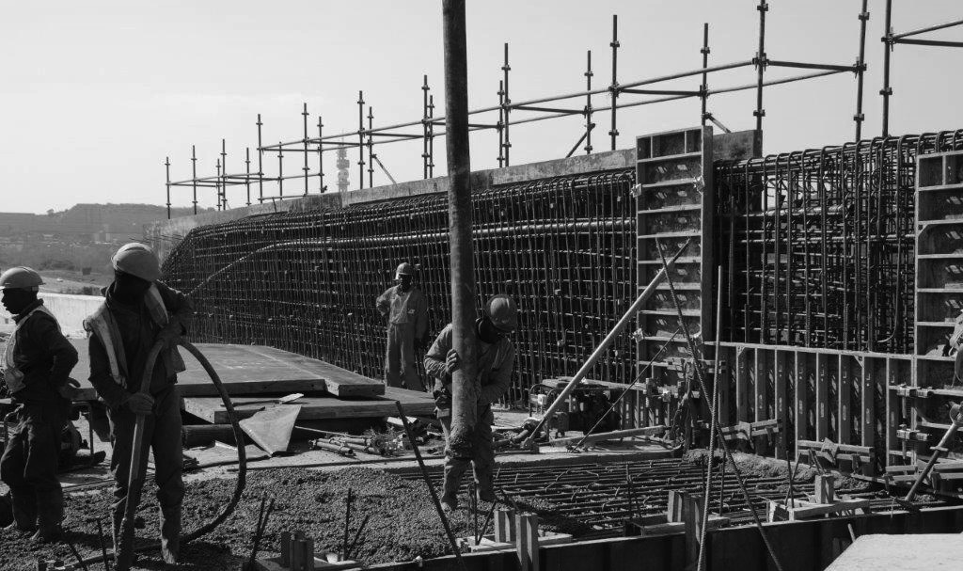
INTERACTIVE ENGAGEMENT

Slide 13


THANK YOU
SMS “Alert” to 32693 for service updates
44 Grand Central Boulevard Grand Central ext. 1 Midrand | PO Box 1266, Kelvin, 2054
Telephone: +27 (0) 11 086 3500 | Email: info@gautrain.co.za | www.gautrain.co.za

