Slide 1
COMMUNAL PROPERTY ASSOCIATIONS AMENDMENT BILL
PRESENTATION ON PUBLIC COMMENTS AND RESPONSES
PORTFOLIO COMMITTEE
30 JANUARY 2018

Slide 2
From the Public (1)
Clause | Comment | Response
1 | In addition to community, define beneficiaries. | Not necessary, beneficiaries are identified in the constitution of a CPA. See item 5 of Schedule to Act.
2 | Act/Bill must not apply to areas under traditional councils. Application of Bill to labour tenants deprives them of right to property. | Act/Bill law of general application and applies throughout the Republic. Members of traditional councils not precluded from being members of CPAs. Labour tenants are not compelled to establish CPAs. They have a choice. The Bill is simply enabling.

Slide 3
From the Public (2)
Clause | Comment | Response
3 | Requirement for general plans onerous and not necessary on land owned communally. | Plans are necessary in relation to spatial planning and land use management in general. Communal areas are developing and in some areas towns are being built e.g. Lephalale, Moruleng, Hammanskraal, Bafokeng, Sekhukhune, et al. Planning is not only necessary but inevitable.
 | Powers of the Registrar: letter for opening bank accounts (sec 9(1)(iii)(aa)), dissolving CPA committees (sec 11(6)(d)) interfere with right of property. | Regulation of CPAs necessitates closer monitoring of entities responsible for managing and administering community property. Powers are aimed at protecting communities against acts of impropriety by committee members.

Slide 4
From the Public (3)
Clause | Comment | Response
7 | The 60% majority required to adopt a CPA constitution is onerous and impractical. | The simple majority that is currently in the Act has led to complaints that decisions are made without consulting sufficiently with the members. Increasing the percentage seeks to ensure sufficient consensus.
8 | The amendment changing the power of a CPA from holding property to administering and managing property interferes with the right to ownership. | The amendment seeks to clarify ownership and does not take away any right of ownership. It seeks to make it clear that it is the community, not the CPA in isolation, that owns the property. CPA committee members have been dealing with property as owners and the amendment seeks to make it clear that the property belongs to a community.

Slide 5
From the Public (4)
Clause | Comment | Response
8 | It also amounts to expropriation. | There is no expropriation of property as the state does not own the property.
12 | The 60% majority required to sell property onerous, impractical and interferes with right of ownership. | The percentage increased to ensure sufficient consensus on any acts aimed at disposing of community property.
 | The consent of the Minister required to dispose of the property onerous and interferes with right of ownership. | The requirement for the Minister’s consent is aimed at protecting the community against possible acts of impropriety by CPA committee members.

Slide 6
From the Public (5)
Clause | Comment | Response
12 | The right of first refusal granted to the Department in relation to the disposal of property is unfair and also interferes with the right of ownership. | The property was obtained at a cost to the state in the first instance. It is only fair that should the community desire to dispose of it, the state must be given preference.

Slide 7
Organizations
Organization | Comment | Response
LRC | The Bill/Act must recognise that CPAs also exist in traditional areas and therefore must also recognise customary law as an applicable legal system. | The Act/Bill does not exclude the application of customary law in areas where CPAs are established. However, the Act and the CPA constitution regulate CPAs and community/beneficiaries.
ARD | A clause must be inserted to allow persons or groups to amicably withdraw from a CPA. | The Act provides for this option in the Schedule. Item 9 provides that the constitution of a CPA must address the grounds and procedure for terminating membership, and what happens to the rights and property of the member concerned.

Slide 8
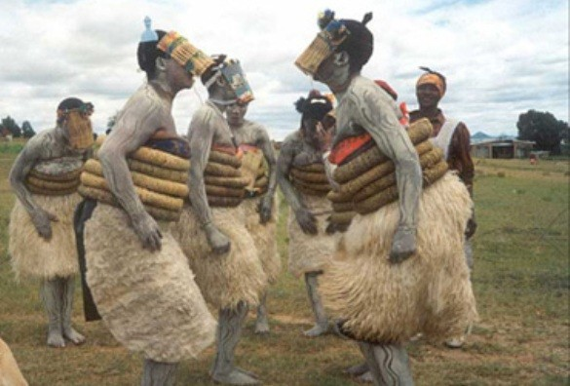
RE A LEBOGA

