Slide 1

PRESENTATION TO THE PORTFOLIO COMMITTEE ON AGRICULTURE, FORESTRY AND FISHERIES
ON 30 JANUARY 2018
DEPARTMENT OF AGRICULTURE, FORESTRY AND FISHERIES
QUARTER 2 PRELIMINARY
ORGANISATIONAL PERFORMANCE REPORT FOR 2017/18 AND
ADDRESSING ISSUES AS REQUESTED BY THE PORTFOLIO COMMITTEE ON AGRICULTURE, FORESTRY AND FISHERIES
1

Slide 2
PRESENTATION OUTLINE
STRUCTURAL ARRANGEMENTS
SECTOR MTSF PROGRESS
SUMMARY OF QUARTER 2 PRELIMINARY PERFORMANCE
Targets Achieved and Not Achieved – Programme 1
Targets Achieved and Not Achieved – Programme 2
Targets Achieved and Not Achieved – Programme 3
Targets Achieved and Not Achieved – Programme 4
Targets Achieved and Not Achieved – Programme 5
Targets Achieved and Not Achieved – Programme 6
CHALLENGES AFFECTING NON-ACHIEVEMENT PLUS CORRECTIVE ACTION
DAFF EXPENDITURE PER ECONOMIC CLASSIFICATION AS AT 29 JANUARY 2018
FINANCIAL STATEMENTS
HIGHLY PATHOGENIC AVIAN INFLUENZA H5N8 IN SOUTH AFRICA

Slide 3
PRESENTATION OUTLINE
TRANSFORMATION IN THE SECTOR
GUIDING FRAMEWORK FOR THE IMPLEMENTATIN AND MONITORING OF CASP FUNDED PROJECTS AND THE USE OF R60 MILLION
DISCIPLINARY ACTIONS
DEREGISTRATION OF NCERA FARMS
FINANCIAL TRANSFERS FROM OTHER DEPARTMENTS
PROGRESS REPORT ON THE REVIEW OF THE MARINE LIVING RESOURCES ACT
PROGRESS REPORT ON DAFF’S AUDIT PLAN AND ARC AUDIT IMPROVEMENT PLAN
VREDE DAIRY PROJECT
OTHER ISSUES
PRESERVATION AND DEVELOPMENT OF AGRICULTURAL LAND BILL
AQUACULTURE BILL
POLICY ON COMPREHENSIVE PRODUCER DEVELOPMENT SUPPORT

Slide 4
STRUCTURAL ARRANGEMENTS
DAFF has six programmes
4

Slide 5
SECTOR MTSF PROGRESS
MTSF target | MTSF Progress (2014/15 – 2017/18 till Q2) | Balance towards achieving MTSF target | Impact
300 000 jobs created | 288 837 | -11 163 | Improved livelihoods
1 million hectares (HA) of unutilised land under production | 1 822 563 ha | +822 563 HA | Improved food security
80 000 smallholder producers supported | 192 929 | +112 929 | Productive and enhanced participation in the economy.
152 500 hectares of land under rehabilitation | 103 093.01 ha | -49 406.99 | Improved natural resources and improved food security
1.6 million households benefiting from food security and nutrition initiatives | 4 010 838 | +2 410 838 | Improved Food security

Slide 6
SUMMARY OF QUARTER 2 PRELIMINARY PERFORMANCE
QUARTER 2 PRELIMINARY
PROGRAMME | QUARTER 2 MILESTONES | COMPLETED | IN PROGRESS | NOT DONE | % COMPLETED
Office of the Director General | 2 | 1 | 1 | 0 | 50%
Corporate Services | 6 | 2 | 4 | 0 | 33%
Chief Financial Office | 1 |  | 1 | 0 | 0%
Policy, Planning and Monitoring and Evaluation | 7 | 5 | 2 | 0 | 71%
Agricultural Production, Health and Food Safety | 8 | 5 | 3 | 0 | 63%
Food Security and Agrarian Reform | 4 | 2 | 2 | 0 | 50%
Trade Promotion and Market Access | 8 | 7 | 0 | 1 | 88%
Forestry and Natural Resources Management | 6 | 4 | 2 | 0 | 67%
Fisheries Management | 9 | 5 | 3 | 1 | 56%
TOTAL | 51 | 31 | 18 | 2 | 61%

Slide 7
TARGETS ACHIEVED AND NOT ACHIEVED – PROGRAMME 1
Achieved | Not Achieved
2017/18 Quarter 1 report Approved by the Audit Committee | Conduct project risk Assessment
Approved training quarterly report submitted to PSETA | Review of core directorates business continuity
Structured stakeholder engagements coordinated (CEO’s Forum/Committee, Minister’s Service Delivery Forum, commodity groups/sector stakeholders) | 100% submission of 2016/17 annual assessments report
Sector economical and statistics baseline information for quarter 2 compiled and updated | Training of business continuity champions with accredited service provider
Present Reviewed ICT DRP to internal stakeholders (ICT Control Advisory Board (CAB) and Departmental Information Technology Committee (DITC)
Consultation with branches on the of the Master System Plan (MSP)

Slide 8
TARGETS ACHIEVED AND NOT ACHIEVED – PROGRAMME 1
Achieved | Not Achieved
1 quarterly project on verified projects with recommendations submitted to EXCO for approval | Submission to EXCO for approval and recommendation to MINMEC on the Draft Integrated AFF Finance Policy
Report on the monitoring of the Sector Research Agenda | Key strategic intergovernmental engagements coordinated (MINMEC, MINTECH, IGR Forum, Imbizo)
Implemented the media plans as captured in the APPs - Nelson Mandela Day; #YAFF; DAFF Female Entrepreneur Awards and Arbor Week
Annual report on the implementation of the Sector Research Agenda through the RTF programme submitted to EXCO

Slide 9
LIST OF TARGETS (ACHIEVED AND NOT ACHIEVED – PROGRAMME 2
Achieved | Not Achieved
Monitoring report on seed crops and seed potato schemes | Collect data from KyD and poultry participants
Document and analyse surveillance results | Manage surveillance actions, verify and analyse collected information
Quarterly report on regulatory interventions implemented (Quarantine inspections, surveillance and testing) | Notification to applicants on approved placements
Document and characterise prioritised accessions of PGRFA (Plan for Conservation and Sustainable Use of Plant Genetic Resources for Food and )
Conduct research on cultural and economic importance of indigenous breeds

Slide 10
TARGETS ACHIEVED AND NOT ACHIEVED - PROGRAMME 3
Achieved | Not Achieved
Needs analysis for 2018/19 intake of graduates conducted | Quarterly review report on National Food and nutritional security interventions coordinated
Provincial extension coordinating forums operational in one province - North West (NW) | National Policy on Comprehensive Producer Development Support recommended by MINTECH, MINMEC

Slide 11
TARGETS ACHIEVED AND NOT ACHIEVED - PROGRAMME 4
Achieved | Not Achieved
Quarterly progress report of SA-GAP certification programme | Consult public on Enforcement Regulation
4 commodity-based cooperatives established
35 cooperatives supported with training
Report on the implementation and negotiations of trade agreements
Report on coordination of bilateral and multilateral cooperation engagement
Report on coordination of strategic engagement of partners within Africa and African agencies
Progress report on compliance to African Union (AU) and Southern African Development Community (SADC) obligations

Slide 12
TARGETS ACHIEVED AND NOT ACHIEVED - PROGRAMME 5
Achieved | Not Achieved
Consultation with stakeholders on the Agro Forestry Concept document | Adoption of community resolution on the entity adopted
100 hectares of state indigenous forests rehabilitated | Midterm performance monitoring report on agricultural land rehabilitation interventions
Tabling for inputs and comments at ASRD/STC
3 – provincial stakeholders Consultation workshops to solicit and consolidate inputs and comments

Slide 13
TARGETS ACHIEVED AND NOT ACHIEVED - PROGRAMME 6
Achieved | Not Achieved
Progress report on integrated production methods within production systems | Aquaculture Development Bill submitted to Cabinet
10 operations compliance= 4 monitoring and surveillance= 3 fisheries protection vessels = 3 | Allocate Rights in the abalone and West Coast rock lobster sector
700 compliance= 400 Fisheries protection vessels = 300
69 investigations conducted on Operation Phakisa initiatives (Oceans Economy)
1 Operation Phakisa project supported
Finalised received Appeals in the 3 allocated fishing sectors
Research reports to update status of fish stocks and recommend catch limits to achieve recovery targets

Slide 14
CHALLENGES AFFECTING NON-ACHIEVEMENTS
Cause | Targets affected | Progress Report/Planned action
Finalisation delays within specific timeframe | Conduct project risk assessment | An analysis report regarding non compliance and recommendation will be issued
 | Consultation with branches on the review of the MSP | Further follow-up with the relevant branches was done in Q3 to finalise the MSP review
 | 100% submission of 2016/17 annual assessments report | The executive management has approved the implementation of consequence management for non-compliance
 | Key strategic intergovernmental engagements coordinated (MINMEC, MINTECH, IGR, Forum, Imbizo) | Consolidated report undergoing approval process

Slide 15
CHALLENGES AFFECTING NON-ACHIEVEMENTS ….
Cause | Targets affected | Progress Report/Planned action
Finalisation delays within specific timeframe | Draft Integrated Development Finance Policy submission to EXCO for approval and recommendation to MINMEC | The chapter on the Integrated Agriculture, Forestry And Fisheries Development Finance has been included in the Comprehensive Producer Development Policy
 | Annual report on the implementation of the Sector Research Agenda through the Research Technology Fund (RTF) programme submitted to EXCO | The report was tabled for departmental approval committees on the 24th November 2017
 | Mid-term performance monitoring report on agricultural land rehabilitation interventions | The report was finalised during quarter 3
 | Training of business continuity champions with accredited service provider | Training was conducted during quarter 3

Slide 16
CHALLENGES AFFECTING NON-ACHIEVEMENTS ….
Cause | Targets affected | Progress Report/Planned action
Finalisation delays within specific timeframe | Collect data from KyD and poultry participants | The report on poultry participants was tabled
 | Manage surveillance actions, verify and analyse collected information | The matter was tabled at MINTECH and a strategy to address the issue was developed
 | Notification to applicants on approved placements 126 CCS veterinarians to be deployed | The short fall will be addressed as follows Through the carry over graduates from the 2016/17 financial year (Student that could not complete their studies in 2016/17) 2017/18 SAVC veterinarians (Foreign Students)
 | Quarter 2 review report on National Food and nutritional security interventions coordinated | The National Food and Nutritional Security Coordinating Committee (NFNSCC ) addressed this matter on the 30th November and coordination of reporting by PDAs was addressed
 | Aquaculture Development Bill submitted to Cabinet | Bill has been recommended for presentation to Cabinet by the DG Cluster.
 | Research reports to update status of fish stocks and recommend catch limits to achieve recovery targets | Measures to fast-track validated evidence were adopted

Slide 17
CHALLENGES AFFECTING NON-ACHIEVEMENTS ….
Cause | Targets affected | Progress Report/Planned action
Finalisation delays within specific timeframe | National Policy on Comprehensive Producer Development Support recommended by MINTECH and MINMEC to Director General (DG) Cluster | The Policy has been tabled at MINTECH and was recommended for tabling at MINMEC
 | Public consultation on AgriBEE Enforcement Regulation | To implement the State Law Advisor recommendation. The recommendation given was for DAFF to develop Guidelines instead of Enforcement Regulations
 | Adoption of community resolution on the Establishment of legal entity | The agreement has been requested from the communities to submit the legal entities that they have registered already
 | Allocate Rights in the abalone and West Coast rock lobster sector | The rights allocation for the Abalone has been reserved for the next financial year based on Ministerial decision
 | Review of core directorates business continuity | The Business Continuity Steering Committee to strengthen respective business continuity plans

Slide 18
CHALLENGES AFFECTING NON-ACHIEVEMENTS ….
Cause | Targets affected | Progress Report/Planned action
Budget constraints | Training of business continuity champions with accredited service provider | Budget has been secured to conduct the training during the current financial year

Slide 19
DAFF EXPENDITURE PER ECONOMIC CLASSIFICATION AS AT
29 JANUARY 2018
Agriculture, Forestry and Fisheries |  |  |  |  | Expenditure as on 29/01/2018
Economic classification | Budget | Exp | % | Earmarked | Available
 | R'000 | R'000 |  | R'000 | R'000
Compensation of employees | 2 100 236 | 1 725 979 | 82,2 | - | 374 257
Goods and services | 795 589 | 626 604 | 78,8 | 133 696 | 35 289
Interest and rent on land | 1 003 | 952 | 94,9 | - | 51
Payments for financial assets | - | 184 | #DIV/0! | - | (184)
Transfers and subsidies | 3 821 394 | 3 667 145 | 96, | - | 154 249
Payments for capital assets | 128 812 | 87 285 | 67,8 | 995 | 40 532
 | 6 847 034 | 6 108 149 | 89,2 | 134 691 | 604 194

Slide 20
FINANCIAL STATEMENTS
PROGRAMME 1: ADMINISTRATION
Annual Target | 2017/18 Budget R' 000 | Q1 Actual R' 000 | Q2 Actual R' 000 | Q3 Actual R' 000 | Q4 Actual R' 000 | Total Actual R' 000
Risk Management implementation plan implemented | 2 847 | 673 | 673
Annual risk-based Internal Audit implemented | 7 294 | 2 044 | 1 826
Core Directorates Business Continuity Plan approved by EXCO (EXCO) Crisis Management Plan approved by EXCO | 1 320 | 330 | 330
Reviewed ICT DRP approved by the DG | 3 850 | 957 | 957
Draft Integrated Development Finance Policy submitted to the Social and Economic Clusters for approval and recommendation to Cabinet | 100 | 25 | - |  |  | 25
2017/18 Workplace Skills Plan approved by the DG and implemented | 8 612 | 672 | 3 315 |  |  | 3 987
100% adherence to the Performance Management and Development System by all staff | 110 | 11 | 36 |  |  | 47
3 Bills submitted to Minister | 7 751 | 1 444 | 1 468 |  |  | 2 912
20 Inter-governmental Relations Forums coordinated | 4 835 | 1 343 | 1 384 |  |  | 2 727

Slide 21
PROGRAMME 1: ADMINISTRATION .…
Annual Target | 2017/18 Budget R' 000 | Q1 Actual R' 000 | Q2 Actual R' 000 | Q3 Actual R' 000 | Q4 Actual R' 000 | Total Actual R' 000
23 functional institutional structures coordinated | 4 657 | 1 178 | 1 247 |  |  | 2 425
Media plans implemented | 15 556 | 3 001 | 8 476 |  |  | 11 477
Updated economical and statistics information for the sector | 26 242 | 6 233 | 6 325 |  |  | 12 558
Sector research agenda monitored | 1 233 | 350 | 776 |  |  | 1 126
Sector research agenda implemented through the RTF programme | 17 310 | 17 310 | - |  |  | 17 310
4 quarterly project verification reports submitted to EXCO for approval | 5 465 | 1 452 | 1 762 |  |  | 3 214
Total for targets | 107 182 | 37 023 | 28 575 |  |  | 65 598
Total budget/actual per programme | 902 473 | 266 363 | 186 917 |  |  | 453 280
% of targets budget/actual per programme | 12% | 14% | 15% |  |  | 14%

Slide 22
PROGRAMME 2: AGRICULTURAL PRODUCTION, HEALTH AND FOOD SAFETY
Annual Target | 2017/18 Budget R' 000 | Q1 Actual R' 000 | Q2 Actual R' 000 | Q3 Actual R' 000 | Q4 Actual R' 000 | Total Actual R' 000
2 animal improvement schemes (Kaonafatso ya Dikgomo and poultry) implemented | 250 | - | 250 |  |  | 250
2 plant improvement schemes (seed crops and seed potato) implemented | 400 | 89 | 110 |  |  | 199
2 animal disease Risk surveillance conducted (Foot and Mouth disease protection zone and PPR) | 1 340 | 334 | 625 |  |  | 959
1 plant disease and pest risk surveillance conducted (exotic fruit fly) | 5 500 | 1 460 | 1 526 |  |  | 2 986
4 regulatory interventions implemented | 253 949 | 63 972 | 65 130 |  |  | 129 102
Draft policy on animal identification and traceability | 50 | 5 | - |  |  | 5

Slide 23
PROGRAMME 2: AGRICULTURAL PRODUCTION, HEALTH AND FOOD SAFETY .…
Annual Target | 2017/18 Budget R' 000 | Q1 Actual R' 000 | Q2 Actual R' 000 | Q3 Actual R' 000 | Q4 Actual R' 000 | Total Actual R' 000
130 veterinary graduates deployed to rural communities | 119 858 | 21 967 | 18 181 |  |  | 40 148
2 targeted taxa conserved ex-situ | 3 948 | 1 217 | 1 265 |  |  | 2 482
Promte conservation and sustainable use of indigenous breeds | 1 867 | 508 | 511 |  |  | 1 019
Total for targets | 909 301 | 150 384 | 196 360 |  |  | 346 744
Total budget per programme | 2 197 187 | 554 692 | 597 641 |  |  | 1 152 333
% of targets budget per programme | 41% | 27% | 33% |  |  | 30%

Slide 24
PROGRAMME 3: FOOD SECURITY AND AGRARIAN REFORM
Annual Target | 2017/18 | Q1 | Q2 | Q3 | Q4 | Total
 | Budget | Actual | Actual | Actual | Actual | Actual
 | R' 000 | R' 000 | R' 000 | R' 000 | R' 000 | R' 000
120 000 ha of underutilised land in communal areas cultivated for production | 522 139 | 60 832 | 108 762 |  |  | 169 594
120 690 ha of underutilised land in communal areas cultivated for production | 317 680 | 38 122 | 66 712 |  |  | 104 834
52 480 households supported with food production initiatives | 52 851 | 6 342 | 11 098 |  |  | 17 440
23559 smallholder producers supported | 558 699 | 78 217 | 145 262 |  |  | 223 479
Implementing the NETSAFF through placement of 30 graduates in APAP commodoties | 2 500 | - | - |  |  | -
Implement the National Policy on Extension and Advisory Service | 125 | 25 | 42 |  |  | 67
20 extension support practitioners deployed to commodity organisations | 200 | 27 | 4 |  |  | 31
Policy on comprehensive producer development support recommended by the intergovernmental structures | 220 | - | 36 |  |  | 36
255 graduates placed in agriculture, forestry and fisheries sectors for capacity development | 18 926 | 5 350 | 5 703 |  |  | 11 053
Total for targets | 951 201 | 128 083 | 228 857 |  |  | 356 940
Total budget per programme | 1 946 764 | 310 217 | 452 506 |  |  | 762 723
% of targets budget per programme | 49% | 41% | 51% |  |  | 47%

Slide 25
PROGRAMME 4: TRADE PROMOTION AND MARKET ACCESS
Annual Target | 2017/18 | Q1 | Q2 | Q3 | Q4 | Total
 | Budget | Actual | Actual | Actual | Actual | Actual
 | R' 000 | R' 000 | R' 000 | R' 000 | R' 000 | R' 000
Annual report on the implementation of the SA-GAP certification programme | 647 | 581 | 91 |  |  | 672
28 agro-processing entrepreneurs trained on processing norms and standards | 700 | - | 274 |  |  | 274
16 commodity -based cooperatives established | 4 513 | 1 126 | 1 123 |  |  | 2 249
118 cooperatives supported with training | 10 700 | 2 278 | 2 405 |  |  | 4 683
AgriBEE Enforcement Regulations published in Government Gazette | 1 255 | 218 | 250 |  |  | 468
Report on the implementation of Forest Sector Code government undertakings | 5 360 | 253 | 290 |  |  | 543
Implement trade agreements and participate in trade negotiations | 12 180 | 1 996 | 3 281 |  |  | 5 277
Report on the implementation of AgrI-BEE Sector Code government undertakings | 981 | 229 | 370 |  |  | 599

Slide 26
PROGRAMME 4: TRADE PROMOTION AND MARKET ACCESS CONT…
Annual Target | 2017/18 | Q1 | Q2 | Q3 | Q4 | Total
 | Budget | Actual | Actual | Actual | Actual | Actual
 | R' 000 | R' 000 | R' 000 | R' 000 | R' 000 | R' 000
Market opportunity profile plan | 1 983 | 399 | 1 088 |  |  | 1 487
Report on strategic engagement of partners within South - South, north south and multilateral agencies/forums | 87 535 | 51 973 | 13 444 |  |  | 65 417
Report on strategic engagement of partners within Africa and African Agencies | 10 867 | 3 718 | 3 199 |  |  | 6 917
Total for targets | 136 721 | 62 771 | 25 815 |  |  | 88 586
Total budget per programme | 261 706 | 115 281 | 34 184 |  |  | 149 465
% of targets budget per programme | 52% | 54% | 76% |  |  | 59%

Slide 27
PROGRAMME 5: FORESTRY AND NATURAL RESOURCES MANAGEMENT
Annual Target | 2017/18 | Q1 | Q2 | Q3 | Q4 | Total
 | Budget | Actual | Actual | Actual | Actual | Actual
 | R' 000 | R' 000 | R' 000 | R' 000 | R' 000 | R' 000
1 725 ha planted in TUPs | 16 550 | - | - |  |  | -
Draft Memorandum of Understanding for 2 pilot sites developed | 300 | 25 | 45 |  |  | 70
Establishment of 3 legal entities | 50 | 12 | 19 |  |  | 31
Revitalisation of 10 irrigation schemes (Vaalharts, Makhathini, Ebenhaeser, Disaneng, Taung, Woodridge, Matsika, Qamata, Keiskamahoek, Zanyokwe) | 90 600 | 12 684 | 4 987 |  |  | 17 671
300 ha woodlands and indigenous forests rehabilitated | 93 089 | 25 066 | 11 866 |  |  | 36 932
16 000 ha of agricultural land rehabilitated | 73 604 | 7 360 | 25 761 |  |  | 33 121
Climate Change Adaptation and Mitigation Plan for agriculture, forestry and fisheries approved by EXCO | 150 | 20 | 20 |  |  | 40
Draft Climate Smart Agriculture Strategic Framework developed | 1 231 | 428 | 777 |  |  | 1 205
Total for targets | 275 574 | 45 595 | 43 475 |  |  | 89 070
Total budget per programme | 1 016 720 | 115 281 | 459 621 |  |  | 574 902
% of targets budget per programme | 27% | 40% | 9% |  |  | 15%

Slide 28
PROGRAMME 6: FISHERIES
Annual Target | 2017/18 Budget R' 000 | Q1 Actual R' 000 | Q2 Actual R' 000 | Q3 Actual R' 000 | Q4 Actual R' 000 | Total Actual R' 000
4 operation Phakisa projects for phase 3 supported | 2 202 | 3 364 | 5 287 |  |  | 8 651
2 new research on new candidate species for aquaculture conducted | 5 174 | 1 096 | 1 667 |  |  | 2 763
Allocate Rights in the Abalone and West Coast Rock Lobster Sector and appeals in 8 newly allocated fishing sectors finalised | 16 313 | 4 531 | 11 911 |  |  | 16 442
Support to registered small-scale fisheries cooperatives | 17 107 | 758 | 4 678 |  |  | 5 436
Recovery plans for the 2 sectors: Abalone and West Coast Rock Lobster and research report to indicate fish stock levels conducted | 92 145 | 4 877 | 27 070 |  |  | 31 947
3 200 compliance and enforcement measures in the 4 prioritised fisheries sectors: hake; abalone; rock lobster and line fish implemented and 276 investigations conducted | 112 885 | 8 847 | 40 008 |  |  | 48 855
Total for targets | 245 826 | 23 473 | 90 621 |  |  | 114 094
Total budget per programme | 482 184 | 258 651 | 81 590 |  |  | 340 241
% of targets budget per programme | 51% | 9% | 111% |  |  | 34%

Slide 29
TARGET V BUDGET V ACTUAL 2017/18 DAFF
Annual Target | 2017/18 Budget R' 000 | Q1 Actual R' 000 | Q2 Actual R' 000 | Q3 Actual R' 000 | Q4 Actual R' 000 | Total Actual R' 000
Total for targets | 2 625 805 | 447 329 | 613 703 | - | - | 1 061 032
Total budget per programme | 6 807 034 | 1 620 485 | 1 812 459 | - | - | 3 432 944
% of targets budget per programme | 39% | 28% | 34% |  |  | 31%

Slide 30
EXPENDITURE QUARTER 2: PER PROGRAMME
PROGRAMMES | Budget | Jul | Aug | Sept | Quarter 2 | % Spent
 | R'000 | R'000 | R'000 | R'000 | R'000
ADMINISTRATION | 906 834 | 60 075 | 69 337 | 57 495 | 186 906 | 20.6%
AGRICULTURAL PRODUCTION, HEALTH AND FOOD SAFETY | 2 202 871 | 135 086 | 320 266 | 142 296 | 597 649 | 27.1%
FOOD SECURITY AND AGRARIAN REFORM | 1 938 057 | 20 558 | 409 394 | 22 506 | 452 459 | 23.3%
TRADE PROMOTION AND MARKET ACCESS | 261 706 | 14 012 | 9 759 | 10 413 | 34 184 | 13.1%
FORESTRY AND NATURAL RESOURCES MANAGEMENT | 1 015 682 | 68 720 | 145 239 | 66 997 | 280 956 | 27.7%
FISHERIES MANAGEMENT | 481 884 | 41 268 | 20 269 | 20 059 | 81 596 | 16.9%
TOTAL | 6 807 034 | 339 719 | 974 265 | 319 766 | 1 633 750 | 24.0%

Slide 31
EXPENDITURE QUARTER 2:
PER ECONOMIC CLASSIFICATION
ECONOMIC CLASSIFICATION | Budget | Jul | Aug | Sept | Quarter 2 | % Spent
 | R'000 | R'000 | R'000 | R'000 | R'000
Compensation of employees | 2 100 236 | 170 401 | 168 583 | 172 657 | 511 642 | 24.4%
Goods and services | 798 260 | 51 118 | 51 862 | 60 928 | 163 907 | 20.5%
Interest and rent on land | 1 967 | 184 | 619 | 0 | 802 | 40.8%
Transfers and subsidies | 3 781 270 | 114 624 | 743 160 | 79 960 | 937 744 | 24.8%
Payments for capital assets | 125 301 | 3 392 | 9 933 | 6 191 | 19 517 | 15.6%
Payments for financial assets | 0 | 0 | 109 | 30 | 139 | 0
TOTAL | 6 807 034 | 339 719 | 974 265 | 319 766 | 1 633 750 | 24.0%

Slide 32
Reasons for over/underspending against 25% target
Programme 1
Claims in respect of capital works from DPW are awaited.
Programme 2
Double payment to Agricultural Research Council (ARC) and quarter 2 payments for conditional grants to provinces for Ilima/Letsema were made.
Programme 3
Payment to Land Bank to boost the agriculture sector by supporting small emerging farmers will be made in quarter 3.

Slide 33
REASONS FOR OVER/UNDER SPENDING AGAINST THE 25% TARGET
Programme 4
Payment to Land Bank in respect of AGRIBEE fund was at the end of Quarter 2.
Programme 5
Quarter 2 payments to provinces in respect of Land Care and CASP conditional grants for flood damage infrastructure were made.
Programme 6
Once-off payments to Marine Living Resources Fund for Vessels operations in quarter 1 were made.

Slide 34
EXPENDITURE QUARTERS 1 AND 2: PER PROGRAMME
PROGRAMMES | Budget | Quarter 1 | % Spent | Quarter 2 | % Spent | Q1+Q2 | % Spent
 | R'000 | R'000 |  | R'000 |  | R'000
ADMINISTRATION | 906 834 | 266 372 | 29.5% | 186 906 | 20.6% | 453 278 | 50.0%
AGRICULTURAL PRODUCTION, HEALTH AND FOOD SAFETY | 2 202 871 | 554 684 | 25.2% | 597 649 | 27.1% | 1 152 334 | 52.3%
FOOD SECURITY AND AGRARIAN REFORM | 1 938 057 | 310 265 | 15.9% | 452 459 | 23.3% | 762 723 | 39.4%
TRADE PROMOTION AND MARKET ACCESS | 261 706 | 115 282 | 44.1% | 34 184 | 13.1% | 149 466 | 57.1%
FORESTRY AND NATURAL RESOURCES MANAGEMENT | 1 015 682 | 293 946 | 28.9% | 280 956 | 27.7% | 574 902 | 56.6%
FISHERIES MANAGEMENT | 481 884 | 258 645 | 53.6% | 81 596 | 16.9% | 340 241 | 70.6%
TOTAL | 6 807 034 | 1 799 194 | 26.4% | 1 633 750 | 24.0% | 3 432 944 | 50.4%

Slide 35
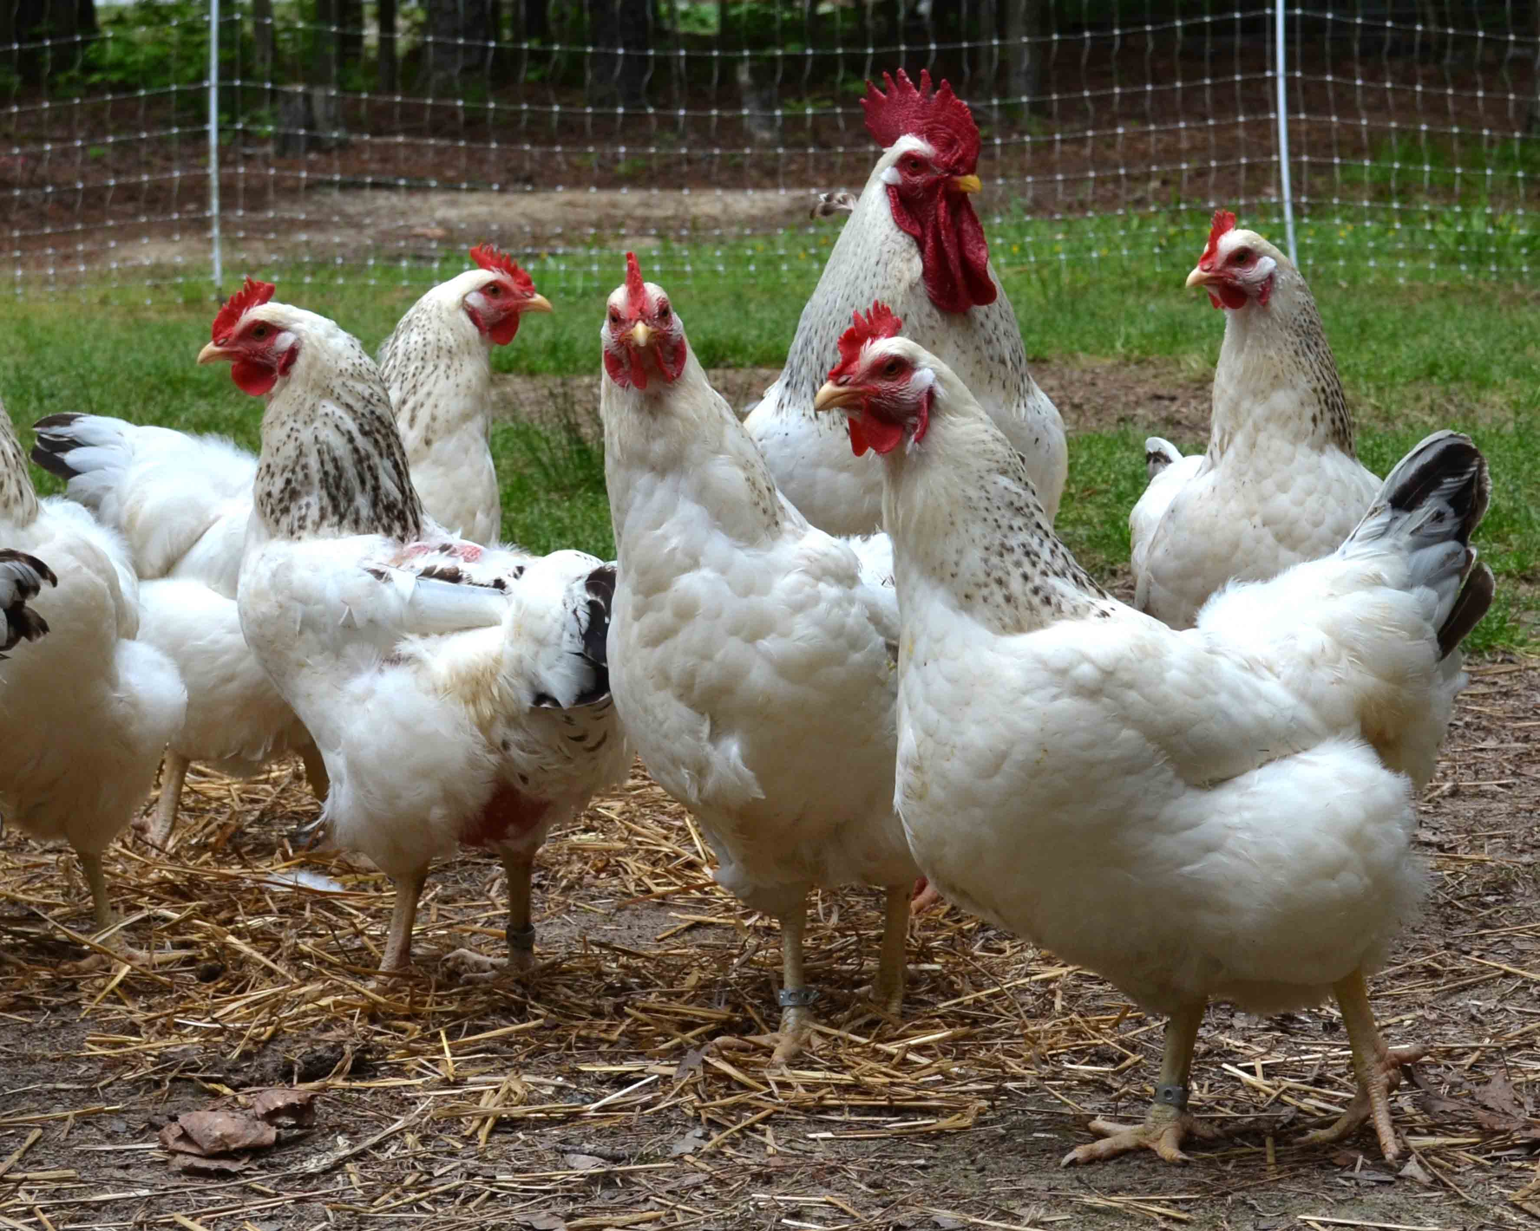
HIGHLY PATHOGENIC AVIAN INFLUENZA H5N8 IN SOUTH AFRICA
January 2018
35

Slide 36
HPAI H5N8 OVERVIEW
On 22 June 2017 DAFF was notified of high mortalities in a breeder flock in Mpumalanga Province. Samples that were collected yielded positive results for HPAI H5N8.
South Africa has never experienced an outbreak of HPAI in chickens or any domestic birds other than ostriches, which makes this current outbreak a very significant and serious outbreak in South Africa’s animal health history.
Industry commissioned a study to determine the exact economic impact of the current outbreak. Expected date of release of the study: early March 2018.

Slide 37
CURRENT STATUS OF HPAI H5N8 OUTBREAKS IN SOUTH AFRICA
The total number of outbreaks detected and reported to date (23 January 2018):
      126 locations tested positive for HPAI H5N8
      8 outbreaks in backyard chickens
      30 outbreaks on commercial chicken farms
      19 outbreak in birds kept as a hobby and Zoos
      40 outbreaks on commercial ostrich farms
      29 outbreaks in wild birds

Slide 38
BREAKDOWN OF OUTBREAK PER PROVINCE
CATEGORICAL BREAKDOWN OF HPAI H5N8 OUTBREAKS PER PROVINCE SINCE THE INDEX CASE UNTIL 22 JANUARY 2018
Province | Backyard | Commercial | Hobbyists and zoo | Ostriches | Wild birds | Total
Mpumalanga | 4 | 5 | 0 | 0 | 2 | 11
Gauteng | 0 | 3 | 5 | 0 | 6 | 14
Limpopo | 0 | 0 | 0 | 0 | 0 | 0
North West Province | 0 | 1 | 1 | 0 | 0 | 2
Free State | 0 | 2 | 0 | 0 | 0 | 2
Kwazulu-Natal | 0 | 1 | 0 | 0 | 0 | 1
Eastern Cape | 0 | 1 | 1 | 1 | 0 | 3
Western Cape | 4 | 17 | 12 | 39 | 21 | 93
Northern Cape | 0 | 0 | 0 | 0 | 0 | 0
TOTAL | 8 | 30 | 19 | 40 | 29 | 126

Slide 39
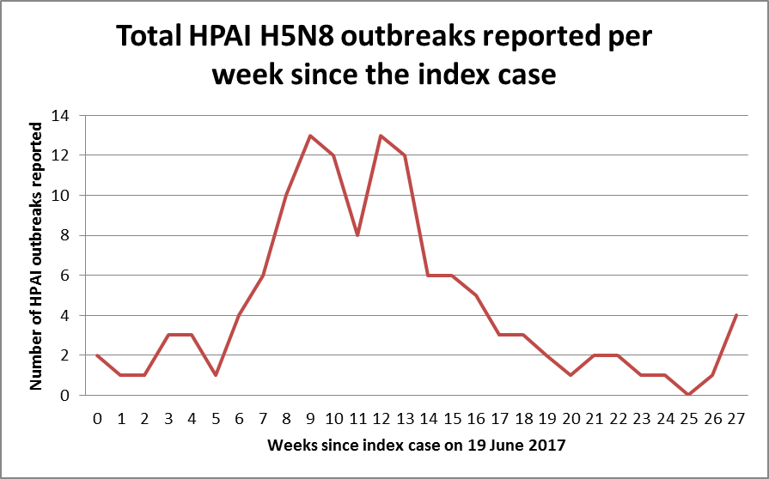

Slide 40
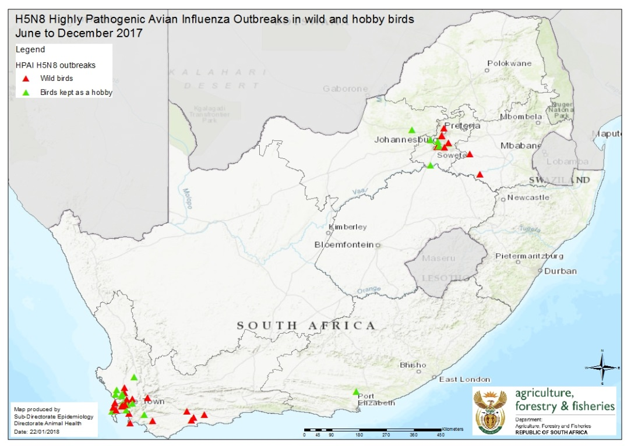

Slide 41
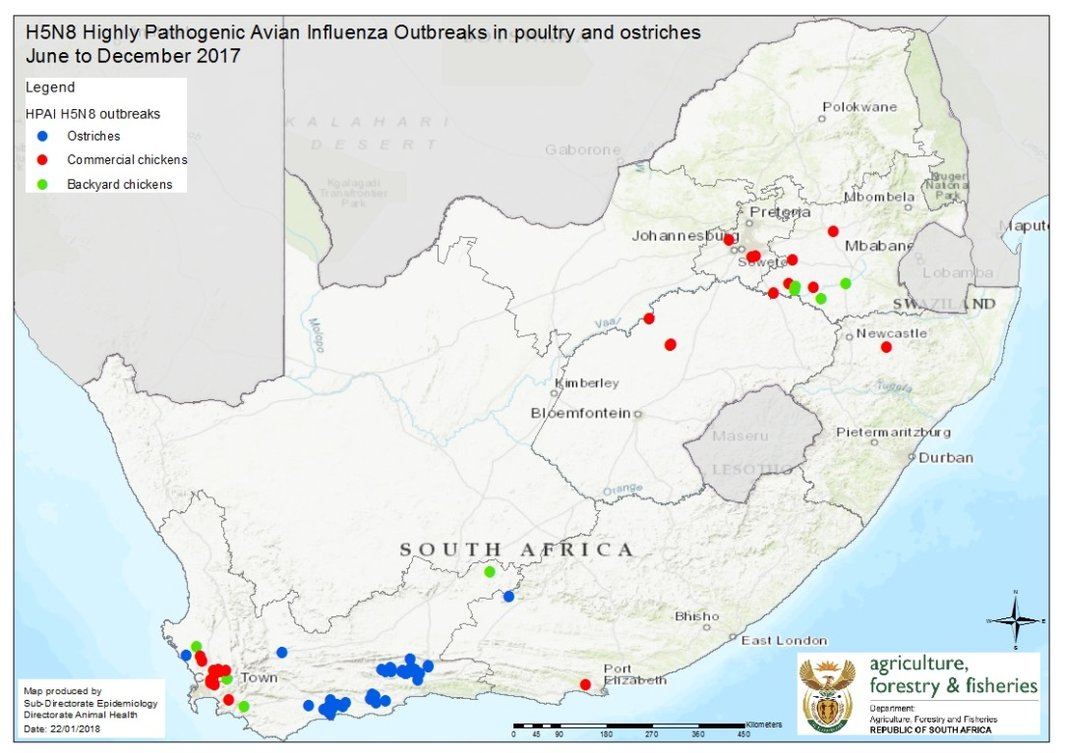

Slide 42
BANS PLACED ON RSA DUE TO OUTBREAK
Country | Date | Commodities banned
European Commission (Norway, Iceland, Switzerland) | 28 June 2017 | Fresh ratite meat, poultry meat preparations, poultry meat products not subject to treatment, Unprocessed animal by-products
Hong Kong | 23 June 2017, 13July 2017 7 August 2017 | All poultry (carcass, parts and offal) poultry products (including eggs)
Israel | 25 June 2017 | Ban import of poultry genetic material, poultry products and birds.
Mozambique | 24 July 2017 | Live domestic and wild birds, eggs, fresh and frozen poultry meat.
Namibia | 23 June 2017 | Poultry, Poultry products, birds, ostrich and their products
 | 22 September 2017 | Import / intransit of Birds, live poultry, raw poultry products and poultry feed
Swaziland | No formal notification to SA, but notified verbally by industry
Zimbabwe | No formal notification to SA but media reports were received
United Arab Emirates | 6 July 2017 | Domestic and wild birds and their untreated by-products, day old chicks, hatching eggs, meat and table eggs
Saudi Arabia | 20 August 2017 | Live birds, hatching eggs and one-day old chicks

Slide 43
VACCINATION
At the moment South Africa does not allow for the vaccination against HPAI.
The decision on vaccination has been done through broad consultation and by taking all the available scientific information into account.
Vaccination against HPAI does not prevent infection; it merely reduces the clinical signs of the disease and shedding of the virus.
Due to the high possibility that vaccination will mask infection with HPAI, most trade partners will not accept poultry, poultry meat or products from a country that vaccinates against HPAI.
Consultation between DAFF and Industry continues to formulate a position on vaccination.

Slide 44
COMPENSATION
Ministers Committee on the Budget (MINCOMBUD) approved R40 million for paying compensation.
Minister approved Guidelines for compensation for the culling of uninfected birds.
Work continues between DAFF and Industry to process claims.

Slide 45
TRANSFORMATION IN THE FISHING SECTOR
During FRAP2015/16, transformation of each sector was measured against the percentage of the Total Allowable Catch (TAC) and/or Total Applied Effort (TAE) that is “owned” by the Historical Disadvantaged Individuals. For TAE fisheries such as Large Pelagics, Seaweed, KZN Beach Seine and Netfish the HDI percentage was calculated as an average.
Disclaimer: Please note that figures provided are subject to change due to reserved decisions and calculation of % held by youth and females in close corporations (CCs), as well as % of youth and females that are Directors in Companies (Ptys), etc.

Slide 46
TRANSFORMATION IN THE FISHING SECTOR (continuation)
No. | Fishing Sector | % of TAC/TAE held by HDIs | % held by Youth | % held by females
1. | Patagonian Toothfish | 53.316 | N/A | N/A
2. | Hake Inshore Trawl (Hake) | 73.546 | N/A | N/A
 | Hake Inshore Trawl (Sole) | 72.863 | N/A | N/A
3. | Horse Mackerel | 72.29 | N/A | N/A
4. | West Coast Rock Lobster (Offshore) | 62.08 | N/A | N/A
5. | Large Pelagics | 73.2 | N/A | N/A
6. | Seaweed (Entities) | 65.35 | N/A | N/A
 | Seaweed (Individuals) | 100 | 0 | 100
7. | West Coast Rock Lobster (Nearshore) | 94 | 10.97 | 25.12
8. | KZN Beach Seine | 57.69 | 11.54 | 15.38
9. | Netfish | 77 | 15.79 | 10.53

Slide 47
TRANSFORMATION IN THE AGRICULTURAL SECTOR
LEGISLATIVE FRAMEWORK
Section 10 of the BBBEE Act No. 53 of 2003 (called principal Act), as amended.
The AgriBEE Sector Code was developed by sector stakeholders, including Government, as the legal framework for implementation to bring about economic transformation of the agricultural sector.
It has been a major challenge to determine the Broad Based Black Economic Empowerment (BBBEE) Status level of the Agricultural Sector,

Slide 48
INTERVENTIONS
As an intervention, DAFF embarked on the process to develop Draft AgriBEE Enforcement Guidelines in terms of Section 10 of the BBBEE Act No. 53 of 2003 (called principal Act), as amended.
These services are for issuing licenses; permits; authorisations; grants; incentives; procurement contracts to agricultural enterprises allowing them to conduct business operations in the sector.

Slide 49
INTERVENTIONS (CONTINUATION)
Section 10 of the BBBEE Act outlines the Government’s leverage for the implementation of BBBEE in the economy and it reads as follows
“ Every organ of state and public entity must take into account and, as far as is reasonably possible, apply any relevant code of good practice issued in terms of this Act” in– :
• Determining qualification criteria for granting of licenses, concessions;
• Developing and implementing a preferential procurement policy;
• Determining qualification criteria for the sale of state-owned enterprises;
• Developing criteria for entering into partnership with the private sector;
• Determining criteria for the awarding of incentives and grants.

Slide 50
ANTICIPATED IMPACT
Economic activity depends on the issuing of licenses; granting of permits and concessions; facilitating investments and partnerships through incentives and funding, as well as public sector procurement.
Enterprises which make use of these levers should contribute to Government’s Programs to address inequality in the economy. The levers are going to be inevitable to speed-up the implementation of the radical socio-economic transformation in the agricultural sector, as they could be used to enforce compliance to the AgriBEE Sector Code.

Slide 51
WAYFORWARD
Advise from the State Law Adviser has been obtained.
DAFF has prioritised a workshop to be held in this last quarter for further deliberation with the relevant regulators.
State and public entities will play a facilitation role towards implementation of BBBEE Codes of Good Practice in the various sectors.
The approved guidelines will be shared with the AgriBEE Sector Council.

Slide 52
TRANSFORMATION IN THE FOREST SECTOR
Forest sector codes
Main objective:
“To extend economic opportunities and benefits of Forest
Sector to the previously disadvantaged black groups”
Reporting entities
  Growers: plantations, nurseries & indigenous forest.
  Contracting: Silviculture, harvesting, fire fighting.
  Fibre: pulp & paper, paper board, timber products etc.
  Sawmilling: industrial, structural & mining timber, match producers
  Pole: Pole treatment plants.
  Charcoal: charcoal producers (not represented & organised).

Slide 53
B-BBEE STATUS ON TRANSFORMATION ….
Certificates received per entity
53

Slide 54
B-BBEE STATUS ON TRANSFORMATION ….
MLE average score comparison:
54

Slide 55
B-BBEE STATUS ON TRANSFORMATION ….
MLE Black owned Vs Black Women Owned Averages:
55

Slide 56
B-BBEE STATUS ON TRANSFORMATION ….
QSE Average Score Comparison:
56

Slide 57
B-BBEE Status of Transformation (cont.)
EME certificates received:
57

Slide 58
B-BBEE STATUS ON TRANSFORMATION ….
Summary- Status
  Sector maintained a level four B-BBEE status
  Increase in terms of submission from MLE
  QSEs maintained level 3 B-BBEE status
  EME’s maintained level 4 B-BBEE status
    Indication shows most EMEs are non-women owned
    Non compliance with industry Codes of Good Conduct

Slide 59
B-BBEE Status of Transformation ( cont.)
Challenges
    Inconsistency in terms of submission (B-BBEE Act)
    Insufficient underlying information making it difficult for in depth analysis- (B-BBEE Act)
    Inaccurate database (Associations, CEO visits)
    Verification using Generic scorecard (Regulators)
    Some entities do not undertake B-BBEE verification
    (SECTION 10 SUBSTITUTED BY SECTION 6 OF ACT)
59

Slide 60
GUIDING FRAMEWORK FOR THE IMPLEMENTATION AND MONITORING OF CASP FUNDED PROJECTS AND THE USE OF R60 MILLION
The R60 million received from National Treasury (NT) was ring-fenced to strengthen CASP management, oversight and monitoring.
This was allocated as follows: R10 million in 2016/17; R20 million in 2017/18 and R30 million in 2018/19;
The DDG: Food Security and Agrarian Reform (FSAR ) ensured that the programme management and oversight role of CASP office is strengthened and identified key positions to be filled; this meant that the structure although falling within the DAFF CoE budget, must be approved and positions advertised or reorganization happen internally. As such the R10 million was never spent end 2016/17 for this purpose due to HR related delays in concluding the work study..
Regarding monitoring, a monitoring schedule was developed and different teams were send out to provinces to monitor and verify implementation of the projects; these included CASP office, programme development support, smallholder, crop and animal production, Extension, Sector Training and capacity building and Internal audit.
As at end September 2017, 314 of the 468 planned projects were initiated (67%) with 39 CASP projects completed. The 3rd quarter reports are due 31 January 2018.
DAFF has conducted monitoring visits to all nine provinces as at end December 2017; visiting 96 projects.
A quarter one and two performance review meeting was held during 8 – 10 November 2017 hosted by Limpopo and three implemented projects were visited during the visit by all delegates to share lessons and provide constructive criticism to improve performance.

Slide 61
DISCIPLINARY ACTIONS
Director General
The Minister is addressing the issue of the suspension of the DG.
Fisheries Management
Harris and Nupen Case: The matter was referred to the Hawks for investigation.
Abalone : An investigation on the awarding of a tender for the sale of Abalone is currently underway. The matter is handled by an independent team.
Agriculture (Ncera and DAFF Officials)
The investigation has been completed and recommendations were submitted for consideration.

Slide 62
NCERA
NCERA CENTRE DEREGISTRATION AND TRANSFER TO THE AGRICULTURAL RESEARCH COUNCIL (ARC) PROGRESS UPDATE

Slide 63
NCERA BACKGROUND
Ncera comprises of two areas, the centre and the farms surrounding the centre.
Area 1: The Training Centre. The centre is registered as government business entity on 1000ha used to provide the following services and training to the community : Agricultural Extension Services, Mechanization Services, Tractor Maintenance courses, Basic Agricultural Course, Breeding of Nguni type cattle and goats.
Area 2: The Leased Farms. A total of thirteen (13) properties, consisting of ten (10) economic portions when consolidated were advertised in the Daily Dispatch and the Eastern Province Herald on the 4th and 11th of March 2005 respectively. A total of 10 farmers (nine individuals and one Cooperative) were selected and settled on these portions through Permission to Occupy (PTO) letters renewed in September 2017 whilst awaiting the finalisation of the leases from the Department of Public Works.

Slide 64
  NCERA BACKGROUND INFORMATION CONT’
The normal procedure as per State Land Disposal Policy was followed in the allocations of the advertised Ncera properties to the land and agrarian reform beneficiaries. The lessees included Mr Qwabe (the current writer of the complaint on additional invasions) and 8 other members as well as a Cooperative.
DAFF held a meeting with the Ncera farmers, including Mr Qwabe on the 22nd November 2017 to deliberate on the use of the farms. All agreed to get into the Macadamia venture.
The Ncera Farms form part of the FALA properties that are in the process of being transferred to the Department of Rural Development and Land Reform (DRDLR).

Slide 65
NCERA PTY (LTD) TRANSFER AND DEREGISTRATION PROCESS
Ncera
Centre – transfer to
Farms transfer to
ARC
DLDLR
-Minister’s letter signed
-Sent to DPW & DRDLR
-DG to DGs
Deregistration request to NT
Meeting called by the Minister on the 25th January 2018
Directives from the Minister:
due date for concluding on Ncera: 15th February 2018
Recommendations:
Pass a special Board resolution; verify assets urgently and lodge papers with CIPC.
Update the MOA.
Task Team Appointed
-DAFF
-DPW
-DRDLR
MoA
Junior Council
Ready to transfer farms agreed upon

Slide 66
NCERA TRANSFER PROGRESS TO DATE : CONSULTATIONS
Consultative meetings were necessary and urgent between ARC, DAFF and Ncera employees and these were undertaken as follows:
The meeting of the 17 November 2016 was coordinated by the Directorate: Employee Relations to conduct consultative meetings with the Ncera Centre Management and the Ncera Centre general workers in relation to the process of transferring the Centre to ARC.
During the first meeting with the Ncera Management the rationale behind the gathering was explained by the Director Employee Relations.
Management was afforded an opportunity to ask questions and their concern was mostly on job security, accommodation as well transportation arrangement of the Ncera workers. The Director Employee Relations responded by explaining how the process of transferring the Ncera Centre will unfold she also gave assurance that no employee will lose their jobs due to the transfer and that all the information regarding the Ncera Centre workers arrangements (accommodation and transport) will be communicated to ARC.

Slide 67
WAYFORWARD
Pass a special Board resolution scheduled for 29th January 2018 with the one Director of the Board remaining and the Secretary
Update assets, finalise joint Ncera employee consultations by ARC and DAFF and report
Lodge deregistration papers with CIPC
Sign MoA by DAFF and ARC
Placement of CEO and CFO at DAFF.
Finalize the transfer with Treasury based on signed MoA.

Slide 68
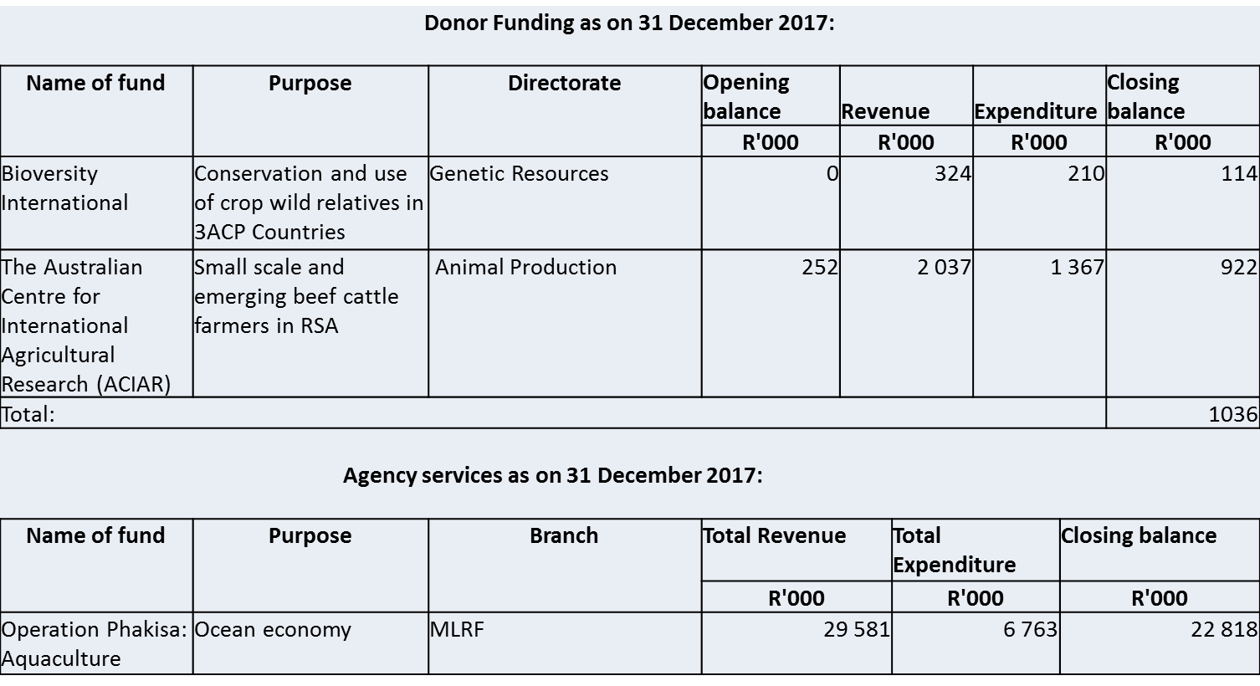
PROGRESS ON TRANSFERS OF OTHER DEPARTMENTS

Slide 69
PROGRESS REPORT ON THE REVIEW OF THE MARINE LIVING RESOURCES ACT (MLRA) (ACT NO. 18 OF 1998)
The Review of the MLRA has not been started yet.
Minister has established Fishing Transformation Council who will look into Reviewing of the MLRA.

Slide 70
PROGRESS REPORT ON DAFF’S AUDIT PLAN
The Audit Matrix was compiled from the Final Audit Management Report issued by the Auditor General of South Africa (AGSA) on 31 July 2017.
The following programme was implemented to manage the progress of the Audit Matrix:
    Directors/Chief Directors/Deputy Directors-General: Submitted an action plan on 28 August 2017.
    Directors/Chief Directors/Deputy Directors-General: Submitted the first progress report on 30 September 2017.
    Directors/Chief Directors/Deputy Directors-General: Submitted the second progress report on 31 October 2017.
    Directors/Chief Directors/Deputy Directors-General: Submitted the third and final progress report on 30 November 2017.
    Directors/Chief Directors/Deputy Directors-General were responsible for the implementation and content of the action plans and progress reports.
    The Audit Matrix was subsequently updated with the action plans and progress reports.

Slide 71
SUMMARY OF THE AUDIT FINDINGS AS PER THE AUDIT MATRIX
Policy, Planning and Monitoring & Evaluation
Five repeated audit findings were raised:
Targets and indicators not in line with the SMART criteria.
Invalid information (households, hectares & entrepreneurs) reported.
Supporting documents not corresponding to the reports.
2. Food Security and Agrarian Reform
Two repeated audit findings were raised:
Conditional grants: Only 13% of the project monitoring visits occurred.
Conditional grants: Payments not inline with the approved payment schedule.
3. Chief Financial Office
Four repeated audit findings were raised:
Understatement of accruals.
Understatement of commitments.
Invoices not paid within 30 days.
Asset control deficiencies.

Slide 72
SUMMARY OF THE AUDIT FINDINGS AS PER THE AUDIT MATRIX ….
4. Forestry & Natural Resources Management
One repeated audit finding:
Misstatement of biological assets.
5. Corporate Services
Seven repeated audit findings:
No approval obtained for remunerative work outside the employment of DAFF.
Lack of funding of ICT Master Systems Plan initiatives and projects.
Comprehensive disaster recovery test not conducted.
Checkpoint firewall logs not stored off site.
Firewall recovery process not specified in the Disaster Recovery Plan.
A number of HP servers were not regularly being patched.
User Account Management standards and procedures had not been designed and implemented for the Forestry Compas System.

Slide 73
WAY FORWARD TO IMPROVE THE MANAGEMENT OF THE AUDIT MATRIX FOR THE AUDIT FINDINGS RAISED IN THE 2017/18 FINANCIAL YEAR
The action plan to be completed immediately when the audit finding is raised.
The action plan to be implemented within two months from raising the audit finding.
The audit finding will be incorporated in the Audit Matrix immediately when the management comments are signed off by the relevant deputy director-general, as to waiting for the Final Audit Management report only issued on 31 July 2018.
A guideline will accompany all audit findings to ensure:
That the correct internal control deficiency/root cause is identified; and
That the management comments includes adequate responses to timeously address the audit findings.

Slide 74
ASSURANCE PROVIDED BY INTERNAL AUDIT ON THE IMPLEMENTATION OF CORRECTIVE ACTION (AUDIT MATRIX)
Internal audit performed follow-up audits on the implementation of corrective action by the Department for the 2016/17 FY audit matrix. Internal audit is currently busy with a follow-up audit on the implementation of corrective action for the AGSA’s 2016/17 management report issued during July 2017 as documented on the audit matrix for 2017/18 FY
Internal audit did a gap analysis on the audit matrix.
Internal audit presented their findings and recommendations to management, EXCO and the Audit Committee.
The Department is in the process of implementing corrective measures as recommended by Internal Audit.

Slide 75
VREDE DAIRY PROJECT
The National Assessment Panel (NAP) for the 2013/14 financial year (30-31 January 2013) approved a CASP allocation of R53 million towards the implementation of the Vrede Dairy Project and the total budget identified by the Free State Department of Agriculture and Rural Development (FSDARD) to completed the project was R525 million.
In July 2013 the Department of Agriculture, Forestry and Fisheries (DAFF) received a letter from National Treasury raising procedural concerns on the partnership entered into.
According to National Treasury, the nature of the arrangement for this project was that of a Public Private Partnership (PPP) and was subject to the provisions of the Treasury Regulation 16.3.1 which states that as soon as an institution identifies a project that may be concluded as a PPP, the accounting officer or accounting authority must in writing :
    Register the PPP with the relevant treasury; and
    Inform the relevant treasury of the expertise within that institution to proceed with a PPP.
    According to National Treasury, this regulation was violated by FSDARD and DAFF needed to act to ensure CASP is not used unlawfully.

Slide 76
VREDE DAIRY PROJECT ….
On 23 July 2013 DAFF send a letter to the Head of the Department (HOD) of FSDARD informing him of its intention to implement section 17 (1) (a) of the Division of Revenue Act (DORA) of 2013 and withhold the quarter two CASP allocation.
A letter of representation was received from the HOD dated 2 August 2013 stating reasons why the funds should not be withheld from the province.
However this representation did not adequately respond to the concerns by National Treasury and DAFF withheld the second CASP transfer to the province for a period not exceeding 30 days; and arranged a site visit with the province to garner more information.
The DAFF undertook a technical visit to the Free State Vrede integrated dairy project on the 13 August 2013.
The DAFF technical team requested certain documentation of which the Province only provided the feasibility study and a copy of the MOU with Estina.
The province was presented with a letter indicating DAFF’s intention to implement Section 17 (1) ( a ) of the Division of Revenue Act 2012 and withhold the second quarter allocation of both CASP and Ilima/Letsema for 2013/14 to DARD for a period longer than 30 days but not exceeding 120 days. The province was given 7 days to submit a representation stating why funds should not be withheld from the province.

Slide 77
VREDE DAIRY PROJECT ….
A follow up technical meeting was held with the province on 22 October 2013 in an attempt to offer technical support .
The DAFF’s confirmed its non-participation in funding the project and this was communicated to the Head of the Provincial Treasury.
National Treasury also commissioned a forensic audit on this project.

Slide 78
OTHER ISSUES
Preservation and Development of Agricultural Land Bill
  On 21 September 2017 DAFF received an opinion from Office of the Chief State Law Adviser (OCSLA). The OCSLA raised concerns amongst others on the concurrent mandate to be shared between the three spheres of Government and the need to clearly define the roles and responsibilities of each sphere without infringing on the powers of the other. It is the opinion of the OCSLA that the Bill is not constitutionally sound.
DAFF shall be appointing a Technical Task Team and legal expert to re-consider and redraft the Bill.
In light of the above it is unlikely that PDALB will be submitted to Parliament on or before 31 March 2018 as envisaged.

Slide 79
OTHER ISSUES (continuation)
Aquaculture Development Bill
As per the Economic Sectors, Employment and Infrastructure Development (ESEID) cluster programme this Bill was presented to the DGs ESEID cluster on 18 January 2018 and it was recommended to Cabinet.
Policy on Comprehensive Producer Development Support
  Draft 5 of the Policy on Comprehensive Producer Development Support has been developed and tabled at MINTECH which has recommended that the Policy should be tabled at MINMEC and routed to Cabinet for approval.
  The Policy on Comprehensive Producer Development Support will be tabled at the Social Protection, Community and Health Development and Economic Sector, Employment and Infrastructure Development Clusters in 2018.
  The Policy has been approved by MINTECH and will be introduced to the DGs Cluster in 2018.

Slide 80
ACRONYMS
ADG Acting Director General
AFF Agriculture, Forestry and Fisheries
APP Annual Performance Plan
APAP Agricultural Production Action Plan
ASRD/STC Agriculture and Sustainable Rural Development/Science and
Technology Committee
AI Avian Influenza
AU Africa Union
BBBEE Broad Based Black Economic Empowerment
CASP Comprehensive Agricultural Support Programme
CEO Chief Executive Officer
CFO Chief Financial Office
COE Cost of Expenditure
CS Corporate Services
CC Close Corporations

Slide 81
Acronyms
CIPC Companies and Intellectual Property Commission
COSMIN Chief of Staff in Ministry
CCS Compulsory Community Service
DAFF Department of Agriculture, Forestry and Fisheries
DDG Deputy Director General
DG Director General
FS Free State
FY Financial Year
HPAI Highly Pathogenic Avian Influenza
HOD Head of Department
HR Human Resources
DDG:SC Deputy Director General: Corporate Services
DITC Departmental Information Technology Committee
DRDLR Department of Rural Development and Land Reform
DPW Department of Public Works
EC Eastern Cape

Slide 82
ACRONYMS
ESEID Economic Sectors, Employment and Infrastructure Development
EXCO Executive Committee
FALA Financial Assistance Land
FSAR Food Security and Agrarian Reform
FM Fisheries Management
FNRM Forestry and Natural Resources Management
HR Human Resources
HA Hectares
IAFFDFP Integrated Agriculture, Forestry And Fisheries Development Finance Policy
ICT Information and Communication Technology
ICT CAB Information and Communication Technology Control Advisory Board
ICT DRP Information and Communication Technology Disaster Recovery Plan
IGR Inter-Governmental Relations
KZN KwaZulu-Natal
KyD Kaonafatso ya Dikgomo

Slide 83
ACRONYMS
LP Limpopo Province
MoA Memorandum of Agreement
MoU Memorandum of Understanding
MINMEC Ministers and Members of Executive Councils
MINTECH Ministerial Technical Committee
MINCOMBUD Ministers Committee on the Budget
MLRA Marine Living Resources Act
MP Mpumalanga Province
MSP Master System Plan
MTSF Medium Term Strategic Framework
NT National Treasury
NW North West
OCSLA Office of the Chief State Law Advisor
PGRFA Plan for Conservation and Sustainable Use of Plant Genetic Resources for Food

Slide 84
ACRONYMS
Q1 Quarter 1
Q2 Quarter 2
Q 3 Quarter 3
Q 4 Quarter 4
RTF Research Technology Fund
RSA Republic of South Africa
SA-GAP South Africa Good Agriculture Practices
SADC Southern African Development Community
SAVC SA Veterinary Council
TAC Total Allowable Catch
TAE Total Applied Effort
TUP Temporary Unplanted Plantations
YAFF Youth in Agriculture, Forestry and Fisheries

