Slide 1

2017/18 Final Business plan
NORTH WEST PROVINCE
June 2017
Notes:
Updated: 13/10/215

Slide 2
PURPOSE OF THE PRESENTATION
The purpose of the presentation is to present:
Summary of 2017-2020
MTSF Summary of 2014-2019
Summary of Planned Targets for 2017/18
Regional Breakdown of Planned Targets
Provincial Summary of Project Readiness
Provincial Summary of Title Deeds to be Eradicated and Readiness
Planned Targets per Programme
Revitalisation of Distressed Mining Communities
Catalytic Projects
Other Programmes
Cash flow
Breakdown Readiness Matrix
Operational Capital Budget

Slide 3
SUMMARY of 2ND DRAFT/ FINAL 2017/18

Slide 4
SUMMARY of the 2018/2020

Slide 5
Summary of Planned Targets: 2017/18

Slide 6
Regional Breakdown of Planned Targets

Slide 7
Provincial Summary of Project Readiness

Slide 8
Provincial Summary of Title Deeds to be Eradicated and Readiness

Slide 9
Planned Targets Per Programme

Slide 10
Planned Targets Per Programme

Slide 11
Planned Targets Per Programme

Slide 12
Planned Targets Per Programme

Slide 13
Revitalisation of Distressed Mining Communities

Slide 14
Catalytic Projects

Slide 15
Other Programmes

Slide 16
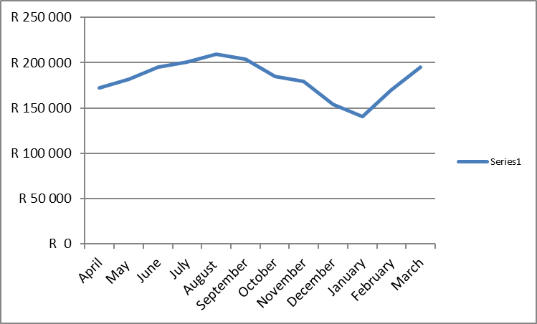
Cash flow

Slide 17
Breakdown Readiness Matrix

Slide 18
OPERATIONAL CAPITAL BUDGET

Slide 19
THANK YOU

