Slide 1
Department of Higher Education and Training
Developments in Community Education and Training
Presentation to the Portfolio Committee
29 November 2017

Slide 2
PRESENTATION OUTLINE
Outstanding payments of Community Education and Training (CET) college lecturers
Update on the development and implementation of the new policies and regulations for the CET sector
Outstanding matter relating to the function shift
Funding of the CET Colleges sector
The Curriculum of CET colleges
Progress on the issuance of certificate
Conclusion and proposed prioritization

Slide 3
1. OUTSTANDING CET LECTURER PAYMENTS
The outstanding lecturer payment has three categories on which the Department is working, namely:
Lecturers who are paid through the claim system
Delays in processing applications for and updating REQVs and payment thereof
Outstanding reversal of the Limpopo CET college lecturer salary cuts dating back to September 2014
Payment of lecturers through the claim system affect 6522 lecturers of the KZN CET College as well as 445 lecturers of the Western Cape CET college
In this respect, due to the submission of claims, there is always a lapse of 2-4 weeks in the processing of salary payment
Individual enquiries in this regard are dealt with on submission of the enquiry
However, the permanent solutions to the problem is eliminating the claim system

Slide 4
1. OUTSTANDING CET LECTURER PAYMENTS
The second cause relate to the delays in the processing and capturing of applications for upgrading REQVs and the Payment.
College | No of APP. | No. Processed | No. Outstanding
EC | 384 | 118 | 266
FS | 201 | 139 | 62
GP | 894 | 790 | 104
KZN | 182 | 69 | 113
LP | 1001 | 301 | 700
MP | 191 | 80 | 111
NC | 115 | 77 | 38
NW | 168 | 114 | 54
WC | 133 | 39 | 94
TOTAL | 3269 | 1727 | 1542

Slide 5
2. DEVELOPMENT AND IMPLEMENTATION OF NEW CET POLICIES AND REGULATION
29 Finance and governance policies: Not implemented yet
Service Delivery Framework: due for implementation in 2018
Strategy for Partnership in CET colleges: being implemented
National Policy on Curriculum Development and Implementation: being implemented
National Policy for Monitoring and Evaluation of CET colleges: being implemented
Policy and procedures for opening, merging, and closing community learning centres: being implemented

Slide 6
2. DEVELOPMENT AND IMPLEMENTATION OF NEW CET POLICIES AND REGULATION
Norms and Standards for Staffing CET colleges: pending availability of funding and collective bargaining
Policy Framework for Funding CET colleges: Finalised and will be used in 2018/2019 as a basis for the development of Norms and Standards for Funding CET Colleges
National Teaching and Learning Improvement Plan: being implemented and reported on
Standard Operating Procedures for Student Enrolment Verification: used for the first time in 2017.
Regulations for the conduct, administration, and management of the examination and Assessment of the NASCA: pending the implementation of this qualification

Slide 7
3. OUTSTANDING MATTER RELATING TO THE FUNCTION SHIFT
There are three major residual matters relating to the function of the erstwhile adult education and training, namely:
Absence of a collective bargaining structure for CET college lecturers
Outstanding reversal of the Limpopo CET College lecturer cuts of 2014

Slide 8
3. OUTSTANDING MATTER RELATING TO THE FUNCTION SHIFT
The standardisation of the CET college lecturer conditions of service, which include the following:
Application of the minimum requirements for appointment
Nature of appointment
Salaries and types of payment
Working Hours
Leave
Performance management
Allowances

Slide 9
a) Absence of the collective bargaining structure
The establishment of a collective bargaining structure/council falls under the jurisdiction of the Minister for Public Service and Administration together with the Public Service Co-ordinating Bargaining Council.
The DHET has taken the necessary steps towards ensuring that the matter is resolved
It is worth noting that all staff who were transferred in terms of the Public Service Act of 1996, as amended, and by virtue of their new status as public servants, their conditions of service must, by law, should be dealt with in the General Public Service Sector Bargaining Council (GPSSBC).
However, only the Public Service Co-ordinating Bargaining Council (PSCBC) has the prerogative on the variation and/or designation of sectoral bargaining councils in the public service.

Slide 10
b) Limpopo salary cuts
No of employees affected | 2 088
Total salary in September 2014 before salary cuts | 12 067 789
Total salary in October 2014 after salary cuts | 9 293 167
Difference | 2 774 622
Average salary cut per person | 1 329
Total arrears for 6 months ( if we implement the adjustment from October 2017) | 16 647 731
Total arrear for 6 months (October 2014 to March 2015) required to pay arrears from October 2014 (Limpopo DBE debt) | 16 647 731
Total arrear for 29 months (April 2015 to sept 2017) | 80 464 035
Overall total | 113 759 498
Arrear per person (29 months) October 2014 to September 2017 | 38 536

Slide 11
c) Outstanding matter relating to the function shift standardisation
Personnel Administration Measures (1999) provides for minimum requirements for employment in Education – Matric plus three years
The Provincial Education Departments did not comply with the requirements, as shown by REQV levels below as at 28 November 2016.

Slide 12
Lecturers by REQV levels in 2017
College Name | Unclassified | REQV 10 | REQV 11 | REQV 12 | REQV 13 | REQV 14+ | Grand Total
EC CET College | 774 | 346 | 381 | 189 | 1149 | 98 | 2937
FS CET College | 2 | 59 | 222 | 69 | 326 | 351 | 1029
G CET College | 603 | 140 | 86 | 102 | 657 | 822 | 2410
KZN CET College | 0 | 2254 | 767 | 148 | 2568 | 785 | 6522
LP CET College | 2 | 35 | 276 | 117 | 778 | 322 | 1530
MP CET College | 1 | 14 | 257 | 28 | 697 | 342 | 1339
NC CET College | 0 | 39 | 26 | 13 | 65 | 26 | 169
NW CET College | 0 | 36 | 129 | 288 | 622 | 96 | 1171
WC CET College | 0 | 17 | 50 | 53 | 328 | 199 | 647
NATIONAL | 1382 | 2940 | 2194 | 1007 | 7190 | 3041 | 17754

Slide 13
Nature of appointments per province
 | 05 | 17 | 25 | 26 | 32 | 34
EC | X | - | - | - | - | -
FS | - | - | - | X | - | X
GP | X | - | X | X | - | -
KZN | - | X | - | - | - | -
LP | - | - | - | - | - | X
MP | - | - | - | - | - | X
NC | - | - | - | - | X | -
NW | - | - | - | - | X | -
WC | - | X | - | - | X | -
Code | Descriptions | Code | Descriptions
05 | Contracts | 26 | CS Educator Temporary
17 | Periodical Appointments | 32 | Abnormal Appointments
25 | CS Educator: Permanent | 34 | CS Educator: Part-time

Slide 14
Actual costing (averaged from May to July, 2017
Prov | NoA | Working hours/ Month | Notch | Number of Empl | Total cost
EC | 5 | 48 | R 150 249.21 | 3063 | R 460 213 321
FS | 34 | 76 | R 170 274.44 | 1062 | R 180 831 454
GP | 25 | 140 | R 195 480.59 | 2472 | R 483 228 016
KZN | 17 | 16 | R 54 198.72 | 4576 | R 248 013 336
LP | 34 | 32 | R 64 439.92 | 1672 | R 107 743 545
MP | 34 | 96 | R 96 012.24 | 1404 | R 134 801 182
NC | 32 | 100 | R 144 744.36 | 1200 | R 173 693 235
NW | 32 | 32 | R 185 893.90 | 164 | R 30 486 600
WC | 32 | 32 | R 151 534.51 | 395 | R 59 856 130
TOTAL |  |  |  | 16 008 | R 1 878 866 819

Slide 15
Standardisation proposal
Place Lecturers on NoA (07) Part time (Public Service Act).
Appoint all staff on part time on 5/8 per day on the following salary level:
Lecturers – (SL6 with REQV13)
Satellite Supervisors – SL7
Centre Managers – SL8

Slide 16
Proposed costing
POST CLASS | SL | FULL TIME NOTCH 8/8 | BONUS | PENSION | HOUSING ALLOWANCE | MEDICAL | TOTAL PACKAGE
CENTRE MANAGER | 8 | 312 333 | 26 028 | 40 603.29 | 15 312 | 42 540 | 435 904.04
SATELITE SUPERVISOR | 7 | 247 785 | 20 649 | 32 212.05 | 15 312 | 42 540 | 357 585.80
LECTURER | 6 | 186 315 | 15 526 | 24 220.95 | 15 312 | 42 540 | 283 002.20
POST CLASS |  | PART TIME 6/8 | BONUS | PENSION | HOUSING ALLOWANCE | MEDICAL | TOTAL PACKAGE
CENTRE MANAGER |  | 234 249 | 19 520.75 | 30 452.37 | 15 312 | 42 540 | 341 162.12
SATELITE SUPERVISOR |  | 185 838 | 15 486.50 | 24 158.94 | 15 312 | 42 540 | 282 423.44
LECTURER |  | 139 737 | 11 644.75 | 18 165.81 | 15 312 | 42 540 | 226 487.56
POST CLASS |  | PART TIME 5/8 | BONUS | PENSION | HOUSING ALLOWANCE | MEDICAL | TOTAL PACKAGE
CENTRE MANAGER |  | 195 207 | 16 267 | 25 376.91 | 15 312 | 42 540 | 293 791.16
SATELITE SUPERVISOR |  | 154 866 | 12 906 | 20 132.58 | 15 312 | 42 540 | 244 844.08
LECTURER |  | 116 448 | 9 704 | 15 138.24 | 15 312 | 42 540 | 198 230.24

Slide 17
Financial implications
Post class | Salary level | Recommended notch | Total package | No of employees | Total cost
Centre Coordinator | To be done later with PPN model
Centre Manager | 7 | 154 866 | 245 756 | 3 139 | 771 428 335
Lecturer | 6 | 116 448 | 199 142 | 16 008 | 3 187 868 978
Total |  |  |  |  | 3 959 297 313
Current |  |  |  |  | 1 878 866 819
Deficit |  |  |  |  | -2 080 430 494

Slide 18
4. FUNDING OF THE CET SYSTEM: MAJOR COST DRIVERS
Compensation of Employees (CoE)
Teaching and Learning Materials
Conduct, Management and Administration of Examinations
Capital/Machinery
Infrastructure (Development, Maintenance and Acquisition)
Indirect Costs: Management, HRD, Councils
Departmental and institutional operational cost

Slide 19
4. FUNDING OF THE CET COLLEGE SECTOR

Slide 20
4. FUNDING OF THE CET COLLEGE SECTOR

Slide 21
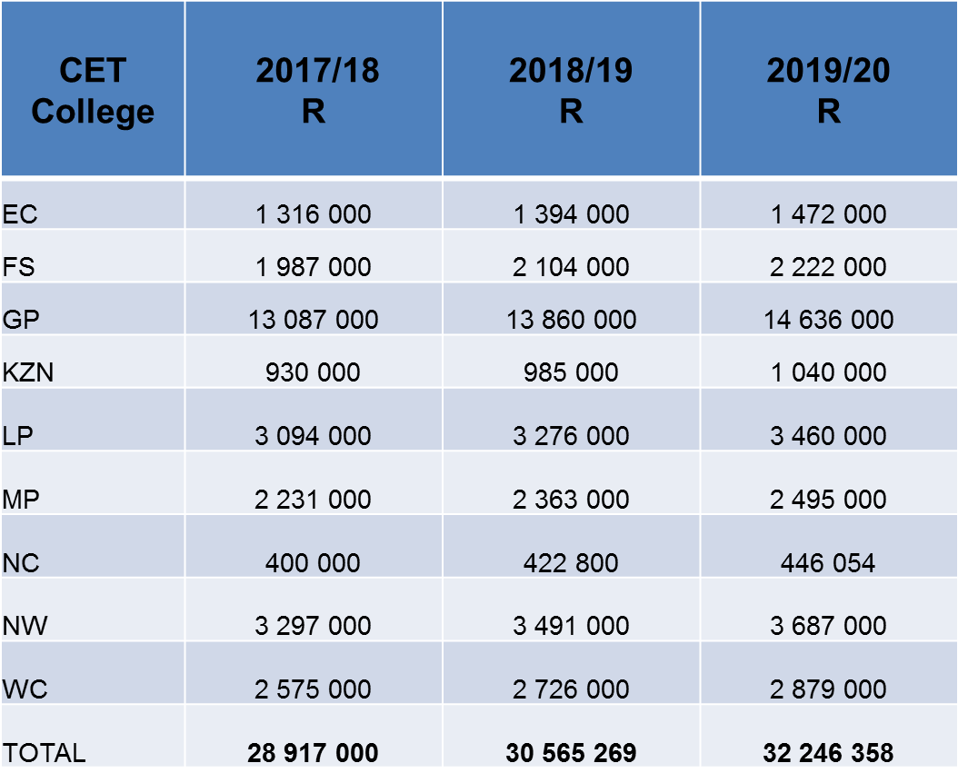
4. FUNDING OF THE CET COLLEGE SECTOR: CET COLLEGES

Slide 22
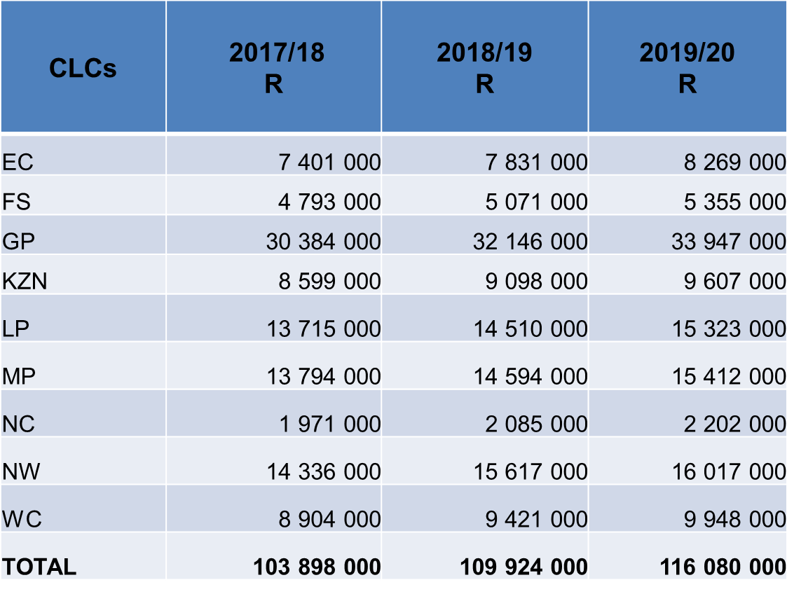
4. FUNDING OF THE CET COLLEGE SECTOR: TRANSFERS TO CLCS

Slide 23
5. PROGRAMME, QUALIFICATION MODEL
Formal General Education qualifications
Community-based programmes
Community Education and Training
Formal occupational qualifications
23

Slide 24
CURRENT PROVISION
The current programmes and curriculum in the CET Colleges is primary inherited from the Provincial Education Departments as party of the previous Adult Education and Training system.
Pursuant to the Constitution and the Triad above, CET Colleges provides learning opportunities to adults and out-of-school youth from basic literacy, basic education for adults up to matric.
Two general education exit qualifications are provided at National Qualifications Framework (NQF) level 1 and 4. The General Education and Training Certificate: Adult Basic Education and Training (GETC: ABET) at NQF level 1 and the Senior Certificate at NQF level 4.

Slide 25
SENIOR CERTIFICATE
The last Senior Certificate examination based on the policy document, A Resume of instructional programmes in schools (Report 550), was conducted in 2014
2017 is the third year of administering the Senior Certificate (amended)
The Senior Certificate retained its qualification structure, but utilized National Curriculum Statement (NCS) subjects to support the qualification.
Examination question papers were therefore based on CAPs.
13 Non languages plus 22 Languages (all eleven official languages offered at HL and FAL level )

Slide 26
SENIOR CERTIFICATE
Adult learners 21 years and older with a GETC or Grade 9 school report or old standard seven or recognised equivalent qualification obtained at NQF Level 1.
Adult learners 21 years and older with an incomplete Senior Certificate qualification.
Adult learners 21 years and older with an incomplete National Senior Certificate and whose School-Based Assessment (SBA) validity has expired.
In exceptional cases, out of school youth, aged 18-21, who were unable to complete their secondary school education due to circumstances beyond their control, as verified by the HOD of the PED.
No School Based assessment
Pass 3 subjects at 40% and 2 subjects at 30%, of which the Home Language must be passed at 40%.

Slide 27
EXAMINATIONS REGIME
The GETC: ABET examinations are administered through the Provincial Education Departments (PEDs)
The Department has entered into a protocol with PEDs for the conduct, administration and management of the GETC examinations till the year 2022
The Department of Basic Education administers the Senior Certificate.
The Department lacks capacity to run examinations at this stage. This has had implications for delayed resulting and certification of candidates.

Slide 28
A SHIFT IN POLICY_WP-PSET INNOVATION
General education qualifications
General Education and Training Certificate Adults
Senior Certificate
National Senior Certificate repeaters
National Senior Certificate Adults
Non-formal programmes: context and community driven
Community determined to suit regional needs
Inter-action with local authorities to drive the local development agenda
Also linked to EPWP, CWP, CDW programmes

Slide 29
NATIONAL SENIOR CERTIFICATE FOR ADULTS (NASCA )
The NASCA provides a general educational pathway for adults who have completed the GETC for Adults (NQF Level 1), and for people who have left school without an exit-level qualification, and provides the opportunity to acquire a school-leaving certificate, one which allows for the possibility of access to higher education also.
It is an equivalent qualification to the National Senior Certificate. The structure of the NASCA allows for a variety of learning delivery options-face-to-face, distance, or a combination of the two-as well as the possibility of private tuition or self-study.
The NASCA is a 120-credit qualification registered at Level 4 on the NQF. This qualification provides an alternative mode for adults for the achievement of the National Senior Certificate.
The qualification is, in every respect, intended as an equivalent qualification to the school-based National Senior Certificate. The NASCA is a qualification underpinned by curricula for every subject, and which is nationally, externally assessed, and certified by Umalusi.

Slide 30
NATIONAL SENIOR CERTIFICATE FOR ADULTS
Compulsory:
One language from Organising Field 4, Communication Studies and Language, which may be offered either as a Home Language or as a First Additional Language.
Either Mathematics or Mathematical / Quantitative Literacy from Organising Field 10, Physical, Mathematical, Computer and Life Sciences;
Options:
Additional official Language (Home or 1st Language)
Natural Sciences from Organising Field 10, Physical, Mathematical, Computer and Life Sciences;
Information and Communication Technology Organising Field 10, Physical, Mathematical, Computer and Life Sciences;
Human and Social Sciences from Organising Field 7, Human and Social Studies;
Economic and Management Sciences from Organising Field 3

Slide 31
PROGRESS – NASCA AND GETCA
National Senior Certificate for Adults (NASCA)
Qualification registered by SAQA
Curriculum finalized and gazetted
Curriculum development for African languages is in process
LTSM development is on process-Development and Adaptation of materials
General Education and Training Certificate for Adults (GETCA)
Policy on the GETCA published by Umalusi in October 2015;
GETCA registration of the qualification by SAQA
Curriculum developed and finalized for the GETCA except African Languages.
The Department is not in a position to determine the implementation date for the two qualifications as funding has not been allocated, despite submission of funding bids to National Treasury since 2015.

Slide 32
LECTURER DEVELOPMENT
Training and orientation of CET College lecturers is a priority
For the CET College system to provide quality education and training, lecturers are a valuable and critical resource.
A proper lecturer management and support system needs to be put in place. A critical sub-activity in the establishment of a new management and support system is the professional development of lecturers within the CET College space.
The Department intends establishing a support system that will deal with the supply, utilisation, development and evaluation of lecturers in CET Colleges.

Slide 33
LECTURERS DEVELOPMENT
The White Paper for Post School Education and Training proposes a number of strategies to address lecturer development:
Training of lecturers in methodologies appropriate for teaching adults and youth;
The development of a qualifications policy that provides for minimum standards for qualifications for those to teach in CET Colleges;
To support Universities and TVET Colleges to develop capacity to train lecturers within the CET Colleges; and
To develop guidelines for the recognition of capacities and experience that exists within communities and to draw on them to strengthen College capacity for the provision of non-formal programmes.

Slide 34
6. PROGRESS: ISSUANCE OF CERTIFICATES
COLLEGE | NO OF CERTIFICATES
EC | 32
FS | 314
GP | ~
KZN | ~
LP | 333
MP | 142
NC | 597
NW | 300
WC | 126
NATIONAL | 1844/

Slide 35
7. CONCLUSION AND PROPOSED PRIORITISATION
In summary, in the context of limited fiscal space and if the department was to prioritise for 2018, the following would be its priorities in dealing with the CET colleges’ challenges:
Secure funding to the value of about R114-m for the adjustment of the Limpopo CET lecturers to their initial salary scales before the cut.
Standardisation of the conditions of the CET college staff at R2.2 billion in 2018/19 and R6.9 billion over the 2018 MTEF.
Rental and maintenance of TLI of R1.5 billion in 2018/19 and just over R5.1 billion over the 2018 MTEF period.
Conduct, management and administration of the GETCA/GETC and NASCA examination of R639-m in 2018/19 and just over R2.2 billion over the 2018 MTEF period

Slide 36
Thank you

