Slide 1
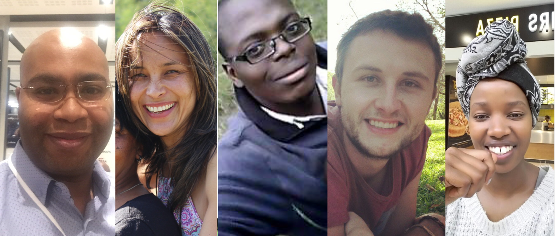
Transforming MTO Holistically

Slide 2
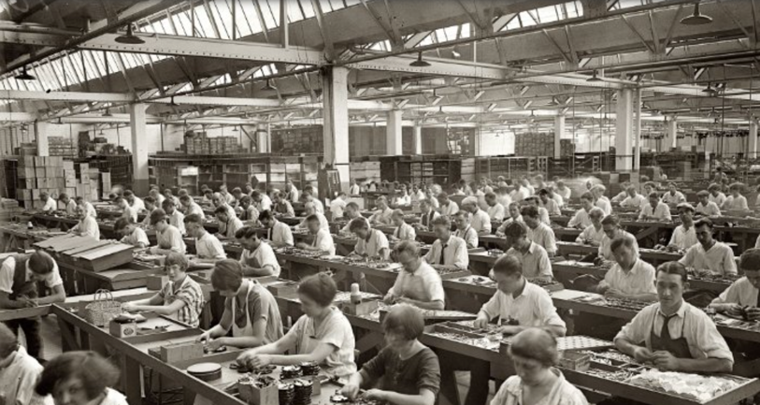
Transformation Debunked
It is in MTO’s DNA to continuously transform
Responsible transformation is interdependent, co-dependent and holistic and cannot be achieved in isolation
Transformation is a exciting journey
We see transformation as inclusive and a strategic imperative
We are committed to reshape and transform the African timber landscape, responsibly

Slide 3
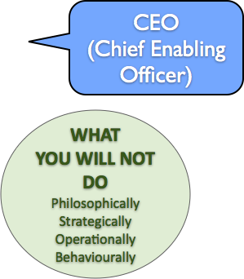
Our Transformation Landscape
TIME
Simplicity
Command and Control
Separation
Uniformity
Certainty
Cause and Effect
Empiricism
Efficiency
Complexity
Influence, delegation, empowerment
Integration
Diversity
Enquiry
Multi Cause
Intuition
Effectiveness and Adaptability
Old
World
Transformed World

Slide 4
MTO Transformation Strategy
Procurement
Industrial
JV’s
Agro-forestry
“business model”
Economic
Core
The “MTO Way”
Our Values
“Operating model”
Cultural
Identity
Enterprise Development
Socio-Economic Development
Employment Equity
Social
Development
System processes
Systems, BI, Digitisation, AI
Logistics
Digital
Innovation

Slide 5
Community
upliftment
Community
Health and Safety
Job Creation
Education
Job Opportunities
Community
Infrastructure
Socio Economic Development
Ownership
Funding
Skills
Enterprise and Supplier Development
Development
Enterprise and Supplier Development
Institutional Capacity
Building
Technical Training
Market Access
And Expansion
Development
Support

Slide 6
Leadership For
Supervisors
30
48
Mentorship Programme
24
30
Internal Skills Programme
120
60
Unemployment Skills Development Programme
Technical
Training
Emotional Intelligence
Development Program
180
13000
6

Slide 7
5000
1400
Wellness
Programme
Nutrition
Programme
200
1
Fire
Protection
Groundnut
Project
Donation of
Wheelchair
260
Community
Health and Safety
Ground Beans
Project
1000
Housing
Job Creation
Wetland
Rehabilitation
Clinic Upgrade
Community
Infrastructure
30
300
Community
Worker
30
200
Edunova
Job
Community
upliftment
Opportunities
Sports Uniforms and Equipment for Clubs
800
Education
Transport of School Learners
Bursaries
42
Key
32
Wilderness
Foundation
40
People
Songo and
Kwano
Community
Creches
Children
Schools
40
Jobs
3000
500
Scholars
18
3
6
40
45
Undefinable

Slide 8
Black Women in Forestry Trust (51% owned)
MTO Forestry (Pty)Ltd
(49% owned)
Asset Financing
Business Assessment
Work Capital requirements
Business Advice and Business Plan
Equity Funding
QSE and EME Business Support
Start Up Capital
Financial, Legal and Technical Assistance
Ownership
Development Driven through industry experts
Development
Support
MTO Enterprise Development (Pty)Ltd
Funding
Preferential Payment Terms
Training and Development
Institutional
Capacity
Building
Interest Free Loans
Market Access
And Expansion
Marketing Plan
Statutory Requirements and Reporting
Corporate Supply Chains
Governance and Compliance
Contractor Forums and Networking
Market Assessment
Create a Safe Working Environment
HSE Requirements Contractual Obligations

Slide 9
MTO Transformation Impact
Wages and Salaries: circa R200m
Wages and Salaries to Forest
Communities: circa R140m
1445 Jobs Supported
Skills Development: circa R8,5m
12000 Mandays trained
Procurement: circa R800m
Generic: circa R130m
QSE: circa R150m
EME: circa R170m
Black Owned: circa R100m
30% Black Women owned: circa R20m
Black owned contractor: circa R90m
2950 Jobs supported via contractors
Enterprise and Supplier Development: circa R14m
36 Black Contractors
Socio Economic Development: circa R4.2m
Taxes Paid: circa R105m
Retained Earnings: circa –R3m
Housing
(Sawlogs)
Infrastructure
(Poles)
Revenue
R1.3 bn
Markets
Mining
(Mining Timber)
Energy
(Biomass)
70 000 ha
Other
(Pulp, Panels, Etc.)
Sustainable
Harvest
Markets
650K m³

