Slide 1
Briefing to the Portfolio Committee on Economic Development
Tuesday, 28 November 2017
Time: 09h30 – 12h00
Venue: Committee Room S35, NCOP Building, Parliament
Presented by Mr Riaan Le Roux, Acting DDG: TISA

Slide 2
WORLD EXPORT
Global exports of goods were resilient, growing 4,3% in 2016.
Over the past seven years, from 2010 to 2016, export growth was 53% at constant prices.
The world’s top exported goods in 2016 were electrical machinery and equipment and parts thereof; sound recorders and reproducers, television; machinery, mechanical appliances, nuclear reactors, boilers and parts thereof; mineral fuels, mineral oils and products of their distillation; bituminous substances; minerals; vehicles other than railway or tramway rolling stock, and parts and accessories thereof; and natural or cultured pearls, precious or semi-precious stones and precious metals.
In world services, leading sectors in export in 2016 were travel (R12 trillion), other business services (R11 trillion) and transport (R9 trillion) at constant prices. The highest export growth in services, however, were realised by maintenance and repair services (18%); telecommunications, computer and information services (12%); charges for the use of intellectual property (10%); and personal, cultural, and recreational services (9,3%) at constant prices.

Slide 3
SA EXPORT SHARE TO WORLD (2010- 2016)
South Africa’s trade of goods with the rest of the world lost share, dropping to 0,47% in 2016 at constant 2010 prices. In the past seven years (2010 to 2016), South Africa’s export share for goods to the rest of the world has been decreasing, reaching its lowest levels of 0,47 per cent in 2016 at constant prices.
The US, China, Germany, the United Kingdom and Japan remain the top world exporters of goods with a collective export share of 38 per cent of the global exports.
South Africa is ranked 38 exporter to the world.

Slide 4
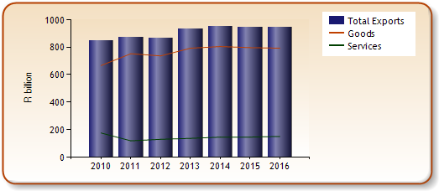
SA EXPORT SHARE TO WORLD (2010- 2016)
Exported goods weakened by 0.5 per cent in 2016,
The past seven years (2010-2016) export showed a firm growth of 19 per cent which was an additional export of R126 billion at constant prices.
The top 5 export partners were China, Germany, the USA, Botswana and Namibia and collectively amounted to R 399 billion or 48 percent of export world in 2016.
Top two exported goods are Platinum unwrought or in semi-manufactured forms, or powder and Motor cars principally designed for the transport of persons, both accounting for 8.3 and 7.3 per cent in 2016, respectively.
Services sector export to the world expanded by 3.5 per cent and reached R152 billion in 2016, contrast to the past seven years which reported a drop in export of 14 per cent or a short fall of R25 billion at constant prices.

Slide 5
SA TRADE BALANCE WITH WORLD(2010- 2016)
South Africa’s trade balance for goods remain in the negative territory, but the deficit improved to R2.1 billion in 2016 from R40 billion in 2015 at constant prices.
A rapid contraction in imports by 5 per cent was the main driver to narrow the trade deficit in the goods sector.
South Africa continued to be a net importer of services in 2016, the deficit was further widened by R1.2 billion to mark R5.9 billion in 2016 from R4.6 billion in 2015 at constant prices.

Slide 6
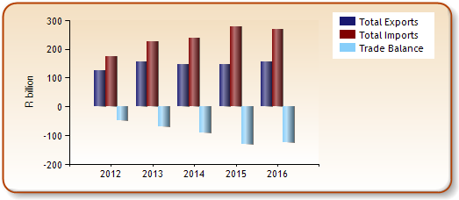
SA EXPORT TO BRICS (2010- 2016)
In 2016, Exports to BRICS, increasing to R156 billion or by 7 per cent, China was the main importer of South African goods, valued at R100 billion, followed by India with a value of R47 billion.
South Africa’s exports to BRICS countries are mainly from the subsectors like: Mining excluding coal; Metals metal products, machinery and equipment and coal with export values of R71 billion; R33 billion; R26 billion in 2016 respectively
Mining is the largest exporting sector to BRICS and grew exports by 9.4 per cent in 2016 to mark R98 billion. About 98 per cent of goods from this sector were destined to China and India. Most goods from this sector comprised of mining excluding coal and accounted for 72 per cent of the total mining exports to BRICS.

Slide 7
CONTRIBUTION TO THE STRATEGY OF THE DTI
Increasing the quality and quantum of foreign and domestic direct investment by undertaking effective investment recruitment campaigns, providing an efficient facilitation and information service in order to retain and expand investment into South Africa as well as into Africa. This will be a one-stop shop initiative.
Developing new and existing South African exporters' capabilities in order to grow exports globally (goods, services and capital) by providing appropriate information, financial support and practical assistance to sustain organic growth in traditional markets and to penetrate new high growth markets.
Effectively managing and administering the Foreign Office network.
Co-operation with key organisations The division works closely with other divisions of the dti, COTII agencies, other national government departments, provincial government departments and their agencies, urban metropolitan councils, chambers of commerce, private sector companies and international counterparts to meet it's objectives.

Slide 8
the dti’s WORK STREAMS
The dti has three work streams viz.:
EXPORT DEVELOPMENT, PROMOTION & MARKETING (TISA)
AFRICAN EXPORT PROMOTION AND INVESTMENTSUPPORT
(TIA)
INVESTMENT PROMOTION & FACILITATION
(INVEST SA)
Export Development as a programme of TISA, is designed to contribute towards the positioning of South Africa as a reliable trade partner by expanding the exporter base of the country thereby increasing the export base of the country thereby increasing the export supply and sales of South African goods and services.
TIA supports ‘Development Integration’ by identifying infrastructure and industrial projects in RoA aimed at trade facilitation with the mandate to implement an outward investment-led trade strategy towards RoA.
Investment Promotion and Facilitation is responsible for attracting foreign direct investment as well as developing and promoting local direct investment

Slide 9
EXPORT DEVELOPMENT, PROMOTION AND MARKETING

Slide 10
EXPORT PROMOTION AND MARKETING
Export Promotion in Context
Export Promotion Directorate is responsible for developing and promoting South African goods and services including specific technical interventions in terms of EMIA financial support, matchmaking, market intelligence, trade lead facilitation and in-market support. This business unit aims to increase the market penetration of South African companies in order to export products and services into various markets. The assistance provided is in the form of financial or non-financial assistance.
The aim of Export Promotion is to lead and facilitate access to sustainable economic activity and employment for all South Africans through higher levels of employment, and increased access for South African products and services in international markets; and, to create a fair, competitive and efficient marketplace for domestic and foreign business as well as for consumers.

Slide 11
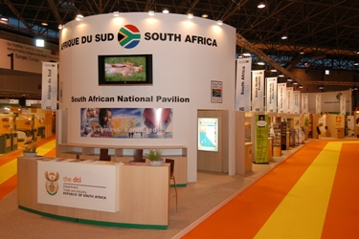
EXPORT PROMOTION AND MARKETING
Export Promotion Offerings:
Group Offerings
National Pavilions
Outward-Selling Trade Missions
Outward Investment Recruitment Missions
Inward-Buying Trade Missions
Inward Investment Missions
Individual Offerings
Primary Export Market Research
Foreign Direct Investment Research Scheme
Individual Inward-Bound Mission
Individual Exhibitions and In-store Promotions
Sector-Specific Assistance Schemes:

Slide 12
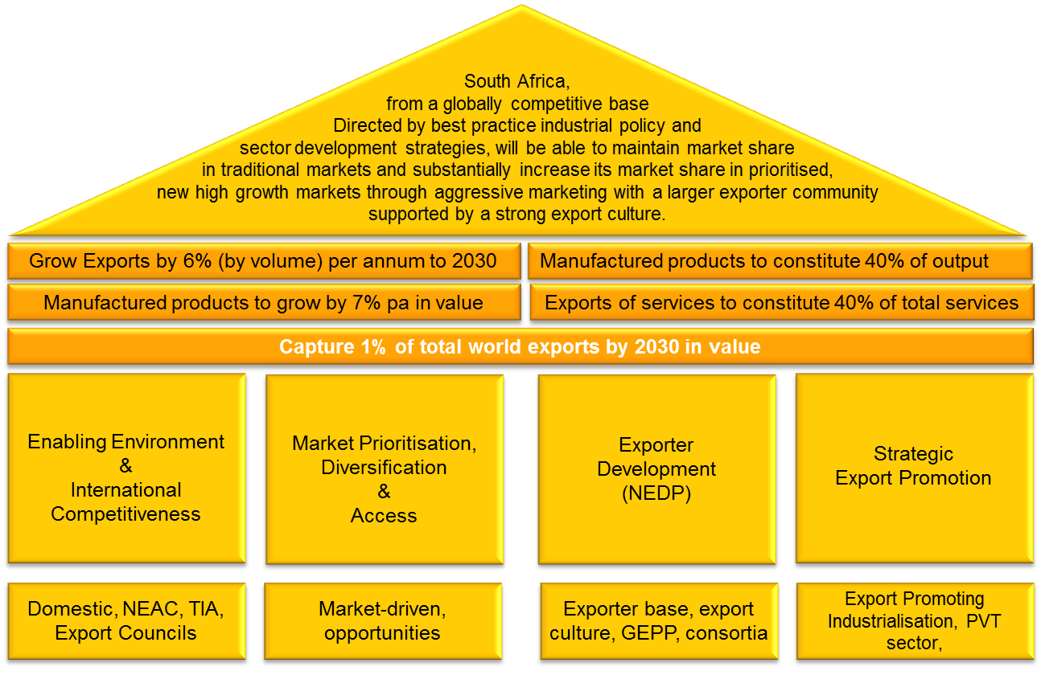
The ines at a glance

Slide 13
INTEGRATED NATIONAL EXPORT STRATEGY
THE export value chain

Slide 14
Raw materials
Ports
Transport. Communication Finance
Energy
Transport. Communication Finance, SPS and other technical standards
Ports
Distribution
Pillar1: Improve on South Africa’s enabling environment and build international competitiveness
Pillar 2: Increase demand through Market Prioritisation, Diversification and Access
Pillar 4: Strengthen the Export Promotion Mechanisms
Pillar 3: Increase export capacity and strengthen exporter performance through NEDP
Cost of inputs
Infrastructure & service costs
Business Environment
Standards compliance
Exporter development
Export costs
Market access
Export Promotion
Tariffs
Regulatory systems
FDI openness
SPP/TBT compliance
Export culture
Efficiency of port services
Agriculture Manufactures Services
Export Promoting Industrialisation
Duty drawbacks
Export investment links
Export information
Export subsidies/ domestic support
Private Sector Engagement
Efficiency of service providers
Tariff on capital goods
Conformity assessment
Trade leads
In-land transport costs and availability
Trade facilitation
Non-tariff measures
Export Instruments
Market access to foreign suppliers
Protection of property rights
Capacity building of potential exporters
Rules of origin
Preferential trade regimes
Market Penetration
Good governance
Mutual recognition/ equivalence agreements
Export Villages & Consortia
Trade facilitation
Customs valuation
Competition policy
Regional integration
EMIA
Financial Instruments & credit guarantee
Labour market
Global Exporter Passport Initiative
Border
Behind the border
At border
Beyond the border

Slide 15
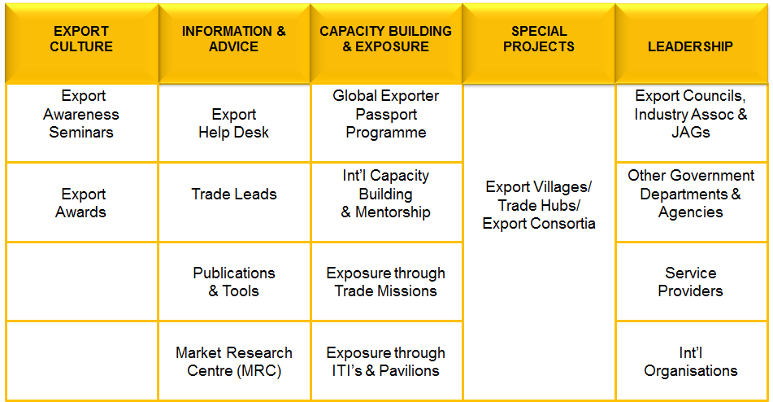
NATIONAL EXPORTER DEVELOPMENT PROGRAMME
COMPONENTS OF THE NEDP

Slide 16
GLOBAL EXPORTER PASSPORT PROGRAMME
GLOBAL EXPORTER
PASSPORT PROGRAMME
Global
Exporter
Start-up
Exporter
Consolidate current markets (market penetration)
Enter new markets (market development)
Develop new products (product development)
Topic Specific Workshops/Seminars
Export
Ready
Export
Aware
Requires a more in-depth training programme culminating in a customised export marketing plan
Export Orientation
Requires further specific training to support the implementation of the export marketing plan
Topic Specific Workshops/Seminars
Explorer
Has an idea of what exporting entails but lacks the necessary knowledge and basic export skills
Introduction to Exporting
Exploring options for developing the business, of which exporting might be a possibility.
Export Awareness Seminar

Slide 17
OVERVIEW TARGET MARKETS
Asia | Latin America | North America | Middle East | Europe
China Hong Kong India Indonesia Japan South Korea Malaysia Philippines Singapore Thailand Vietnam | Argentina Brazil Chile Peru Colombia Venezuela Uruguay | Canada Mexico USA Cuba | Iraq Iran Kuwait Oman Qatar Saudi Arabia UAE | EU28 Russia Turkey

Slide 18
Target sectors
Aligned with sectors already prioritised in the basket of broader industrialisation and growth initiatives undertaken by the government;
The sectors, include a mix of high, medium and low value addition activities;
The sectors also have a strong domestic firm base of both large and small producers.
Advanced
Manufacturing
Boatbuilding & associated services
Electro-technical (incl. Software & White Goods)
Aerospace &
Defence
Clothing, Textiles, Leather & Footwear
Metal Fabrication, Capital & Rail Transport Equipment
Agro-processing (incl. Food/Beverages & Furniture)
Cultural and Creative Industries
Plastics, Pharmaceuticals, Chemicals and Cosmetics
Automotives
Green Industries
Services

Slide 19
IPAP LINKAGES WITH INTERVENTIONS: MAIN TRANSVERSAL FOCUS AREAS
IPAP LINKAGES WITH INTERVENTIONS:
MAIN TRANSVERSAL FOCUS AREAS
Export Promoting Industrialisation
Export culture
REN Approach Support
Export Development & Promotion

Slide 20
CURRENT GLOBAL FOOTPRINT
Europe: Brussels, London, Milan, Moscow, Stockholm, The Hague, Berlin, Madrid, Munich, Paris & Vienna
North America: Chicago, New York, Washington & Toronto
Asia: Beijing, Hong Kong, Seoul, Shanghai, Tokyo, Bangkok, Jakarta, Kuala Lumpur, Mumbai, New Delhi a & Singapore
Middle East: Cairo, Dubai, Riyadh, & Tehran
South America: Sao Paulo & Buenos Aires
Africa: Addis Ababa, Abuja, Harare, Kinshasa, Luanda, Maputo, Nairobi, Dakar Accra, Juba, & Algiers and Dar es Salaam
Australia: Canberra

Slide 21
South african value proposition
 | Value Proposition | Sector Opportunities
MIDDLE EAST | Proximity to markets Agro-processing and supply capabilities Growing Talent pool Technology and skills transfer Defence technologies and solutions | Agriculture and Agro-Processing Infrastructure
AMERICAS | AGOA duty-free access on most products. Fresh fruit can be supplied during counter-season. Easy transport access from RSA to USA East coast and to Canada. Expertise equipment and services for deep mining. Due to bio-diversity in RSA, many natural products and ingredients can be exported. | Automotive Components Mining Equipment and other machinery Fresh and Processed food Pharmaceutical Products Perfumes and cosmetics Jewellery Sailing Yachts

Slide 22
South african value proposition
 | Value Proposition | Sector Opportunities
ASIA | Low levels of sufficiency in agribusiness Infrastructure opportunities in ASEAN Refurbishment / Revitalisation of Mining | Automotive Components Mining Equipment and other machinery Agriculture and Agro-processing Pharmaceutical Products Perfumes and cosmetics Jewellery
EUROPE | SADC-EPA and TDCA market access Counter-seasonality Commitment to quality assurance to meeting EU standards Export infrastructure Advanced manufacturing capabilities | Agro-Processing including organics Cosmetics including natural ingredients Vehicles & Automotive Components Metal Processing Electronics Composites Processing Rubber Plastics Industrial Equipment Sub-contracting

Slide 23
Implementation plan
SHORT-TERM
MEDIUM-TERM
LONG-TERM
Export Culture
National Exporter Development Programme (NEDP)
Export Promotion in prioritised markets
National and Sector Branding
Competitiveness Issues
Financing mechanisms
Increasing manufacturing capacity and capabilities
National and Sector Branding
Infrastructure, Logistics
Skills

Slide 24
the Implementation of the INES
INES
Three Year Rolling Plan
Annual Budget
Country Export Plans (FSM)
Provincial Export Plans (PIPAs)
Sector Export Plans (Export Councils)
Regional Export Plans

Slide 25
The end game
Leading per capita exporting nation in Africa through export promoting industrialisation
South Africa’s domestic competitiveness move towards international competitiveness
Stronger export culture with robust export community
Improved trade facilitation
Strong political support for the export agenda
Improved export infrastructure and reduced trade-related costs
Strengthen linkages between exports and investments
A national system of Trade Promotion Organisations
Streamlined and strengthen institutional architecture
Improved and effective trade promotion efforts
Enhanced market access and penetration through GVCs
Improved incentive regime aligned to WTO rules

Slide 26
TRADE INVEST AFRICA

Slide 27
SA’s APPROACH TO RoA DEVELOPMENT INTEGRATION
Industrial Development
Market Integration
Infrastructure Development

Slide 28
GENESIS OF TRADE INVEST AFRICA
Medium Term Strategic Framework 2014 – 2019 and the DTI Strategic Goals:
“Work for regional industrialisation and integration:
• Work with our partners to ensure increased exports - particularly manufactured and value-added exports.
• Working with other African states, South Africa will take forward a regional industrialisation agenda to ensure Africa becomes a manufacturing and industrial power.
• Trade among African countries will be further promoted as part of our effort to support regional integration to create large regional markets to sustain industrialisation.
• We will work together with state-owned enterprises, development finance institutions and the private sector to address infrastructural needs in Africa.”
TARGET: Create an Africa Export Council in the 2016/17 financial year.
01 April 2016 – Redefinition of the target. Africa Export Council refined and re-branded to Trade Invest Africa to ensure a holistic and sustainable approach to trade and investment on the continent.
Trade Invest Africa launched on 15 July 2016.

Slide 29
WHO WE ARE
Launched on 15 July 2016, Trade Invest Africa is an initiative of the dti aimed at increasing the levels of South Africa’s investments and trade with the rest of Africa (RoA).
Trade Invest Africa is created to be the go-to unit in the dti for companies looking for trade and investment opportunities in the rest of Africa and those that are already operating on the continent and are facing challenges.
Trade Invest Africa will also work closely with governments and business in the rest of Africa to facilitate exports from the continent into South Africa. This is our direct contribution to increasing the levels of intra-Africa trade.
Trade Invest Africa offers facilitation support to business and utilises outward investments to the RoA to drive South Africa’s value-added exports and create mutually beneficial economic relationships.

Slide 30
WHO WE ARE
Trade Invest Africa supports ‘Development Integration’ by identifying infrastructure and industrial projects in RoA aimed at trade facilitation.
Mandate: implement an outward investment-led trade strategy towards RoA.
This is the only way to address the trade imbalance with RoA and ensure sustainable economic partnerships and growth.
As South Africa invests in and imports from the RoA, we create future demand for South Africa’s own value added exports – Virtuous Cycle

Slide 31
OUR OBJECTIVES
To position South African entities and companies (SA Inc.) as the preferred suppliers of value-added goods and services to the RoA.
To uncover trade and investment opportunities for SA Inc. in the RoA.
To assist South African businesses already operating in RoA to resolve any market access issues.
To assist South African business with market entry strategies for RoA markets.

Slide 32
OUR OFFERINGS
Trade Invest Africa will facilitate for South African business the necessary services related to trade and investment on the continent.
The focus is specifically on export ready companies that are able to supply goods and services to the RoA.
We encourage the businesses we support to embrace the Guidelines for Good Business Practice in Doing Business in Africa.

Slide 33
OUR OFFERINGS

Slide 34
OUR OFFERINGS
Access to Capital
Trade Invest Africa is working with various institutions to facilitate access to capital. Financial support will be provided through leveraging SA DFIs and the dti incentives for:
Export insurance financing.
Export market exploration support.
Export promotion financial support.
Infrastructure and industrial project funding.

Slide 35
OUR OFFERINGS
2) Access to Markets
Trade Invest Africa facilitates access to market opportunities through:
Undertaking sector-specific and project-specific business missions to the continent.
Unlocking trade and investment opportunities through government-to-government engagements.
Addressing non-tariff barriers to trade.

Slide 36
OUR OFFERINGS
3) Other Non-Financial Support
A suite of other support measures provided by Trade Invest Africa include the following:
Undertaking market research.
Establishing a portal for business networking and match-making.
Sharing of information on African markets with business through dialogue platforms.

Slide 37
CURRENT OPERATIONAL MODEL AND BUDGET
Trade Invest Africa is currently operating on the basis of transferred officials from within the dti.
The current staff complement is 18 officials and 10 interns who are on a two year contracts which will expire on 31st March 2018.
The allocated goods and services budget for the 2017-18 financial year is R2,786 million.

Slide 38
TIA SUB-PROGRAMMES
TIA Executive Unit provides strategic and operational support to the dti to ensure effective and efficient implementation of an outward investment-led trade strategy towards the Rest of the continent.
TIA Stakeholder and Knowledge Management creates and maintains strategic relations key stakeholders; generates cutting-edge knowledge on trade and investment opportunities on the continent and also facilitates the publication of opportunities and dissemination thereof to stakeholders.
TIA Investment Facilitation facilitates South Africa’s manufacturing infrastructural development investment to other African markets continent as part of South Africa’s contribution in increasing intra-Africa industrialization.

Slide 39
TIA SUB-PROGRAMMES (2)
TIA Trade Facilitation positions South Africa as a preferred source for value added goods and services on the African continent through undertaking project- and sector- specific outward missions aimed at increasing South Africa’s exports to markets on the African continent. It also creates sourcing relationships within the African market for increased imports from the rest of the continent into South Africa. Address market access concerns and barriers to trade and investments.
TIA Government to Government Relations broadens and strengthens bilateral economic relations with partner countries thereby contributing to conducive environments for business to thrive. The unit utilises bilateral platforms to address and unlock trade and investment barriers experienced by businesses operating in the African continent and it also supports the deepening of regional integration.

Slide 40
KEY DELIVERABLES (01 April 2017 – TO DATE)
1) MARKETING AND OUTREACH
Participated in a regional workshop with the Chemical Clusters Industry association in KZN
Co-hosted inward delegations from Ghana and Nigerian with Investment Promotion Agencies in partnership with GGDA and WESGRO – MoUs with IPAs are being discussed
Participation in workshop hosted by the Cross Border Road Transport Agency
Participated in the WEF Africa workshop
Participated in the CEO’s forum of the Association of African Development Finance Institutions in Nigeria
Participated in the AFREXIM Conference in Kigali, Rwanda
Participation the African Development Bank’s – Private Sector Development Forum – Africa focus
Participation in the African Development Bank’s review of the South African Country Strategy Paper
Shared the TIA approach at an Africa Focused Information Shared at the Gordon’s Institute of Business Science

Slide 41
KEY DELIVERABLES (01 April 2017 – TO DATE)
2) STAKEHOLDER ENGAGEMENTS
Meetings held with various companies looking input on their market entry strategies and market optimization strategies; as well as with respect to infrastructure and industrial project opportunities on the continent.
Meetings held with various African Missions based in South Africa for collaboration and information-sharing.
Continuous engagements with DFIs and SOCs for activating the SA Inc. approach to the continent.

Slide 42
KEY DELIVERABLES (01 April 2017 – TO DATE)
3) GOVERNMENT-TO-GOVERNMENT PLATFORMS
Chaired the Economic Cluster deliberations of the following bilateral government-to-government engagements to discuss amongst other investment projects, bilateral cooperation and resolve barriers to affecting the trade and investment
South Africa - Tanzania Bi-National Commission
South Africa – Zimbabwe Bi-National Commission
South Africa – DRC Bi-National Commission
South Africa – Botswana Bi-National Commission
South Africa – Mozambique Bi-National Commission
South Africa – Angola JCC
South Africa – Senegal JCC
South Africa – Angola JTIC
South Africa – Republic of Congo JTIC
4) TRADE AND INVESTMENT CONFERENCES
Co hosted the Invest in Madagascar conference in partnership with the DBSA – Pretoria
Participated in the Exports to Africa seminar held in Tshwane with the Export Development unit of TISA
Hosted an information session with the World Bank focused on increasing South African participation in World Bank funded programmes.
Participated in the Manufacturing East Africa Conference – Nairobi Kenya.
Co-hosted the Infrastructure Africa Conference in Johannesburg

Slide 43
KEY DELIVERABLES (01 April 2017 – TO DATE)
5) ACCESS TO MARKETS
Co-drafted strategy for Inter Ministerial Committee on engagement with Zimbabwe
Facilitated and undertook the 2nd outward business mission with Black Industrialists to Uganda.
Undertook the flagship Investment and Trade Initiative to Democratic Republic of Congo (franco-phone).
Undertook a rail and infrastructure technical mission with Transnet to Benin
Undertook business mission to Ghana and Ethiopia in collaboration with WESGRO.
Undertook an infrastructure focused investment mission to the Republic of Congo
Undertook a agriculture focused mission to Ethiopia with Agricultural Research Council
Undertook an energy focused mission to Zambia
Engaged South African investors already invested in Zambia through a dinner hosted at Ministerial level in order to uncover challenges affecting investors
Managed the business forum component to inward State Visit from Senegal to advance collaboration on infrastructure development.
Co-Managed the business forum component to outward State Visit to Zambia and mobilized South African participation

Slide 44
ENVISAGED OUTPUTS BY 31 MARCH 2018
Manage the Business Forum component of the Inward State Visit from Angola – November 2018
Lead and Outward Trade and Investment Mission to Ghana and Nigeria – March 2018
Mobilise South African participation in the Ghana International Trade Fair – February 2018
South Africa – Uganda JTIC
Draft Concept on Africa Gateway project to facilitate Trade Missions on the Continent
Draft Concept on the Africa Dashboard as part of non-financial support that is availed to potential South Africa exporters and investors engaging on the continent

Slide 45
SOUTH AFRICA’S TRADE AND INVESTMENT LINKS TO RoA

Slide 46
South Africa’s Global Export Markets 1994 - 2016
Source: www.thedti.gov.za
Notes:
Africa as a substantial export market gained momentum since 2002, where it became the 3rd largest market for South African goods and has grown significantly, surpassing Europe and Asia in 2009 and 2015 respectively to become the leading export destination for South Africa (Figure 1).
• Exports of goods to the African continent rose significantly from R 9, 66 billion in 1994 to R 301, 45 billion in 2015. Growth in Asia, Europe and Americas also recorded significant amounts but far below the growth of Africa. This highlights the importance of Africa as an attractive market for South Africa’s goods and services.

Slide 47
South Africa’s Trade with RoA, 1994 - 2015
Source: www.thedti.gov.za
Notes:
Exports to the RoA exceeded the R 300 billion mark for the first time in 2015, rising from R 6, 9 billion in 1994.
• However, imports from the RoA decreased from its peak of R 141 billion in 2014, to R 114 billion in 2015.
• South Africa has consistently enjoyed a trade surplus with the RoA throughout the 21 year period.
• As illustrated above, exports to the RoA have continued to grow sharply since 2008, during the financial crises from R 104 billion in 2008 to R 301 billion in 2015.

Slide 48
Top-10 Export Destinations in RoA 2006 - 2015
Source: Quantec
Notes:
• Botswana consumes most exports from South Africa at 17.3% followed by Namibia and Mozambique while Nigeria and Angola as our priority countries registers a low 3,8% and 3,5% respectively.
• South Africa’s share of exports in Africa is dominated by the SADC countries (Angola, Botswana, DRC, Lesotho, Mozambique, Namibia, Swaziland, Zambia and Zimbabwe).
• For the rest of Africa, only Nigeria is featured with the lowest market share of SA exports.

Slide 49
INVESTMENT PROMOTION AND FACILITATION

Slide 50
Background ISA
The ability to attract foreign direct investment largely depends on factors such as image, brand awareness and investor perceptions. Investment Promotion Agencies must therefore ensure that their operational functions are geared towards addressing the aforementioned imperatives holistically as a pre-condition for success.
A number of different models for a national investment promotion agency were considered, through research conducted in a number of countries and reports emanating from various multi-lateral institutions. the dti also studied various models of trade and investment promotion specific to international best practice including Malaysia, Singapore and Ireland and as such our current model reflects aspects of those studied.

Slide 51
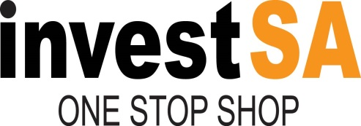
Who are we?
National Investment Promotion Agency and One Stop Shop

Slide 52
Who are we?
National Investment Promotion Agency and One Stop Shop

Slide 53
The Investment Cycle
The following is a depiction of the Investment Cycle and outlines what an IPA has to do for investor (above the arrow) and what the investors expects in terms of developing their business case for an investment location (below the arrow). It highlights the need for capacity to be built and the fact that resources to develop a well-functioning Investment Promotion Agency and One Stop Shop facility at National level.

Slide 55
The Investment Promotion and Facilitation Strategy (IPFS) Value Chain
According to international best practice for an Investment Promotion Agency (IPA) to execute the basic universal functions, it requires four distinct functional areas.
These are: (1) Investment Policy and Strategy (2) Lead Generation Activities (Promotion) (3) Investment Marketing (targeting); and (4) Investment Servicing (Facilitation, Aftercare and Retention).
The Investment Promotion and Facilitation Strategy (IPFS) value chain is depicted in the following illustration.

Slide 57
Factor Endowments
Industrial Policy
Improve Competitiveness
Trade
Policy
Export Promotion
Domestic investment
Exporter Development
FDI Promotion
FDI
Resource seeking
Beneficiation
Investment
Exports
Market seeking
Trade Facilitation
Efficiency seeking
Integration into GVC
Strategic asset seeking
Sound macro, monetary policy, infrastructure, skills

Slide 58
SECTOR FOCUS
GREEN ECONOMY
SERVICES
MANUFACTURING
ADVANCED MANUFACTURING
RESOURCE BASED INDUSTRIES

Slide 59
Priority Sectors For FDI
Advanced Manufacturing
Nanotechnology
Metals
Mining & Beneficiation
Biofuels
Agribusiness
Automotives & Components
Capital Equipment
Precision engineering
Aerospace
Film production
Tourism
Oil & Gas
Boat Building
ICT and electronics
BPO (Business Processing & Outsourcing) and Call Centres
Chemicals & Biochemicals
Plastics & Composites
(Bio) Pharmaceuticals & Medical Devices
Leather and footwear
Forestry products & Furniture
Energy and Renewables
Infrastructure Development
Waste Management
Energy Efficiency & Cleaner Technology

Slide 60
INVESTMENT CLIMATE Response by President Zuma: IMC on Investment
President Zuma established an Inter-Ministerial Committee on Investment Promotion to further improve the investor climate and support. The IMC, which is chaired by the President, assisted by the Minister of Trade and Industry, focuses on the following tasks: 1. Overall coordination, alignment and policy coherence on economic policy and regulatory framework, thereby providing clarity and certainty to investors. 2. Improvement in South Africa's investment climate in particular the ease of doing business and competitiveness of South Africa. 3. Coordination and roll out of the One Stop Shop Service across all levels in government. The One Stop Service will fast track, unblock and reduce red tape in government. All departments in the three spheres of Government need to commit to a continuous improvement and a service delivery ethos. 4. Overall coordination and alignment in terms of South Africa's marketing, communication, and media in terms of our messaging of South Africa as an investment destination both locally and abroad. 5. Scaling up private sector investment, higher impact Industrial Policy Action Plan, support for the black industrialist programme, SME development and the Township Economy. 6. Identification, packaging and implementing investment projects in terms of the national interest and economic development. 7. Regional integration and industrialisation of the African Continent. 8. Promoting cooperation and partnerships between government and the private sector. 9. Coordinate inputs into the task teams of the Presidential Big Business Working Group and the new BBBEEE Commission.

Slide 61
Investment South Africa
Investment South Africa (InvestSA) was formally established as a separate division at the Department of Trade & Industry as Programme 8 from 1 April 2016. Investment South Africa was separated from TISA with a view to being the central nodal operational structure at national level that would act as a convener for the Inter Government Clearing House, establish a National and nine Provincial One Stop-shops and coordinate the work of the Provincial Investment Agencies.
Currently, InvestSA is the defined focal point in Government that supports and facilitates investment. ISA’s main contribution to the objective of the dti is that of promoting inward investment as well as developing a sustainable long-term competitive market position and international profile for the country. In this context, ISA focuses on improving South Africa’s investment climate, the cost of doing business, and continues to build South Africa’s position as an attractive investment destination.
Investment South Africa plays a critical client role within the dti. The division fulfils one of the dti’s core mandates, namely Investment Promotion, Facilitation and Aftercare.
The operational functions of Investment South Africa are based on an accumulated set of methodologies premised on international best practices. It is incumbent on Investment South Africa to innovate in the execution of this mandate.

Slide 62
Investment South Africa
Is the focal point of contact in government for all investors to coordinate and facilitate the relevant government departments involved in regulatory, registration, permits and licensing;
Will shorten and simplify administrative procedures and guidelines for issuance of business approvals, permits and licenses, thereby removing bottlenecks faced by investors in establishing and running businesses;
Will reduce the silo mentality, turnaround times , red tape and improve service delivery. ISA will fast track, unblock and reduce red tape in Government;
Will provide the following services to Investors:
Facilitation of the entire investment value chain;
Specialist advisory services to investors;
Co-ordination between the various line ministries;
Communication of these services to potential investors; and
Be the facilitation window of clearance for registration, licensing and permits

Slide 63
ONE STOP SHOP CONCEPT
Serve and accessible entry point for investors in need of regulatory compliance with laws and / or regulations at a national level;
Change regulator decision process (registration, lisencing, permitting, land allocation or property registration) by increasing transparency, clarify regulations and improve the quality and timeframe of service;
Perform pre-and post investment screening for appropriate investors and investments into South Africa on a project by project basis;
Allocate various incentives (tax, land, training, free zones, etc.);
Participate in the regulatory reform / roadmap process of South Africa;
Provide pre-approval services (market data, costs, incentives, project approval, visits, local partners, etc.) to investors; and
Provide post approval services (permits, approvals, import equipment & raw materials, central bank profit repatriation, work permits, etc.) to the investor.

Slide 64
How will it function?
Inter-Governmental Clearing House
Presidency
PBWG
Economic Sector Employment & Infrastructure Development (ESEID)
Technical Cluster
IMC
MinMec
Invest SA
One Stop Shop
Technical MinMec
SOEs
Govt Depts
Agencies
SEZs and PIPAs
Policy & Regulatory
Permits & Licensing
Infrastructure
Finance & Incentives
dpme, the dti, Treasury, dha, DOL, DPME, Water & Sanitation, DEA, COGTA, Rural Development & Land Reform, DOE, DAFF, dst, DOH, dpe, EDD, dot, dtps
the dti, dha, DMR, COGTA, dea, Rural Development & Land Reform, Water & Sanitation, DOL, dirco, DAFF, DOH, EDD, DOE, dpe, dot, dtps
EDD, the dti, dpe, COGTA, Water & Sanitation, dot, dtps
the dti, Treasury, DOE, DAFF, dst, EDD

Slide 65
IMPLEMENTATION
One Stop Shop
Secretariat
Immigration, Labour & Talent
Regulatory & Compliance
Environmental Impact Assessment
Licensing, Permits & Registrations
Due Diligence, Incentive Facilitation, Funding & Finance
Inter- Governmental Facilitation
Investor Information
Investor Service & Aftercare
Stakeholder Management
Contact Centre
Marketing, Communication, Operations , Legal & Financial Management
IT and CRM
Monitoring & Evaluation

Slide 66
Coordination of the IMC & Top 40 Projects
4 March 2016 – Inaugural Inter-Ministerial Committee (IMC) on Investment meeting.
April 2016 – the dti establishes a new division Investment South Africa to implement One Stop Shop.
Regular Technical Task Team (TTT) meetings are chaired by DG in Presidency Dr. C. Lubisi.
TTT has identified Top 40 projects for Government to implement in terms of the 9 point plan.
InvestSA & TTT meet regularly to fast track, unblock and reduce red tape in Government.
Investment South Africa was tasked by the Inter-Ministerial Committee (IMC) on Investment to coordinate the Top 40 Investment projects across government and implementing agencies.
These high-impact investment projects are in Agriculture and Agro-processing, Agri-parks, Energy, Infrastructure, Beneficiation and Manufacturing subsectors.
Of these 40 projects, 10 have been assigned high-priority status and will be fast-tracked and monitored by the IMC.

Slide 67
Establishment of the One Stop Shop
The National One Stop Shop in Pretoria became operational from 17 March 2017
Additionally, three more One Stop Shops in Gauteng, KwaZulu Natal and the Western Cape are scheduled to be launched during the 2017/18 Financial year.
The graph below illustrates the operational activities of the National One Stop Shop over the reporting period:

Slide 68
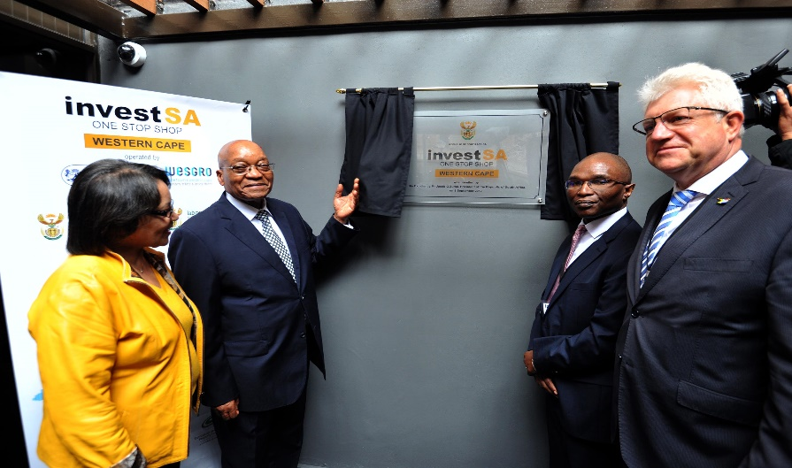
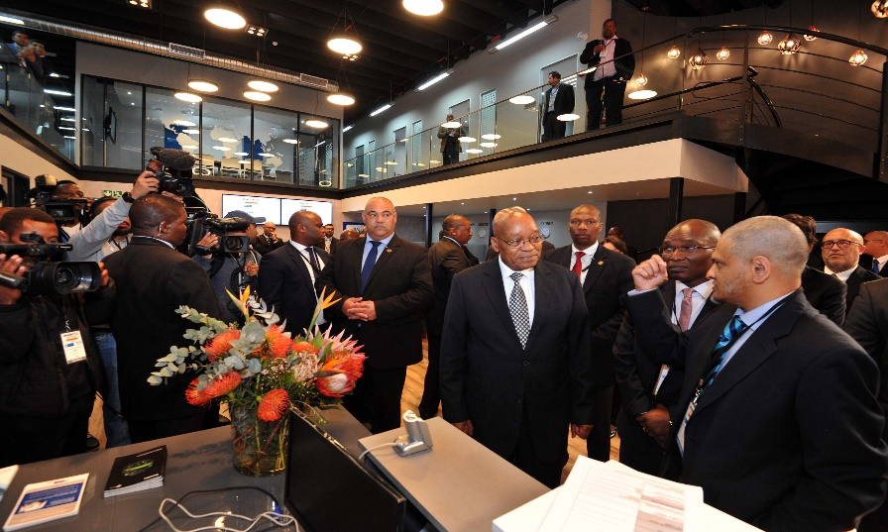
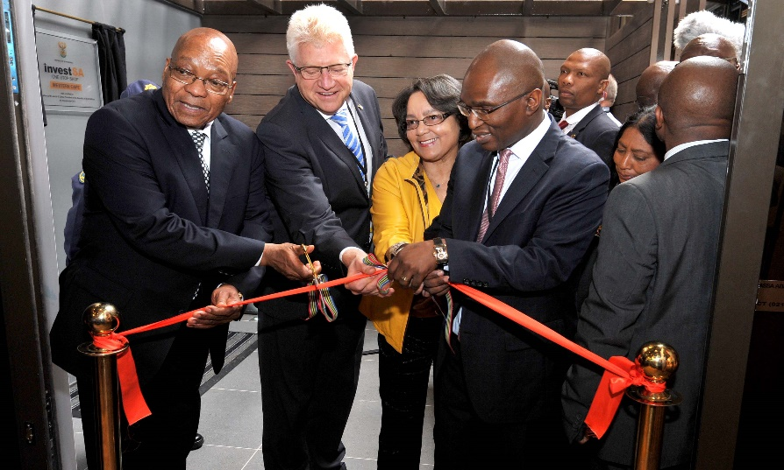
Launch of Provincial InvestSA One Stop Shops
The InvestSA Western Cape One Stop Shop was launched on 8 September 2017 and the IvestSA KZN OSS on the 18th November 2017
The operational launches of the One Stop Shops was attended by National and Provincial Government officials; Investors and Regulatory Agencies.
President Zuma lauded this as an important milestone to enhance investor services and confidence.

Slide 70
SUPPORTING SLIDES

Slide 71
CONTENTS
IDAD export incentive suite
Overview of export support offerings
Output and impact of support
Challenges
Improvements

Slide 72
Industrial Development Administration Division (IDAD)
Mission
To stimulate and facilitate the development of sustainable, competitive enterprises through efficient provision of effective and accessible funding mechanisms (i.e. incentive schemes) that support national priorities
Strategic Objective
Facilitate transformation in the economy, to promote industrial development, investment, competitiveness and employment creation

Slide 73
CURRENT IDAD EXPORT INCENTIVES
Aspiring & existing exporters
EMIA Individual Exhibition Assistance (IE & IP)
EMIA Primary Market Research (PMR & R)
Sector Specific Assistance Scheme (SSAS)
Capital projects Feasibility Programme (CDP)
Individual Inward Bound Missions (IIBM)
Aspiring exporters
Seasoned exporters
Seasoned and aspiring exporters
Capital
goods contractors and engineers

Slide 74
PURPOSE OF THE INCENTIVES
SSAS
Sector focussed groups of emerging exporters developing into seasoned exporters and sector focused market development/research projects
IE & IP
Individual entities participation at recognised exhibitions abroad where TISA does not provide a national pavilion
PMR & PR
Individual entities for conducting primary research in foreign countries to develop new export markets
CPFP
IIBM
Groups of five or more SMME or HDI entities to showcase SA manufactured products in targeted retail outlets abroad
Individual entities for international patent registration, trademark, copyright and product certifications
Individual entities organising an inward buying mission for prospective international buyers to conclude export orders
Capital goods feasibility projects that will increase SA exports and stimulate the growth of local capital goods and services sector and allied industries

Slide 75
EMIA I SECTORAL APPROVAL PROFILE
408 individual entities approved in the previous financial year with agro processing, textiles, chemicals and allied sectors showing increasing approvals from the previous financial year

Slide 76
EMIA I REGIONAL APPROVAL PROFILE
More than half of the approvals emanated from the Western Cape and within the agro processing sector with improvements in the number of approvals from Limpopo North West and KZN from the previous financial year

Slide 77
EMIA I ENTITY OWNERSHIP PROFILE
‘Other’ entities referring to large entities
SMME’s approvals representing more than half of the 408 approvals of which 71 were female owned

Slide 78
EMIA I APPROVAL PROFILE
13 Countries representing 80 % of the total number of approvals in the 2016/2017 financial year
Approvals for events in Africa representing 8 % of the total number of approvals for the 2016/2017 year

Slide 79
SSAS SECTORAL APPROVALS
764 individual entities approved in the previous financial year with creative industries, textile and agro processing sectors constituting 70 % of the total number of approvals with on average 15 enterprises participating per exporter event

Slide 80
APPROVED SSAS REGIONAL PROFILE
Encouraging trend developing towards high value adding products and services in the previous financial year 76 % of approvals from Gauteng and Western Cape Provinces

Slide 81
APPROVED SSAS OWNERSHIP PROFILE
58 % of all approvals were for black owned enterprises and a total of 332 female owned enterprises received financial support

Slide 82
SSAS SECTORAL SHIFTS
Encouraging shift of the number of enterprise approved for Textiles, Electro technical, Metal, Mining, Energy and Services sectors from the previous year

Slide 83
APPROVED SMME’s
92 % of all enterprise approved were SMME’s with 65 % emanating from SSAS

Slide 84
EMIA INCENTIVE CHALLENGES
Sub-optimal national central repository and touchpoints for all emerging and SME exporters to better respond to their individual life cycle, capacity and capability requirements in order to raise their success in export markets;
Lack of a digital platform for the collection, storage and capturing of enterprise information and export benefit analytics ;
Limited verifiable means to track export sales generated over the life of individual exporters;
Varied exporter capabilities and entity sizes means that “one size fits all” suite of offerings may need always be well aligned to the requirements of these entities;
Varying visibility and quality of SSAS emerging exporter development models across the various National support institutions and export councils;
Geographic participation still dominated by Gauteng, Western cape and Kwazulu- Natal provinces

Slide 85
SUGGESTED IMPROVEMENTS
Raise pre and post application approval visibility of emerging exporter maturity levels in order to better understand progression and growth of these enterprises over time;
Improve financial support alignment with geographic and IPAP priority sector diversification and within national sectors;
Strengthen Export Council managed tracking, validation and reporting of export sales performance and related data;
Standardise the integrity of a national pre and post event support architecture and repository for smaller entities – to better set them up for success and understand their individual competitiveness improvement support requirements;
Better socialization of incentive offerings in under represented regions and IPAP sectors;
Strengthen Export Councils as conduits for competitiveness driven support tracking and signposting of sector specific value chains ie supply innovation, cluster growth, ESD etc.

Slide 86
SUGGESTED IMPROVEMENTS
Continual improvement of EMIA guidelines clarity and easier interpretations;
Strengthened applicant credential and export plan review;
Subsistence allowance limited to six days and maximum of four EMIA approvals per calendar year per applicant;
Increase the threshold for the number of approvals per enterprise in the African Continent
Aligning financial statement requirements with Companies Act prescripts;
Exclusion of commission agents to improve value for money and empowering individual exporter capacities rather than third parties;
Raising B-BBEE compliance requirements at application and claim stages;
Refining entity type definitions.
Strengthen internal post event export benefit tracking and event quality appraisals;
Improve internal operational consistency and lead time reduction for all applications and claims with a web based front end for EMIA I applications management.

Slide 87
IN CLOSING
Optimise financial support across national stakeholders for better coherence and more sustainable outcomes, specifically for SMME’s and black owned enterprises:
Within the IPAP sectors and their extended clusters;
Within and across Provincial stakeholders and agencies such as SEDA.
Strengthen inter and intra export cluster collaboration to:
Better leveraging of the complete IDAD incentive suite ie SPP, innovation mechanisms etc. ie shifting the dial on value chain competitiveness not just export sales;
Develop a single life cycle view of every enterprise.

