Slide 1
PRESENTATION TO THE STANDING COMMITTEE ON APPROPRIATIONS 28 NOVEMBER 2017

Slide 2
2017/2018 SECOND QUARTER FINANCIAL PERFORMANCE

Slide 3
Expenditure Per Programme
PROGRAMME | BUDGET R'000 | BUDGET % | PROJECTED BUDGET TO 30 SEPTEMBER 2017 R'000 | EXPENDITURE R'000 | VARIANCE R'000 | AVAILABLE TO YEAR END R'000 | % Spent
Administration | 194 242 | 12% | 102 424 | 107 808 | (5 384) | 86 435 | 55,5%
ICT International Affairs | 47 793 | 3% | 36 723 | 38 026 | (1 303) | 9 767 | 79,6%
Policy Research and Capacity Dev | 90 365 | 6% | 41 422 | 32 782 | 8 641 | 57 584 | 36,3%
ICT Enterprise Develop and SOE Oversight | 251 115 | 16% | 136 954 | 134 932 | 2 023 | 116 184 | 53,7%
Infrastructure Support | 1 030 691 | 64% | 632 563 | 419 064 | 213 499 | 611 627 | 40,7%
Total | 1 614 206 | 100% | 950 086 | 732 612 | 217 476 | 881 596 | 45,4%
A global leader in the development and use of Information and Communication Technologies for socio-economic development
Making South Africa a Global Leader in Harnessing ICTs for Socio-economic Development

Slide 4
Expenditure per Economic Classification
 | Budget | Projected Budget To 30 September 2017 | Expenditure | Variance | Available Budget to year end | % Spent
Compensation of employees | 221 206 | 107 215 | 106 479 | 736 | 114 727 | 48%
Goods and services | 574 063 | 283 400 | 66 607 | 216 793 | 507 456 | 12%
Transfers & Subsidies | 806 713 | 550 089 | 551 395 | (1 306) | 255 318 | 68%
Payment of Financial Asset | - | - | 22 | (22) | (22)
Payments for Capital Assets | 12 224 | 9 382 | 8 109 | 1 273 | 4 115 | 66%
Total | 1 614 206 | 950 086 | 732 612 | 217 474 | 881 594 | 45,4%
Making South Africa a Global Leader in Harnessing ICTs for Socio-economic Development

Slide 5
The spending as at 30 September 2017 spending of the Department amounted to R732.6 million or 45.4 percent of the total budget of R1.614 billion
Compensation of Employees – spending (R106.5 million) under this item is lower than the projected amount (R107.2 million). This is due to critical posts (2 DDG’s in ICT Policy Development programme and DDG International Affairs) that has not yet being filled.
Goods and Services - spending (R66.6 million) under this item is lower than the projected amount (R283.4 million). The variance is mainly comprised of underspending in Consultants: Business and Advisory services due to delays in implementing the rollout of broadband as well as other projects that did not kick off as expected (e.g. agreement for Cybersecurity operations and cybersecurity hub is not signed yet pending approval for a deviation by the Treasury).
Transfers and Subsidies - spending (R551.4 million) under this item is higher than the projected amount (R550.1 million). The overspending is due to transfers made for membership fees to international organisations due to fluctuations in the currency rate and leave gratuity.
Payments for capital assets – spending (R8.1 million) under this item is lower than the projected amount (R9.4 million).. This is due to the delay in purchasing a vehicle for the Executive Authority.
Making South Africa a Global Leader in Harnessing ICTs for Socio-economic Development

Slide 6
TRANSFERS
 | Appropriation | Actual Transfer | Variance | % Spent
Foreign governments and international organisations | 25 532 | 25 964 | (432) | 102%
National Electronic Media Institute of South Africa | 85 785 | 50 190 | 35 595 | 59%
Universal Service and Access Agency of South Africa | 75 684 | 40 284 | 35 400 | 53%
Sentech: Dual Illumination | 193 000 | 193 000 | 0 | 100%
Sentech: Migration of digital signals | 53 000 | 53 000 | 0 | 100%
Universal Service and Access Fund | 54 684 | 28 535 | 26 149 | 52%
South African Post Office: Broadcasting Digital Migration | 240 000 | 120 000 | 120 000 | 50%
Universal Service and Access Fund: Broadcasting Digital Migration | 79 098 | 39 548 | 39 550 | 50%
TOTAL | 806 783 | 550 521 | 256 262 | 68%
A global leader in the development and use of Information and Communication Technologies for socio-economic development
Making South Africa a Global Leader in Harnessing ICTs for Socio-economic Development

Slide 7
2017/2018 ANNUAL PERFORMANCE PLAN SECOND QUARTER PERFORMANCE

Slide 8
Department Performance per Programme in Q2 against APP targets
Departmental Programmes | Total Number of Second Quarter Targets For 2017/18 Financial Year | Quarterly Targets Fully Achieved | Quarterly Targets Partially Achieved | Quarterly Targets Not Achieved | Percentage (%) Achieved
Programme 1: Administration | 3 | 2 | 0 | 1 | 67%
Programme 2: ICT International Affairs | 7 | 6 | 1 | 0 | 86%
Programme 3: Policy, Research & Capacity Development | 5 | 5 | 0 | 0 | 100%
Programme 4: ICT Enterprise Development And SOE Oversight | 5 | 5 | 0 | 0 | 100%
Programme 5: ICT Infrastructure Support | 3 | 2 | 1 | 0 | 67%
Departmental | 23 | 20 | 2 | 1 | 87%

Slide 9
APP Targets Not Fully Achieved
Annual Target | Q2 Target | Challenges | Remedial Actions
Organisational structure approved and implemented | Job evaluation conducted for newly created posts and revised jobs | Functional structure not yet approved by Minister. Job evaluations to be informed by the functional structure and work study analysis | Process of Minister's approval of functional structure on progress. Process of appointing service providers to conduct work study analysis on progress
2 partnerships secured for the Digital Economy towards ICT enterprise development, SMME growth, e-skills and innovation in line with the ICT SMME Strategy | Draft Business Case developed on SAPO as an e-Commerce Hub in line with SAPO Strategic Turn-around Plan and submitted for approval | Delays in the Submission of the Business Case for approval was due to the consultation between the DG and SAPO CEO. A Workshop was held as part of the consultation between the DG and SAPO CEO where a Business Case was presented. | Submission of the SAPO Business Case will be prioritised in the third quarter.
Project Manage the roll-out of the Broadband connectivity Implementation Plan Phase 1 towards connecting 2700 identified sites | Connectivity to an additional 800 identified sites project managed and monitored | The signing of MSA took longer than anticipated. Transfer of funds by Treasury to BBI SITA has not yet happened | Outstanding contractual issues were duly escalated and resolved. Compliance to fund transfer requirements has been prioritised.

Slide 10
SA CONNECT PROGRAMME

Slide 11
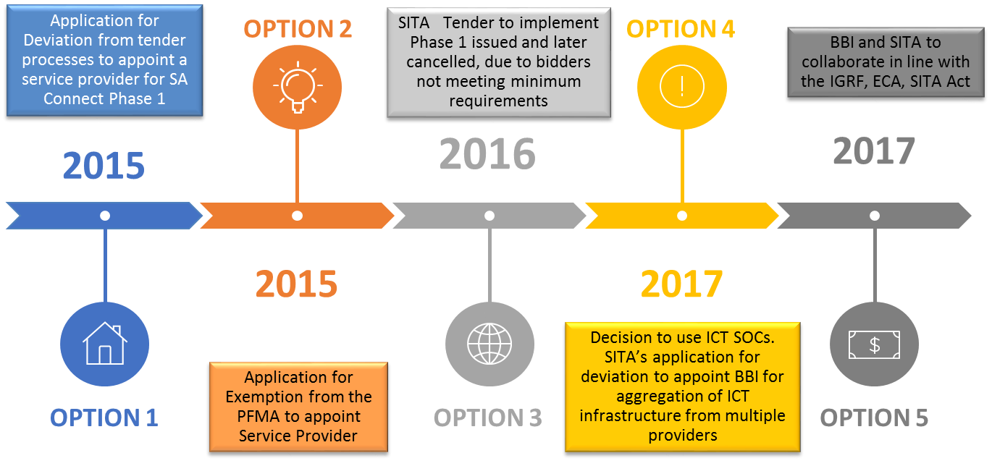
SA Connect Implementation Update
Since the signing of the tripartite MSA, on 4 August 2017, both SITA and BBI have developed their roll-out plans.
SITA has connected two sites in OR Tambo District, Mhlontlo Local Municipality, Tsolo College of Agriculture and Dr Malizo Mpehle Memorial Hospital, through a proof-of-concept (PoC) as part of SA Connect implementation in preparation for sites upgrades. The two sites are carrying live traffic and provide internet services to users at a speed of 10 Mbps.
On the core network, BBI issued RFI to determine potential infrastructure synergies and gaps. This process was concluded in August 2017. An RFP was subsequently issued for core network expansion where infrastructure gaps were identified through the RFI process. The adjudication for the RFP has been concluded.
On the access network, BBI issued RFP for last mile connectivity on 19 September 2017. The RFP closed on 31 October 2017. adjudication is underway and is expected to concluded by end of November 2017.

Slide 12
The Impact of Treasury Budget Cut on SA Connect Phase 1
The Treasury has informed the Department of the cut on the budget for SA Connect Phase 1 for the current financial year by R139 million and for 2018/19 by R143 million.
 | 2017/18 | 2018/19 | 2019/20 | Total
MTEF Allocation | R411 million | R703 million | R724 million | R1.8 billion
Number of new sites to be connected | 2 700 | 1 718 | 1 717 | 6 135
Number of sites connected to maintained | 0 | 2 700 | 4 418 | 6 135
Budget cut | R139 million | R143 million | R0 | R283 million
Revised number of sites to be connected | 2 071 | 397 | 400 | 2 868
Revised number of sites to be maintained | 0 | 2 071 | 2 468 | 2 868

Slide 13
STATUS UPDATE ON SAPO TURNAROUND

Slide 14
Status update on SAPO turnaround
FOCUS AREA | CHALLENGE | Mitigation
Social Mandate | Lack of lack of financial support for Universal Service Obligation and inadequate regulatory enforcement leading to encroachment in the reserved postal market | ICT White Paper: Reviewed the Postal Policy in order to reposition SAPO in the digital era Engagements with ICASA: relaxation of USO targets & need to enforce regulatory compliance
Cost reduction & promotion of efficient utilization of resources | Overall high operational costs: Expenditure exceeding revenue, high labour costs (60% of total costs) | Implementation of cost reduction initiatives. Optimization of the property portfolio: approval of the sale of non-core assets and imploring to develop a property strategy that is aligned to the broader organisational repositioning of the future
Revenue Growth/ Revenue diversification | Declining mail volumes, lost of customers post the previous prolonged illegal strike | Assist SAPO to regain lost customers Leading & facilitating initiatives to support SAPO to grow and implement e-commerce strategy. Assist SAPO to secure government business opportunities (e.g.social grants etc).

Slide 15
Status update on SAPO turnaround
FOCUS AREA | CHALLENGES | MITIGATION
Funding Challenges | Reliant on debt funding | DTPS supported SAPO’s funding applications through the 2017 budget adjustment process and the 2018 MTEF process and also in securing funding with the commercial banks: R3,7 billion allocated in terms of the budget adjustment process. Provided support in securing government guarantees and borrowings from the commercial banks
Leadership stabilisation | Historic labour instability & governance | Appointment of the Board and the three most senior executives (Group: CEO, CFO and COO)

