Slide 1
DEPARTMENT OF PUBLIC WORKS
Presentation to Portfolio Committee on Small Medium and Micro Enterprise (SMME) development initiatives

Slide 2
The Vuk’uphile Learnership programme

Slide 3
Introduction
The Vuk’uphile Learnership Programme is an initiative implemented by the Department of Public Works in collaboration with the Construction Education Training Authority (CETA) and different public bodies to develop contractors and supervisors who can implement projects using labour-intensive methods.
The Vuk’uphile Learnership Programme has been implemented since 2004.
The Vuk’uphile Learnership Programme has been successful in developing contractors, with 34% of the 578 contractors trained through the programme have remain in business after exiting a programme for three years or more. This is high, considering that 90% of SMMEs collapse with 2 years of existence internationally.

Slide 4
Courses trained in the Vuk’uphile programme
All Learners are trained in Supervision of Construction Processes NQF Level 4 Qualification.
Contractors will also be trained in International Labour Organisation (ILO) Start and Improve Your Business (SIYB) going forward.
On completion of the learnership programme Contractors & Supervisors will also to emerge with:
Recognized Qualification
Project Track Record
Financial Track Record
Relationship with a bank/financial institution

Slide 5
Overview of Vuk’uphile Contractors and Supervisors being trained
A total of 850 learner are currently being trained consisting 432 learner contractors and 418 supervisors for Vuk’uphile Phase 2 and 3.
195 learners being trained are female contractors with 108 supervisors.
A total of 19 public bodies are currently implementing the programme.

Slide 6
LEARNERS IN TRAINING (Phase 2)
PROVINCE | IMPLMENTING BODY | ORIGINAL LEARNERS | ACTUAL LEARNERS | NO. OF CONTRACTORS | NO. OF SUPERVISORS | FEMALE
 |  |  |  |  |  | FEMALE CONTRACTORS | FEMALE SUPERVISOR | TOTAL FEMALE
EC | Amathole | 20 | 20 | 10 | 10 | 5 | 5 | 10
EC | EC DRPW | 20 | 20 | 10 | 10 | 4 | 3 | 7
EC | BCM | 20 | 19 | 9 | 10 | 2 | 1 | 3
EC | Alfred Nzo | 20 | 20 | 10 | 10 | 7 | 4 | 11
FS | Matjhabeng | 20 | 20 | 10 | 10 | 5 | 3 | 8
FS | Mangaung | 20 | 20 | 10 | 10 | 5 | 2 | 7
GP | Ekurhuleni | 40 | 40 | 20 | 20 | 10 | 6 | 16
GP | GP DRT | 58 | 58 | 29 | 29 | 12 | 7 | 19
GP | Johannesburg Water | 130 | 130 | 65 | 65 | 31 | 18 | 49
GP | EPWP: DID | 40 | 40 | 20 | 20 | 11 | 5 | 16
KZN | Ethekwini (phase 1) | 50 | 50 | 25 | 25 | 9 | 7 | 16
KZN | Ethekwini (phase 2) | 50 | 50 | 25 | 25 | 15 | 4 | 19
KZN | kwa Sani | 10 | 10 | 5 | 5 | 4 | 0 | 4
KZN | Umhlathuze | 20 | 20 | 10 | 10 | 3 | 1 | 4
LMP | Lepelle-Nkumpi | 8 | 8 | 4 | 4 | 3 | 1 | 4
LMP | Public Works | 55 | 55 | 35 | 20 | 16 | 6 | 22
NC | Umsobomvu | 20 | 20 | 10 | 10 | 3 | 3 | 6
NW | City of Matlosana | 18 | 18 | 9 | 9 | 3 | 1 | 4
NW | Tlokwe | 18 | 18 | 9 | 9 | 4 | 4 | 8
WC | Overstrand | 10 | 10 | 5 | 5 | 0 | 2 | 2
TOTAL |  | 647 | 646 | 330 | 316 | 152 | 83 | 235

Slide 7
LEARNERS IN TRAINING (Phase 3)
PROVINCE | IMPLMENTING BODY | ORIGINAL LEARNERS | ACTUAL LEARNERS | NO. OF CONTRACTORS | NO. OF SUPERVISORS | FEMALE
 |  |  |  |  |  | FEMALE CONTRACTORS | FEMALE SUPERVISOR | TOTAL FEMALE
GP | Ekurhuleni III | 200 | 204 | 102 | 102 | 43 | 25 | 68
TOTAL |  | 200 | 204 | 102 | 102 | 43 | 25 | 68

Slide 8
FUTURE PLANS
Vuk’uphile is planning to sign 10 Agreements (MOA) in the following Provinces to train about 310 more learner contractors.
Province | No. of Learners
Eastern Cape | 50
Free State | 20
Gauteng | 100
KwaZulu-Natal | 100
Limpopo | 20
North West | 10
Western Cape | 10
 | 310

Slide 9
EPWP ENTERPRISE DEVELOPMENT

Slide 10
EPWP enterprise development
The EPWP is implemented through four sectors: Social, Infrastructure, Environment & Culture and the Non-State Sector.
Furthermore, training and enterprise development support is provided across all sectors.
The primary objective of EPWP Enterprise Development is to support EPWP participants in their quest (desire or drive) to start and operate businesses, and thereby promote sustainable livelihoods.

Slide 11
Type of Support Provided EPWP to enterprises
Compliance with Compensation Of Injuries and Disease Act (COIDA), Central Supplier Database (CSD) and Unemployment Insurance Fund (UIF)
Business Registrations with Companies Intellectual Property Commission (CIPC)
Market Access to grow business
Training through the SIYB Programme
Business Coaching and Handholding
Linkages to small business development agencies and departments

Slide 12
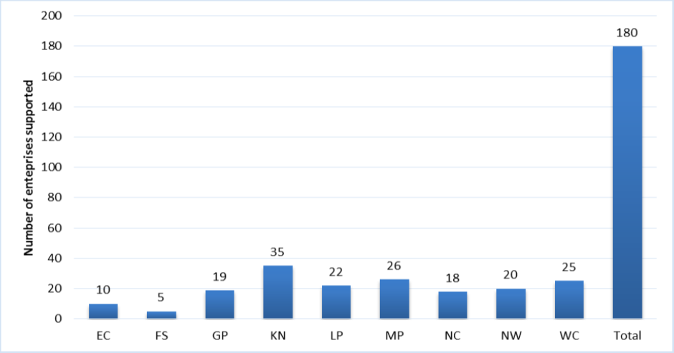
EPWP enterprise development progress after 2nd quarter of the 17/18 financial year
The figure above shows the distribution of Enterprises supported by end quarter 2 of 2017/18 financial year. The figure shows 180 SMMEs were supported in total and there is there is variation in terms of number of SMMEs supported per province. The highest number of SMMEs supported is recorded in KZN, WC, and MP whilst the least is recorded in in FS.

Slide 13
EPWP enterprise development progress after 2nd quarter of the 17/18 financial year
Of the SMME Supported 26% were from the EPWP Infrastructure Sector while the majority of them (61%) are from the EPWP Environment & Culture Sector (E&C). The SMMEs from the EPWP Social sector contributed 1% to the total SMMEs whilst the NPOs contributed 13%.
The Infrastructure projects are mostly from the Large projects such the renovation of the Parliamentary Village from the Cape Town Regional Office and building of New Police Station by the Durban Regional office.

Slide 14
CONTRACTOR INCUBATOR PROGRAMME

Slide 15
CONTRACTOR INCUBATOR PROGRAMME
The Contractor Incubator Programme (CIP) is mandated to transform CIDB Grades 3-6 medium enterprise contractors into sustainable business enterprises able to compete in the mainstream economy.
The key proposed intervention is contractor performance enhancement through:
Training
Mentorship
Access to Finance
Access to technology, information and business linkages
The CIP seeks to create enabling environment for sustainable growth of contractors by assisting contractors to gain necessary experience, track record and capital growth.
.

Slide 16
SUMMARY OF CDP / CIP Programme
The programme will be for a duration of 3 years for Contractors within
Civil Engineering (CE),
General Building (GB),
Electrical Engineering (EB)
Landscaping, Irrigation and Horticultural works (SH), and
Precast Concrete, Security Fencing or Steel security fencing (SQ).
Contractor Development, i.t.o of National Contractor Development Programme (NCDP), is a deliberate and managed process to achieve targeted developmental outcomes that improves a contractor:
Grading status
Performance and quality
Equity and targeted ownership

Slide 17
SUMMARY of IMPLEMENTATION
Progress to date
To date, the following activities have been completed:
Strategy approved by Accounting Officer and implementation team
Advertised on government gazette
Briefing sessions held
Applications received
Appointment of Bid Evaluation Committees (BECs) in each region
Evaluations in regions underway for Vukuphile Grades 1 to 2
Submission approved by National Bid Adjudication Committee (NBAC) for the second phase for Grades 3 - 6

Slide 18
OTHER INTERVENTIONS

Slide 19
SCM INITIATIVES – PORTFOLIO COMMITTEE BRIEFING
The department has decreed that all tenders and quotes must subscribe to the Preferential Procurement Regulations whereby these are designated for service providers holding B-BBEE status levels of contributors levels 1, 2 & 3.
The department is appointing panels of professional service providers (PSPs) within the built environment and this is focused on promoting local participation and advancement of black-owned PSPs.
A bilateral is being scheduled between the department’s SCM and the BBCBE to advance procurement strategies for commodities specifically designated by the Council.
The Department is also monitoring payments to SMMEs to ensure improvement in processing them within 30 days.

Slide 20
Challenges in Supporting SMMEs
Difficulties in market linkages
Unable to maintain profit and increase revenues.
Delays in awarding of training projects by Implementing Bodies to Learner Contractors.
Inability to access bridging finance provided from the appointed Financial Service Provider (FSP) by some of the Learner Contracting Companies. This is due to some contractors not being credit worthy.
Insufficient level of interest by public bodies on Enterprise Development (ED) activities

Slide 21
Measures being taken to address challenges in the implementation of the Vuk’ uphile programme
Inclusion of project lists in MOAs of implementing bodies and improving planning processes.
Continuous close monitoring and evaluation of implementation of the programme.
Explore relationships with other Financial Service Providers, e.g. Small Enterprise Finance Agency (SEFA), Small Enterprise Development Agency (SEDA), Independent Development Corporation (IDC) etc. for assistance with bridging finance.
Conduct ED awareness workshops
Improvement of partnership programmes with departments and agencies that promote enterprise development
Training on the SIYB programme

Slide 22
Thank You

