Slide 1
Impediments facing SMEs in the Construction Industry
28 November 2017

Slide 2
SMEs: cidb Grading
Source: draft Construction Sector Code (June 2016)
Enterprise Category | Total Turnover (less than) | Approximate cidb Grade for Contractors | Maximum Tender Value Limit
Large Enterprise |  | greater than Grade 7 | na
Qualifying Small Enterprise (QSE) | R50m pa | Grade 6 to 7 | R40m
Exempt Micro Enterprise (EME) | R10m pa | less than Grade 6 | R6,5m

Slide 3
cidb Grading
Grade | Maximum Tender Value Limit | Minimum Turnover (Rm) | Minimum Track Record (Rm) | Comment
9 |  | 270 | 100
8 | 130 | 90 | 32.5
7 | 40 | 24 | 10
6 | 13 | 7.8 | 3.25 | Small
5 | 6.5 | 3.3 | 1.6
4 | 4.0 | 2.0 | 1 | Micro
3 | 2.0 | 0.1 | 0.5
2 | 0.7 |  | 0.15
1 | 0.2 |  |  | Entry

Slide 4
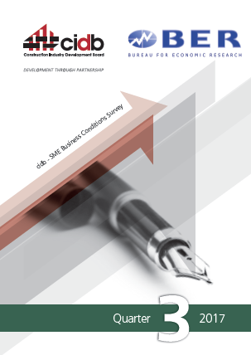
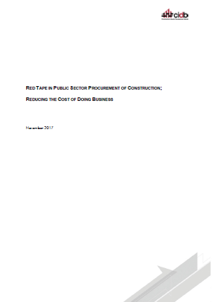
Challenges: Sources of Information
cidb National and Provincial Stakeholder Meetings
cidb SME Business Confidence Survey (Quarterly)
cidb report; Reducing Red Tape in Construction (November 2017)

Slide 5
cidb SME Business Confidence Survey; 2017 Quarter 3; General Building
Largest constraint: Lack of access to work
For Micro-contractors; Lack of access to credit is increasing as a constraint
Grades | Insufficient Demand for Work | Inadequate Access to Credit | Shortage of Skilled labour
7 & 8 | 71 | 23 | 50
5 & 6 | 72 | 23 | 48
3 & 4 | 67 | 46 | 33
Notes:
Weighted Index
Low is low constraint
High is high constraint

Slide 6
Reducing Red Tape in Construction; Constraints to Business
Largest Constraints:
Delayed payments
Lack of access to work
Lack of access to credit
Corruption in procurement
Challenge | Grades 2 to 6 | Grades 7 to 9
Payment processes | 29% | 31%
Access to work | 22% | 18%
Access to credit | 10% | 5%
Corruption | 9% | 13%
SCM processes | 8% | 12%
Skills | 8% | 11%
B-BBEE requirements | 8% | 11%
CIDB grading | 6% | 3%

Slide 7
Legislation, Regulation and Administrative Practices; Negative Impact on Business
Largest Constraints:
cidb registration process
Note: Process not criteria
Legislation, Regulation and Administrative Practices | Grades 2 to 6 | Grades 7 to 9
cidb registration process | 36% | 28%
B-BBEE Codes | 19% | 44%
DoL H&S inspections | 20% | 18%
COIDA registration requirements | 19% | 11%
NT Central Supplier Database (CSD) registration | 17% | 11%

Slide 8
Summary:
Access to Work
Access to Credit
Delayed Payments
cidb Grading Process

Slide 9
Access to Work; Status
Fiscal constraints
2016/17 – 2018/19 Medium Term Expenditure Framework (MTEF) period; average growth:
1,6% nominal; -5% to -7% real
Delays in spending
Underspending against budget

Slide 10
cidb Strategies; Access to Work
Monitoring:
Construction Monitor: Supply & Demand; Contractor Development; Employment; Transformation
Advocacy:
Construction Monitor; MinMec; Press releases
Public Sector Procurement:
Capacity support;
Skills and competency
As per presentation to PPC, 21 November 2017

Slide 11
cidb Strategy; Access to Credit
cidb Developmental Support Strategy:
cidb Best Practice Fee income
0,2% on Grades 7 to 9
80% used for development purposes
Partnering with Small Enterprise Finance Agency (SEFA):
R350m over 5 years
leverage ratio
10 000 to 20 000 contractors over 5 years

Slide 12
cidb Strategy; Delayed Payments
cidb aimed to introduce Prompt Payment Regulation:
falls outside of cidb Act
Draft cidb Standard for prompt Payment:
remedies for late payment on construction works contracts
prohibits conditional payment provisions in construction contracts
cidb Standard for Minimum Requirements for Engaging Contractors and Sub-Contractors on Construction Works Contracts ( November 2017):
written contract between principal and subcontractor
payment to sub-contractor may not be later than 30 days
after the date on which the subcontractor has submitted a statement for payment
contract may not contain any provision making payment to a subcontractor conditional on the principal contractor receiving payment from a third person

Slide 13
cidb Strategy; cidb Grading Process
Monitoring and reporting of turn-around time
Contractor satisfaction survey on completion of grading
Initiating on-line registration system
Investigating decentralisation of registration process
Enhancing capacity in cidb Provincial Offices
Note: cidb Registration Criteria
cidb has initiated full review of registration criteria

Slide 14
Thank You

