Slide 1

Briefing to Parliamentary Portfolio Committee on Public Works
22 November 2017

Slide 2
Presentation Outline
The national contractors grading register (from grades 1 – 9)
Strategy to upgrade and ensure access to lower - grade contractors especially those in rural areas
Grading methods and criteria
Breakdown of lower grade contractors (grades 1 – 4) in construction projects of each municipality in the country
Reasons and remedial actions for the reported 140 000 job losses within the 1st and 3rd quarter of 2017 in the construction industry

Slide 3
The national contractors grading register (from grades 1 – 9)

Slide 4
Mandate – Registers of Contractors
The Register of Contractors has been established in terms of Chapter 3 of the Construction Industry Development Act (CIDB Act) and it provides for the categories of contractors in a manner that facilitates public sector procurement.
The objectives of the Register is to:
Support risk management in the tendering process
  Contractors are graded according to financial and works capability, including experience in the relevant classes of work
  It is mandatory for public sector clients to apply the Register in procurement for construction works projects
Reduce the administrative burden
  cidb administers the National Register of Contractors through the application and verification of documentation
  Costs are reduced for clients in terms of evaluating eligibility of tenders and for contractors in terms of responding to tenders
To facilitate sustainable growth and transformation of contractors and enable effective access by the emerging sector
  The Register enables the monitoring the growth of contractors in targeted categories and grades on the Register
  The Register tracks ownership trends and transformation

Slide 5
Mandate – Registers of Contractors cont…
Promote minimum standards and contractor best practice
  Phase two of the Registers involves the implementation of the Best Practice Contractor Recognition Scheme. The performance of contractors will be tracked and reflected on the Register.
Enable access by the private sector
  The Register is available to the general public. Private sector clients may apply the Register on construction projects. The link to contractor performance has an important bearing on the private sector application of the Register.
Provide information on the size, distribution, nature and development of contractors
  cidb tracks the growth of contractors in terms of upgrading (vertical growth). A focus area for the cidb would be to track the horizontal growth of contractors i.e. through registrations across the specialist classes of work)

Slide 6
The
Statistics of Black Ownership 1 – 9)
CE – Civil Engineering; EB – Electrical Installation: Buildings; EP – Electrical Infrastructure; GB – General Building; ME – Mechanical Works; SW – Other Specialist classes. Black Ownership is defined here as 50%+ black owned. Black people defined in terms of the Broad-Based Black Economic Empowerment Amendment Act, 2013
Inadequate black ownership Grades 5 to 9 which is more acute in the specialist classes of work. In terms of the demographics of South Africa black people make up 92% of the population.

Slide 7
Statistics of Women Ownership
CE – Civil Engineering; EB – Electrical Installation: Buildings; EP – Electrical Infrastructure; GB – General Building; ME – Mechanical Works; SW – Other Specialist classes. Women owned defined as 50%+ women owned.
Low concentration of women contractors across all grades. More acute in the specialist class of work

Slide 8
Strategy to upgrade and ensure access to lower - grade contractors especially those in rural areas

Slide 9
Developmental Approach Strategy
The cidb performs its administrative function to develop all contractors registered on the Register as mandated by the CIDB Act.
The cidb has endorsed and agreed on a developmental approach strategy that focuses on increasing the representative of contractors in all categories and grades by:
Developing a business plan towards establishing the business advisory services, to be implemented in 2019/20 financial year;
Providing development support through mentoring support, construction management systems, training and other interventions;
Facilitating access to finance with mainstream banks and other financiers;
Accrediting the implementation of the Contractor Development Programme; and
Monitoring the performance of the contractors.
The infrastructure client to account for rural investment and the budget spent in rural areas.

Slide 10
Proposed Tender Value Limit (TVL) Adjustments (Rounded for easy application of the RoC)
Grade | Current (TVL) | Proposed (TVL) | % Inc.
1 | 200 000 | 300 000 | 50 %
2 | 650 000 | 1 000 000 | 54 %
3 | 2 000 000 | 3 000 000 | 50 %
4 | 4 000 000 | 6 000 000 | 50 %
5 | 6 500 000 | 10 000 000 | 54 %
6 | 13 000 000 | 20 000 000 | 54 %
7 | 40 000 000 | 60 000 000 | 50 %
8 | 130 000 000 | 200 000 000 | 54 %
9 | No Limit | N/A | N/A
Restores market share that was eroded due to inflationary impacts. Proposed TVL submitted to the Minister of Public Works, Oct 2017. The process of reviewing tender value limits will be conducted on an annual basis.

Slide 11
Grading Methods and Criteria

Slide 12
RoC: Tender Value Limits and Classes of Work
Grade | Tender Value Limits
1 | R 200 000
2 | R 650 000
3 | R 2 000 000
4 | R 4 000 000
5 | R 6 500 000
6 | R 13 000 000
7 | R 40 000 000
8 | R 130 000 000
9 | No limit
      Classes of Work
General Building
Civil Engineering
Mechanical Engineering
Electrical Engineering (Building)
Electrical Engineering (Infrastructure)
Specialist works
  Asphalt works (supply and lay)
  Demolition and blasting
  Piling and specialized foundations for buildings &structures
  Road markings and signage
  Structural steelwork fabrication and erection
  Other specialist works

Slide 13
Registration Criteria and Requirements
Criteria effected through Regulations
  Last amendment was in July 2013
  Registration criteria under review
Example: Application for 4GB (General Building). Tender Value Limit: R 4 million
  Contractor is required to have completed a GB project to the value of R 900,000 in the five years preceding the application
  Contractor is required to have available capital (net asset value) of R 200,000 or Annual Turnover of R 2 million
Example: Application for 7CE (Civil Engineering). Tender Value Limit: R 40 million
  Contractor is required to have completed a CE project to the value of R 9 million in the five years preceding the application
  Contractor is required to have available capital (net asset value) of R 4 million and Annual Turnover of R 20 million

Slide 14
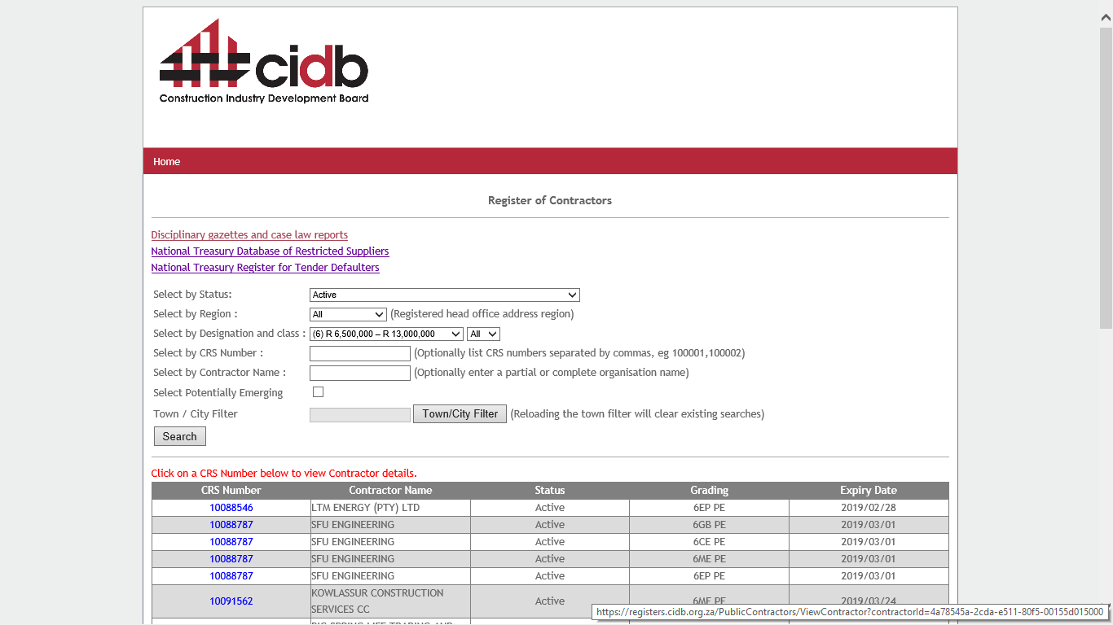
Contractor grades may be viewed on the cidb website,
www.cidb.org.za

Slide 15
Registration Methods and Plans Ahead
Registrations conducted through head office and provincial offices
Reassessment of cidb office infrastructure underway with focus on head office and selected provincial offices
Organisational Design process underway in order to improve services
Online registration planned

Slide 16

Registration Criteria Review
Grade 1 registration open entry
  Grade 1 study conducted.
    “Considering that most of the contractors enter the industry out of (i) financial considerations and (ii) their (sometimes presumed) knowledge of and experience in the industry, it can be expected that in the absence of regulated entry-level requirements the number of industry entrants will continue to be high. In addition, the high rate of stagnation at Grade 1 and exit from the industry can also be expected to continue. It has been suggested that more attention should be paid to some level of barriers to entry in these sectors and to providing support to entrepreneurs once they have already become active in a sector.”

Slide 17
Registration Criteria Review
Review the manner to transfer the records from one contractor to another contractor
  Assess adequacy of current Regulations
  Create certainty and minimise legal challenges
2. Reassessment of financial and works capability requirements
  Experience with downgrading resulted in a proposed amendment to registration renewal criteria
  Study of current criteria as well other registration systems underway.
3. Changing trends in the industry necessitates the reassessment of the adequacy of the existing cidb registration criteria and classes of work

Slide 18
Registration Criteria Review cont…
4. B-BBEE Scorecard
  The cidb captures the overall B-BBEE charter rating. To extend registration requirements to include capturing of individual scorecard elements. This will harness the Register as a tool to track transformation.
5. To provide for subcontractor registration and classes of work for Trade Contractors

Slide 19
Breakdown of lower grade contractors (grades 1 – 4) in construction projects of each municipality in the country

Slide 20
Register of Projects
The Register of Projects has been established in terms of Chapter 4 of the Construction Industry Development Act (CIDB Act), to gather information on the nature, value and distribution of projects.
  CID Regulations; Public Sector, on projects over R200 000:
    advertisement of tender invitations (Clause 38(6)) (transitional measure)
    registration of the tender award (Clause 18)
  Excludes Grade 1 quotations.

Slide 21
cidb Register of Projects; Tender Notices (2016Q2)
Client Description | Compliance Ratio
Buffalo City Local Municipality (BCLM) | 100%
City of Cape Town Metropolitan Municipality (CCTMM) | 100%
City of Johannesburg Metropolitan Municipality (CJMM) | 100%
City of Tshwane Metropolitan Municipality (CTMM) | 100%
Ekurhuleni Metropolitan Municipality (EMM) | 89%
eThekwini Metropolitan Municipality (EMM) | 55%
Mangaung Metropolitan Municipality | 98%
Nelson Mandela Bay Municipality (NMBM) | 60%

Slide 22

cidb Register of Projects; Tender Awards (in terms of Tender Notices) (2017Q2)
Entity Type | 2016Q3
District Municipalities | 53%
Local Municipalities | 51%
Metropolitan Municipalities | 39%
Municipal Entities | 63%
National Departments | 58%
Provincial Departments | 60%
State Owned Enterprises | 56%

Slide 23
Contract Awards by Grade; %
(2016Q3 to 2017Q2) (limited data)
Grade | Municipal | Provincial | National | SoE
9 | 26% | 44% | 21% | 60%
7 & 8 | 52% | 42% | 60% | 33%
5 & 6 | 18% | 7% | 15% | 6%
2 to 4 | 5% | 8% | 4% | 1%
Total | 100% | 100% | 100% | 100%
Note: Excludes sub-contracts

Slide 24
Contract Awards by Grade; % Number (2016Q3 to 2017Q2) (limited data)
Grade | Municipal | Provincial | National | SoE
9 | 5% | 5% | 4% | 18%
7 & 8 | 34% | 14% | 35% | 41%
5 & 6 | 36% | 25% | 28% | 25%
2 to 4 | 26% | 57% | 33% | 16%
Total | 100% | 100% | 100% | 100%
Note: Excludes sub-contracts

Slide 25
Contract Awards by Grade; Number (2016Q3 to 2017Q2) (limited data)
Grade | Municipal | Provincial | National | SoE
9 | 46 | 52 | 12 | 98
7 & 8 | 309 | 154 | 97 | 217
5 & 6 | 328 | 276 | 79 | 134
2 to 4 | 237 | 637 | 92 | 85
Total | 920 | 1 119 | 280 | 534
Increasing Compliance
Note:
1) Excludes sub-contracts
2) No correction for lack of compliance

Slide 26

Contract Awards; Public and Private (2016)
R200m
R2 000m

Slide 27
Contract Awards; Public and Private (2016)
R200m
R2 000m

Slide 28
Reasons and remedial actions for the reported 140 000 job losses within the 1st and 3rd quarter of 2017 in the construction industry

Slide 29




cidb Construction Monitor
Q1; April; Supply & Demand
Q2; July; Contractor Development
Q3; October; Employment
Q4; January; Transformation
To request to be put on mail list, please contact ramim@cidb.org.za

Slide 30
Employment in the Construction Industry
Construction accounts for around 10% of total formal and informal employment
Construction industry employs around 1 004 000 people in the formal sector and a further 479 000 in the informal sector (i.e. total of 1 483 000 people)
Between 2017Q1 and 2017Q3, the construction industry 140 000 jobs in the formal and informal sectors:
  cidb Press Release; October 2017

Slide 31
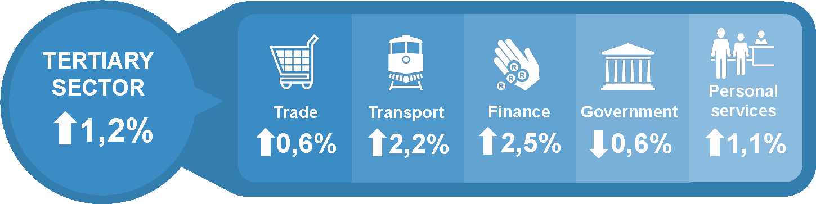
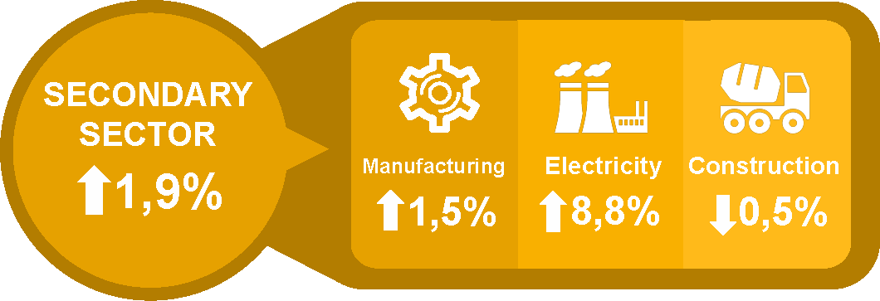

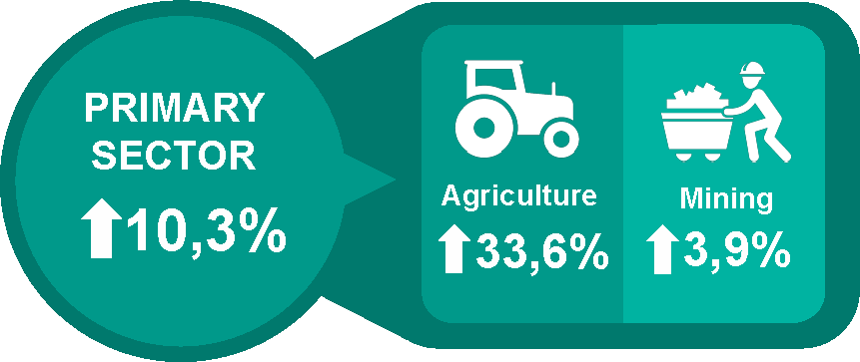
Growth by Sector in 2017Q2 - Annualised

Slide 32
State of the Construction Industry
 | Construction Spend; Rand (Million) 2016 |  |  |  |  | %Public/ Total
 | 2015 | 2016 | 2017f | 2018f | 2019f
Construction-Total | 411 869 | 409 081 | 395 381 | 394 220 | 401 626 | 54%
General Building | 149 506 | 145 407 | 139 617 | 141 012 | 143 862 | 16%
Civil Engineering | 262 363 | 263 675 | 255 764 | 253 206 | 257 765 | 78%

Slide 33
State of the Construction Industry
 | Construction Spend; Rand (Million) 2016 |  |  |  |  | %Public/ Total
 | 2015 | 2016 | 2017f | 2018f | 2019f
Construction-Total | 411 869 | 409 081 | 395 381 | 394 220 | 401 626 | 54%
General Building | 149 506 | 145 407 | 139 617 | 141 012 | 143 862 | 16%
Civil Engineering | 262 363 | 263 675 | 255 764 | 253 206 | 257 765 | 78%
 | Change in Spend; Rand (Million) 2016 |  |  |  |  | %Public/ Total
 | 2015 | 2016 | 2017f | 2018f | 2019f
Construction-Total | 17 842 | -2 788 | -13 700 | -1 161 | 7 406 | 54%
General Building | 3 241 | -4 098 | -5 790 | 1 395 | 2 850 | 16%
Civil Engineering | 14 601 | 1 312 | -7 911 | -2 558 | 4 558 | 78%

Slide 34
A Key Contributor - Underspending
(but not new)
 | Variance Against Budget (R million)
 | 201202 | 201302 | 201402 | 201502 | 201602
Metro | -4 519 | -3 216 | -3 928 | -4 632 | -4 925
District Municipality | -2 954 | -1 889 | -2 252 | -2 155 | -2 175
Local Municipality | -5 382 | -5 494 | -8 021 | -6 667 | -6 164
Total | -12 855 | -10 599 | -14 201 | -13 454 | -13 264
 | Variance Against Budget (R million)
 | 201201 | 201301 | 201401 | 201501 | 201601
Education | - 456 | - 749 | - 453 | - 151 | 290
Health | - 808 | - 873 | 64 | - 495 | 305
Public Works, Roads & Transport | -4 511 | -1 029 | -3 273 | - 997 | 0
Total | -5 775 | -2 652 | -3 662 | -1 643 | 594

Slide 35
Infrastructure Spend
Difficult economic conditions:
  local and international
Fiscal constraints
  2016/17 – 2018/19 Medium Term Expenditure Framework (MTEF) period; average growth:
    1,6% nominal
    -5% to -7% real
Delays in spending
Underspending against budget

Slide 36
Remedial Actions
1. Monitoring:
  Construction Monitor: Supply & Demand; Contractor Development; Employment; Transformation
2. Advocacy:
  Construction Monitor; MinMec; Press releases
3. Public Sector Procurement:
  Capacity support;
  Skills and competency

Slide 37
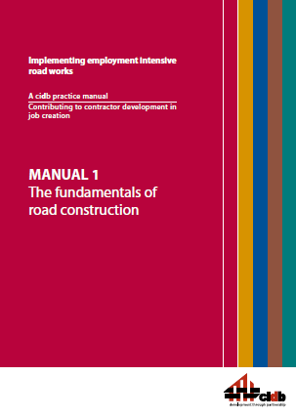

Remedial Actions cont…
Guidelines:
  Labour-based Methods and Technologies for Employment Intensive Construction Works
  Implementing employment intensive road works
Standards:
  cidb Standard for Contract Participation
  Goals

Slide 38
Thank you cidb
2 Dr Lategan Road
SABS Campus
Groenkloof www.cidb.org.za
012 482 7200

