Slide 1

PORTFOLIO COMMITTEE ON HIGHER EDUCATION & TRAINING
CHIETA STRATEGIC PLAN 2015/16 TO 2019/20 AND ANNUAL PERFORMANCE PLAN(APP) 2017/18
22 NOVEMBER 2017

Slide 2
        OUTLINE OF PRESENTATION
Legislative framework
Policy framework
CHIETA vision and mission
Strategic outcomes and strategic objectives
Situational analysis chemical industry
CHIETA partnerships
2017\18 performance indicators and targets
Highlights of the CHIETA Strategic Plan and APP 2017\18
Organisational environment
CHIETA 2017/18 budget
Challenges and Opportunities
Focus Areas 2017 TO 2020
QUESTIONS, ANSWERS AND CLARITY

Slide 3
  LEGISLATIVE FRAMEWORK THAT INFORMS CHIETA STRATEGY, PERFORMANCE PLANNING AND MANAGEMENT
Skills Development Act and Regulations (Act 97 of 1998)
Skills Development Levies Act and Regulations (Act 9 of 1999)
Public Finance Management Act - PFMA ( Act 1 of 1999)
Treasury Regulations issued in terms of the PFMA
Labour legislation with reference to LRA, Employment Equity, Basic Conditions of Service and Occupational Health and Safety
Public Audit Act 2004 (Act 25 of 2004)
SETA Grant Regulations Government Notice R 990 dated 3 December 2012
Protection of Personal Information Act (9Act 4 of 2013)
BBB- EE Act (Act 53 of 2003)
Tax legislation
SAQA and QCTO

Slide 4
  POLICY FRAMEWORKS THAT DRIVE CHIETA STRATEGY, PERFROMANCE PLANNING AND MANAGEMENT
National Skills Development Strategy (NSDS III)
Human Resource Development Strategy
SONA prioirty areas
CHIETA Sector Skills Plan- Skills Priority for Chemical Industry
Performance areas of Minister of Higher Education and Training- DHET priorities
National Development Plan 2030
Government Medium Term Priorities and Expenditure Framework
Industry Policy Action Plan II (IPAP II)
National Infrastructure Plan and Strategic Integrated Projects (SIPS)
Strategies on energy provision namely Biofuels, Integrated Resource Plan and Nuclear
White Paper on Post School Education and Training

Slide 5
VISION & MISSION OF THE CHIETA
VISION
World class Education and Training for the Chemical Industry
MISSION
CHIETA contributes to sustainable development through facilitating the provision of skills for the growth of the Chemical Industry
CHIETA VALUE STATEMENT
Stakeholder Orientation | We seek to meet stakeholder expectations in everything we do
Accountability | We are committed to CHIETA delivery imperatives
Integrity | We do the right thing even when we are not watched
People | We are committed to our employees
Performance | We achieve our desired results all the time
Service Excellence | Meet and exceed client expectations in all CHIETA functional areas

Slide 6

CHIETA ORGANISATIONAL ACHIEVEMENTS
CHIETA, The Catalyst for Enhanced Skills, Economic Growth and Employability
Sound Corporate Governance: Highly effective CHIETA Governing Board that has ensured sound corporate governance and oversight of the CHIETA mandate, which is a priority in public entity
Strategic Agility: Focus on scenario planning as an organization which provided structured way to think about the future and enabled alignment of skills and strategic planning.
Performance Monitoring: strong oversight on performance and delivery through management and monitoring of pre-determined targets as contracted with the Minister of Higher Education & Training in CHIETA’s Strategic plan
Research and Development : stakeholder driven research and skills planning framework that’s sustained credible mechanism for skills planning
Stakeholder Engagement and Consultation: Effective CHIETA Chambers and stakeholder structures fed valuable information on the skills needs of the chemical industry into CHIETA’s skills planning processes
Brand Equity: Excellent service delivery and promotion of stakeholder experiences with the CHIETA increasing our brand value.
Quality and Risk Management: Continuous improvement and management of CHIETA control environment

Slide 7
  CHIETA STRATEGIC OUTCOME ORIENTATED GOALS
Sustained culture of good Governance within CHIETA
Providing the South African Chemical Sector and its nine economic subsectors with accurately identified skills needs
Developing value adding skills development interventions in support of the scarce and critical skills needs of the Chemical Industry
Producing cohorts of highly competent learners through quality learning programmes
Above-mentioned outcomes supported by thirteen (13) strategic objectives

Slide 8
  CHIETA STRATEGIC OBJECTIVES IN SUPPORT OF STRATEGIC OURCOMES
Alignment to KING IV
Sustianed financial and supply chain management in accordance with PFMA
Integrated people Management framework supporting core mandate
Credible Research and Skills Planning Framework
Impact studies on the effectiveness of CHIETA and Industry Skills Development interventions
Optimal access and delivery of occupationally directed programmes
Strategic Public and Private partnerships to support TVET graduates and Work Integrated Learning
Adressing low level laungage and numeracy skills to provide access to aditional training and pathways
Supporting Co-ops, SMME’s, worker iniated NGO’s and community training initiatives

Slide 9
  CHIETA STRATEGIC OBJECTIVES IN SUPPORT OF STRATEGIC OUTCOMES CONTINUED
Increasing Public Capacity for improved delivery and building of a Developmental State
Building career and vocational guidance
Supporting Government’s medium term Strategic priorities
Accreditation and management of CHIETA Training Providers, Moderators and Assessors.
CHIETA STRATEGIC OUTCOMES AND STRATEGIC OBJECTIVES ARE SUPPORTED THROUGH FOUR (4) PERFORMANCE PROGRAMMES AND SIXTY SIX (66) PERFORMANCE INDICATORS/ PRE-DETERMINED PERFORMANCE TARGETS

Slide 10
SOUTH AFRICAN CHEMICAL INDUSTRY
SITUATIONAL PERSPECTIVE

Slide 11
  NINE ECONOMIC SECTORS WITHIN SOUTH AFRICAN CHEMICAL INDUSTRY
Petroleum
Base Chemicals
Speciality Chemicals
Surface Coatings
Fast Moving Consumer Goods
Pharmaceuticals
Explosives
Fertilisers
Glass

Slide 12
  SITUATIONAL ANALYSIS CONTINUED
SA Chemcial Industry plays a critical role in SA economy – contribue 25% of SA Manufacturing production and 3,5% of GDP
Contribute to 1.1% of total employment in SA
2180 levy paying companies
Petroleum Sector contributes 40 % of levies paid and only comprose 12% of employment
81% of companies in sector is small, 16% as medium and 35% large
Net importer and almost double that of exports and Industry is capital intensive
Sector is also effected by economic growth, cost of raw material, exchange rates, compliance costs etc
Net employment growth in 2016 of over 5000 workers with seven of the economic sectors reporting growth in employment figures
Industruy employes 799 different occupations

Slide 13
  SITUATIONAL ANALYSIS CONTINUED
Skills Requirements for the Industry has changed gradually over the last few decades where the demand for semi and unsklilled workers declined and need for highly skilled workers increased
In terms of supply 38% of the Industry employees have HET qualifications (NQF 5 to 10) and 44% have NQF 4 qualification- highly educated sector
Skills Development needs also to be articluated within ever changing technology development and innovation
SMME’s support needed towards competitiveness and sustainability in Chemical Manufacturing
Green Skills requirements in support of green occupations
Despite current economic situation the need to retain medium to long term perspectives on skills development in areas such as shale gas for increased capacity on occupations such as drilling engineers, geophysicists and geochemists

Slide 14
Employer Profile
CHIETA, The Catalyst for Enhanced Skills, Economic Growth and Employability
Levy-paying organisations: 2015/2016
Source: CHIETA data system, extracted June 2016

Slide 15
    Labour Market Profile
CHIETA, The Catalyst for Enhanced Skills, Economic Growth and Employability
Estimate of total employment in the Chemical Sector: 2012-2016
Source: CHIETA data system, June 2016

Slide 16
    Labour Market Profile
CHIETA, The Catalyst for Enhanced Skills, Economic Growth and Employability
Race distribution of employment in the Chemical Sector: 2012 – 2016
Source: CHIETA data system, June 2016

Slide 17
    Labour Market Profile
CHIETA, The Catalyst for Enhanced Skills, Economic Growth and Employability
Gender distribution of employment in the Chemical Sector: 2012 – 2016
Source: CHIETA data system, June 2016

Slide 18
    Labour Market Profile
CHIETA, The Catalyst for Enhanced Skills, Economic Growth and Employability
Disabled workers in the Chemical Sector: 2012 – 2016
Disabled workers |  | 2012 |  | 2013 |  | 2014 |  | 2015 |  | 2016
 |  | N | % | N | % | N | % | N | % | N | %
Population group | African | 531 | 51 | 655 | 56 | 729 | 59 | 448 | 46 | 601 | 48
 | Coloured | 167 | 16 | 120 | 10 | 138 | 11 | 138 | 14 | 172 | 14
 | Indian | 69 | 7 | 77 | 7 | 76 | 6 | 83 | 8 | 177 | 14
 | White | 277 | 27 | 317 | 27 | 302 | 24 | 304 | 31 | 306 | 24
 | Total | 1 044 | 100 | 1 169 | 100 | 1 245 | 100 | 972 | 100 | 1 256 | 100
 |  | N | % | N | % | N | % | N | % | N | %
Gender | Female | 324 | 31 | 485 | 41 | 480 | 39 | 426 | 44 | 474 | 38
 | Male | 720 | 69 | 684 | 59 | 764 | 61 | 546 | 56 | 782 | 62
 | Total | 1 044 | 100 | 1 169 | 100 | 1 245 | 100 | 972 | 100 | 1 256 | 100
 |  | N | % | N | % | N | % | N | % | N | %
Age | 15-34 | 243 | 23 | 396 | 34 | 391 | 31 | 305 | 31 | 320 | 25
 | 35-54 | 520 | 50 | 553 | 47 | 587 | 47 | 437 | 45 | 647 | 51
 | 55-59 | 160 | 15 | 131 | 11 | 162 | 13 | 118 | 12 | 178 | 14
 | 60-64 | 120 | 11 | 89 | 7 | 104 | 8 | 89 | 9 | 91 | 7
 | 65+ |  |  |  |  |  |  | 22 | 2 | 21 | 2
 | Total | 1 044 | 100 | 1 169 | 100 | 1 245 | 100 | 972 | 100 | 1 256 | 100
Percentage of total employment |  |  | 0.7 |  | 0.7 |  | 0.8 |  | 0.6 |  | 0.8
Source: CHIETA data system, June 2016

Slide 19
Extent and Nature of Supply
Supply Problems Experienced in the Sector
    Career guidance
    The quality of education at school level, in specific maths and science
    The TVET college sector with low troughputs,insufficient resources and infrastructure.
    The Higher Education Sector were stronger collaboration with Industry is needed to provide industry relevant graduates
    Work integrated learning in terms of companies opening workplaces

Slide 20
KEY FINDINGS OF THE CHIETA SECTOR SKILLS PLAN (SSP)
The sector’s dependence on highly skilled human resources
The sector’s growth is closely linked to its R&D capability
Skills that are in short supply in the sector require people with advanced higher education qualifications as well as specialised, sector-specific training and work experience
Usage of sophisticated and expensive equipment, and hazardous substances
Operation and maintenance of plants and equipment is critically important, as a consequence the sector depends on technical skills – especially those of artisans
Development of many of the occupations in the sector require workplace experience

Slide 21
SKILLS PRIORITIES FOR THE SECTOR
Priority 1: Enhancing the skills of the existing workforce of the Chemical Sector
  Further development and maintenance of a labour market intelligence system
  Updating and improvement of the CHIETA Occupations Handbook
  Occupational profiling process that will culminate in a Chemical Sector qualifications framework
  Research on existing skills and skills gaps of the workforce (skills survey)
  Better utilisation of workplace based skills development and increased access to occupational learning programmes at the entry, intermediate and high level

Slide 22
SKILLS PRIORITIES FOR THE SECTOR
Priority 2: Supporting skills development of new entrants to the Chemical Sector
  CHIETA supports programmes to increase the pool of school leavers with maths and science
  Bursaries made available for learners to study in relevant chemical disciplines at tertiary institutions
  Deepening and expanding career development and support opportunities through partnering with government and other professional or industry associations
  Enhance the flow of new skills into the sector
  Respond to the White Paper by supporting WIL

Slide 23
SKILLS PRIORITIES FOR THE SECTOR
Priority 3: Responding to changing sectoral needs and priorities
  Through research and skills planning processes changing sectoral needs and priorities are identified
  Adaptations to ever-changing modern environment s often entail changes in the skills sets required in specific occupations or even the creation of new occupations
  Technological changes leading to changing skills needs
  The CHIETA will need to establish whether sufficient skills will be available for the various phases of fracking
  The CHIETA will work with industry players to identify other changing needs and respond accordingly

Slide 24
SKILLS PRIORITIES FOR THE SECTOR
Priority 4: Strengthening and expanding strategic partnerships to maximise sustainability and impact of skills development interventions
  The CHIETA has a range of relationships with public TVETs, UoTs and universities as do some of the CHIETA companies
  The SETA will continue to play a central role in facilitating conversations
  Promoting the growth of the public TVET college system in various forms
    programme approval
    infrastructure support and development of TVET lecturers
  Supports Operation Phakisa in the Maritime Industry & Health through the CHIETA pharmaceutical sub-sector
  Rolling out the flagship blue print CHIETA –Industry – TVET partnership to other TVETs and communities
  Rural and community development is also a priority

Slide 25
SKILLS PRIORITIES FOR THE SECTOR
Priority 5: Support national imperatives in relation to skills development, with emphasis on the Chemical Sector
  Responsive to the medium term priorities of government with dedicated projects in support of specifically rural development and the strengthening of the human resources and skills base of South Africa
  Partnership with Lephalale TVET College and Eskom Medupi Station in support of SIP 1 in the training coded welders, riggers, fitters and electricians
  Partnerships with Mpumalanga Department of Labour on the training of 200 unemployed youth in occupationally directed programmes
  Planned skills development partnership on Operation Phakisa in the Maritime, Oil and Gas and in Health for the pharmaceutical subsector
  Support to the Saldanha Bay IDZ & the Coega IDZ
  Future plans of support to Gibela for Artisan Development Programmes

Slide 26
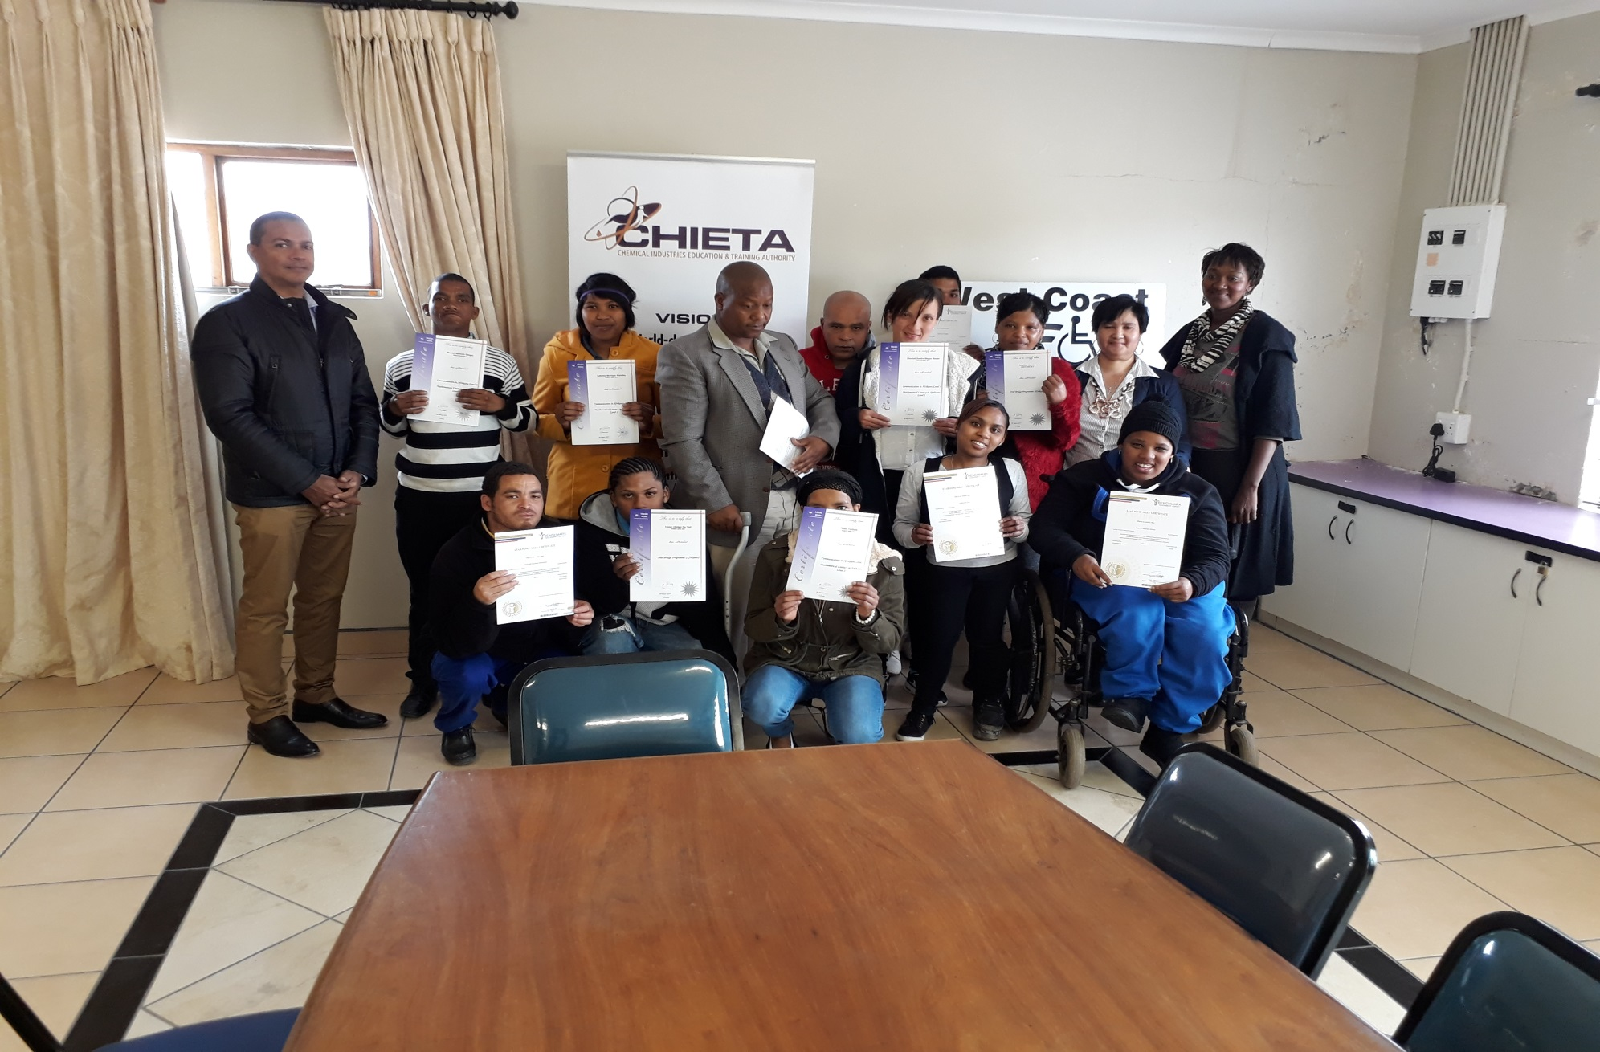
learners -AET level 1 Numeracy and Literacy – West Coast Disability Forum – Saldanha Bay

Slide 27
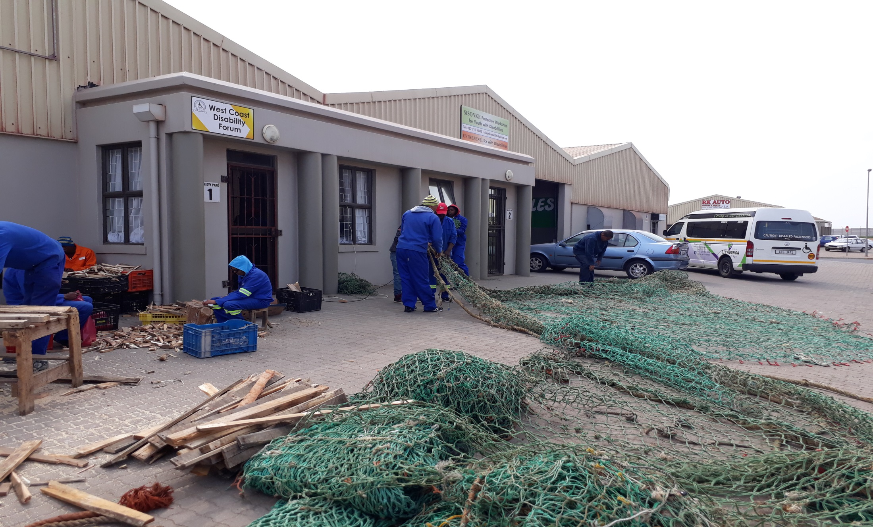
Partnership with West Coast Disability Forum to provide work opportunities for disabled learners.

Slide 28
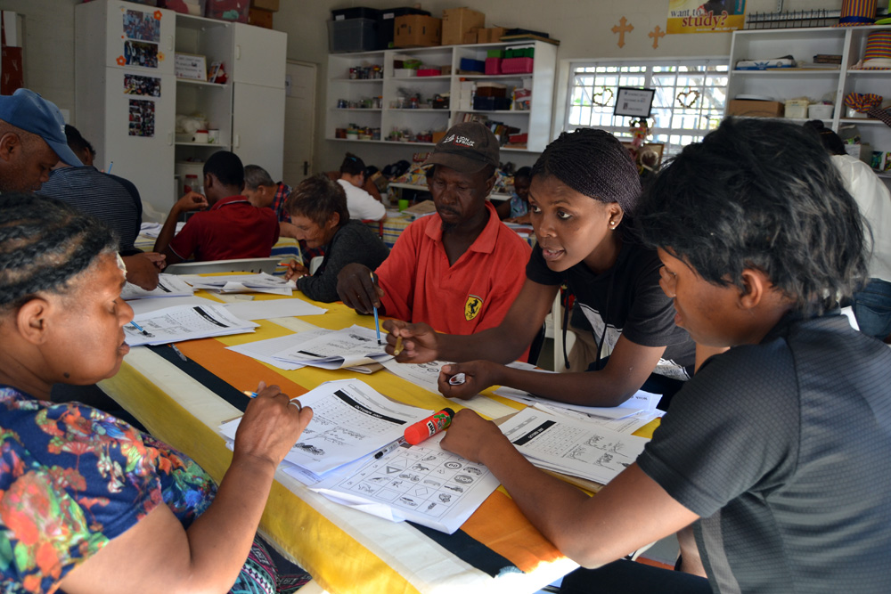
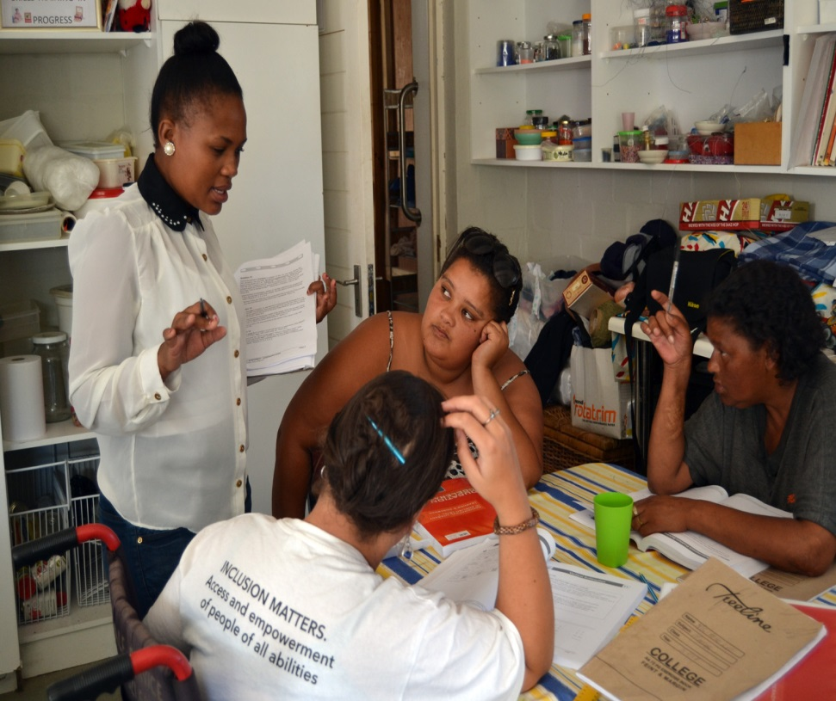
Media Works/CHIETA - 25 learners - AET level 1 Numeracy and Literacy – Hout Bay

Slide 29
Pivotal List
CHIETA TOP 10 PIVOTAL OCCUPATIONS
SETA NAME | Responsible Person | Period | Occupation Code | Occupation | SS | Interventions
CHIETA | Kedibone Moroane | 2016/17 | 2015-651202 | Welder | Y | Apprenticeships Grant, Artisan Programmes Apprenticeships - Engineering Trades, FET College Lecturer Development, FET College Lecturer Development, Learnerships Grant - Artisan Related, Learnerships Grant - Non-Artisan Related, RPL - Artisan Related, Skills Programmes, Work Integrated Learning
CHIETA | Kedibone Moroane | 2016/17 | 2015-671101 | Electrician | Y | Apprenticeships Grant, Artisan Programmes Apprenticeships - Engineering Trades, FET College Lecturer Development, FET College Lecturer Development, Learnerships Grant - Artisan Related, RPL - Artisan Related, Work Integrated Learning
CHIETA | Kedibone Moroane | 2016/17 | 2015-226302 | Safety, Health, Environment and Quality (SHE&Q) Practitioner | Y | Skills Programmes
CHIETA | Kedibone Moroane | 2016/17 | 2015-651302 | Boiler Maker | Y | Apprenticeships Grant, Artisan Programmes Apprenticeships - Engineering Trades, Learnerships Grant - Artisan Related, RPL - Artisan Related
CHIETA | Kedibone Moroane | 2016/17 | 2015-214502 | Chemical Engineering Technologist | Y | Bursaries, Work Integrated Learning
CHIETA | Kedibone Moroane | 2016/17 | 2015-311301 | Electrical Engineering Technician | Y | Bursaries, Learnerships Grant - Non-Artisan Related, Skills Programmes, Work Integrated Learning
CHIETA | Kedibone Moroane | 2016/17 | 2015-733201 | Truck Driver (General) | Y | Learnerships Grant - Non-Artisan Related, Skills Programmes, Work Integrated Learning
CHIETA | Kedibone Moroane | 2016/17 | 2015-652302 | Fitter and Turner | Y | Apprenticeships Grant, FET College Lecturer Development, FET College Lecturer Development, RPL - Artisan Related, Skills Programmes
CHIETA | Kedibone Moroane | 2016/17 | 2015-214501 | Chemical Engineer | Y | Bursaries, Skills Programmes, Work Integrated Learning
CHIETA | Kedibone Moroane | 2016/17 | 2015-313301 | Chemical Plant Controller | Y | Bursaries, Learnerships Grant - Artisan Related, Learnerships Grant - Non-Artisan Related, Other Occupationally Directed Chemicals Industry Related Programmes, RPL - Non-Artisan Related, Skills Programmes, Work Integrated Learning

Slide 30
CHIETA PARTNERSHIP MODEL AS DELIVERY INSTRUMENT
Stakeholders with shared interests and mutual benefits are brought together to achieve alignment
The CHIETA acts as the coordinator, funder, and facilitator in the process
Outcome: correct identification of supply side and demand side needs for fit for purpose projects and project outcomes

Slide 31
CHIETA PARTNERSHIP MODEL AS DELIVERY INSTRUMENT Continued..
CHIETA partnership model has been benchmarked against international best practice. We seek the following elements in all partnerships, to ensure success:
  Partnerships are driven by a need in the economy for a specific vocation
  Curriculum is revised to meet the needs of industry
  College/University staff are capacitated to align to the real activities of industry
  Learners and colleges/universities are supported with funding to ensure sustainability of the partnership and project
  Learners have an opportunity to visit industry and have workplace experience
  Improved Infrastructure for the TVET College/University is promoted
  Partnerships are led by a Steering Committee that includes industry and college/university decision makers and CHIETA Governing Board members or CHIETA Executives and Managers.

Slide 32
  PROGRAMME PERFORMANCE INDICATORS AND 2017\18 TARGETS

Slide 33
M I N D M A P C H I E T A O R G A N I S A T I O N A L A L I G N M E N T
NSDSIII, GOVERNMENT, STAKEHOLDER AND LEGISLATIVE CONTEXT, GOVERNING BOARD
CHIETA UPDATED SSP 2017-2022
CHIETA STRATEGIC PLAN 2015/16 – 2019/20 AND ANNUAL PERFORMANCE PLAN 2017/18
FOUR STRATEGIC PROGRAMMES / DEDICATED BUDGETS AND PEFORMANCE TARGETS
P R O G R A M M E 1
ADMINISTRATION
P R O G R A M M E 2
RESEARCH AND SKILLS PLANNING
P R O G R A M M E 3
LEARNING PROGRAMMES AND PROJECTS
P R O G R A M M E 4
LPDI QUALITY ASSURANCE
Finance & Supply Chain
Governance, Risk & ICT
Human Resources
Research Agenda
Sector Skills Plan
WSP/ATR Data Analysis Reporting
Employed / unemployed learnerships, internships, skills programmes, bursaries, artisans entered and certified
Workplace Integrated Learning HET
AET, ABET, FLC, Bridging and foundational programmes
Support to co-ops, SMME, NGO’s, CBO’s, CBC’s and worker initiated training
Public Sector Partnerships
Number of career guides inclusive of maths & science
Number of career guidance events
Partnership with professional bodies in vocational and career guidance
Dedicated strategic projects in support of Government imperatives
Provider Accreditation
Qualification Development
Certification
B A S E L I N E T A R G E T
2017/18: R 65 531 534
B A S E L I N E T A R G E T
2017/18: R 9 751 928
B A S E L I N E T A R G E T
2017/18: R 404 666 130
B A S E L I N E T A R G E T
2017/18: R 49 560 158
B U S I N E S S U N I T
Research and Skills Planning, Grants, Regions
B U S I N E S S U N I T
Grants, Regions, ETQA, Apprenticeship, Projects (Bursaries)
B U S I N E S S U N I T
Grants, Projects, Regions
B U S I N E S S U N I T
Grants, Regions
CEO, FINANCE, HR, GOVERNANCE CROSS CUTTING ON STRATEGIC AND FUNCTIONAL LEVEL OVER ALL FOUR STRATEGIC PROGRAMMES

Slide 34

CHIETA Performance Information 2017/18
CHIETA, The Catalyst for Enhanced Skills, Economic Growth and Employability
Performance Indicator(Learnerships, Skills Programmes, bursaries and internships) | Annual Target 2017/18 | Six Monthly Target 2017/18 | Six Monthly Achievement 2017/18 | Projected 2017/18 Achievement | Projected 2018/19 Achievement
Employed learners entered | 5 540 | 2 000 | 3 174 (159%)
Employed certificated | 2 735 | 875 | 1 481 (169%)
Unemployed entered | 4 967 | 1 375 | 3 363 (245%)
Unemployed certificated | 2 424 | 825 | 2 811 (341%)

Slide 35
CHIETA Performance Information 2017/18
CHIETA, The Catalyst for Enhanced Skills, Economic Growth and Employability
Performance Indicator(Learnerships, Skills Programmes, bursaries and internships) | Annual Target 2017/18 | Six Monthly Target 2017/18 | Six Monthly Achievement 2017/18 | Projected 2017/18 Achievement | Projected 2018/19 Achievement
Artisans Entered | 1 830 | 830 | 951 (115%)
Artisans Certified | 479 | 178 | 356 (200%)
TVET College Partnerships | 18 | - | -
TVET Workplace Experience Entered | 800 | - | 434

Slide 36
CHIETA Performance Information 2017/18
CHIETA, The Catalyst for Enhanced Skills, Economic Growth and Employability
Performance Indicator(Learnerships, Skills Programmes, bursaries and internships) | Annual Target 2017/18 | Six Monthly Target 2017/18 | Six Monthly Achievement 2017/18 | Projected 2017/18 Achievement | Projected 2018/19 Achievement
Support to Co operatives,NGOs,Worker Initiated Training & Small Businesses | 180 | - | 3
Support to Large,Meduim & Small Companies | 564 | - | -

Slide 37
  HIGHLIGHTS OF THE CHIETA STRATEGY AND APP 2017\18
Integration with CHIETA Sector Skills Plan and Government policy frameworks- refer to supplementary pack which illustrate levels of integration
Funding alignment to identified prioirty areas
Effective Partnership delivery models with Industry and training providers
Credible Research and Skills Planning processes to ensure relevance and accuracy
Substantial allocation of funds to Occupationaly Directed Programmes with work integrated learning
Strong focus on Transformational imperatives
Co- funding models with Industry and to ensure maximum impact and value for money
Monitoring and Evaluation which will also to start to include Impact Assessment Studies and tracking and tracing of of learners through a skills supply and demand database
Supporting Co-ops, SMME’s, worker iniated NGO’s and community training initiatives
Upskilling current workforce to ensure National and International Competetiveness

Slide 38
  CHIETA PERFORMANCE ENVIRONMENT
Effective Governance structure which leads by excample and setting the correct tone at the top through strategic and ethical leadership
Strong Integrated Risk Management Framework with a functional internal control environment
Functional and efficient business processes in support of stakeholder delivery and performance
Strong and efficent Grants management processes to ensure funding and delivery moves within agreed timeframes
Skilled, competent, motivated and experienced staff on all collective levels in the organisation
Sustained track record of meeting and exceeding our organisational performance targets
Sixtheen(16) years of an unqualified audit opinion and received in 2014\15 , 2015\16 and 2016/17 clean audit awards from AGSA
Integrated performance management culture within the organisation with clear roles and accounatbility
Strong, supportive and healthy relationship with DHET and CHIETA Stakeholders

Slide 39
Auditor- General (SA) evaluation of CHIETA Leadership, Financial and Performance management and Governance for the 2016/17 financial year audit

Slide 43
  CHIETA BUDGET 2017\18

Slide 44
CHIETA, The Catalyst for Enhanced Skills, Economic Growth and Employability
DG Program – Sector Skills / NSDS Priority | Expenditure 2016/17 (R’000) | No. of Beneficiaries | Average Cost per Learner | % of Total DG expenditure
Work Integrated Learning | R46,698 | 3 366 | R13,874 | 13.3%
Learnerships | R115,888 | 7 991 | R14,502 | 39.5%
Artisans / Apprenticeships including RPL | R73,201 | 2 729 | R20.039 | 16.8%
Bursaries | R53,170 | 2 034 | R26,141 | 16.7%
Skills Programs | R16,491 | 8 768 | R1,881 | 5.3%
ABET | R5,780 | 588 | R9,830 | 1.6%
TVET Support (Partnerships and lecturer capacitation) | R1,643 | 88 | R18,669 | 0.6%

Slide 45
CHIETA, The Catalyst for Enhanced Skills, Economic Growth and Employability
DG Program – Sector Skills / NSDS Priority | Expenditure 2015/16 (R’000) | No. of Beneficiaries | Average Cost per Learner | % of Total DG expenditure
Work Integrated Learning | R62,668 | 2 087 | R30,027 | 23.0%
Learnerships | R85,568 | 5 811 | R14,725 | 31.4%
Artisans / Apprenticeships | R44,468 | 1 864 | R23,856 | 16.3%
Bursaries | R43,095 | 1751 | R24,611 | 14.6%
Skills Programs | R24,437 | 6792 | R3,598 | 9.0%
ABET | R2,053 | 427 | R4,807 | 0.8%
Recognition of Prior Learning (RPL) | R8,659 | 1362 | R6,357 | 3.2%
TVET Support (Partnerships) | R3,254 | 195 | R16,688 | 1.2%

Slide 46
CHIETA, The Catalyst for Enhanced Skills, Economic Growth and Employability
DG Program – Sector Skills / NSDS Priority | Expenditure 2014/15 (R’000) | No. of Beneficiaries | Average Cost per Learner | % of Total DG expenditure
Work Integrated Learning | R49,463 | 1766 | R28,008 | 20%
Learnerships | R87,786 | 5 671 | R15,480 | 35.5%
Artisans / Apprenticeships (Including RPL) | R45,211 | 2 294 | R19,708 | 18.3%
Bursaries | R25,669 | 948 | R27,076 | 10.4%
Skills Programs | R21,649 | 8 559 | R2,529 | 8.8%
ABET | R2,655 | 795 | R3,340 | 1.1%
Career Guidance | R573 | 4291 | R574 | 0.2%

Slide 47
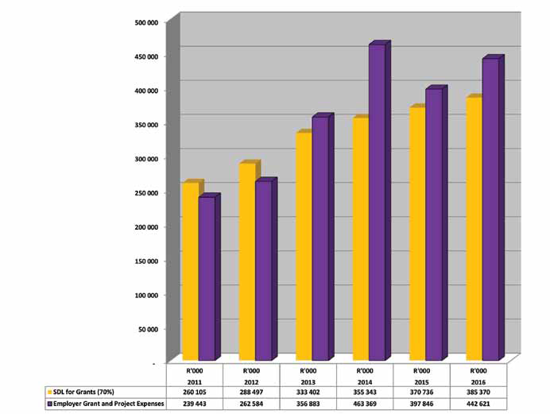
SDL Income vs Employer Grant and Project Expenses 2011 -2016
CHIETA, The Catalyst for Enhanced Skills, Economic Growth and Employability

Slide 48
ESTIMATED BUDGET FOR CHIETA STRATEGIC PROGRAMMES FOR 2017/2018 FINANCIAL YEAR
PROGRAM NUMBER | PROGRAMME NAME | BUDGET ALLOCATION 2017/18
1 | Administration | R 65 531 534
2 | Research and Skills Planning | R 9 751 928
3 | Learning Programmes and Projects | R 404 666 130
4 | Learning Programme Development | R 49 560 158
TOTAL |  | R 529 509 750

Slide 49
  CHALLENGES IN IMPLEMENTING NSDS III
Limitations on basic education system and specifically maths and science learners
Sluggish economic growth that will impact on the reduction of employment oppurtunities
Absorption rates by companies of qualified learners into gainfull employment
Bottom line pressure on companies that can potentially disturb delivery of agreed projects outcomes

Slide 50
  FOCUS AREAS GOING FORWARD INTO 2017 TO 2020I
Optimal utilisation of Non-Pivotal Funding for Impact Analysis
Multi - pronged strategic approach to subsector growth and related skills development interventions
How do CHIETA maintain and enhance relevancy with Industry within a changing PSET system
Increasing CHIETA economic growth oppurtunities through chemical realted areas of energy, nuclear and advanced manufacturing
Oppurtunties for creative and innovative skills development interventions in an economic downturn
Industry shareholding and leadership of TVET systems- Understanding the cost of private provision and strategic integration of public private provision to achive econmies of scale
Continuous engagements with companies on increased absorption levels of unemeployed learners- new social accord
Increased multi party partnerships
More collaboration and coherence amongst SETAs
Increased throughput rates of learners
New strategic planning approach moving away from singular forecasting but to pluasible scenario planning to strengthen strategic agality and response time from CHIETA to optimally service all stakeholders

Slide 51
QUESTIONS, ANSWERS AND CLARITY
THANK YOU

