Slide 1
FUNDING: EFFECT ON CGS’s MANDATE
Expanded Mapping Programme
Parliamentary Portfolio Committee on Mineral Resources
15 November 2017

Slide 2
PRESENTATION THEMES
Mandate, Vision, Mission and Core Values
Alignment of Strategic Objectives with Government Developmental Imperatives and the NDP Vision 2030
Problem statements:
South Africa in the global context: Exploration Expenditure
Inadequate Geological Mapping Coverage
The CGS Expanded Mapping Programme
Some Project of National Importance
Financial considerations
Concluding remarks

Slide 3
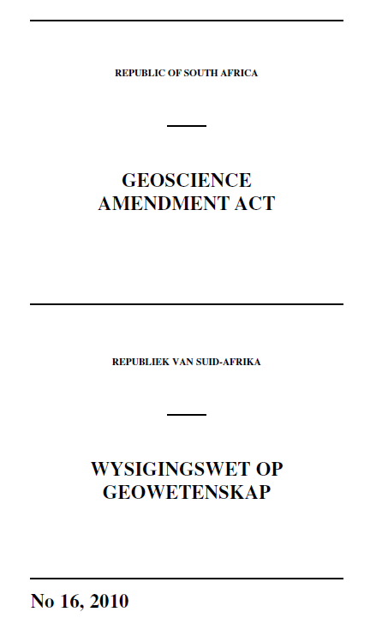
MANDATE: Geoscience Act 100 of 1993, as amended
The systematic onshore and offshore geoscientific mapping of South Africa
Basic geoscience research into the nature and origin of rocks
The collection and curation of all geoscience data and act as a National Geoscience Repository
The compilation of all geoscience data and information, particularly the geological, geophysical, geochemical and engineering-geological data in the form of maps and documents
Render geoscience knowledge services and advise to the State
Manage a number of national geoscience facilities on behalf of the State
Render commercial services and products to clients (national and international)

Slide 4
MANDATE: PROVISIONS HELD IN ABEYANCE
The Geoscience Amendment Act No. 16 of 2010 was passed with exception of the following sections;
§ 4(c) - National custodian of geotechnical, prospecting and other geoscience information including in the geomagnetic space
§ 4(eA) - Review and evaluation of all geotechnical reports in relation to geohazards that may affect infrastructure
§ 4(f) - Development and maintenance of library, information centre, core library, museum, analytical laboratory, seismological network, geochemical and geophysical test sites
§ 5(b) - Compilation and development of comprehensive and integrated knowledge of geosciences including geomagnetism
§ 8 - Appointment of Geotechnical Appeal Committee; Internal Appeal Process; Permission from the Minister for geoscience work outside SA
PLANNING APPLICATION FOR LIFTING THE SUSPENSION OF THESE
PROVISIONS TO BRING THE MANDATE INTO FULL OPERATION.

Slide 5
OUR VISION AND MISSION
Vision
A prosperous and transformed society enabled by geoscience solutions.
Mission
Providing integrated, systematic and thematic maps and conducting research on the onshore and offshore geology of South Africa, as mandated, to:
Facilitate mineral, energy and agricultural development;
Contribute to the assessment and sustainable management of mineral, geohydrological and geo-environmental resources;
Support infrastructure development
Acting as a national advisory authority on geo-environmental pollution.
Providing an information repository and delivery platform that facilitates actionable decisions and the accessibility of relevant information by relevant stakeholders.
Discharging the mandate in a manner that supports transformation and national developmental imperatives.

Slide 6
OUR CORE VALUES (IDEALS)
INNOVATION
Problems-solving through novel ideas for CGS’s stakeholders
DIVERSITY
Inclusive culture and respect for diversity
EXCELLENCE
Exceptional quality in all CGS does
ACCOUNTABILITY
Ownership and commitment to achieve
LEARNING
Learning organisation that seeks continuous professional and personal development
SERVICE
Consistently efficient and effective service to all

Slide 7
STRATEGIC FOCUS AREAS
STRATEGIC OBJECTIVES | MAIN OUTCOME
Delivery of the mandate (Integrated, thematic and systematic mapping and research) | GEOSCIENCE INFORMATION AND SOLUTIONS ENABLING PROSPERITY FOR ALL
Advisory and stakeholder engagement and knowledge management
An empowered, transformed, motivated and capacitated workforce
Organisational effectiveness and efficiency
Financial Sustainability
We are committed to our mandate, We care about our stakeholders

Slide 8
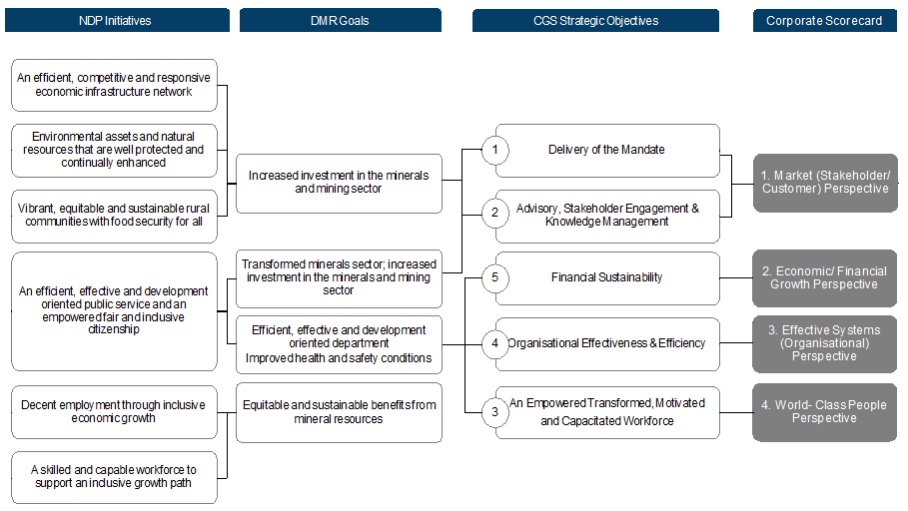
ALIGNMENT OF STRATEGIC OBJECTIVES WITH GOVERNMENT DEVELOPMENTAL IMPERATIVES

Slide 9
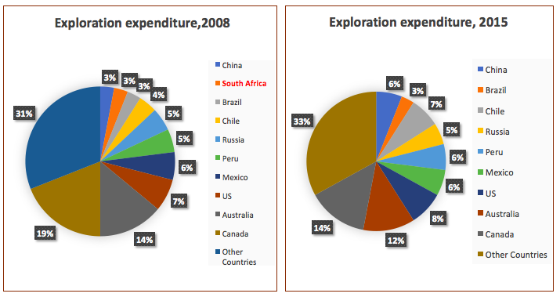
PROBLEM STATEMENT: SA HAS FALLEN OUT OF THE GLOBAL TOP TEN EXPLORATION EXPENDITURE COUNTRIES
SOURCE: Metal Economics Group 2009, SNL Metals & Mining
2008 – 3% of global exploration spend (SA in the top 10)
2015 – 2% of global exploration spend (SA not in the top 10)

Slide 10
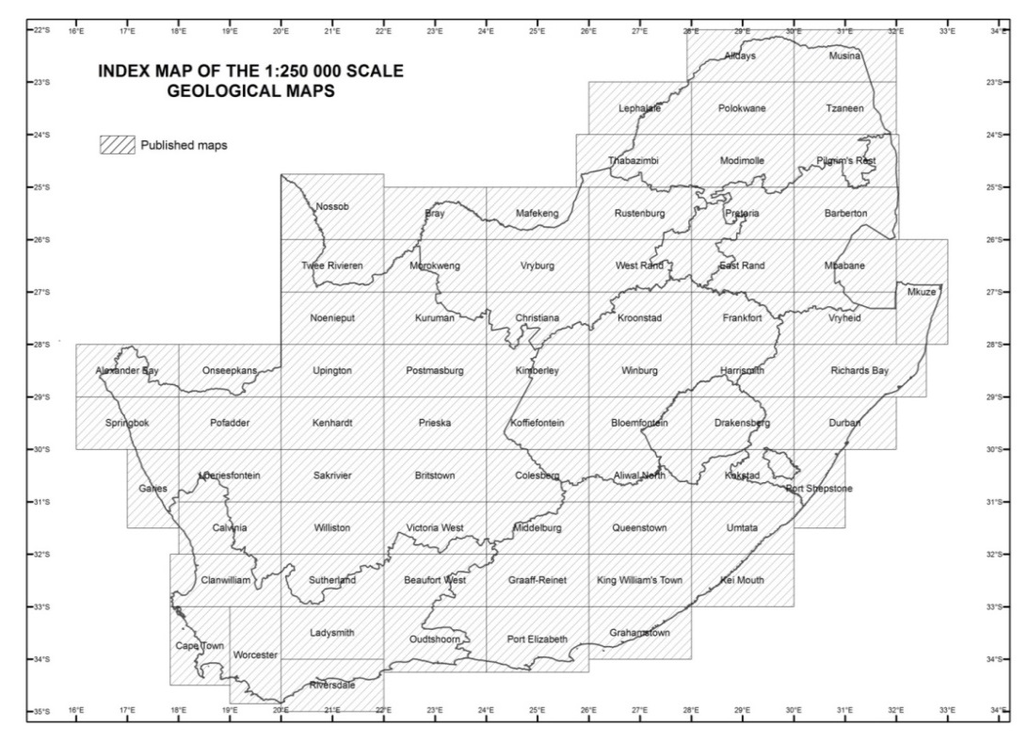
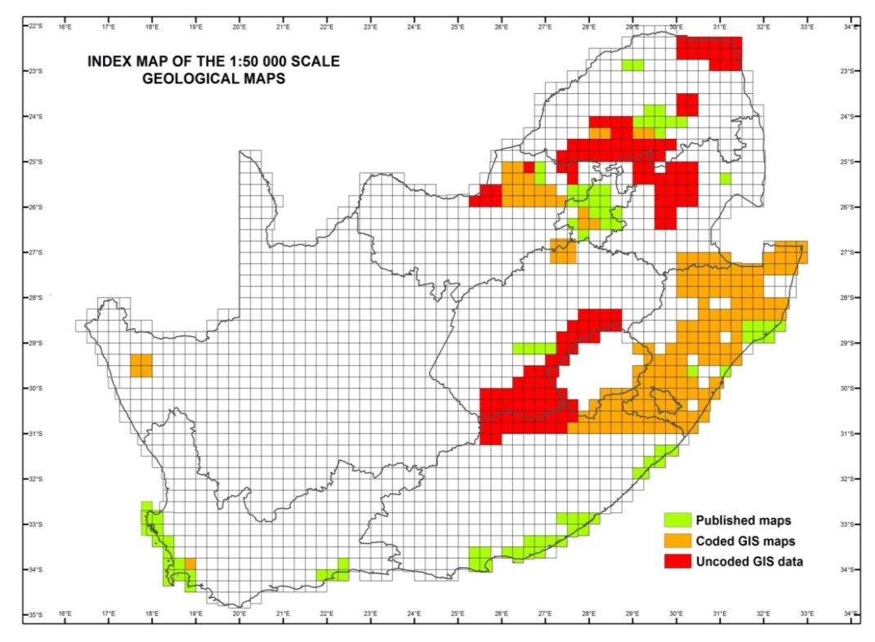
PROBLEM STATEMENT: INADEQUATE COVERAGE OF PUBLISHED GEOLOGICAL MAPS
The geology of South Africa has been published at scales of 1:1 000 000 and 1:250 000
About 5% of South Africa has published
Detailed (1:50 000 scale) maps

Slide 11
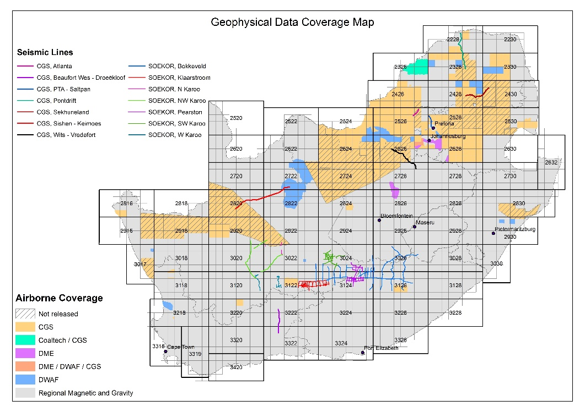
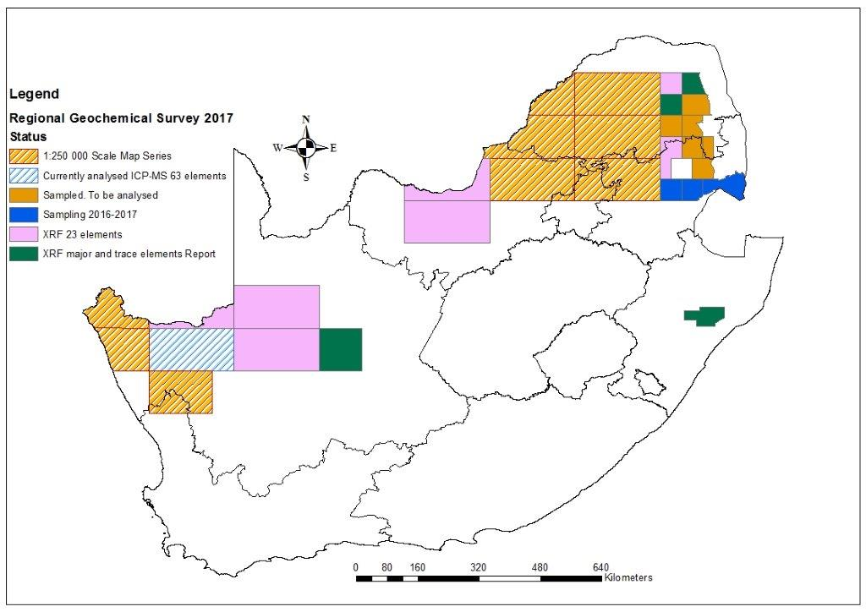
PROBLEM STATEMENT: LIMITED HIGH RESOLUTION GEOPHYSICAL AND GEOCHEMICAL DATA
High resolution airborne geophysics: About 30% of South Africa has been covered
Geochemical soil surveys: About 23% of South Africa has been covered
Notes:
CHANGE THE SLIDE

Slide 12
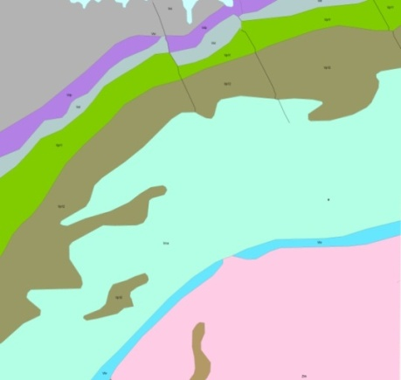
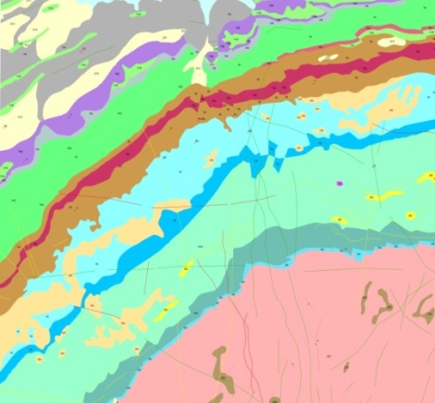
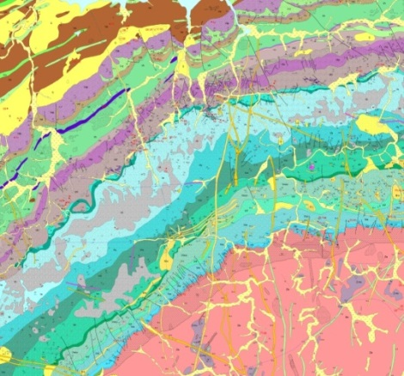
THE CGS EXPANDED MAPPING PROGRAMME (EMP)
Detailed (high resolution) integrated mapping and various other surveys to generate new geoscience data using recent technologies
1:50 000-scale multi-disciplinary maps
Thematic and Systematic
On- and offshore
Seeks to address National Imperatives in South Africa
Infrastructure Development, Food Security, Mineral and Upstream Petroleum Exploration and Mining, Energy Security, Environmental Health, Hydrogeology, Geohazards, Carbon Capture and Sequestration, etc.
1:1 000 000 scale
1:250 000 scale
1:50 000 scale

Slide 13
OUTCOMES /BENEFITS OF THE EXPANDED MAPPING PROGRAMME
Investment attraction from increased mineral exploration and mining activity
Accessible data to early/junior miners
Improved ocean governance and data management with increased environmental stewardship (BLUE ECONOMY)
Sustainable food security
Improved predictive capability of geohazards (sinkholes, landslides, earthquakes, tectonic movements), reduction of costs of rebuilding collapsed infrastructure and assist in disaster prevention
Safer water to communities
Medical geology: ease disease burden (prevention or mitigation of non-communicable diseases) – decrease on primary health care budget
Socio-economic development and rural upliftment through exploitation of minerals

Slide 14
RELEVANCE TO SOME State Programmes
National Development Plan (NDP)
9-point Presidential Plan
National Strategy for Sustainable Development
Oceans Operation Phakisa – Blue Economy
Comprehensive Rural Development Plan
National Groundwater Strategy
Expanded Public Works Programmes
Presidential Infrastructure Programme (Housing, Rail, road, ports, etc.)
Energy and food security programmes

Slide 15
SOME PROJECTS OF NATIONAL IMPORTANCE

Slide 16
STRATEGIC MINE WATER MANAGEMENT PROJECT
Finalised designs for canals to stop ingress in the East Rand Gold Fields (CGS and DMR in process for appointing a contractor)
In progress with;
identifying and characterising ingress points in focused areas in the gold fields
assessing groundwater vulnerability in the Mpumalanga coal fields and Karoo uranium projects
Planned work;
Potential risks in marine mining and possible mitigation measures
Assessments of risks posed by the mine residue and formulate methods to utilise mine waste products for other uses
Direct ingress into an abandoned incline shaft – Moderbee Mine, Benoni

Slide 17
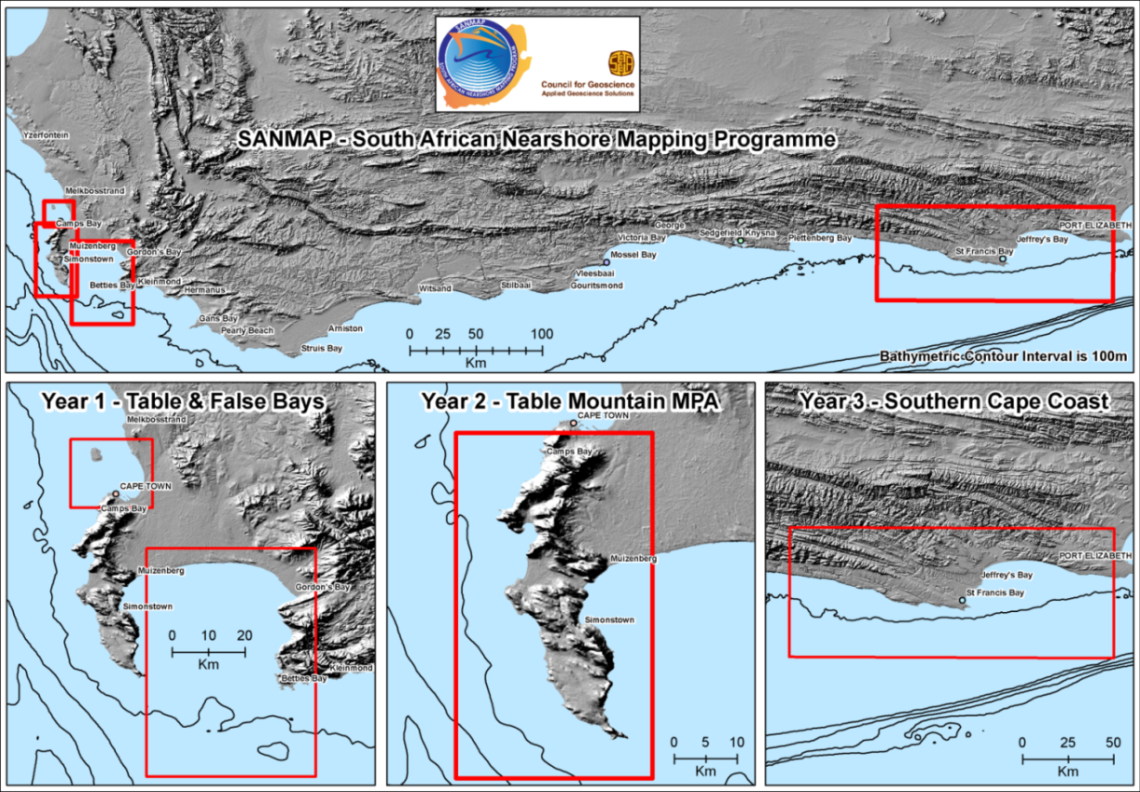
NEAR- AND OFFSHORE MAPPING PROGRAMME
BOOSTING THE BLUE ECONOMY
Used for mineral resource characterisation (e.g. marine gravels, phosphate, possibly diamondiferous gravels)
Important for food security, renewable energy resources, desalination plants
Petroleum production platforms, submarine telecommunication cables, port and harbour infrastructure, etc.
Archaeological and historical heritage management
Geohazard Identification (palaeoseismicity) for infrastructure development
Ocean Governance: International Seabed Authority;
Operation Phakisa; extended shelf claim.

Slide 18
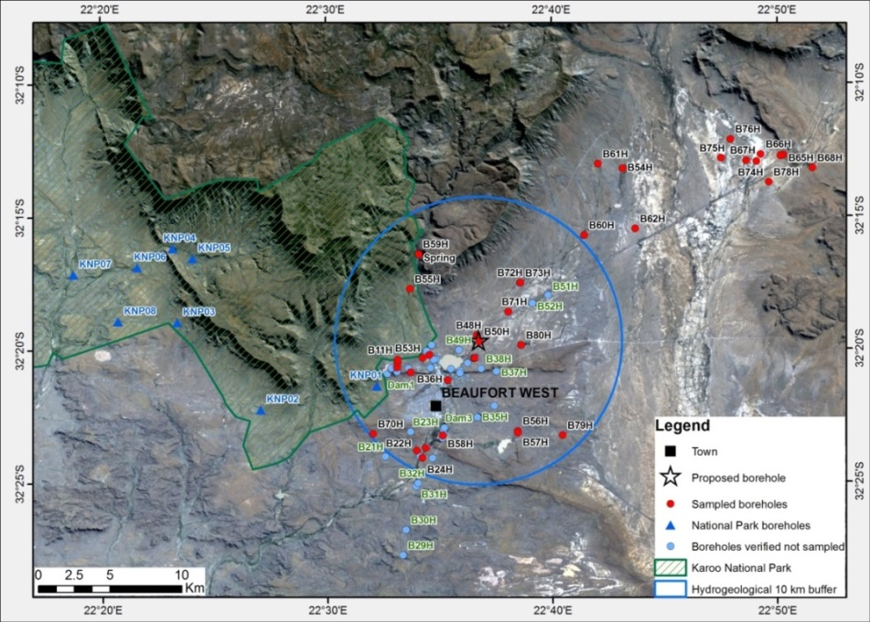
KAROO DEEP DRILLING AND GEO-ENVIRONMENTAL BASELINE PROGRAMME (Shale Gas)
Shale gas potential studies in the Karoo Basin
Airborne geophysics surveys are complete and ground geophysics is currently being finalised. Data not processed yet
Geology, Structural Analyses are completed
Planned 6 boreholes to assess impact on deep and shallow water resources, natural gas emissions and induced seismicity monitoring
Analyses of all the data and surveys will mark the concluding stages of the Project.
Selected and audited boreholes within the study area. The focus of the study will be concentrated within the 10 km hydrogeological buffer zone

Slide 19
MANAGEMENT OF DERELICT AND OWNERLESS (D&O) MINES OF SOUTH AFRICA
Assessment of the D&O sites still continues (and maintenance of GIS database of D&O sites
Continue closing unsafe D&O mine openings nationally
Working together with the Mine Health and Safety Council
CGS is also busy with Air Quality Monitoring studies around few Asbestos dumps in Mpumalanga and Limpopo to establish baseline conditions for rehabilitation purposes.

Slide 20
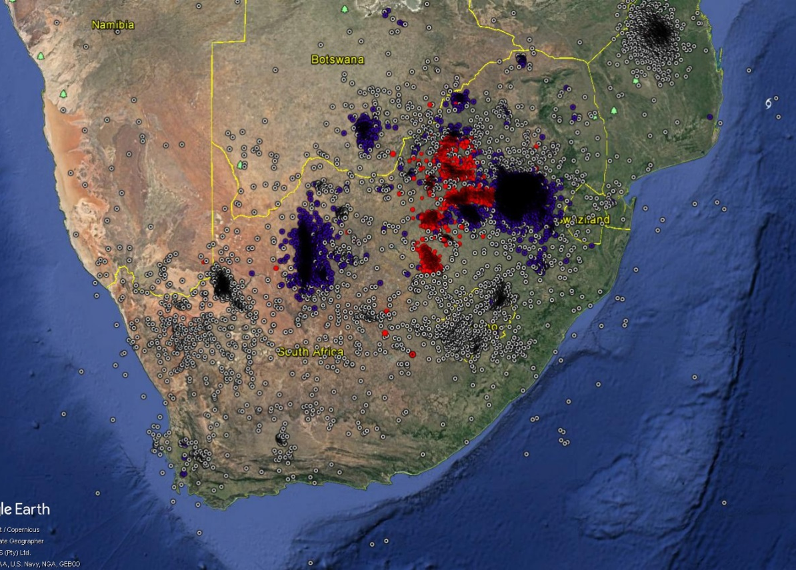
SEISMIC NETWORK MONITORING
Seismic hazard mapping or modelling for infrastructure development and mine safety
More focused seismic monitoring around mine sites in addition to the National Network
Blue = Explosions
Red = Mining-related
White = tectonic
19

Slide 21
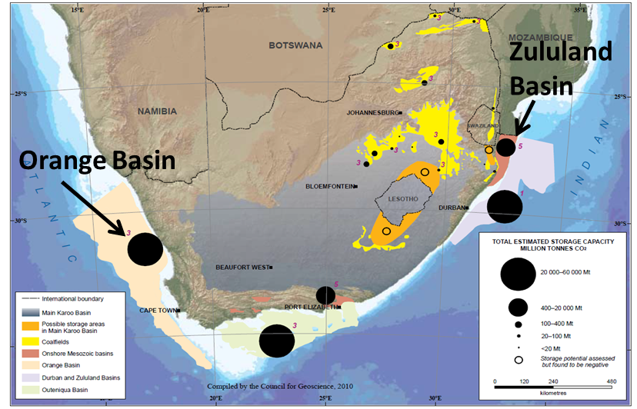
CARBON CAPTURE AND STORAGE OPTIONS FOR SA
Zululand Basin Study (World Bank Funded Pilot Carbon Sequestration Project )
Full Basin Analysis
Seismic and Well data acquisition and interpretation
Preliminary 3D model
Awaiting new additional seismics and well data acquisition
Orange Basin Study (West Coast)
Preliminary mapping of potential storage sites in the southern Orange Basin offshore Cape Town underway
Southern Section Mapped
New data acquisition
These projects are in collaboration with DOE, SANEDI and BATTELLE.
Some Data is purchased from Petro-SA

Slide 22
FINANCIAL CONSIDERATIONS
REVENUE ANALYSIS FOR 2017/18 TO 2020/21
Item | 2017/18 | 2018/19 | 2019/20 | 2020/21
 | x 1 000 | x 1 000 | x 1 000 | x 1 000
Government grant | 474.4m | 393.9m | 320.9m | 340.2m
Baseline allocation | 177.2m | 206.9m | 218.5m | 231.7m
MTEF Projects (Ring Fenced) | 264.7m | 96.9m | 102.4m | 108.5m
Economic Competitiveness and Support Package | 32.5m | 90m | 0 | 0
Commercial Revenue | 22m | 24.2m | 26.6m | 29.2m
Sundry income | 3.5m | 3.7m | 3.9m | 4.1m
TOTAL REVENUE (RAND) | 499.9m | 421.8m | 351.4m | 373.5m
The figures are prior to receipt of Preliminary Allocation for Estimates of National Expenditure from the DMR and Treasury

Slide 23
2017 STATUS: BUDGET SHORTFALLS
 | R’000 | R’000 | R’000 | R’000
 | Budget 2017/2018 | Budget 2018/2019 | Budget 2019/2020 | Budget 2020/21
Baseline allocation | 177 200 | 206 938 | 218 526 | 213 638
Personnel Costs | (226 777) | (244 919) | (264 513) | (285 674)
Shortfall | (49 577) | (37 981) | (45 987) | (72 036)
Operational Costs (excluding MTEF ring fenced) | (19 897) | (23 045) | (25 475) | (23 437)
Total Shortfall | (69 474) | (61 026) | (71 462) | (95 473)

Slide 24
SUMMARY OF FINANCIAL NEEDS ANALYSES TO FUND THE 3 YEARS OF THE EXPANDED MAPPING PROGRAMME
Budget Allocation | Activity | Year 1 | Year 2 | Year 3 | Total
 |  | Rand, Millions
Geoscientific Mapping R1.06 billion | On-shore Mapping | 25 | 40 | 60 | 125
 | Off-shore Mapping | 40 | 70 | 100 | 210
 | Geophysical Surveying | 75 | 100 | 250 | 425
 | Remote Sensing | 50 | 100 | 150 | 300
Geohazard Mapping R 135 million | Engineering Geology | 15 | 20 | 25 | 60
 | Seismology | 20 | 25 | 30 | 75
Economic Geology R 415 million | Mineral Mapping | 30 | 45 | 75 | 150
 | Soil Geochemistry | 40 | 75 | 150 | 265
Environment and Water Resource Assessment R 155 million | Environmental Health Assessment and Groundwater Assessment | 40 | 50 | 65 | 155
GIS/Cartography/KIMS R55 million | Map Compilation | 0 | 25 | 30 | 55
Total |  | 335 | 550 | 935 | 1820
Ten sub-programmes – MTEF Total

Slide 25
PRELIMINARY ALLOCATION FOR 2018-2021
 | MTEF |  |  | TOTAL
Budget Allocation | 2018/19 | 2019/20 | 2020/21 | MTEF
 | R’ 000 | R’ 000 | R’ 000 | R’ 000
Operational Budget | 203,615 | 215,017 | 226,842 | 645,474
Capital Budget | 3,323 | 3,509 | 3,702 | 10,534
Mine Rehabilitation Project | 42,247 | 44,613 | 47,067 | 133,927
Water Ingress Project | 26,063 | 27,523 | 29,037 | 82,623
Shale Gas | 27,614 | 29,160 | 30,764 | 87,538
Expanded Public Works Programme: Derelict and Ownerless mines | 1,047 | 1,106 | 1,167 | 3,320
Economic Competitiveness and Support Package (ECSP) | 90,000 | 188,000 | 198,340 | 476,340
Digital Information system; buildings; equipment and facilities* (Implementation of Sections of the CGS Act that were put in abeyance) | 90,000 | 0 | 0 | 90,000
Analytical and research work for the Geoscience (Expanded Mapping Programme) | 0 | 188,000 | 198,340 | 386,340
TOTAL | 393,909 | 508,928 | 536,919 | 1,439,756

Slide 26
FUNDING CHALLENGES
 | 2018/19 | 2019/20 | 2020/21 | TOTAL
Requested Amount | R335m | 550m | R935m | R1 820m
Preliminary Allocation for 2018 | R0m | R188m | R198m | R386m
(Shortfall) | (R335m) | (R362m) | (R737m) | (R1434m)
Total required funding is R20 billion over 10 years
An amount of R1.82 billion was requested for the MTEF period 2018/19 – 2020/21
A total of R386m is preliminary allocated for the MTEF period
It is difficult to plan , employ the requisite capacity and deliver expediently when funding is not guaranteed

Slide 27
CONCLUDING REMARKS
The CGS welcomes the preliminary allocation for Estimates of National Expenditure.
The CGS has shifted from excessive commercial exposure and is now primarily focusing on its legislative mandate
The EMP will boost South Africa in reclaiming its rank as an exploration destination of choice
However, the research and development in geoscience is a long-term business. Consequently, the current model of allocation impedes the sustainability of the CGS in terms of the following:
Generation and retention of the ‘crème de la crème’ geoscientists to bequeath the function to posterity
Long-term planning and monitoring of strategic programmes
Therefore, the CGS recommends that the baseline allocation be substantially augmented in order to address the concerns raised above.

Slide 28
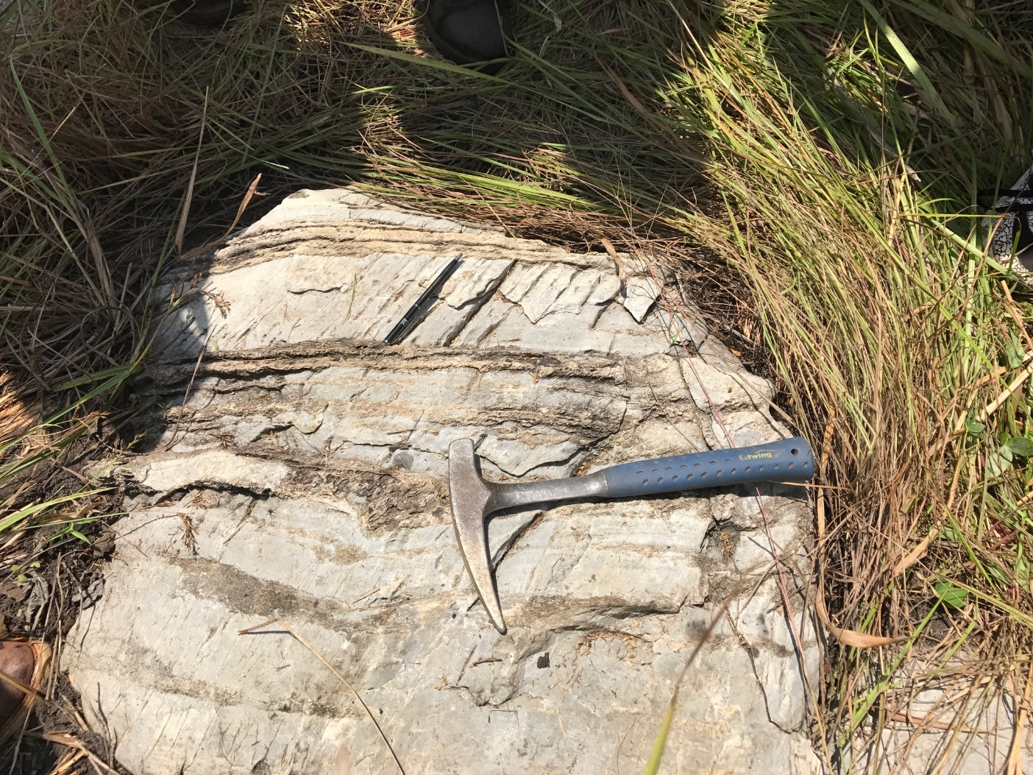
THANK YOU

