Slide 1

Results of South African STI Indicators Report
Presentation by
Dr Azar Jammine (Chief Economist & NACI Council Member)
15 November 2017

Slide 2
Presentation Outline
  Introduction and context
    Global context
    Local context
  Results of 2016 STI indicators report
  South African Innovation Scorecard Framework

Slide 3
  Global Context
World in transition and changing science technology and innovation (STI systems)

Slide 4

Expressions of a World in Transition
1. Mega Trends
2. Grand
Challenges
World in Transition
3. Transforming
Innovation
4. Deep Transitions
Notes:
World is in Transition.
Four expressions of World in Transition, four ways of talking about it. First two are fairly general, third one is more specific to SPRU and together with first three has generated
A New Agenda for SPRU called Transformation Innovation, which is also main theme of this conference
Fourth expression is more related to my own specific research and agenda.

Slide 5
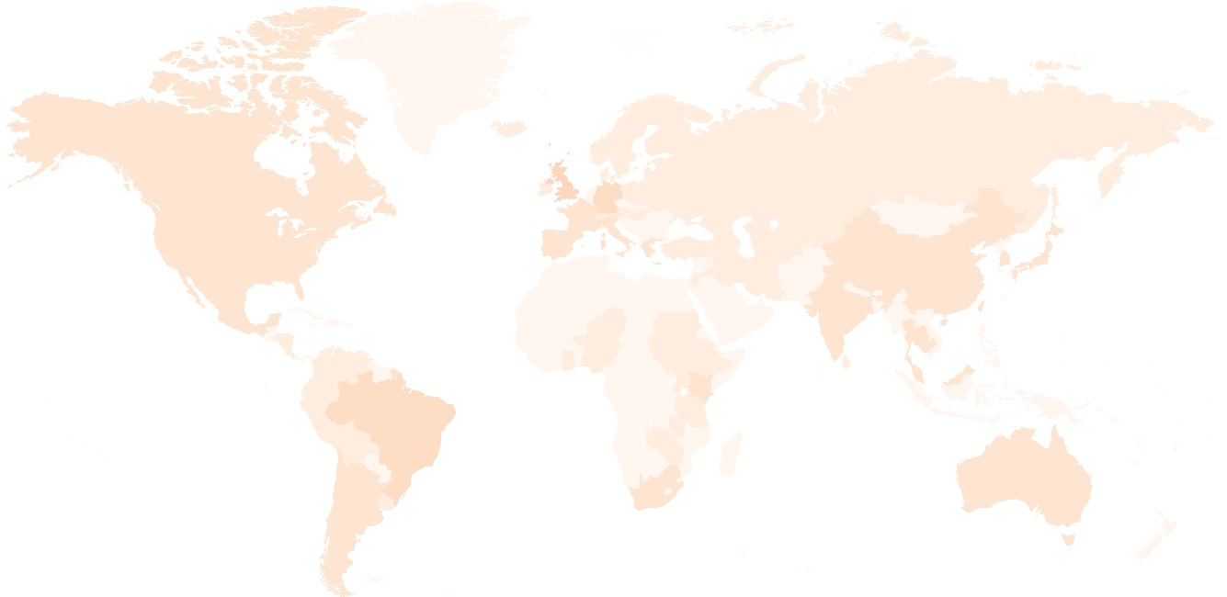
  Mega Trends
Growing Unemployment
Megacities
Climate Change
Multi-polar world
Growing Inequality
Migration
New Wars
Hollowing out of Nation-States
Notes:
These are a number of mega-trends, you find them in scenario’s and many reports. This list is not comprehensive. Together these trends are leading to a lot of turbulence and sense of urgency that world is in transition and science, technology and innovation policy need to respond
Many of them also have caused Brexit, and in writing a Comment on this for Nature, and a blog for the Guardian with Ed we make the point that we are too concerned about the consequences of Brexit, and forget to talk about its causes. This is central to my own work but also much of work of SPRU, and our community at large.
Amends - Map behind made darker so can see

Slide 6

  Grand challenges
Notes:
Urgent challenges can be translated in goals. This has been done forcefully by the UN in their 17 SDGs.
Sussex has taken up these challenges through establishment with IDS SSRP.
Two remarks….
1) Goals are embraced by both developing and developed world, it is a joint challenges, and one could argue they erase the distinction between developing and developed, we are all in the need of developing but in a complete new direction. Solutions will also not just come from the West and diffuse to the rest.
2) They also take the focus away from single issue challenges, such as climate change. Focus on a range of issues, including climate change, poverty reduction. For me they represent a new way of thinking about Social Progress. We have lost our ability to talk about social progress, Therefore I am very happy that next to the IPCC we now have the IPSP to combine issues of social and environmental justice, and having SPRU heavily involved.

Slide 7
Local Context
South Africa (through the National Development Plan [NDP]) and as a member of BRICS recognise the role and contribution of science technology and innovation (STI) to inclusive and sustainable socioeconomic development:
There is a consensus regarding the need to shift from broad policy orientations/aspirations to the implementation
NACI recently completed the 20 year review of 1996 White Paper on STI and DST is finalising the new White Paper.

Slide 8
Key Trends
Effects of global economic crisis, unemployment, poverty and inequality
Water scarcity, global change, energy, food security, disease threats (such as HIV/AIDS)
Low business confidence
Positive and negative impact of fourth industrial revolution

Slide 9
Results of 2016 South African STI Indicators Report

Slide 10
Background about South African STI Indicators Report
An annual publication produced by NACI to assess the progress in development of the effective and efficient national system of innovation
It is not a primary statistics report, but rather an analysis report that relies on various STI data and information
This report provides a necessary platform for discussing the state of innovation in SA

Slide 11
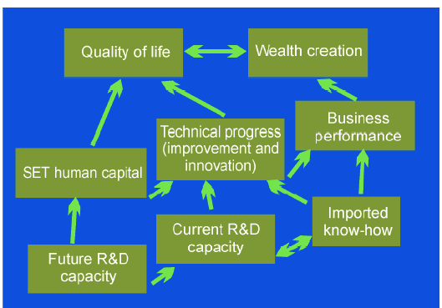
  SA STI Indicators Report: Conceptual Framework

Slide 12
Focus of this Report
Assessment of the SA innovation system for 1996 – 2015 period;
In most cases SA is benchmarked against SADC, SSA, Africa, BRICS countries, developing countries, upper middle income economies, G20 countries & the world total;
Notable new indicators that were introduced are performance on TIMSS, capitalised (SNA) R&D expenditure, ICT indicators, factor productivity & JSE market capitalisation by sector.

Slide 13
Key Highlights
Sci, Eng. & Tech. (SET) enrolment is increasing gradually although it remains low (29.9% in 2015)
  This also applies to proportion of female SET enrolment (46.2% in 2015, 45.8% in 2014 and 45.5% in 2013)
  Share of female SET graduations is high (50.6% in 2015)
The number of scientific publications have tripled from a period 1996 – 2000 (25,453) to a period 2011 – 2015 (75,270)
  Though a share of Engineering and Technology publications remains stagnant at an average of 13.9% during 2011 – 2015 from 14.1% during 1996 – 2000
The country has one of the largest mobile cellular subscriptions per 100 people (159 in 2015)

Slide 14
Key Highlights (Contd.)
Multinational corporations are playing a significant role for SA’s technological innovation progress:
  Share of SA non-residents patents granted: 46.1% during 1996 – 2000; 59.2% during 2011 – 2015
  Share of SA non-residents industrial designs registered: 45.6% during 1996 – 2000; 69.5% during 2011 – 2015
However, there is a decline in FDI as % of GDP:
  2001 – 2005: 1.91%, 2001 – 2005: 1.85%, 2001 – 2005: 1.32%
  The country’s FDI as % of Africa declined from 14% in 1996 to only 3% in 2015
Related to this is a decline in % of capital goods import and a declining country share of high-tech exports

Slide 15
NSI human capital development pipeline remain constrained
TIMSS
Higher education
Low scores at no-fee public schools
Increasing female & PDIs SET enrolment
Poor ECD
Stagnant undergraduate SET enrolment (30%)
Low maths & science performance
Increasing postgraduate SET enrolment
Constrained Human Capital Pipeline
Maths & science passes with 50% remain low (<20%)
Declining # of female learners passing maths & science with > 60% (43% & 44% in 2016)
Slight improvement in past 3 years
NSC/ matric

Slide 16
South Africa’s Performance at 2015 Trends in International Maths & Science Study (TIMSS)
International Benchmark | Grade 5 | Grade 9
 | Mathematics | Mathematics |  | Science
 | 2015 | 2011 | 2015 | 2011 | 2015
Advanced (>625) | 1% | 1% | 1% | 1% | 1%
High (550-625) | 4% | 2% | 3% | 3% | 4%
Intermediate (475-550) | 12% | 6% | 10% | 7% | 9%
Low (400-475) | 22% | 18% | 21% | 14% | 18%
Not Achieved (<400) | 61% | 73% | 66% | 75% | 68%
Average SA Scores | 376 | 352 | 372 | 332 | 358
Source: Human Sciences Research Council (HSRC)

Slide 17
South Africa’s Performance at 2015 TIMSS (Contd.)
Source: Human Sciences Research Council (HSRC)

Slide 18
  Trend in Proportion of R&D Expenditure by Sector

Slide 19
  Change in Business Sector R&D Intensity by Industry

Slide 20
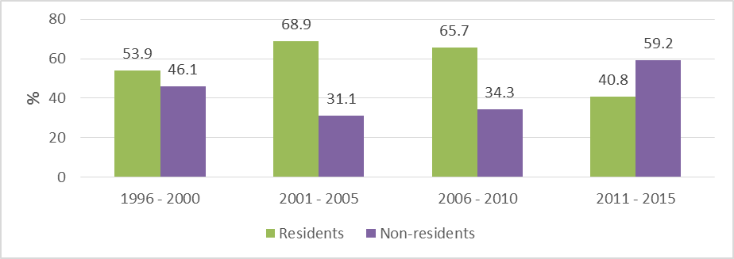
  Growing Role of Non-residents for SA’s Technical Progress (albeit declining FDI):
Trend in Residents and Non-Residents South African Patents Granted

Slide 21
  Declining Inflow of Foreign Direct Investment (in real values and as % of GDP)

Slide 22
Benchmarking of South African Inflow of FDI
 | 1996 |  | 1996 - 2000 | 2001 - 2005 | 2006 - 2010 | 2011 - 2015 |  | 2013 | 2014 | 2015
SA FDI inflow as % of SADC FDI | 45.85 |  | 37.21 | 45.47 | 45.48 | 27.66 |  | 51.07 | 25.73 | 8.05
SA FDI inflow as % of SSA FDI | 17.89 |  | 20.17 | 22.48 | 18.33 | 11.45 |  | 20.20 | 12.15 | 4.13
SA FDI inflow as % of Africa FDI | 13.54 |  | 15.12 | 16.48 | 11.31 | 9.21 |  | 15.91 | 9.90 | 3.28
SA FDI inflow as % of BRICS FDI | 1.40 |  | 2.04 | 3.61 | 2.49 | 1.83 |  | 3.11 | 2.13 | 0.69
SA FDI inflow as % of developing economies FDI | 0.56 |  | 0.79 | 1.41 | 1.05 | 0.71 |  | 1.25 | 0.83 | 0.23
SA FDI inflow as % of upper middle income countries FDI | 0.85 |  | 1.19 | 2.05 | 1.64 | 1.24 |  | 1.99 | 1.52 | 0.48
SA FDI inflow as % of G20 FDI | 0.34 |  | 0.30 | 0.83 | 0.64 | 0.61 |  | 0.98 | 0.89 | 0.19
SA FDI inflow as % of world FDI | 0.21 |  | 0.19 | 0.48 | 0.37 | 0.33 |  | 0.58 | 0.45 | 0.10

Slide 23
Proportion of Merchandise Imports by Broad End Use Classification

Slide 25
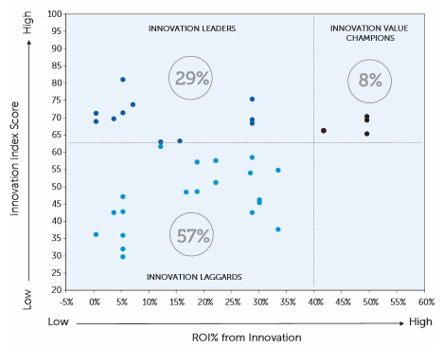
Innovation performance and ROI from innovation
Source: 2016 Accenture Innovation Index

Slide 26
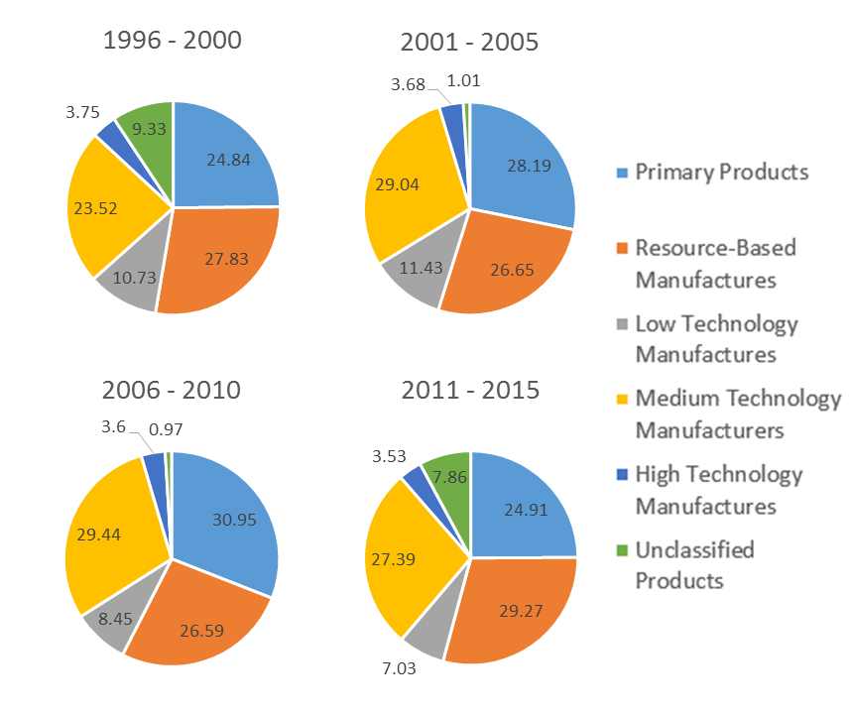
SA’s share of merchandise exports by technology intensity

Slide 28
  Benchmarking of South African CO₂ Emission
 | 1996 |  | 1996 - 2000 | 2001 - 2005 | 2006 - 2010 | 2011 | 2012 | 2013
SA CO₂ emissions as % of SADC CO₂ emissions | 92.82 |  | 93.15 | 91.66 | 89.52 | 87.87 | 86.78 | 86.38
SA CO₂ emissions as % of SSA CO₂ emissions | 74.82 |  | 74.00 | 67.16 | 67.38 | 64.62 | 63.26 | 62.51
SA CO₂ emissions as % of Africa CO₂ emissions | 46.87 |  | 45.91 | 42.39 | 41.59 | 39.70 | 38.17 | 38.01
SA CO₂ emissions as % of BRICS CO₂ emissions | 5.53 |  | 5.70 | 5.00 | 4.19 | 3.33 | 3.19 | 3.13
SA CO₂ emissions as % of G20 CO₂ emissions | 1.88 |  | 1.92 | 1.85 | 1.90 | 1.71 | 1.67 | 1.66
SA CO₂ emissions as % of World CO₂ emissions | 1.62 |  | 1.64 | 1.57 | 1.60 | 1.45 | 1.41 | 1.40

Slide 29
Concluding Remarks
  There is a clear need for deep transitions for a fundamental shift in economy as not much has changed since 1996.
  The functioning of the NSI continues to be impeded by the deficit in SET skills, particularly in the area of design, engineering, entrepreneurship and management.
  The NSI was making an inadequate contribution to poverty reduction and wider inclusion in the mainstream economy.
  There is a good progress in building critical mass for research capacity, though at few prominent universities

Slide 30
South African Innovation Scorecard Framework

Slide 31
Background
  Objective of SA Innovation Scorecard:
  To enhance the monitoring of the innovation system by developing Composite Innovation Indicators for South Africa
  Methodology:
  Literature review of international composite indicators
  Identify coverage of South Africa
  Selection of appropriate composite indicators for SA
  Pilot development of SA Innovation Scorecard

Slide 32
Background (Contd.)
  Why composite innovation indicators?
  They are synthetic indices of individual variables. They combine (aggregate) a number of variables into a single valued metric
  They are useful as they are able to integrate large amounts of information into easily understood formats and are valued as a communication and political tools
  Are used to rank countries in various performance and policy domains

Slide 33
Proposed SA Innovation Scorecard
  Characteristics
Framework as per Innovation Union Scoreboard
Three pillars – enablers; firm activities; outputs
8 dimensions (Human resources; Open, excellent and attractive research system; Finance and support; Firm investments; Linkages and entrepreneurship; Intellectual assets; Economic effects; Social effects)
20 Indicators

Slide 34
Proposed SA Innovation Scorecard (Contd.)
SA Innovation Index
ENABLERS
Human resources
Open, excellent research systems
FIRM ACTIVITIES
OUTPUTS
Finance and support
New Doctoral graduates
Population with tertiary education
International scientific co-publications
In top 10% most cited scientific publications
R&D expenditure in the public sector
Venture capital investments
Linkage and entrepreneurship
Firm investments
R&D expenditure in the business sector
ICT investments
Public – private co-publications
Business funding of Higher Education
Intellectual assets
PCT patent applications
PC patent applications in societal challenges
Economic effects
Social effects
Medium High product exports
High tech products
Licence and patent revenues from abroad
Exports in commercial services
Life expectancy
Internet users
GDP/ energy
Trademarks

Slide 35
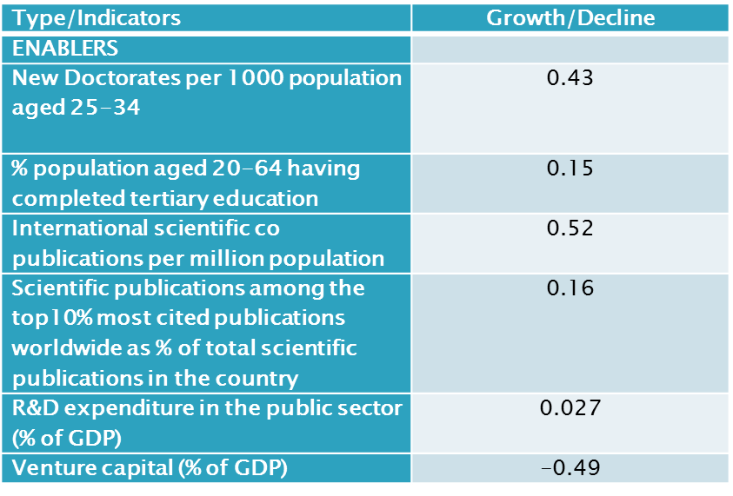
Pilot Results (2010 to 2014)
  Enablers

Slide 36
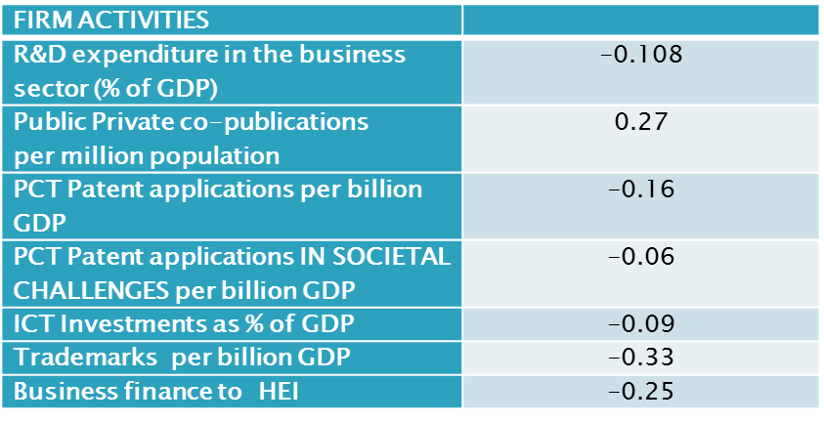
Pilot Results: 2010 to 2014 (Contd.)
  Firm Activities

Slide 37
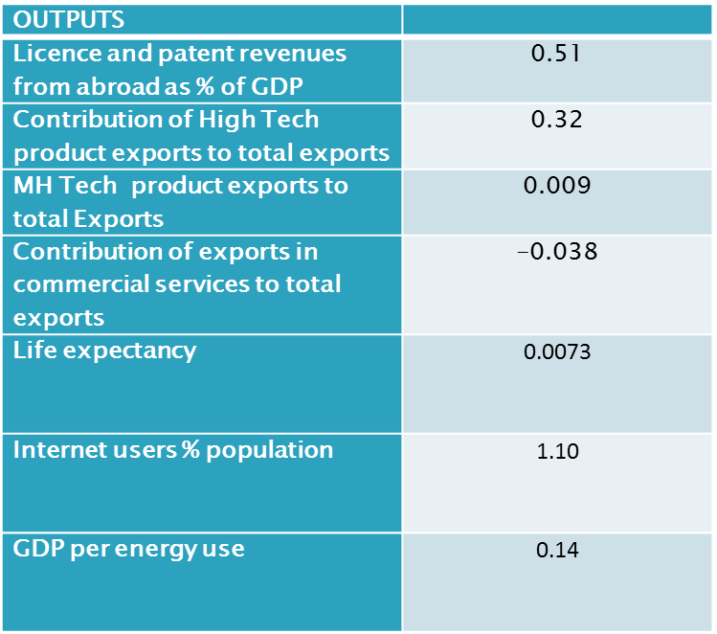
Pilot Results: 2010 to 2014 (Contd.)
  Outputs

Slide 38
Pilot Results: 2010 to 2014 (Contd.)
  Innovation Dimensions

Slide 39
Thank You!!

